Slide 1
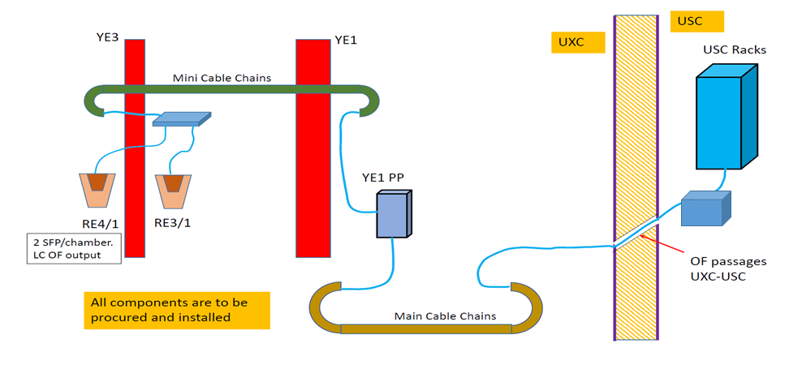
Cable Routing of the iRPC to off-detector Electronic
1.
2.
Trunk Cable passing through the Mini Cable chains
Trunk Cable passing through the Main Cable chains
Requirements at the FEB end.
Multimode fibres TX of 10Gbit/s with LC connectors

Slide 2
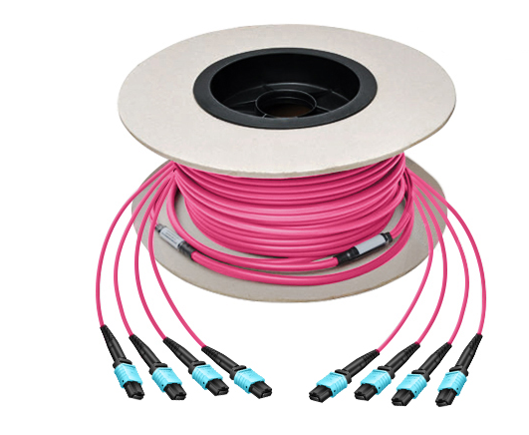
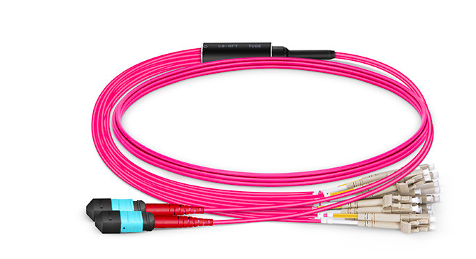
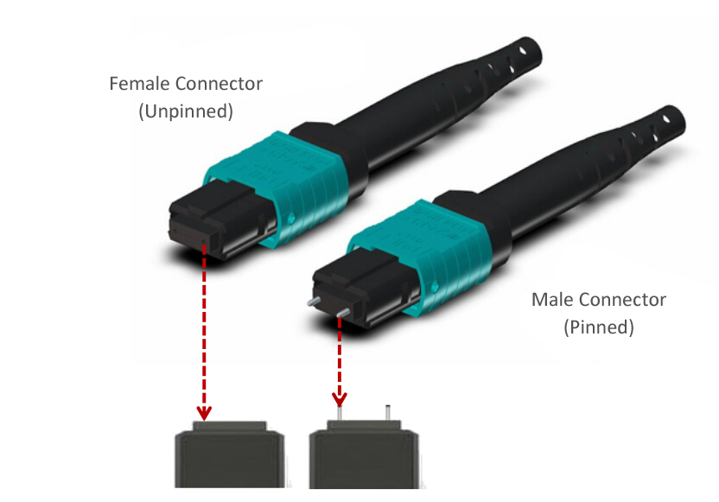
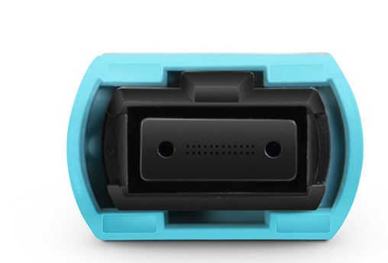
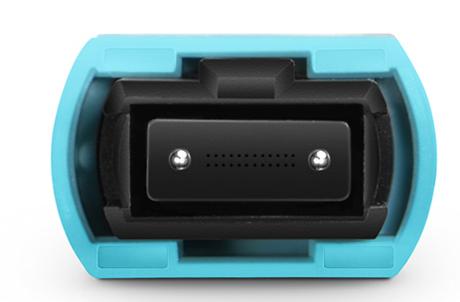
Options for items 1. and 2. at fs.com
# Fibers:144, 96, 72, 48, 24.
MTP/MPO connector
24 fibers per connector

Slide 3
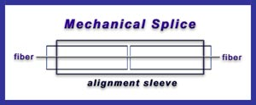

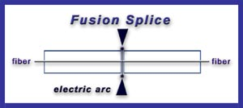
Splicing vs Connectors
Typical loss: 0.3 dB
MTP/MPO connector
Typical loss: 0.1 dB

Slide 4
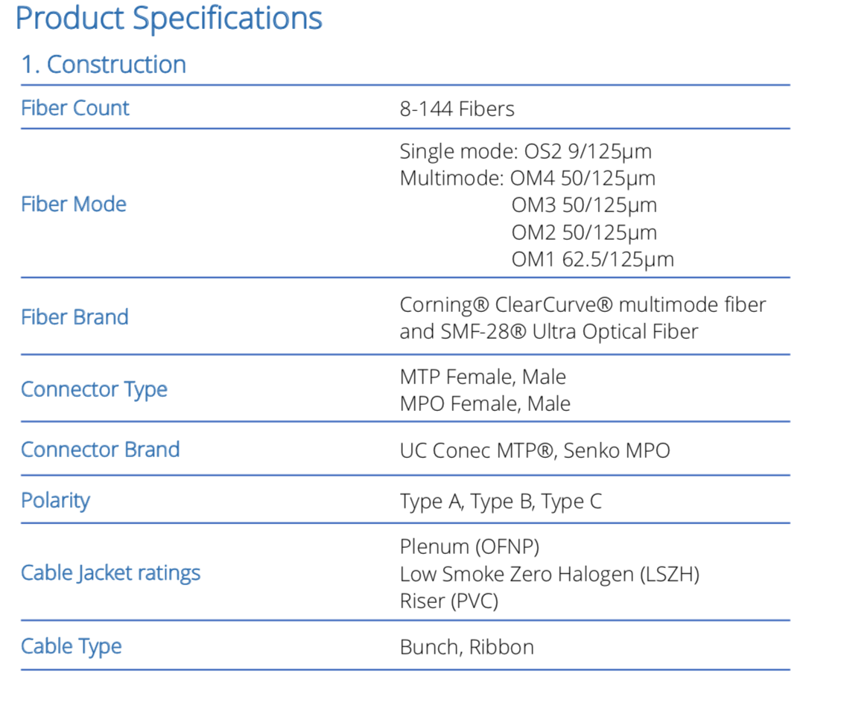

Slide 5
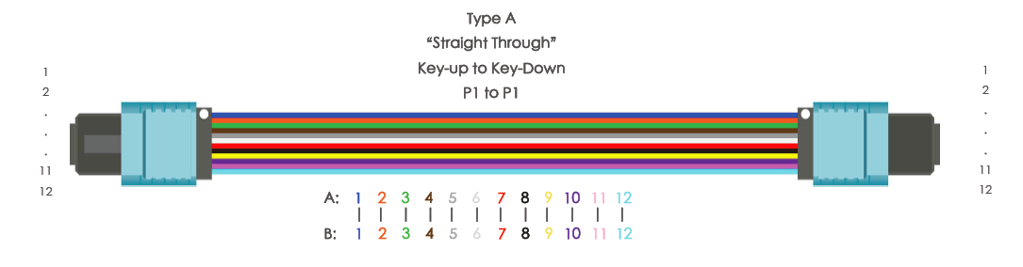
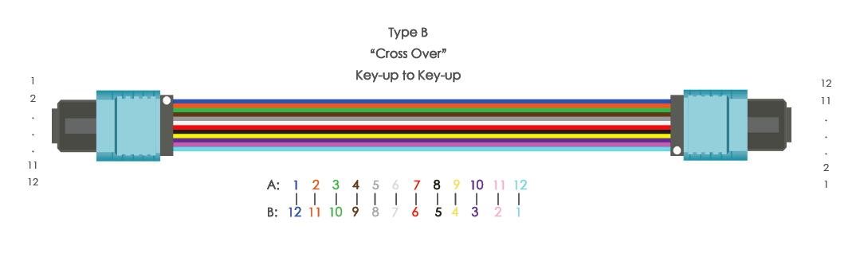
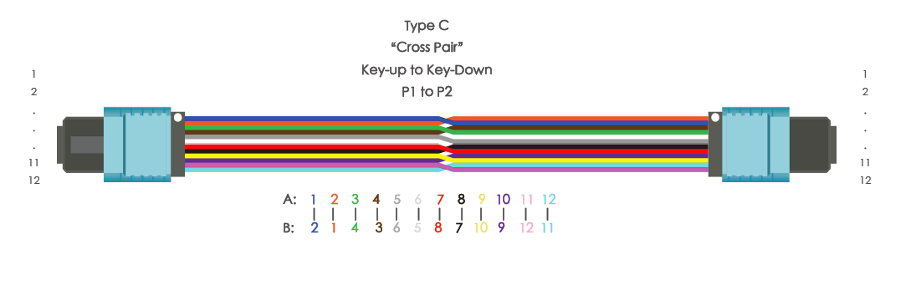

Slide 6
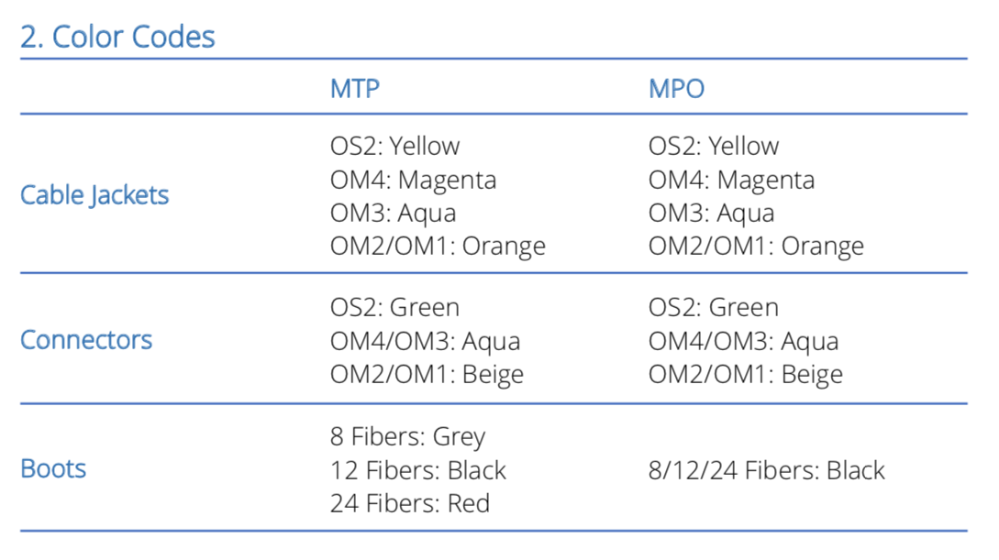
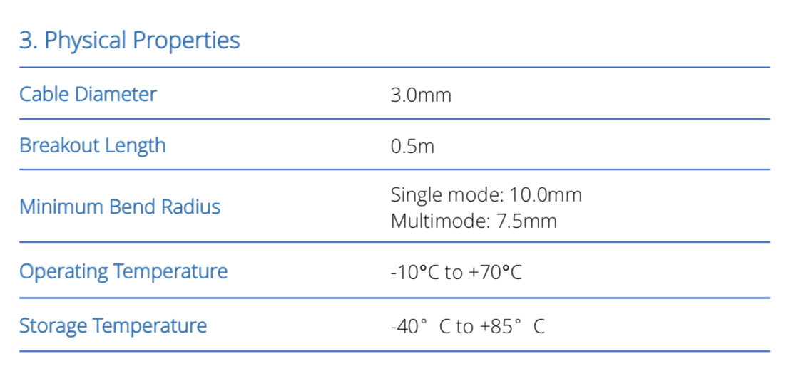

Slide 7
