Slide 1
CERN LHC CMS RPC Upgrade
Andrés Cabrera
Ian Crotty
5 Nov 2018

Slide 2
YE3
YE1
UXC
USC
Mini Cable Chain
0.35 dB
Panel iRPC
Trunk Cable 1
Trunk Cable 2
Patch Panel
USC
iRPC
Patch
Panel
0.35 dB
0.35 dB
0.35 dB
USC Rack
0.35 dB
Main Cable Chain
iRPC: 4 fibers per chamber
Number of Chambers:
18 RE+3/1 -> 72 fibers
18 RE+4/1 -> 72 fibers
18 RE-3/1 -> 72 fibers
18 RE-4/1 -> 72 fibers
Proposal:
4 Trunk cable 1 (96 fibers: 72 used + 24 spares)
4 Trunk cable 2 (96 fibers: 72 used + 24 spares)
*1 cable per 18 chambers

Slide 3
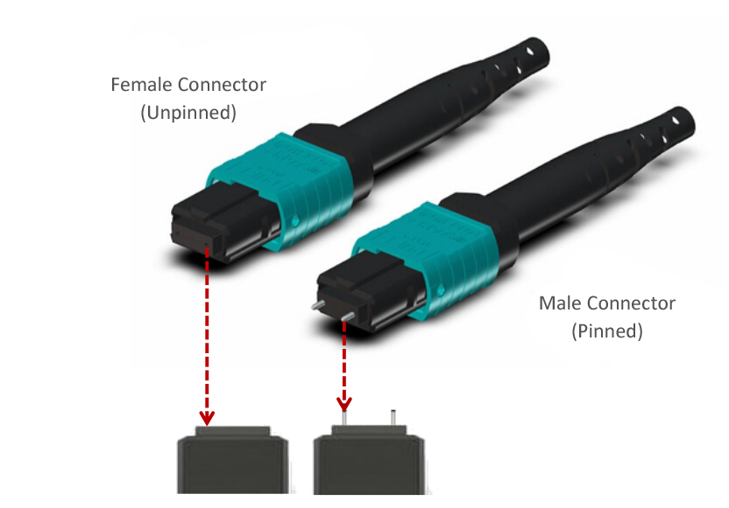
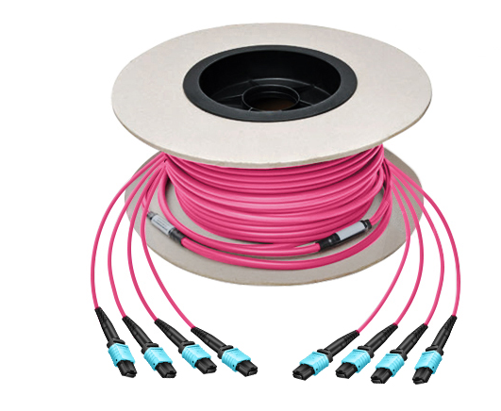
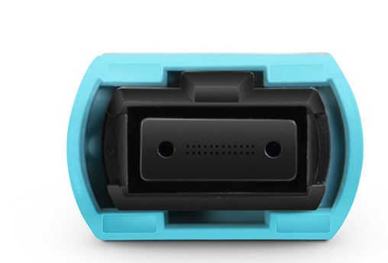
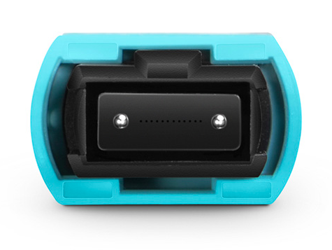
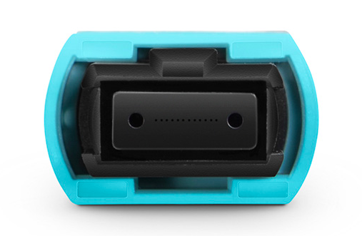
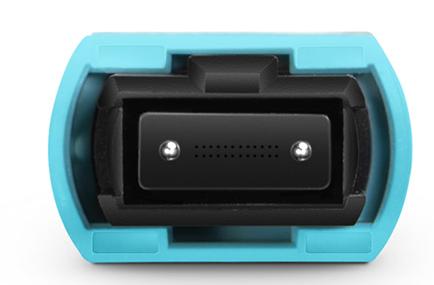
Trunk cable option
MTP/MPO connector
24 fibers per connector
12 fibers per connector
Male
Female
Male
Female

Slide 4
Specification Trunk Cable 1 (96 fibers)
Length A: 1 m. ?
Length C: 1 m.?
Length B: 30 m.?
Patch
Panel
Panel iRPC
8 MPT/MPO Connectors Female
6 used + 2 spares
(12 fiber per connector)
4 MPT/MPO Connectors Female
3 used + 1 spare
(24 fiber per connector)
Specification Trunk Cable 2 (96 fibers)
Length A: 1 m. ?
Length : 1 m. ?
Length B: 80 m.?
Patch Panel
USC
Patch
Panel
4 MPT/MPO Connectors Male
3 used + 1 spare
(24 fiber per connector)
4 MPT/MPO Connectors Male
3 used + 1 spare
(24 fiber per connector)

Slide 5
General Cable Requirements
96 fibers per cable
Multimode OM3
Jacket: Low Smoke Zero Halogen (LSZH)
Compliance with CERN IS23:
https://edms.cern.ch/document/335745/LAST_RELEASED/

Slide 6
To solve?
Is there enough space for the installation in the main cable chain?
The connectors spread out 10 cm each…
How the connectors are protected when are delivered?
Are protected the connectors to pass the tunnel?

