Slide 1
OF Installation
Andres with input from numerous colleagues
11 Feb 2019

Slide 2
3.1 and 4.1 station fiber system components
YE3
YE1
UXC
USC
Mini Cable Chain
Two panels: Positive and negative side
USC Rack
Cable 2
RPC Backend
Patch Panel 1
Cable 1
Patch
Panel 2
Cable 4
Cable 3
Patch Panel 3
FEB
RE+4/1
FEB
RE+3/1
One panel
Main Cable Chain
Assuming standard 144 fiber cable
(gives 72 fibers used + 72 spares) ->1 cable per station
To be installed 72 Chambers in total.
18 chambers -> RE+3/1 (72 fibers) 18 chambers -> RE-3/1 (72 fibers)
18 chambers -> RE+4/1 (72 fibers) 18 chambers -> RE-4/1 (72 fibers)
2 fibres from each FEB
2 FEB per chamber
4 fibres per chamber
Not including spares
February 11th, 2019
2

Slide 3
Supply Summary and Lead Time
CERN Reference | Description | Length (m) | Quantity | Section | Name in these slides
RPC_C1 | LC-LC simplex patch cord | 37 | 576 | 3.3.1 | Cable 1
RPC_C2 | 144-fiber cable: 144 LC to 6xMTP24(F) | 30 | 4 | 3.3.2 | Cable 2
RPC_C3 | 144-fiber cable: 144 LC to 6xMTP24(M) | 65 | 4 | 3.3.2 | Cable 3
RPC_C4 | 12-fiber cable: 12 LC to MTP12(F) | 2 | 30 | 3.3.3 | Cable 4
RPC_PP1 | Customized patch panel | n/a | 4 | 3.3.4 | Patch Pannel 1, Patch Pannel 3
RPC_AA1 | Adapter array | n/a | 2 | 3.3.5 | Patch Panel 2
RPC_BOX1 | Box to protect adapter array | n/a | 2 | 3.3.6 | Patch Panel 2
Supplies | Lead time
RPC_C1, RPC_C2 (25%) | 4 weeks
RPC_C1, RPC_C2 (75%) | 8 weeks
RPC_C3, RPC_C4, RPC_PP1, RPC_AA1, RPC_BOX1 | 12 weeks
February 11th, 2019
3

Slide 4
OM3 vs OM4 prices
SYLEX |  | PRICES IN: | USD
Table 3: RPC
 | Description | Quantity | Unit Price OM4 | Total price OM4 | OM3 decrease (per unit) | Total price OM3 | Difference total price OM4 and OM3
1 | RPC_C1 | 576 | 22.08 | 12718.08 | 2.55 | 11249.28 | 1468.8
2 | RPC_C2 | 4 | 1462.49 | 5849.96 | 288.9 | 4694.36 | 1155.6
3 | RPC_C3 | 4 | 2367.45 | 9469.8 | 625.95 | 6966 | 2503.8
4 | RPC_C4 | 30 | 65.99 | 1979.7 | 1.34 | 1939.5 | 40.2
5 | RPC_PP1 | 4 | 976.75 | 3907 | 0 | 3907
6 | RPC_AA1 | 2 | 88.34 | 176.68 | 0 | 176.68
7 | RPC_BOX1 | 2 | 36.4 | 72.8 | 0 | 72.8
TOTAL PRICE RPC FOR TENDER FORM: |  |  |  | 34174.02 |  | 29005.62 | 5168.4
FIBERNET
Table 3: RPC
 | Description | Quantity | Unit Price OM4 | Total price OM4 | OM3 decrease (per unit) | Total price OM3 | Difference total price OM4 and OM3
1 | RPC_C1 | 576 | 19.8 | 11404.8 | 3.7 | 9273.6 | 2131.2
2 | RPC_C2 | 4 | 2154 | 8616 | 420 | 6936 | 1680
3 | RPC_C3 | 4 | 3210 | 12840 | 910 | 9200 | 3640
4 | RPC_C4 | 30 | 58.95 | 1768.5 | 2.6 | 1690.5 | 78
5 | RPC_PP1 | 4 | 560 | 2240 | 0.0 | 2240
6 | RPC_AA1 | 2 | 73 | 146 | 0.0 | 146
7 | RPC_BOX1 | 2 | 187 | 374 | 0.0 | 374
TOTAL PRICE RPC FOR TENDER FORM: |  |  |  | 37389.3 |  | 29860.1 | 7529.2
February 11th, 2019
4

Slide 5
Remarks
The color of the cables is magenta (the standard for OM4 cables).
Sylex is proposing also duplex LC connectors for cable 1 (instead of simplex). Both options are available.
LC Simplex
LC Duplex
Proposed “patch panel 1” is made of Aluminium
Proposed material for the “patch pannel 2”
is plastic PC/ABS.
February 11th, 2019
5

Slide 6
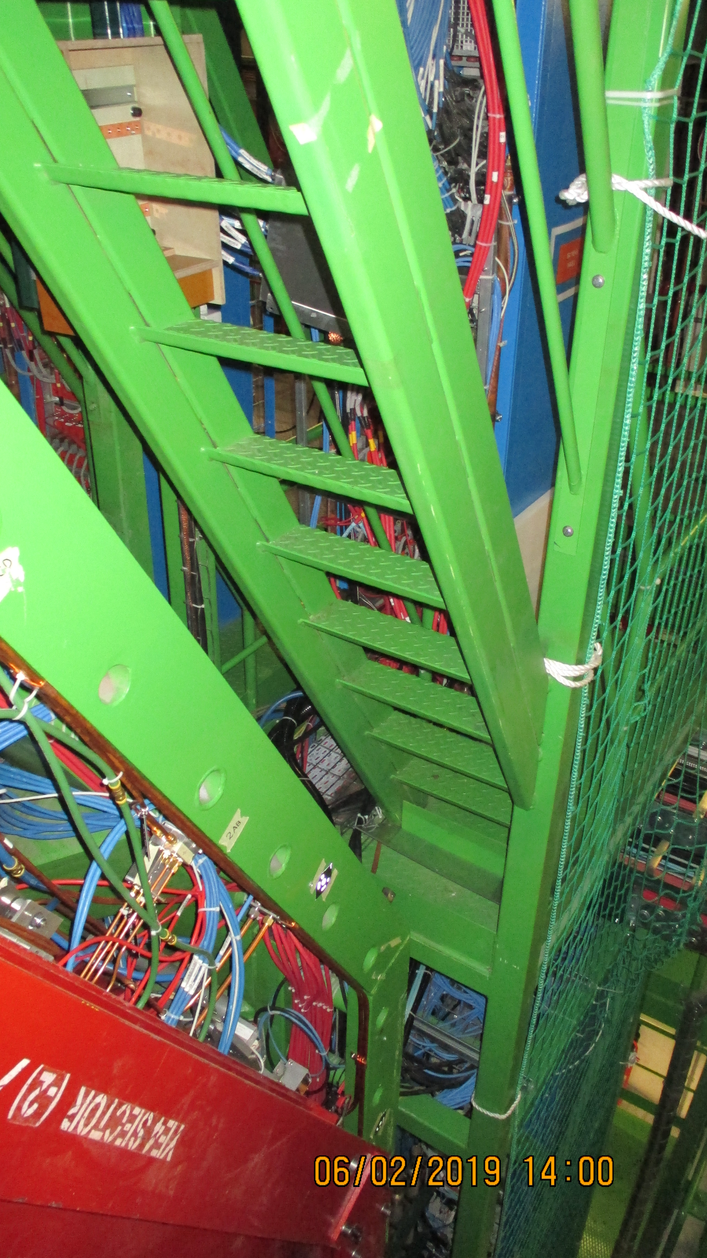
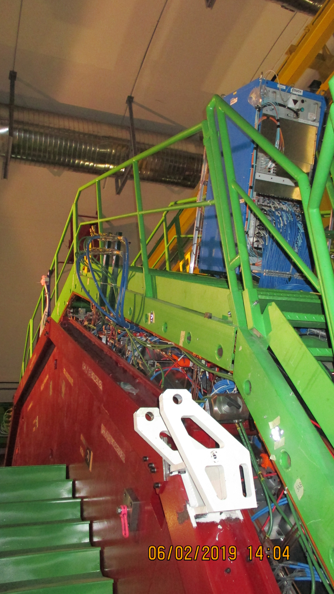
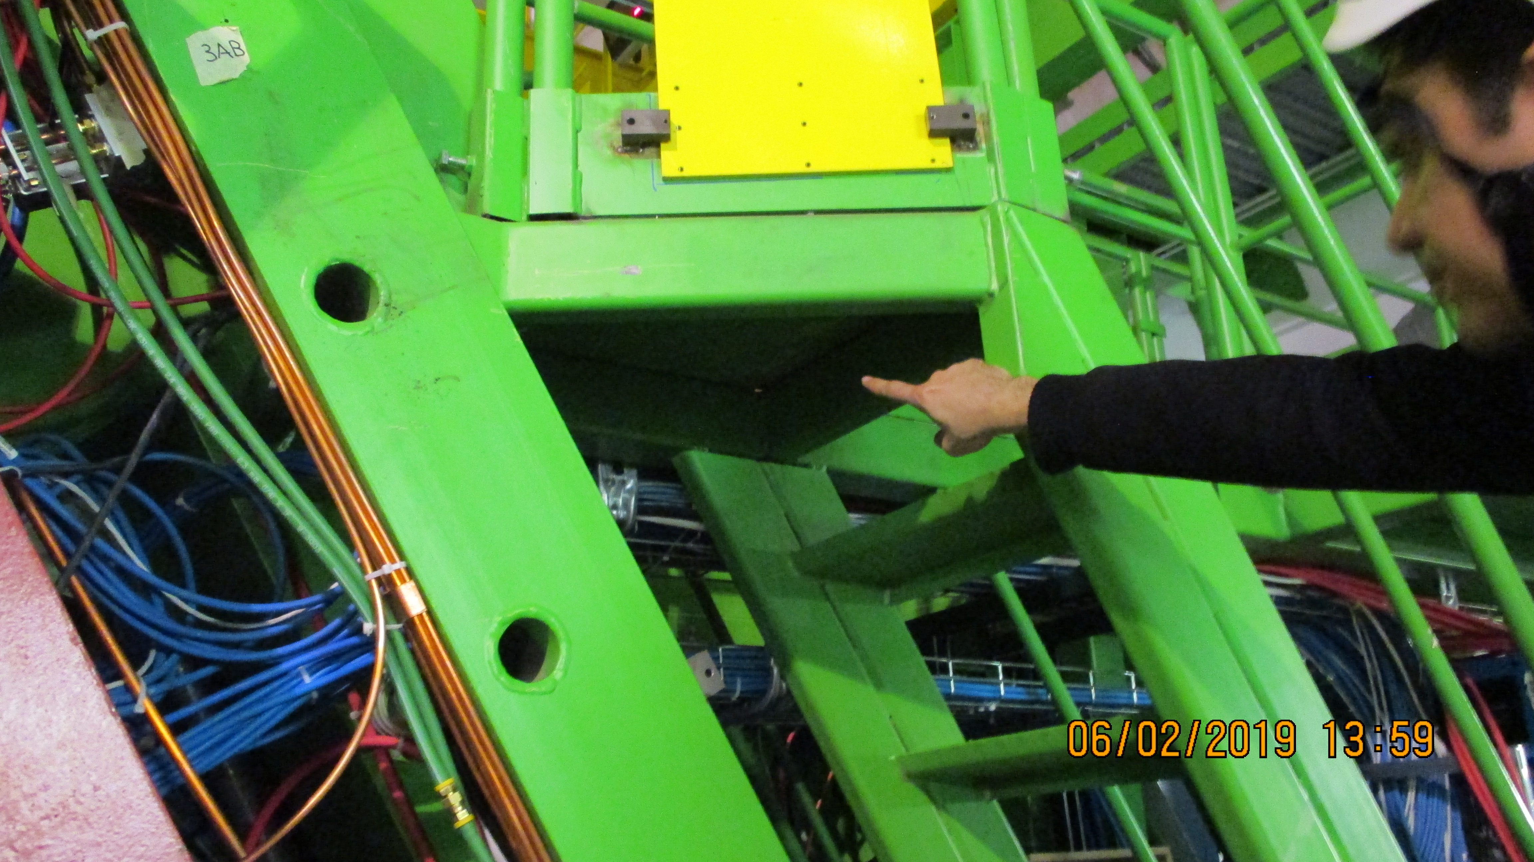
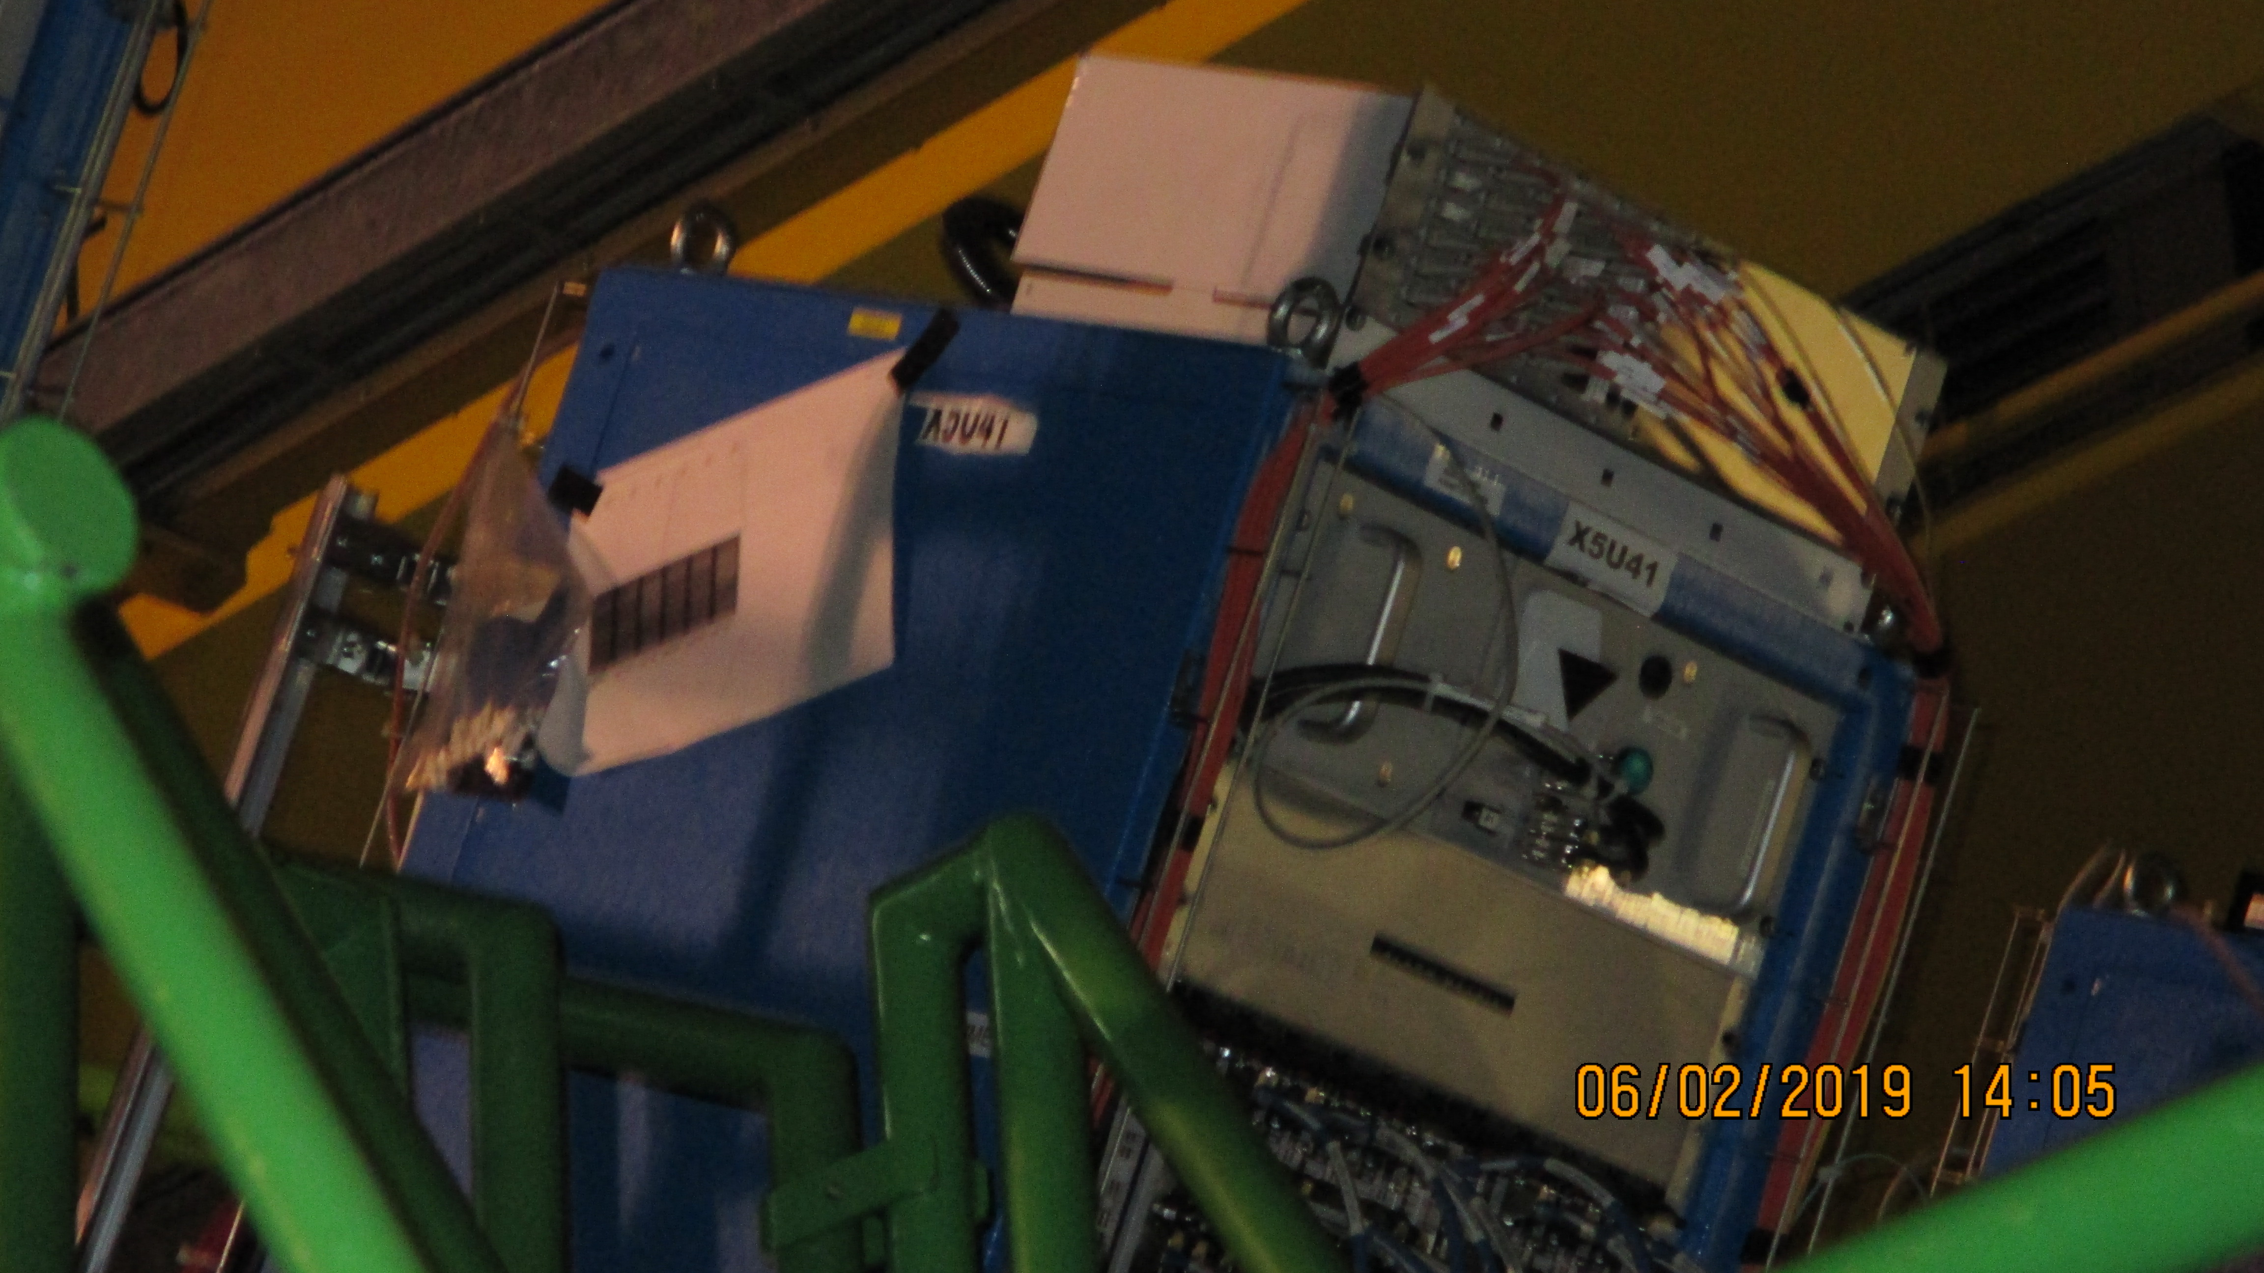
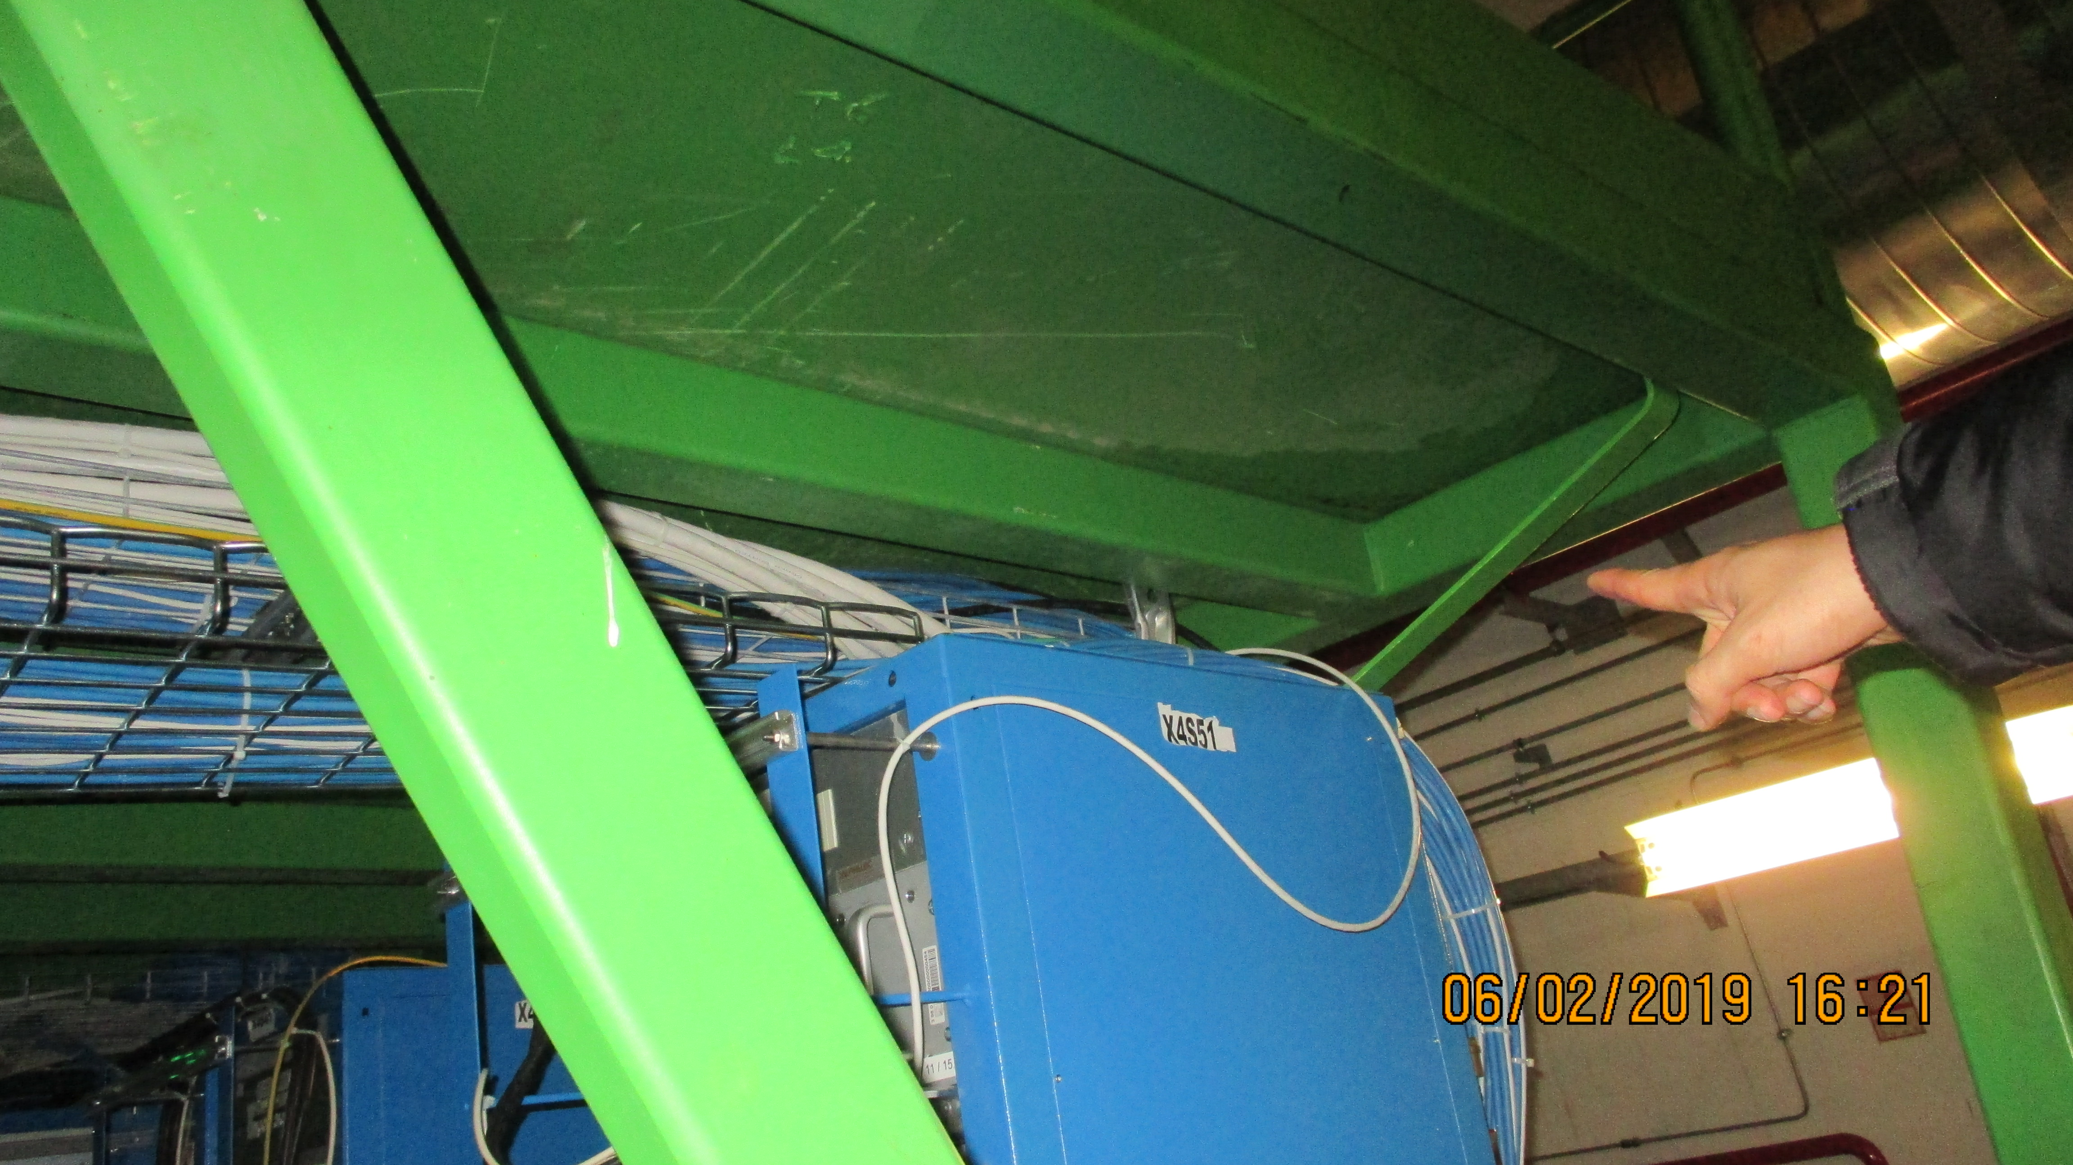
UXC Inspection or routing 6 Feb 2019
YE3 PP 5 possible locations
On top of X5 racks as CSC
Under the floor or on top

Slide 7
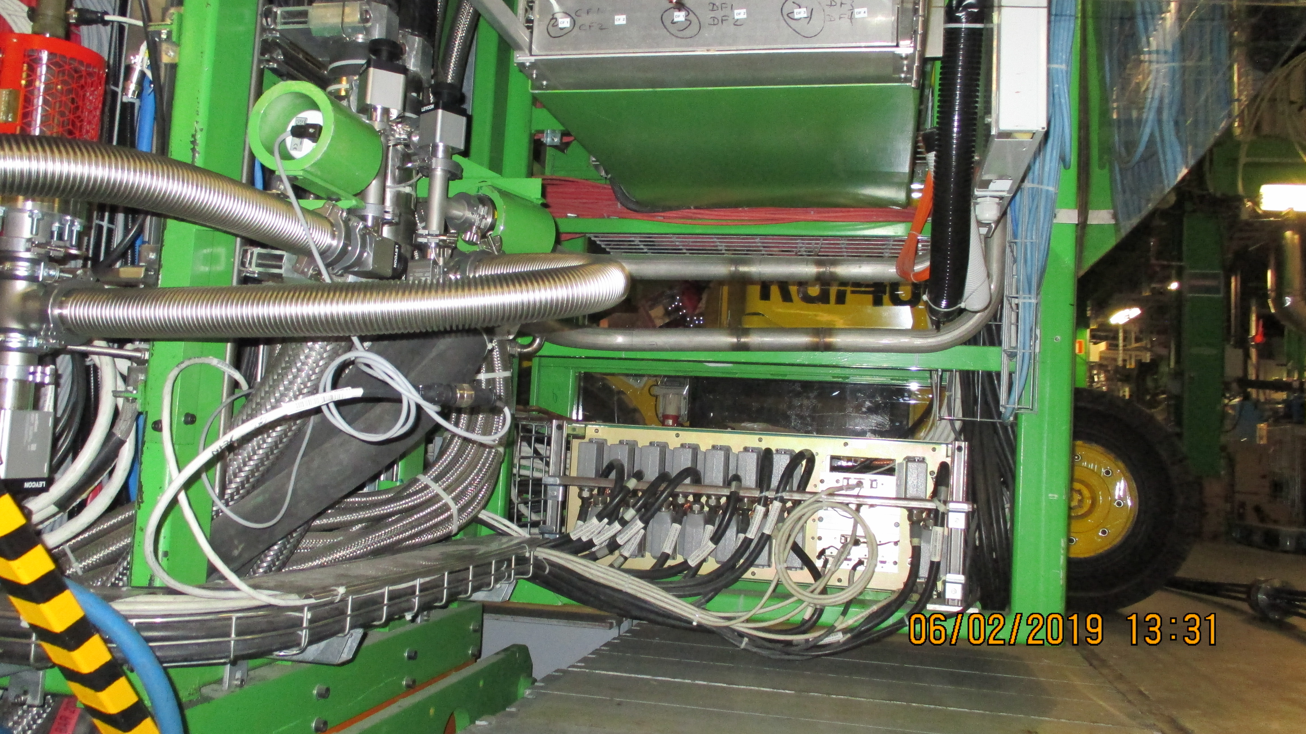
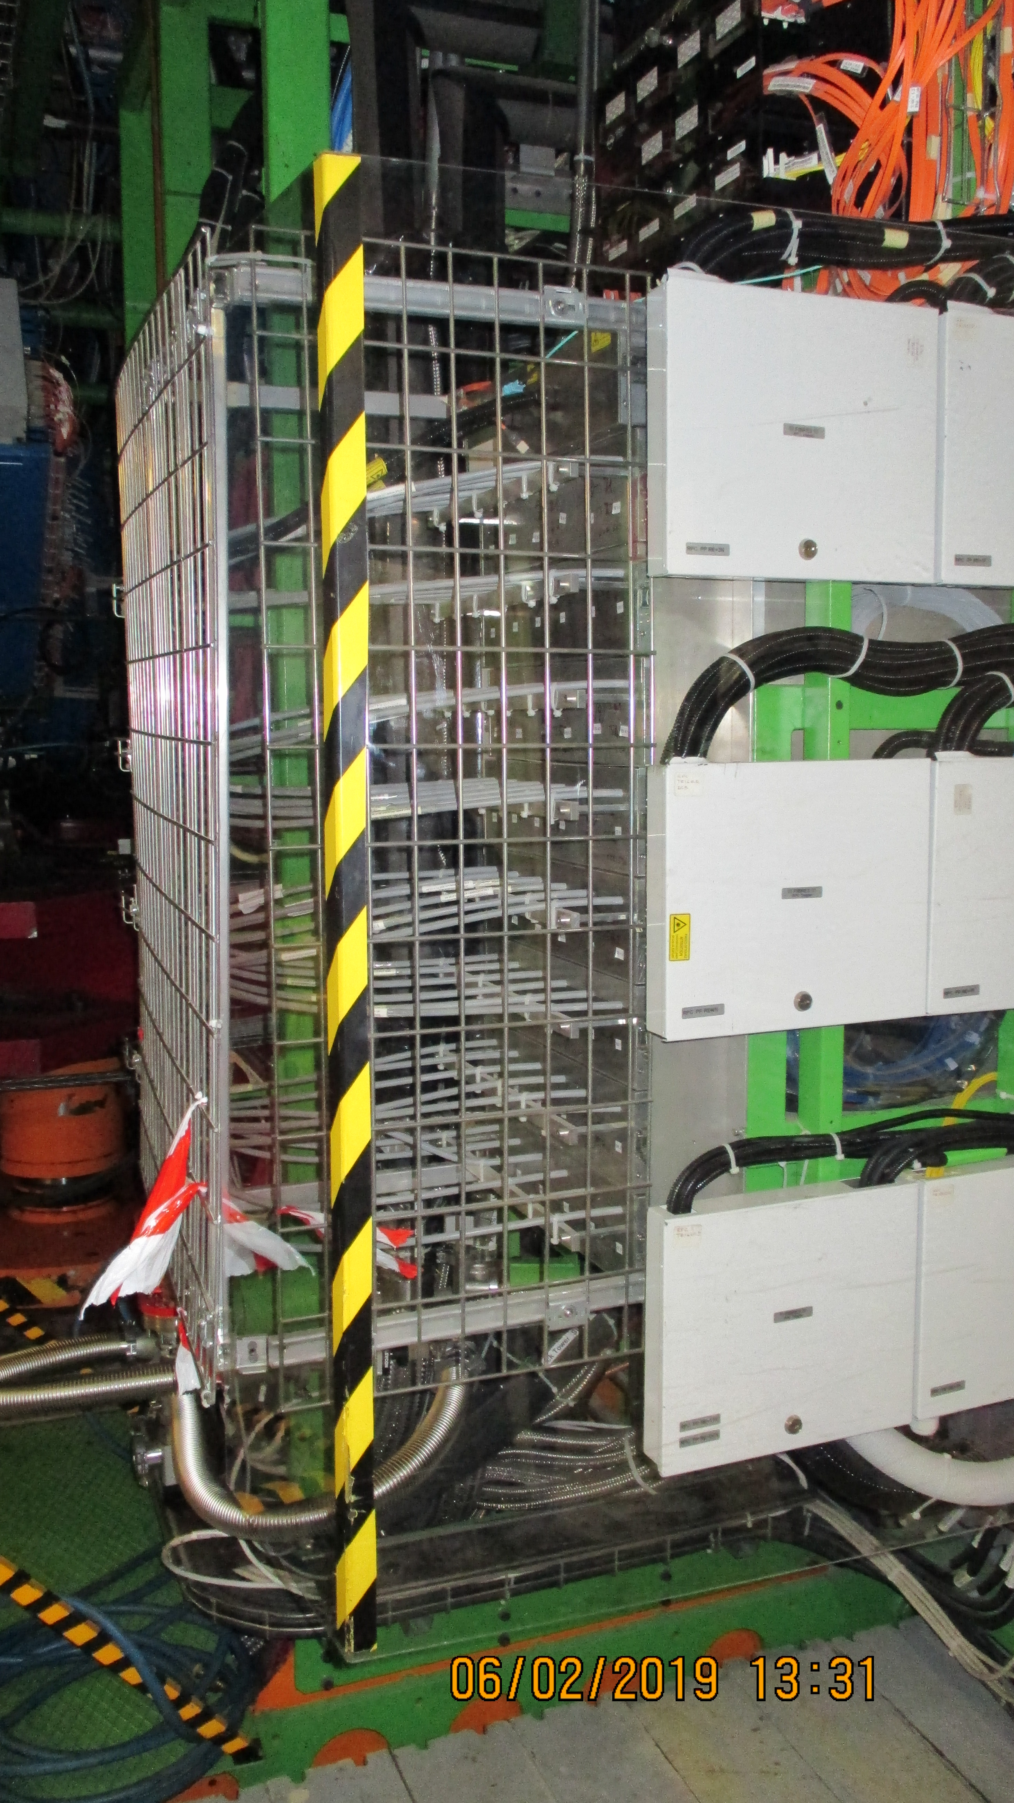
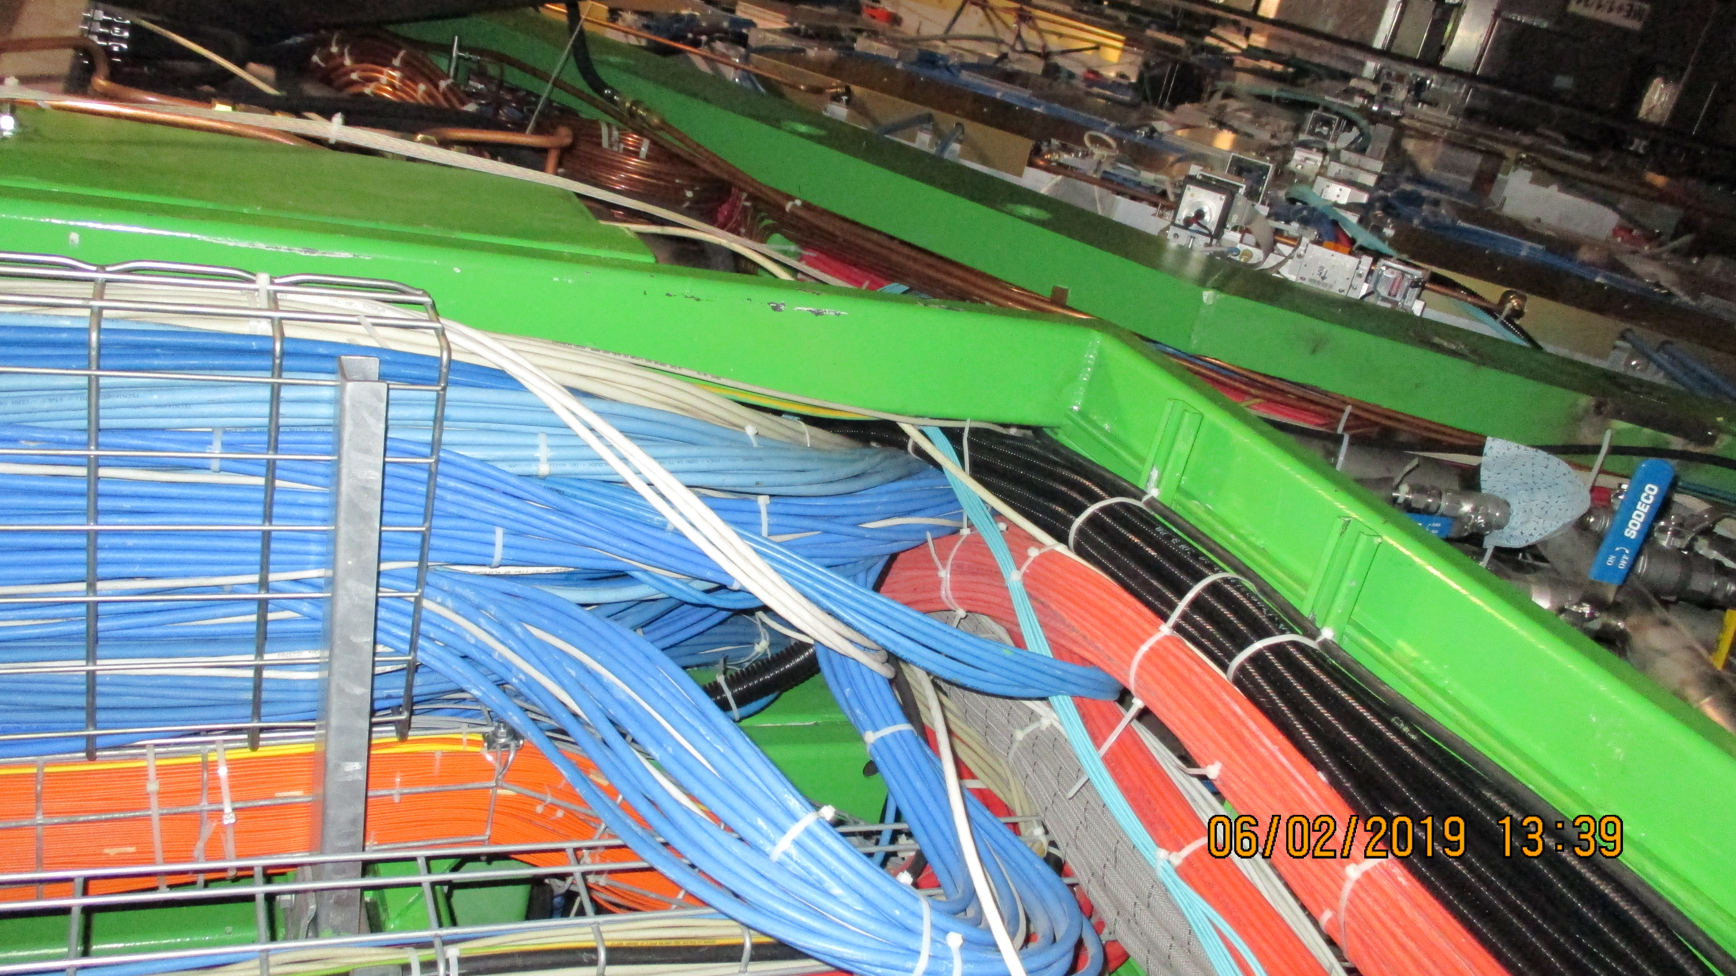
YE1 PP possible locations
Fibre routing up to mCC is not obvious

Slide 8
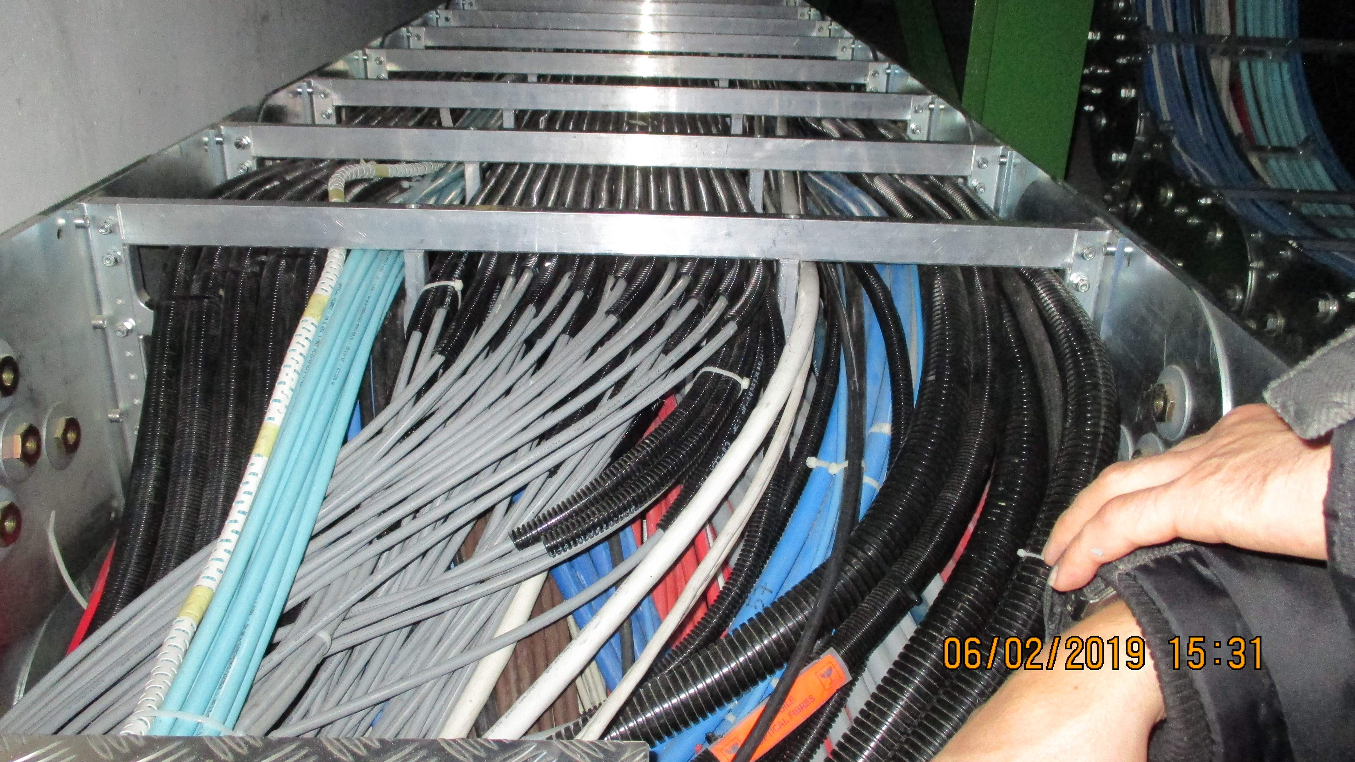
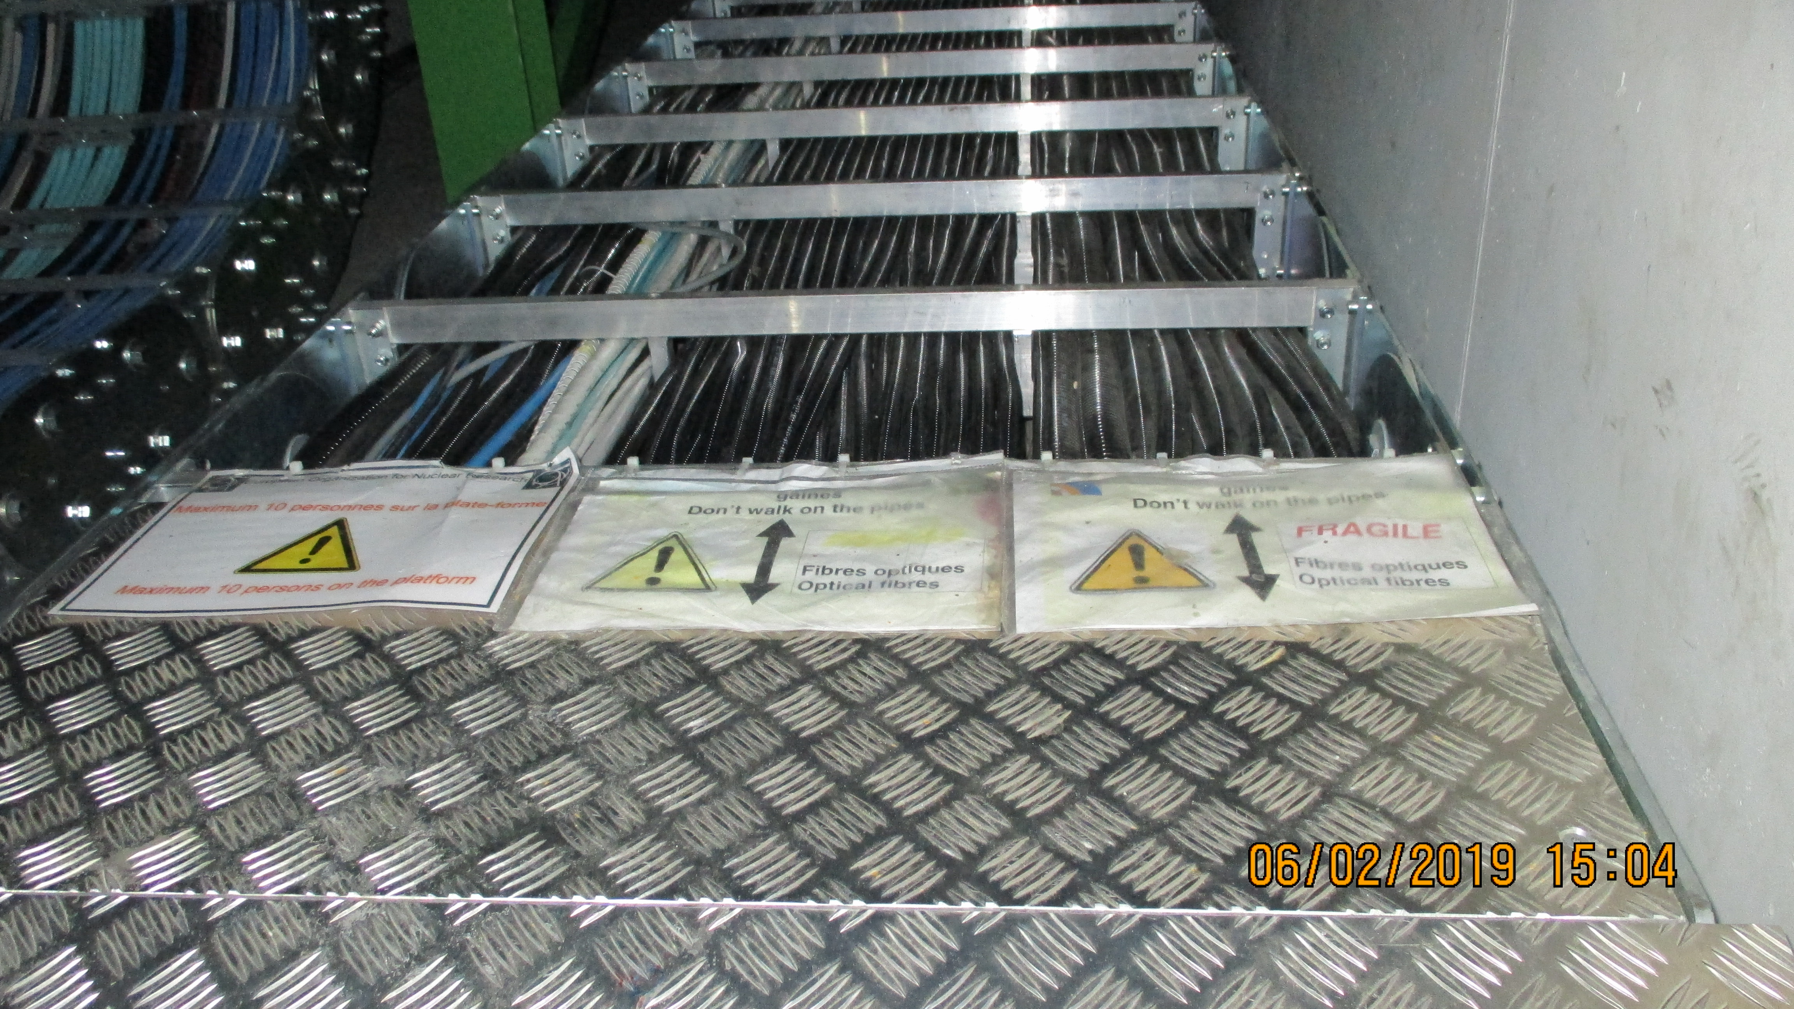
Near –Z has ample space
Near +Z MCC is very full !

Slide 9
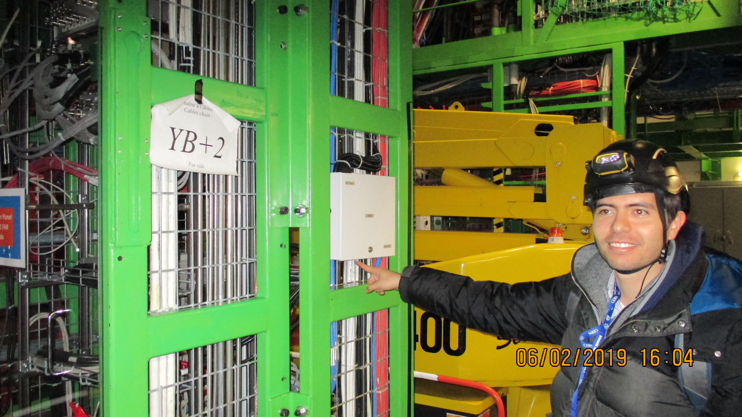
RB present FO PP

Slide 11
Conclusion
Call for Tender is close to be ready
We have to go back and look at the details of the lengths and the positions of the PP 1 (on YE3)and 2 (On YE 1 PP)
Meeting with S. Bally this Wednesday.

