Slide 1
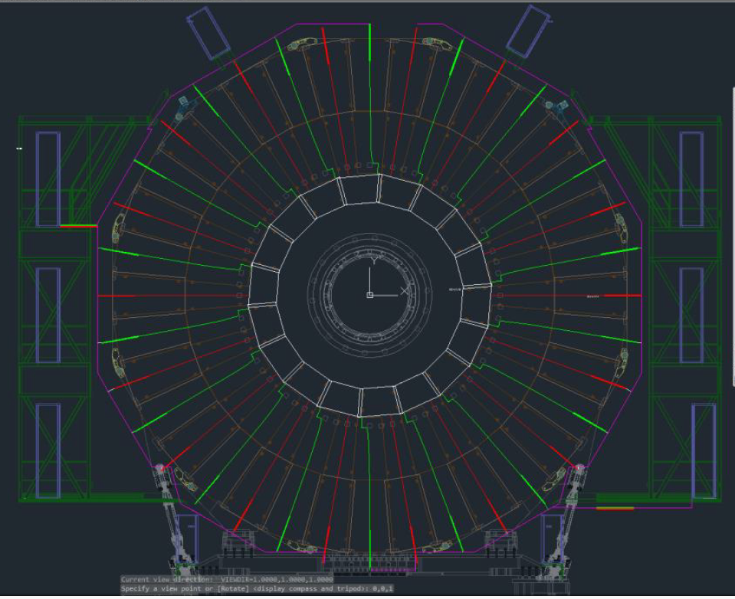
LV RE3/1 and RE4/1
RE3/1 services pass underneath the RE3/2 and RE3/3 odd numbered chambers. That is to say chambers RE3/2/01 and RE3/3/01 on the “x” axis. They are the red radial lines on this diagram.
RE4/1 services pass underneath the ME3/2 odd or even numbered chambers. That is to say chambers ME3/2/01 on the “x” axis. They are the green radial lines on this diagram.
The “X” axis is on the RHS. Notice the “X” axis cuts through the RE3/1/01 and RE4/1/01 5degrees above their centre line, the red line here.
Text in red is to be confirmed
RE3/1/01
Ian and Stephan.
11 June 2019

Slide 2
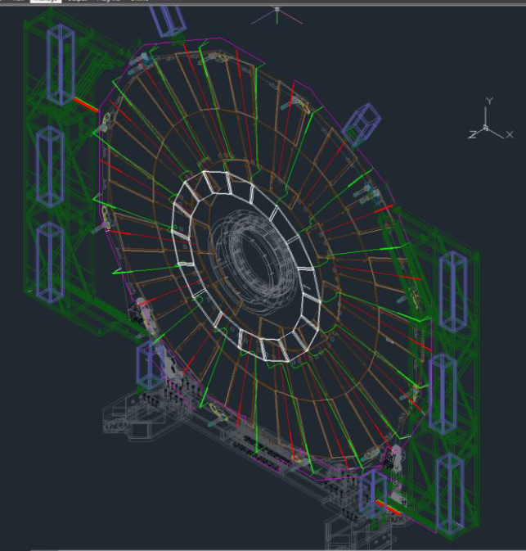
View from the Near and plus “Z” end towards the IP represented by the X,Y and Z axes, in the top right hand corner.
Routing around the periphery, the green structure, is done on the IP side.
The white chambers represent the low eta version of RE+4/1. The golden lines represent station RE+3, low eta version.
RE3/1 and RE4/1 are in the same “phi” position.
The RE3/1/01 is also off yoke, as are the RE3/2s .
RE4/1/01 is off yoke as is RE4/2 and 3 SMs
The services entire the X2 and X4 racks at their base as represented by the combined red and green lines.
Text in red is to be confirmed

Slide 3
