Slide 1
LV cable production
Ian
13 March 2019

Slide 2
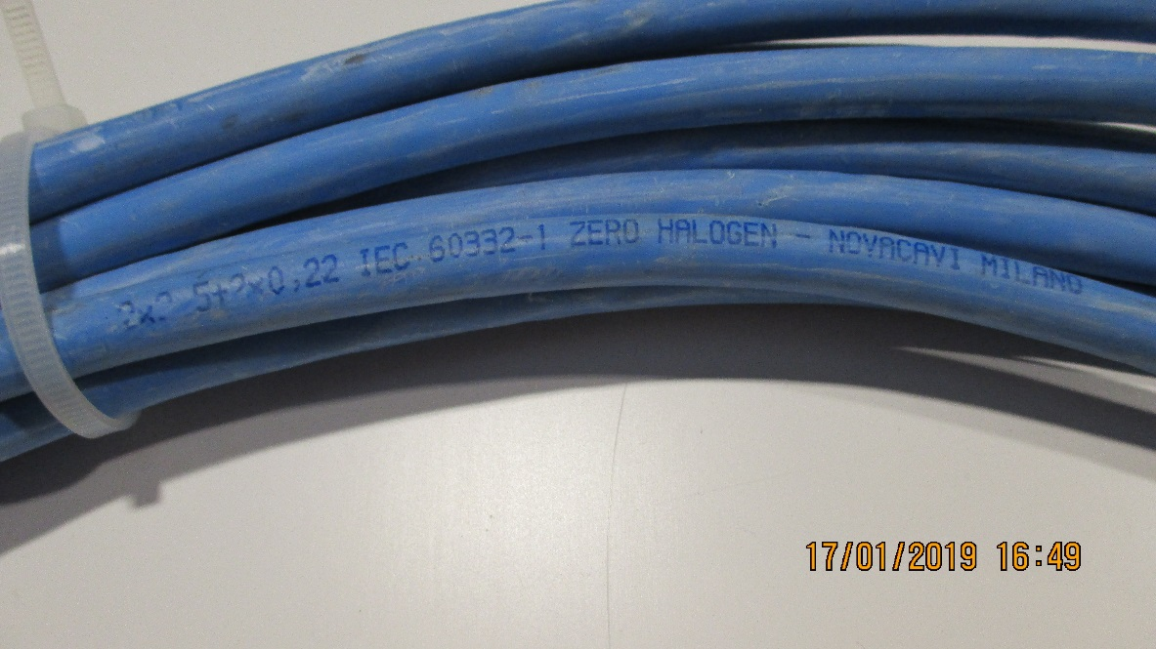
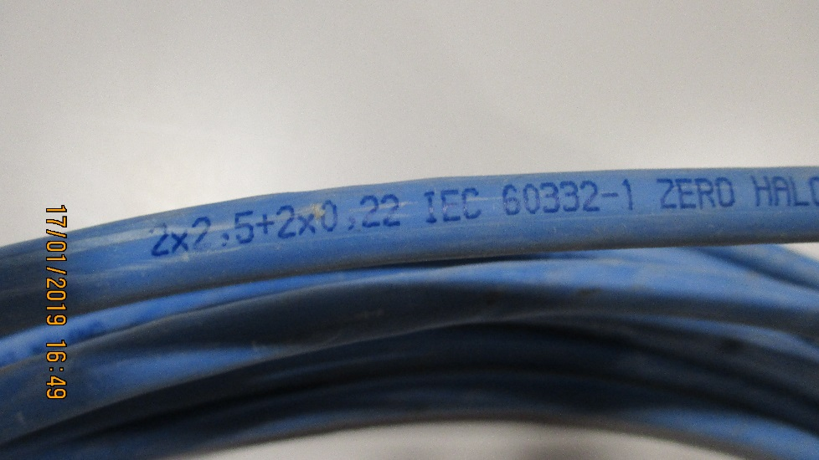
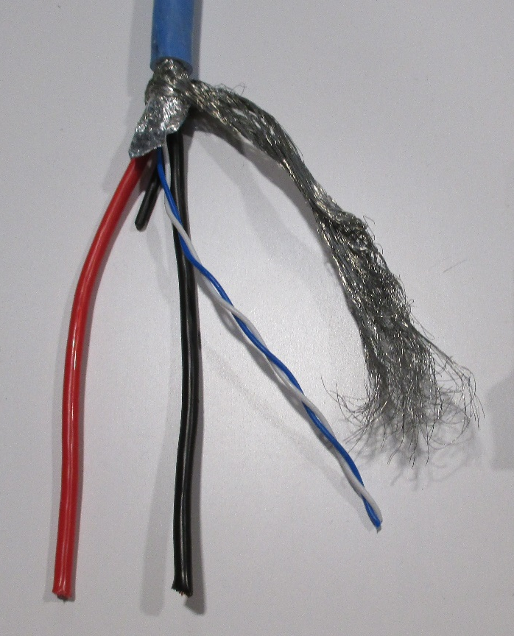
Use the LV Link board cable, used for the initial installation
2 x 2.5mm² (13AWG=2.62mm2) + 2 x 0.22mm2 (24AWG )
Sheath diameter = 8.3mm approx. (8.22mm)
Perhaps we have 3.5km available
P5 was not able to measure this !
https://www.rapidtables.com/calc/wire/awg-to-mm.html#how

Slide 3
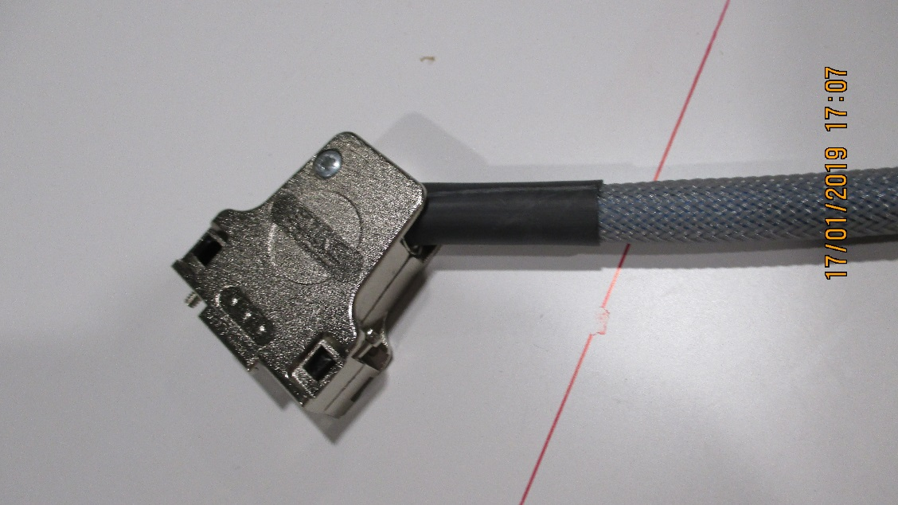
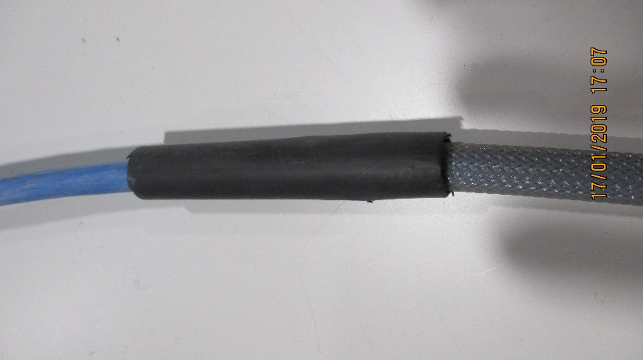
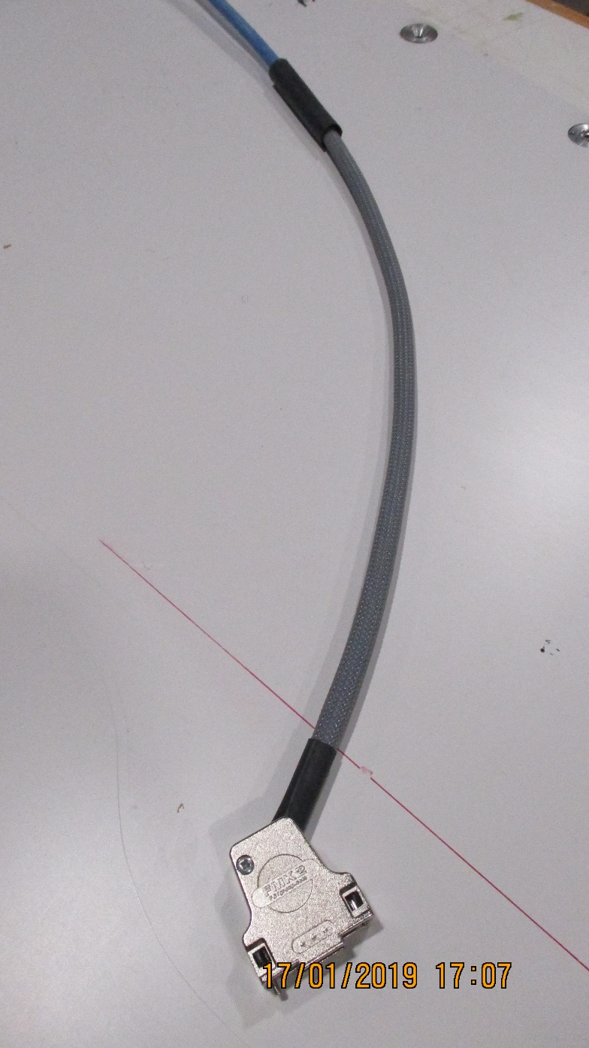
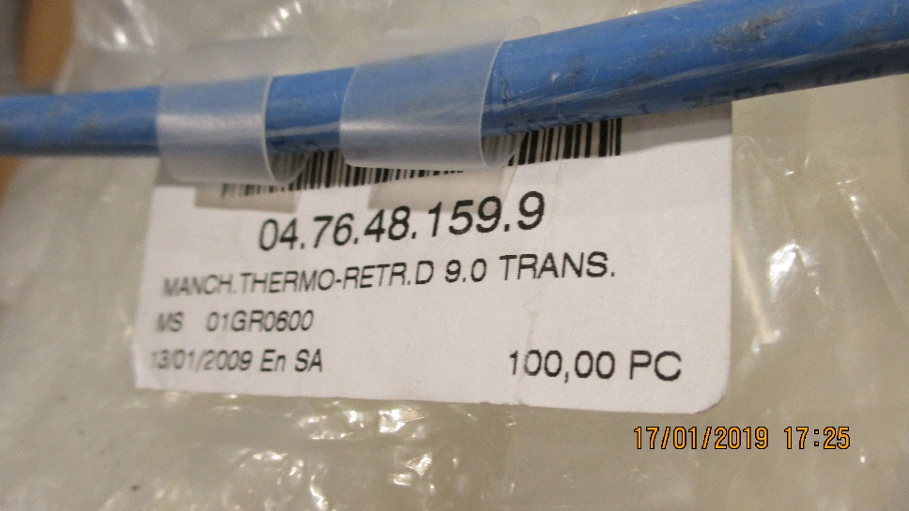
Connecteur cote Chambre
Thermo retractable , protection Etiquettes

Slide 4
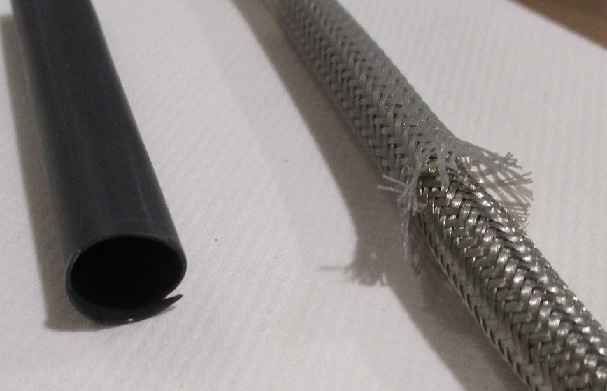
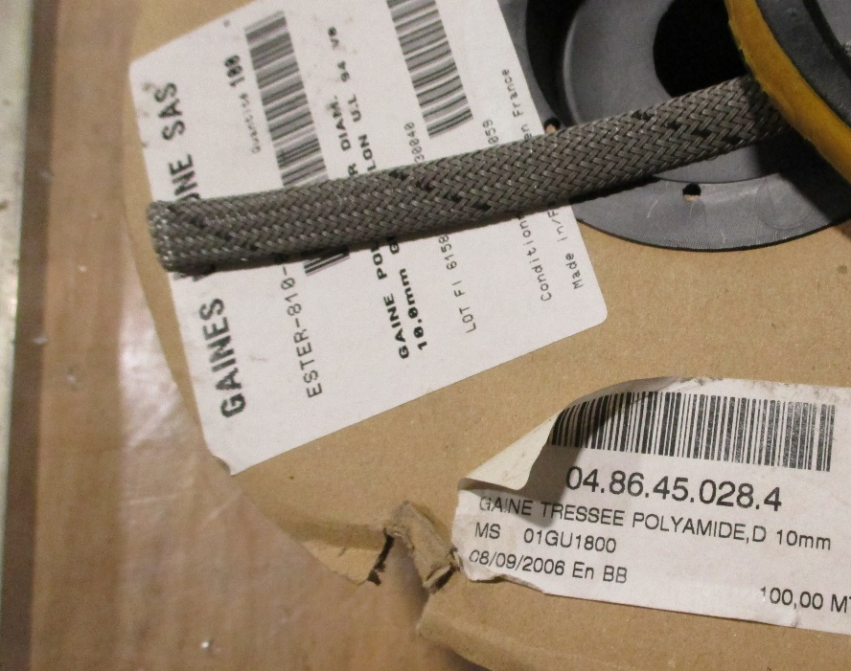
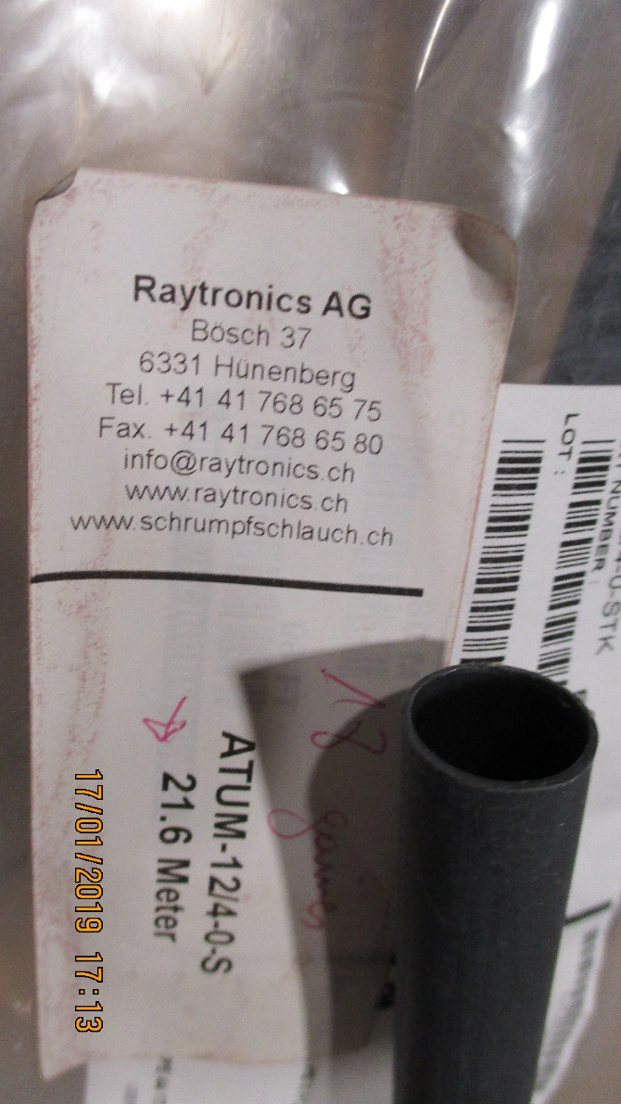
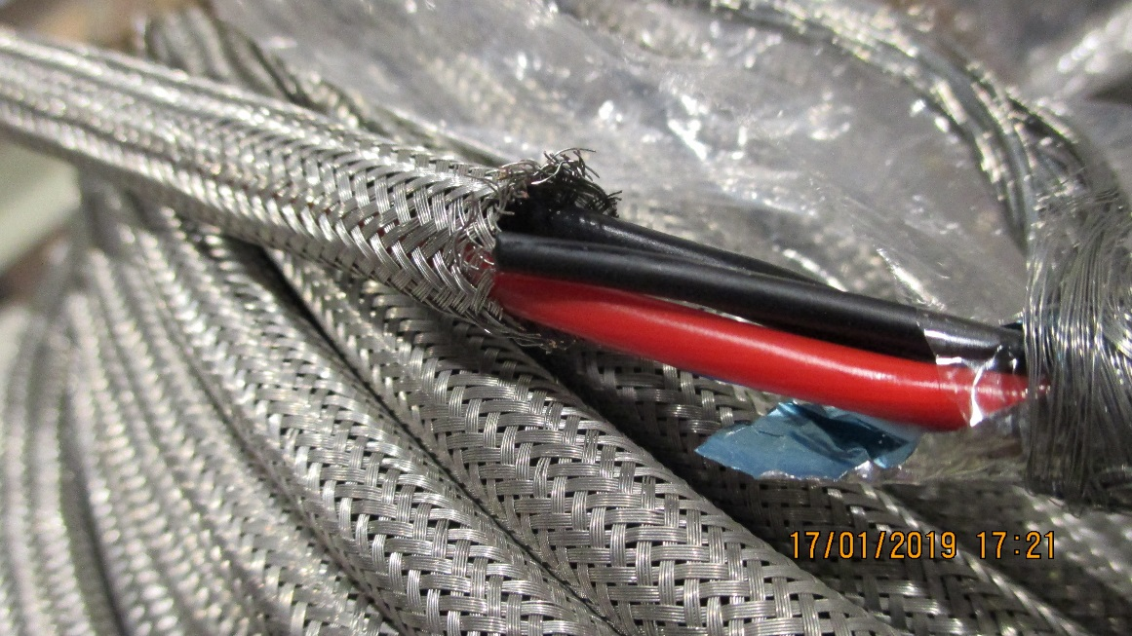
Tresse poly et Cuivre
Tresse Cu04.01.33.050.5
Nominal dia. 6mm
Sheath dia. 4 -7mm
160 wires of 15/100
Thermo retractable , Raychem 12/4-0-STK

Slide 5
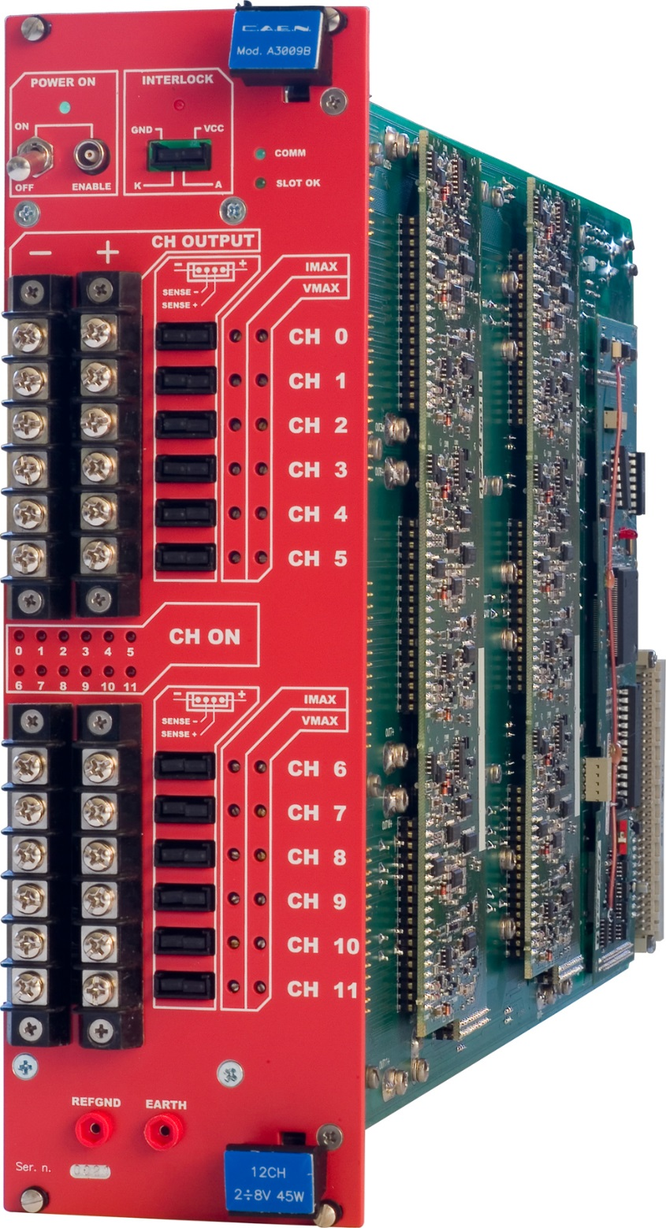

Thread dia.
3.38mm
6-32 UNC inch thread
8.3mm
https://www.caen.it/products/a3009b/
https://www.boltdepot.com/fastener-information/machine-screws/machine-screw-diameter.aspx

Slide 6
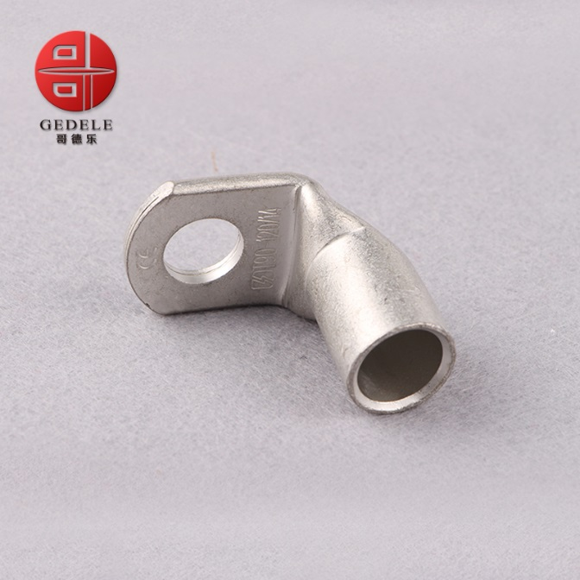
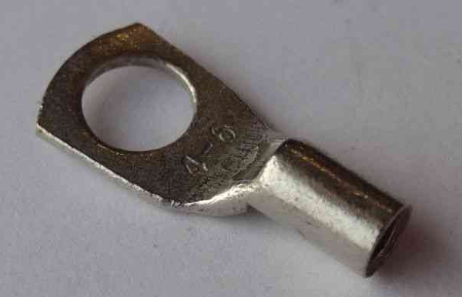
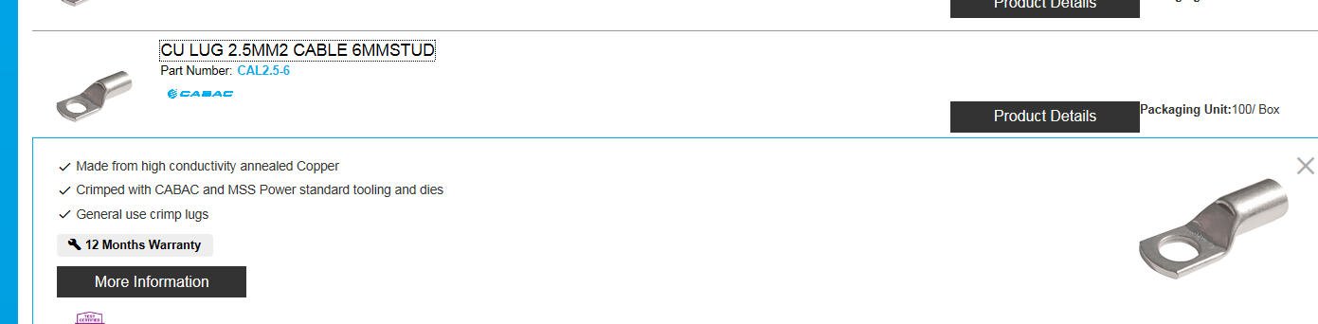
Lug dia 6mm
Section 2.5mm²
Ring terminal,
T90-25mm 90 Degree Angle Battery End Termi
https://www.cabac.com.au/brands/cabac/lugs-links-and-terminals/lugs-and-links/copper-crimp-lugs/cu-crimp-15-95mm2/10100505?s=

Slide 7
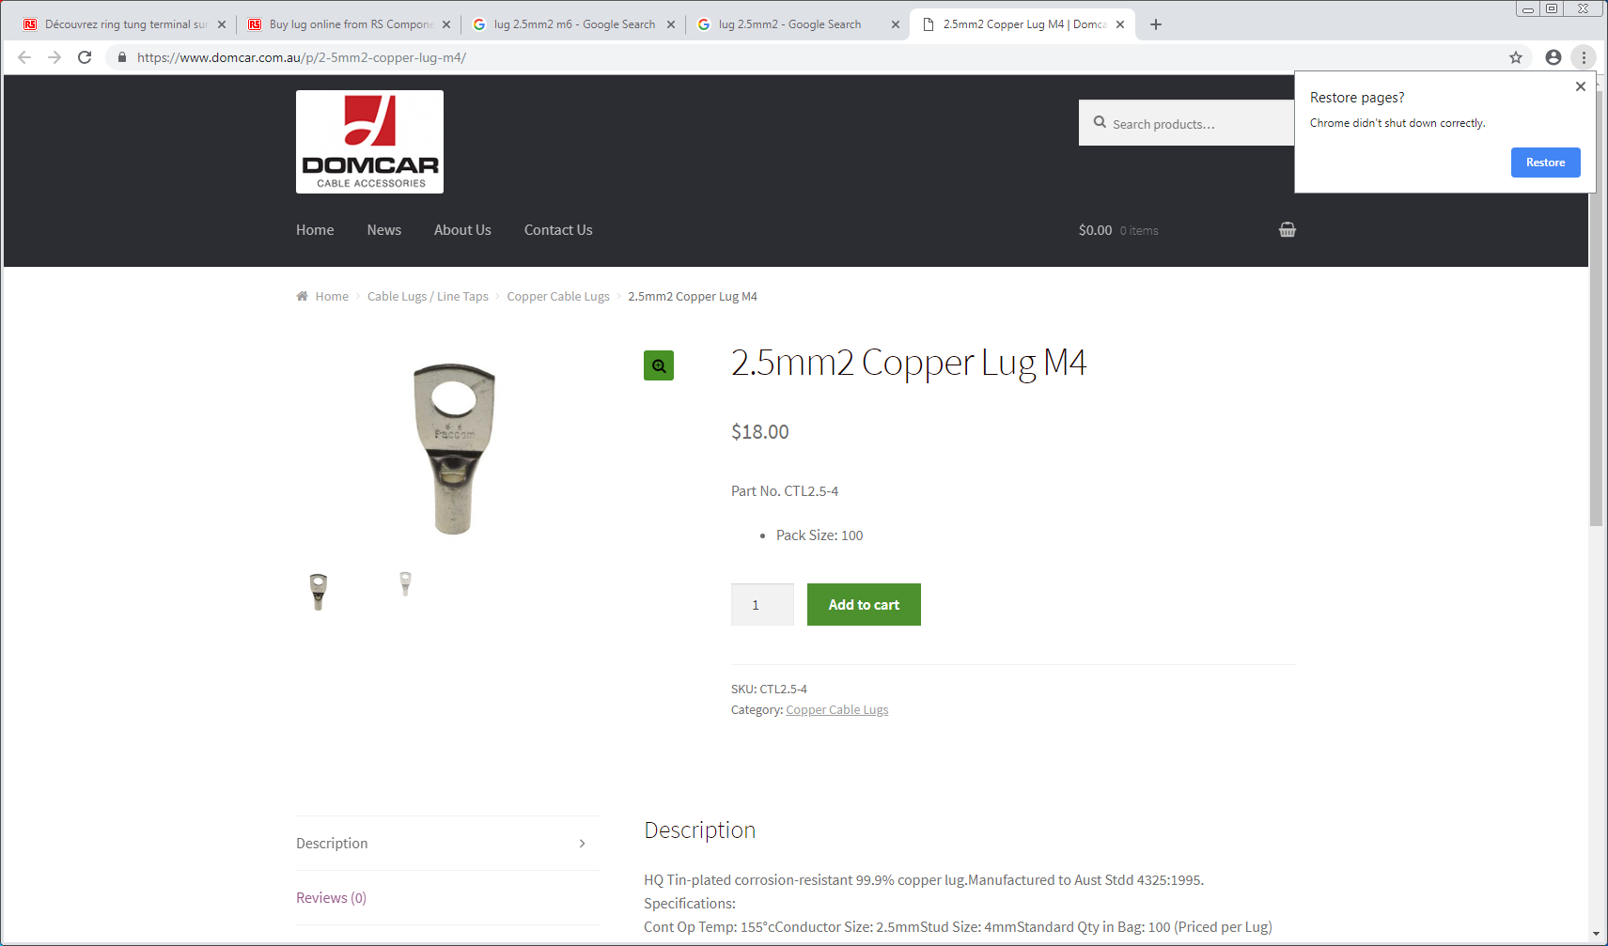
https://www.domcar.com.au/p/2-5mm2-copper-lug-m4/

Slide 8
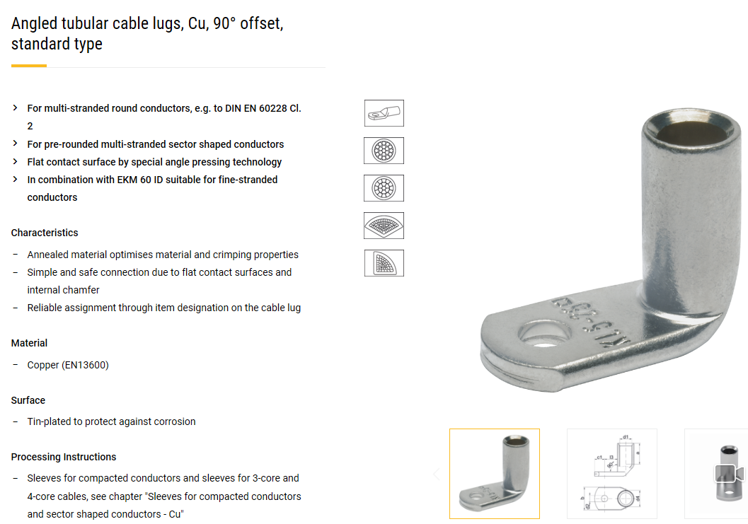
Lusin input week 2
https://www.klauke.com/en/electrical/electrical-connection-systems/
Gustav Klauke GmbH
Auf dem Knapp 46
42855 Remscheid
Deutschland
Tel.: +49 (0)2191 / 907-0
Fax: +49 (0)2191 / 907-141
E-Mail: Klauke-Info@Emerson.com

Slide 9
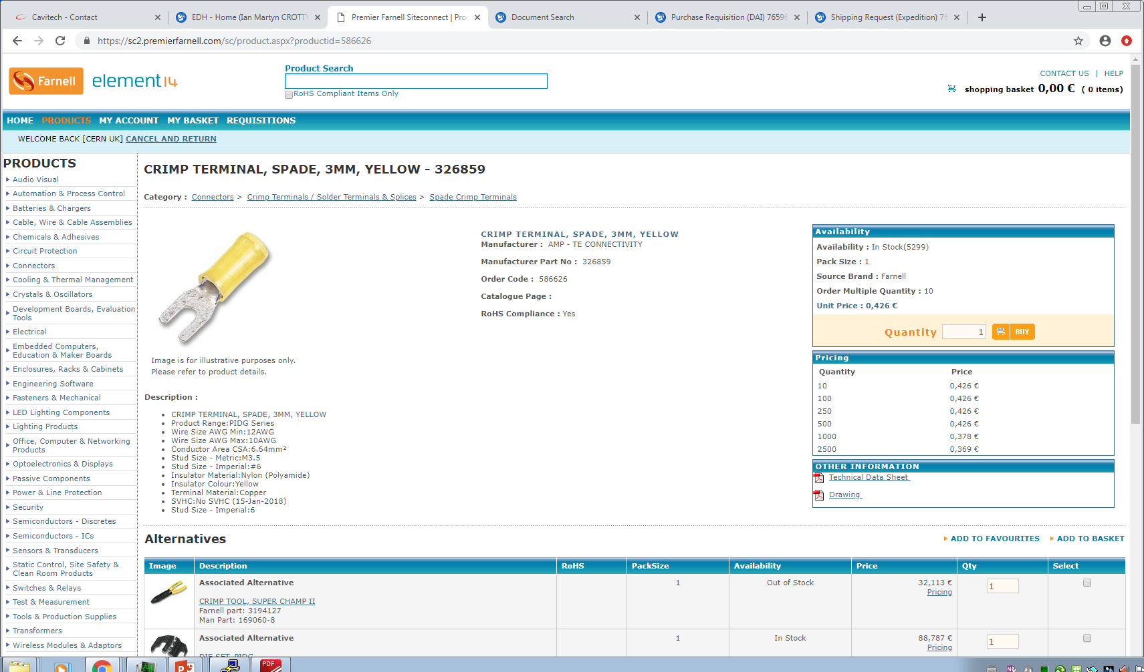
Alice Inner tracker
23 R-024
165464
Hartmut.Hillemanns@cern.ch
Two type of connector that can be used on the modified front panel of the CAEN 309B
AMP 12-10 fork type lug. Farnel 586626
Crimp tool AMP 12-10 APP 2518
Part No. 1309G4 2518 PP75 / 5B50 6-12 AWG
Or
Multicomp . Porder No. 9971653 …….?
2.5mm2 = 14 AWG
3.66mm
Availability : In Stock(5299)
Pack Size : 1
Source Brand : Farnell
Order Multiple Quantity : 10
Unit Price : 0,426 €
7.91mm

Slide 10
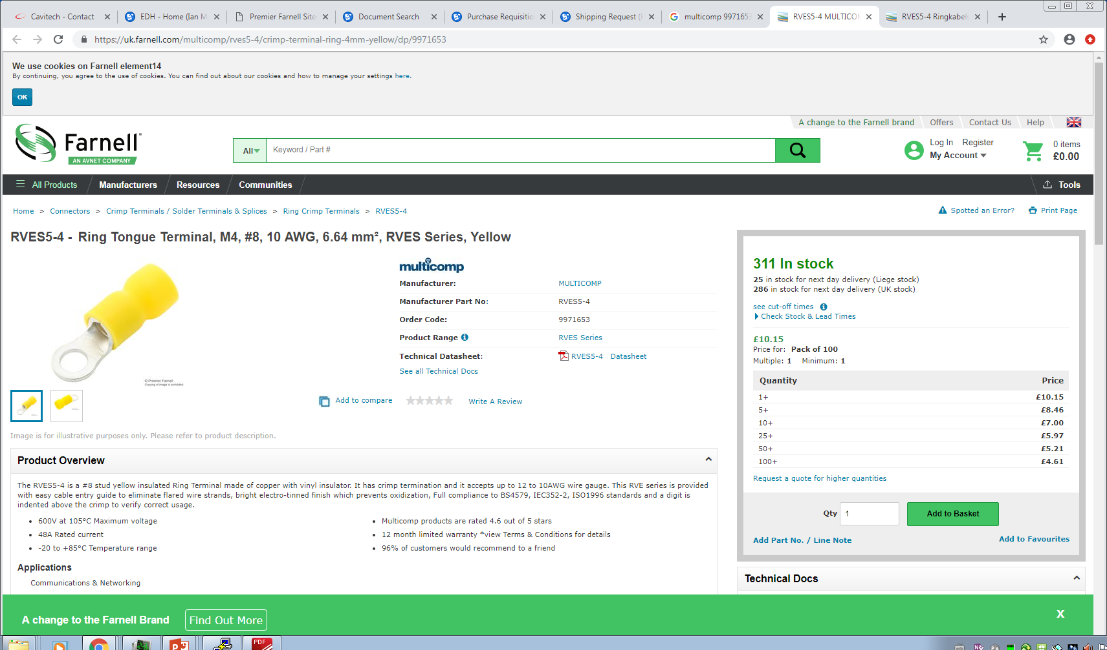
RVES5-4 - (9971653) Ring Tongue Terminal, M4, #8, 10 AWG, 6.64 mm², RVES Series, Yellow
KS 12-10 (5.5-4S)
7.23mm
Dia. 4.38mm

Slide 11
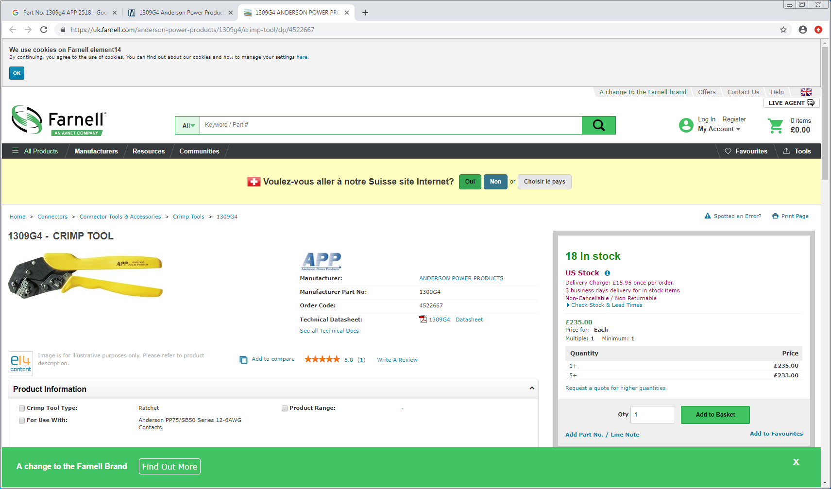
Is this the correct tool, Alice, Hartmutt showed me this ?? 300chf

Slide 12
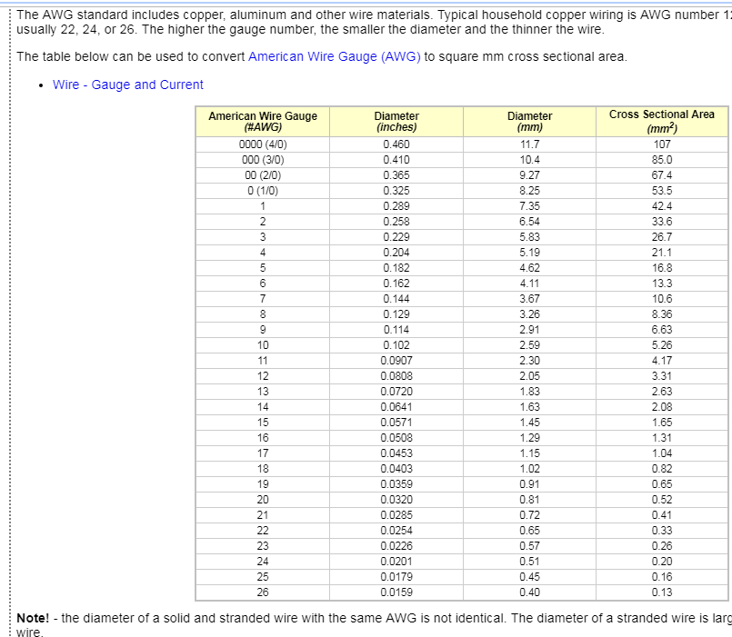
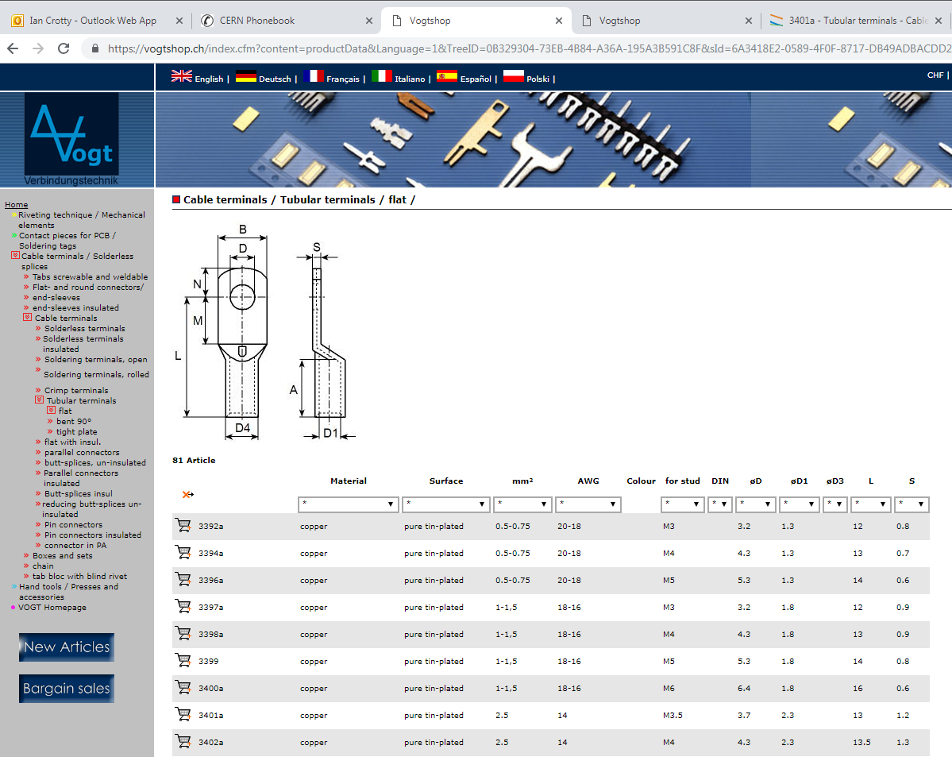
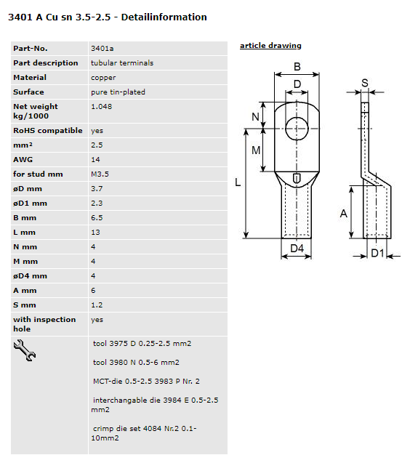
Material sourced by Cavitech Vogt 3401A
https://www.engineeringtoolbox.com/awg-wire-gauge-d_731.html
https://vogtshop.ch/index.cfm?content=productData&Language=1&TreeID=0B329304-73EB-4B84-A36A-195A3B591C8F&sId=6A3418E2-0589-4F0F-8717-DB49ADBACDD2

Slide 13
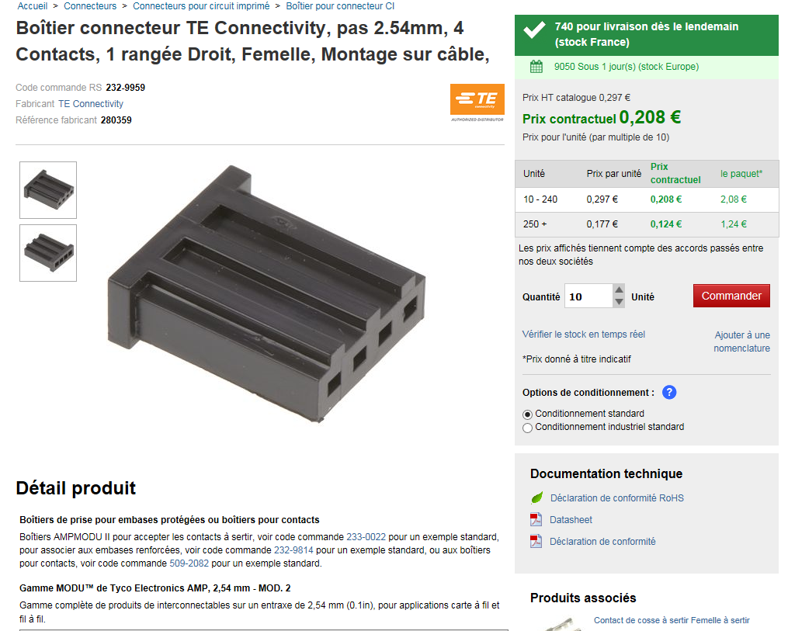
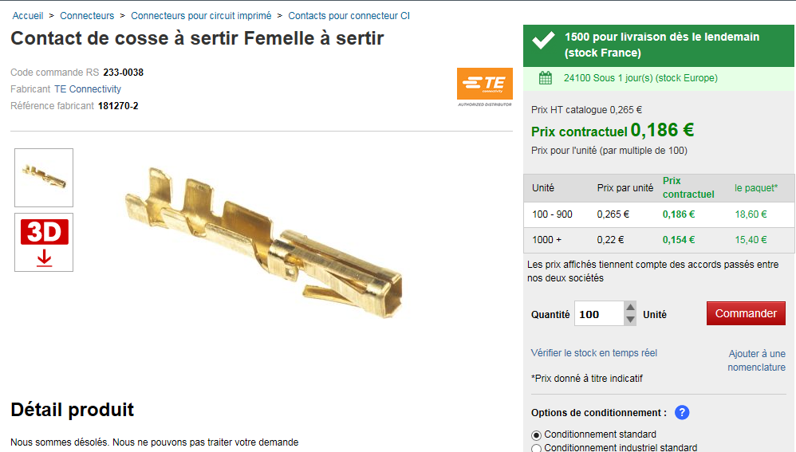
PS end
Lugs and Sense wire connectors
Sense wire connectors 232-9959 (RS)
Pins 233-0038 (RS) or Farnell 182206-2

Slide 14
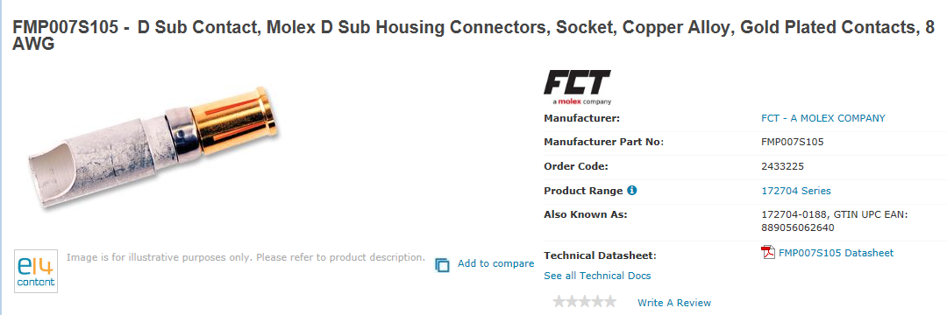
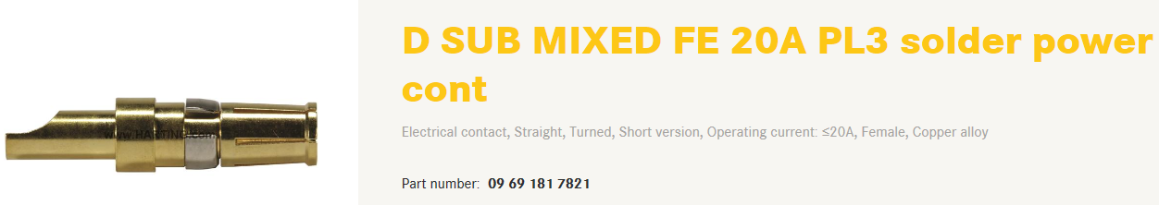
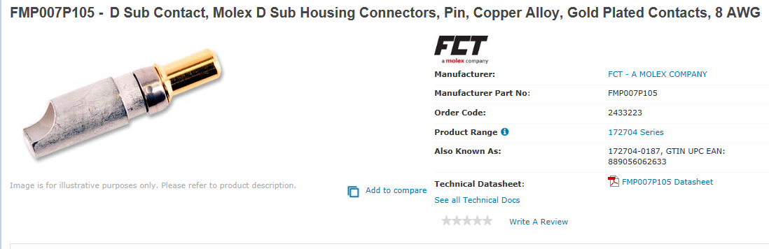
Pins
Farnell
Power
2433225 female
2433223 male
Sense
http://www.farnell.com/datasheets/1836824.pdf?_ga=2.199927789.278703743.1546866397-246438842.1465995239
http://www.farnell.com/datasheets/1836823.pdf?_ga=2.199927789.278703743.1546866397-246438842.1465995239

Slide 15
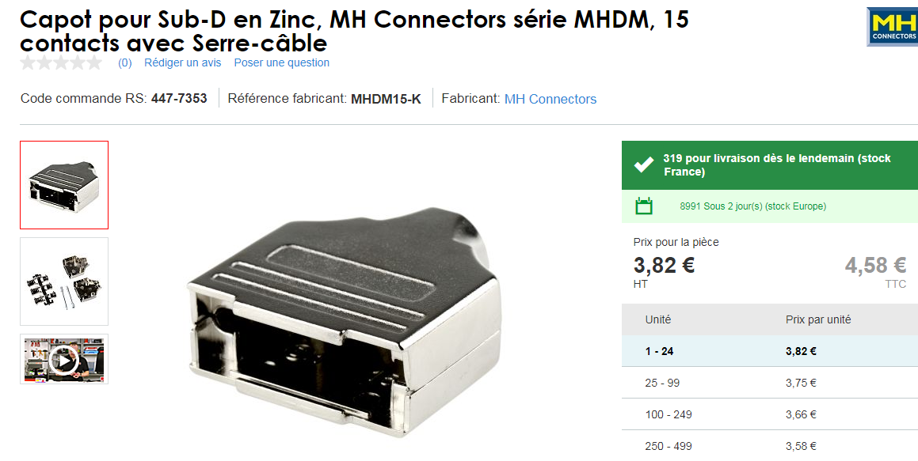
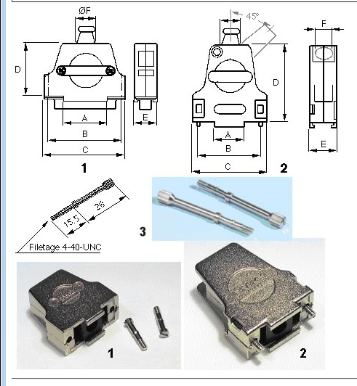
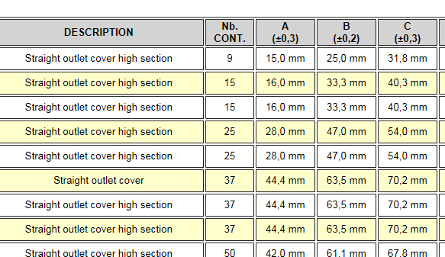
Drawing
https://docs-emea.rs-online.com/webdocs/167c/0900766b8167c5a2.pdf
447-7353
Hood is therefore for a 15pin size connector
09.21.23.013.7 Straight outlet cover high section 8,5 mm FMK21G 2
OR
For dia 12,5 mm cable FMK2G SCEM 09.21.23.013.9
For dia 9,6 mm cable with 45deg entry FMK21 09.21.23.022.0 4.1chf

Slide 16
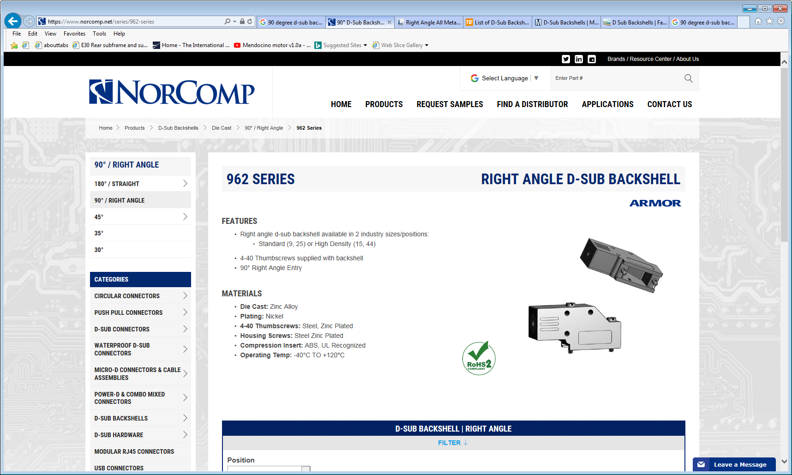
https://www.norcomp.net/series/962-series

Slide 17
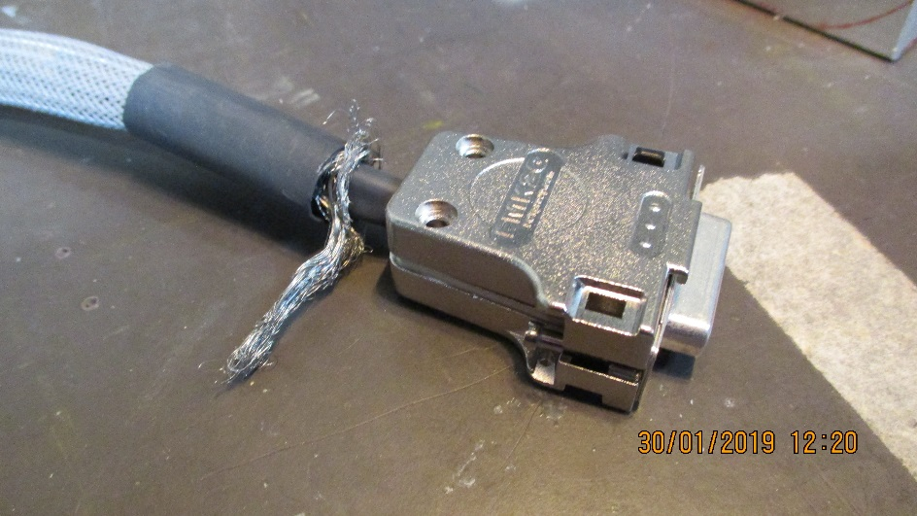
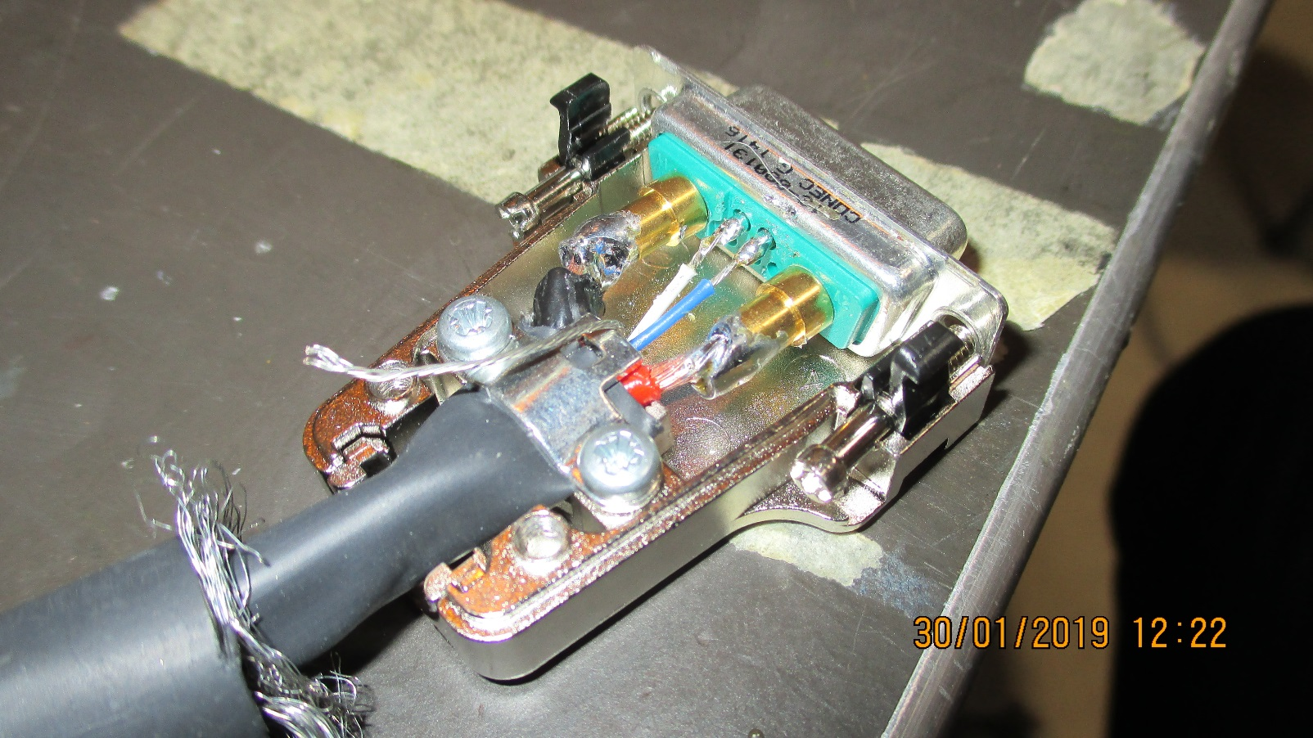
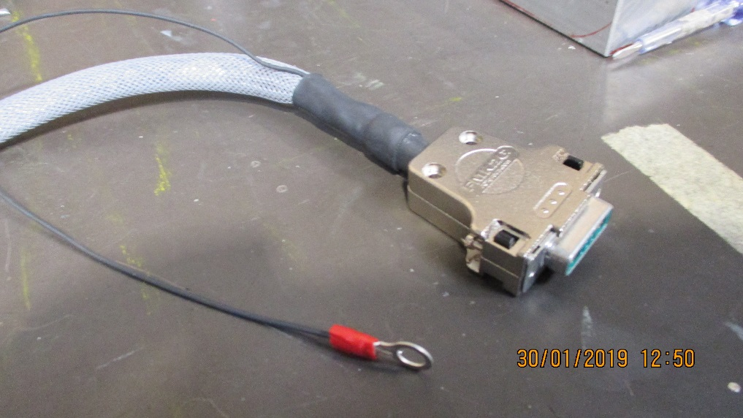
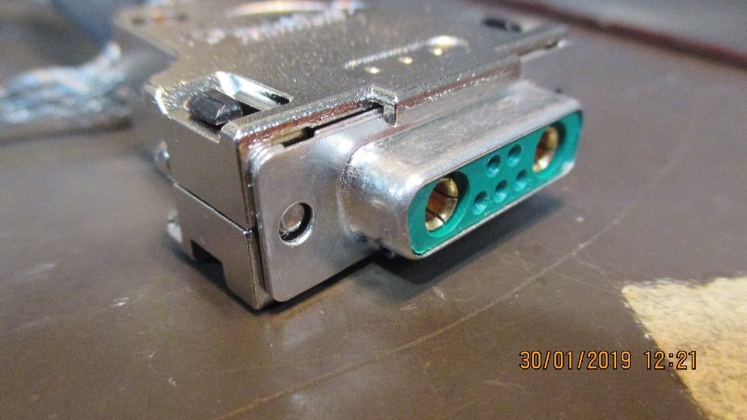
Grounding of the cable shield.
Two solutions ;
By ground cable to star point on the chamber patch panel. Is the shield isolated from the body or both body and flying lead ground wire are used (ground strap).
By the screws in the body. The shield has to be screwed to some where in the body.
The shield consists of the braid and the nude cable

Slide 18
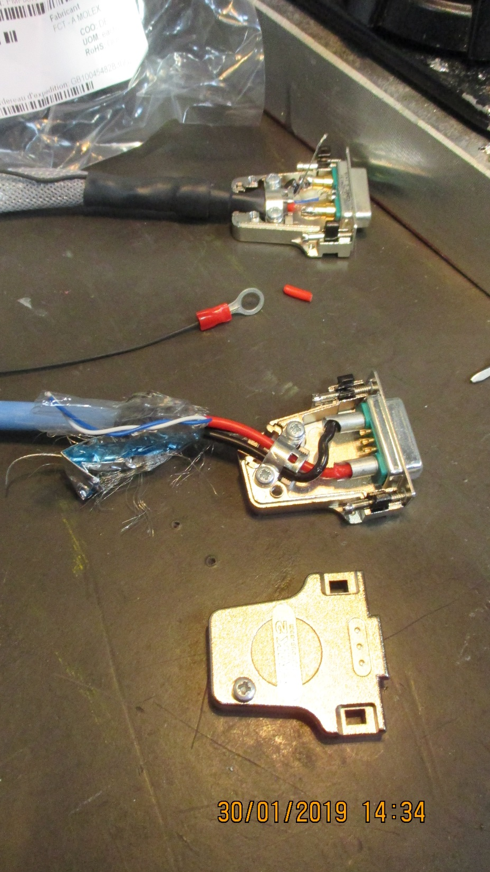
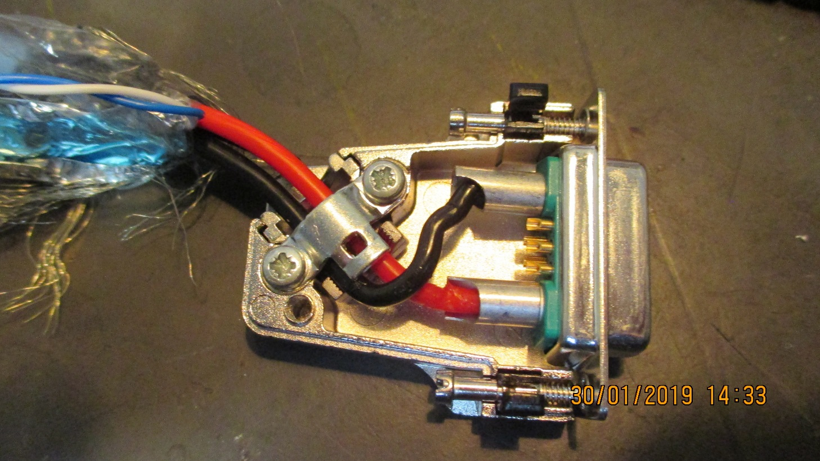
45 Degree cable exit
Cable is not straight into the pin next to the screw on the inner radius
The 45 deg connector housing is very difficult to mount with cable bending radius and stress make it unlikely., to be seen with manufacturer.

Slide 19
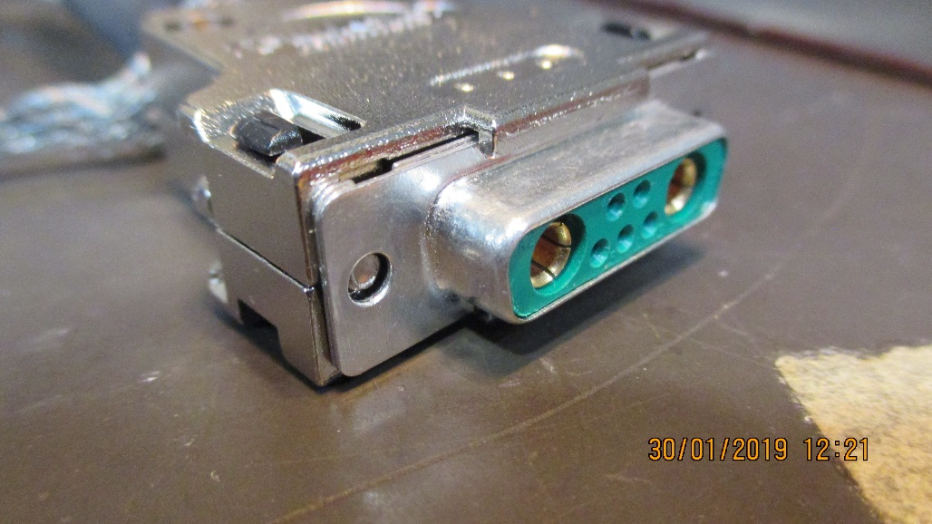
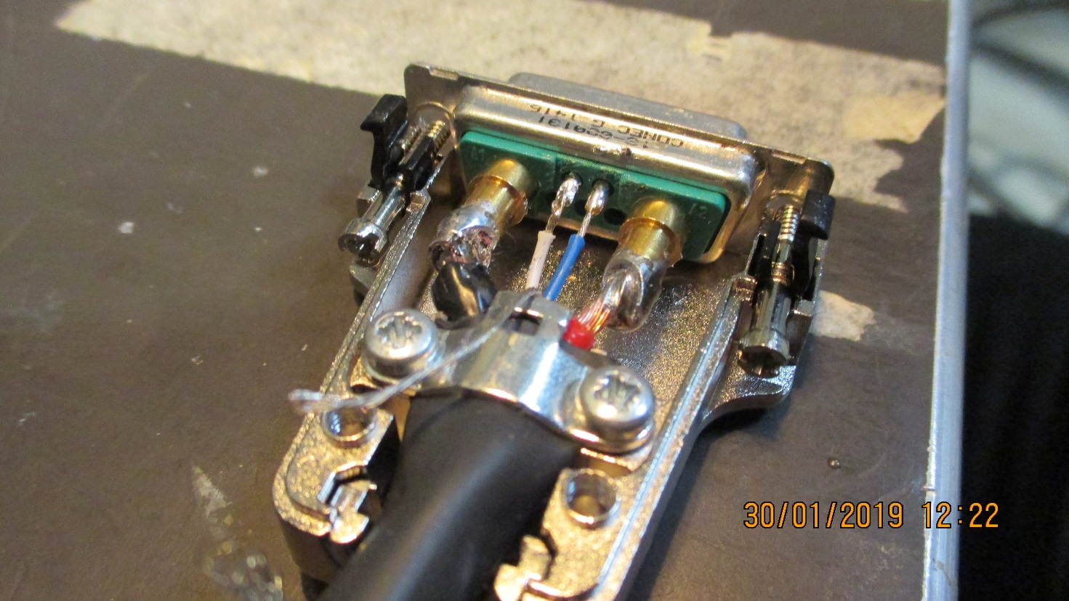
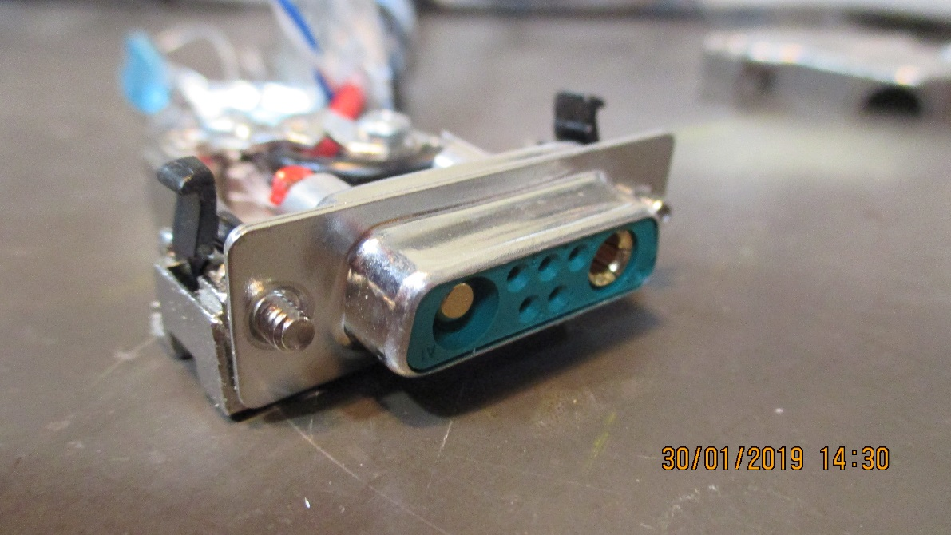
Questions of pin layout.
Pin gender mixed , female on cable ?
Positive on for the RHS of the PS.
Put positive on the rhs of the connector as seen from the back of the connector in order to be intuitive.
The above also true for the sense wires
3 spare wires in the connector, can they be used ?

Slide 20
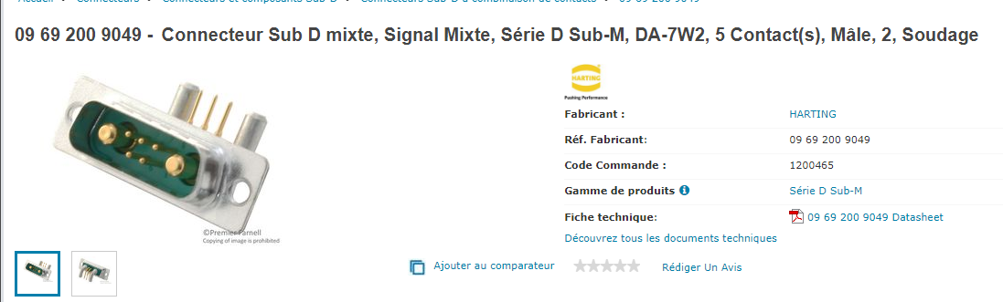
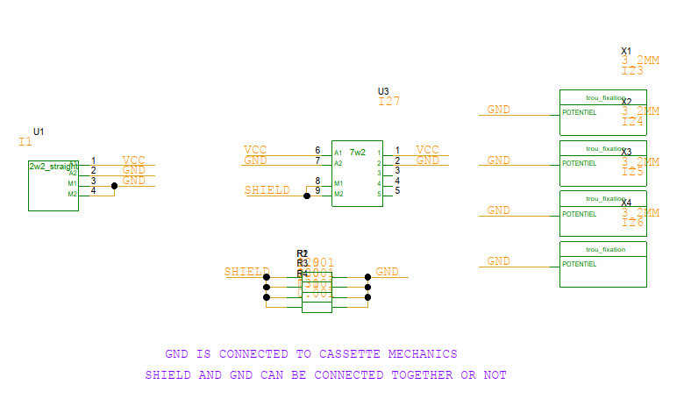
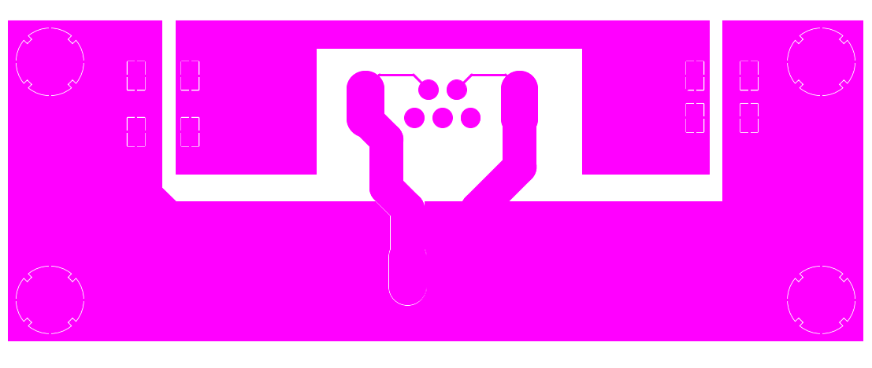
From Christoph 5 Feb 2019
10Euro for >75 pieces
Insulated PP made from PCB

Slide 21
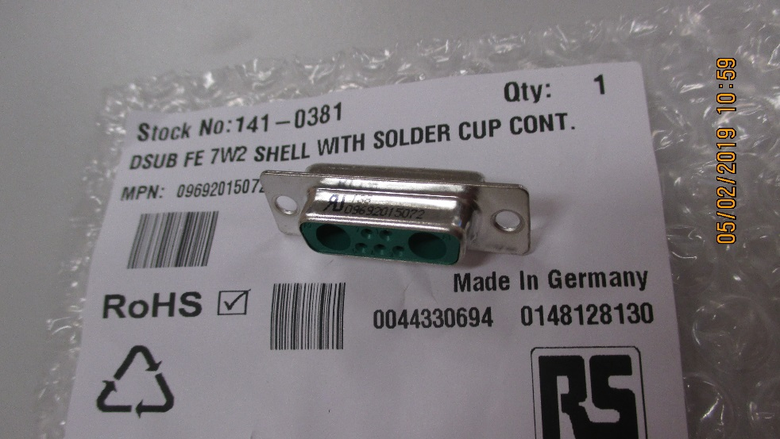
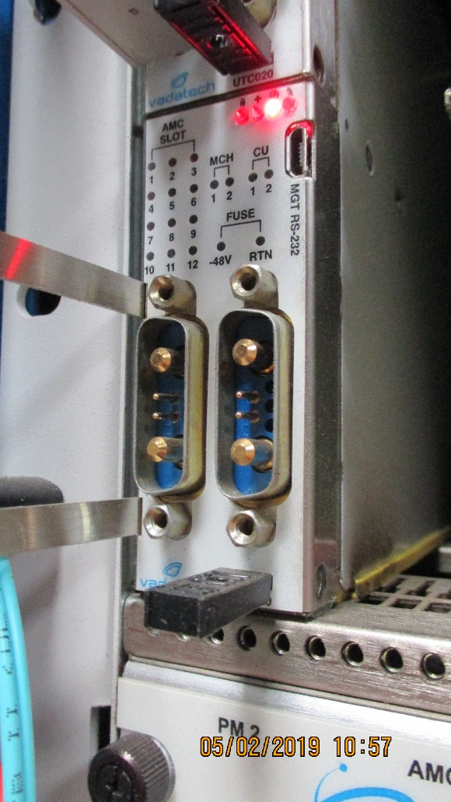
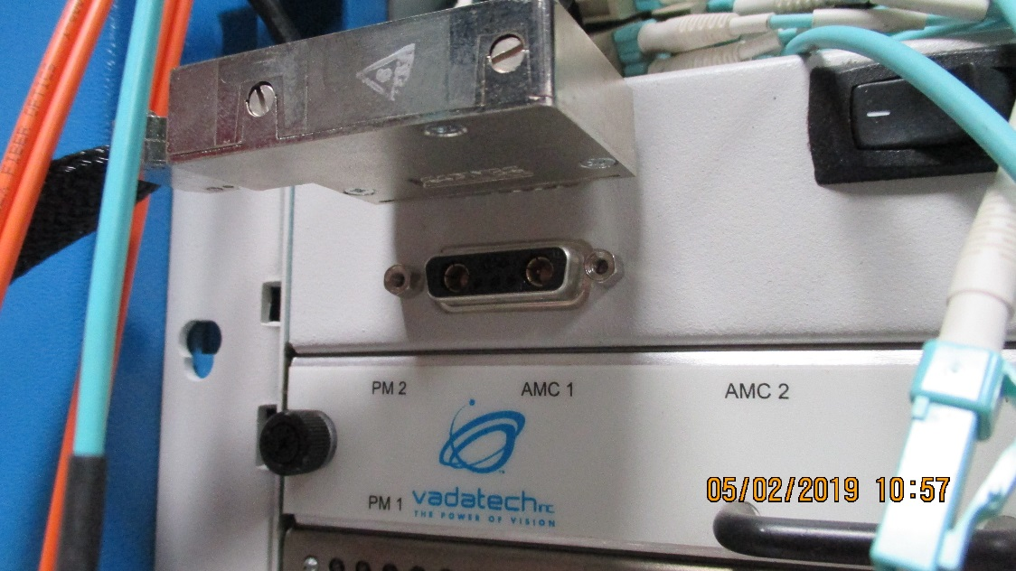
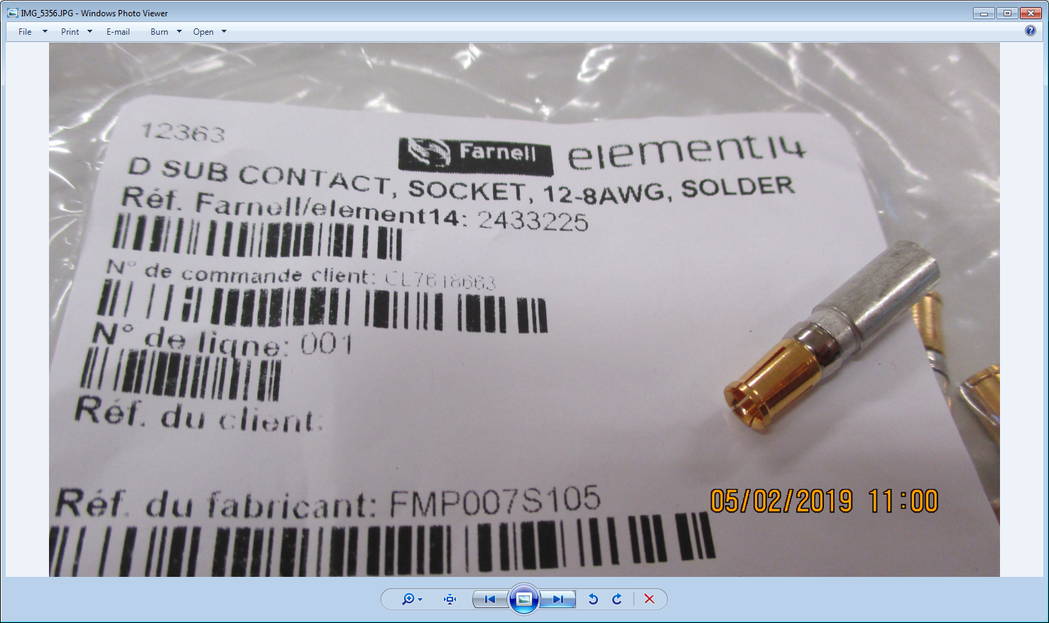
Conclusion from 904 installations.
Cable has female pins and cable body is male

Slide 22
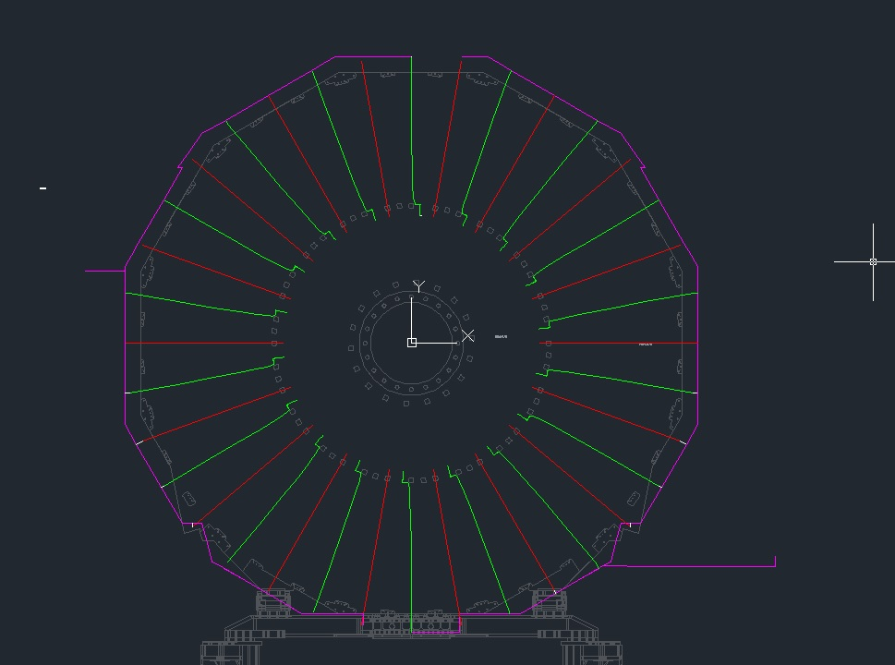
Lengths by S. Bally from the IO
X4 Far
X2 Near

Slide 23
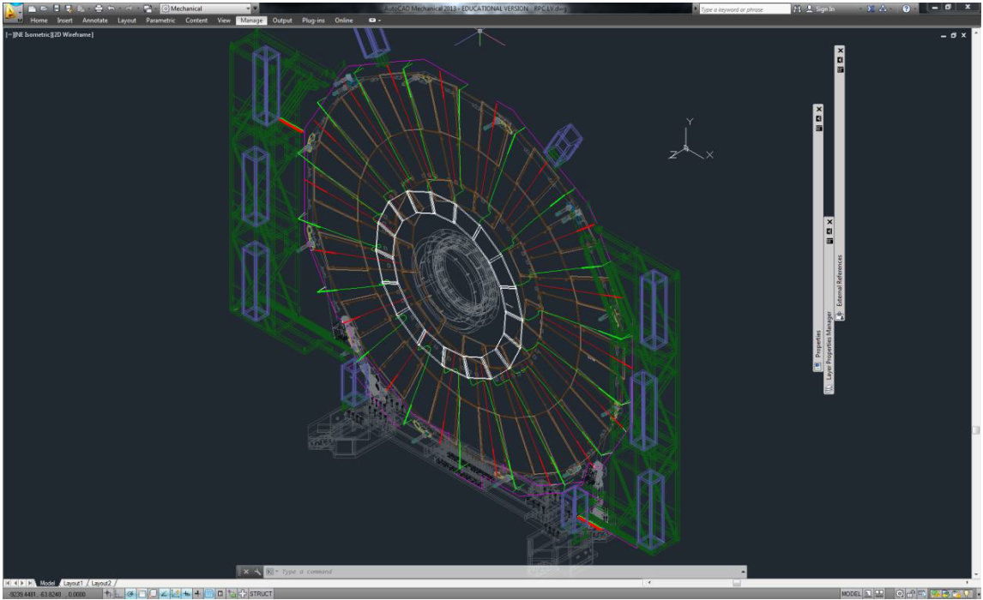

Slide 24

Draft lengths done. Slack to be added

Slide 25




Visit to the production site at Boudry 5 Feb 2019

Slide 26
Conclusions
Material can be provided by Cavitech, cost increase on Cavitech contract.
We will arrange quantities and component supply in order to remain below the 5kchf
They will produce 36 cables rapidly. Request 160.
The PS lug they will source.
I must provide final details of flexible lengths for quote.
Exact pin-out details arranged during visit.

Slide 27

Pin-out decided at Cavitech according the accepted norms.

Slide 28


The Chassis Mount equivalent connector
https://www.digikey.ch/product-detail/en/harting/09692117072/1195-5156-ND/4323561?cur=CHF&lang=en
Ref; 09692117072 by Harting

