Slide 1
LV cable production V3
Ian
12 Feb 2018

Slide 2
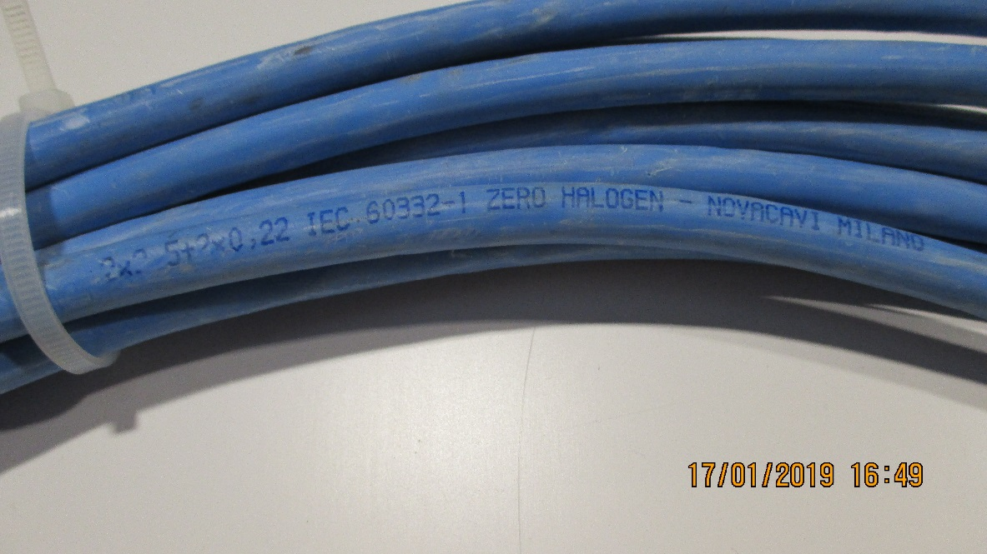
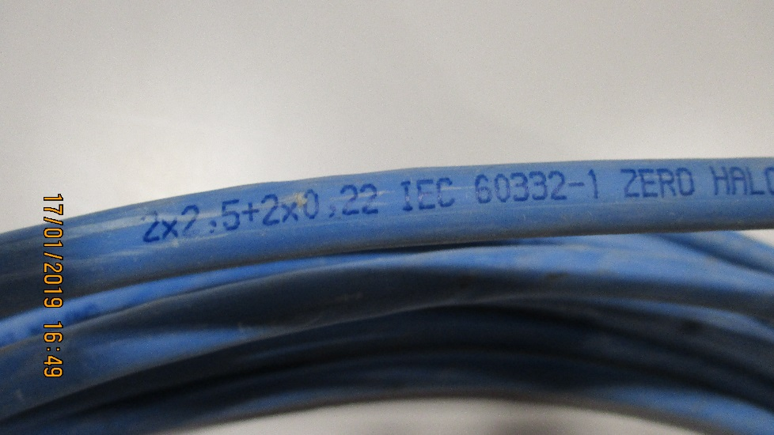
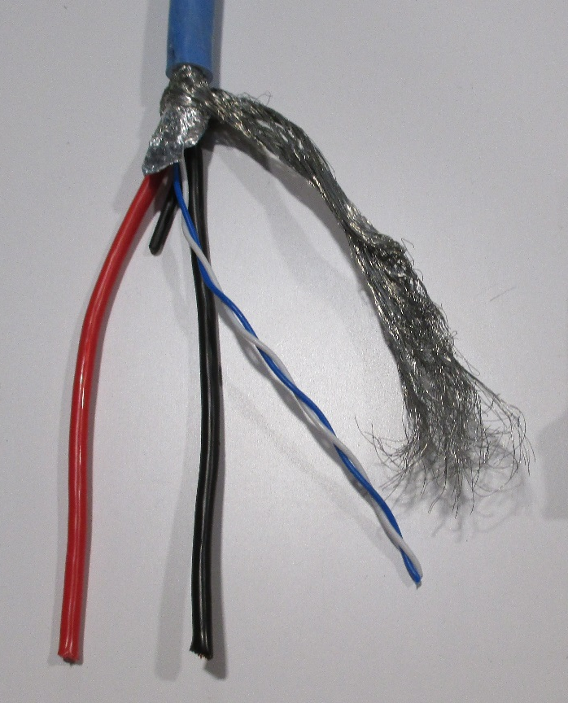
Use the LV Link board cable, used for the initial installation
2 x 2.5mm² (13AWG) + 2 x 0.22mm2 (24AWG )
Sheath diameter = 8.3mm approx. (8.22mm)
Perhaps we have 3.5km available
P5 was not able to measure this !

Slide 3
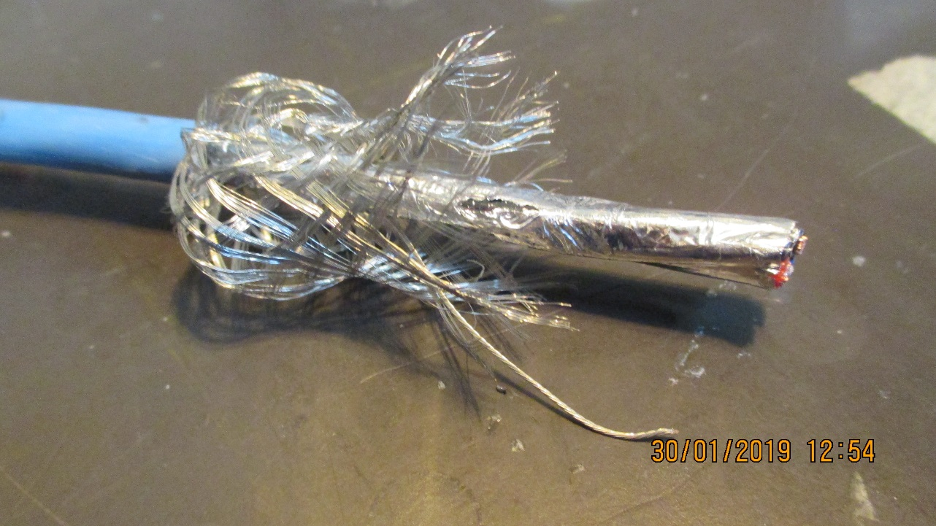
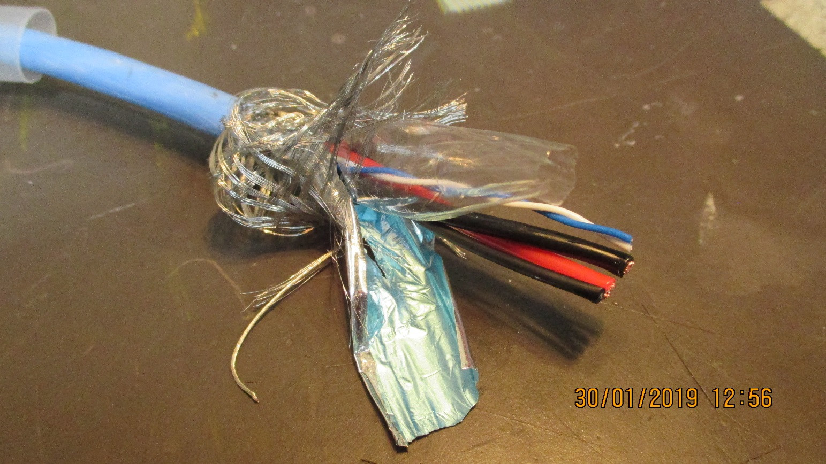

Slide 4
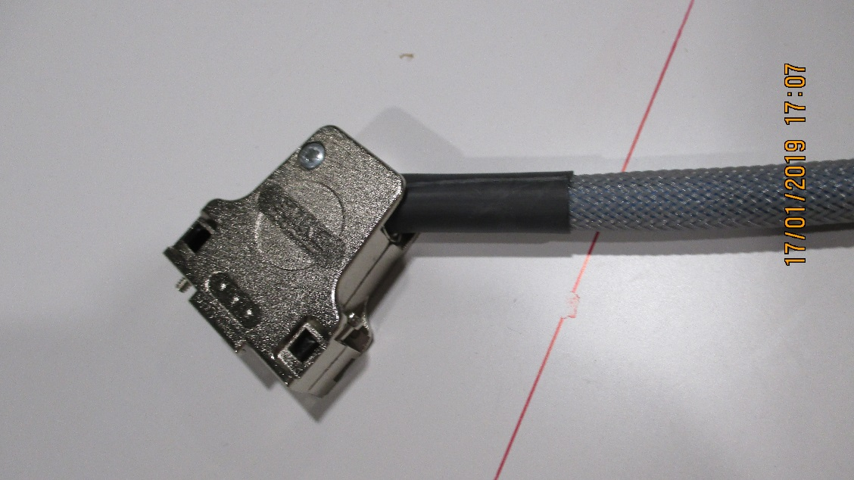
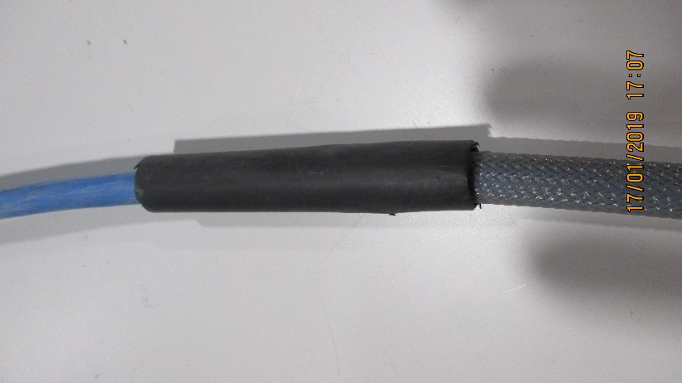
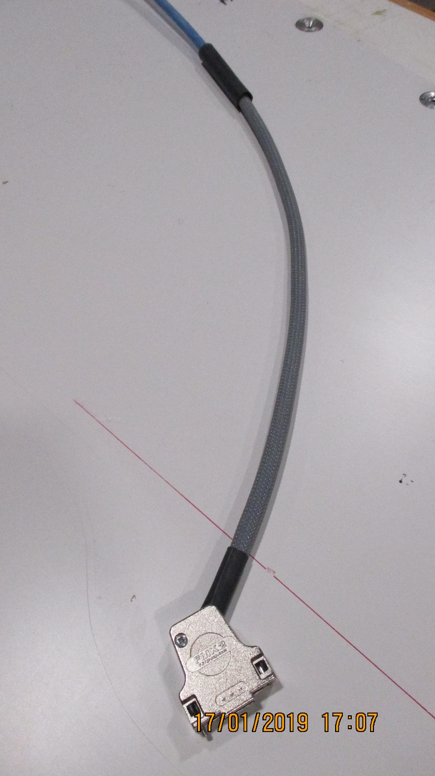
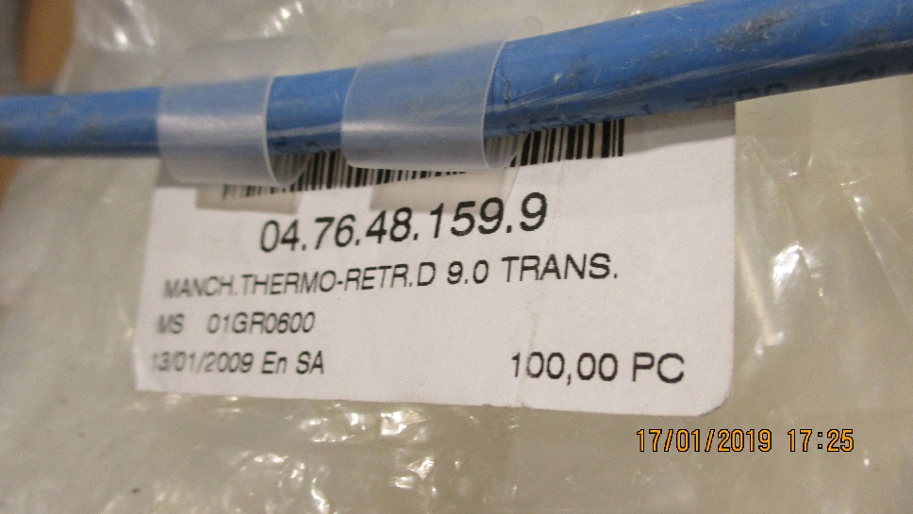
Connecteur cote Chambre
1000mm
± 20mm
Thermo retractable , protection transparent etiquettes. 2 x 100mm

Slide 5
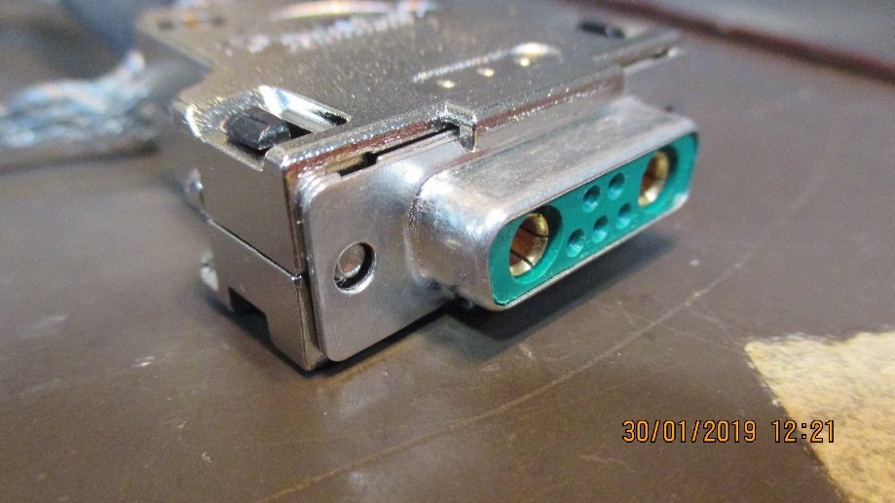

Slide 6
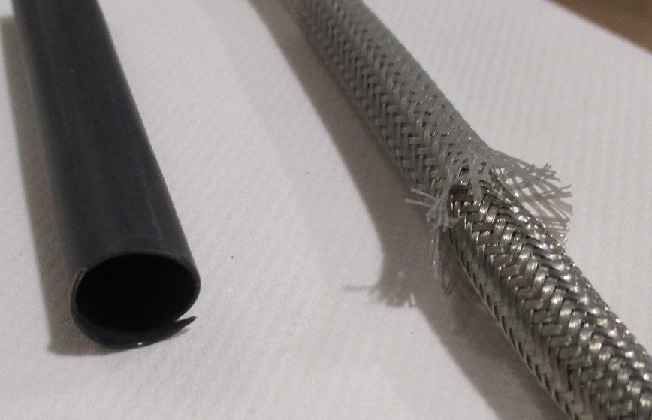
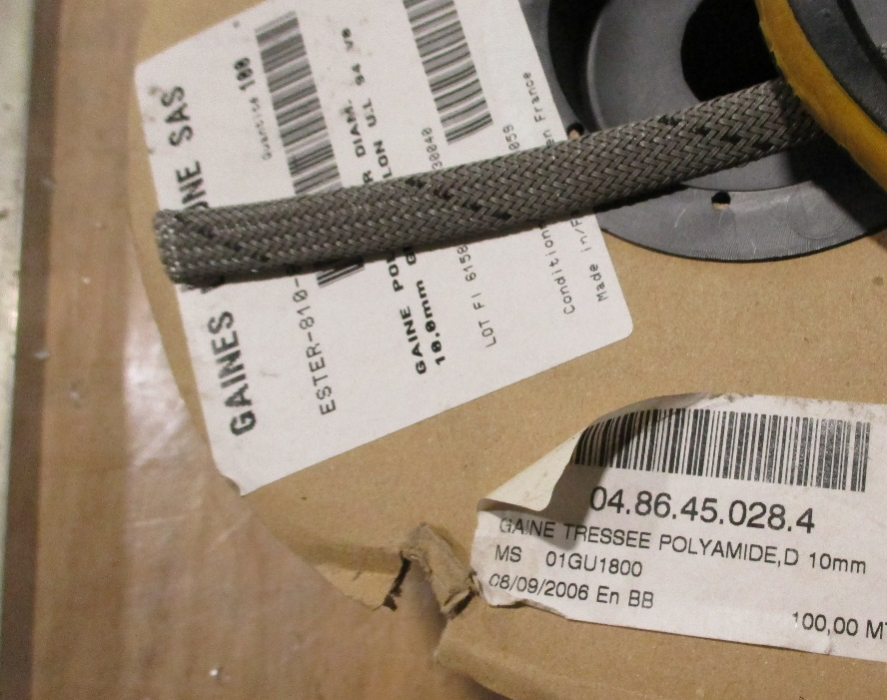
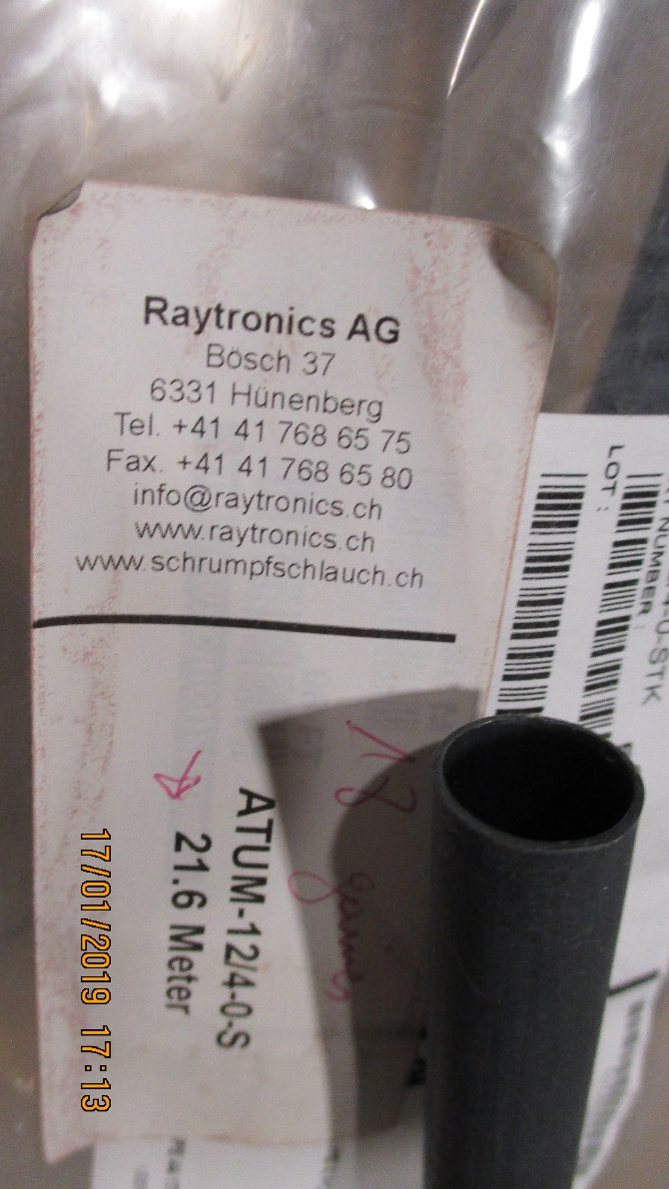
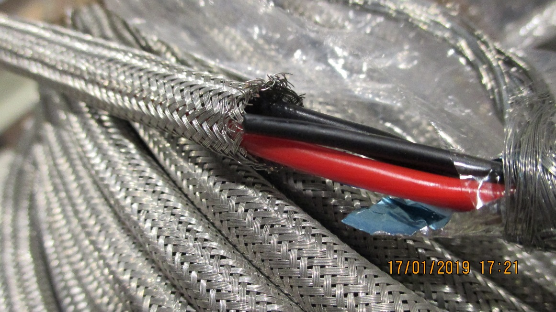
Tresse poly et Cuivre
Tresse Cu04.01.33.050.5
Nominal dia. 6mm
Sheath dia. 4 -7mm
160 wires of 15/100
Thermo retractable , Raychem 12/4-0-STK

Slide 7
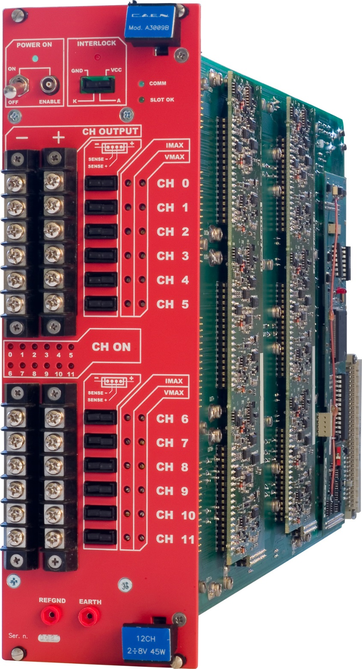

Thread dia.
3.38mm
6-32 UNC inch thread
8.3mm
https://www.caen.it/products/a3009b/
https://www.boltdepot.com/fastener-information/machine-screws/machine-screw-diameter.aspx

Slide 8
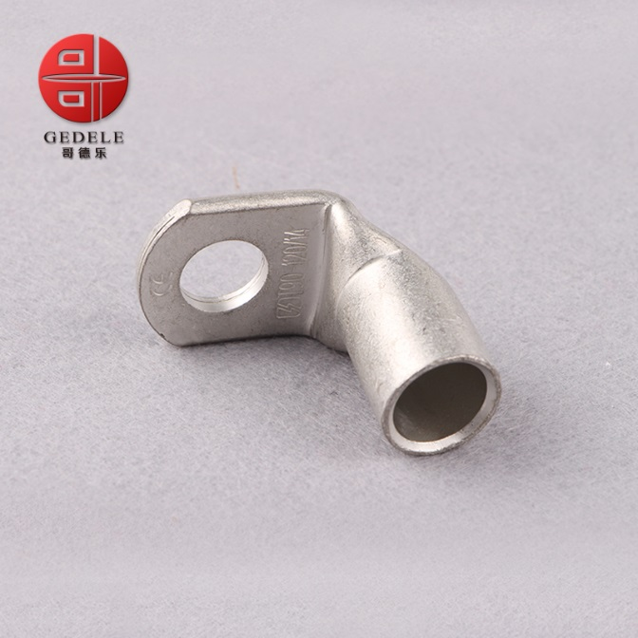
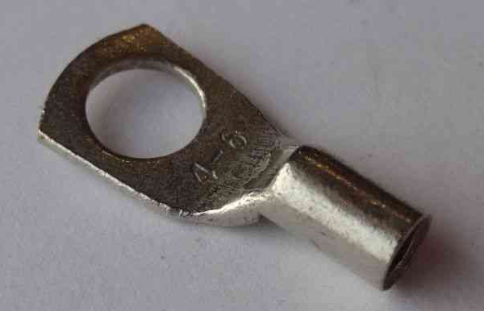
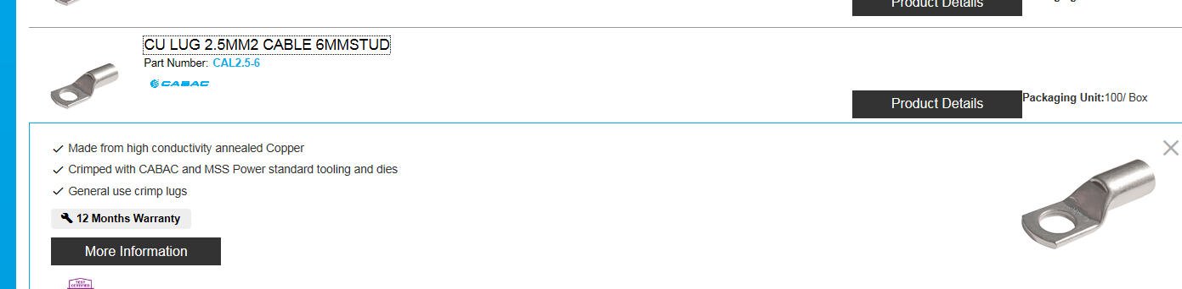
Lug dia 6mm
Section 2.5mm²
Ring terminal,
T90-25mm 90 Degree Angle Battery End Termi
https://www.cabac.com.au/brands/cabac/lugs-links-and-terminals/lugs-and-links/copper-crimp-lugs/cu-crimp-15-95mm2/10100505?s=

Slide 9
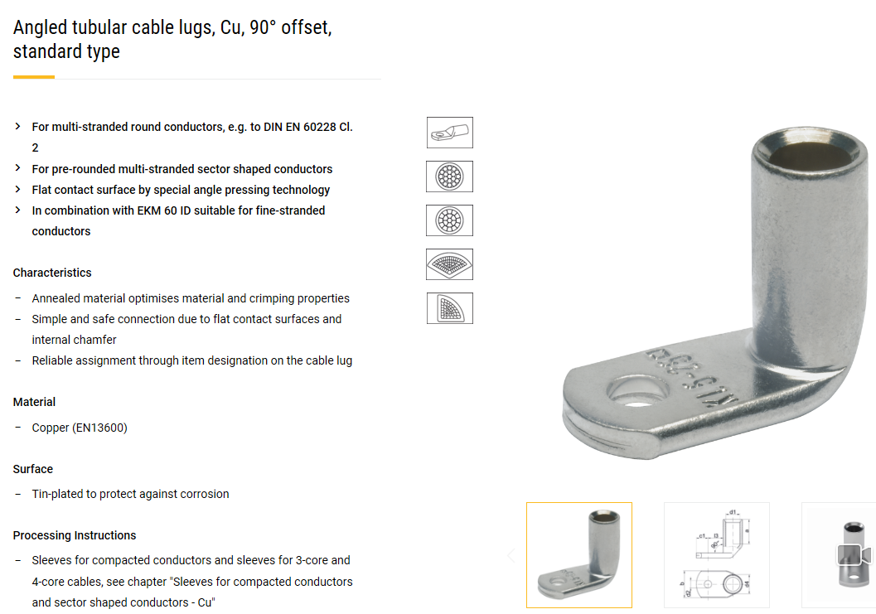
Lusin input week 2
https://www.klauke.com/en/electrical/electrical-connection-systems/
Gustav Klauke GmbH
Auf dem Knapp 46
42855 Remscheid
Deutschland
Tel.: +49 (0)2191 / 907-0
Fax: +49 (0)2191 / 907-141
E-Mail: Klauke-Info@Emerson.com

Slide 10
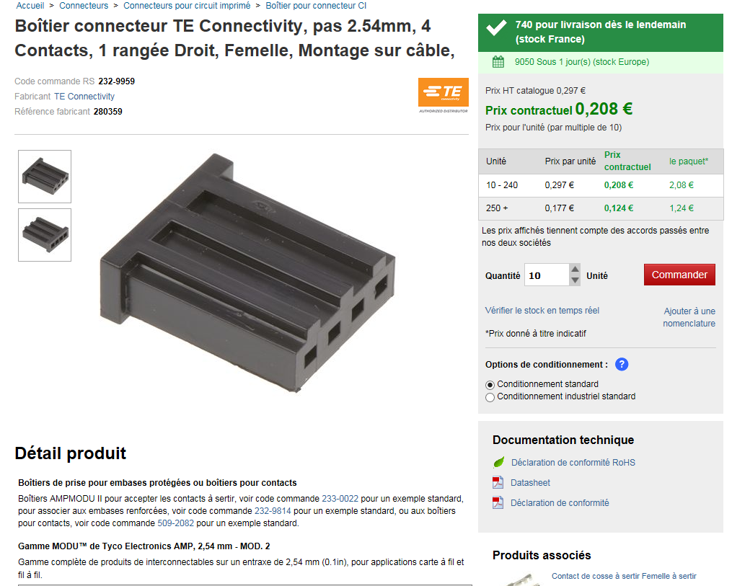
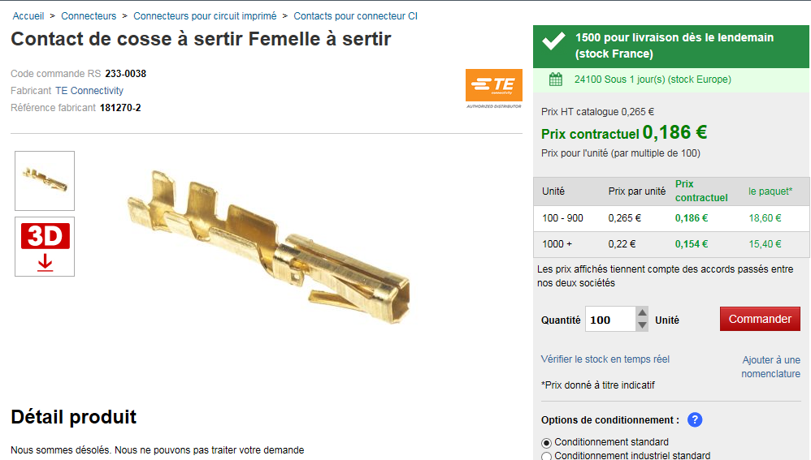
PS end
Lugs and Sense wire connectors
Sense wire connectors 232-9959 (RS)
Pins 233-0038 (RS) or Farnell 182206-2

Slide 11
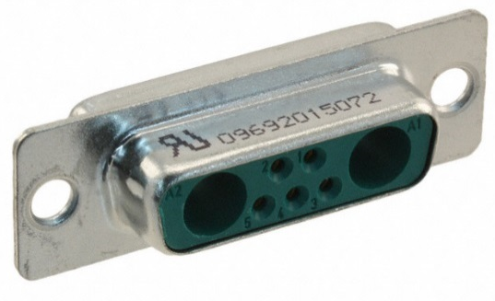
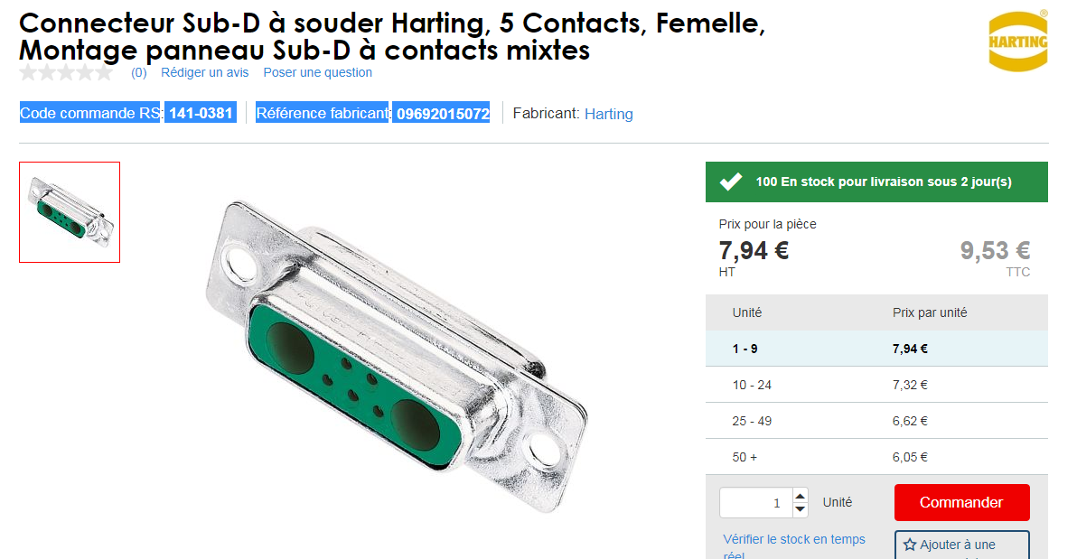
Chamber end with sense wire
D-sub.
Harting 0969201X072
Code commande RS 141-0381
Référence fabricant 09692015072
https://b2b.harting.com/ebusiness/en/DSUB-FE-7W2-SHELL-WITH-SOLDER-CUP-CONT/09692015072
Also another supplier
http://common.leocom.kr/pdfcat/pdfcat2009/c126_sec3_Con(D-sub).pdf

Slide 12
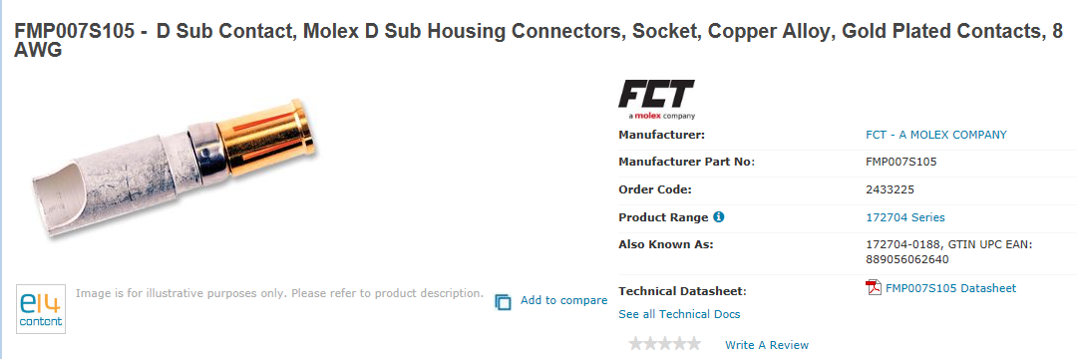
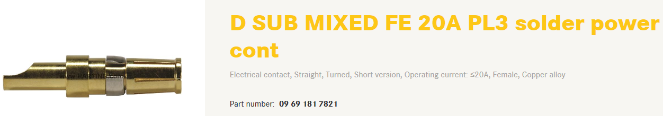
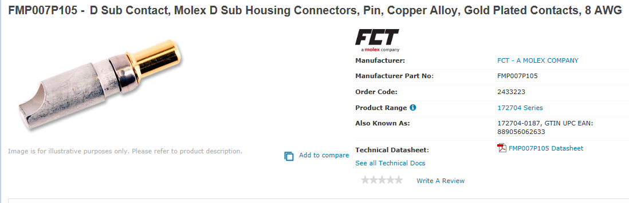
Pins
Farnell
Power
2433225 female
2433223 male
Sense
http://www.farnell.com/datasheets/1836824.pdf?_ga=2.199927789.278703743.1546866397-246438842.1465995239
http://www.farnell.com/datasheets/1836823.pdf?_ga=2.199927789.278703743.1546866397-246438842.1465995239

Slide 13
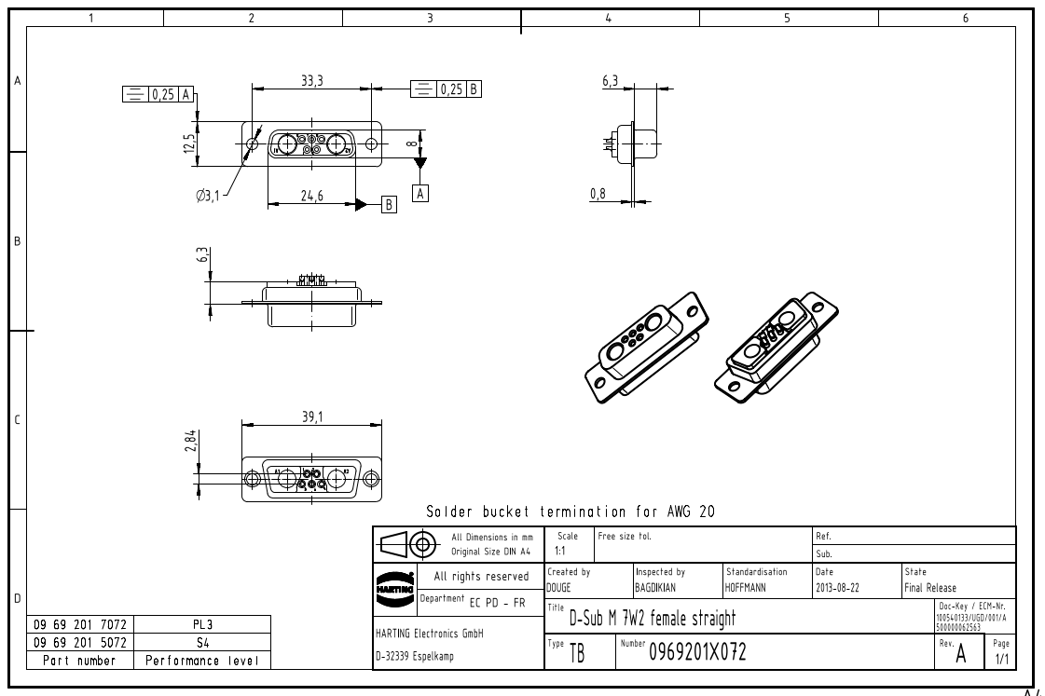
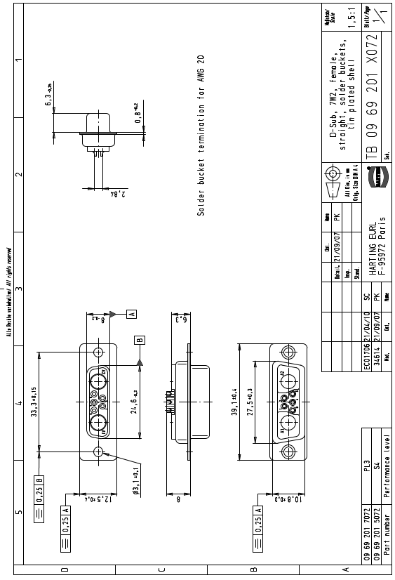
What is female the pins or the body ….???

Slide 14
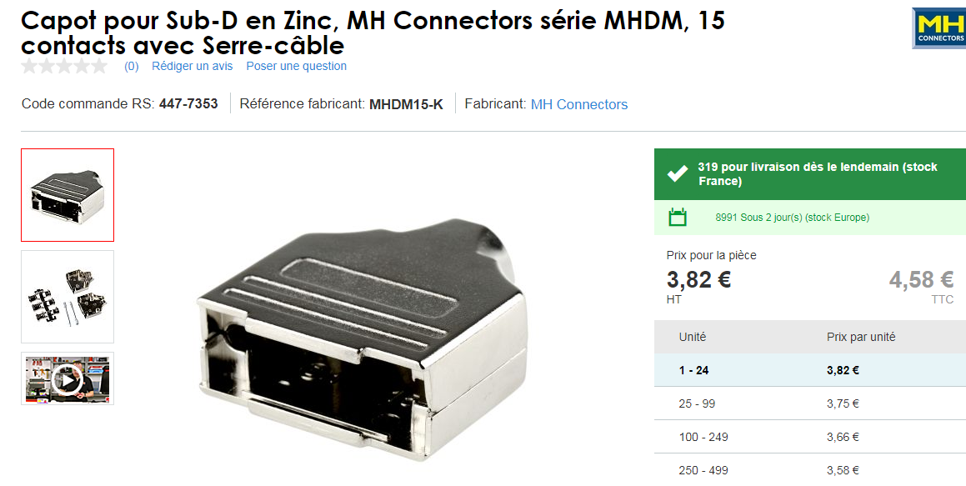
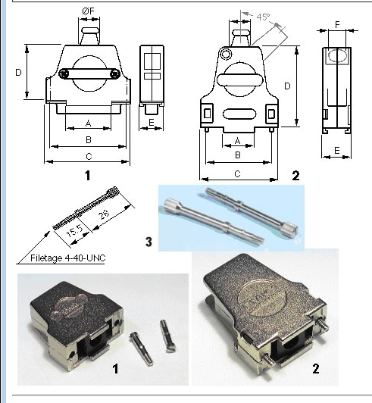
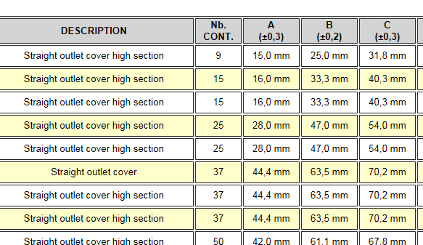
Drawing
https://docs-emea.rs-online.com/webdocs/167c/0900766b8167c5a2.pdf
447-7353
Hood is therefore for a 15pin size connector
09.21.23.013.7 Straight outlet cover high section 8,5 mm FMK21G 2
OR
For dia 12,5 mm cable FMK2G SCEM 09.21.23.013.9
For dia 9,6 mm cable with 45deg entry FMK21 09.21.23.022.0 4.1chf

Slide 15
Resume of connectors D-Sub
RS Farnel Quantity
Base Cable end 923-5189 144 + 26 = 170
Female pins 2433225 144 + 26 = 170
Male pins 2433223 144 + 26 = 170
Hood 447-7353 144 + 26 = 170

Slide 16
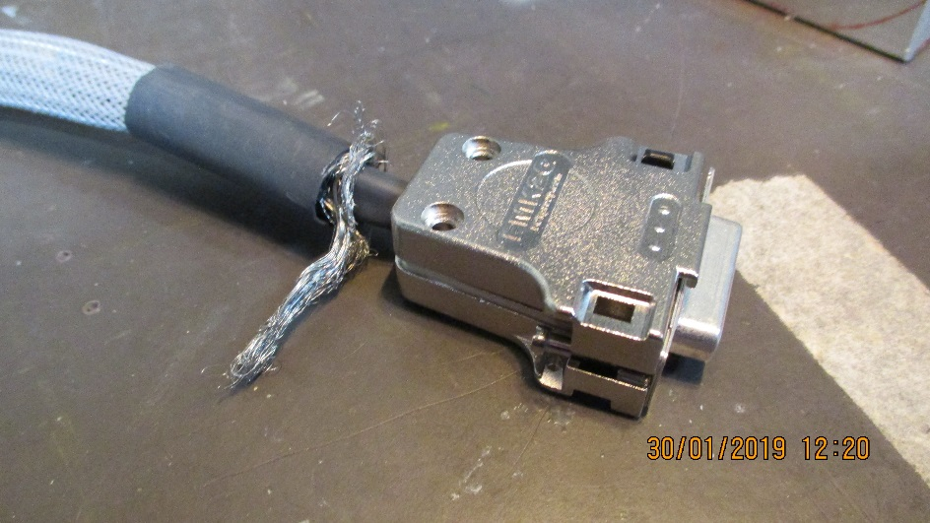
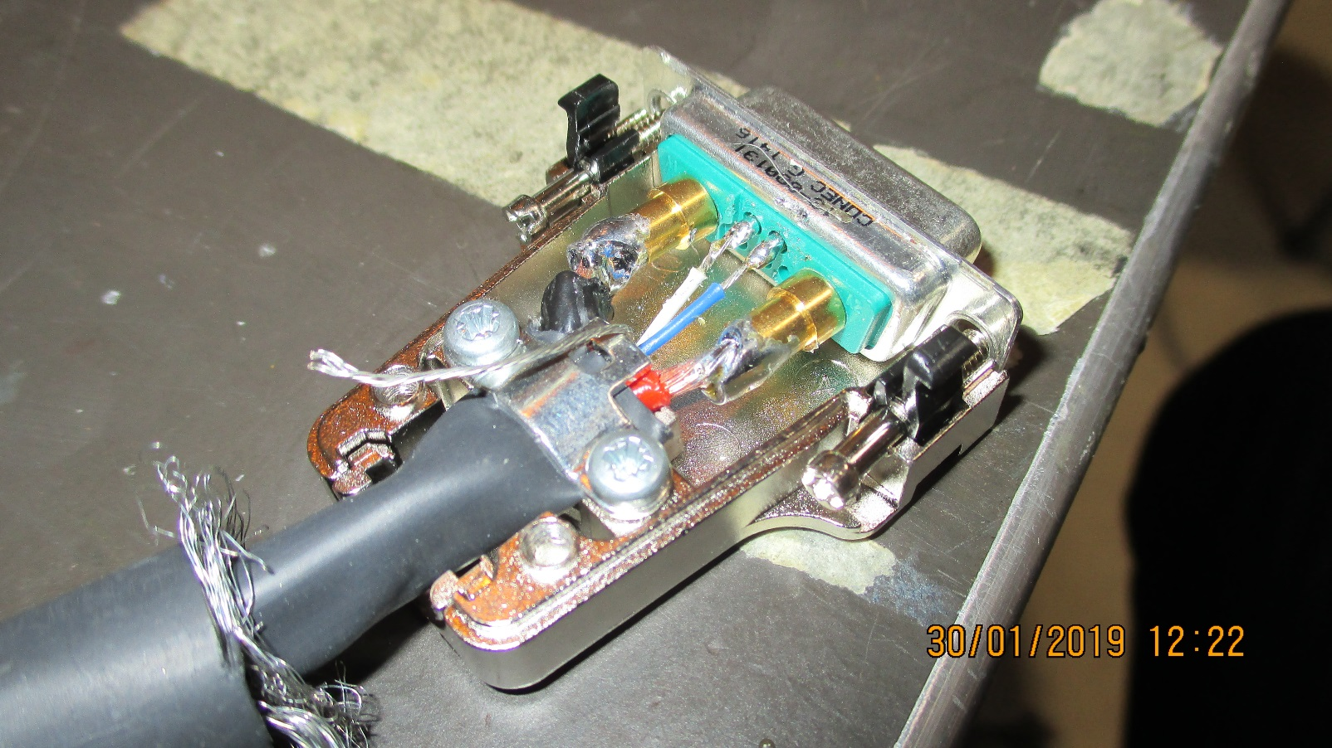
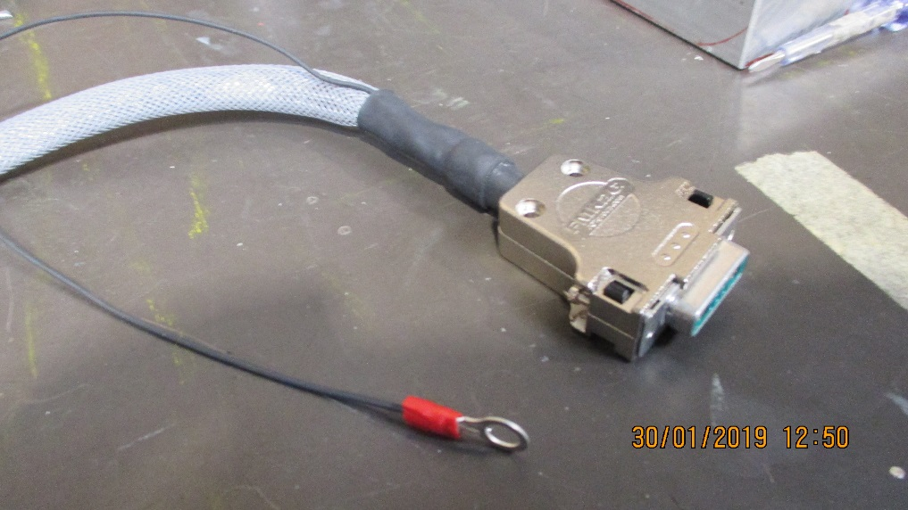
Grounding of the cable shield.
Two solutions ;
By ground cable to star point on the chamber patch panel. Is the shield isolated from the body or both body and flying lead ground wire are used (ground strap).
By the screws in the body. The shield has to be screwed to some where in the body.
The shield consists of the braid and the nude cable

Slide 17
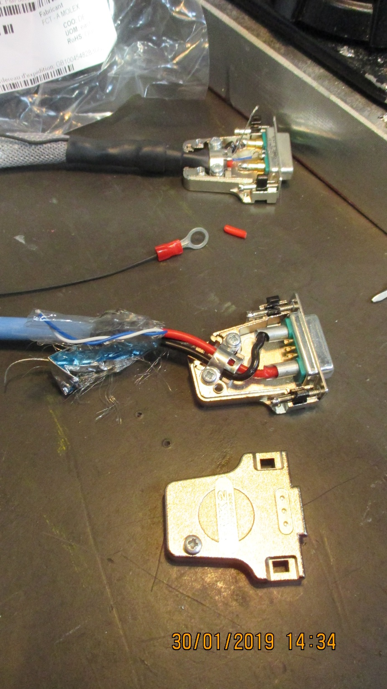
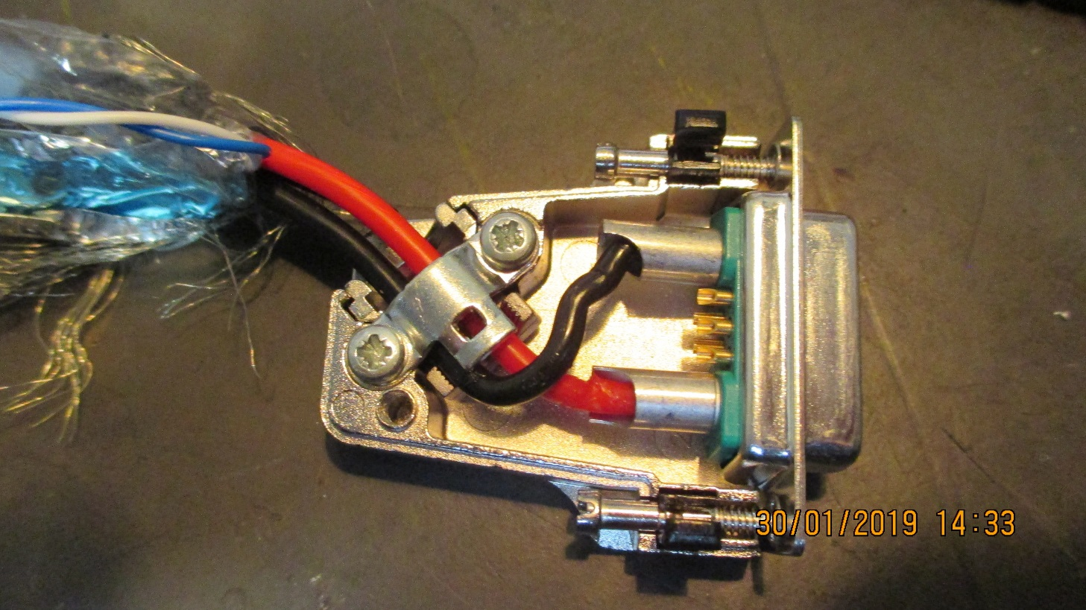
Cable is not straight into the pin next to the screw on the inner radius
The 45 deg connector housing is very difficult to mount with cable bending radius and stress make it unlikely., to be seen with manufacturer.

Slide 18
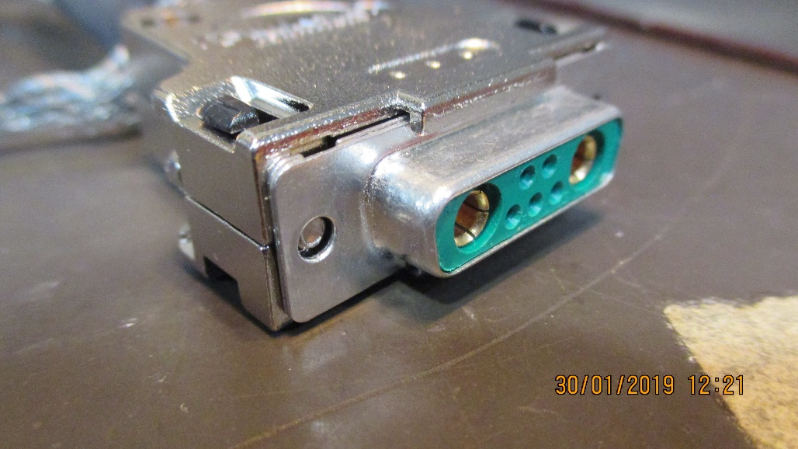
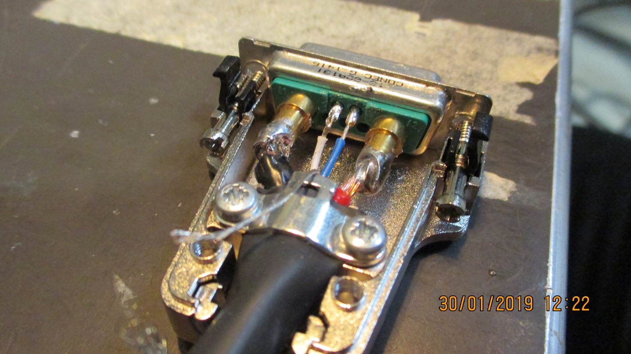
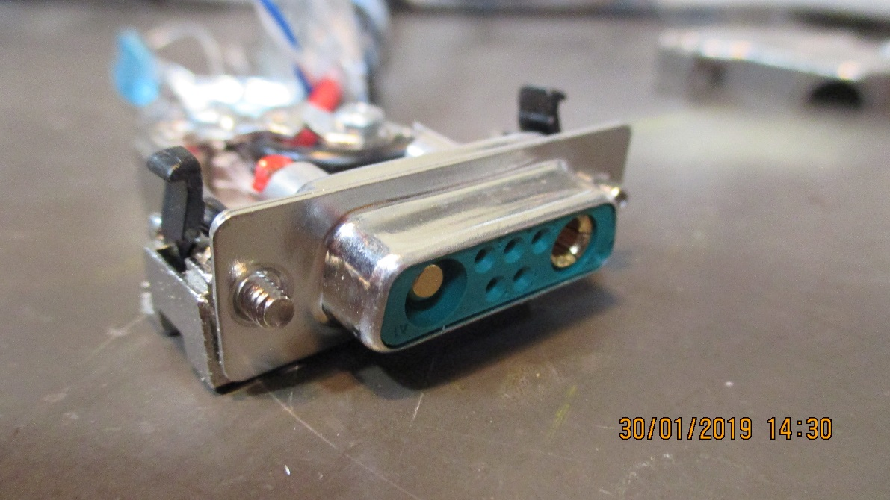
Pin gender mixed , female on cable ?
Positive on for the RHS of the PS.
Put positive on the rhs of the connector as seen from the back of the connector in order to be intuitive.
The above also true for the sense wires
3 spare wires in the connector, can they be used.

Slide 19
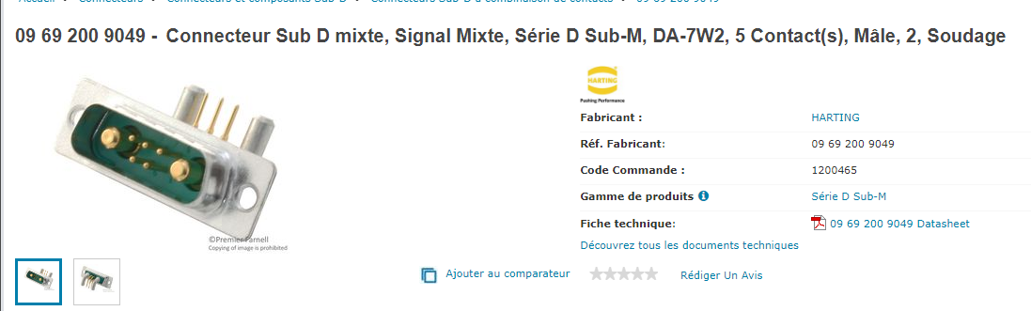
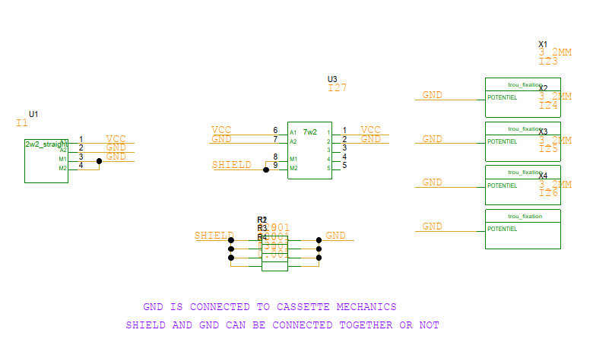
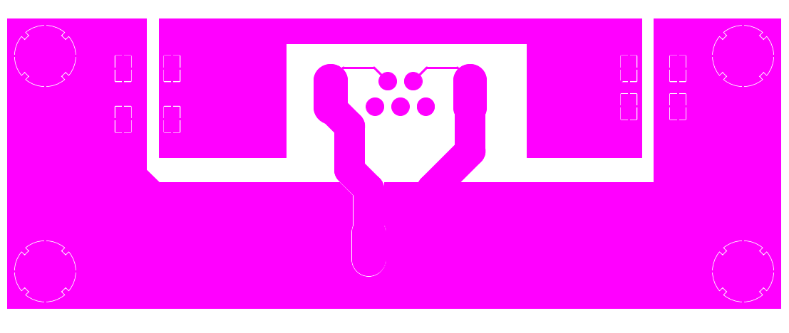
From Christoph 5 Feb 2019
10Euro for >75 pieces
Insulated PP made from PCB

Slide 20
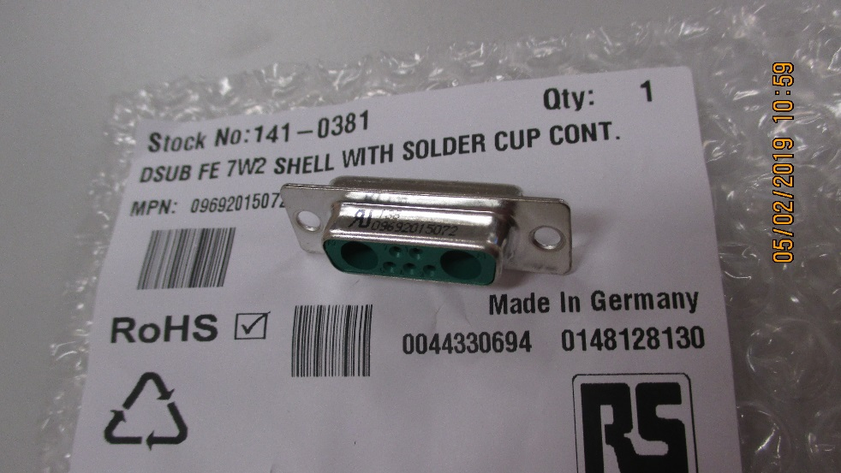
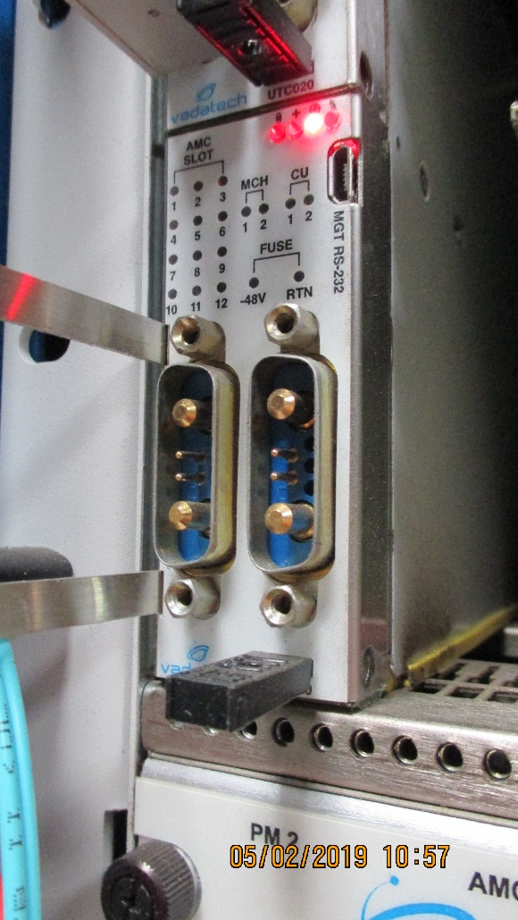
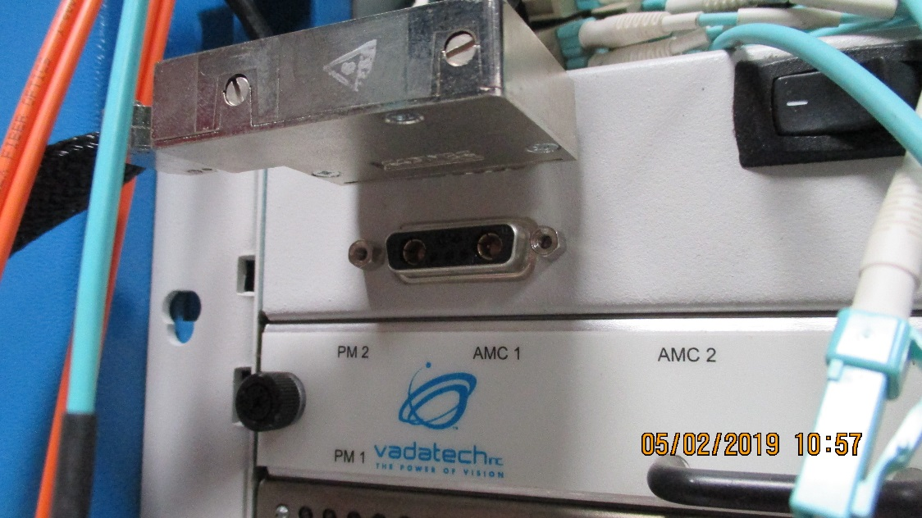
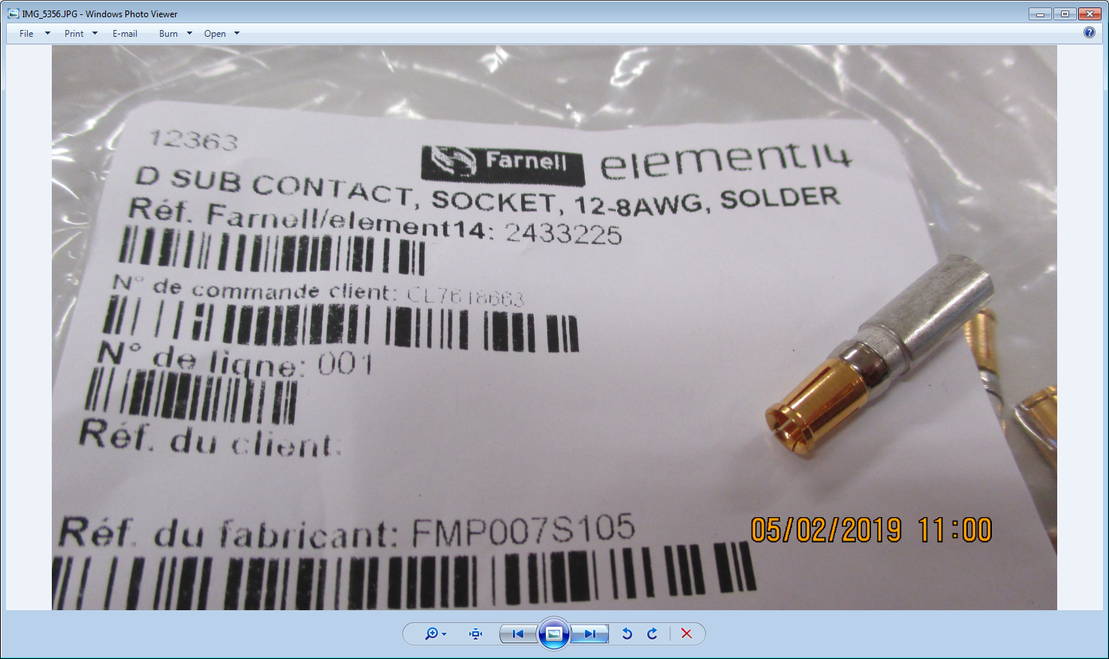
Conclusion from 904 installations

Slide 21
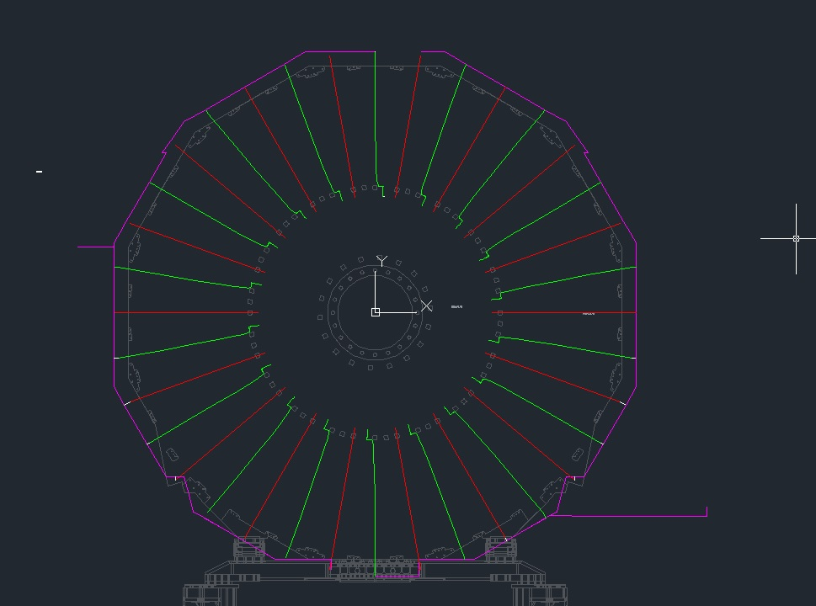
Lengths by S. Bally from the IO

Slide 22
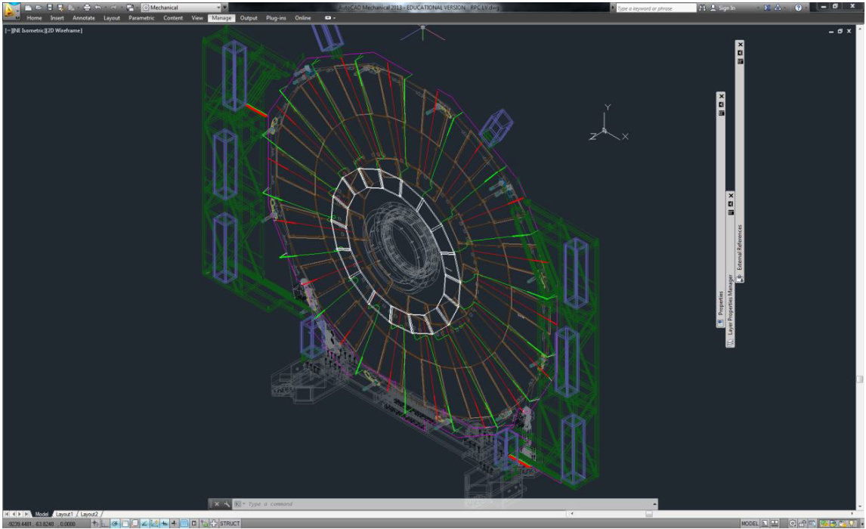

Slide 23
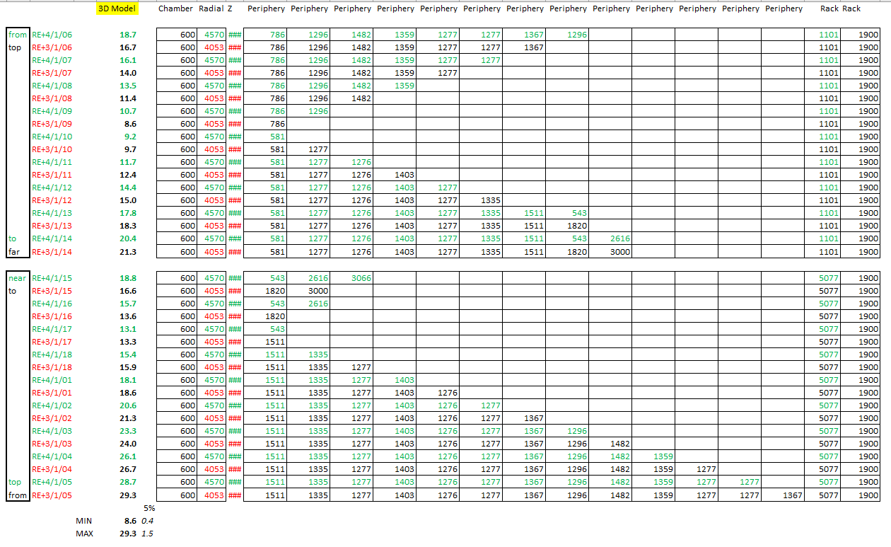

Slide 24
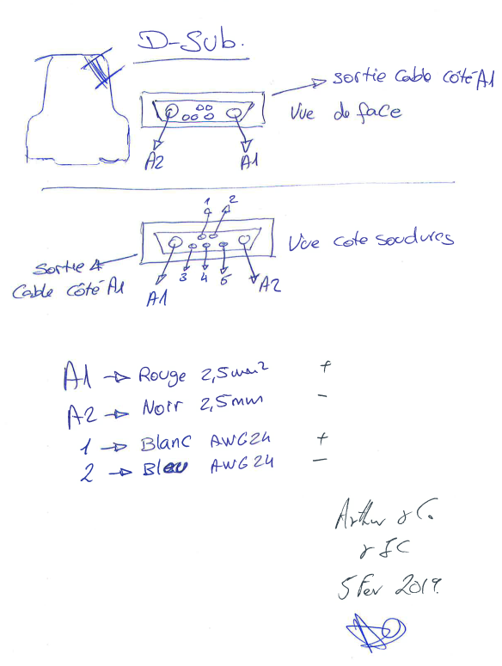
Pin-out decided at Cavitech according the accepted norms.

Slide 25
references
AWG to mm2 https://www.multicable.com/resources/reference-data/cross-reference-awg-to-mm2/

Slide 26

https://www.boltdepot.com/fastener-information/machine-screws/machine-screw-diameter.aspx

Slide 27

https://en.wikipedia.org/wiki/Computer_case_screws

Slide 28

https://www.server-racks.com/rack-screws-10-32-12-24-m6.html

Slide 29


