Slide 1
LV cable production V2
Ian Crotty
18 Mars 2019

Slide 2
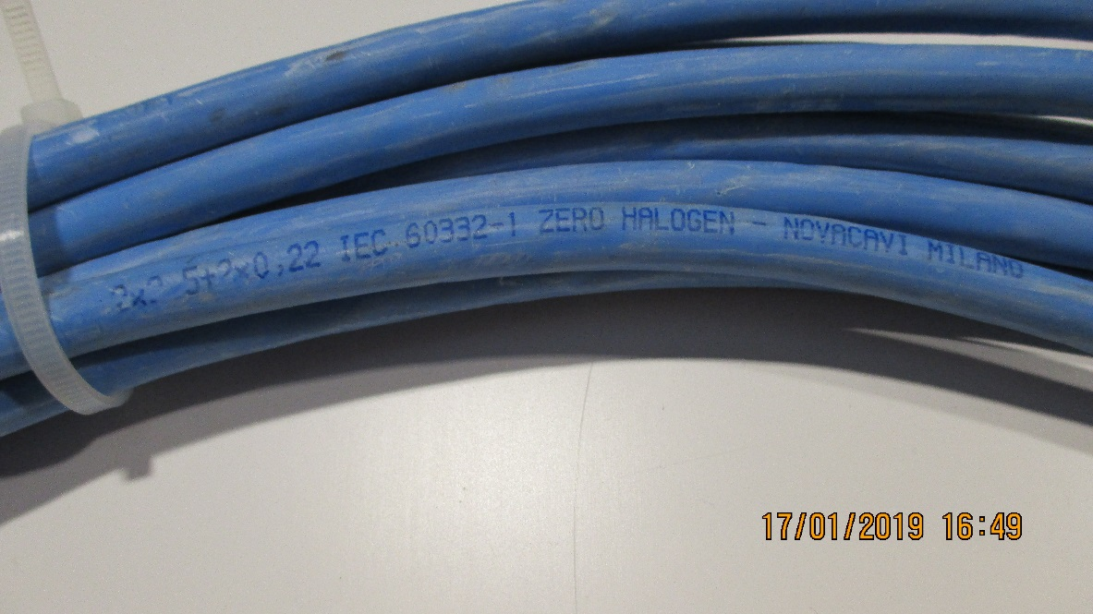
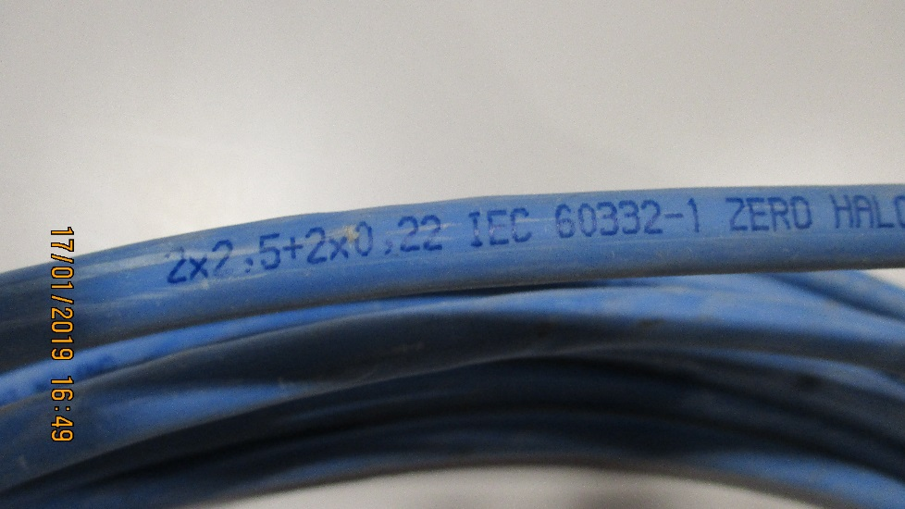
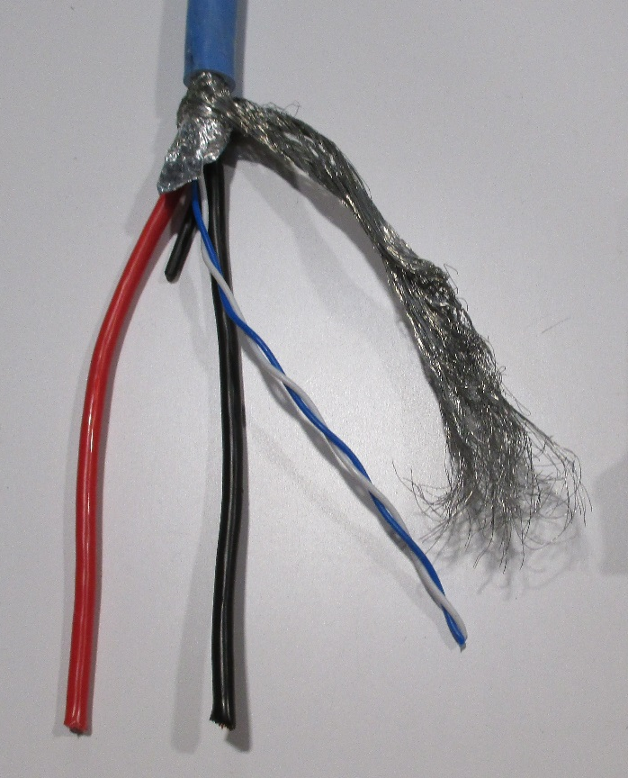
Cable
2 x 2.5mm² (13AWG) + 2 x 0.22mm2 (24AWG ? )
Diameter Exterieur = 8.3mm approx. (8.22mm)
160 Cables

Slide 3
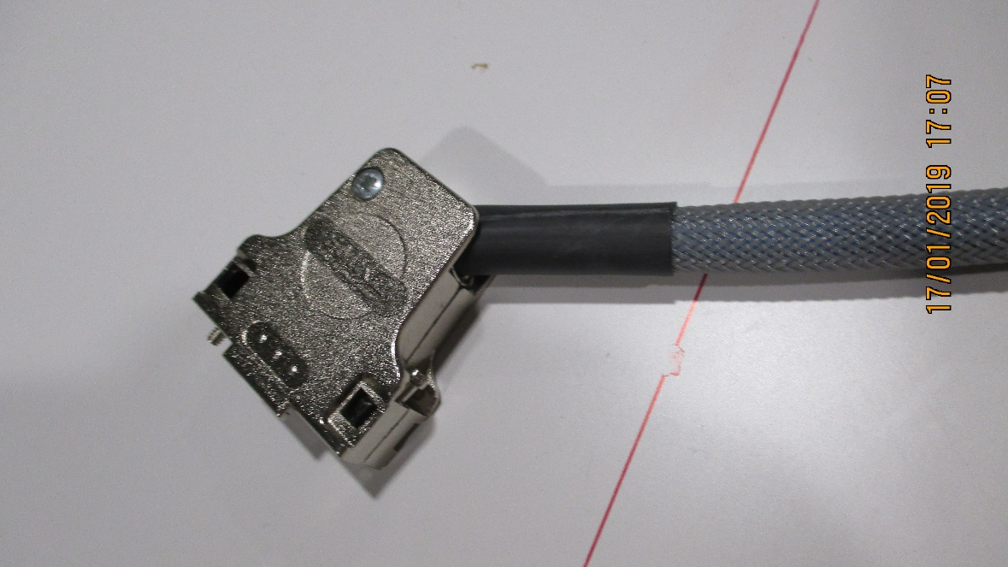
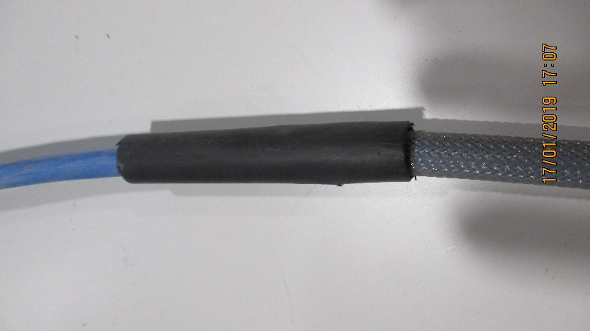
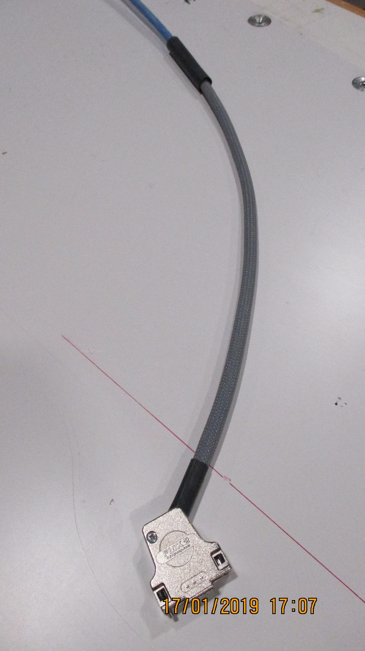
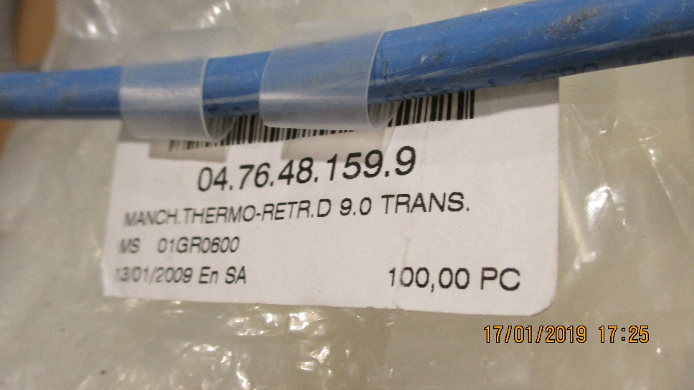
Connecteur cote Chambre
80cm
Thermo retractable , protection Etiquettes

Slide 4
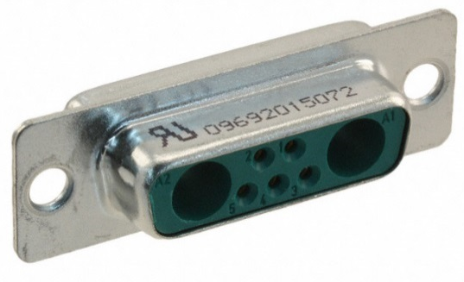
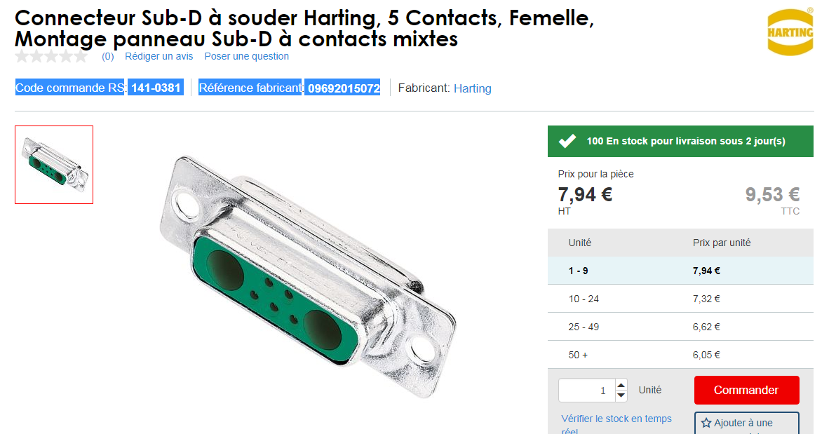
Chamber end with sense wire
D-sub.
Harting 0969201X072
Code commande RS 141-0381
Référence fabricant 09692015072
https://b2b.harting.com/ebusiness/en/DSUB-FE-7W2-SHELL-WITH-SOLDER-CUP-CONT/09692015072
Also another supplier
http://common.leocom.kr/pdfcat/pdfcat2009/c126_sec3_Con(D-sub).pdf

Slide 5
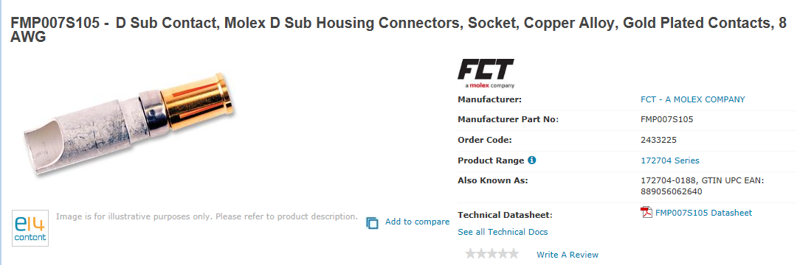
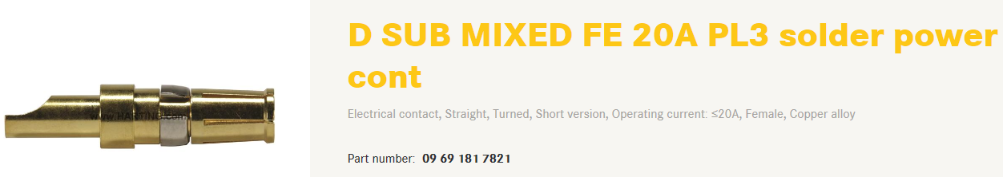
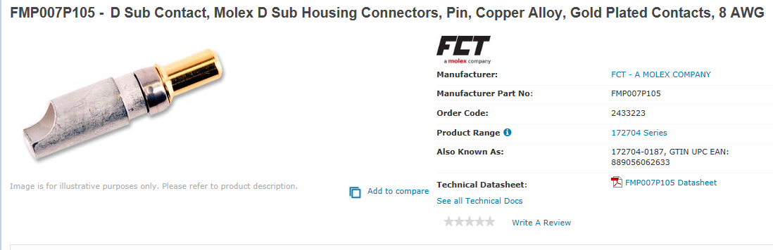
Pins
Farnell
Power
2433225 female
2433223 male
Sense
already in the connector
http://www.farnell.com/datasheets/1836824.pdf?_ga=2.199927789.278703743.1546866397-246438842.1465995239
http://www.farnell.com/datasheets/1836823.pdf?_ga=2.199927789.278703743.1546866397-246438842.1465995239

Slide 6
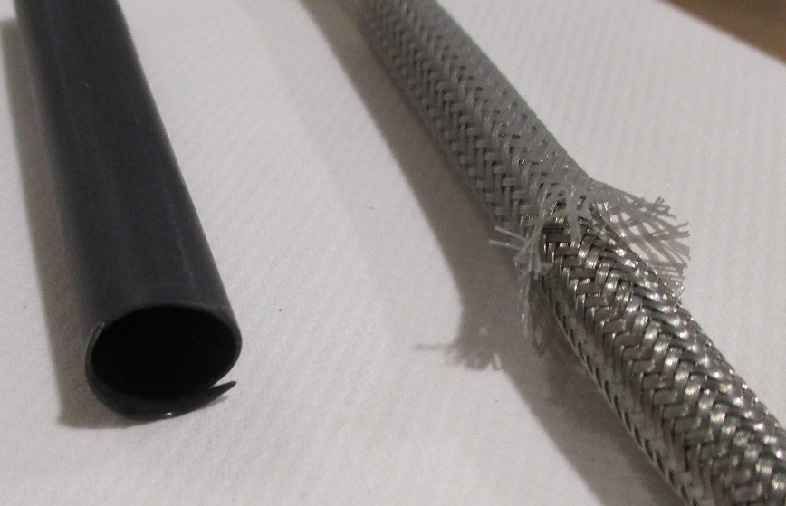
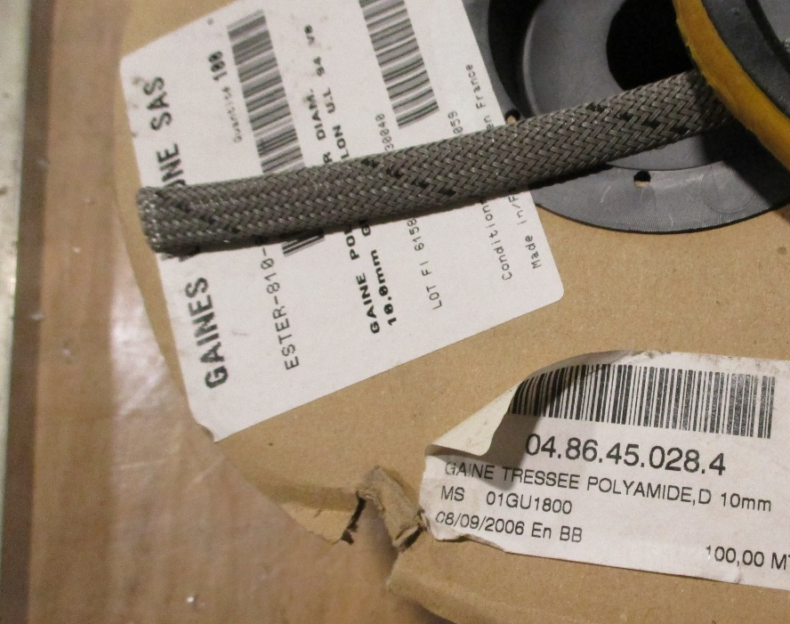
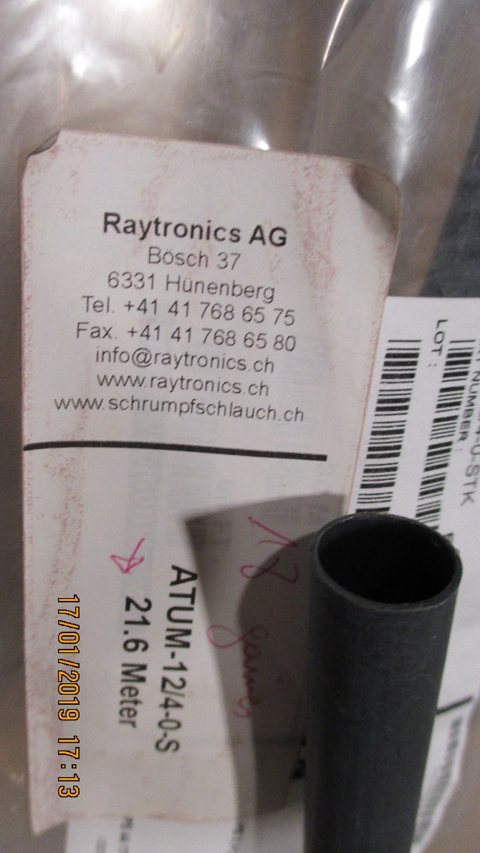
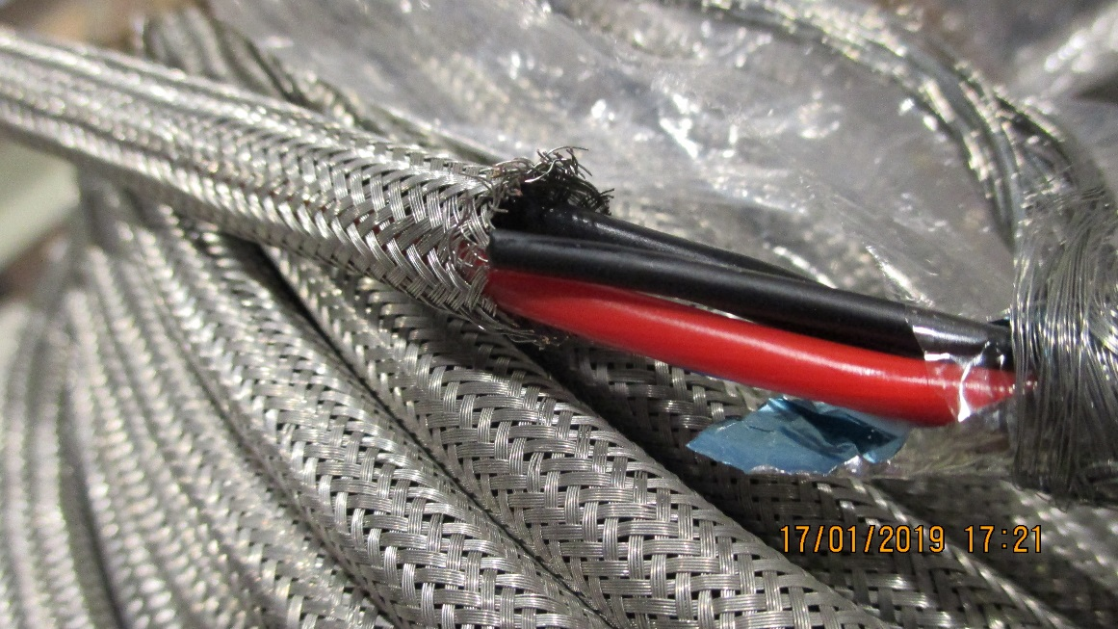
Tresse poly et Cuivre
Thermo retractable , Raythem 12/4-0-STK

Slide 7
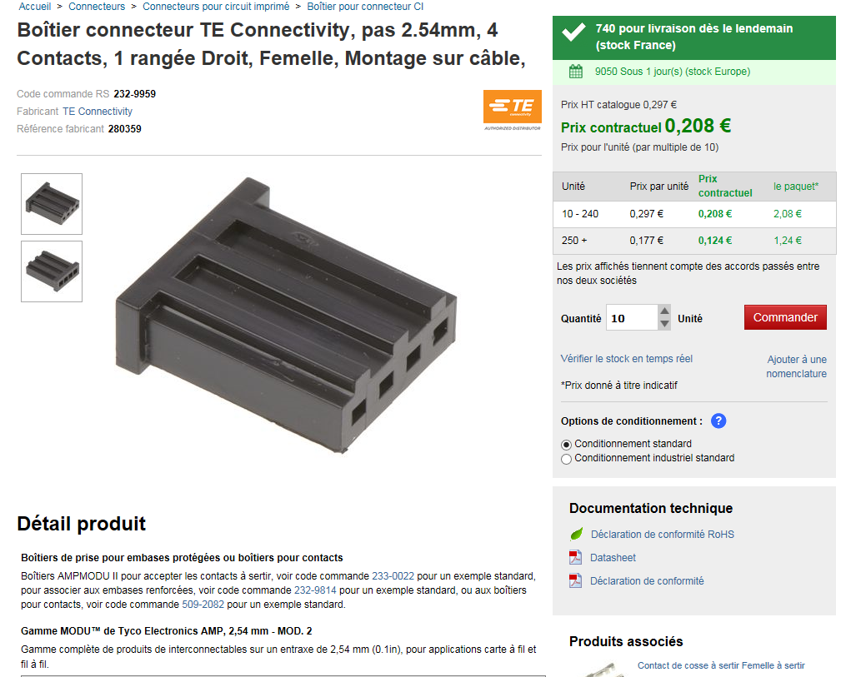


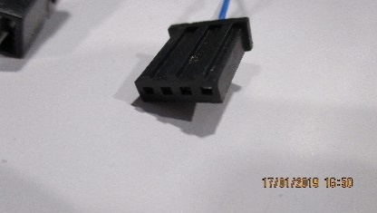

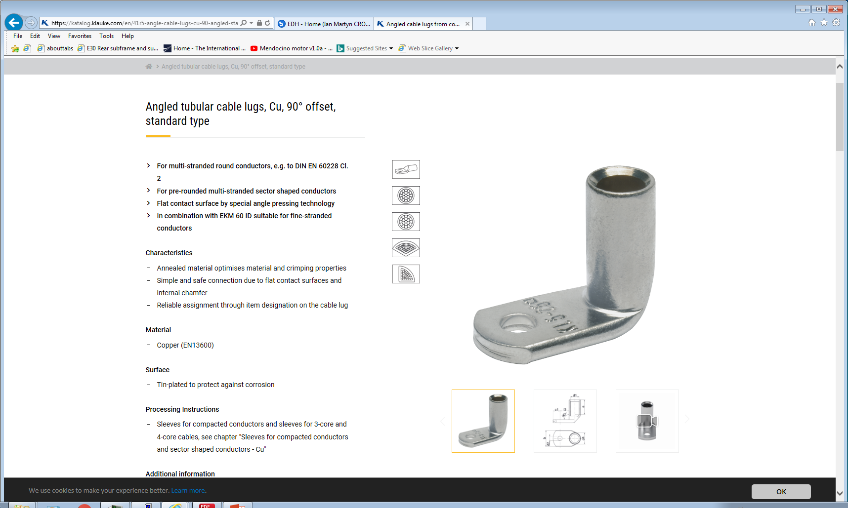
Connecteur cote Alimentation A3009B
60cm
Lug dia 3.5mm
Section 2.5mm²

Slide 8
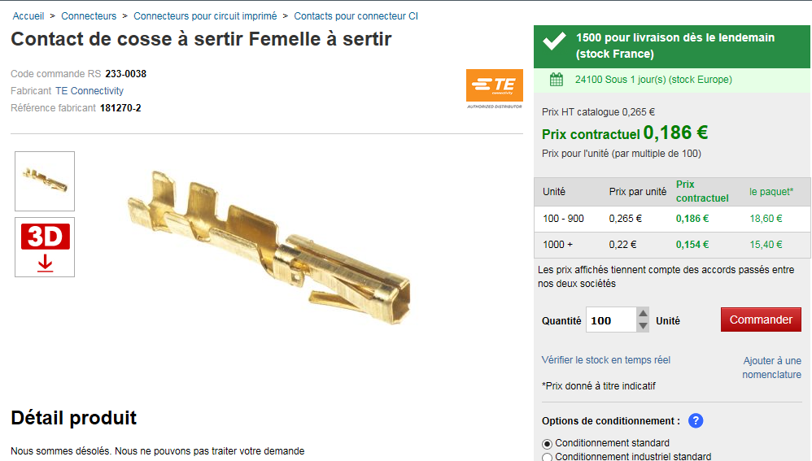
Sense wire connectors
Sense wire connectors 232-9959 (RS)
Pins 233-0038 (RS) or Farnell 182206-2

Slide 9
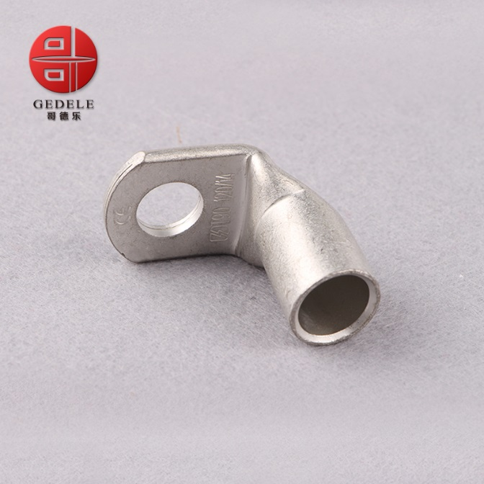
Ce terminal n’est pas connue ce vendredi. Mais pour le cable de 2.5mm2. Voir emplacement sur le alimentation

Slide 10
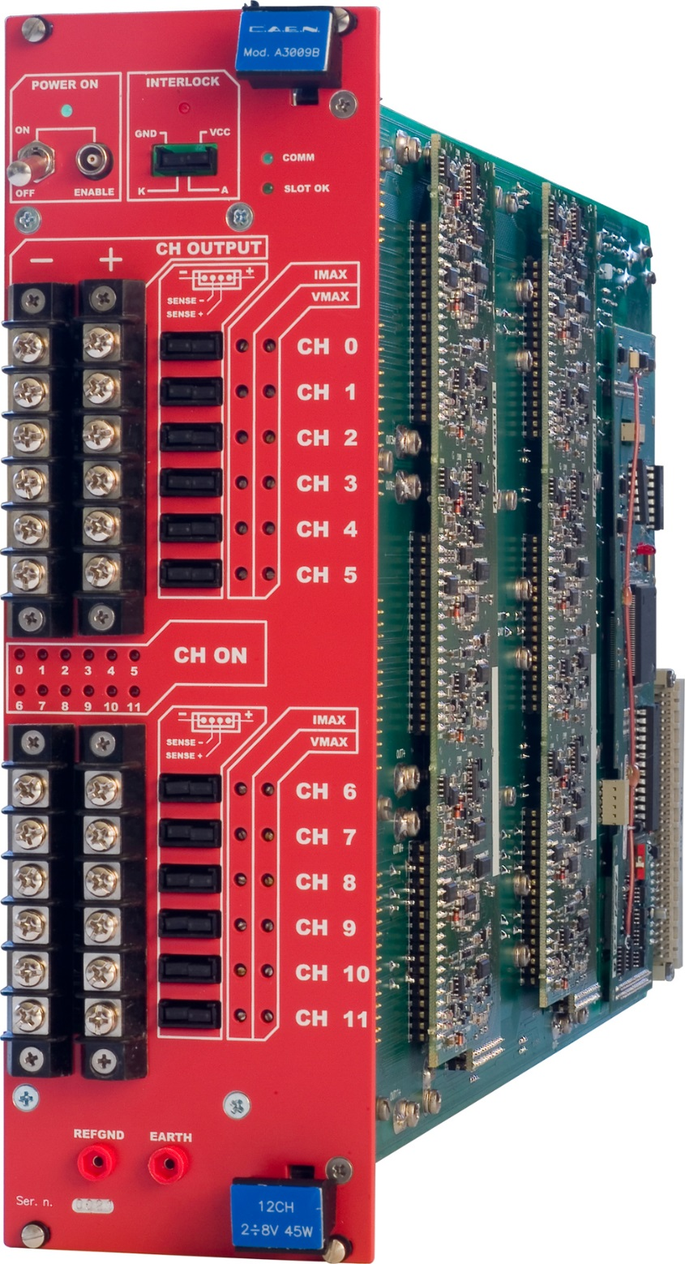

Thread dia.
3.38mm
6-32 inch thread
8.3mm
https://www.caen.it/products/a3009b/
https://www.boltdepot.com/fastener-information/machine-screws/machine-screw-diameter.aspx

Slide 11
Annexes

Slide 12
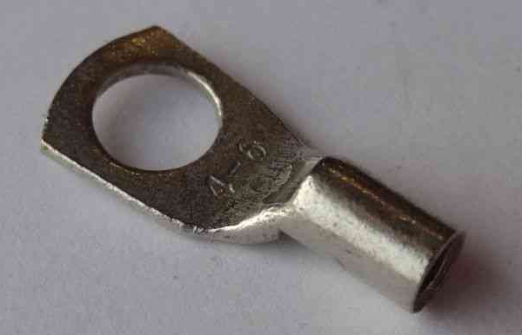
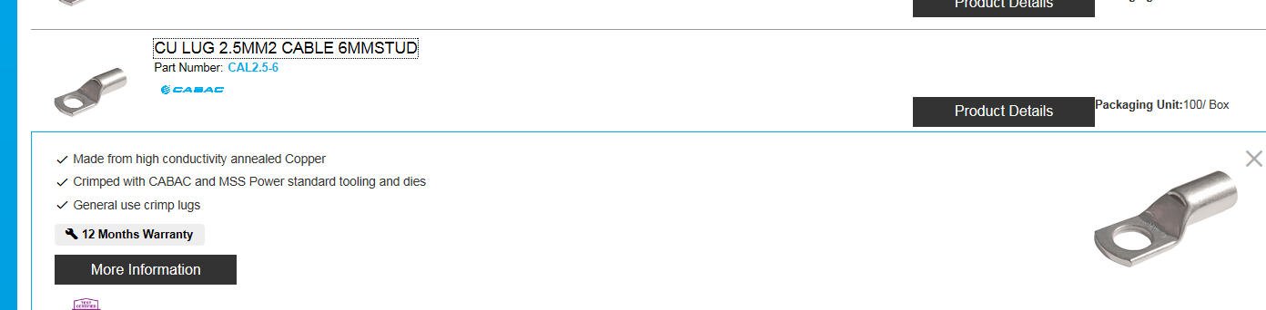
Lug dia 6mm
Section 2.5mm²
Ring terminal,
T90-25mm 90 Degree Angle Battery End Termi
https://www.cabac.com.au/brands/cabac/lugs-links-and-terminals/lugs-and-links/copper-crimp-lugs/cu-crimp-15-95mm2/10100505?s=

Slide 13
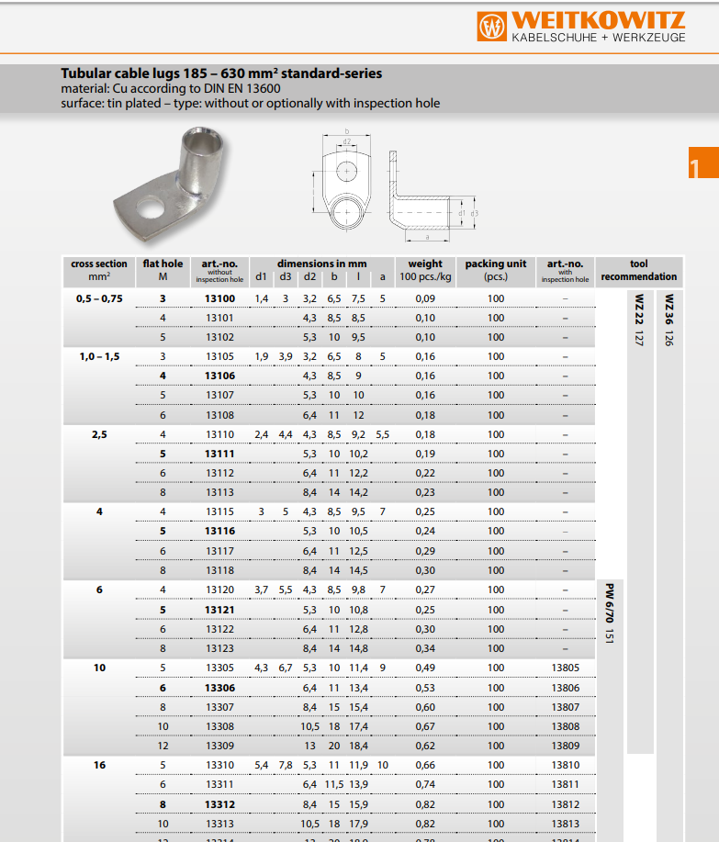
http://ftp.weitkowitz.de/downloads/print/weitkowitz_maincatalog_english_web.pdf

Slide 14
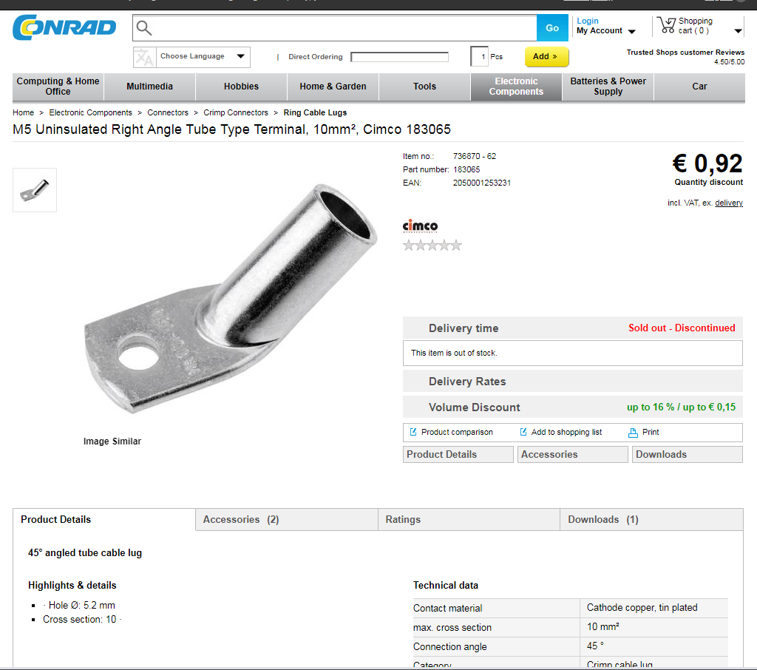
https://www.conrad.com/ce/en/product/736870/M5-Uninsulated-Right-Angle-Tube-Type-Terminal-10mm-Cimco-183065

Slide 15
Lusin input week 2
https://www.klauke.com/en/electrical/electrical-connection-systems/
Gustav Klauke GmbH
Auf dem Knapp 46
42855 Remscheid
Deutschland
Tel.: +49 (0)2191 / 907-0
Fax: +49 (0)2191 / 907-141
E-Mail: Klauke-Info@Emerson.com

Slide 16
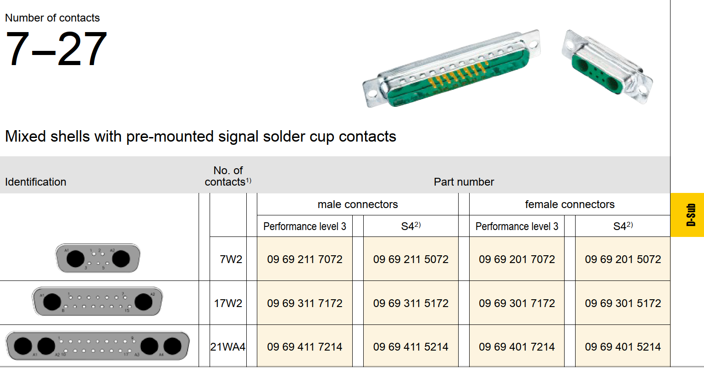
Panel Mount
Nota , what does the “with solder cup cont” mean
https://b2b.harting.com/ebusiness/en/DSUB-FE-7W2-SHELL-WITH-SOLDER-CUP-CONT/09692015072
https://b2b.harting.com/files/livebooks/en/PRD0200000100047/downloads/395.pdf

Slide 17
Chamber end with sense wire
D-sub.
Harting 0969201X072
Code commande RS 141-0381
Référence fabricant 09692015072
https://b2b.harting.com/ebusiness/en/DSUB-FE-7W2-SHELL-WITH-SOLDER-CUP-CONT/09692015072
Also another supplier
http://common.leocom.kr/pdfcat/pdfcat2009/c126_sec3_Con(D-sub).pdf

Slide 18
Pins
Farnell
Power
2433225 female
2433223 male
Sense
http://www.farnell.com/datasheets/1836824.pdf?_ga=2.199927789.278703743.1546866397-246438842.1465995239
http://www.farnell.com/datasheets/1836823.pdf?_ga=2.199927789.278703743.1546866397-246438842.1465995239

Slide 19
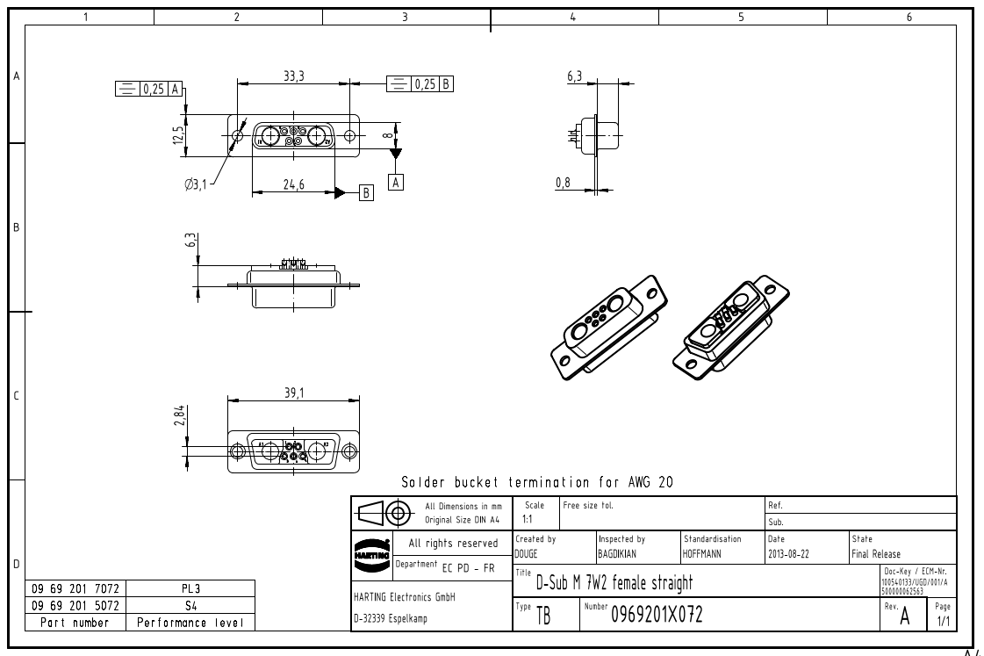
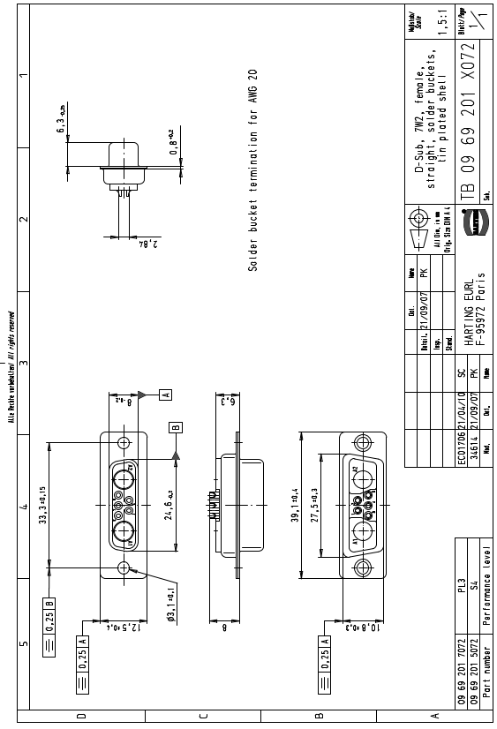
What is female the pins or the body ….???

Slide 20
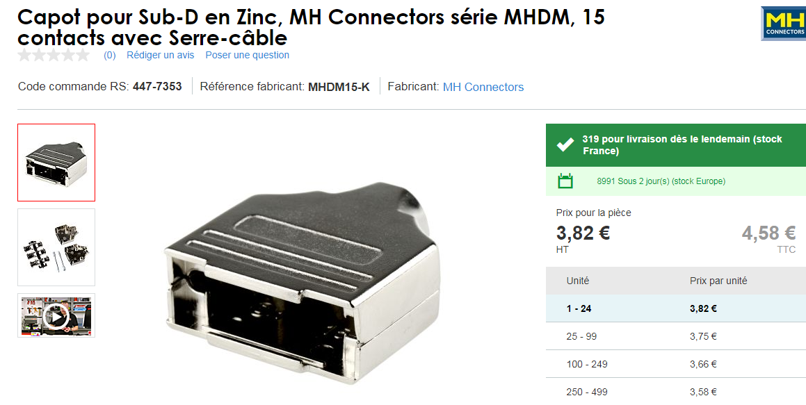
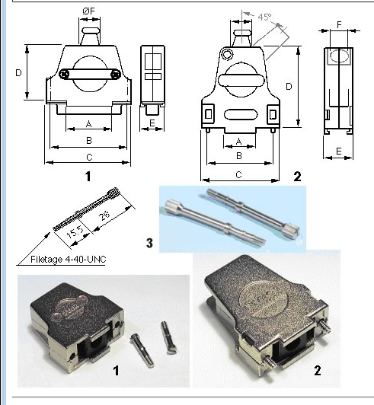
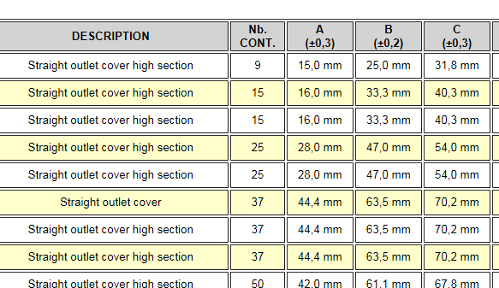
Drawing
https://docs-emea.rs-online.com/webdocs/167c/0900766b8167c5a2.pdf
447-7353
Hood is therefore for a 15pin size connector
09.21.23.013.7 Straight outlet cover high section 8,5 mm FMK21G 2
OR
For dia 12,5 mm cable FMK2G SCEM 09.21.23.013.9
For dia 9,6 mm cable with 45deg entry FMK21 09.21.23.022.0 4.1chf

Slide 21
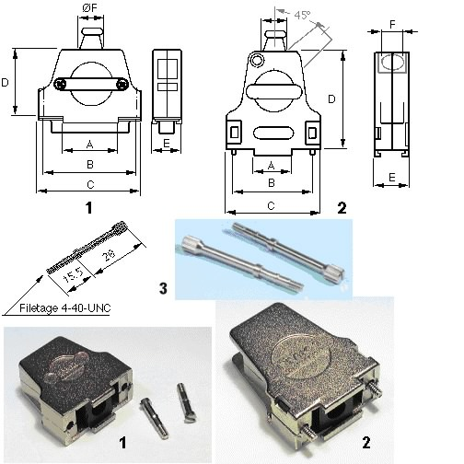
Resume of connectors D-Sub
RS Farnel Quantity
Base Cable end 923-5189 144 + 26 = 170
Female pins 2433225 144 + 26 = 170
Male pins 2433223 144 + 26 = 170
Hood 447-7353 144 + 26 = 170
FMK21 with 45deg entry
For dia 9,6 mm cable

Slide 22
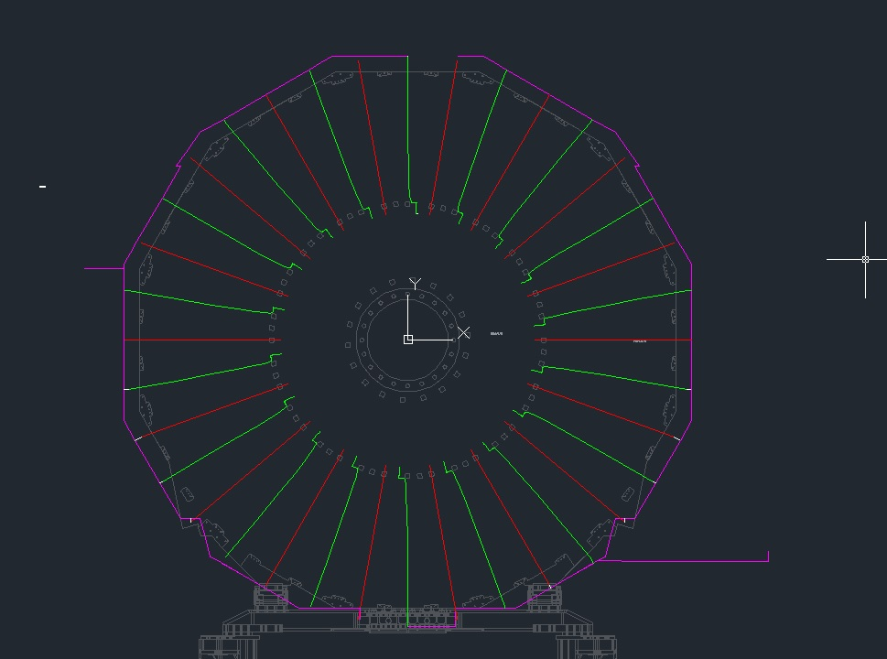
Lengths by S. Bally from the IO

Slide 23
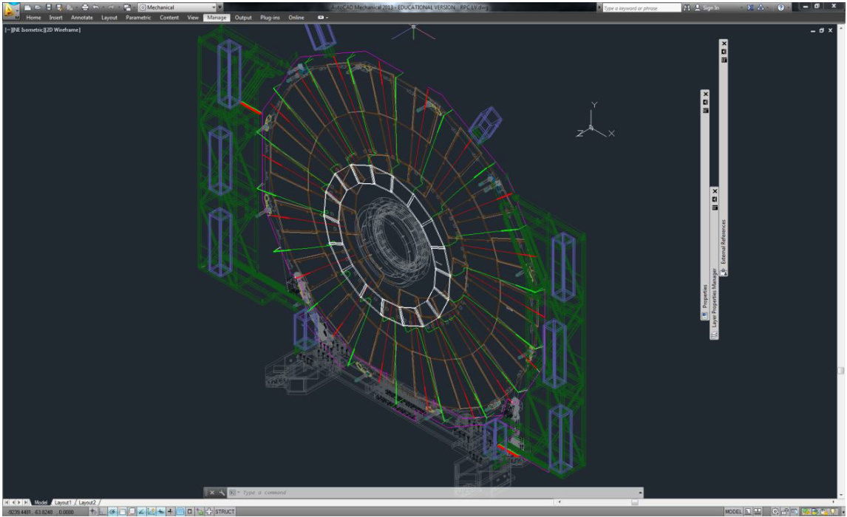

Slide 24
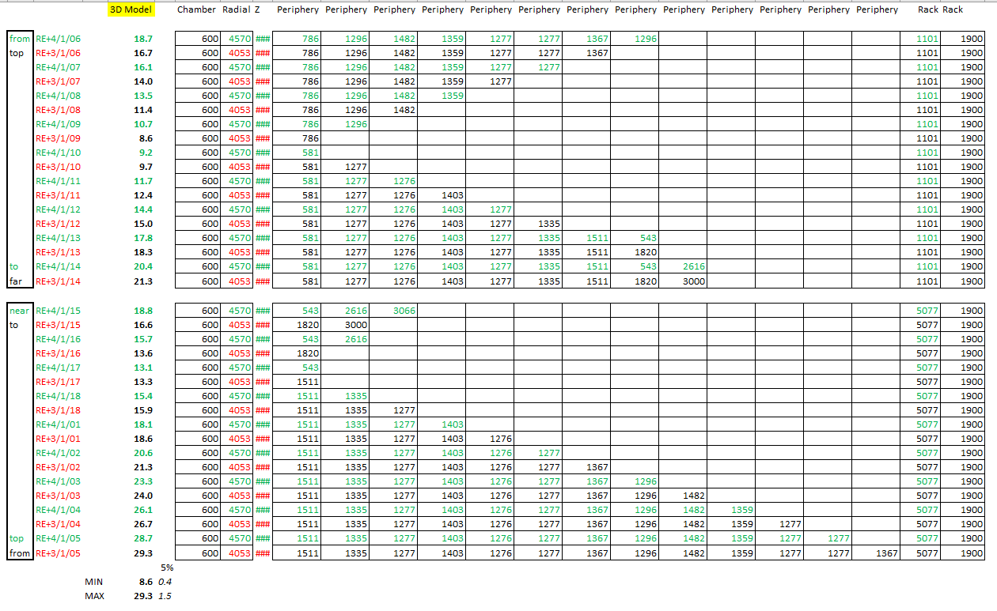
Pas Definitive

Slide 25
references
AWG to mm2 https://www.multicable.com/resources/reference-data/cross-reference-awg-to-mm2/

