Slide 1
Visit Cavitech
Ian
05 Feb 2019

Slide 2
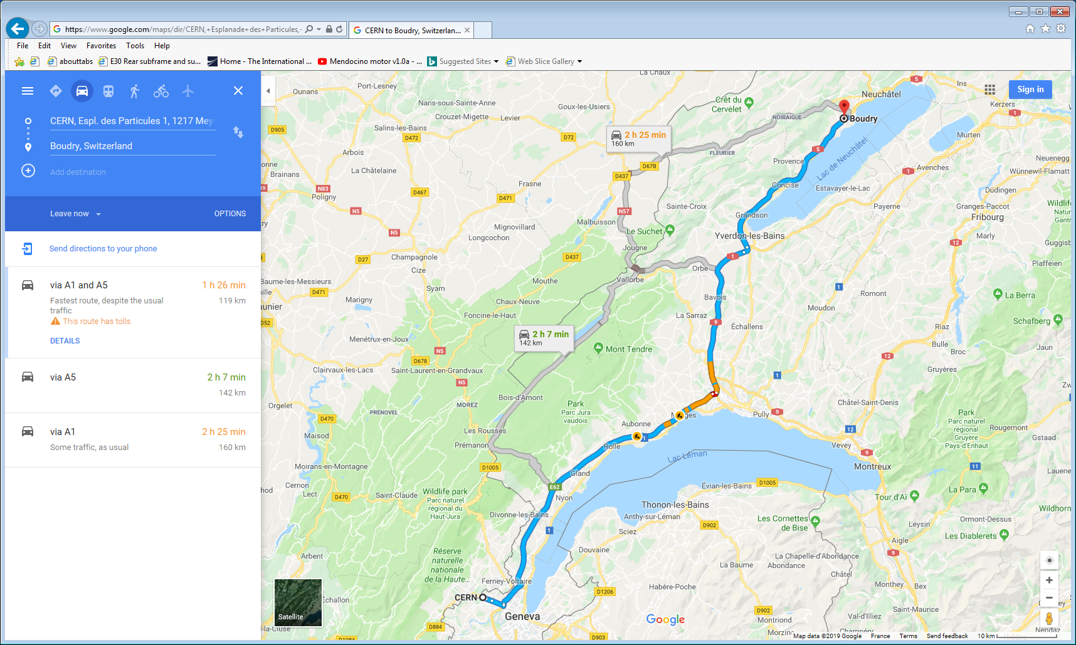

Slide 3
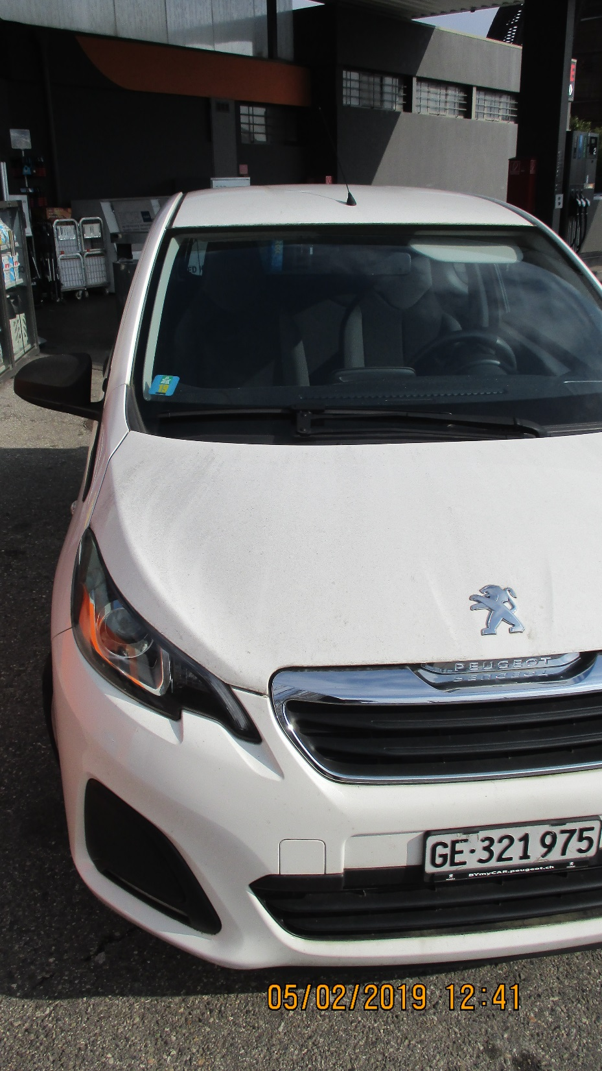
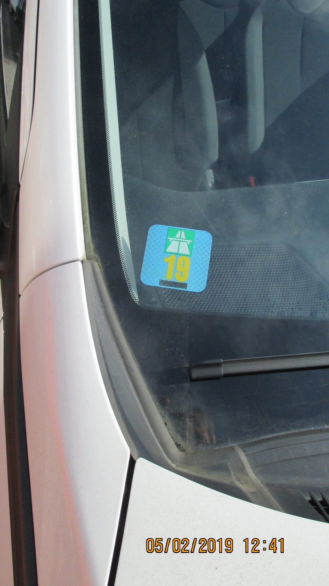
7636115 - Mission Order

Slide 4
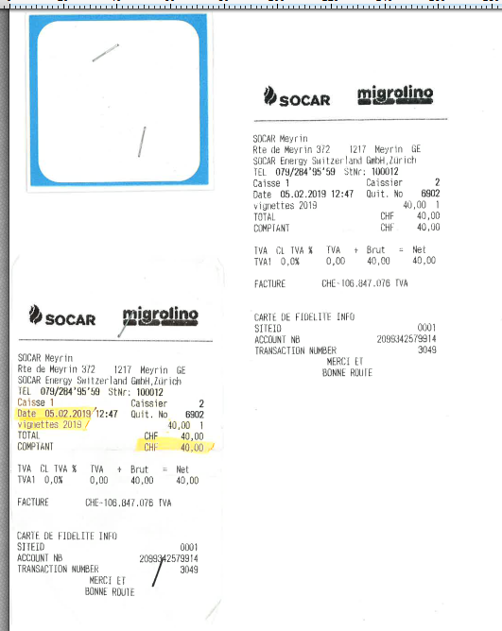

Slide 5
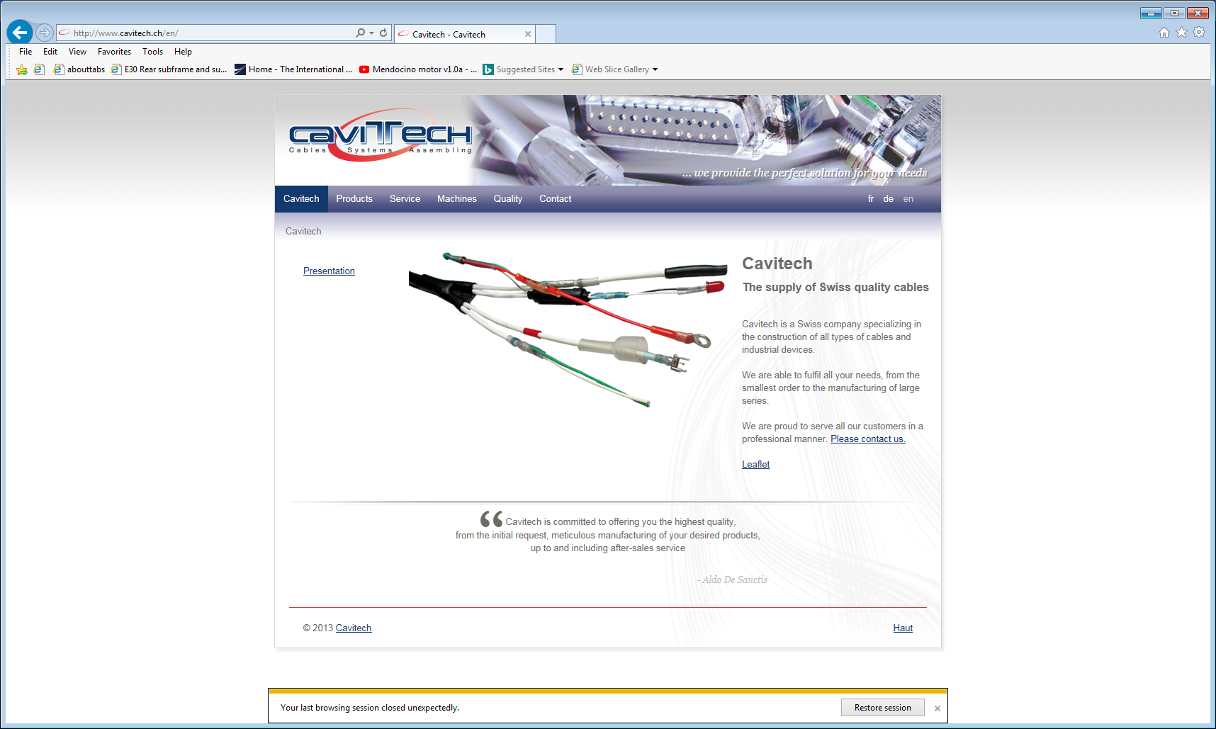
Cavitech company
  Ch. de la Baconnière 49b
  CH - 2017 Boudry
  Tel +41 32 841 70 30
  Fax +41 32 841 70 30

Slide 6
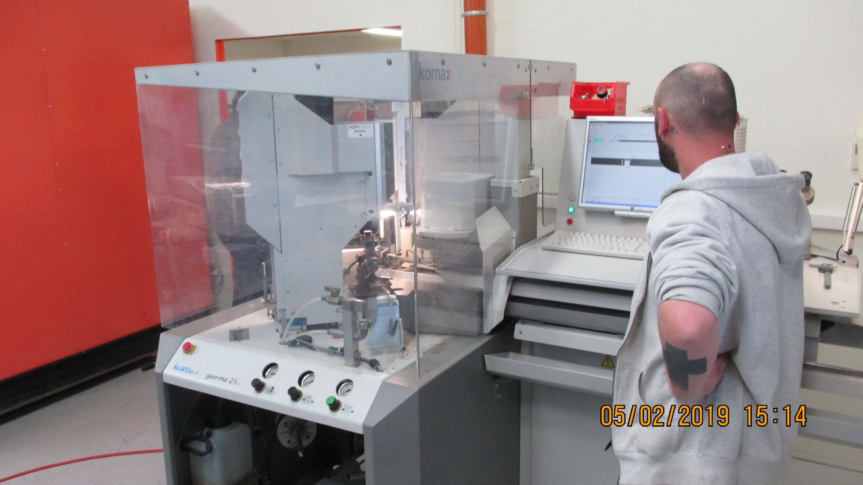

Slide 7
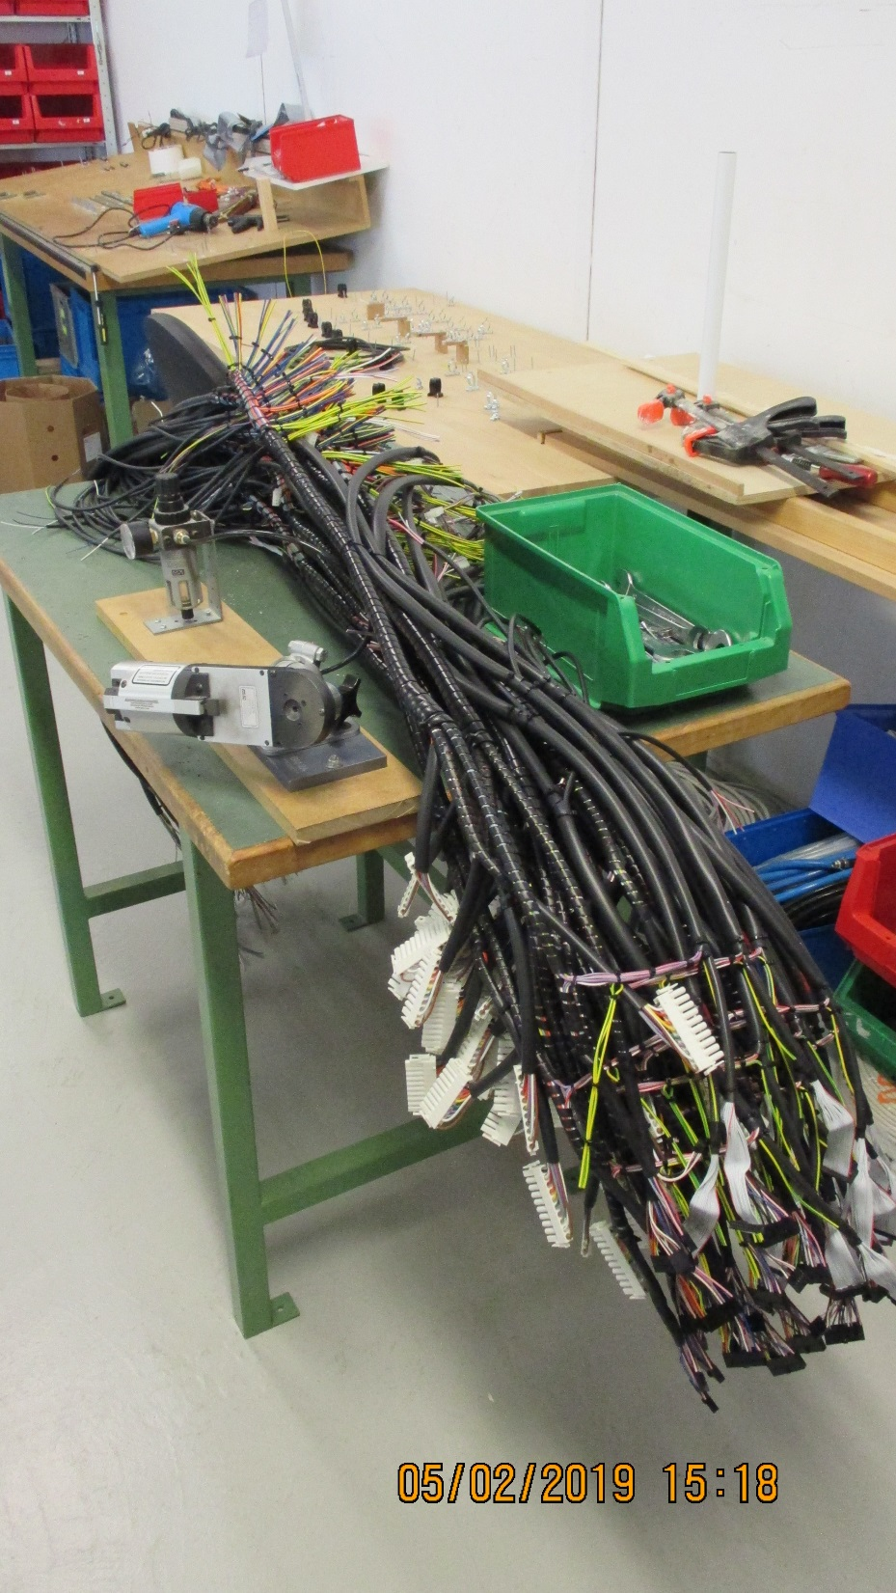
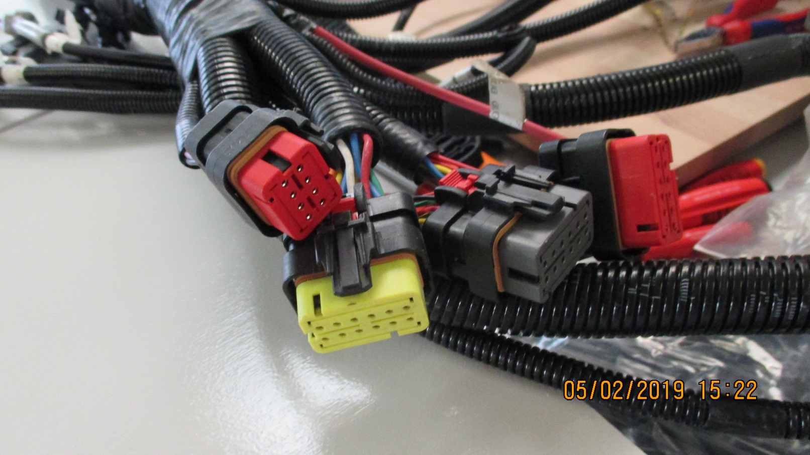

Slide 8
