Slide 1
Services and installation plan for RE3&4 Upgrade
Ian Crotty
(on behalf of RPC Collaboration)

Slide 2
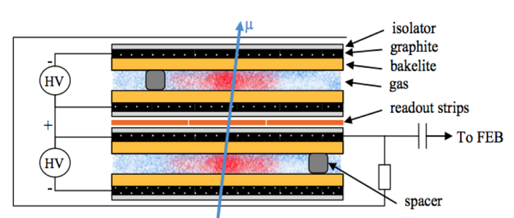
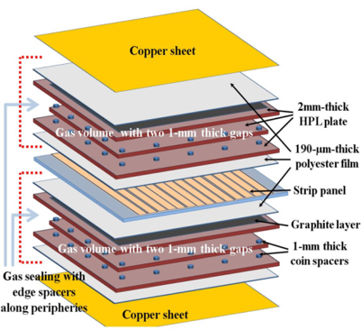
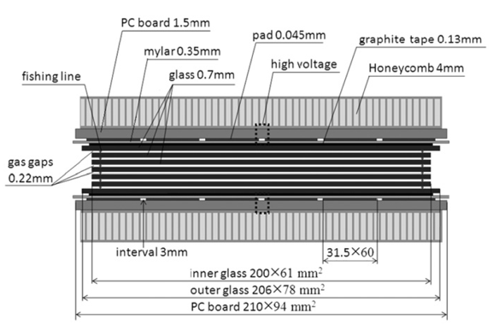
Improved RPC for RE3/1 and RE4/1
Standard double-gap RPC
Most of the services are not dependant on the technology choice.

Slide 3
Subjects covered
Gas system
Electrical and Signal (HV, LV, Signal & Power) systems
Service passage
Installation (Integration & schedule)

Slide 4
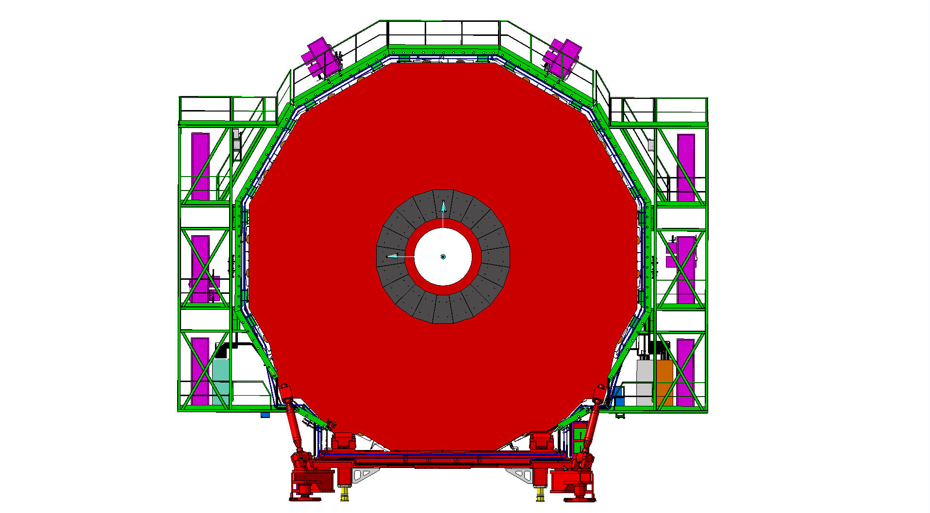
Services on YE3 serving RE3 and RE4
Mini Cable Chains for HV
Mini Cable Chains for HV
LV racks
LV racks
Signal LBB Crates
RPC Gas Rack with spare channels

Slide 5
Gas system
Baseline
Using present mixture no changes to be made only completing the piping.
Using different mixture requires a mixer in SGX, New rack in UGX and UXC racks removed and modified. This alternative solution is not considered so far.

Slide 6
HV system requirements
Umbilical cables USC > UXC
PP on YE1
Rack space in USC

Slide 7
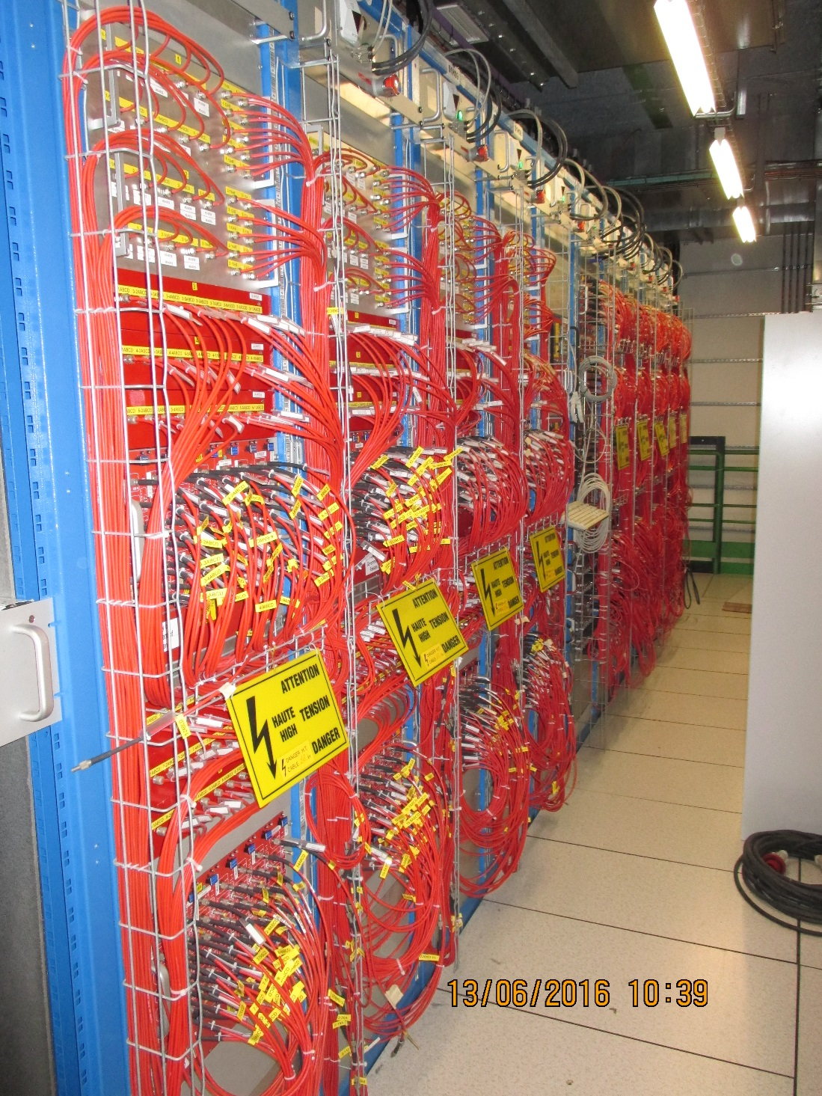
RPC HV Racks in USC

Slide 8
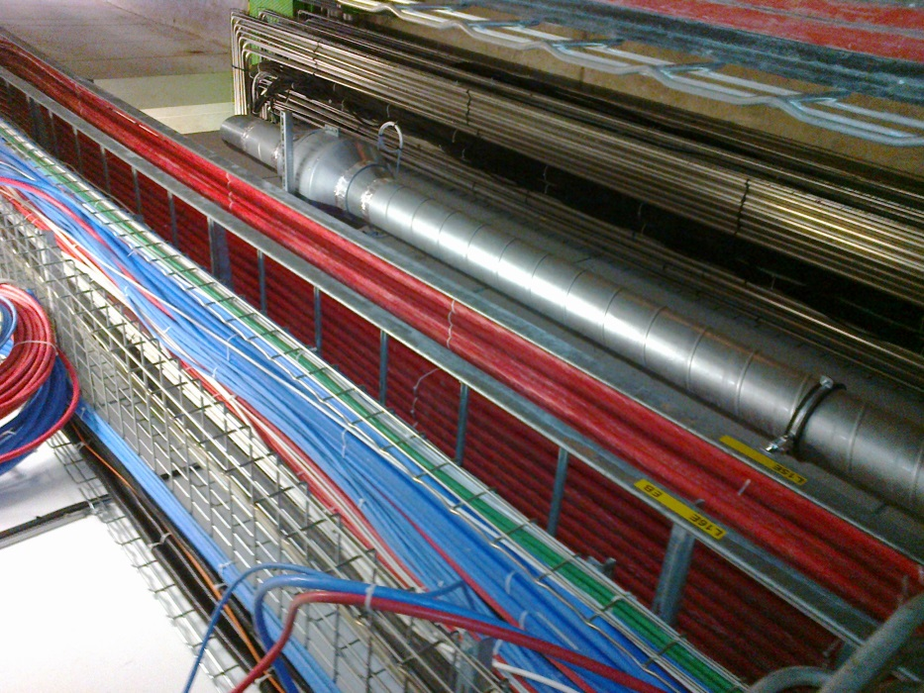
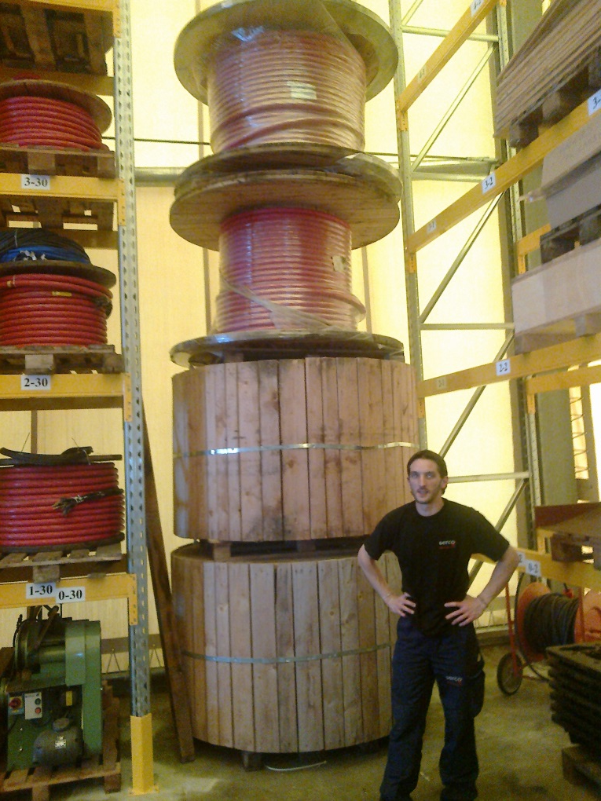
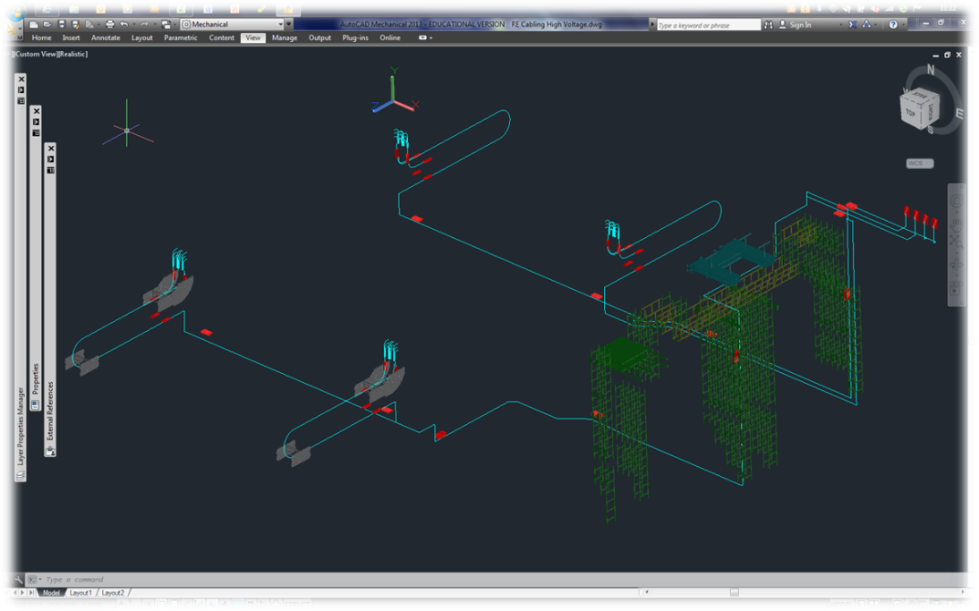
The path is clear and we have the cable. This is a big job
Approx 1.5km
Cable length 57-90m

Slide 9
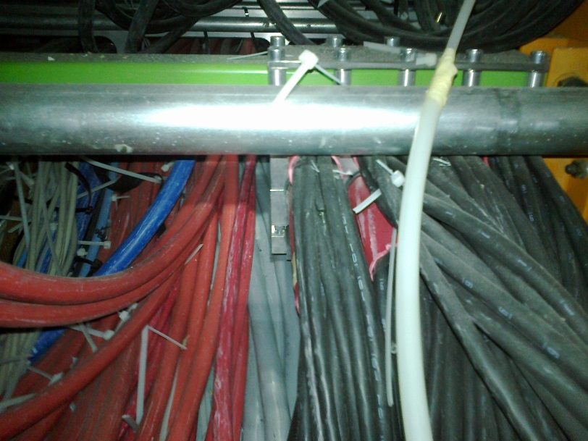
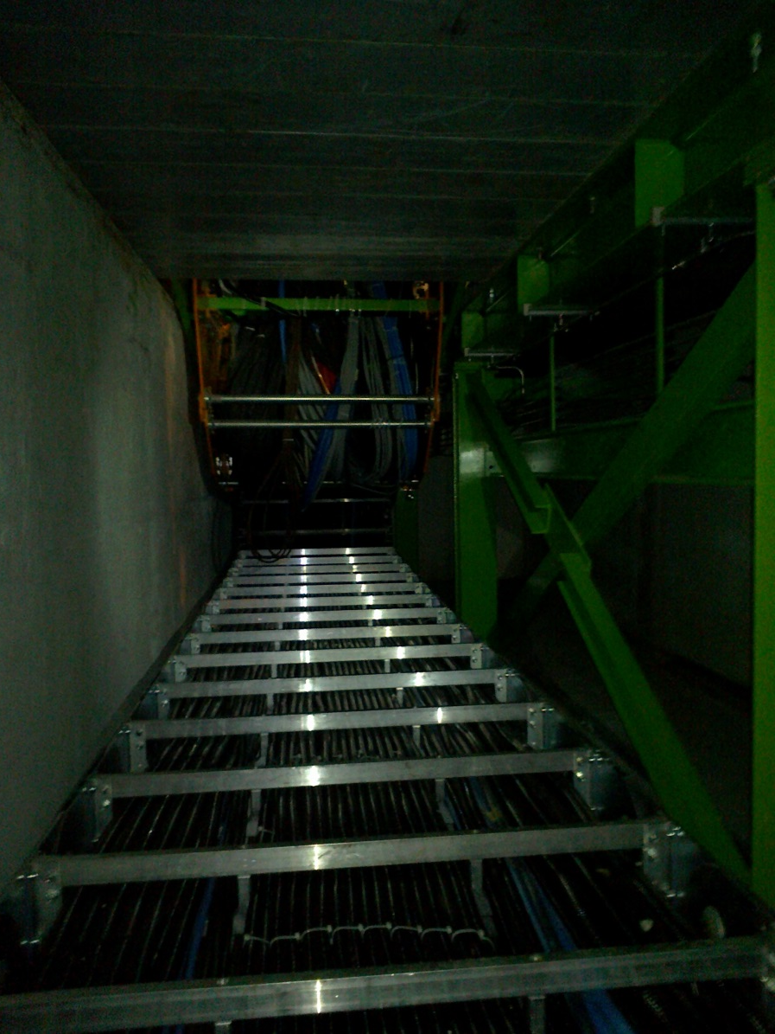
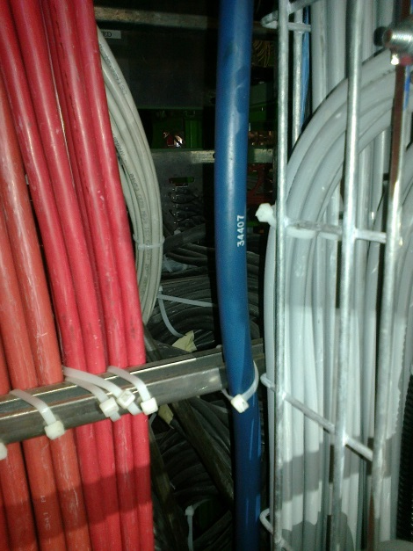
But it gets worse in the last 5% of the path length
Clamp of thee Cable under PP YE1
The Main Cable chains in X0 under CMS
Access to rear of the PP

Slide 10
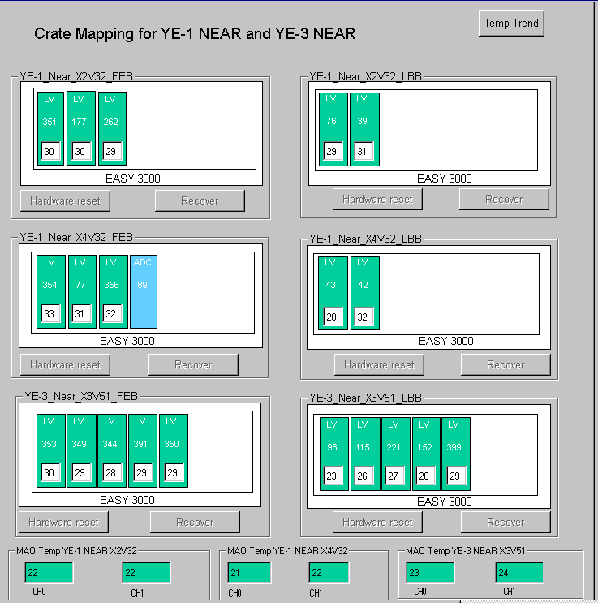
LV power system requirements
For each end && side we would need 2 A3016 LV boards to power the RE3/1 and RE4/1 chambers.
If we redesign the entire RPC LV system such that:
  We redistribute the LV power cables of 2 A3009
  boards into neighbouring 3 A3009 boards
then
  We will free slots for 2 A3016 boards for powering RE3/1 and RE4/1
Need 6U Rack space in each tower of YE3
OR
Re-mapping of LV cabling to give crate space must be tested first
At present 1 LV A3009 channel powers 6 FEBs
which is ~30% of max channel power.
Assuming we double them after the power
redistribution, it will still continue to work in
optimal power regime ~60% of max power.
The real question is how to group the chambers into
LV board channels to keep some logical and physical
power distribution in phi… to be thought
In this scenario – no additional crates, branches and
rack space is required!

Slide 11
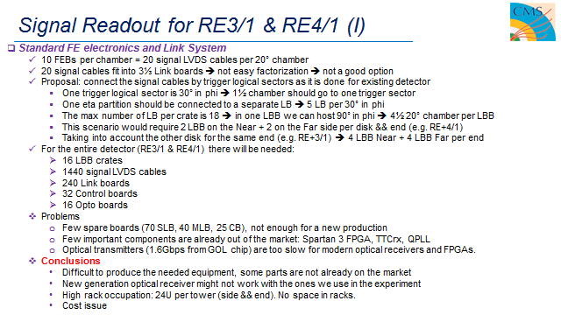
Significant cable section, cost and rack space (24U) with original FEB/LBB system

Slide 12
Signal Readout for RE3/1 & RE4/1 (II)
New/Developing RPC FE electronics
  1 GBT optical link per chamber to transmit data to one data concentrator card per station ~1 W
  Data Concentrator Card: One card, common for one disk of 18 chambers, includes 18 + 2 spares = 20 GBT links
  and 1 FPGA to be located on the detector periphery.
  DCC in UXC or USC?
    UXC: shorter paths from detector to DCC
    USC: from DCC to USC would go 2 fibers instead of 18, but is length long for optical power losses?
  DCC output: 2 optical fibers: 1 trigger and 1 data link per disk.
  Rack space: No much space in racks is needed. The “Link system” is presented only by 2 DCC per end.
DCC, low power 40W/station
New FE is being investigated with greatly reduced space requirements in the crates and service section on yoke is clearly better with 72 FO instead of 1440 dia10mm signal cables.
Optical link goes to towers OR all the way to USC. Under study

Slide 13
Upgrade Power
Provisional values (x1 YE3)
Present configuration 3.3 kW
Upgraded configuration
Standard FEB 6kW
PETIROC (embed) 5.1kW
PETIROC (FPGA) 8.3kW
Values given include an estimate of the rack component loads and losses.

Slide 15
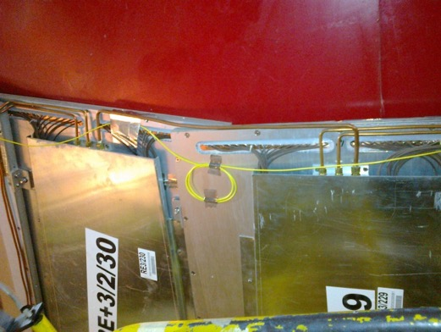
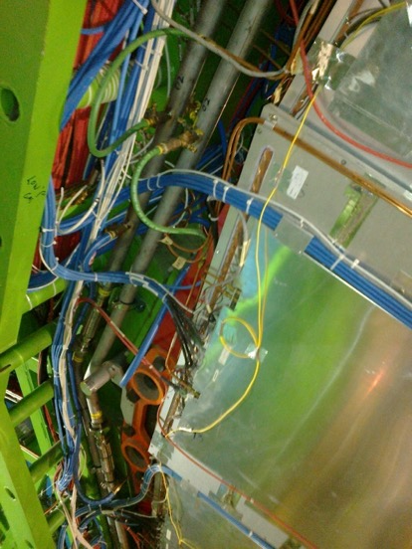
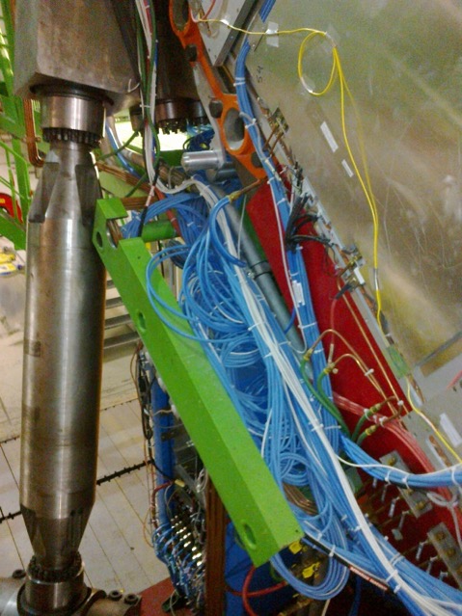
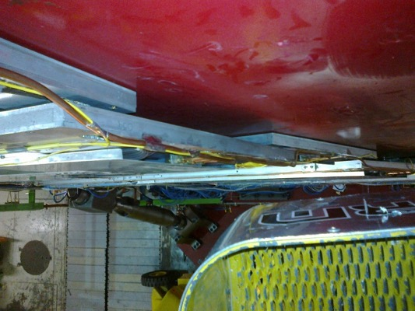
RE3/1 service passages
Space on the periphery is very limited
Service passage to the periphery is either on top of or under the RE3/2 & RE3/3, to be checked with IO

Slide 16
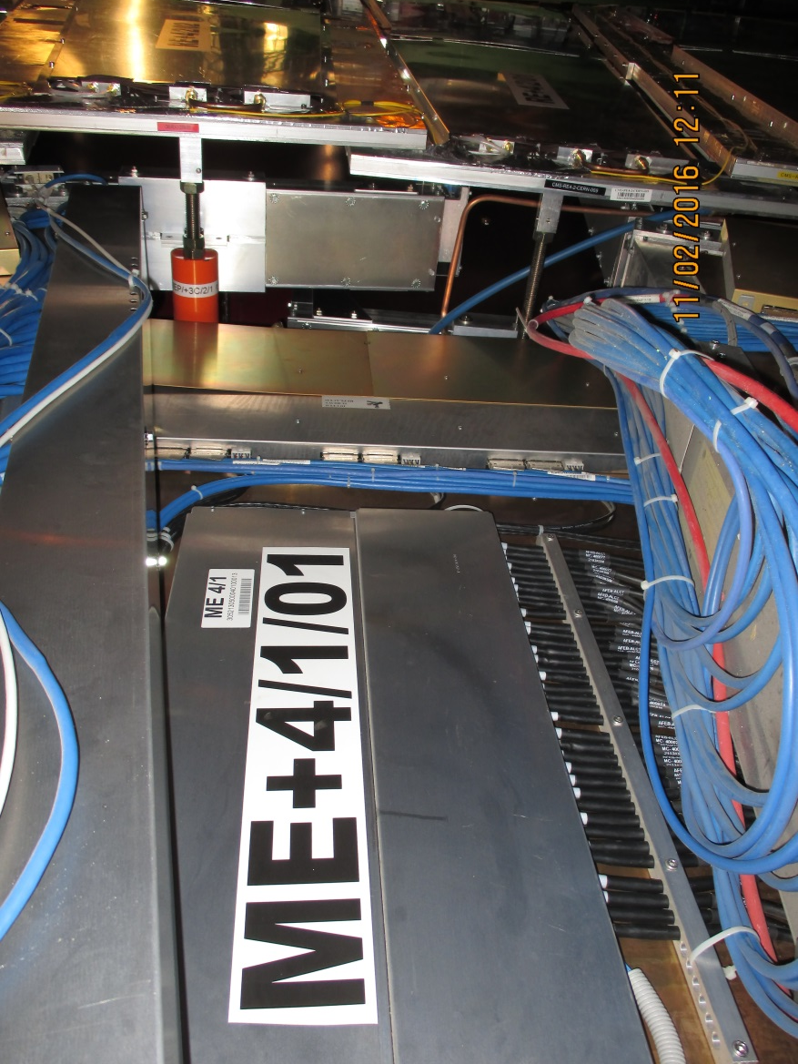
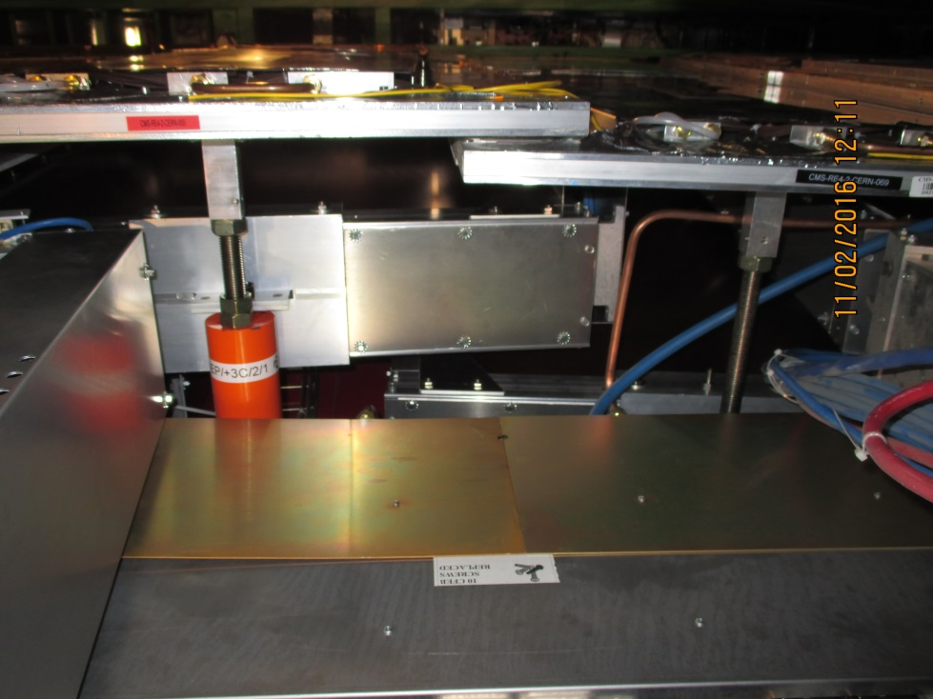
RE4/1 Service Passages
There are large passages over the CSCs that may be used. If not then services must transit over the RE4 SMs. This is not the prefered solution.
RE4 SMs
CSCs
OR

Slide 17
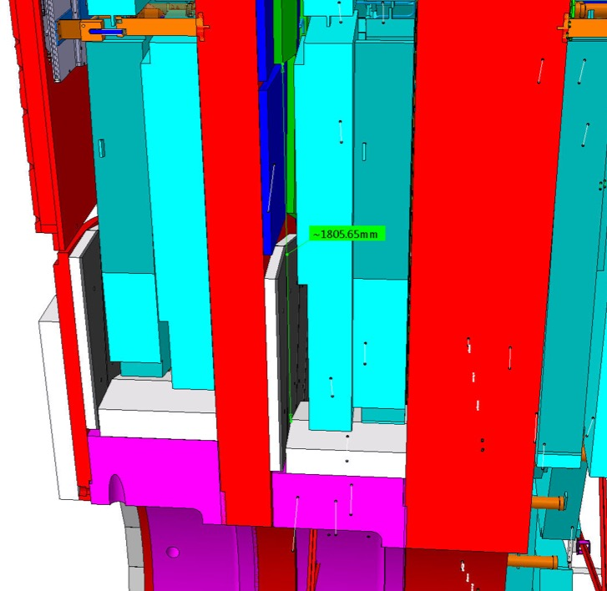
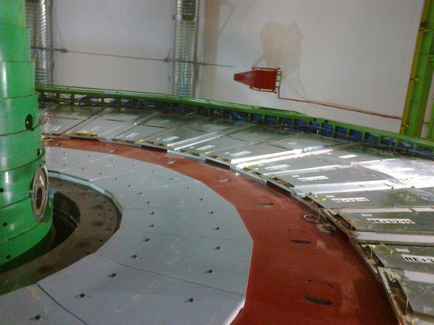
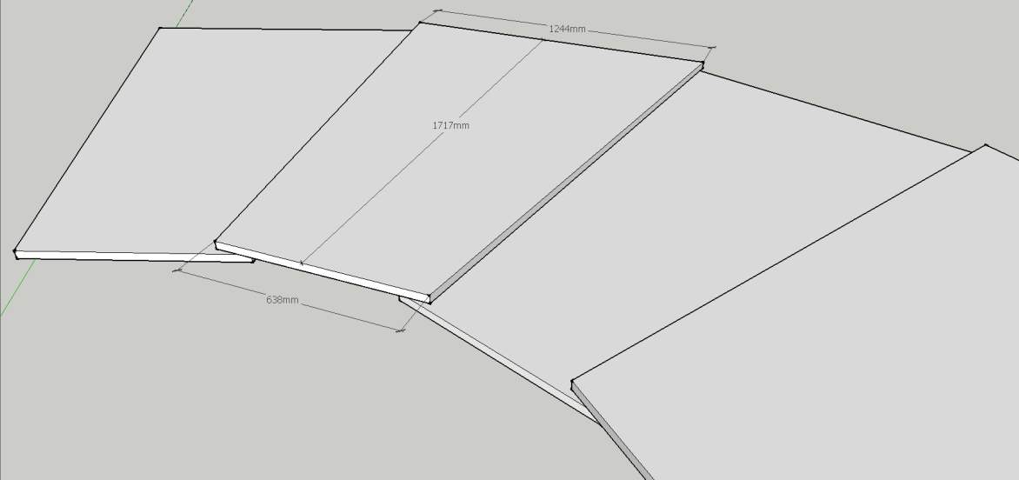
Envelope of RE3/1
Basic parameters
R Outer = 3302
R Inner = 1526
Delta = 1776
Exact envelope is under study.
Integration by Boki from IO

Slide 18
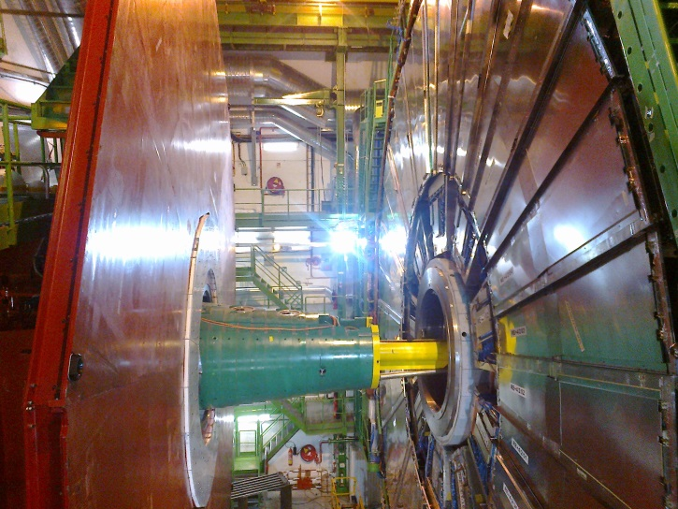
RE4/1 Mounting
Chambers to be mounted between the shielding, CSCs and RE4 SMs
YE4

Slide 19
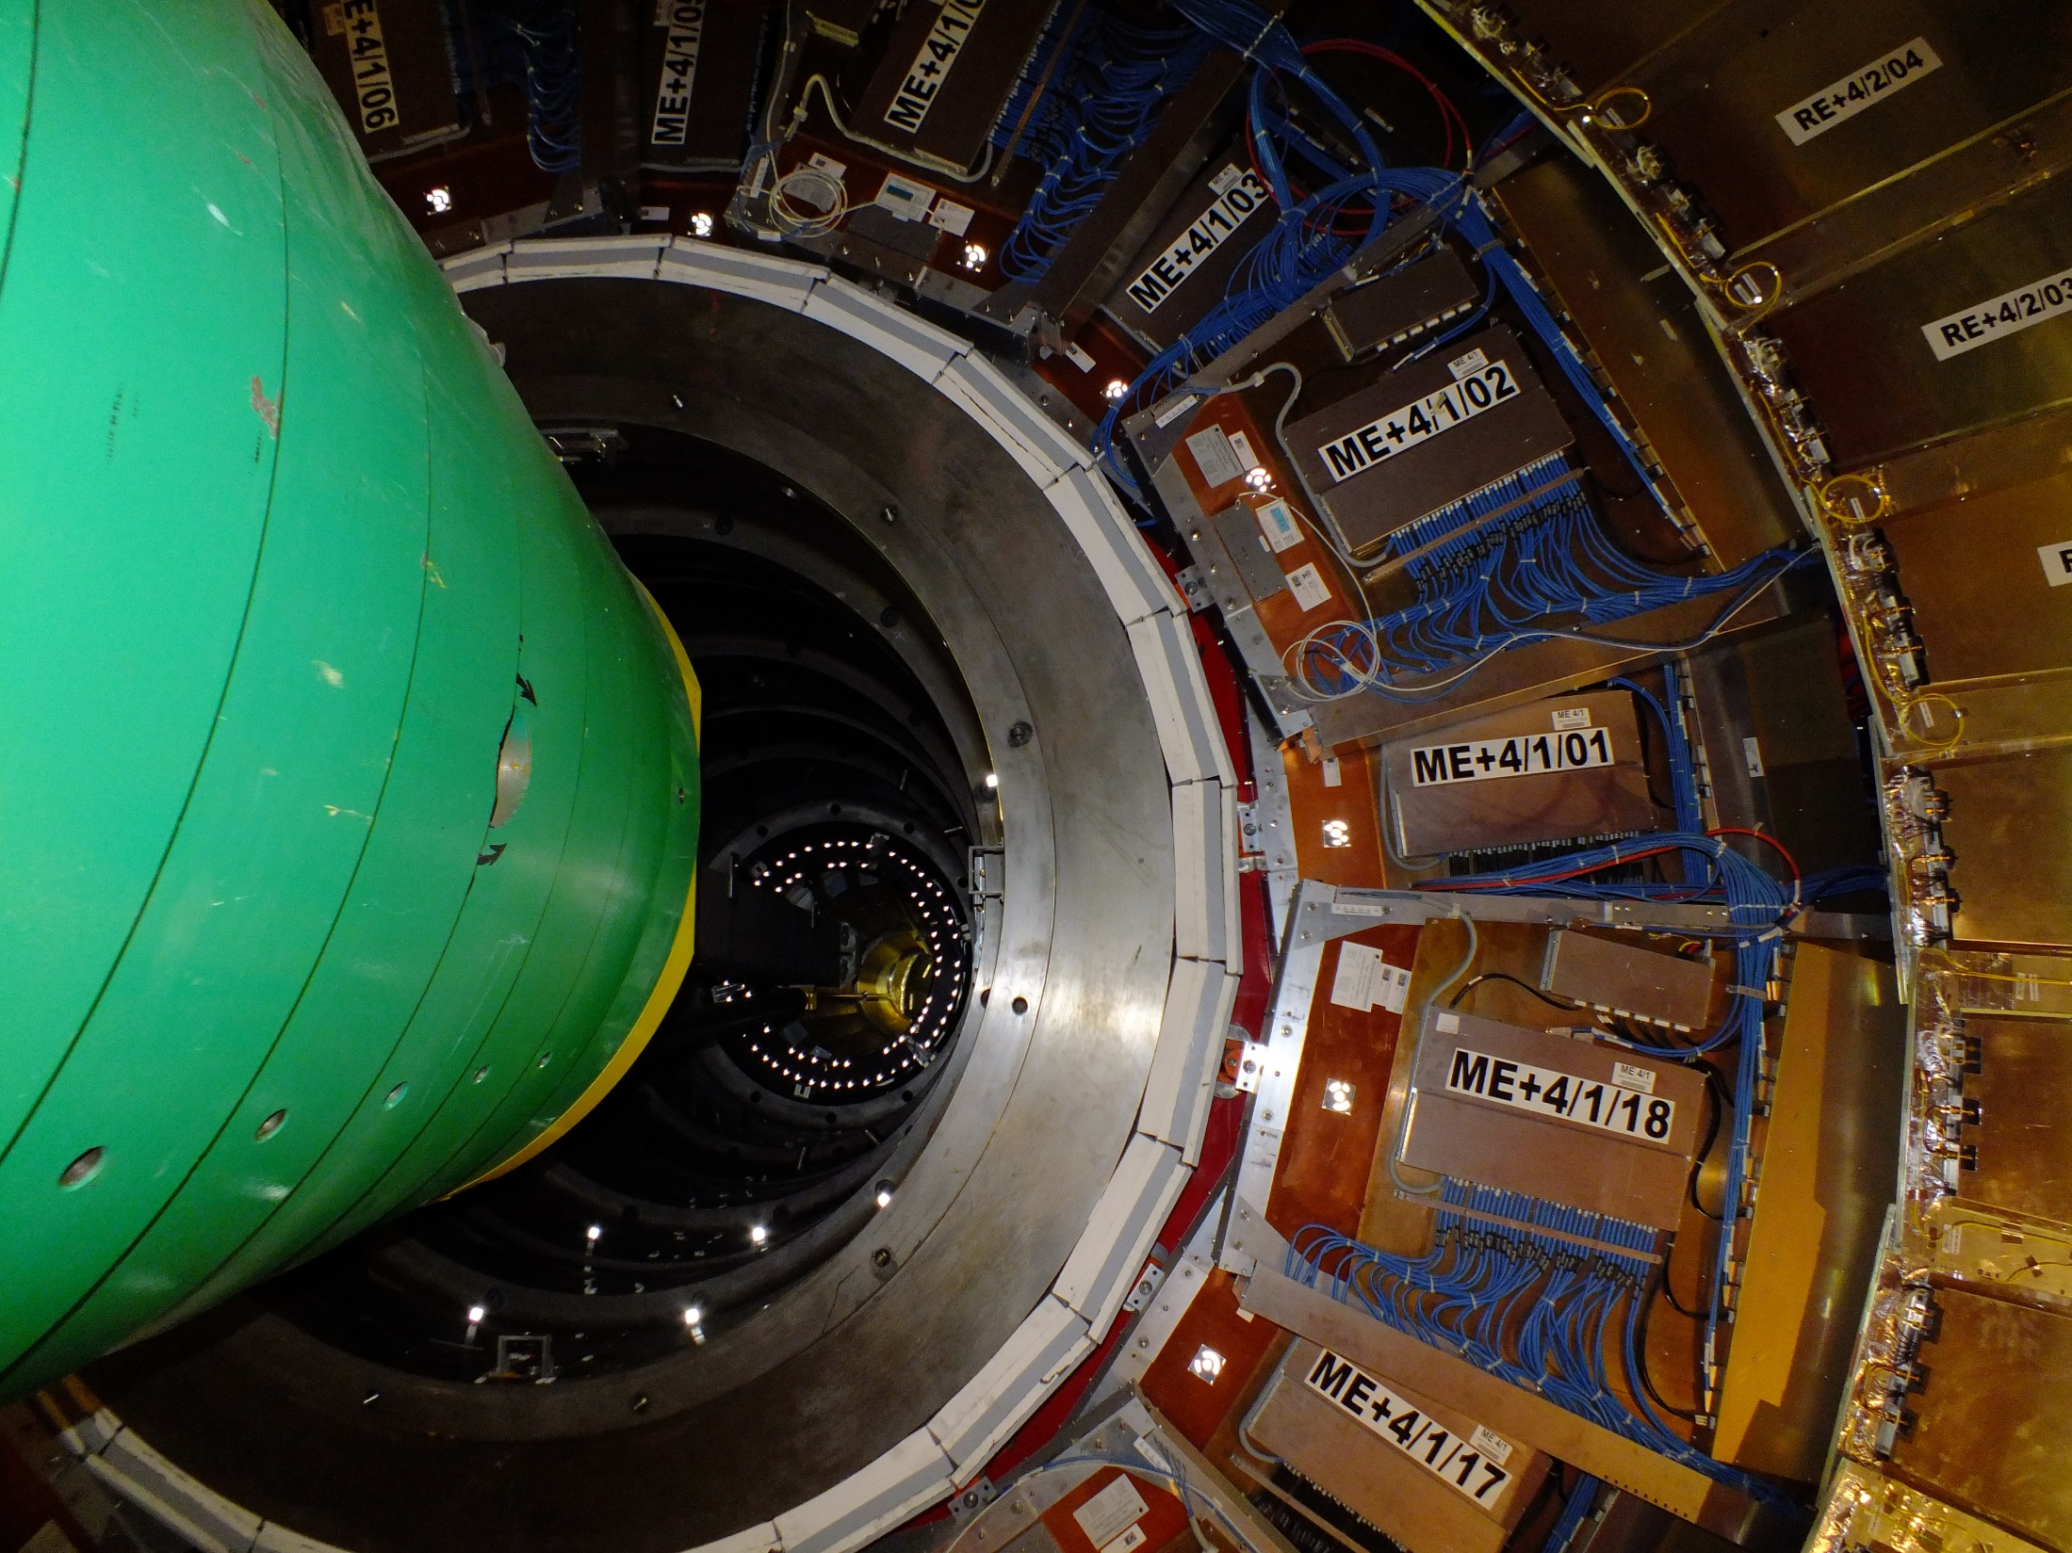

Slide 20
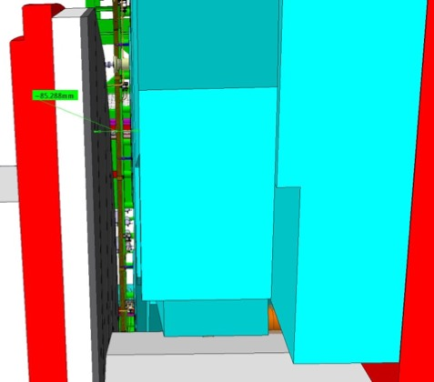
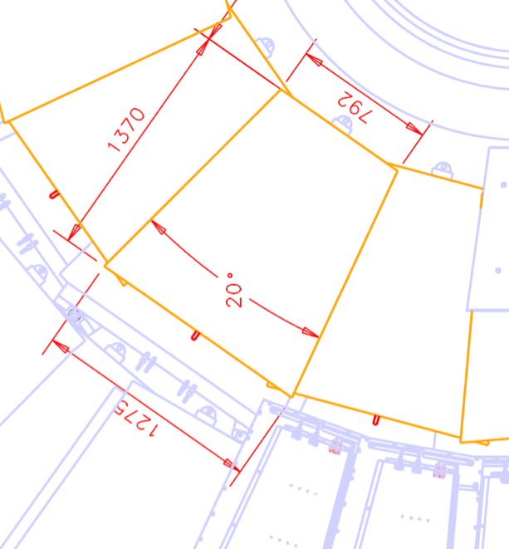
Envelope of RE4/1
These dimensions are being verified with Integration office .
Resultant RE4/1 envelope
85mm Gap.
A model will be made and tested in situ for mounting and service study.

Slide 21
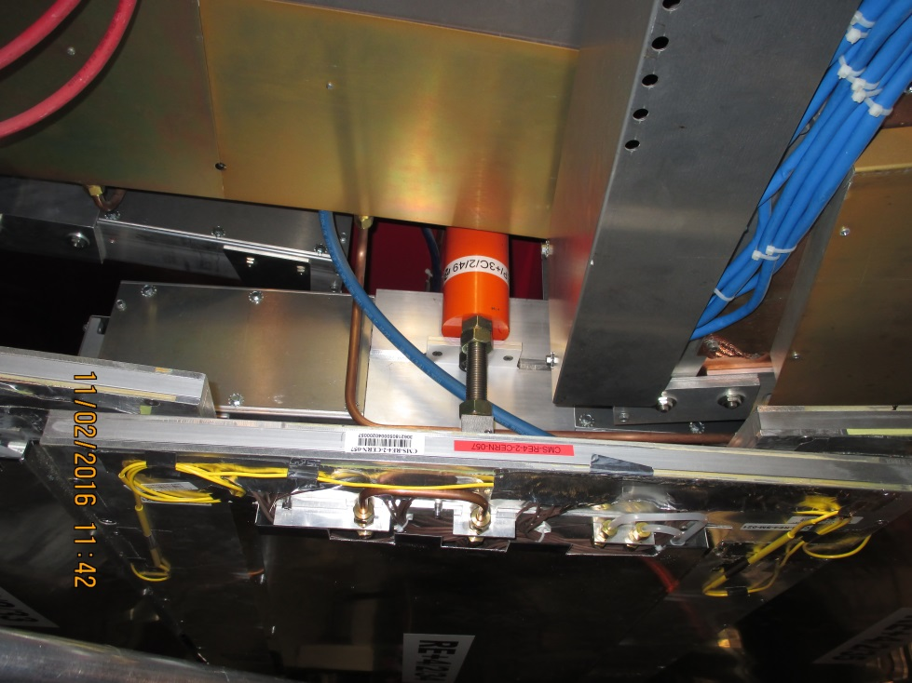
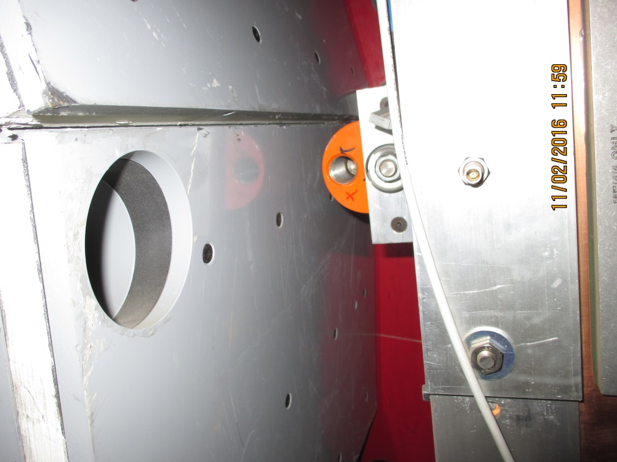
RE4/1 mounting
Inner radius CSC mounting with Spare M24
Outer radius mounting (M24) supporting the RE4 SMs are hidden under them. An astute mechanical solution is required to latch onto these points.

Slide 22
Preliminary installation schedule
For each disk of RE3/1 or RE4/1
18 chambers installed in 3 days. Crane needed full time.
Cable (HV/LV,Signal) : 3 days
Cooling (including commissioning at 18 bar with gas): 4 days
Gas : 3 days
Final chamber commissioning: 1 week
Total installation/commissioning time ~ 3 weeks (including w.e.)
Services have to be installed in advance during previous LS or YETS
Job on different disks can be parallelised if manpower available.

Slide 23
Conclusion
The services needed for the RE3/1 and RE4/1 Upgrade almost defined.
The services are transparent to the choice of detector technology.
Services can be installed before and during LS2
Chambers will be installed during YETS before LS3.

Slide 24
Additional Slides

Slide 25
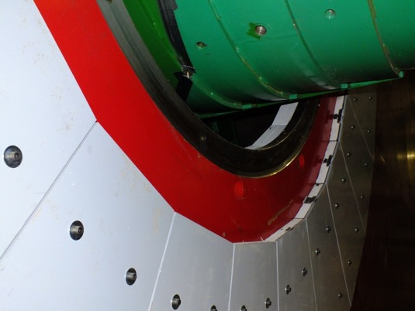
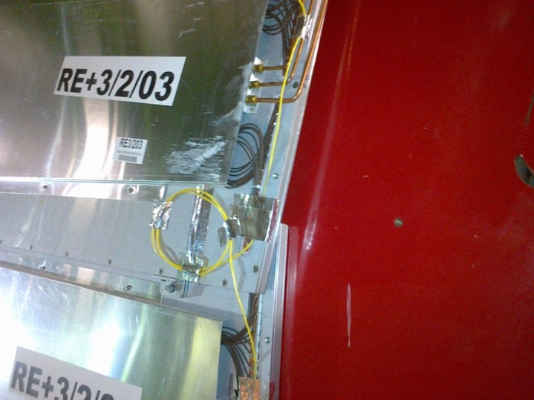
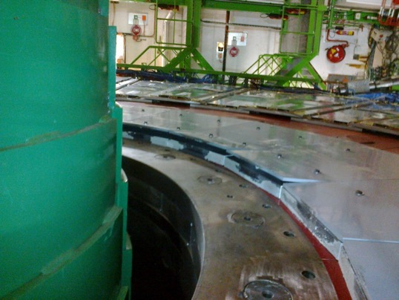
RE3/1 Mounting
Remove
Bolt heads (and washers ?) to be made flush with shield (Pb) to gain >10mm
Chambers will be exposed to this type of error !
M12 Mounting holes drilled for “short” RE3/1
Now corrected, clearance introduced

Slide 26
LV Power System Requirements: Summary

Slide 27
Gas System modification
  Use the same gas mixture: Requires minimal efforts from gas group and ZEC team. The spare 12 gas channels of rack 85 (RE+3/Top) and of rack 67 (RE-3/Top) can be used to supply RE(3,4)/1. Also this possibility is implemented in the GCS software.
  Use the same but not humidified (dry) gas mixture: Requires medium efforts from the gas group and ZEC team. Modifications of the existing gas system are needed in SGX and USC gas room. The supply to the new chambers can be included in the close loop of the existing system. The manifolds (rack 81, RE+3/Bot and rack 63, RE-3/Bot) can be used to supply the dry gas to the chambers while the chambers from RE±3 will be connected to the free manifold of rack 85 and rack 67. Again no change in the GCS software.
  Use different gas mixture: Requires an enormous amount of efforts from gas group and ZEC team. Installation of new mixer in SGX and new gas distributor in the USC gas room. Installation of new pipes from USC to the gas racks are needed. The gas racks (racks 85, 67) have to be extracted and modified. There is no possibility for close loop unless a new gas system is build. Also there should be performed some changes to the GCS software.

Slide 28
RPC Upgrade RE(3,4)/1 gas system
The gas supply from SGX to USC gas room is covered by the existing spare gas lines even if different gas mixture is used.
The free manifold (12 gas channels) of the gas racks X2(A,S)51 (racks 85 and 67 from GCS) can provide the gas supply for RE±(3,4)/1 → installation of new gas racks in UXC is not required.
The flow cells of the free manifolds and their readout are already implemented in the GCS software.
In case a different gas mixture have to be used the two manifolds of racks 85 and 67 sharing a common gas line have to be separated → requires installation of new gas pipes from UXC to the gas racks, modifications of the racks and a new mixer in SGX.
Taking into account the volume of the chambers, the refresh rate for HL-LHC (1 volume change/hour) and using 6 gas channels per RE±(3,4)/1) fixes the upper limit for the flow of a single gas channel to ~9 l/h.
The gas distribution from the gas racks to RE±(3,4)/1 chamber patch panel requires installation of copper pipes ((1 return + 1 supply)/gas channel), patch panels and flow reducers.

Slide 29
RPC Upgrade RE(3,4)/1 gas system
The gas supply from surface to USC gas room will be covered by the existing gas lines.
Taking into account the volume of the chambers and refresh rate of HL-LHC (1 volume change/hour, ~9l/h), 6 gas channels per disk are needed.
From USC gas room to the chambers: it can be used the present gas racks in UXC. No new gas racks are needed.
From gas racks to chambers: gas pipe needed.
  IN case of alternative gas mixture for the upgrade: to be installed a new mixer in SGX and new gas distributor in the USC gas room and new closed loop, new pipes from USC to the gas racks. The gas racks (racks 85, 67) have to be extracted and modified. This solution is not considered for the moment.

Slide 30
HV Power System for RE3/1 & RE4/1 (I)
Assume 20° chambers
  18 chambers per Endcap disk or 36 per station
  RE3/1 – 36 chambers
  RE4/1 – 36 chambers
Unique powering independent on detector technology
1 HV channel per chamber = 72 HV channels & 72 HV cables
  18 HV cables per disk, 36 HV cables per end
  18 HV cables in mCC per side & end
  RE3/1 & RE4/1 slots already available on X1 RE HV PP
  72 HV channels in 4 crates ➔ 18 channels (3 HV boards) per crate
  Upgrade present HV system from 4 to 6 crates in EASY chain
  More service power will be required (A3485S)
  This powering schema is valid for Double and Multigap design.
  Double gap design:
  1 HV connection, top and bottom layer powered separately.

Slide 31
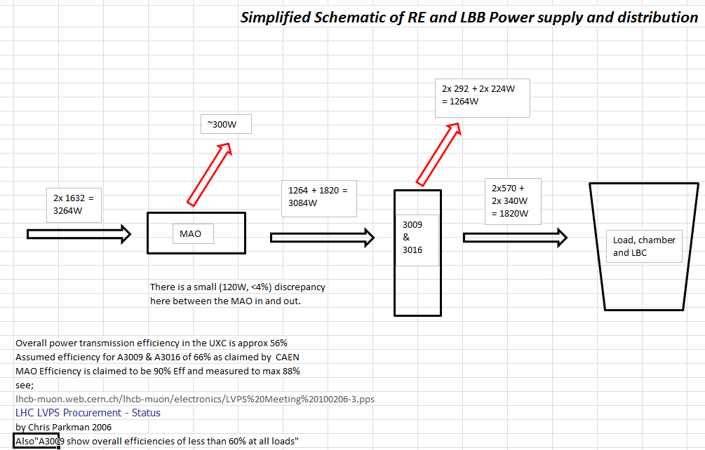
RE Electrical Power loads on one YE3 and dissipation.
Present Configuration
Cabling losses have not been included

Slide 32
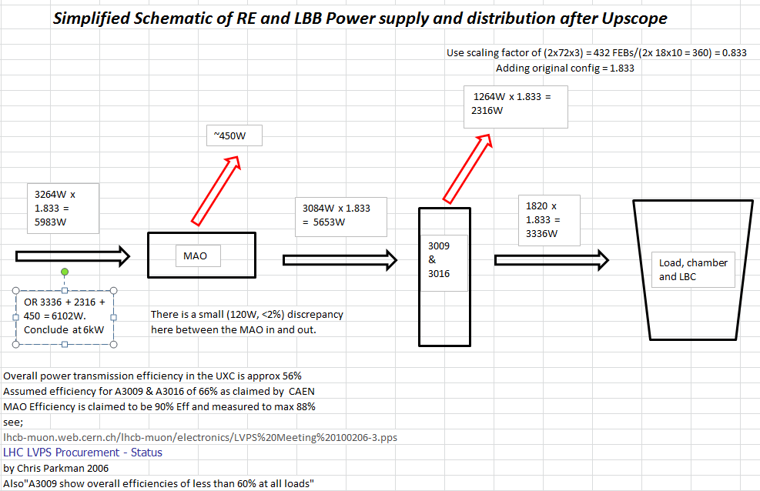
RE Electrical Power loads on one YE3 and dissipation.
Upgrade
Configuration
Cabling losses have not been included

Slide 33
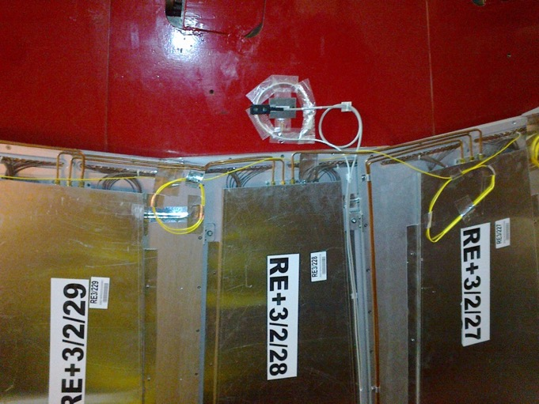
RE3/1 as designed, “short version” was mounted flush with the Yoke. Shielding takes up significant space in “Z”. Z space over shielding to be studied.
Services to extend to RE3/1 ? Gas and cooling.
Space to cover

Slide 34
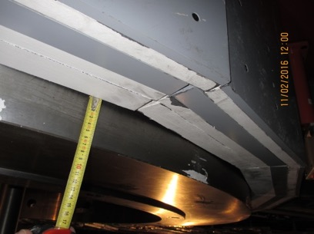
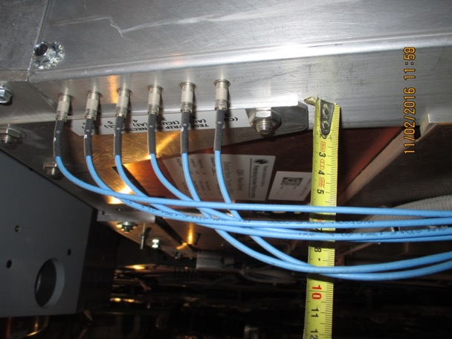
RE4/1 Mounting
Services on top of CSCs to be understood wrt the envelope that Integration office have
Details of as built to be understood.

