Slide 1
RPC LV LBB

Slide 2
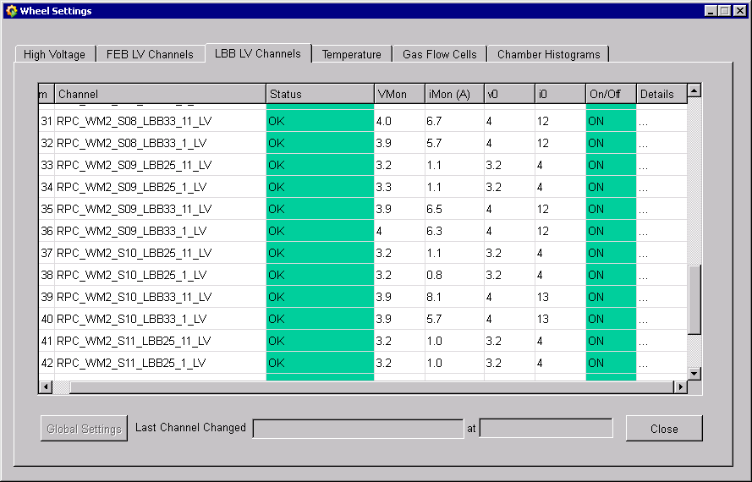
W-2

Slide 3
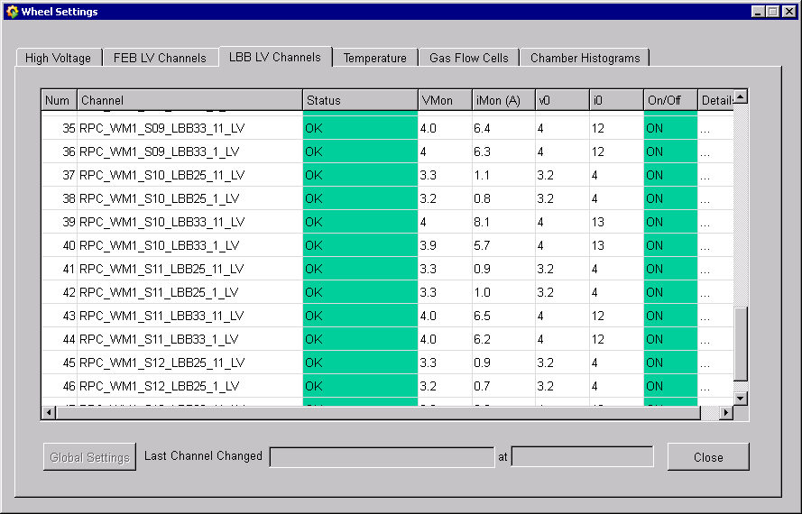
W-1

Slide 4
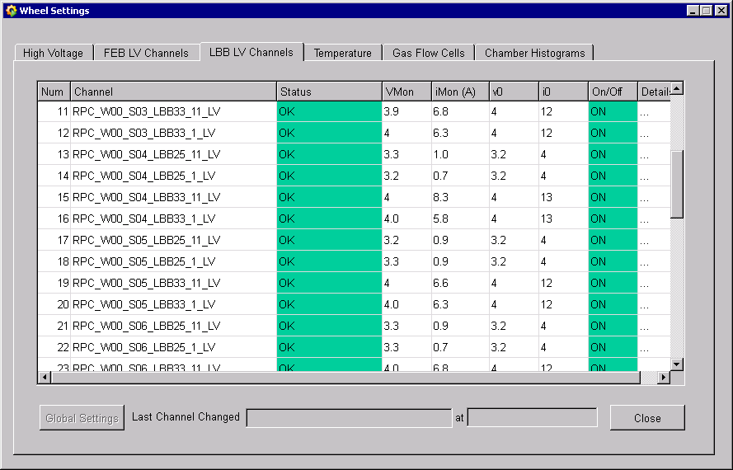
W0

Slide 5

W+1

Slide 6

W+2

Slide 7
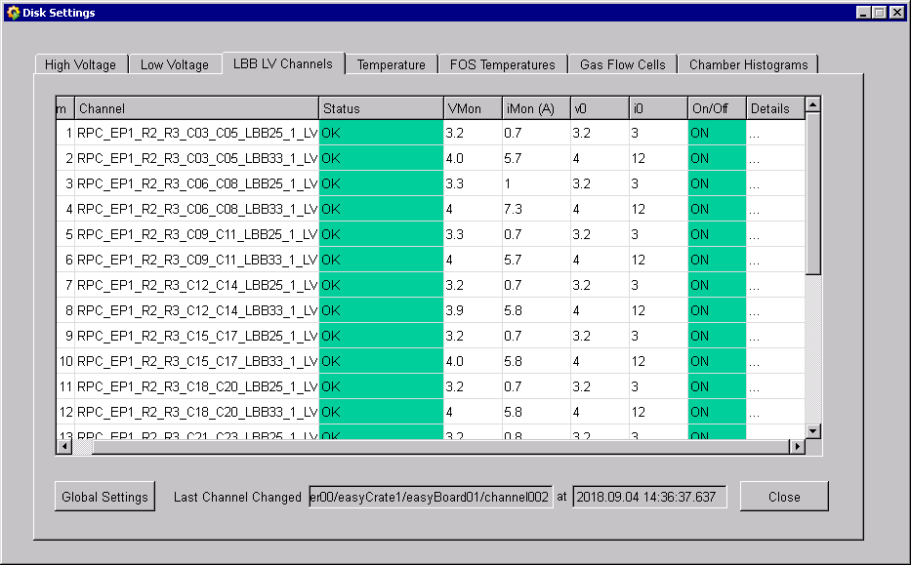
RE+1

Slide 8
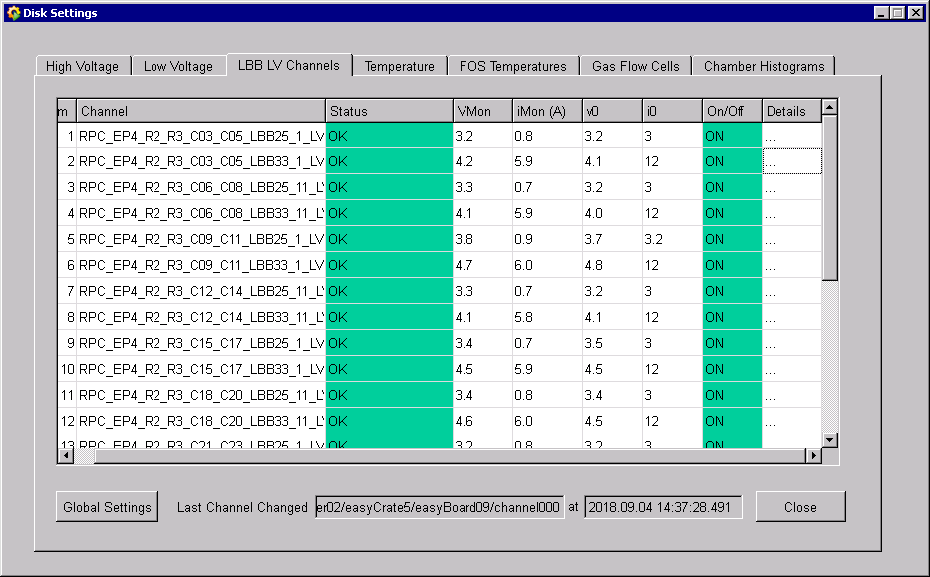
RE+4

