Slide 1
L/HVPS CAEN Contracts
fv/19May2016

Slide 2
CAEN P&M Contracts
P=Procurement
M=Maintenance
B1226 P&M
Stopped by CAEN
2009
B1281 M
LHC equipment list
2010
B1291 P
2011
2 price lists
LHC & Addendum list
2012
B1226 P
B1337 P
Re-launched 2012
LHC equipment list
As B1281
Addendum list
2013
B1387 P
2014
Continue post LS1
Addendum list
2015
Spent 1.8M till Dec 2015
Spent 5.1M till Dec 2015
B1451 P
2016
Addendum list
Revisit situation once experiments have clearer view
of LS2 needs
2019
End 31.12.2019
End 31.12.2019

Slide 3
CAEN contracts: B-1173 (FC/4832-obsolete) + B-1226 (IT-3330)+ B-1281 (FC/5277) + B-1291 (obsolete)+ B-1337 (obsolete) + B1387 (obsolete)
(in CHF)

Slide 4
CAEN B1281 Maintenance Contract
On-Site maintenance:
All LHC experiments
75’000 CHF per year (54’000 CHF supported by CMS)
Plus software maintenance fee
Annual fault reports statistics

Slide 5
CAEN B1281 Maintenance Contract
2014 repair and preventive maintenance statistics

Slide 6
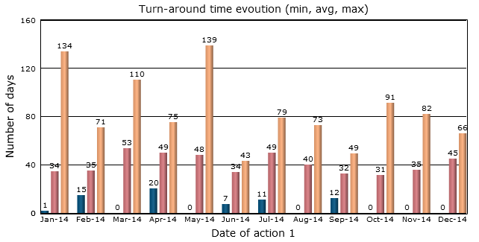
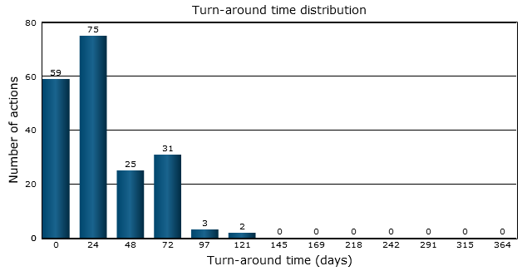
Caen - Repair turnaround time (at contractor’s premises)
Between ‘repair authorized’ and ‘returned from repair’ actions
On-Site maintenance:
All LHC experiments
75’000 CHF per year (54’000 CHF supported by CMS)
Plus software maintenance fee
Caen 2014
Average turnaround time: 29.6 days
(In 2013: 51.8 days)

Slide 7
CAEN contracts up-to-now
Running smoothly
Appreciated by users
Stable failure rate since 2010 (~3%, no sign of wearout)
Acceptable turn-around time (avg 30 days)
Stock of critical components available
~Monthly visits and meetings
Costly
Probably no change till 2019
Annual fault reports statistics

Slide 8
CAEN contracts after 2019
Extension to LS3 likely
  2019-2023/24?
  Good service to us
  Good money to CAEN
  No sign of equipment wearout (yet)
  On-site service is expensive (but convenient)
  Subject to re-evaluation of spares situation
  Subject to re-negociation of prices
  Subject to agreement with other LHC experiments
Beyond LS3
  Existing equipment will wear-out
    Not well matched to long-term contract
  CAEN has a tradition of repairing aged equipment if they can
    Best effort
  New equipment subject to new Tender
    Maintenance contract linked to new equipment

