Slide 1
iRPC Scenarios
Assume 20° chambers
  18 chambers per endcap disk or 36 per station
  36, 72 or 108 chambers in total, for 1, 2 or 3 stations
Assume 1 or maximum 2 HV channels per chamber
  Double gap design:
  2 HV connections, top and bottom layer powered separately, when a redundancy required. Otherwise, 1 HV for a RPC module.
  Multigap design:
  1) Phenolic (HPL) dual bi-gap design:
  Each RPC composed of top and bottom bi-gaps. The strip plane is placed between the two bi-gaps (each gap thickness = 0.5 ~ 0.8 mm).
  2 HV connections for top and bottom layers, to bias them separately, when a redundancy required. Otherwise, 1 HV for a RPC module.
  The operational HV: - 9.0 kV ~ - 10.0 kV on cathode electrodes
  2) Low-resistive glass multi-gap design:
  Each RPC composed of a single layer of 4 or 6 stacked thin gaps (each gap thickness = 0.22 ~ 0.30 mm).
  1 HV connection for a RPC module
  Operational HV: ~ 12 kV on cathode electrodes

Slide 2
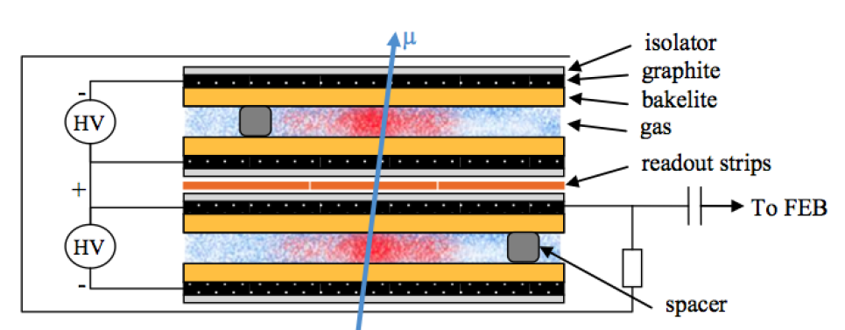
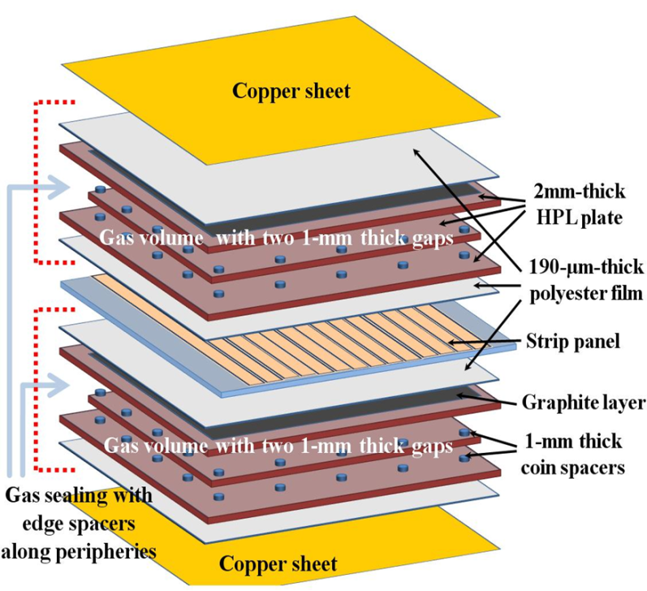
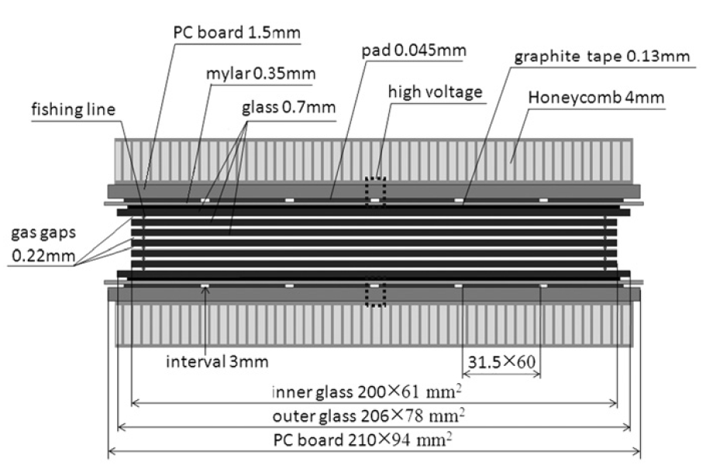
Standard double-gap RPC
Phenolic dual bi-gap RPC
Low-resistive glass multi-gap RPC

Slide 3
Front-end Electronics
  Present FEB electronics (32 ch)
    2 LV channels per chamber (or per 2 chambers?)
    Assume present granularity, i.e. 64 strips/20°; 5 η partitions per chamber, i.e. 5x2 FEBs or 320 ch/chamber
    2.6W/FEB, i.e. 26W/chamber
  PETIROC electronics (64ch in new version?)
    Assume 2mm pitch, i.e. ~565 strips/20°;1 η-partition (both end strip readout), i.e. 9 ASICs/chamber
    3mW/ch (?), i.e. 1.7W/chamber (ASICs only, what about TDC?)

Slide 4
iRPC Scenarios: wrap-up I
Assume 20° chambers
  18 chambers per endcap disk or 36 per station
  RE3/1 – 36 chambers
  RE4/1 – 36 chambers
Assume 1 or maximum 2 HV channels per chamber
  Double gap design: top and bottom layer powered separately?
  MG Lyon (glass): 1 HV connection per chamber (300µm x 4 || 5 layers), negative polarity from 0 to -12/13 kV. Remark: EASY HV boards A3512N used presently at CMS can power up to 12kV max.
  MG Korea (HPL): 1 HV cable per chamber, WP ~ 9KV (neg. polarity)
Front-end Electronics
  Present FEB electronics (32 channels)
    2 LV channels (ANA && DIG) per 2 chambers, powered by 12-channel A3009 board, 8V, 45W max.
    Assume present granularity, i.e. 64 strips/20°; 5 η partitions per chamber, i.e. 5x2=10 FEBs or 320 channels/chamber
    Power Consumption/Currents (A)
      LV_ANA 0.029A per chip, 0.116A per FEB, 1.16A per chamber
      LV_DIG 0.066A per chip, 0.264A per FEB, 2.64A per chamber
    Power Consumption/Dissipation (W)
      LV_ANA 0.203W per chip, 0.812W per FEB, 8.12W per chamber
      LV_DIG 0.495W per chip, 1.98W per FEB, 19.8W per chamber
      2.792W per FEB, i.e. ~28W per chamber
    Remark: see next page

Slide 5
iRPC Scenarios: little evolution
Present FEB electronics (continue from previous page)
  Remark: Using present CAEN LV power boards A3009, they provide 45W max per channel, divided by 8V (the max Voltage we can provide per this type of module), it makes 5.625A the max. value of current to be drawn by all FEBs. Divided by the DIG current drawn by a single FEB, it finally makes that 21 FEBs can be powered by one A3009 channel, which means that we can still preserve the present powering schema (2 LV channels powering 2 chambers). However, this value is very close to the power failure limit of the board and we risk to experience a lot of HVmax errors while powering. Therefore, I will prepare the following alternative powering schemas:
    2 A3009 LV channels powering one 20° chamber;
    2 A3016 LV channels powering two 20° chambers. In this option the powering schema is the same as the present CMS detector, but we use a different type of board where the max power per channel is 90W, but the number of channel per board are 6 instead of 12. This option will increase the number of boards and the cost. However, we will be using about 50% of the power, so it is possible another solution, namely
    2 A3016 LV channels powering three 20° chambers. In this case 75% of the power of the board will be used which is quite optimal regime of operation and it is also cost saving.
    2 A3009 LV channels powering two 20° chambers. This is the present CMS RPC LV powering scheme which I discourage to use as explained above.

Slide 6
iRPC Scenarios: wrap-up II
Developing FEB electronics
    PETIROC electronics (64ch in new version)
    on ASIC TDC
      Assume ~3mm pitch, i.e. 320 strips per 20° or 640 channels (320 strips readout on both ends);1 η-partition i.e. 10 ASICs x 64 channels each = 640 channels.
      Power consumption: 3.6 mW per channel x 640 = 2.3W per 20° chamber
      Question: How are these channels powered? How many volts, how many PCB, how is the LV power distributed?
    on FPGA TDC
      Assume ~3mm pitch, i.e. 320 strips/20° or 640 channels.
      Power consumption: ~80mW per channel x 640 = 51W per chamber
    Strip Readout? In general, for the cabling I would need more details on how those strips will be read out. At present, a front-end LVDS driver is converting the signal to LVDS which is sent to the Link boards (LB) located in the periphery towers where the signal is multiplexed and converted to optical by an optical driver. Then the fibers go from the towers to the PP at the bottom of each tower and from the PP they go through the tunnel to reach the Trigger Boards (TB) in USC.
    This chain is not quite clear to me at present for the new electronics. Can anyone elaborate on this? From the last meeting I only wrote down the following:
    1 OF per chamber going to GBT board → DAQ, but
      what these GBT boards are and how they would be integrated into existing CMS electronics (CMS compatibility)
      where will they be located? This is extremely important to evaluate the length of the optical fibers, we need the endpoints (obviously one end is the chamber, but where is the other length?)

