Slide 1
GE2/1 and ME0
Integration and Services
Andrey Marinov
On behalf of the CMS GEM collaboration

Slide 2
GE2/1
Base line technology is a triple GEM, same as GE1/1. Other MPGDs are under study as option
The single detector is designed to have 4 modules inside
The GE2/1 Super-chamber will consist of 2 single detectors and will cover 20 degrees of the YE1 station 2
The available clearance to install GE2/1 is 74mm in Z

Slide 3
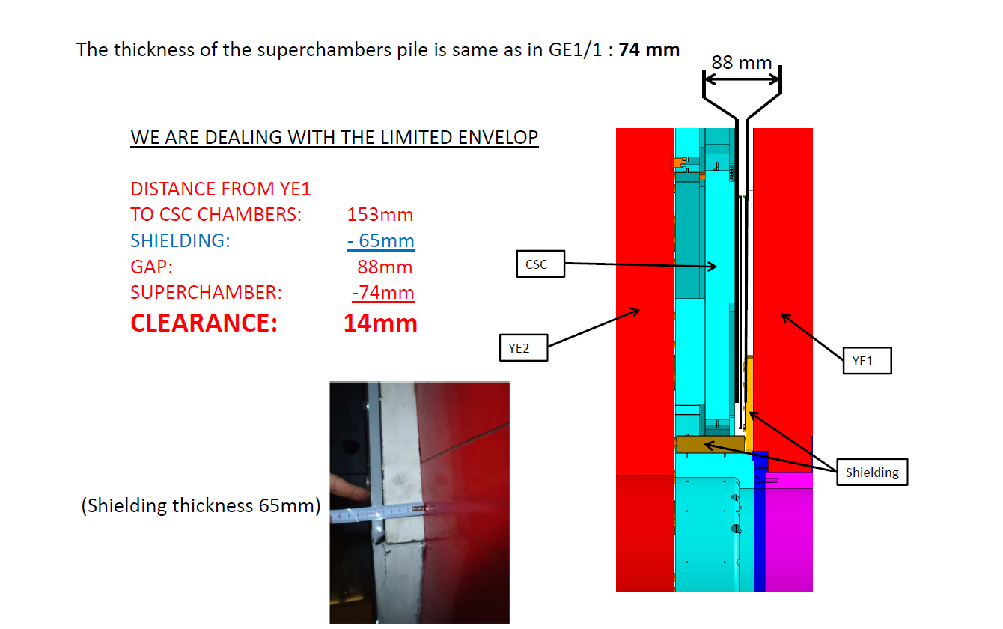
GE2/1 Clearance

Slide 4
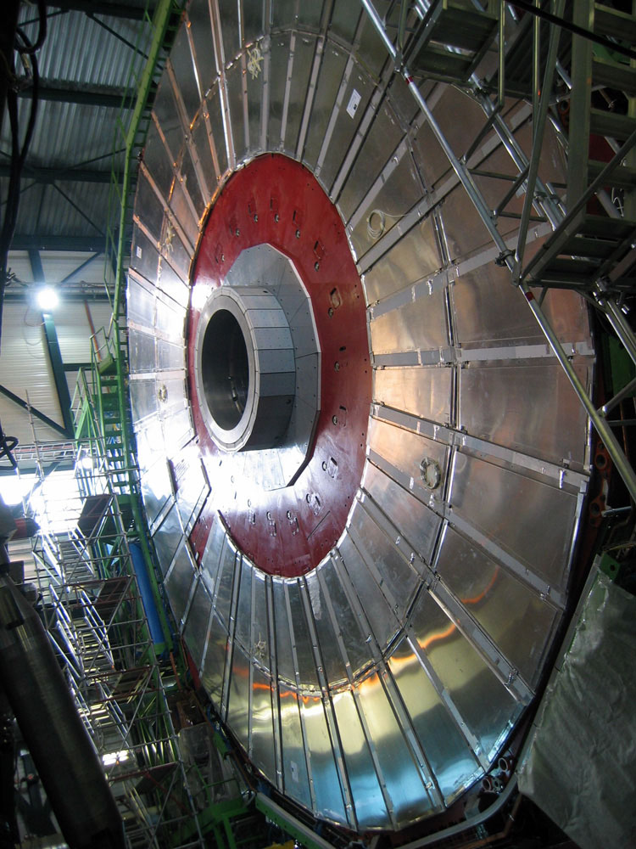
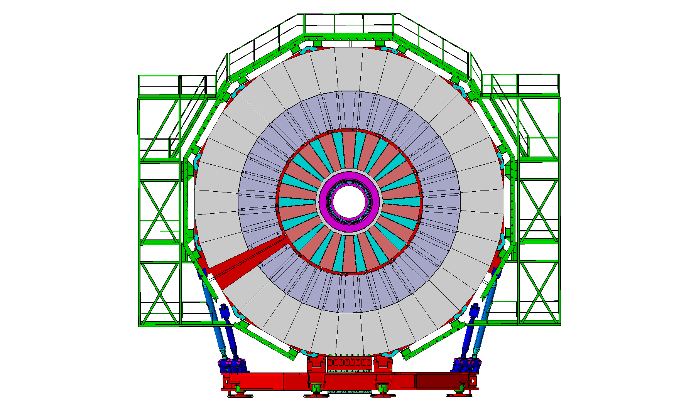
GE2/1 Services
GE2/1 will be mounted on the back of YE1, station 2. It will be installed layer by layer in order to form the super-chamber configuration
Thus all the services should be installed on YE1 to secure minimum length, and avoid the usage of the YE1-YE2 mini cable chains. LS2 is the best moment for the GE2/1 services installation

Slide 5
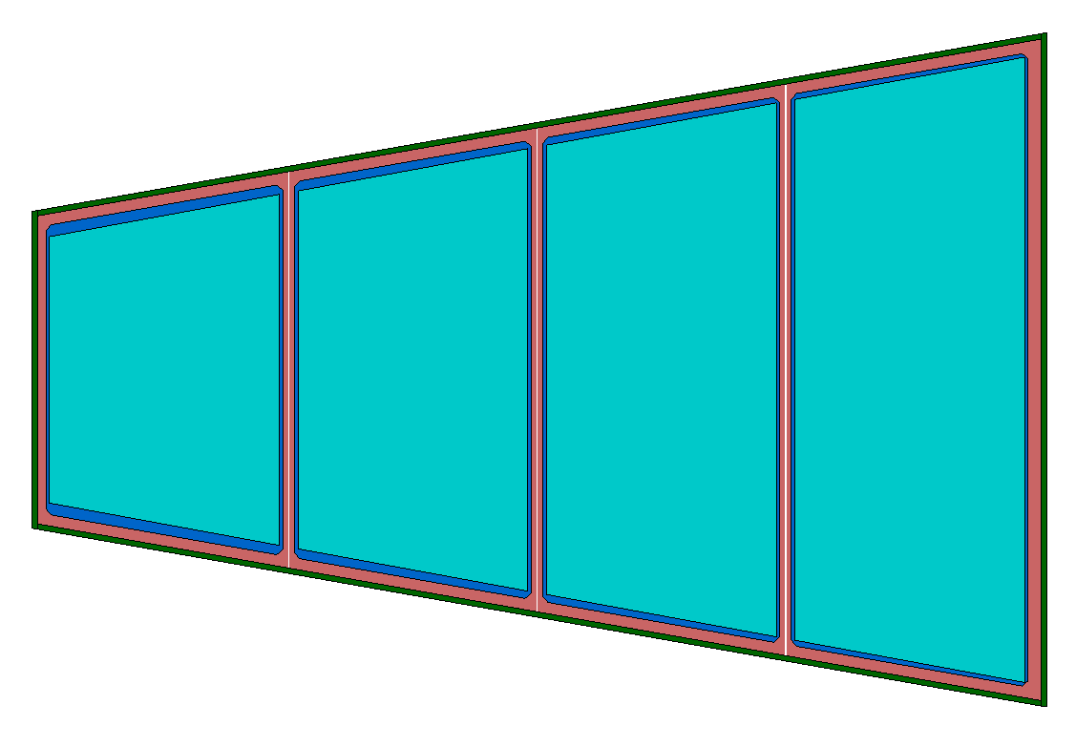
GE2/1 Single Chamber Services
HV Multiconnductor cable
LV Cable from the PS to FEAST DCDC
26 Fibers in total to USC
12 for Tracking
8 for Trigger
OH
OH
OH
OH
8 Fibers to ME2/1 TMB
Gas (Supply Return)
24 VFAT3
18 VFAT3
Cooling (Supply Return)
DRAFT
18 VFAT3
12 VFAT3
OH board will be specially design for GE2/1 modules. Less bandwidth and VFATs per OH compare with the GE1/1.

Slide 6
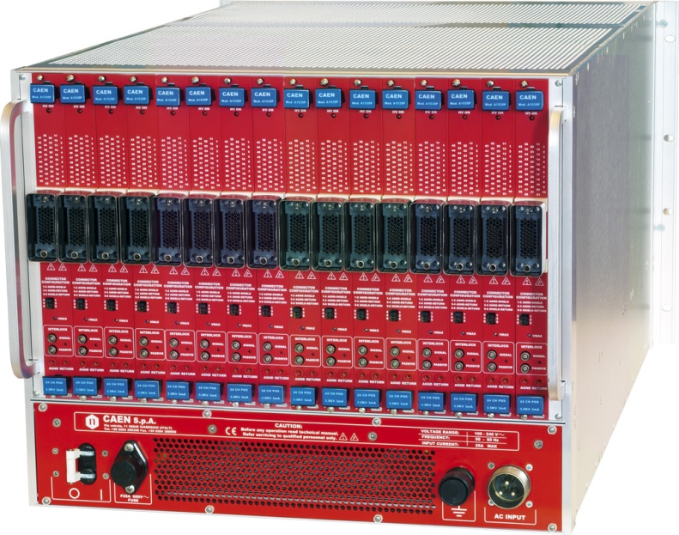
HV System for GE2/1
The base line Power HV power source will be A1515 from CAEN.
In the finest granularity one GE2/1 super-chamber can be powered with 4 modules.
16, A1515 modules can fit in SY4527 Main frame, located in USC S2 level
In total we need 5 mainframes per endcap in USC S2 level (one rack per endcap).
In the worst case (finest granularity), We have to pull
72 HV multicon. cables per endcap. Each with 16 HV channels inside
All must go via the YE1’s cable chains
It is the same HV power supply as GE1/1.
Long term maintenance will be secured by CAEN-CERN contract.
DCS software will be identical as GE1/1.

Slide 7
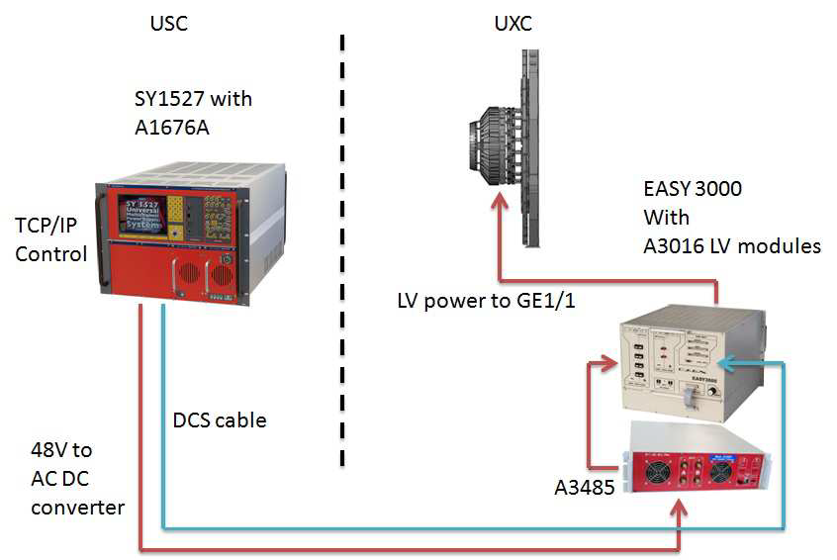
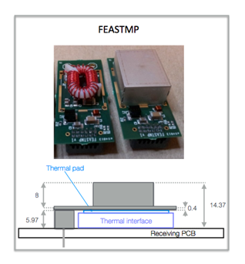
LV System for GE2/1
FEASTMP DCDC modules are developed at CERN to meet the LHC requirements
GE2/1 Detectors for will be equipped with VFAT3 front-end chip and OH per each sub module.
The CERN FEST DCDC converter will be integrated on the GEB boards to provide LV power for the on detector electronics – VFATs and OHs for each GE2/1 module
Reducing the number of LV channels (cost) per detector
Having an option to use smaller power cables, sensitive for the GEM installation regions
Effective power distribution inside the detector

Slide 8
UXC Rack Space Budget for the GE2/1 LV
EASY3000
EASY3000 with 5x A3016
6U
A3485
3U
A3016
A3016
A3016
A3016
A3016
EASY3000
6U
30 LV channels, each module has 6 channels up to 90W per ch.
EASY3000
6U
If we have 18 super-chambers per endcap And we merge to 1.5 super-chamber per A3016 we need:
12x A3016
4 EASY3000 crates
2x A3485 dual AC/DC converters
Total U space is 30 per endcap
A3485
3U
EASY3000
6U
Plus Ventilation U

Slide 9
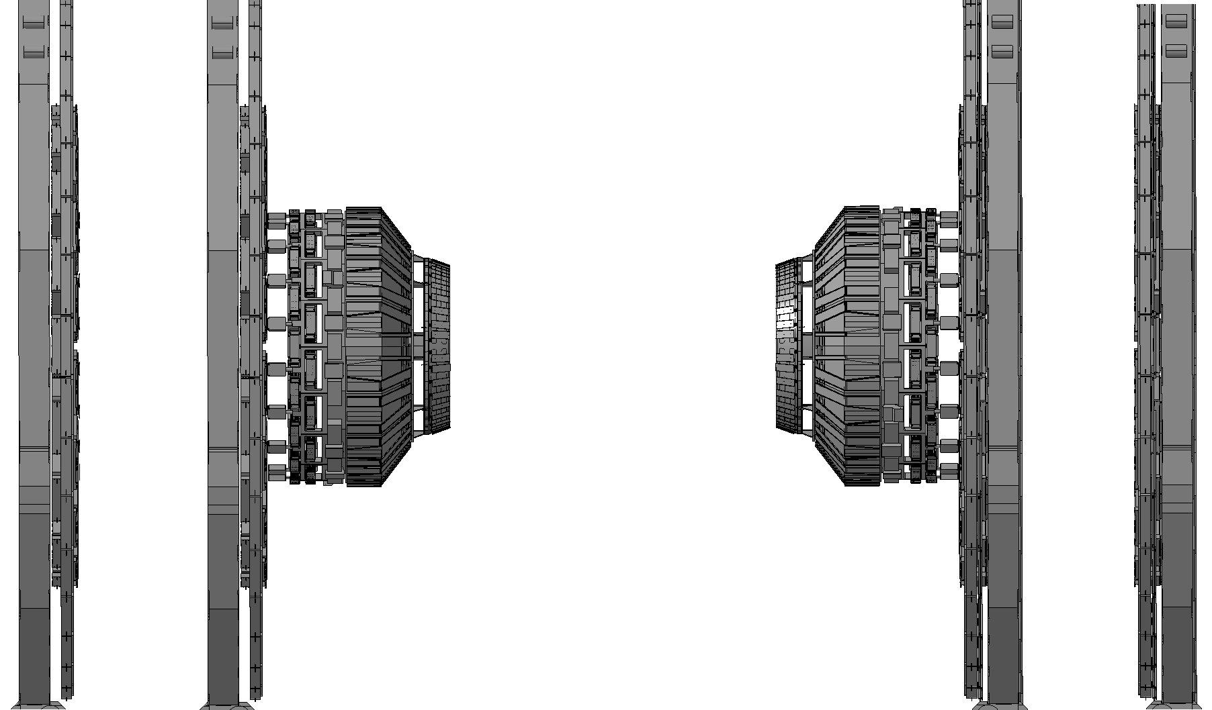
GE2/1 Fibers
YE-2
YE-1
YE+1
YE+2
936 fibers per endcap to USC
8x40mm duct to USC S2 per endcap
To patch them we need 40U rack space in UXC (Balcony) and 40U in USC S2 level
ME2/1
Mini Cable-Chain (Caterpillar)
GE2/1s
Mini Cable-Chain (Caterpillar)
In addition there are 18x16 (288) fibers from GE2/1 (YE1) to the ME2/1 TMB(YE2). The length is between 30 and 50m and must go trough the mini cable chains YE1 YE2.

Slide 10
UXC space budget summary for the GE2/1 per Endcap
LV – 30U
Fibers – 40U
HV – 2x 6U space on X1(near and far sides) for the HV patch-panel
Alignment and temperature sensing 10U per endcap
The option to eventually use for the LV system the free left UXC rack space from the GE1/1 is under study
Fiber patch panel can be installed on the periphery balcony
Or install new racks in UXC

Slide 11
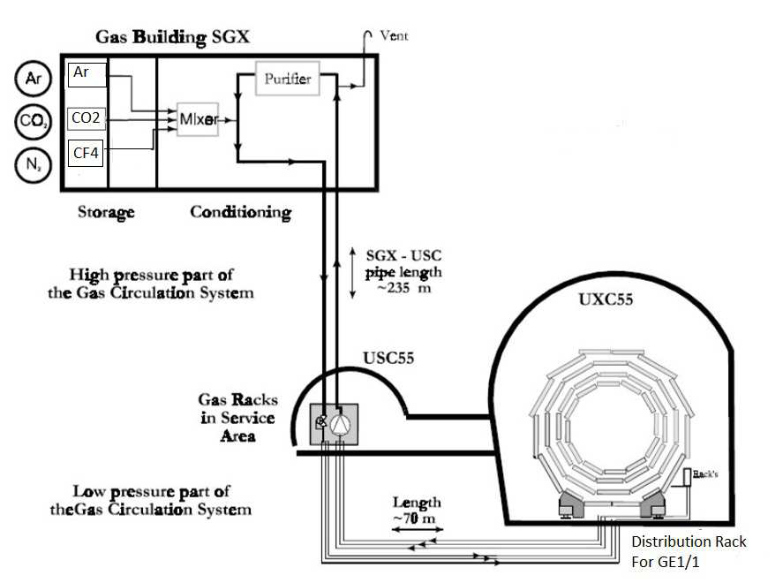
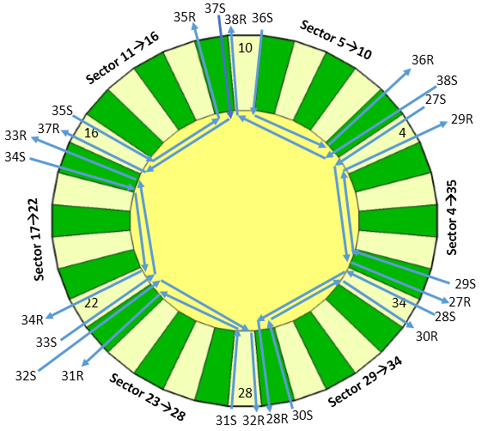
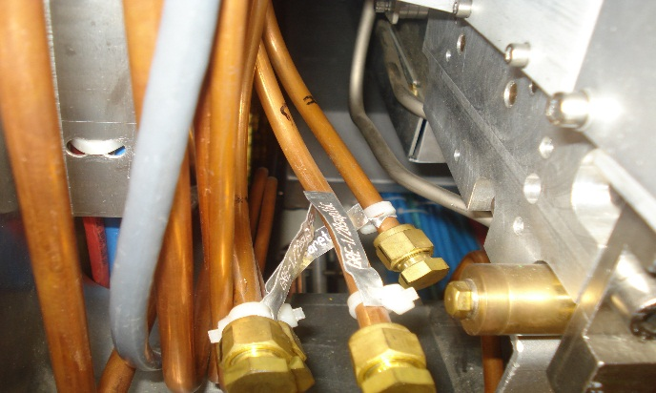
GE2/1 Gas System
We can use the same gas distribution pattern as GE1/1
Ar-CO2 70-30%
As baseline
GE2/1 distribution rack
During LS2 we have to install all the gas pipes for GE2/1. They should run from X2R31 (YE-1) X2L31 (YE+1) to the GE2/1 Patch panels. We have to use the same Gas distribution as GE1/1 (defined by the number of flow cells in the racks)
-3 GE2/1 super-chambers connected in serial.

Slide 12
GE2/1 Cooling
For GE2/1 The only available Cooling is the one for the RE2 Chambers. It is not a good option because the RPC detectors are very sensitive about temperature changing.
New Cooling pipes should be placed between the RE2s the YE1 yoke. They should run from the GE2/1 patch panels to the cooling manifolds of the YE1
The expected approximate power per GE2/1 super-chamber is
- 100W per 144 VFAT3 chips
240W for the 8 Ohs
40W for the DCDC converters - preliminary
Total 380W (with included safety margins)
Per endcap is 6.84kW

Slide 13
GE2/1 Services on the Disk
Services | GE2/1 Chamber | GE2/1 Super-Chamber | Per Endcap
HV | 1 cable of 32 conductors inside | 2 cables | 36 cables
LV Up to the Periphery of the YE1 | 1 cable of 4 conductors inside | 2 | 36
Fibers to UXC pp – toward USC S2 | 26 | 52 | 936
Fibers to ME2/1 TMB. Vie the miniCC | 8 | 16 | 288
Gas Daisy chain with 3 chambers | 2 | 4 | 24 pipes 12 supply and 12 return Copper pipes 8 mm external diameter
Cooling | - | 2 | 36 pipes

Slide 14
GE2/1 Services USC - UXC
Services | Per Endcap | Full System
HV | 36 | 72
Fibers to USC S2 | 936 | 1872
Fibers for FOS Alignment and Temperature | tbc | tbc
Gas | tbc | tbc
YETS2016 Slice Test will help us to learn in more details the services for GE2/1 UXC-USC

Slide 15
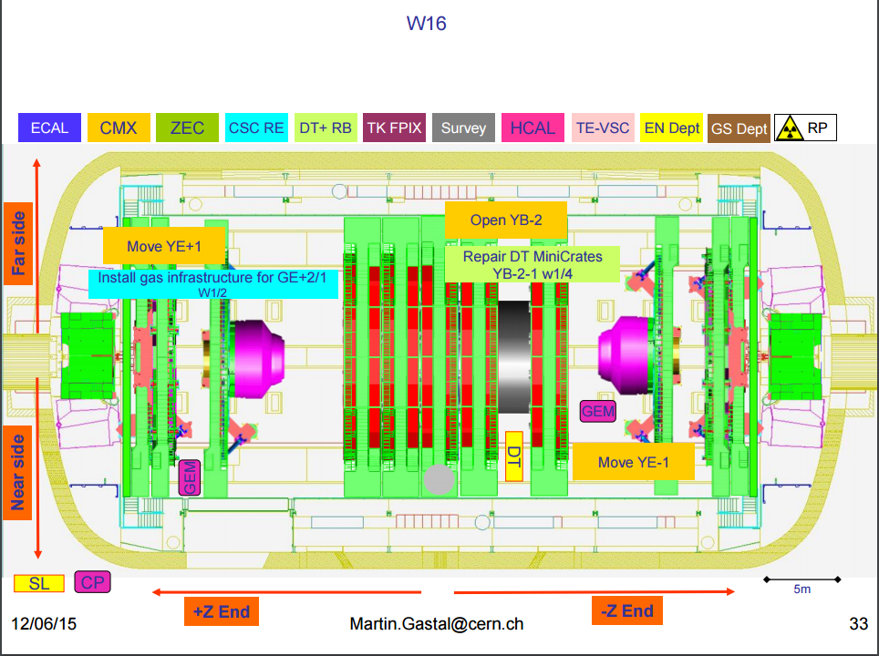
GE2/1 LS2 Schedule YE+1
We start On week 16 (end of March 2019) with the installation of the GE2/1 Pipes Gas, Cooling. Time allocated for this is 2 weeks.

Slide 16
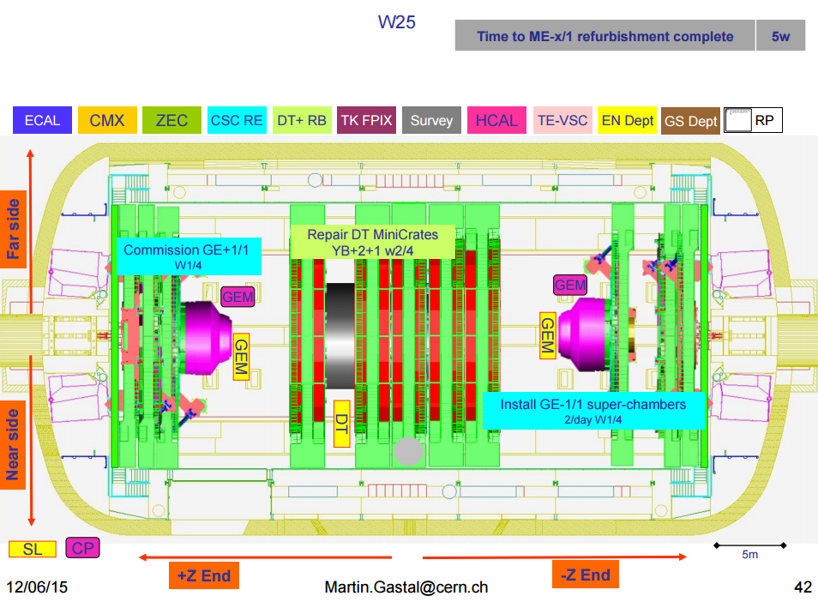
GE2/1 LS2 Schedule YE-1
We start On week 25 (beginning of May2019) with the installation of the GE2/1 Pipes Gas, Cooling. Time allocated for this is 2 weeks.

Slide 17
GE2/1 Schedule Proposal
GE2/1 Services installed during LS2
Ready to install GE2/1 disk 1 during YETS2021
Ready to install GE2/1 disk 2 during YETS2022
The LS3 period will be mainly focused on the YE1 noses and the Barrel part of the CMS. Access to YE1 station 2 will not be in the priorities.
It is under discussion with the CMS Technical Coordinators to anticipate the GE2/1 Services installation during LS2 and to install the detectors on YETS2021 and YETS2022

Slide 18
ME0

Slide 19
ME0 Introduction
Eta Coverage 2.03 – 2.82
20 Degrees – 18 ME0 super-modules per endcap
6 readout boards per super-module
During LS3 we have to install 36 ME0 super-modules plus all the services in UXC and USC

Slide 20
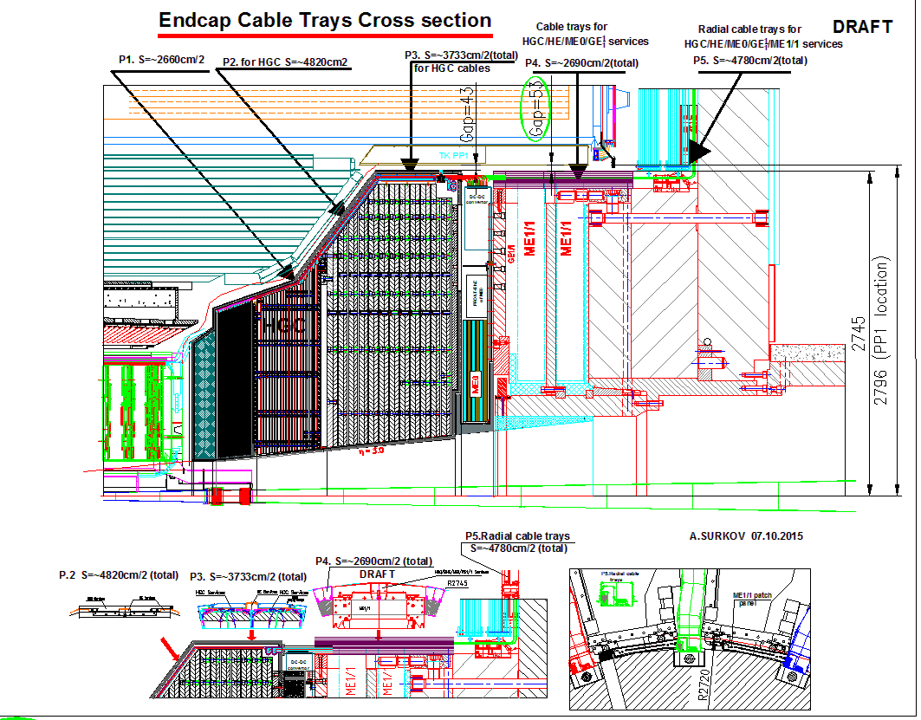
ME0
Drawings
A.Surkov

Slide 21
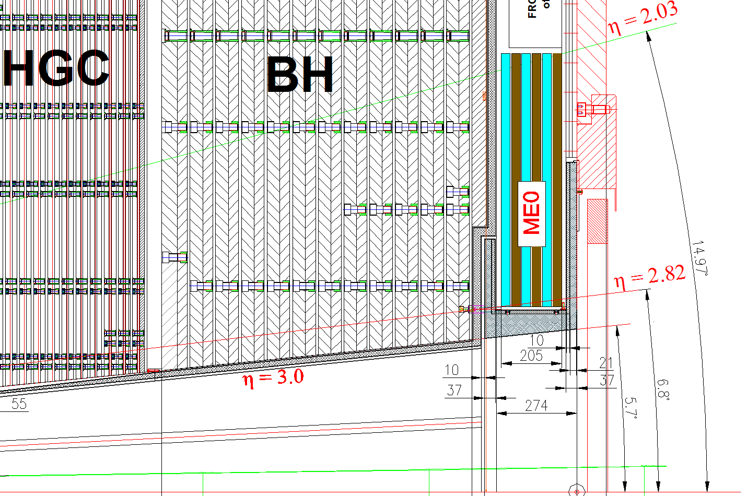
ME0
Drawings
A.Surkov

Slide 22
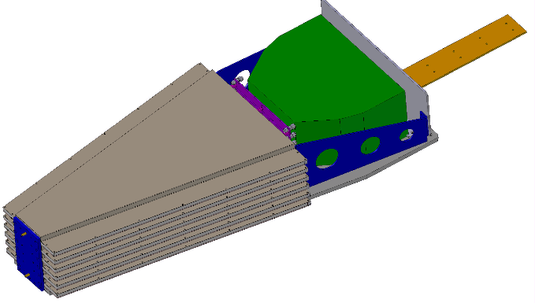
ME0
Go-Out Services path
Electronics Volume
DC/DC converter and OHs
Structure of 6 layer detectors.
The base line is ready to be triple GEM.
Other MPGDs are under study as option

Slide 23
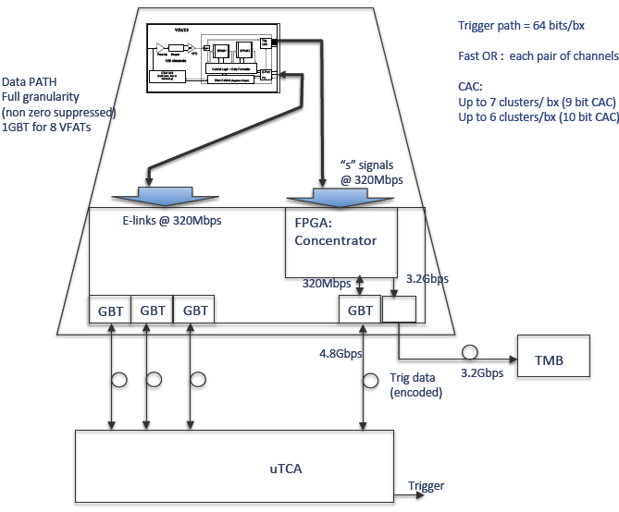
Readout Electronics - Current baseline
VFAT3 ASIC
GEB
Opto-hybrid
GBT
TTC
TTC
Opto links
DCS
uTCA
uTCA
DCS
DAQ
DAQ
Muon TF
Backend electronics

Slide 24
ME0, Based on the GE1/1 Electronics Granularity
Each single detector will consist
  3072 readout channels – strips running one directional in φ
  24 VFAT3 chips
  1 optical-hybrid based on GBTs
One ME0 super-module will consist 6 single detectors.
  18432 readout channels – strips running one directional in φ
  144 VFAT3 chips
  6 optical-hybrids based on GBTs

Slide 25
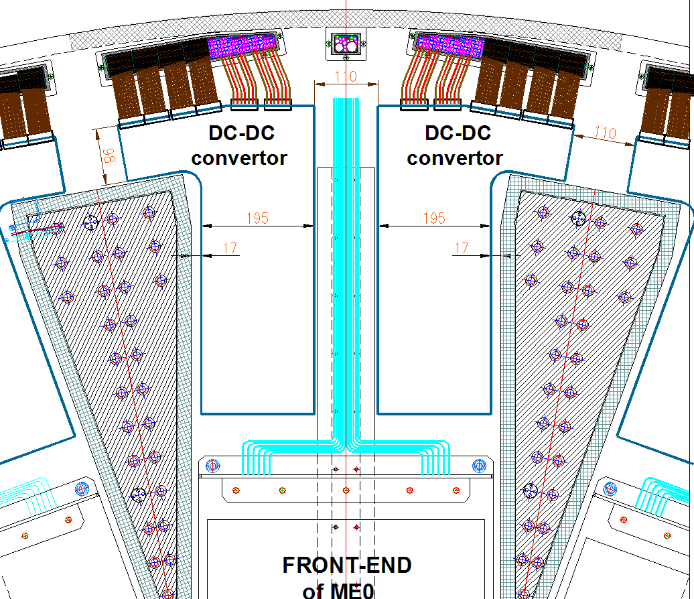
ME0 Services Envelope
If we use the GE1/1 services as baseline for ME0 super module than we can have
6 LV cables, 6x ~10mm dia.
96 fibers for Data – 4 patch cords of 24 fibers = 4x ~12mm
HV multicon cable 3x ~10mm
Gas pipes – Supply and Return – 2x 6mm
Cooling pipes – 2x 10mm?
FOS ?
This represents the ME0 services, which we can use to discuss the common envelope with the BH

Slide 26
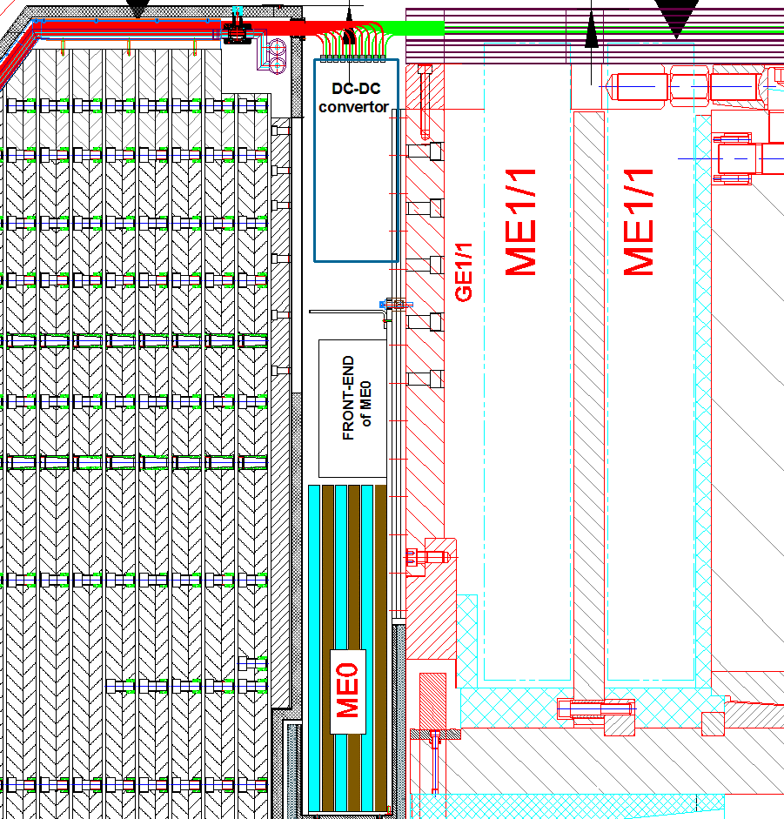
ME0 Services Position Inside the Nose
View from IP
Side View

Slide 27
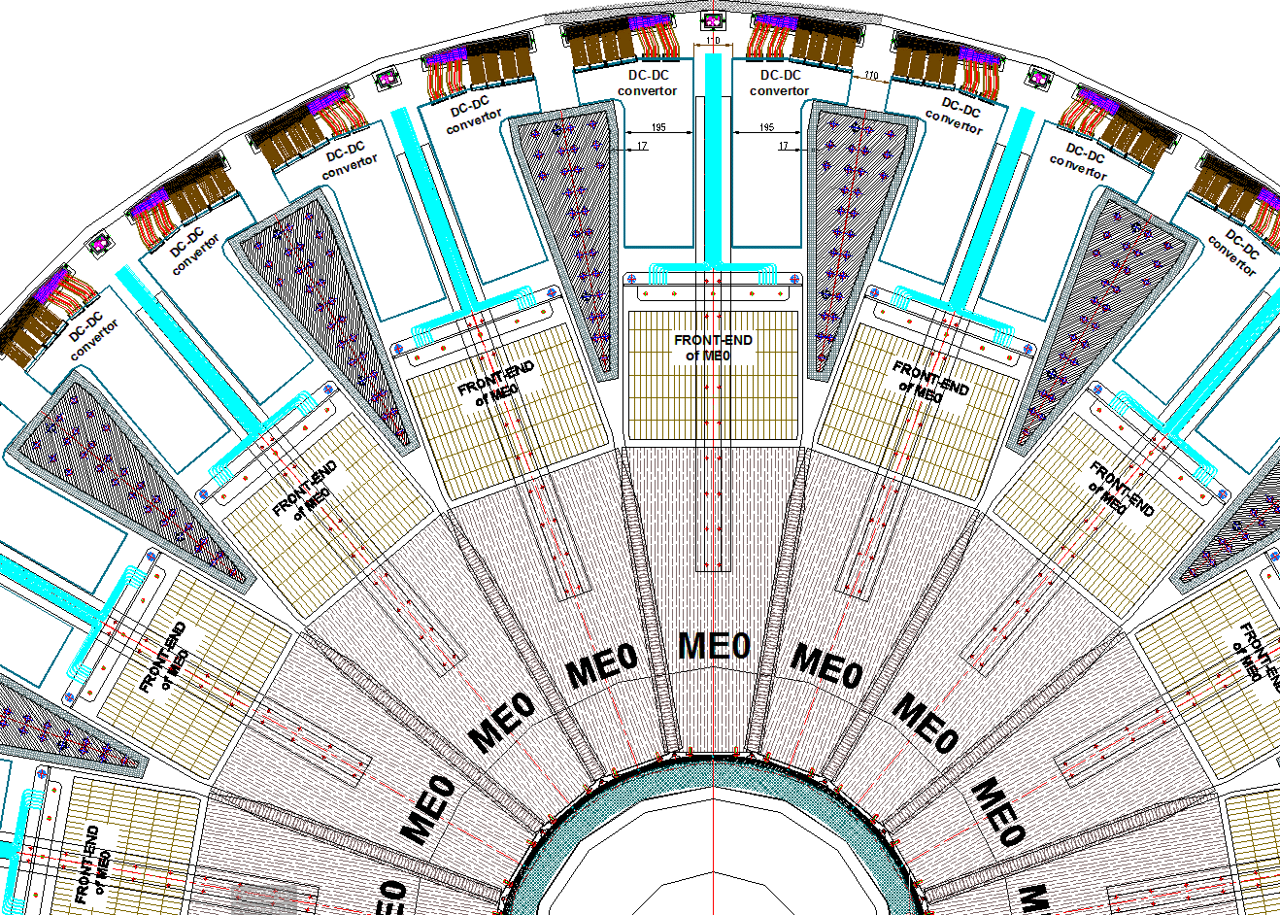
ME0 General View

Slide 28
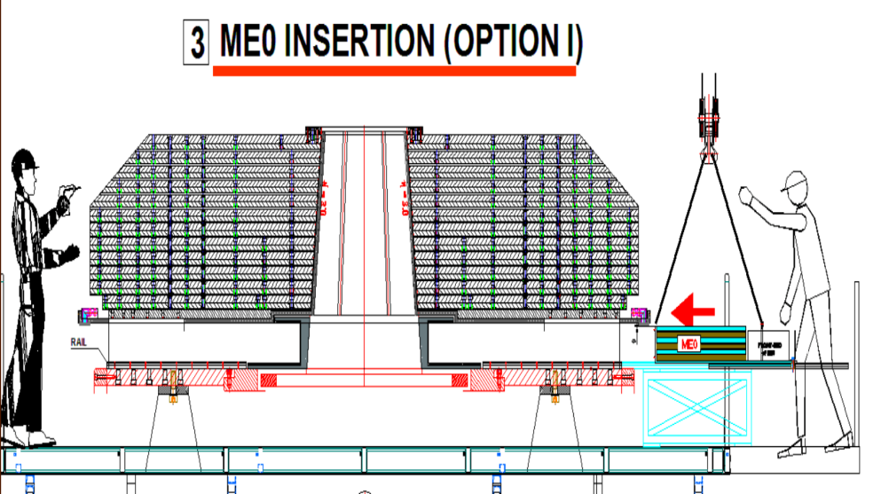
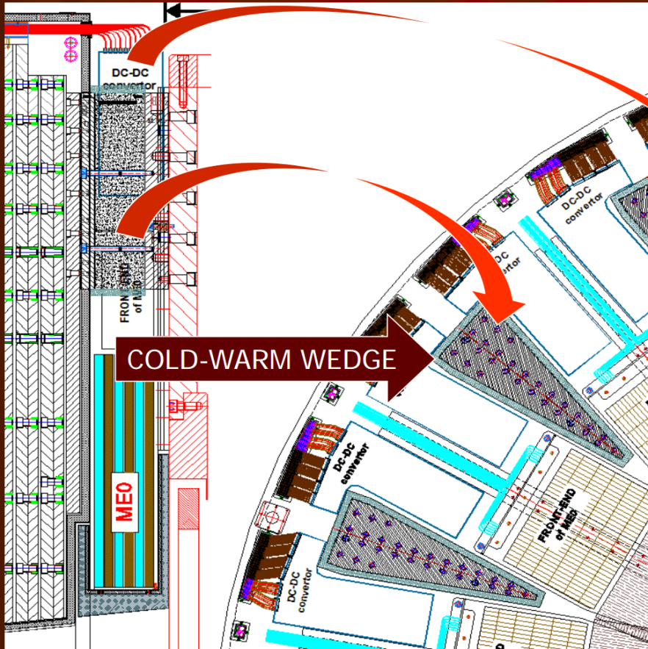
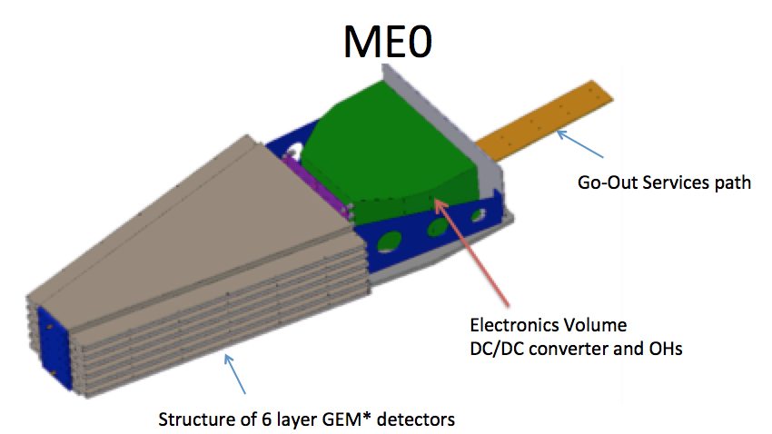
ME0 Services and integration
Surkov
BH/ interface area/ ME0 could be mounted at BD904 together before moving to p5.
Commissioning should be done in bd904 after insertion in HGC.
Challenge for services and integration: no access to the ME0 service after installation.
UXC rack space?
BD904
View from IP

Slide 29
ME0 production, commissioning and installation in LS3

Slide 30
Thank You

