Slide 1
CAEN LV BOARD Comparison for RPC Upgrade Project

Slide 2

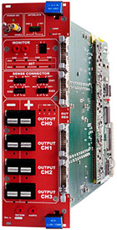
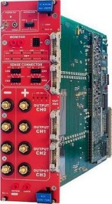

Model | A3025 | A3025B
No. of Channels | 4 | 4
Connectors | APP PC5933T | Bress hexagon head bolt
No. max of boards per crate | 5 | 5
Width (slots) | 4 | 4
Max power per channels | 150 W | 150 W
Iset/Imon resolution | 100 mA | 100 mA
Vset/Vmon resolution (mV) | 5 | 5
Current Full Scale (A) | 25 | 25
Voltage full Scale (V) | 2 ÷ 8 | 2 ÷ 8
Max Ripple (mVpp) | 10 | 10
Highlights | EASY Subsystem Power Supply Module Magnetic field and radiation tolerant 4 floating 2 ÷ 8 V / 25 A channels 150 W maximum output power per channel VMax and IMax set by trimmer for each channel On/Off for each channel Channels individually controlled and protected Line Drop Regulation on board panel Interlock capability 48 V Service local and remote on/off | EASY Subsystem Power Supply Module Magnetic field and radiation tolerant 4 floating 2 ÷ 8 V / 25 A channels 150 W maximum output power per channel VMax and IMax set by trimmer for each channel On/Off for each channel Channels individually controlled and protected Line Drop Regulation on board panel Interlock capability 48 V Service local and remote on/off Screw Lock output connectors

Slide 3
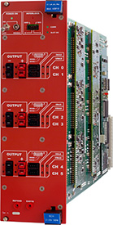
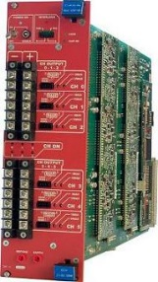
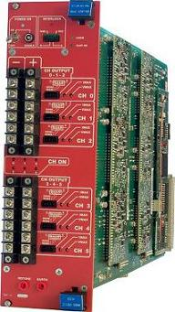
Model | A3016 | A3016B
No. of Channels | 6 | 6
Connectors | APP 1317G4 | Bress hexagon head bolt
No. max of boards per crate | 5 | 5
Width (slots) | 4 | 4
Max power per channels | 90 W | 90 W
Iset/Imon resolution | 10 mA | 10 mA
Vset/Vmon resolution (mV) | 5 | 5
Current Full Scale (A) | 16 | 16
Voltage full Scale (V) | 2 ÷ 8 | 2 ÷ 8
Max Ripple (mVpp) | 20 | 20
Highlights | EASY Subsystem Power Supply Module Magnetic field and radiation tolerant 6 floating 1.5 ÷ 8 V / 16 A channels 90 W maximum output power per channel VMax and IMax set by trimmer for each channel On/Off for each channel Channels individually controlled and protected Interlock capability 48 V Service local and remote on/off | EASY Subsystem Power Supply Module Magnetic field and radiation tolerant 6 floating 1.5 ÷ 8 V / 16 A channels 90 W maximum output power per channel VMax and IMax set by trimmer for each channel On/Off for each channel Channels individually controlled and protected Interlock capability 48 V Service local and remote on/off Screw Lock output co

