Slide 1
LV installation on RE+4/1
Ian with input from Anton. Yan Ivan and Ian
Oct 2109

Slide 2
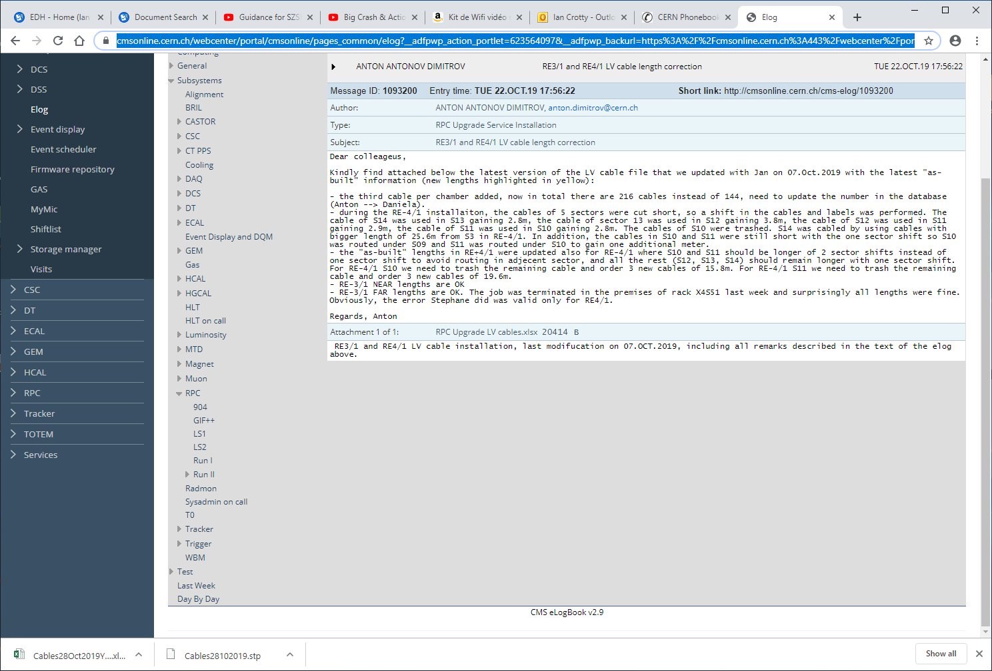

Slide 3
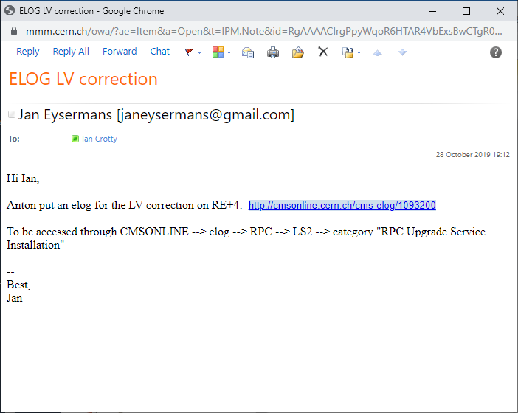

Slide 6
https://cmsonline.cern.ch/webcenter/portal/cmsonline/pages_common/elog?__adfpwp_action_portlet=623564097&__adfpwp_backurl=https%3A%2F%2Fcmsonline.cern.ch%3A443%2Fwebcenter%2Fportal%2Fcmsonline%2Fpages_common%2Felog%3FMedia-Type%3Dscreen%26Media-Feature-Scan%3D0%26Media-Feature-Orientation%3Dlandscape%26Media-Feature-Device-Height%3D1080%26Media-Feature-Height%3D878%26_afrWindowMode%3D0%26Media-Feature-Monochrome%3D0%26Font-Size%3D16%26Media-Feature-Color%3D8%26Media-Featured-Grid%3D0%26_afrLoop%3D1027225974785820%26Media-Feature-Resolution%3D96%26Media-Feature-Width%3D1486%26Media-Feature-Device-Width%3D1920%26Media-Feature-Color-Index%3D0%26Adf-Window-Id%3Dw1%26__adfpwp_mode.623564097%3D1&_piref623564097.strutsAction=%2FviewSubcatMessages.do%3FcatId%3D891%26subId%3D1631%26page%3D1

