Slide 1
Power Pole Connectors
31 July 2018

Slide 2
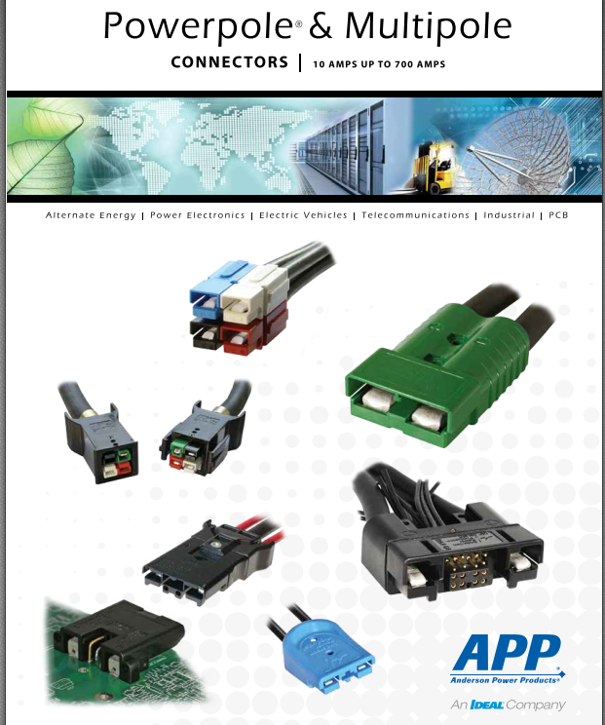
https://www.andersonpower.com/_global-assets/downloads/pdf/cat-ppmp.pdf
Catalogue of 124pages !

Slide 3
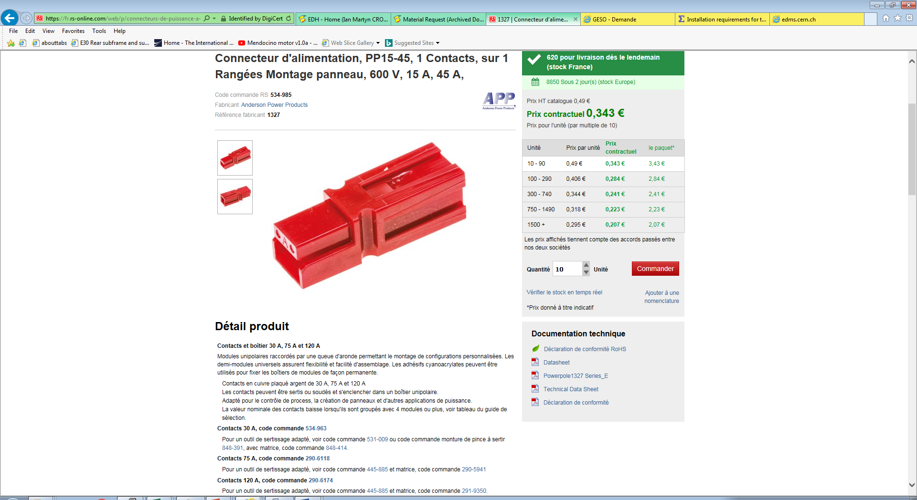

Slide 4
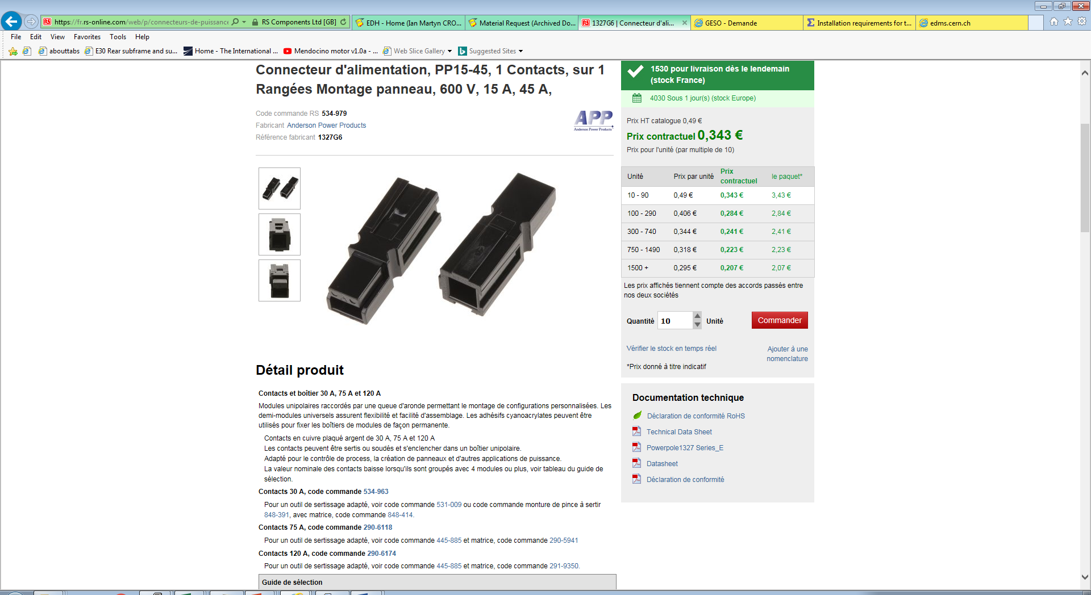

Slide 5
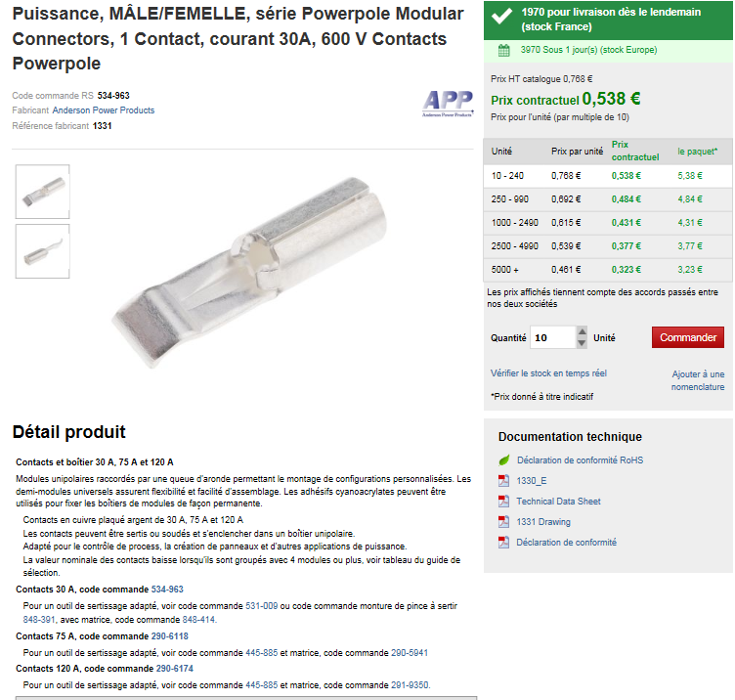
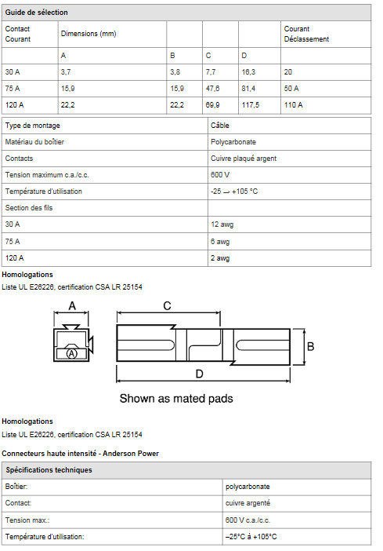

Slide 7
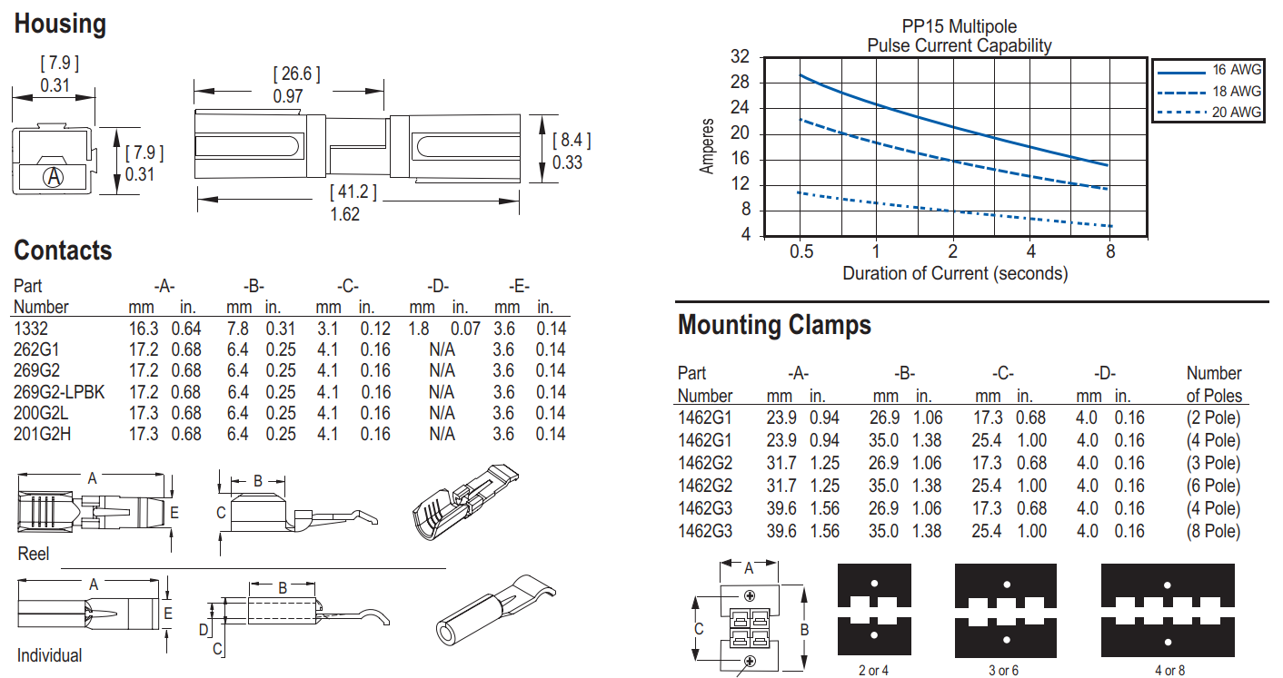
https://www.connector-techals.com.au/media/wysiwyg/pdf/APP-Singlepole.pdf

Slide 8
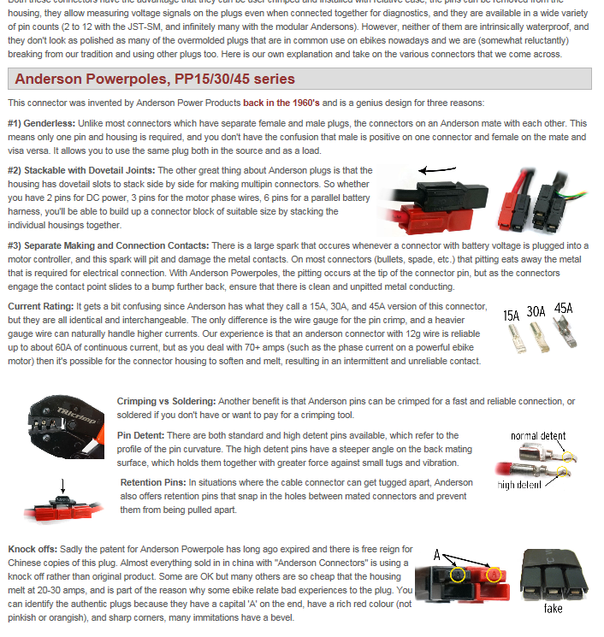
http://www.ebikes.ca/learn/connectors.html

Slide 9
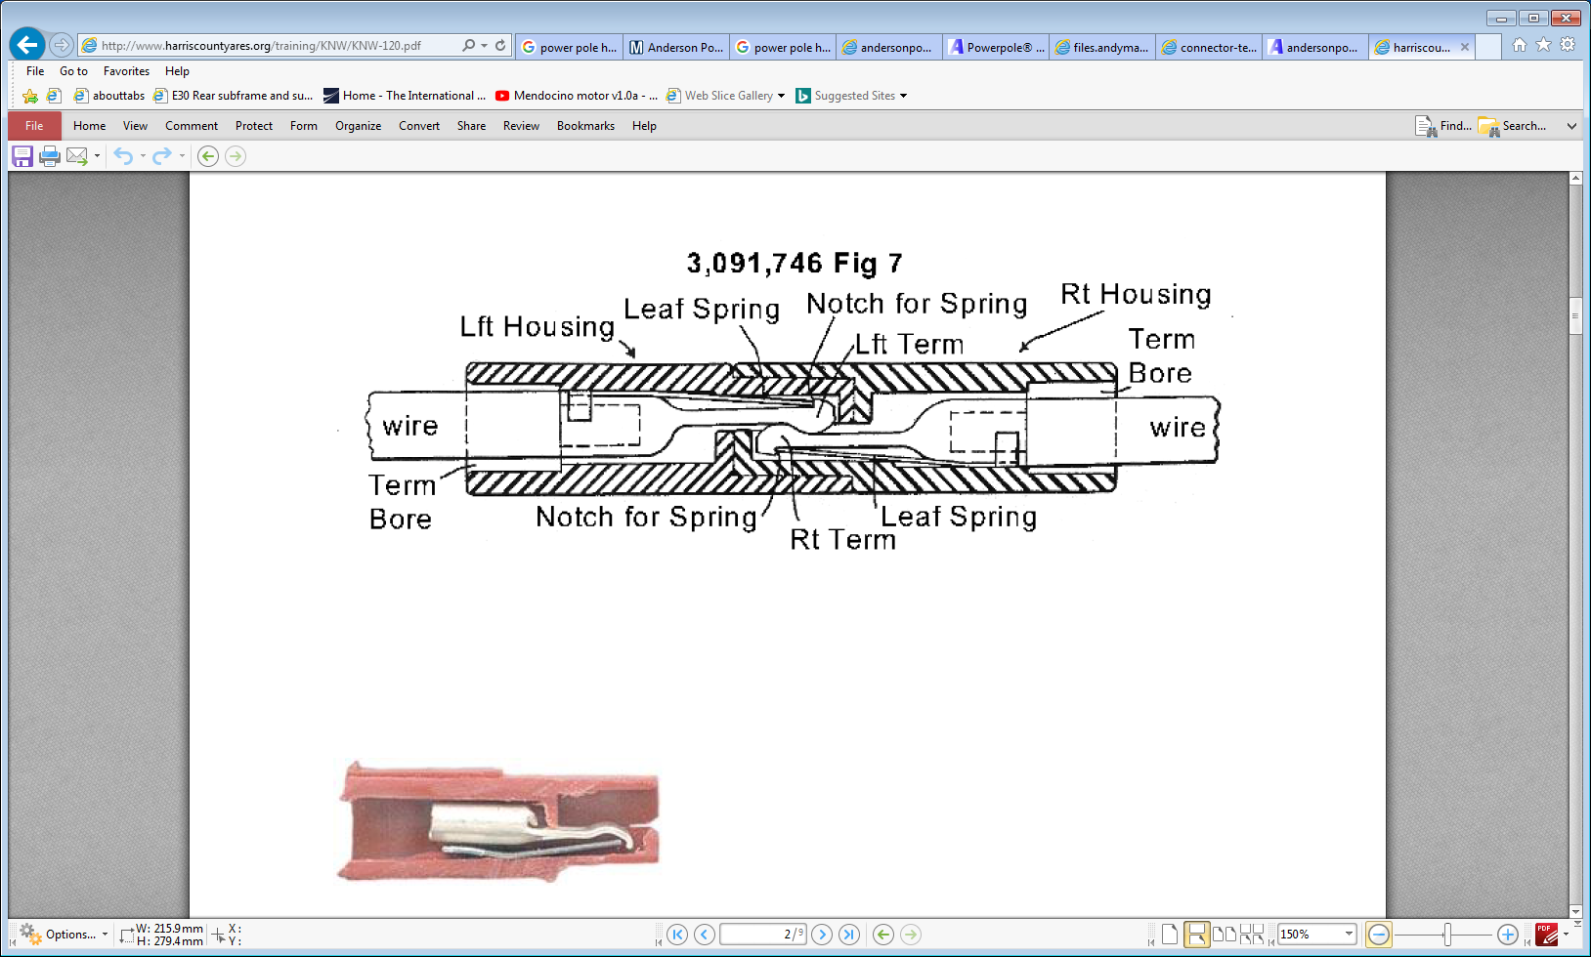
http://www.harriscountyares.org/training/KNW/KNW-120.pdf
Good practical doc on assembly

