Slide 1
LV Connecters
Ian based on input from Christoph
5 July 2018

Slide 2
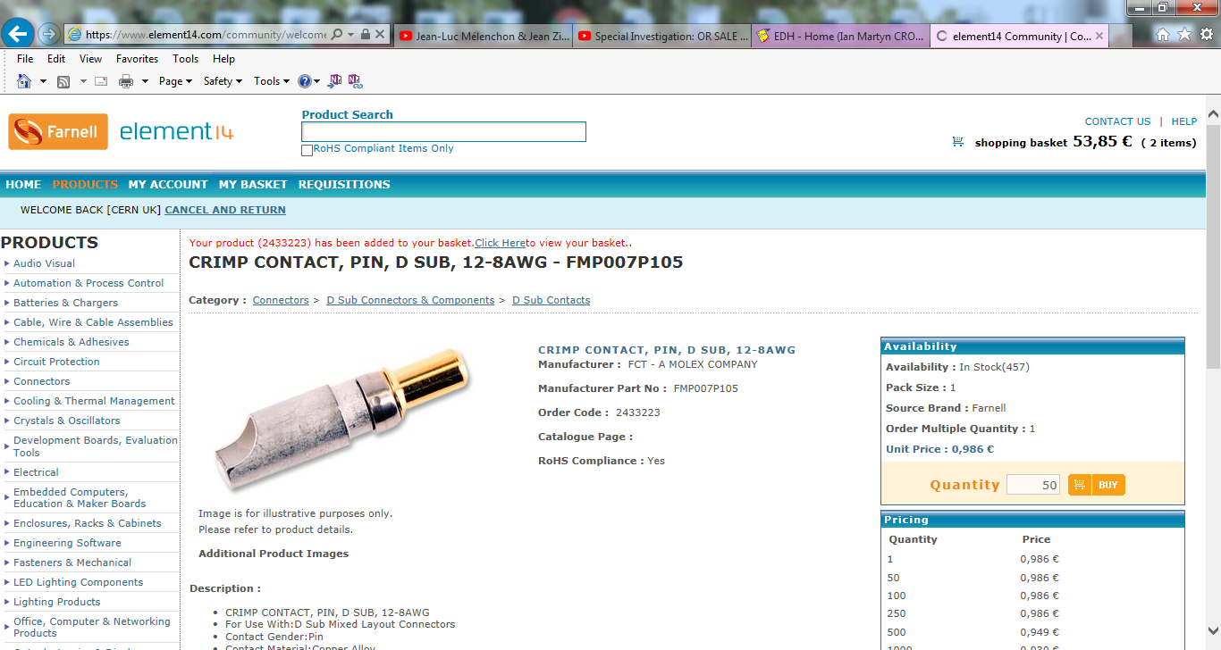
Farnell 2433223

Slide 3
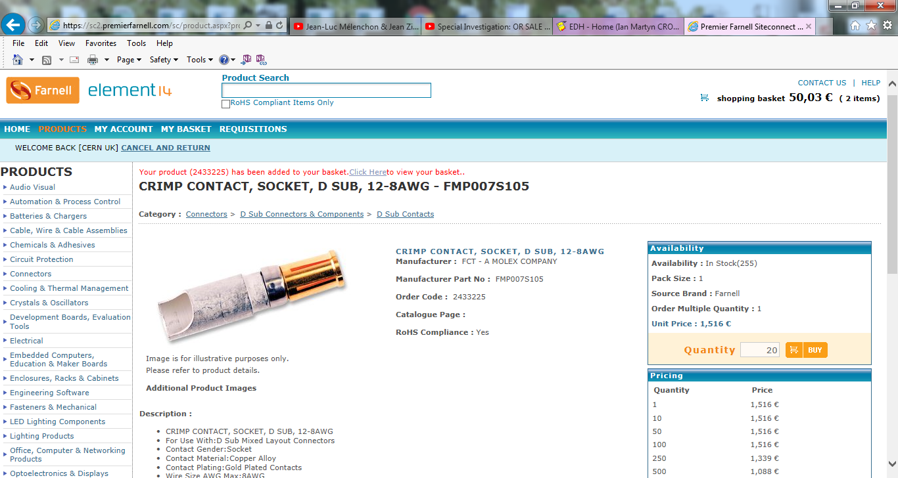
Farnell 2433225

Slide 4
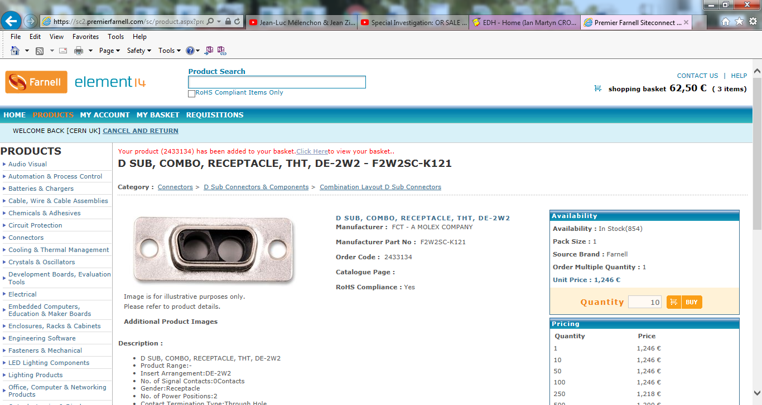
farnell 2433134

Slide 5
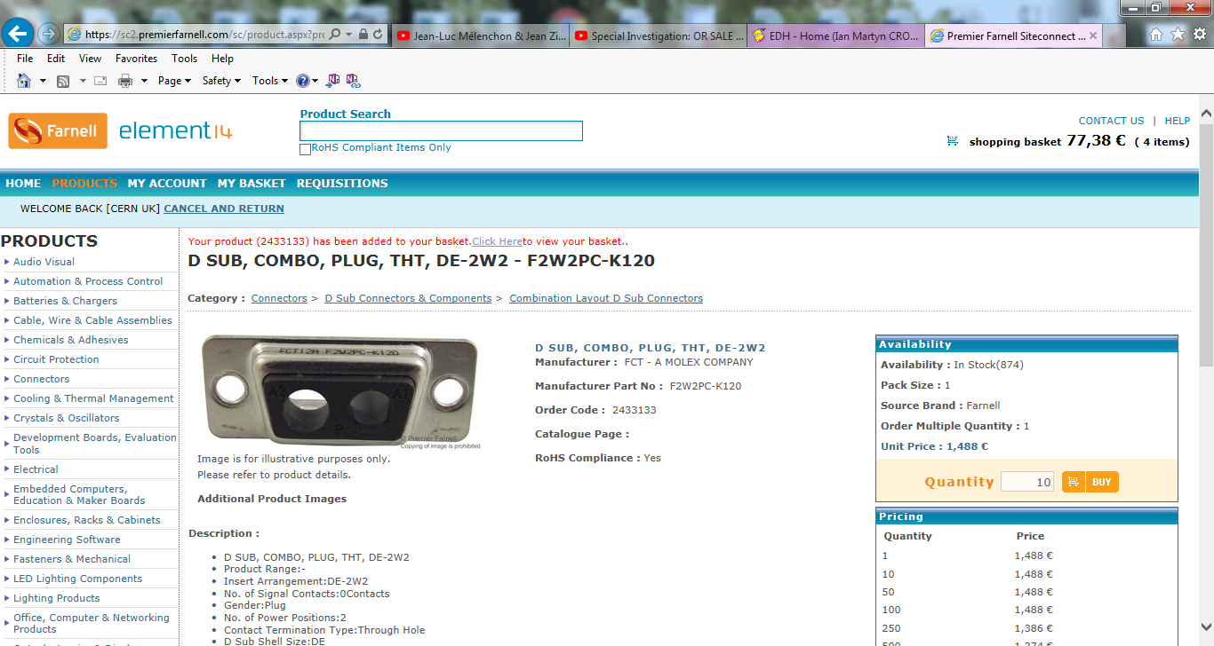
Farnell 2433133

Slide 6
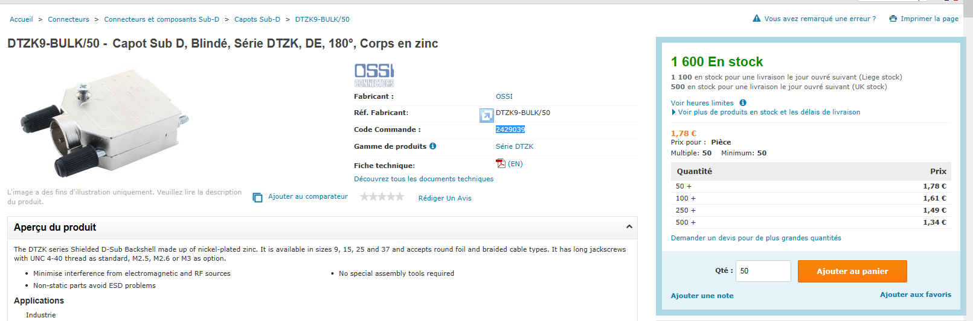
Capot
Farnel 2429039, recommended by Christoph
Radio Spares 4477347

Slide 7
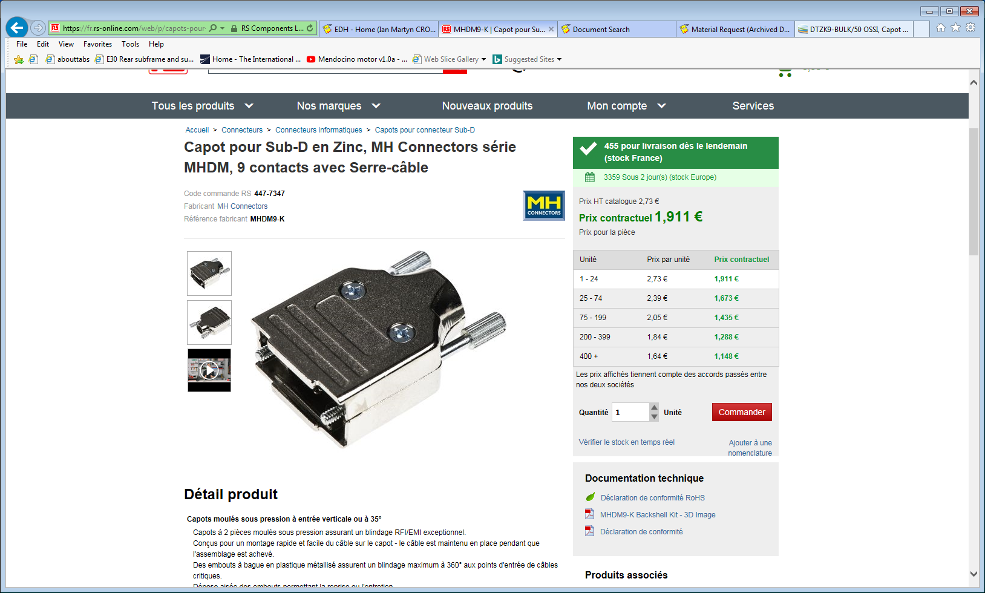

Slide 8
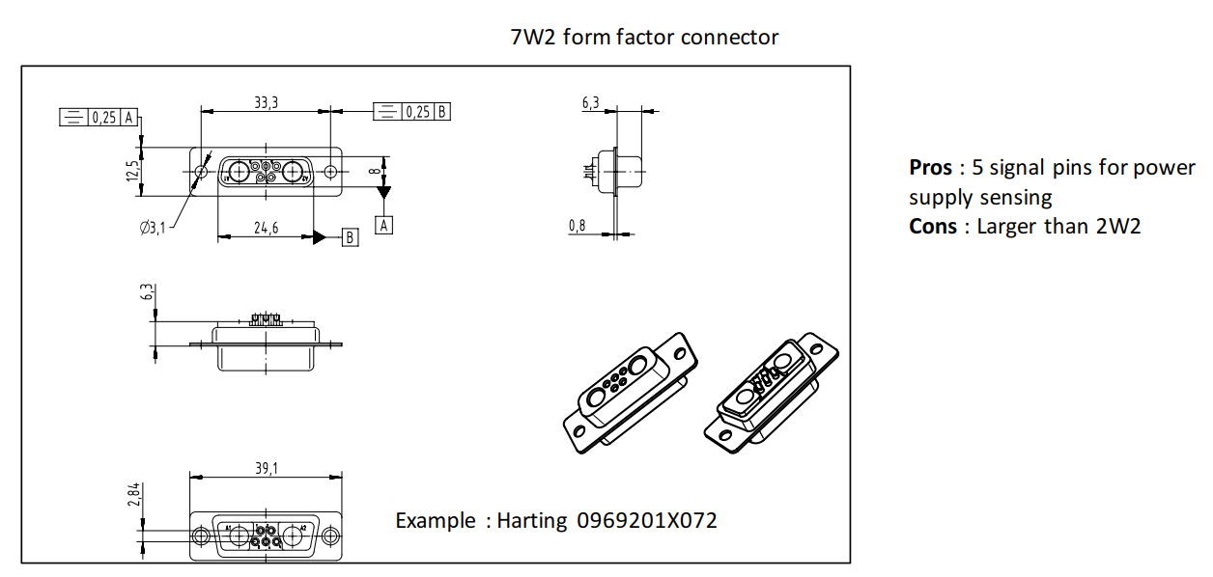
Connecters with sense wires on Chamber End
From Christoph

Slide 9
Cables that fit the connectors

Slide 10
Sense wires connecters on the CAEN PS 3009
AMP 280359-0
AMP.182206-2
Dear Ian,
09 July 2018 17:59
I checked that the sense wire connectors recommended by CAEN are:
AMP connector AMP 280359-0 with 2 pins AMP.182206-2
I checked with Karol that what we have used in the past for the Link system was
2329959 Prise Femelle 4 CTS AMP MODU
2330038 CONTACTS A SERTIR 26-22 AWG
Fourn. RADI91
I took few connectors, but Karol was not sure which was the crimping tool. We can try in Wednesday when Christphe comes.
Regards, Anton

Slide 11
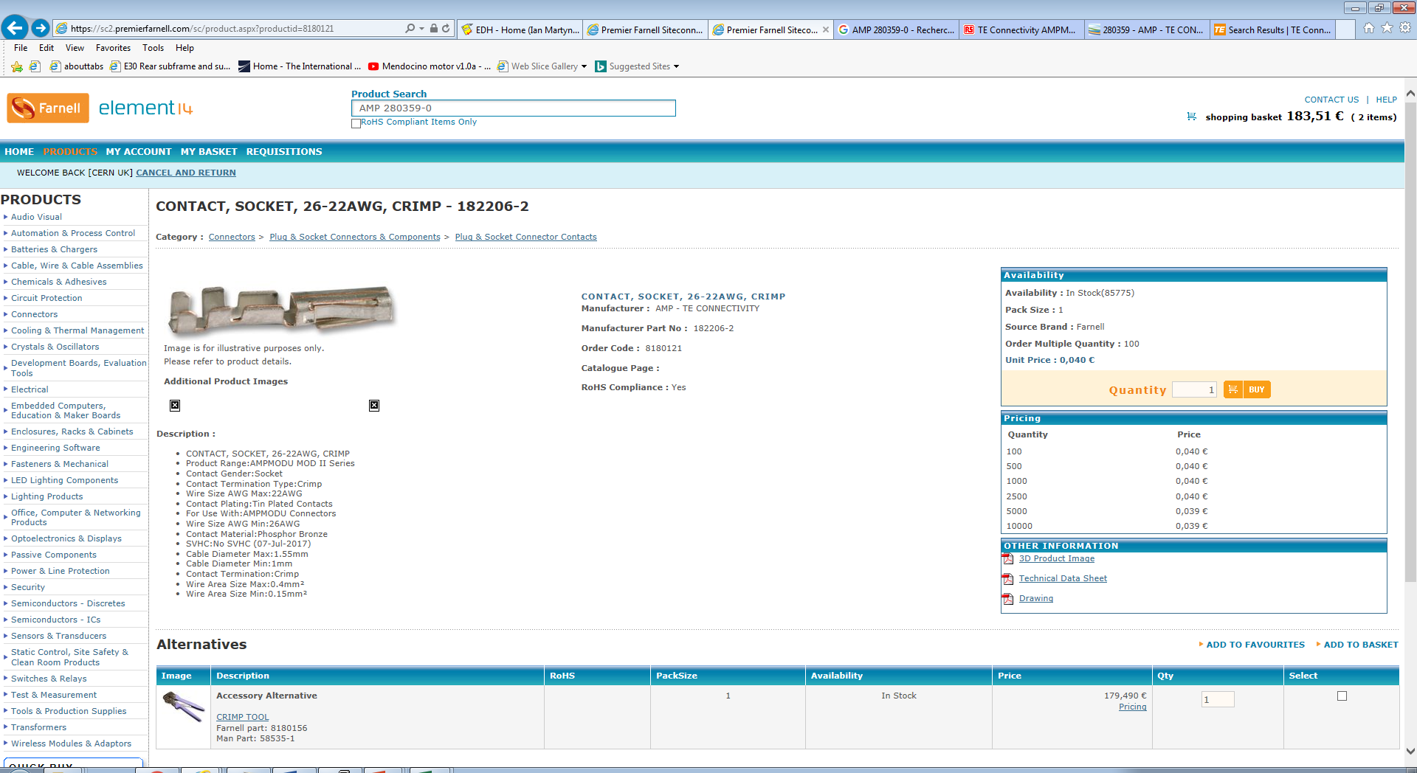
https://sc2.premierfarnell.com/sc/product.aspx?productid=8180121

Slide 12
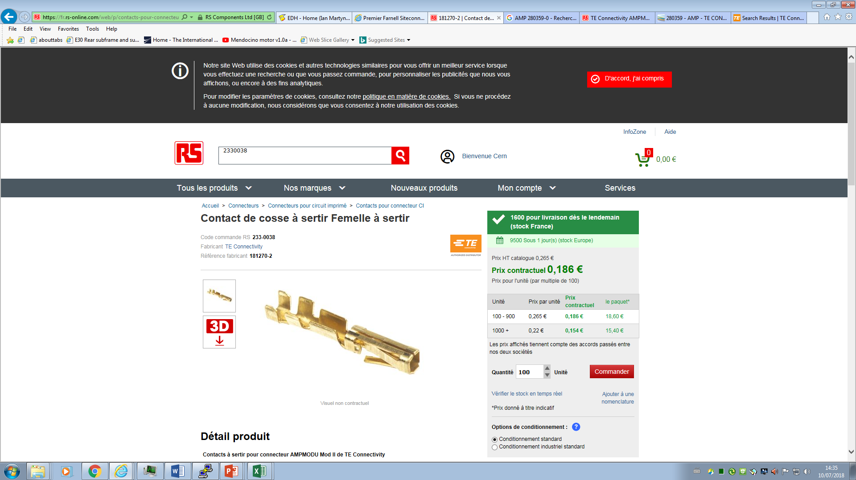
Anton found RS 232 -9959
In P5 for the tests

Slide 13
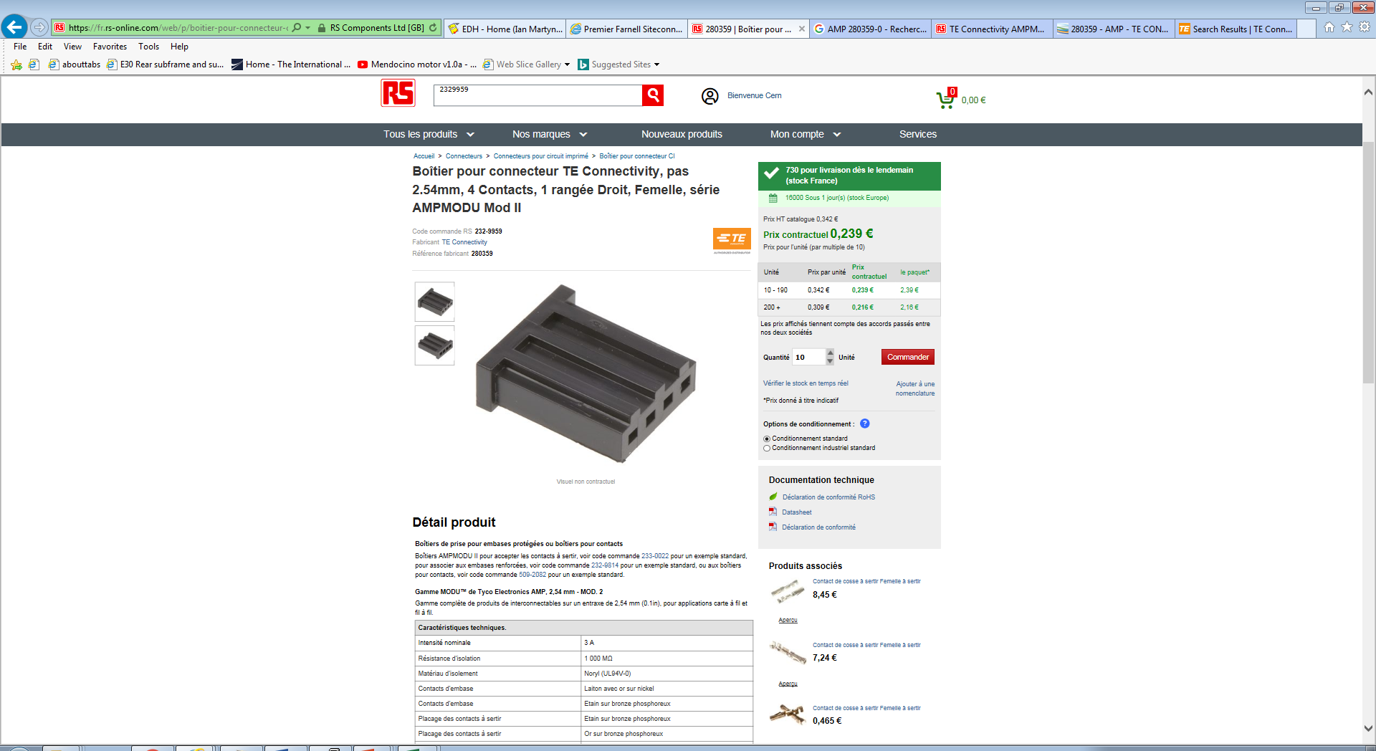

Slide 14
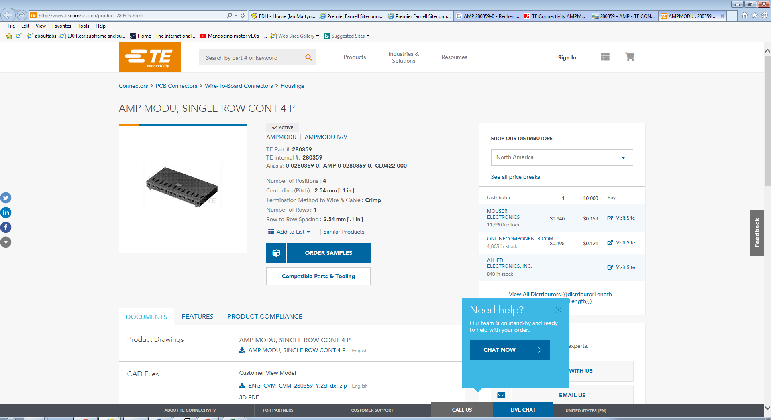
http://www.te.com/usa-en/product-280359.html

Slide 15
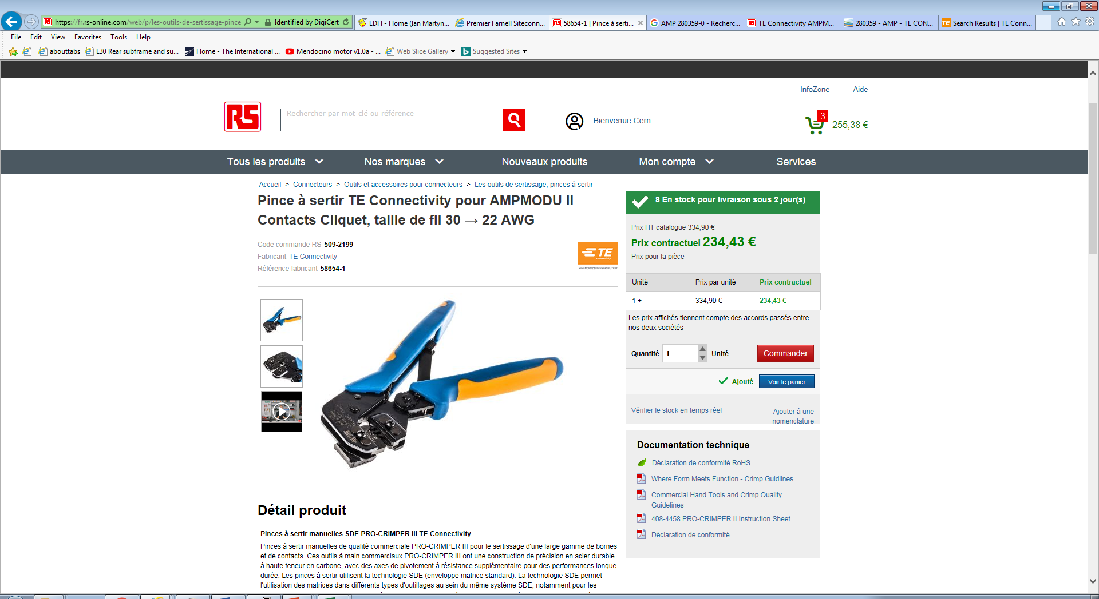

Slide 16
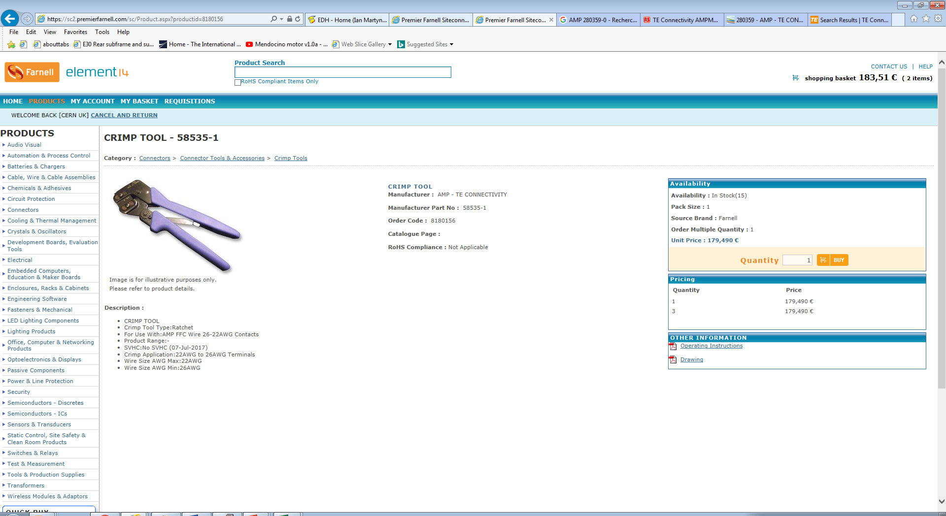
https://sc2.premierfarnell.com/sc/Product.aspx?productid=8180156
179.5Euro

Slide 17
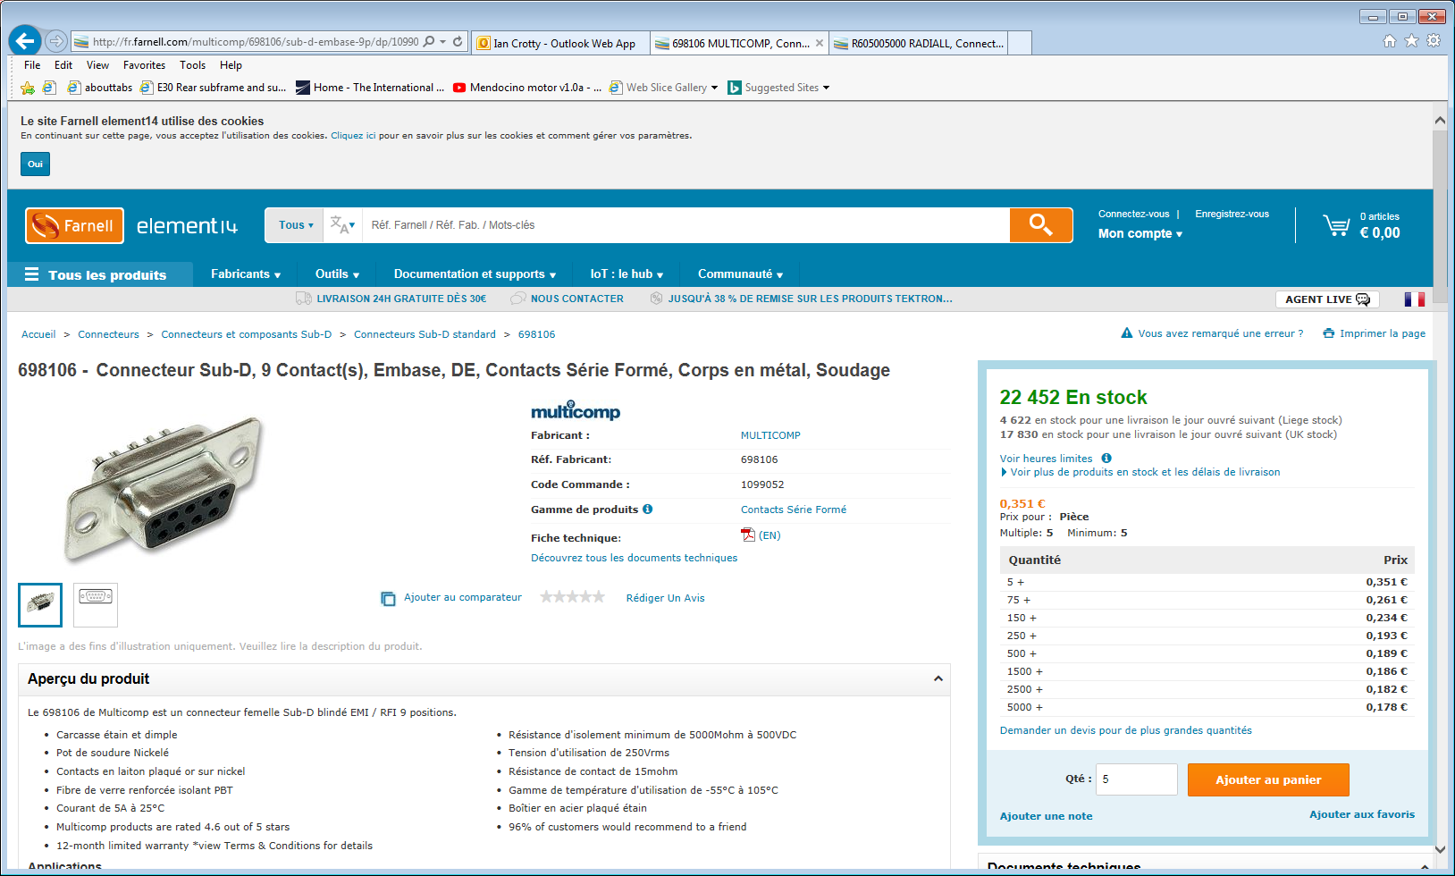
Alternate Sense wire connection FEB end Christoph 18July 2018
http://fr.farnell.com/multicomp/698106/sub-d-embase-9p/dp/1099052

Slide 18
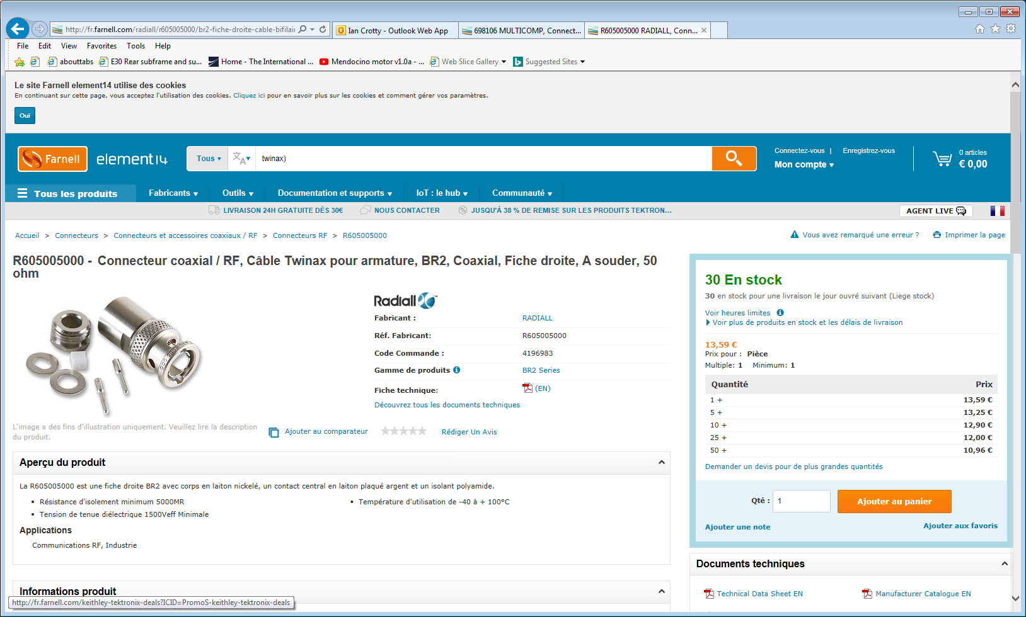
http://fr.farnell.com/radiall/r605005000/br2-fiche-droite-cable-bifilaire/dp/4196983?st=twinax)

