Slide 1
LV for new FEB for RE3/1 and RE4/1. Some notes from Colleagues.
Ian
13 June 2018

Slide 2
Assume the PS are in the X2 and X4 racks
Estimate cable length from racks to chamber is ~ 10m
18 chamber / station
4 stations
800m
See calculations for the RE3/2 and RE4/2

Slide 3
IS23 and IS41
There is a new norm out but few know. It will include a fire test.
Could contact Fritz (Tel; 164030 friedrich.szoncso@cern.ch ) help ?

Slide 4
Advice from Magnus Hansen, tel. conversation 13 June 2018
16A needs 4mm2 for a 10m cable
Example for house installation 20A is 2.5mm2
ECAL 60A uses 50mm2 for 25m cable
Factor 2 as you are running at full power
Buy from CERN stores, NOT CERN EDH purchase request !
Greatest influence is whether you can connect it to the connectors at each end.

Slide 5
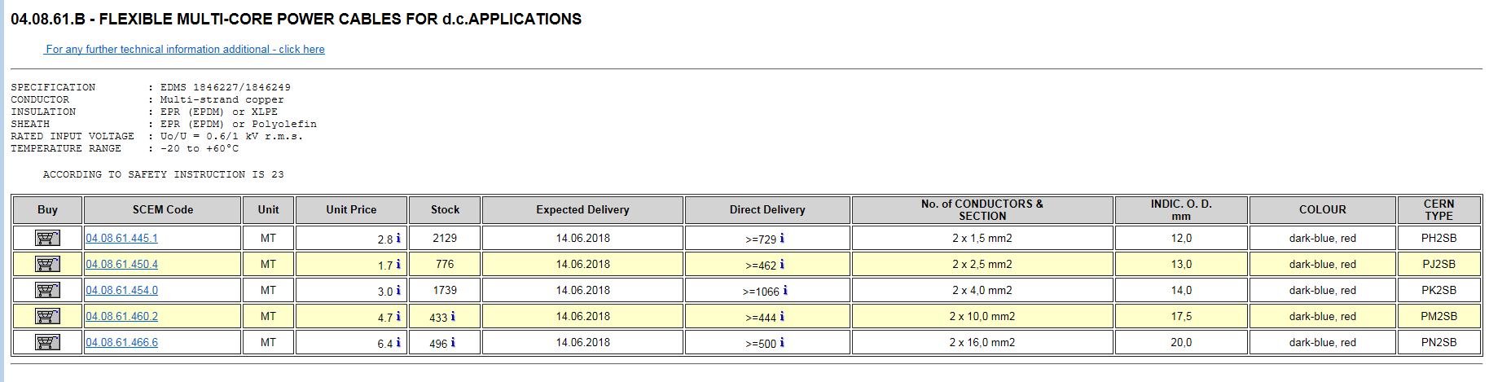
Taking advice from M. Hansen
But it is not shielded !

Slide 6
GEM as an example
The biggest cable that will fit the connector (in the PS)
35m long cables
AWG = 3.3mm2
6.0 – 6.5V available on the load
Current = 5A
Resistance /km = 5.2 [Ohm/km]
Approx 1V drop, remember that you go to the load and back gives 1.82V total drop
Max approx. 40W/chamber ( 6.0V + 1.82V) X 5A = 39.1W
Novacavi special order
IS 23 and IS41 together
3 month delivery though Napoli

Slide 7
If sense wires are required, despite the large increase in x-section,
can they be run in a separate cable alongside the power cable ?
Anton tells use that CAEN do not think that running the 3016 (ie 16A ) at 15 Amps is a good reliable idea.
They propose the A3025 (ie 25 A) 150 W and 4 Channel

