Slide 1
Cables trails
July 2018
Ian

Slide 2
Cables purchased for trials with CAEN PS and Lyon FEB
EDH 7345400 04.08.82.040.2 CABLE CU CEM DC 2x4.0 mm2
04.21.51.102.4 CAB.SIG.BL. 2x0,50mm2
EDH 7346271 04.21.60.300.9 CAB.RS485 PROFIBUS-PA 1 P Blue
FARNELL 1743951 CABLE, 16AWG, 2 CORE, BLACK, 30.5M Black
04.08.82.015.2 CABLE CU CEM DC 2x1,5 mm2

Slide 3
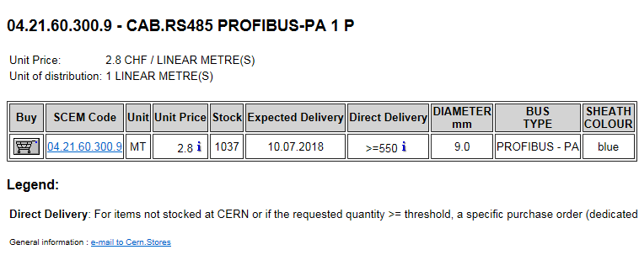

Slide 4
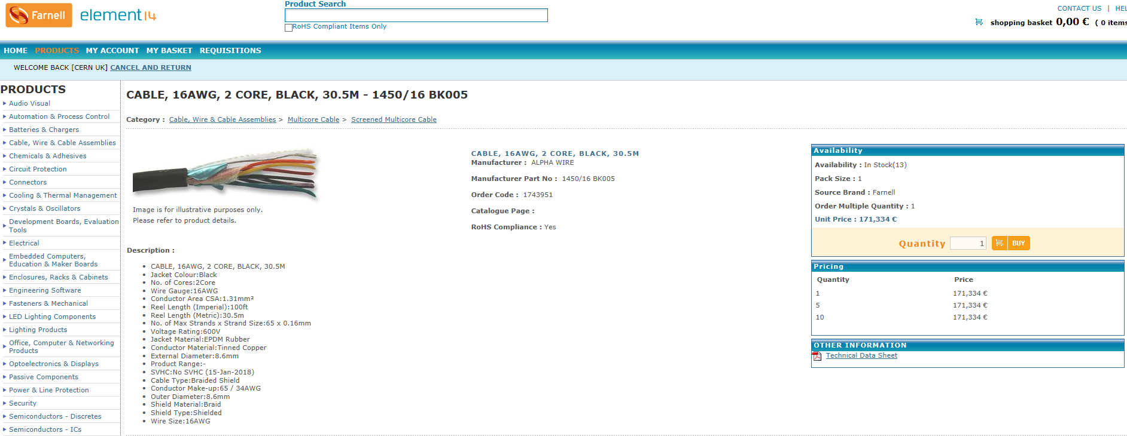
6.6chf/m

Slide 6
GEM cables

Slide 7
LV Link Board cable

