Slide 1
As routed cables for RE-3/1 on Yoke face
July 2020
Ian

Slide 2
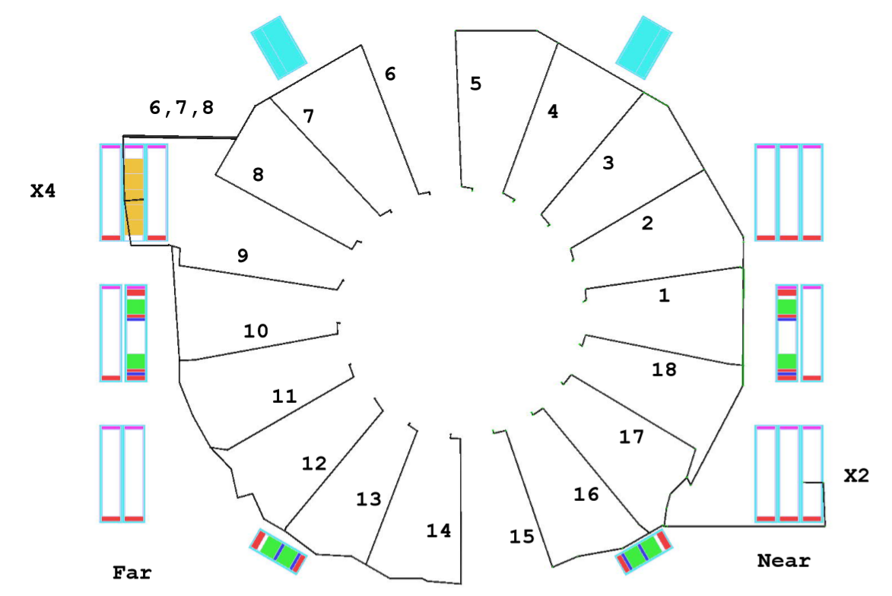
RE-3/1/06
RE-3/1/05
RE-3/1/07
RE-3/1/04
RE-3/1/08
RE-3/1/03
RE-3/1/02
RE-3/1/09
RE-3/1/01
RE-3/1/10
RE-3/1/18
RE-3/1/11
RE-3/1/17
RE-3/1/12
RE-3/1/13
RE-3/1/16
RE-3/1/14
RE-3/1/15

Slide 3
Some notes on ;
Gas piping not secured
Gas piping periphery
Short cuts for OF

