Slide 1
HV installation in UXC & USC for RE3/1 & RE4/1
Schematic
Ian
3 June 2021
Updated 11 March 2022

Slide 2
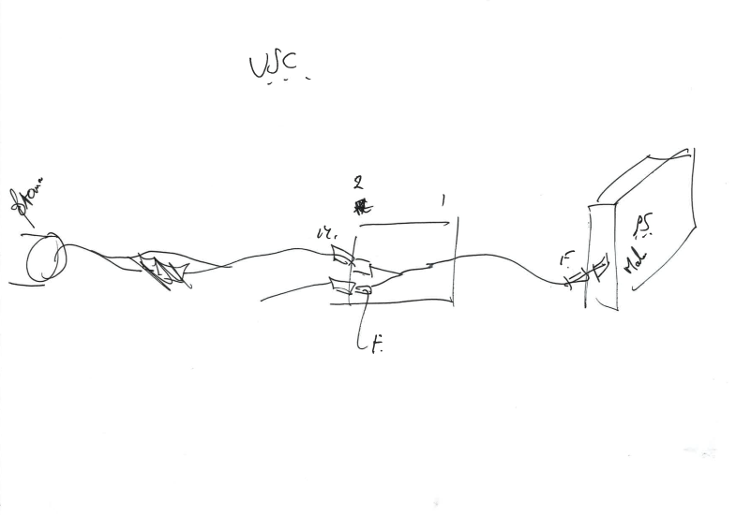
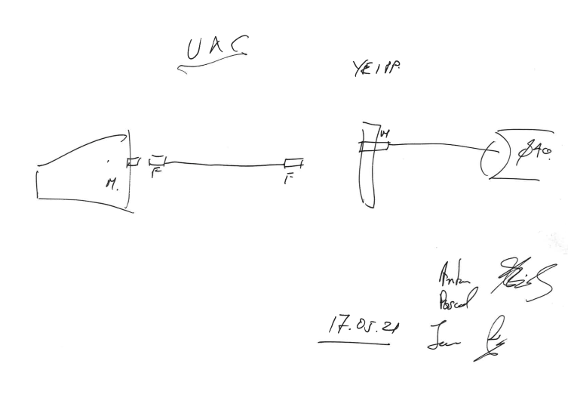
The layout with application & gender definition. Agreed.

Slide 3
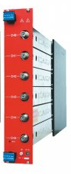
The layout with application & gender definition.
UXC55
USC55
Female. Cab.
Female. Cab.
Male. Ch.
Male. Cab.
Male. Ch.
Female. Ch.
HV Dist. Box
Female. Cab.
Umbilical dia. 40mm
YE1 PP
Ch. = Chassis
Cab. = Cable

Slide 4
Pin out for Umbilical cable
Top Gap
1
2
Jupiter Male Cable (USC) or Male Chassis (UXC)
3
4
Bottom Gap

Slide 5
Order for the entire upgrade for RE3/1 and RE4/1
 |  |  |  |  |  |  | Ian
 |  |  |  |  |  |  | 28-May-21
 |  | Umbilical |  |  | Distbox
 |  | USC | UXC |  | box | cable
 |  | male Cab | Male Ch |  | Female Ch | Female Cab |  |  | Cab = Cable
 |  |  |  |  |  |  |  |  | Ch = Chassis
 | 1 Chamber | 2 | 2 |  | 2 | 1
 | RE3/1 | 36 | 36 |  | 36 | 18
 | RE4/1 | 36 | 36 |  | 36 | 18
 | Both endcaps | 144 | 144 |  | 144 | 72
 | Spares 20% | 173 | 173 |  | 173 | 86

Slide 6
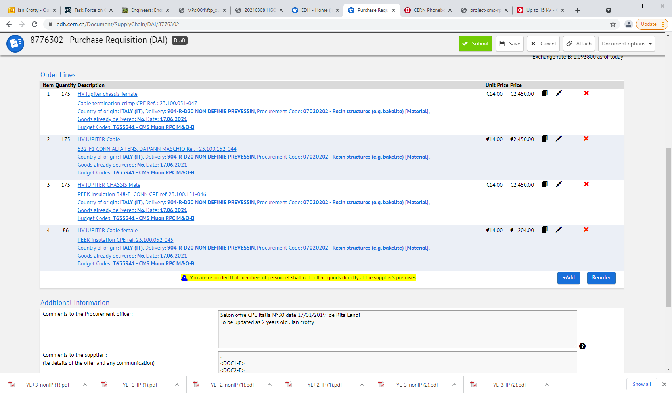
Monobloc
Crimp
Missing 10 March 2022
Monobloc
Crimp

Slide 7
Materials and tooling necessary for Connector assembly

Slide 8
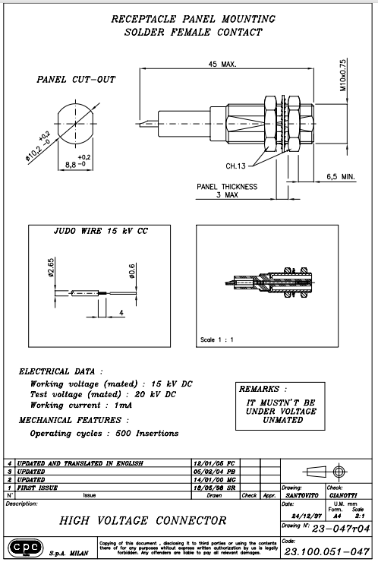
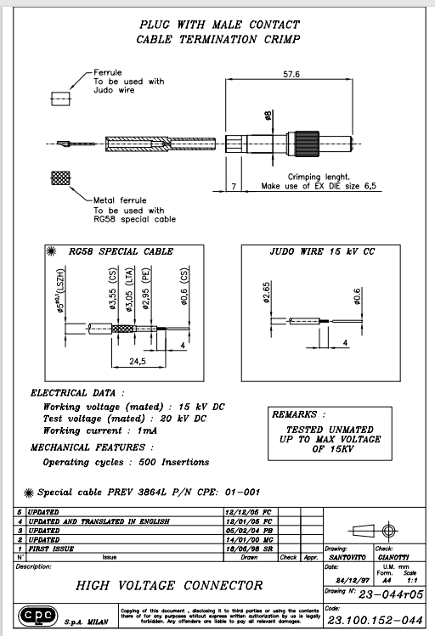
Line 01 in EDH
23.100.051-047
Line 02 in EDH
23.100.152-044
Missing 10 March 2022

Slide 9
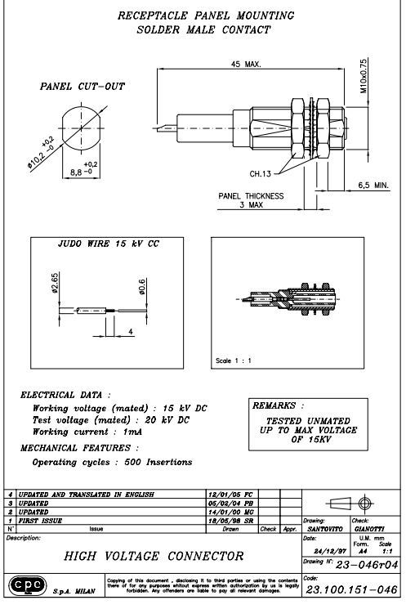
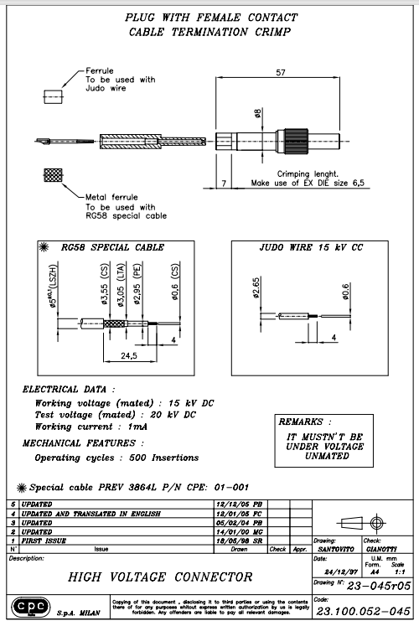
Line 03 in EDH
23.100.151-046
Line 04 in EDH
23.100.152-044

