Slide 1

Patch Panel Connecter System
Lachavanne Theo

Slide 2
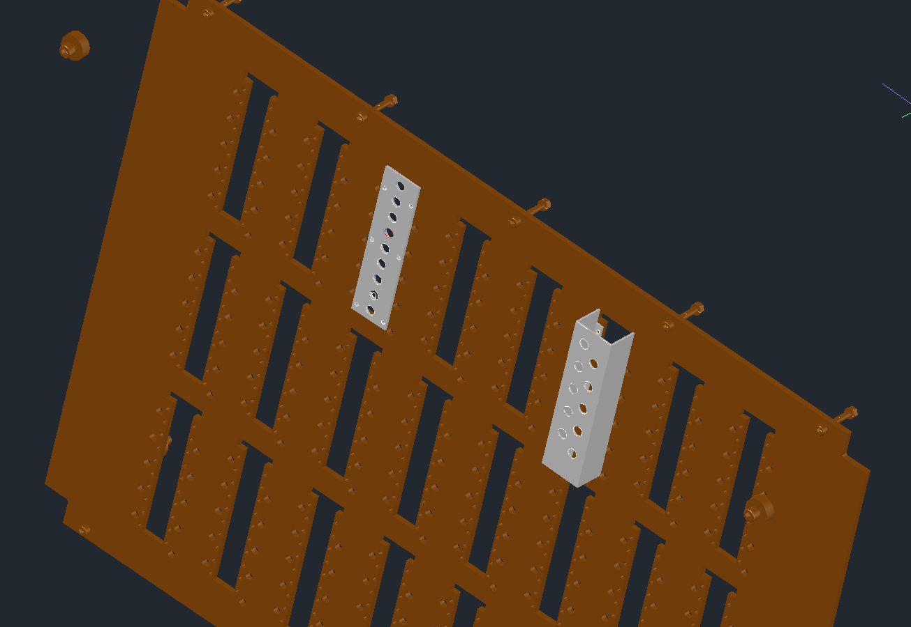
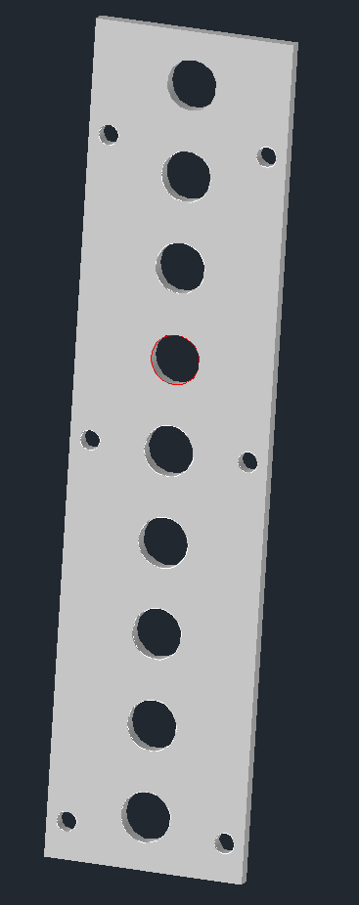
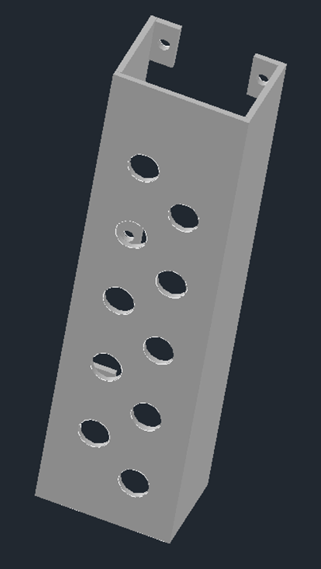
- Two systems
- The first Idea: simple plate, 9 holes (connecters).
- Second design: a U profile who can fit 10 holes.
Both idea reuse hole on the PP to fix them.
Both will probably use 2mm aluminium sheet.

Slide 3
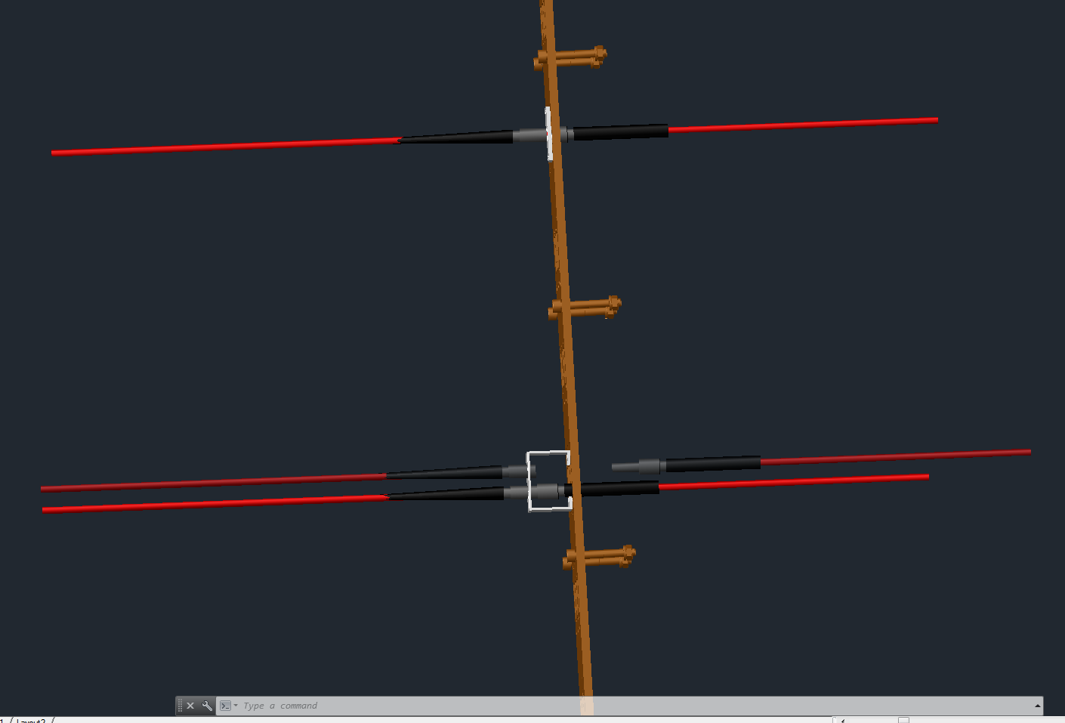
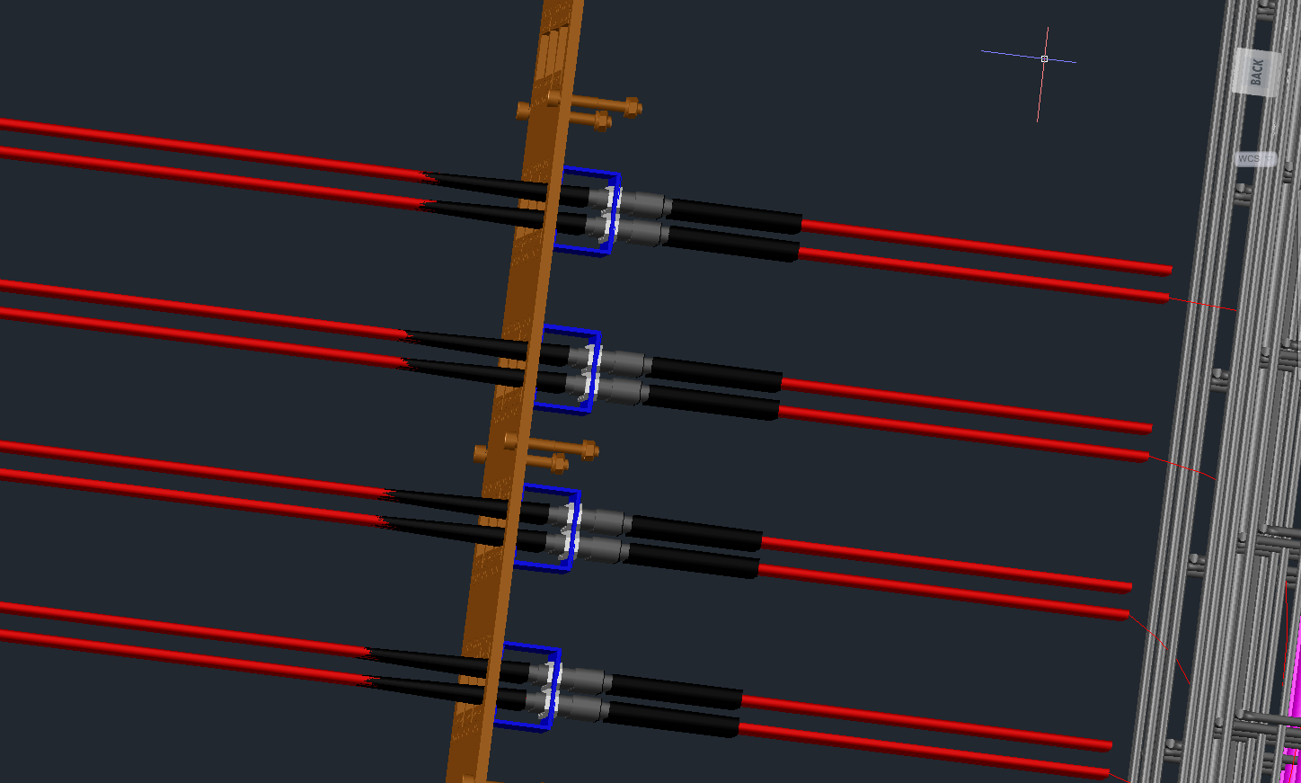
- With Cables assembly or not
- I think, with this position, it’s easier to install, but need confirmation.

Slide 4
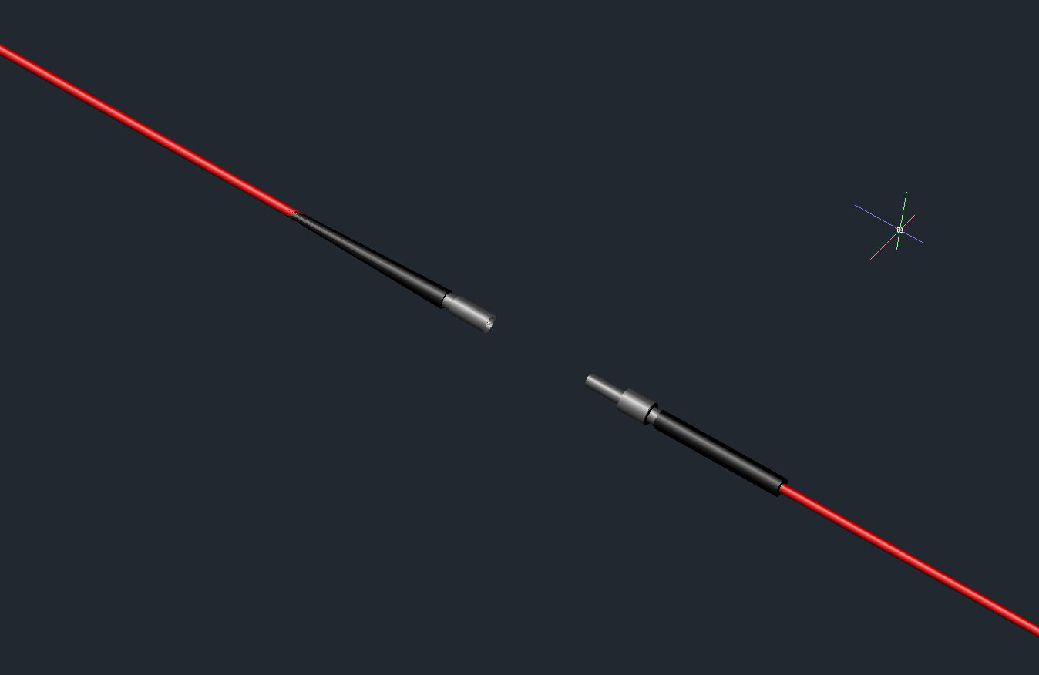
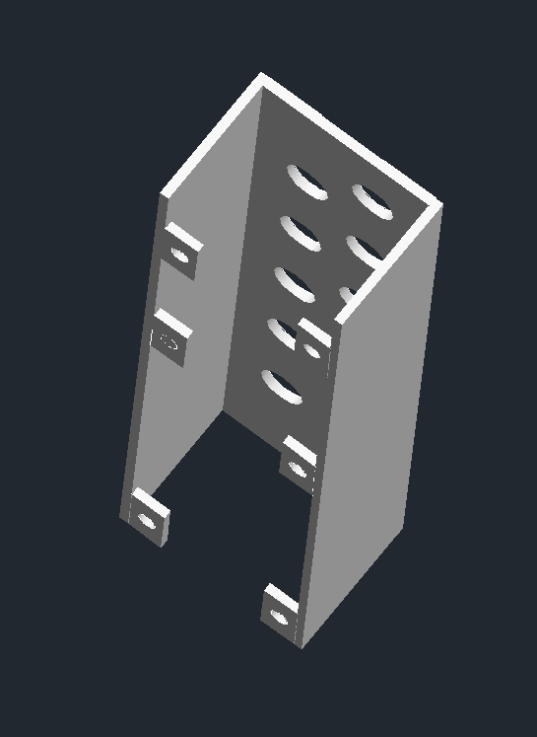

- 3D model of 5∅mm cable
Back view
- Nut of the connecter in 3D representation.

Slide 5
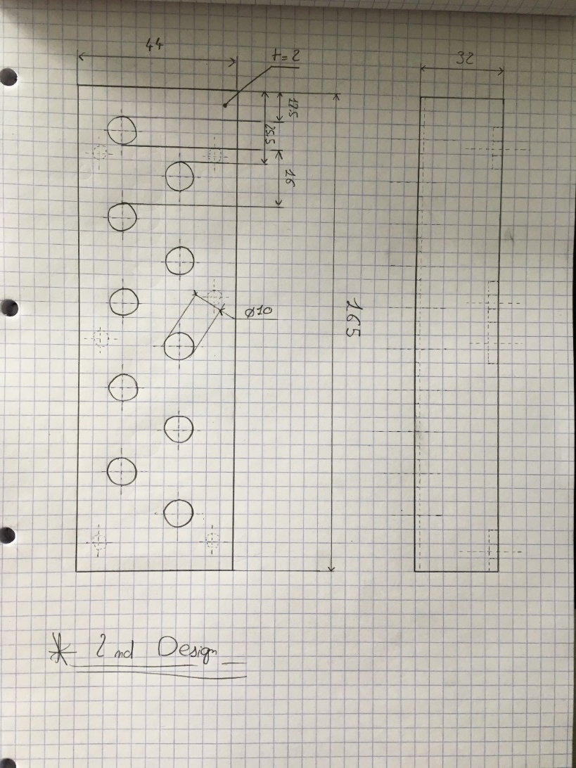
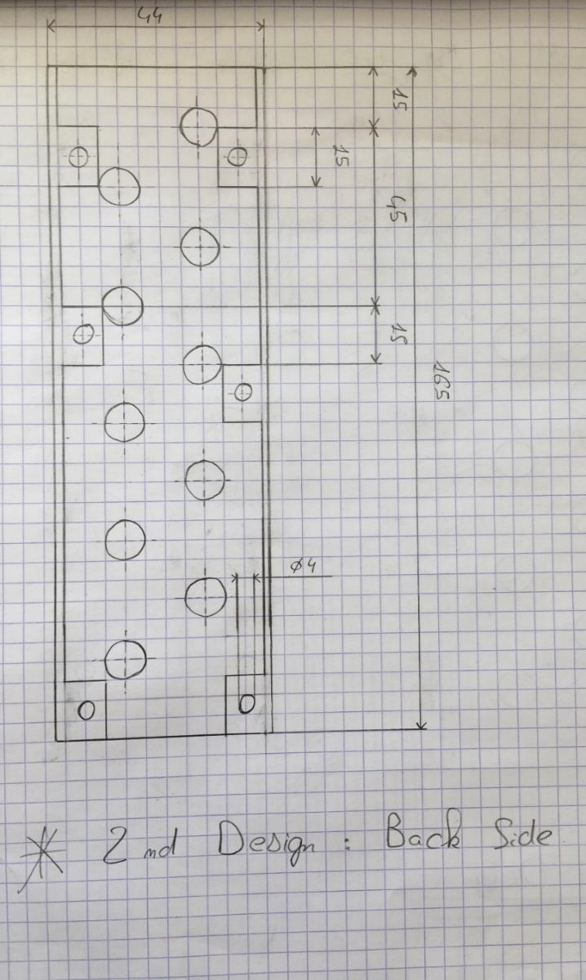
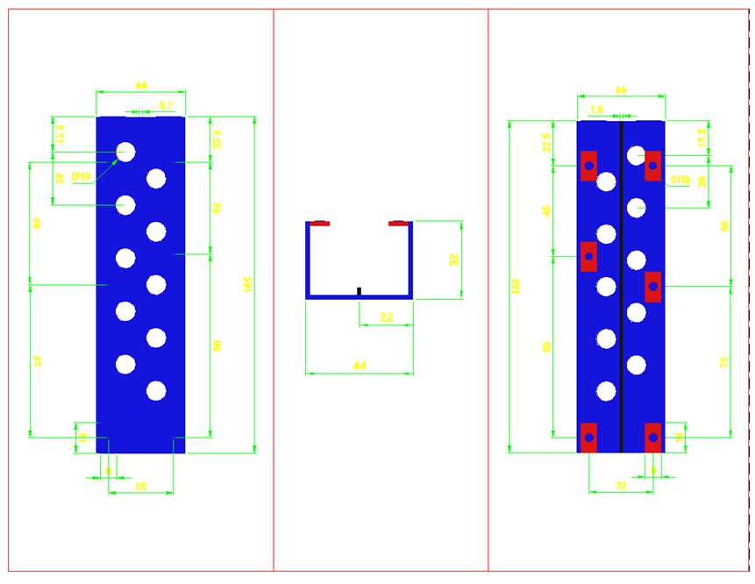
- Plan first Prototype:

Slide 6
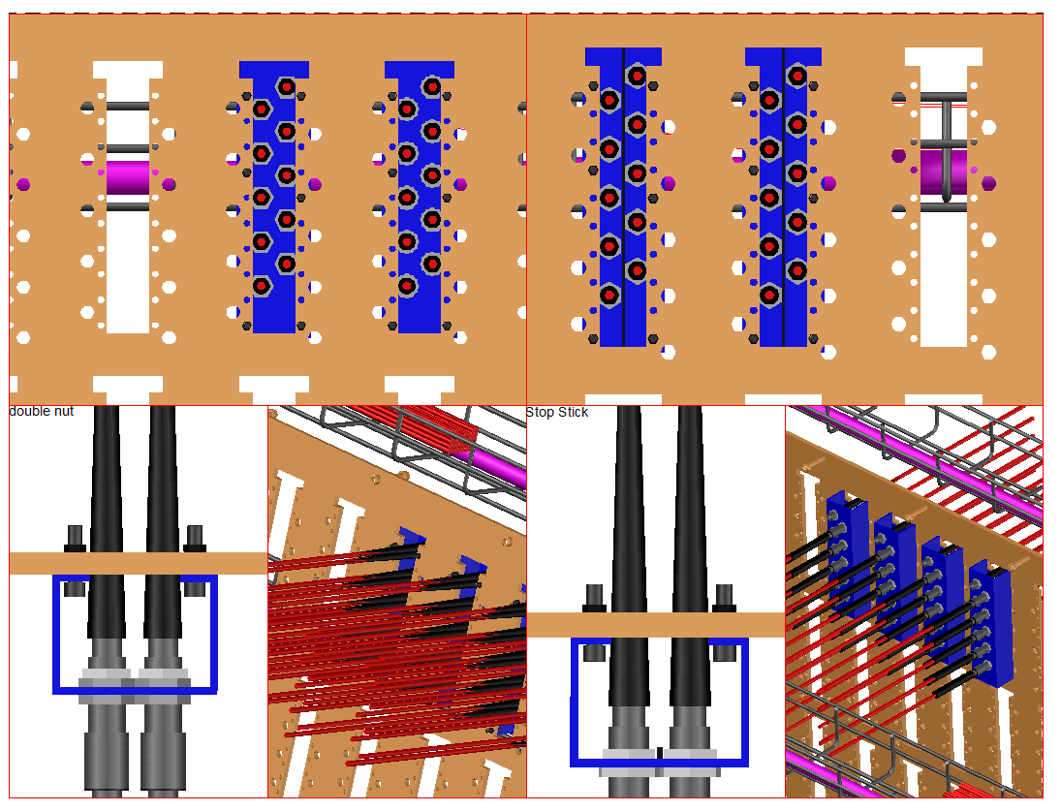
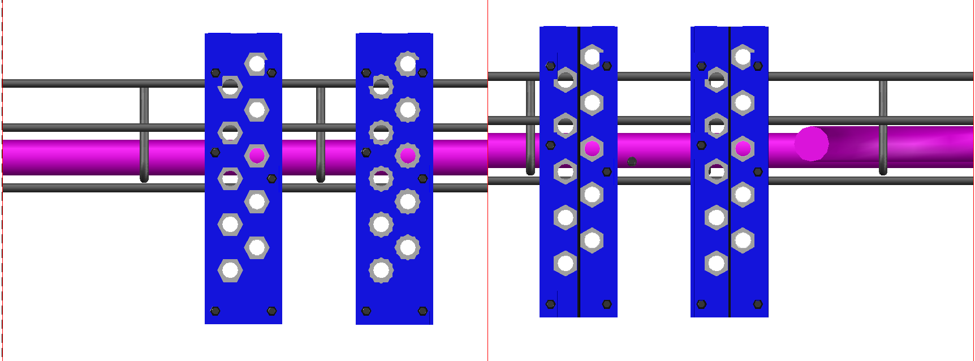
Final assembly, witch screw, nuts…

Slide 7
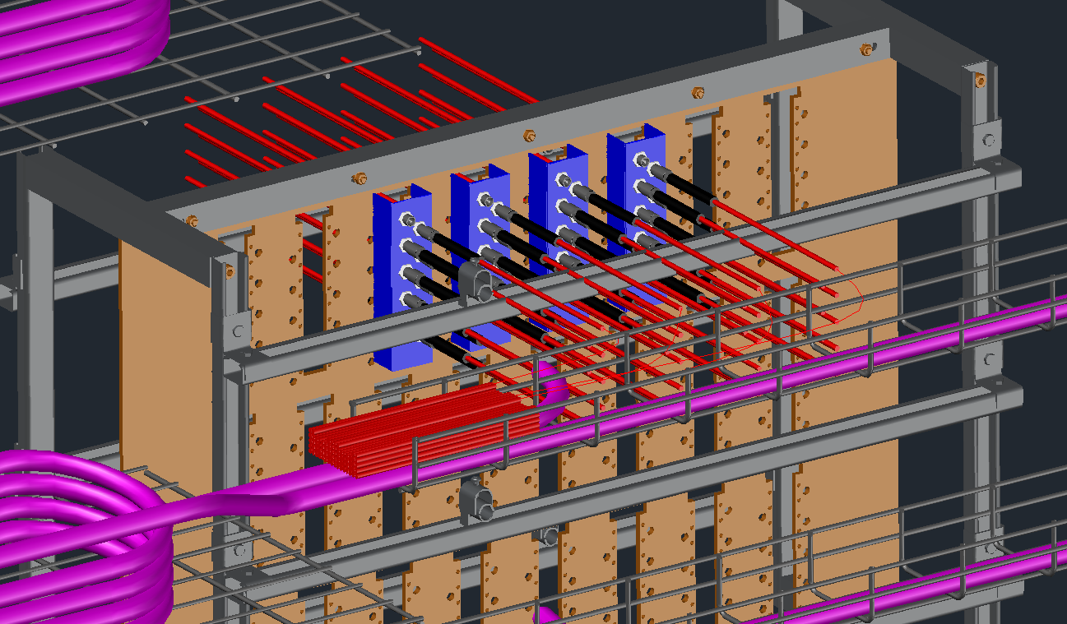
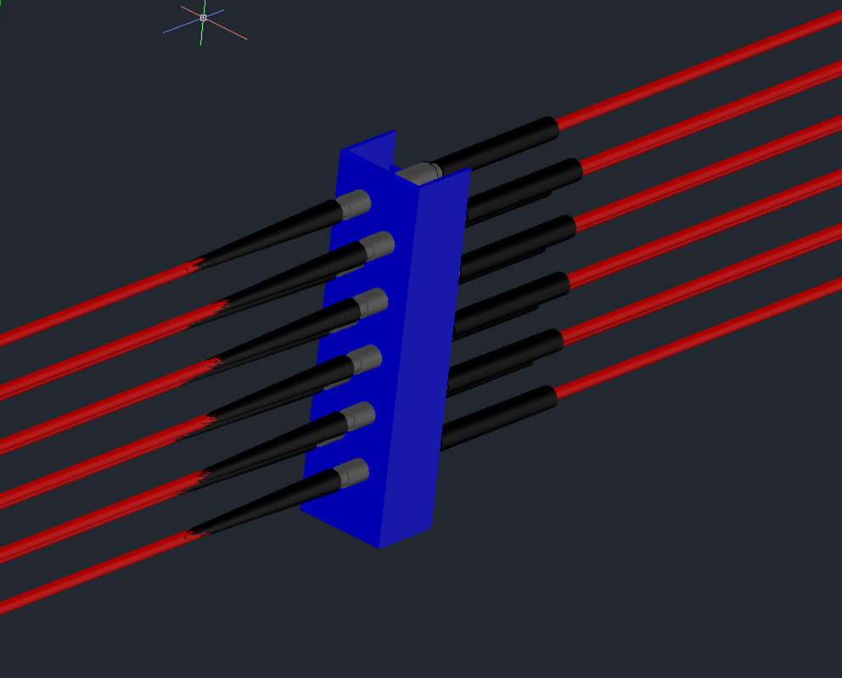
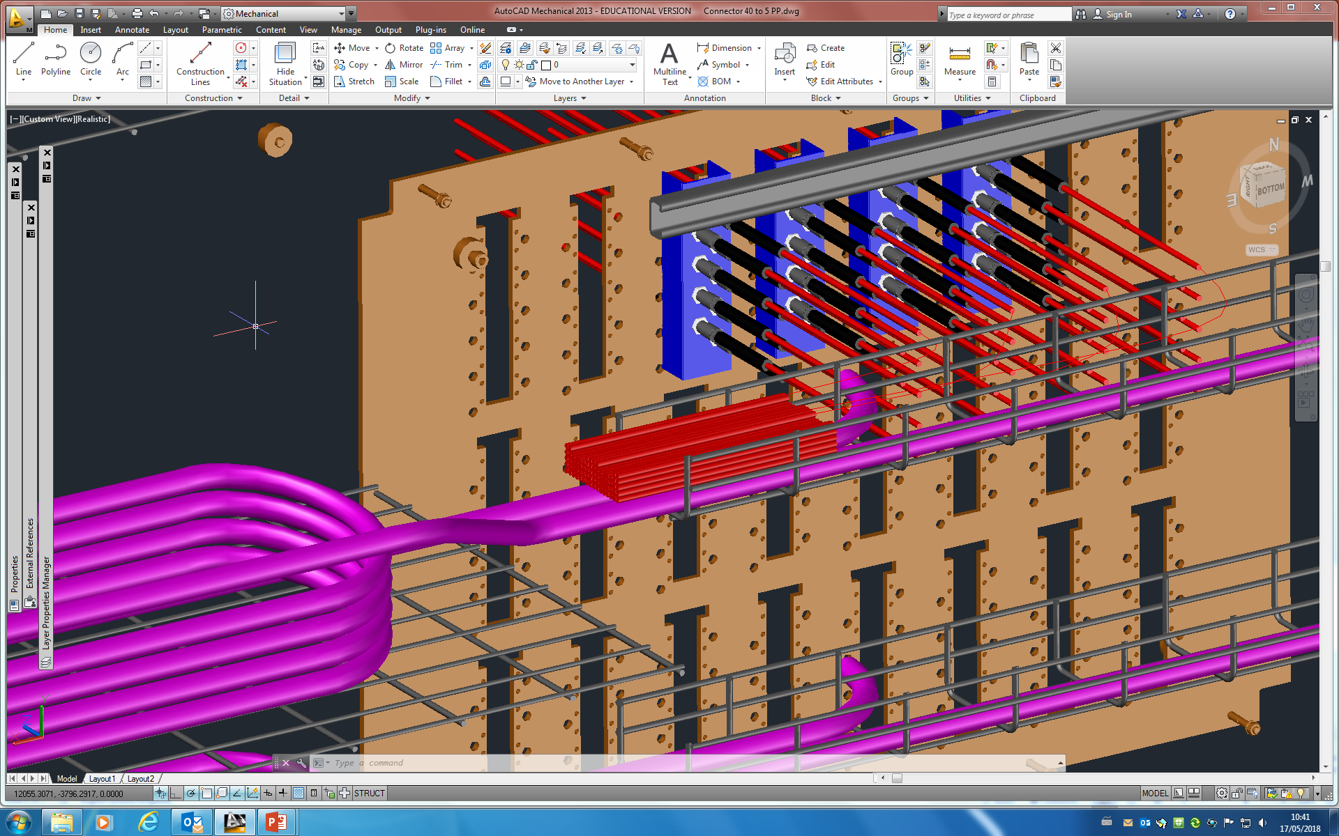
- 3D model of the adapter of ten connecters
- Position of all 40 news cables.
- Amount of cables to install in the cables rails support if there is a security length (72cables)

Slide 8
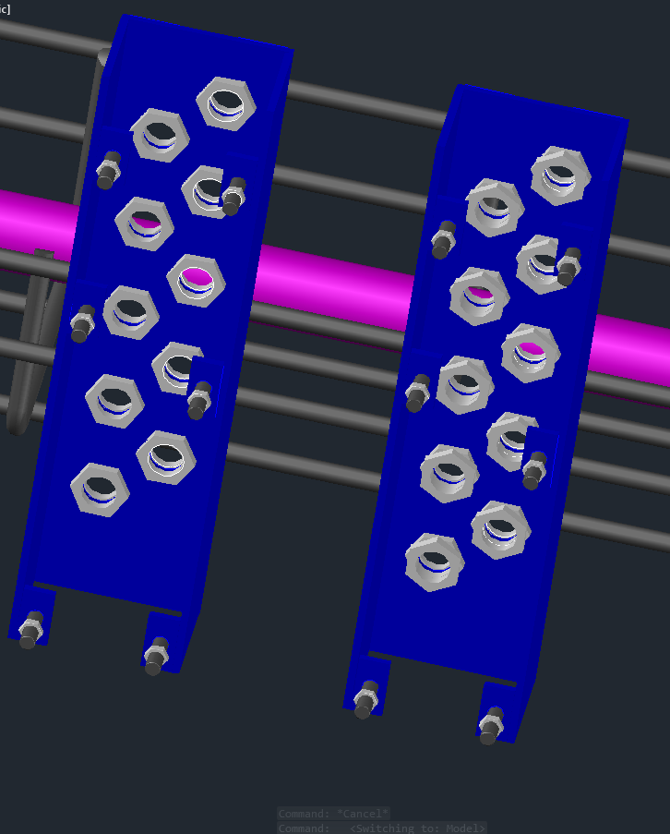
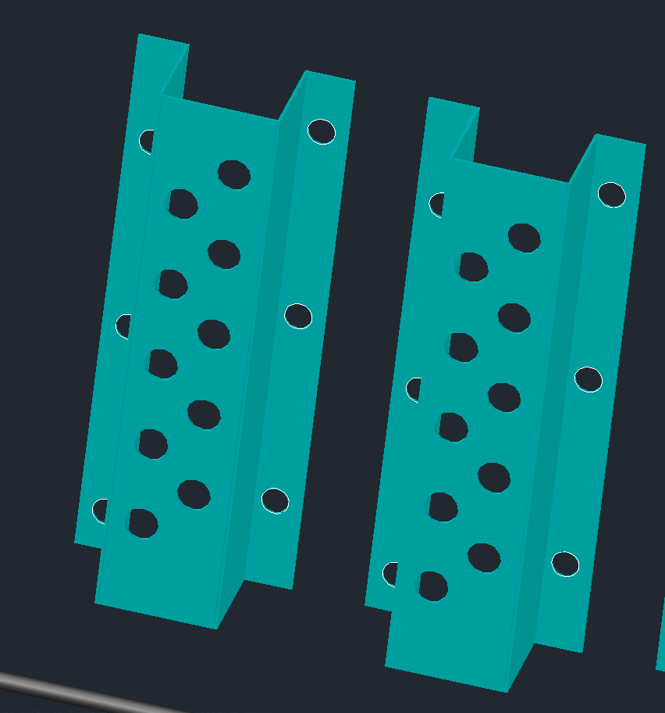
- Second design of the adapter: the modification was the mounting brackets. Now it’s outside of the U shape because it was to difficult to put it inside.
- To screw the nuts inside the U shape, the easier way it’s to put two nuts to blocks each other.

Slide 9
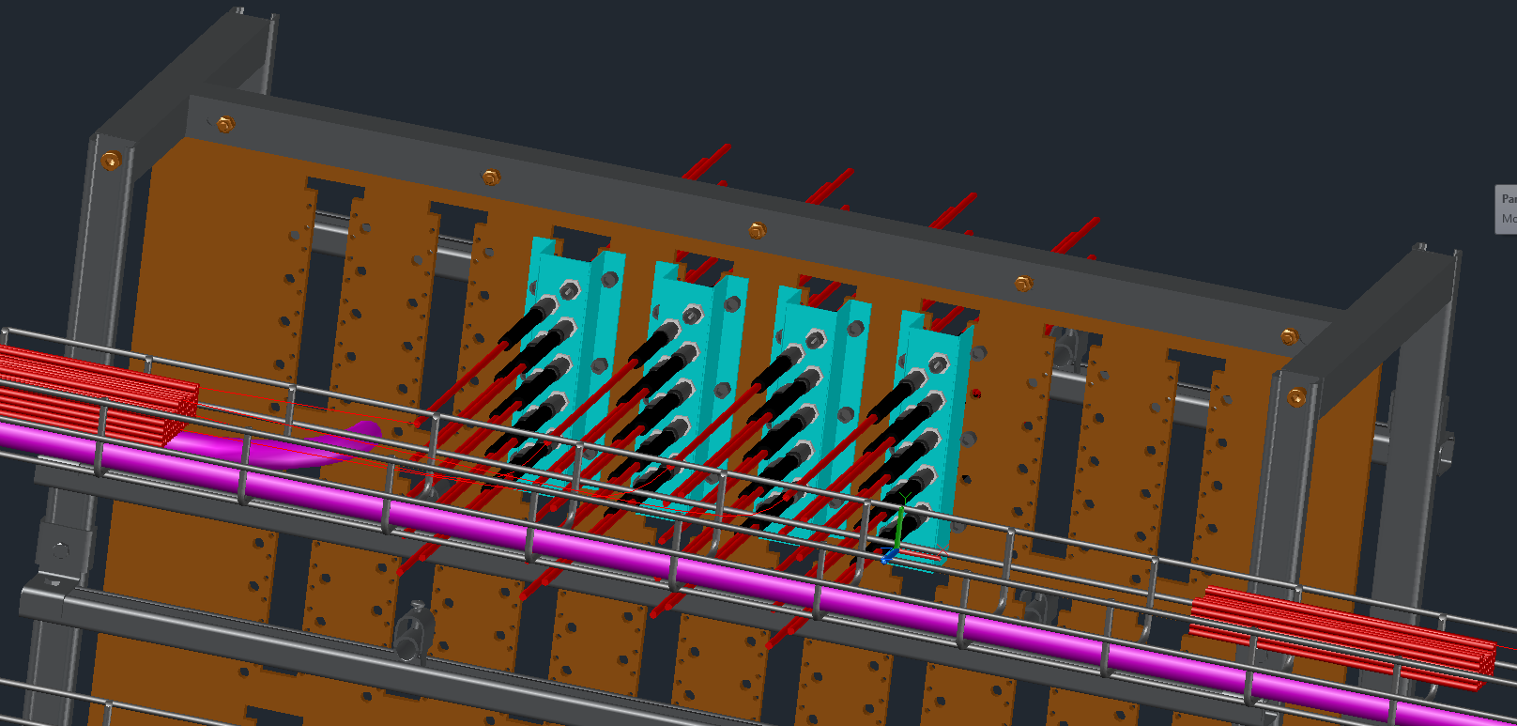
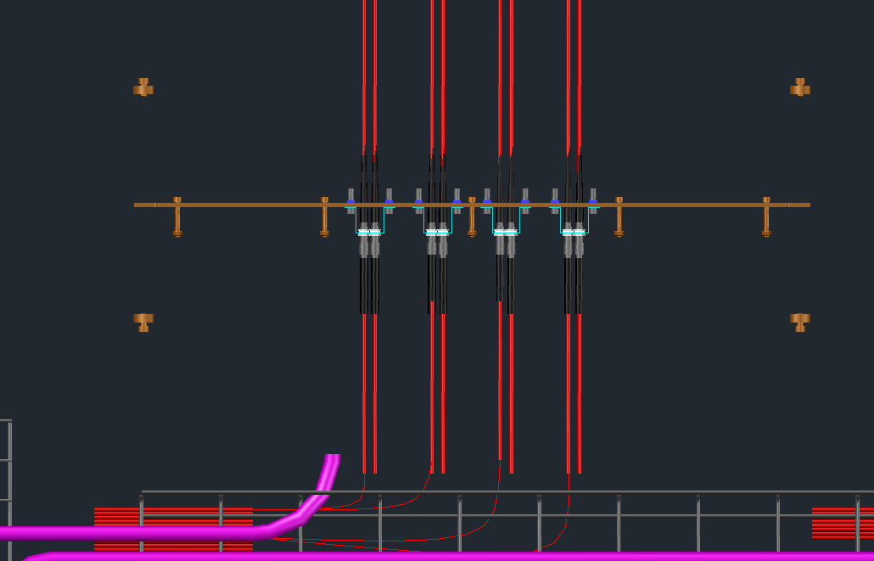
- There are 36 cables from news chambers (RE3_1 and RE4_1) and a total of 40 cables HV (2 of 40mm of 20 cables) so after the installation we will have 4 connecter empty from the chambers.
- Top view, just enough space to tighten the nut.

Slide 10
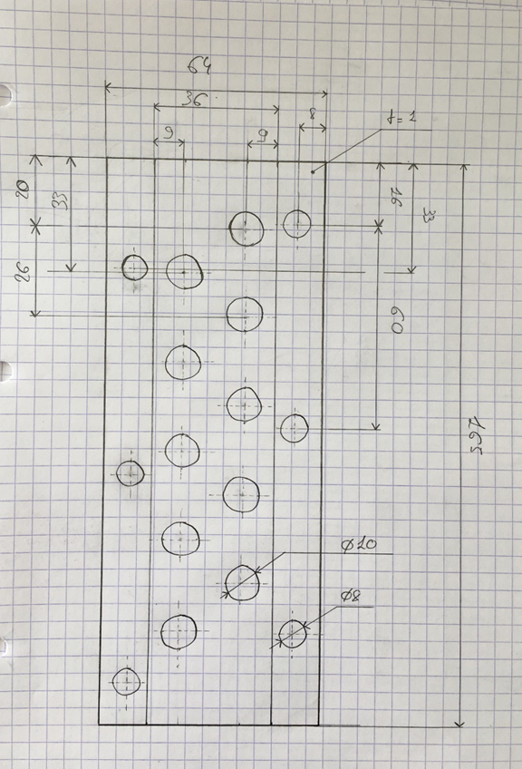
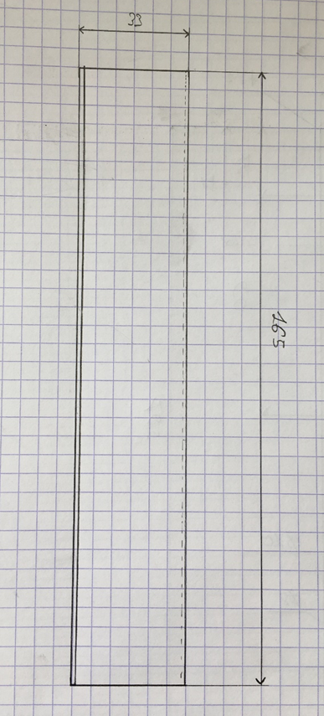
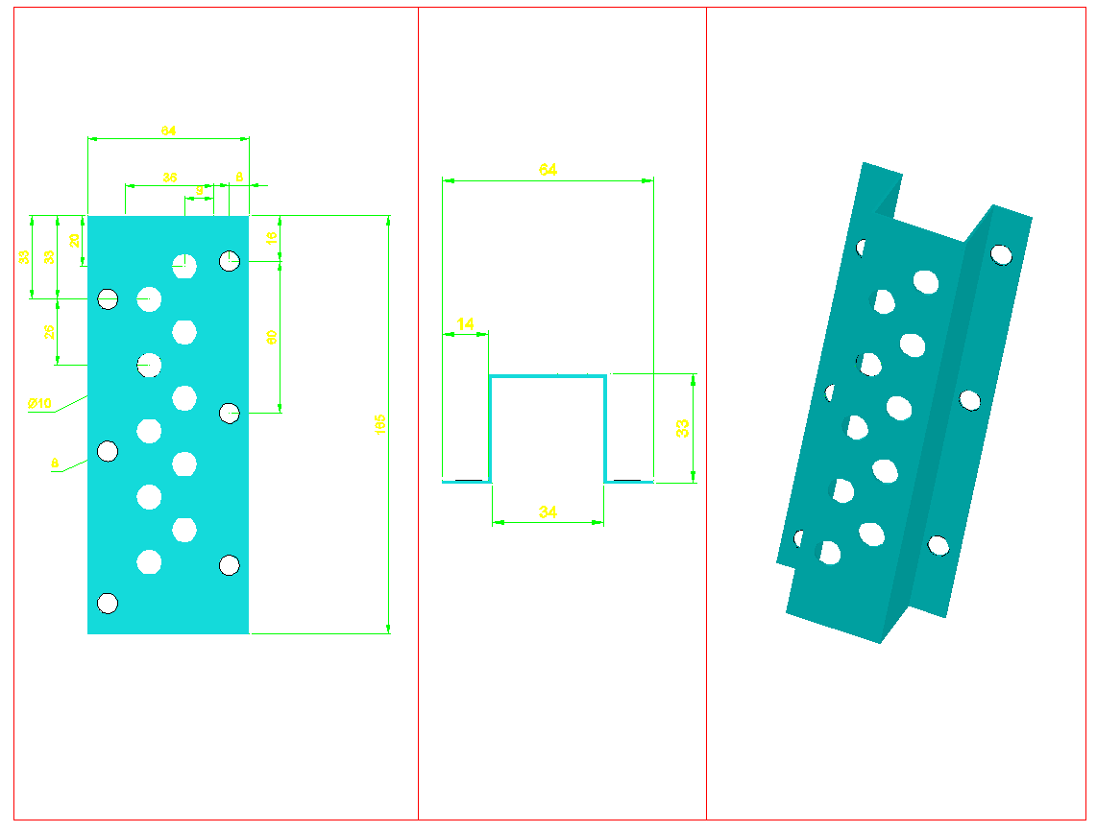
- Plans of the last version of the adapter (on paper and 3D model):

Slide 11
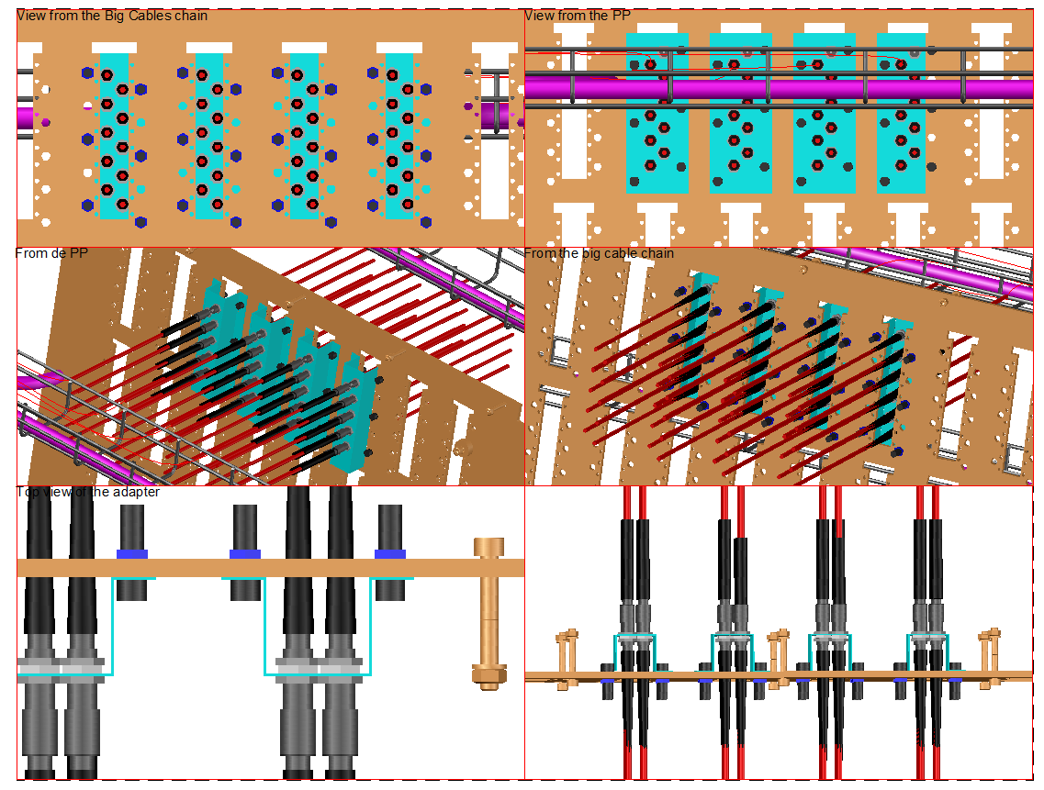
- Some views on the Patch Panel

Slide 12
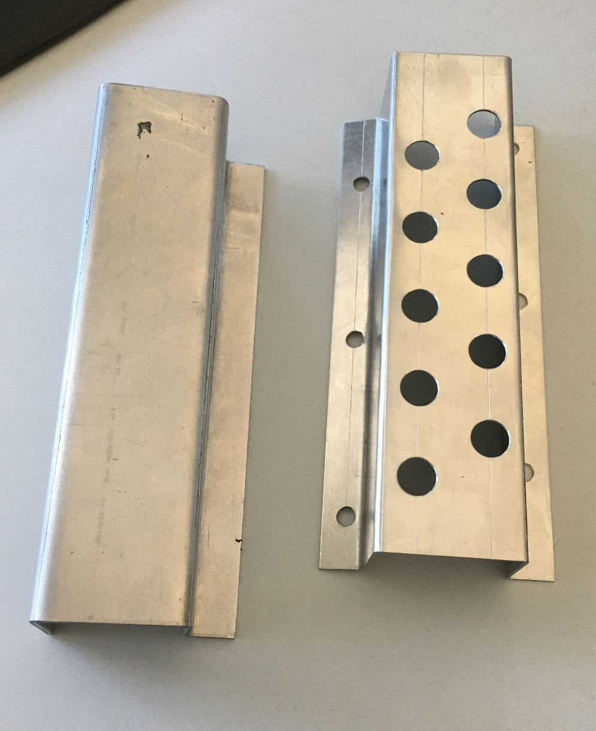
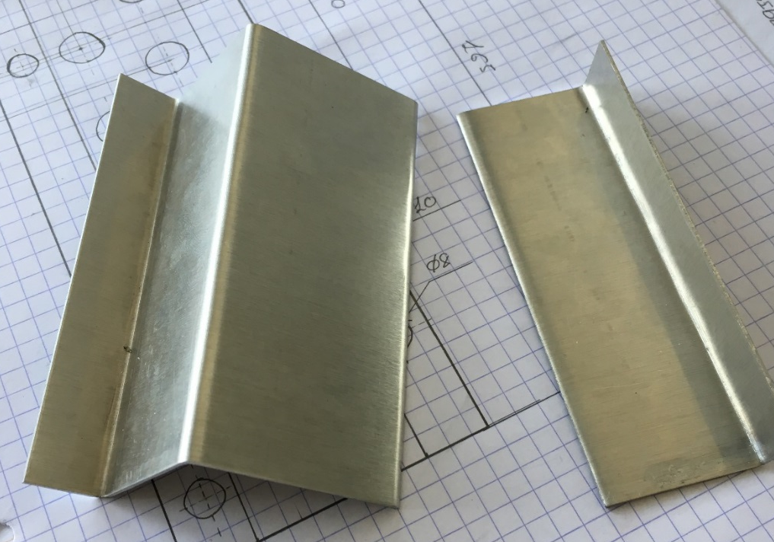
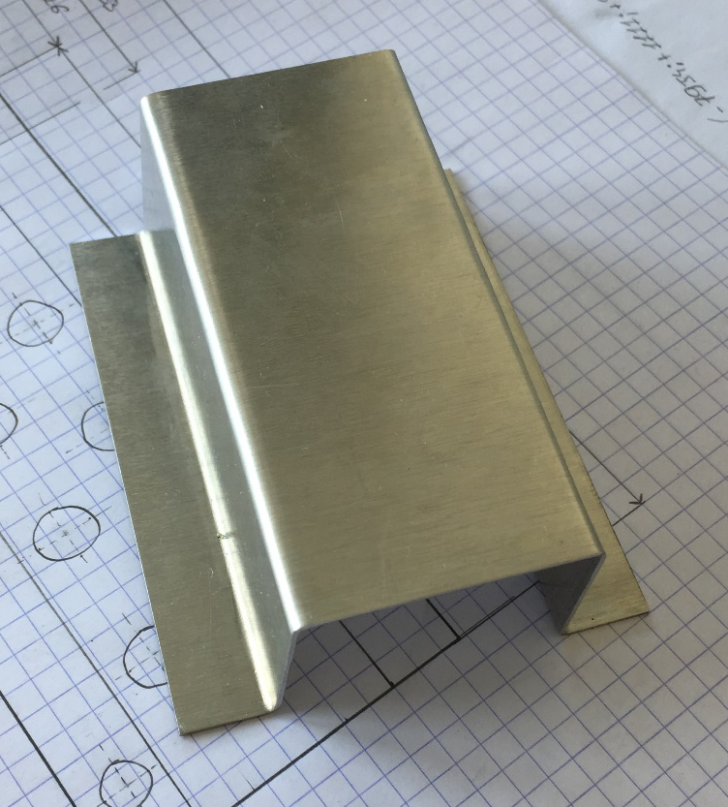
Test and first prototypes.
A difficulty is the folding of the U shape, need to find a solution.
- This is the result of the first prototype of the adapter, made with Aluminium T6: The fact is this type of Aluminium is too hard to be fold with this angle.

Slide 13
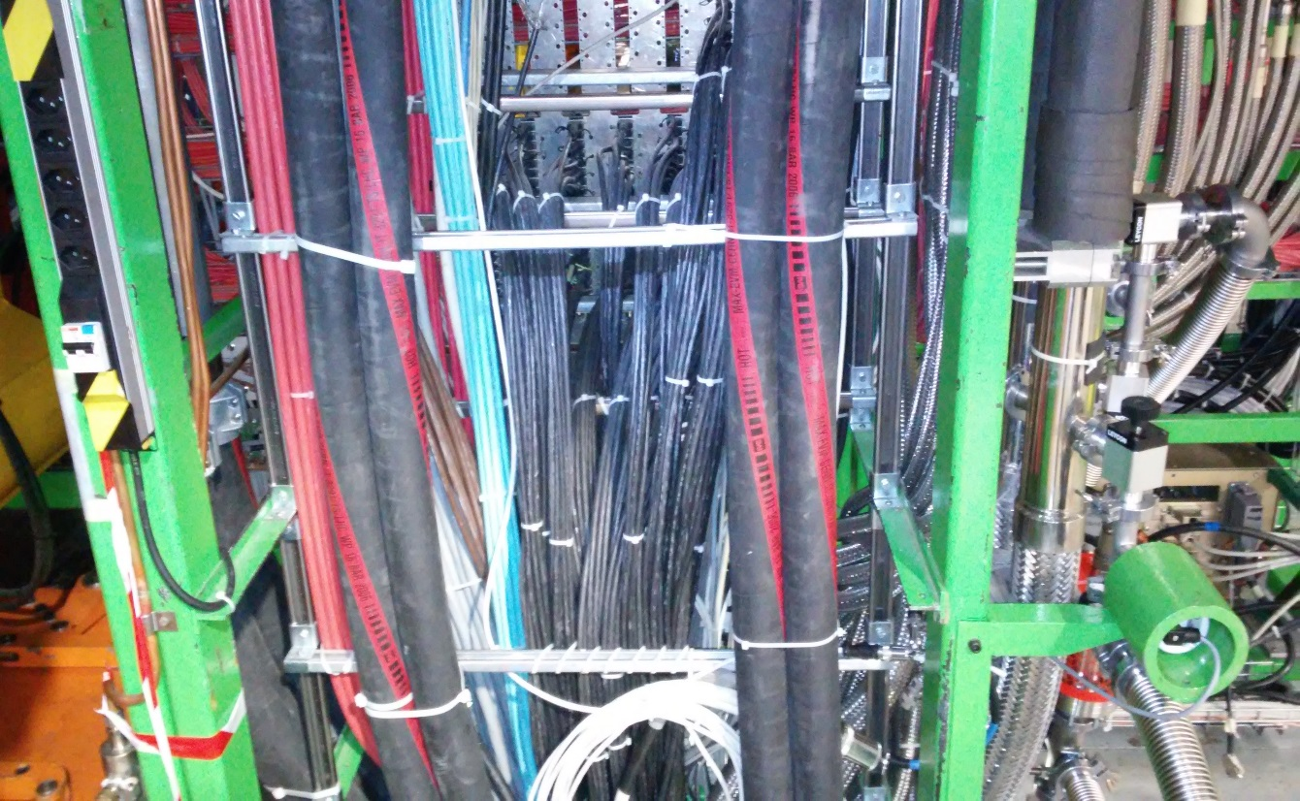
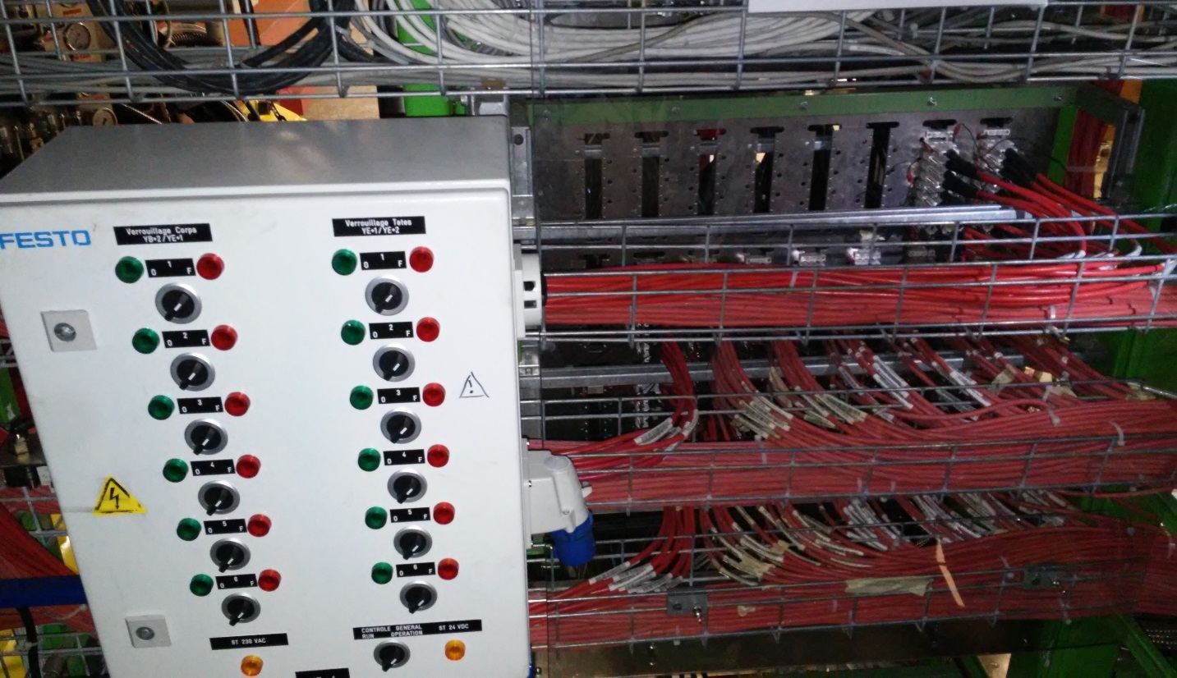
D
- From the big cable chain
- From the chamber

Slide 14
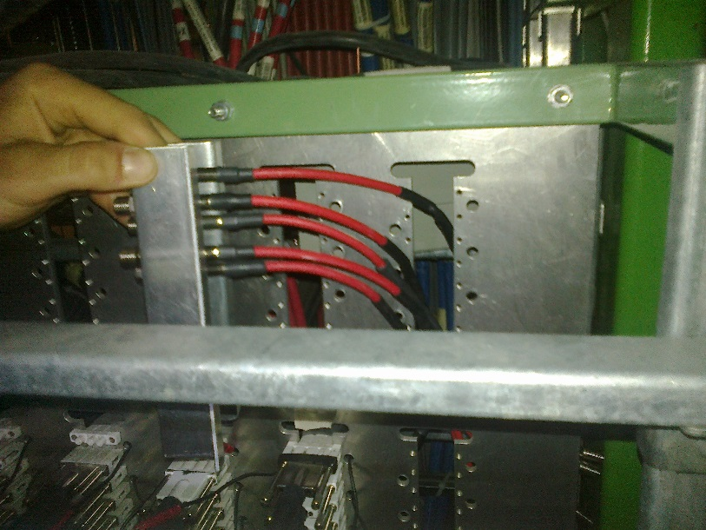
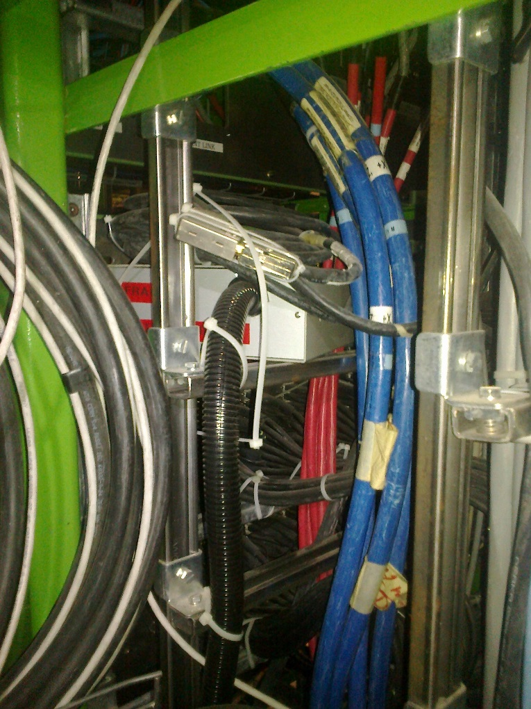
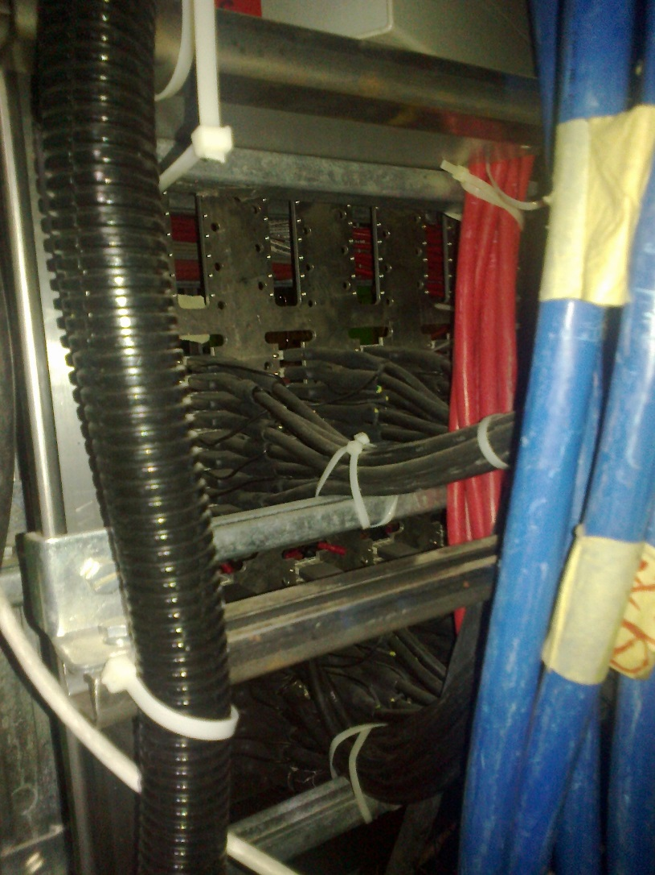
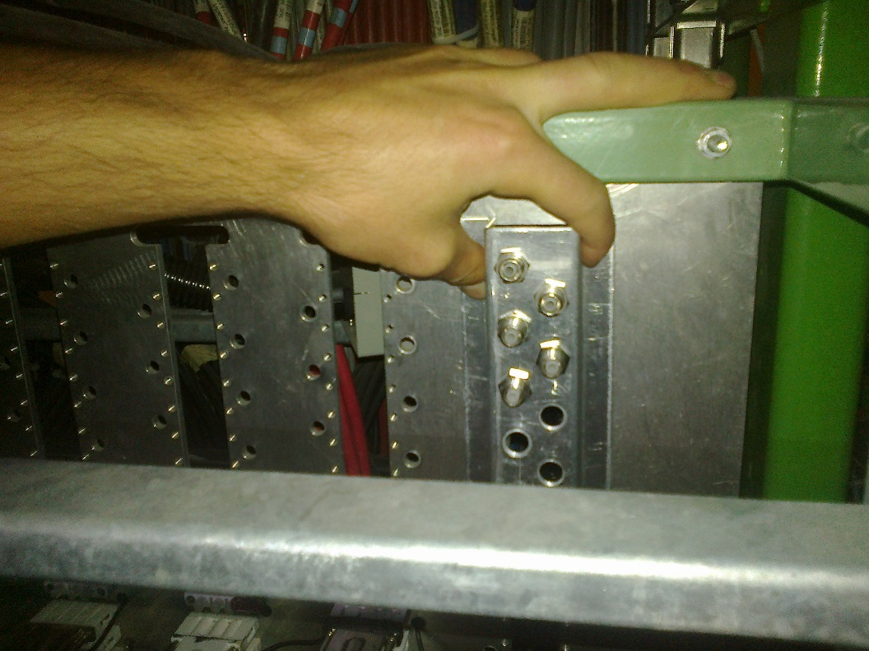
Check for fit insitu in P5 4 July 2018

