Slide 1
HV Cables and Connectors to go from Chambers to YE1PP
Ian
3 June 2018

Slide 2
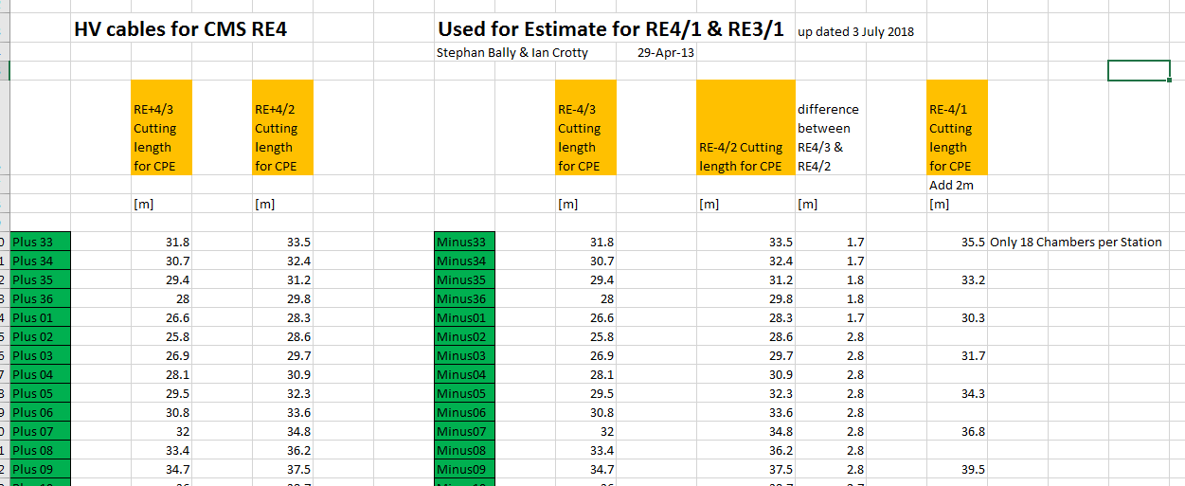
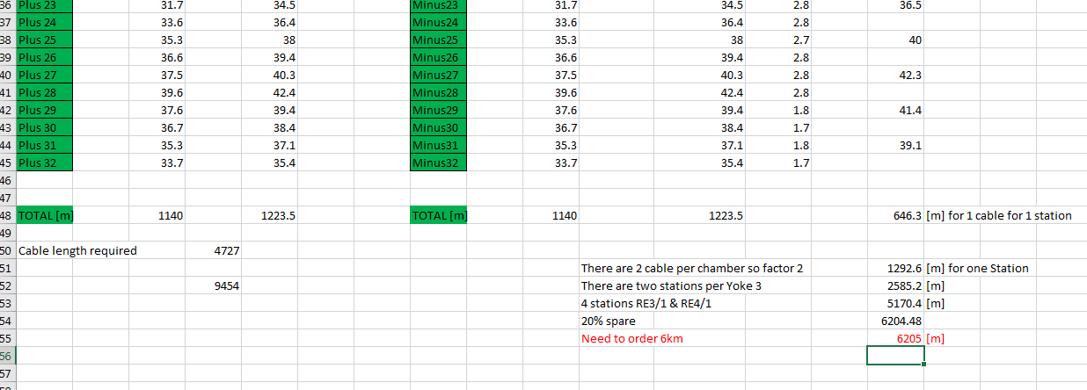
In order to make the orders we will use the first estimates of the previous lengths calculated for RE3/3 RE3/2 to estimate the length for RE4/1 and RE3/1
See calculation based on CPE request for RE4 cables
http://project-cms-rpc-endcap.web.cern.ch/project-cms-rpc-endcap/rpc/UpscopeHighEta/RPCDevelopements/RE31and41/Services/HV/Requirements/CablesChamberToYE1PP/EstimateofRE41cablesRE42andRE43.xlsx

Slide 3
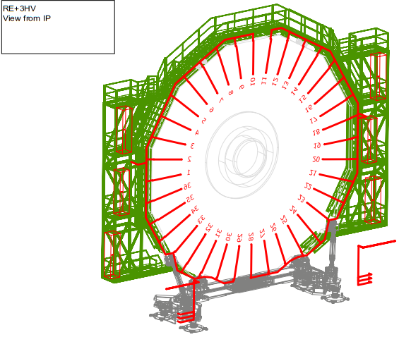
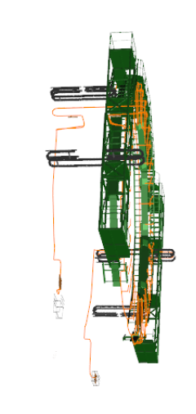

Slide 4
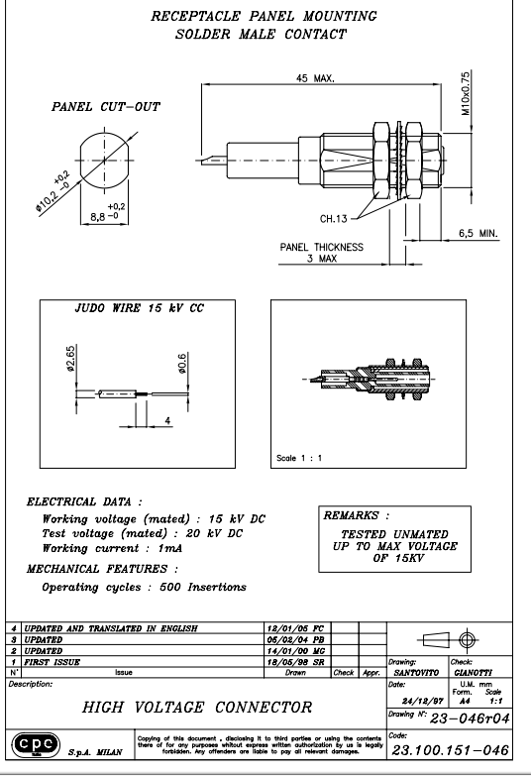
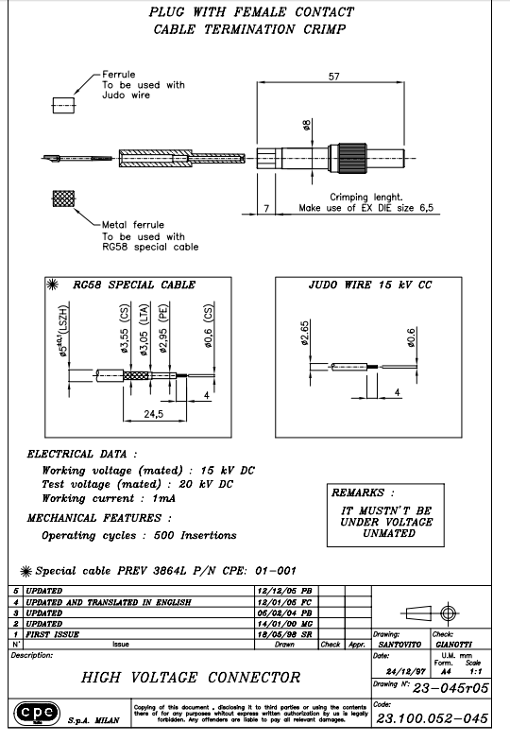

Slide 5
UXC Coaxial Connecters
Umbilical dia. 40mm Cable USC-UXC
YE1 PP
Chamber RE3/1 & RE4/1
Male Coaxial connecter
Female Coaxial connecter

Slide 6
Connecter Quantities
4 Male connecters per 20 degrees
4 Female connecters per 20 degrees
18x4 Male per Station = 72 male
18x4 Female per Station = 72 male
RE3/1 & RE4/1 total both Endcaps 72x4 = 288 Male
RE3/1 & RE4/1 total both Endcaps 72x4 = 288 Female
10% Spares 320 Male and 320 Female Connecters

Slide 7
Conclusion
To do one endcap with x2 coaxial cables we need to order 6200m which includes 20 % extra.
To start cable production we need a minimium of half of the female connecters meaning 160 pieces.
See EDH 7340243

