Slide 1
HV mCC
Ian
11 Feb 2019

Slide 2
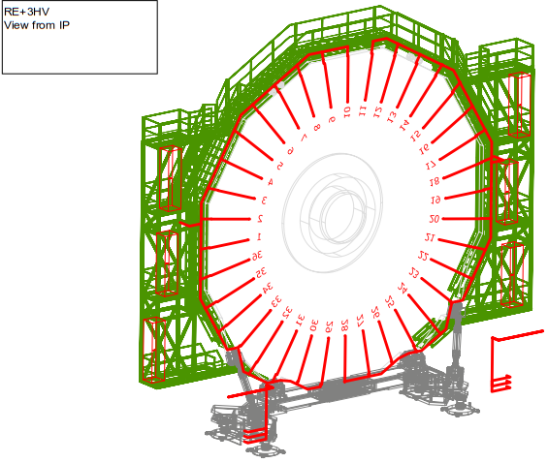
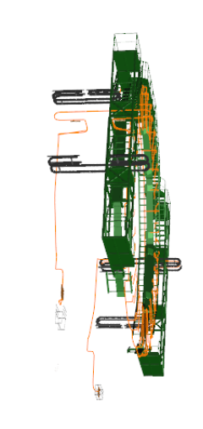

Slide 3
 |  |  |  |  |  |  |  | Stephan Bally & Ian Crotty |  |  | 29-Apr-13
 |  |  |  |  |  |  |  | Modified Ian |  |  | 18-Nov-18
 |  |  | RE+4/3 Cutting length for CPE |  | RE+4/2 Cutting length for CPE | RE4/1 Add 2m |  |  |  | RE-4/3 Cutting length for CPE |  | RE-4/2 Cutting length for CPE
 |  |  | [m] |  | [m] |  |  |  |  | [m] |  | [m]
 | Plus 33 |  | 31.8 |  | 33.5 | 35.5 |  | Minus33 |  | 31.8 |  | 33.5
 | Plus 34 |  | 30.7 |  | 32.4 | 34.4 |  | Minus34 |  | 30.7 |  | 32.4
 | Plus 35 |  | 29.4 |  | 31.2 | 33.2 |  | Minus35 |  | 29.4 |  | 31.2
 | Plus 36 |  | 28 |  | 29.8 | 31.8 |  | Minus36 |  | 28 |  | 29.8
 | Plus 01 |  | 26.6 |  | 28.3 | 30.3 |  | Minus01 |  | 26.6 |  | 28.3
 | Plus 02 |  | 25.8 |  | 28.6 | 30.6 |  | Minus02 |  | 25.8 |  | 28.6
 | Plus 03 |  | 26.9 |  | 29.7 | 31.7 |  | Minus03 |  | 26.9 |  | 29.7
 | Plus 04 |  | 28.1 |  | 30.9 | 32.9 |  | Minus04 |  | 28.1 |  | 30.9
 | Plus 05 |  | 29.5 |  | 32.3 | 34.3 |  | Minus05 |  | 29.5 |  | 32.3
 | Plus 06 |  | 30.8 |  | 33.6 | 35.6 |  | Minus06 |  | 30.8 |  | 33.6
 | Plus 07 |  | 32 |  | 34.8 | 36.8 |  | Minus07 |  | 32 |  | 34.8
 | Plus 08 |  | 33.4 |  | 36.2 | 38.2 |  | Minus08 |  | 33.4 |  | 36.2
 | Plus 09 |  | 34.7 |  | 37.5 | 39.5 |  | Minus09 |  | 34.7 |  | 37.5
 | Plus 10 |  | 36 |  | 38.7 | 40.7 |  | Minus10 |  | 36 |  | 38.7
 | Plus 11 |  | 35 |  | 36.7 | 38.7 |  | Minus11 |  | 35 |  | 36.7
 | Plus 12 |  | 33.7 |  | 35.4 | 37.4 |  | Minus12 |  | 33.7 |  | 35.4
 | Plus 13 |  | 32.2 |  | 34 | 36 |  | Minus13 |  | 32.2 |  | 34
 | Plus 14 |  | 31.1 |  | 32.8 | 34.8 |  | Minus14 |  | 31.1 |  | 32.8
 | Plus 15 |  | 29.8 |  | 31.5 | 33.5 |  | Minus15 |  | 29.8 |  | 31.5
 | Plus 16 |  | 28.4 |  | 30.1 | 32.1 |  | Minus16 |  | 28.4 |  | 30.1
 | Plus 17 |  | 27.2 |  | 28.9 | 30.9 |  | Minus17 |  | 27.2 |  | 28.9
 | Plus 18 |  | 25.8 |  | 28.6 | 30.6 |  | Minus18 |  | 25.8 |  | 28.6
 | Plus 19 |  | 26.6 |  | 29.4 | 31.4 |  | Minus19 |  | 26.6 |  | 29.4
 | Plus 20 |  | 28 |  | 30.8 | 32.8 |  | Minus20 |  | 28 |  | 30.8
 | Plus 21 |  | 30.4 |  | 33.2 | 35.2 |  | Minus21 |  | 30.4 |  | 33.2
 | Plus 22 |  | 30.5 |  | 33.3 | 35.3 |  | Minus22 |  | 30.5 |  | 33.3
 | Plus 23 |  | 31.7 |  | 34.5 | 36.5 |  | Minus23 |  | 31.7 |  | 34.5
 | Plus 24 |  | 33.6 |  | 36.4 | 38.4 |  | Minus24 |  | 33.6 |  | 36.4
 | Plus 25 |  | 35.3 |  | 38 | 40 |  | Minus25 |  | 35.3 |  | 38
 | Plus 26 |  | 36.6 |  | 39.4 | 41.4 |  | Minus26 |  | 36.6 |  | 39.4
 | Plus 27 |  | 37.5 |  | 40.3 | 42.3 |  | Minus27 |  | 37.5 |  | 40.3
 | Plus 28 |  | 39.6 |  | 42.4 | 44.4 |  | Minus28 |  | 39.6 |  | 42.4
 | Plus 29 |  | 37.6 |  | 39.4 | 41.4 |  | Minus29 |  | 37.6 |  | 39.4
 | Plus 30 |  | 36.7 |  | 38.4 | 40.4 |  | Minus30 |  | 36.7 |  | 38.4
 | Plus 31 |  | 35.3 |  | 37.1 | 39.1 |  | Minus31 |  | 35.3 |  | 37.1
 | Plus 32 |  | 33.7 |  | 35.4 | 37.4 |  | Minus32 |  | 33.7 |  | 35.4
Max |  |  |  |  |  | 44.4
Min |  |  |  |  |  | 35.5
 | TOTAL [m] |  | 1140 |  | 1223.5 | 1295.5 |  | TOTAL [m] |  | 1140 |  | 1223.5

Slide 4
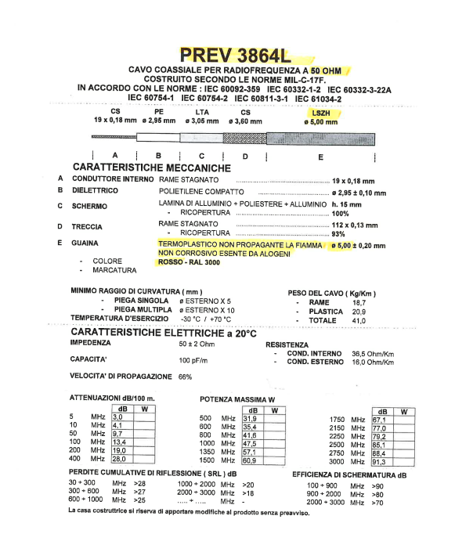

Slide 5
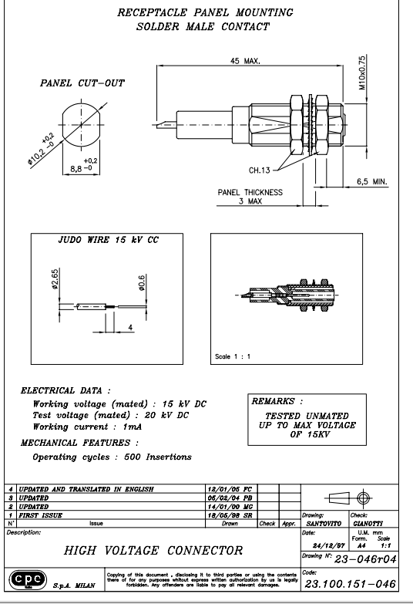
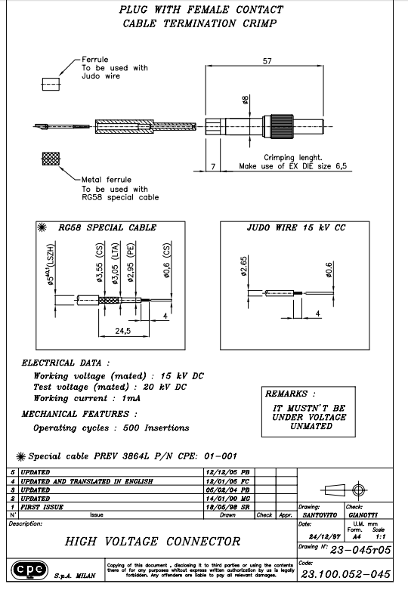

Slide 6
Connecter Quantities
4 Male connecters per 20 degrees
4 Female connecters per 20 degrees
18x4 Male per Station = 72 male
18x4 Female per Station = 72 male
RE3/1 & RE4/1 total both Endcaps 72x4 = 288 Male
RE3/1 & RE4/1 total both Endcaps 72x4 = 288 Female
10% Spares 320 Male and 320 Female Connecters

Slide 7
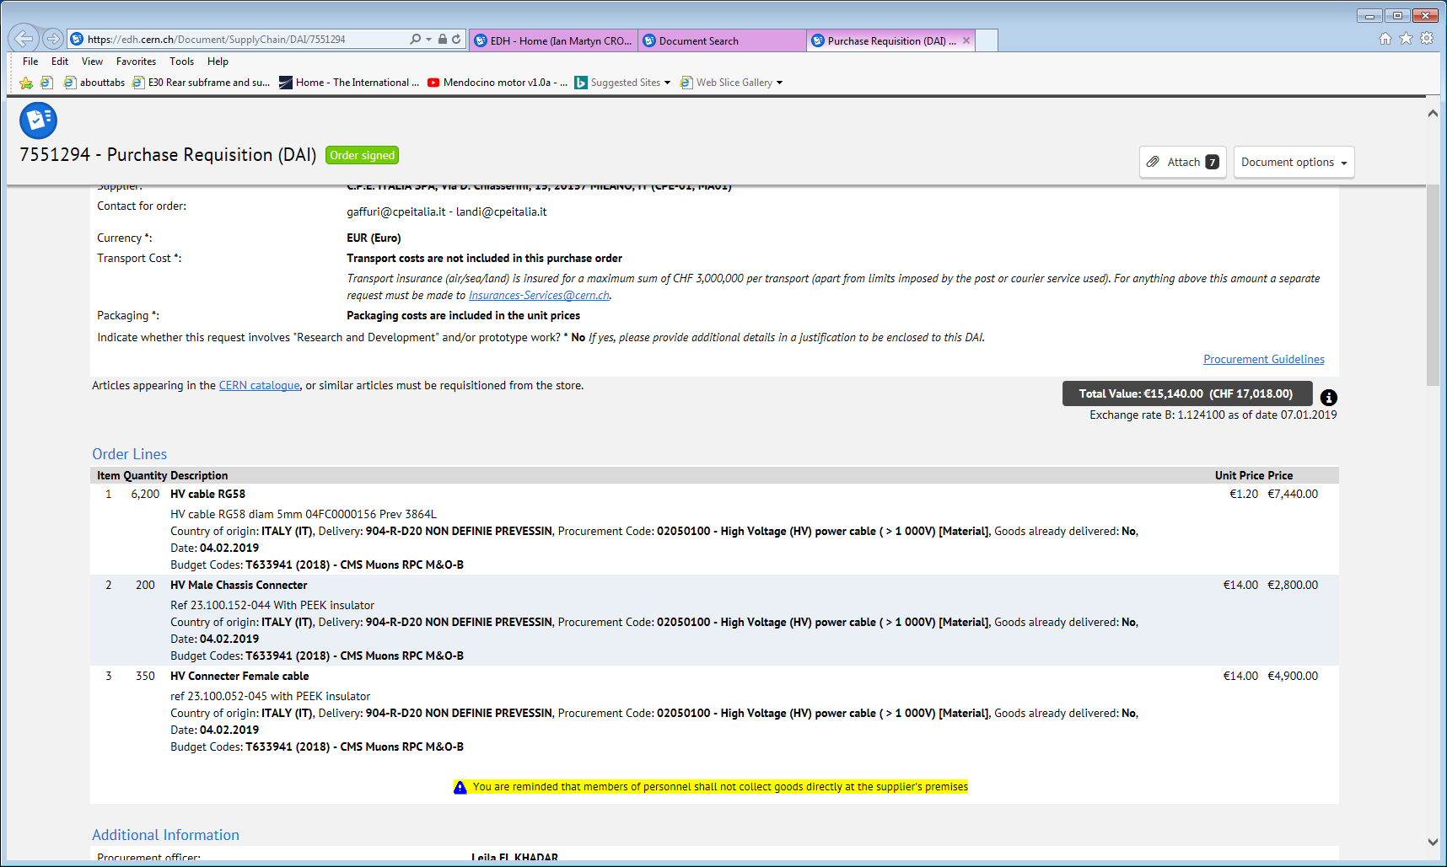

Slide 8
Conclusion
The components are ready for cable production
The order for the fabrication requires the QA procedure
It appears not possible to do a good quality QA on the spot.
Suggest that extended QA be done in 904 before installation

