Slide 1
Gas on YE3
Takebn from see next slide

Slide 2
RE3/1 & RE4/1 Parameter Space
Services
Ian Crotty
12 Feb 2014

Slide 3
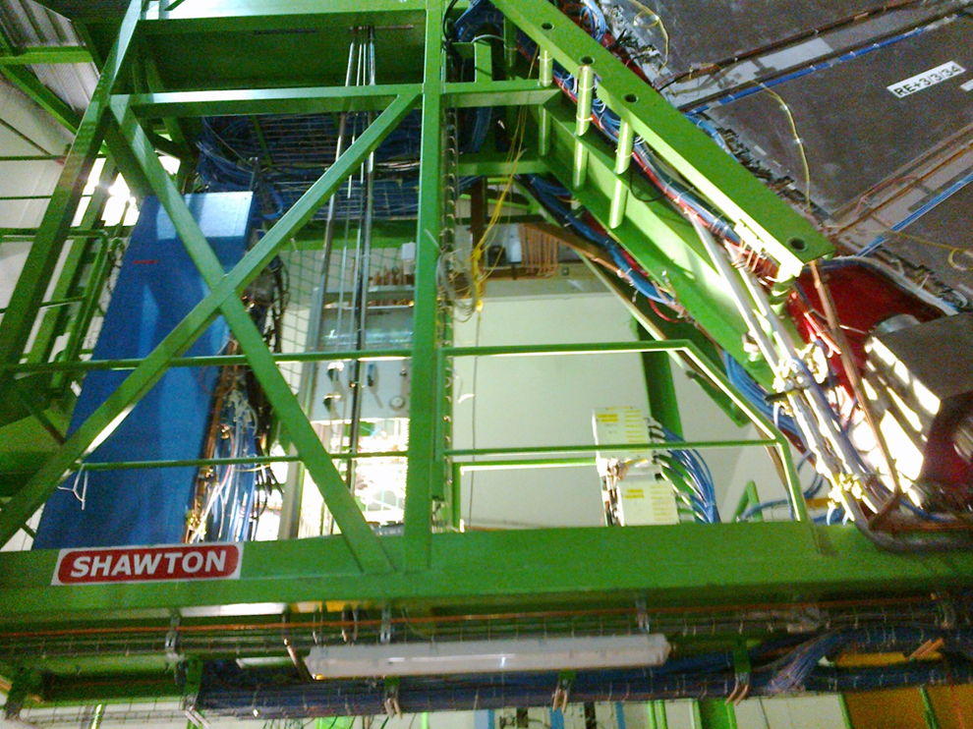
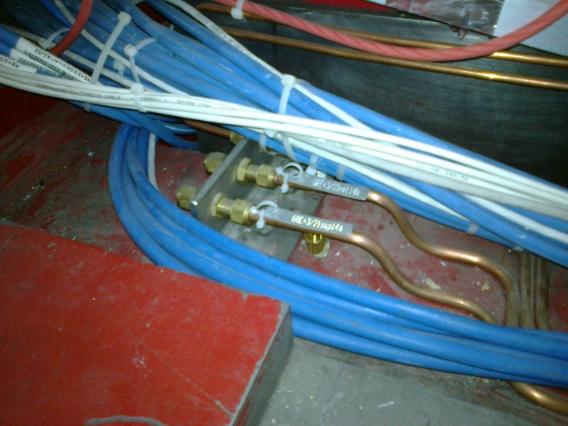
Gas rack space available on Near of YE3 suitable for both RE3/1 & 4/1 ?

