Slide 1
Gas impedances making the job easier and quicker
Ian
17 Dec 2018

Slide 2
To avoid different radii during the papillary forming
High radius
Only one high radius
Small radius
Tooling is a simple tube only

Slide 3
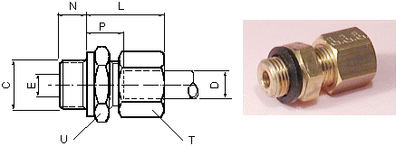

Using standard unions (Sagana, Gyrolok) eg 6mm
Legris is shown for reasons of simplicity but are true for ALL makes
Capillary pipe soldered into plug

Slide 4
Conclusion
Keep it simple.
These solutions are discussed with the first person I met in the gas WS Bat. 155 when I was waiting for the cooling meeting.

