Slide 1
Capillary tube Δ P measurements
Nicola Lacalamita, Aleksandar Aleksandrov, Roberto Guida
TC meeting,
14/01/2019, CERN, Meyrin

Slide 2
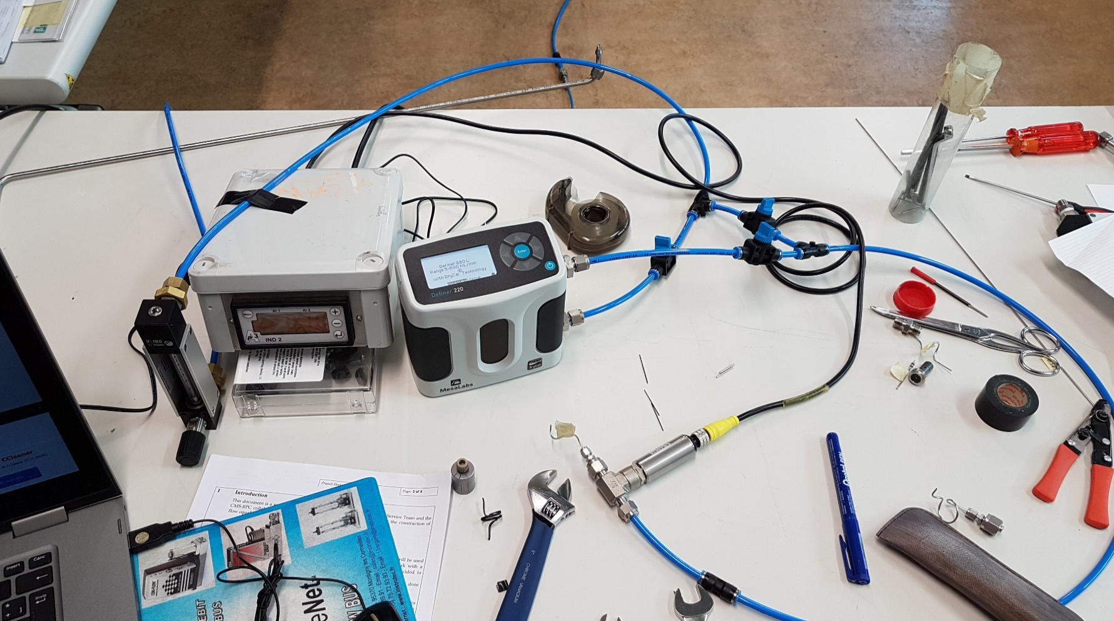
Experimental setup for ΔP tests
Gas: freon
Rotameter and flowmeter
Pressure sensor
The goal: define the tube specification for RE4.1, RE3.1 impedance boxes.
Two types of capillary:
  OD 1.59mm, ID 0.99 mm (used for RE4)
  OD 1.59 mm, ID 0.87 mm

Slide 3
Results (1)
1 vol/h = 2 l/h

Slide 4
Results (2)
1 vol/h = 2 l/h

Slide 5
Results (3)
1 vol/h = 2 l/h

Slide 6
Notes and conclusions
The specifications of the capillary tubes is suggested to be:
OD 1.59 mm, ID 0.87 mm, length = 120 mm
To check the ID of the pipes we used drills: 1.0 mm, 0.9 mm and 0.85 mm. For the tube ID 0.87 mm the 0.85 mm drill has to be used.
The swagelok union was tightened according to the specifications or ¾ turn.
It is very important to clean the tube after cutting because it can produce additional delta P (up to 0.5 mbar).
The delta P from 6mm tube may have additional impedance variation in the range [0.2 mbar: 0.5mbar] for pipes with lengths between 6 m and 14 m, measured for flow of 3 vol/h.
In order to decrease the impact of this systematic a new gas layout is proposed: moving from 1 channel =120 ° sector (only TOP/BOTTOM gaps from 6 chambers are connected) to 1 channel = 60 ° sector (both gaps of 3 chambers are connected).

Slide 7
Gas distribution schematic (1 gas channel = 120° sector)
Bulkhead Swagelok brass union 8 mm
Impedance box
RE4(3).3 chamber
8 mm copper pipe
RE4(3).2 chamber
Parallel flow
Supply
Return
6 mm copper pipe
Gas Rack
Legris brass unions (6mm)
Top layer
RE4(3).1 chamber

Slide 8
Gas distribution schematic (1 gas channel = 60° sector)
Bulkhead Swagelok brass union 8 mm
Impedance box
RE4(3).3 chamber
8 mm copper pipe
RE4(3).2 chamber
Parallel flow
Supply
Return
6 mm copper pipe
Gas Rack
Bottom layer
Top layer
RE4(3).1 chamber

