Slide 1
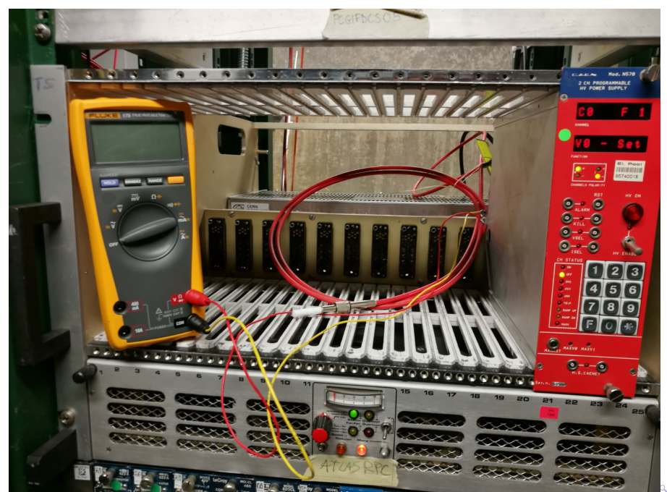

Slide 2
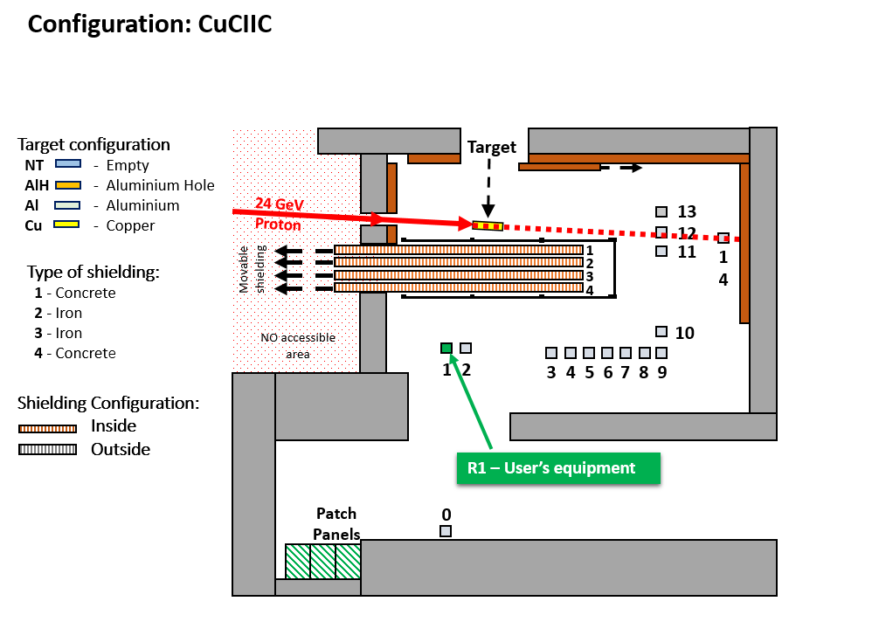
CHARM facility Layout
For more details, the CHARM web site: http://charm.web.cern.ch
HV connector placed in Pole 1 of the Charm facility during one week
24-31 /10/2018

Slide 3
Here are the dose reached during the irradiation of the HV connector :
Dose (Gy) | HEH Fluence (cm⁻²) | 1MeV n eq. (cm⁻²) | Total POT*
103 | 2.83·10¹¹ | 2.71·10¹² | 1.4·10¹⁶
The reference document related to the irradiation test: https://edms.cern.ch/document/2048697/1
Max dose in R3,4/1 : 45 Gy for 3000 fb-1
Thanks to Salvatore Danzeca and Chiara Cangialosi of the Charm facility Group who took care of the irradiation test

Slide 4
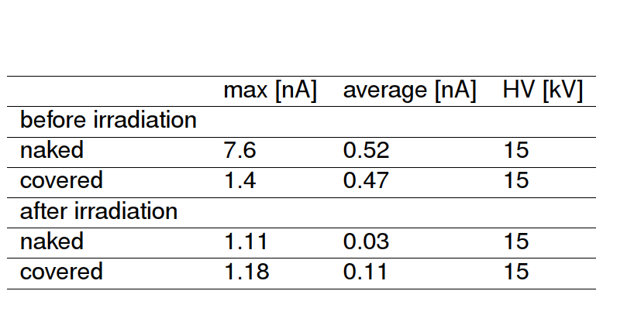
Naked : connector left open in the air
Covered : connector close by insulator
Preliminary measurement done by Atlas colleagues.
They think it is sufficient to assess the insulator did not suffered from the irradiation.
They are completing the measurement in more details.

