Slide 1
Alternative HV connectors
Ian
June 2018

Slide 2
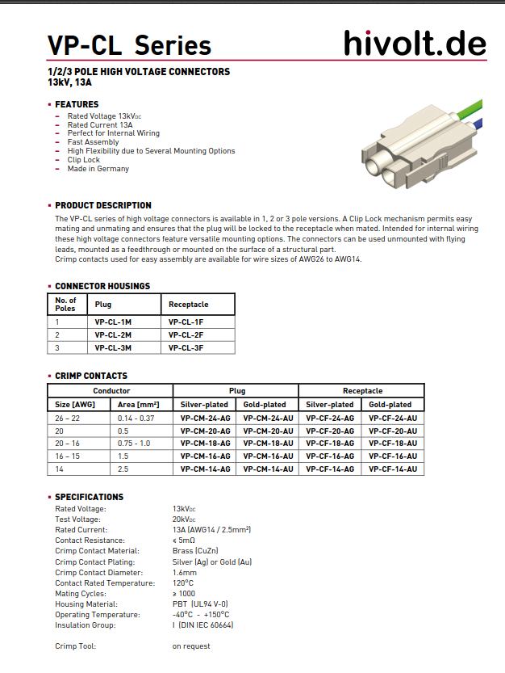
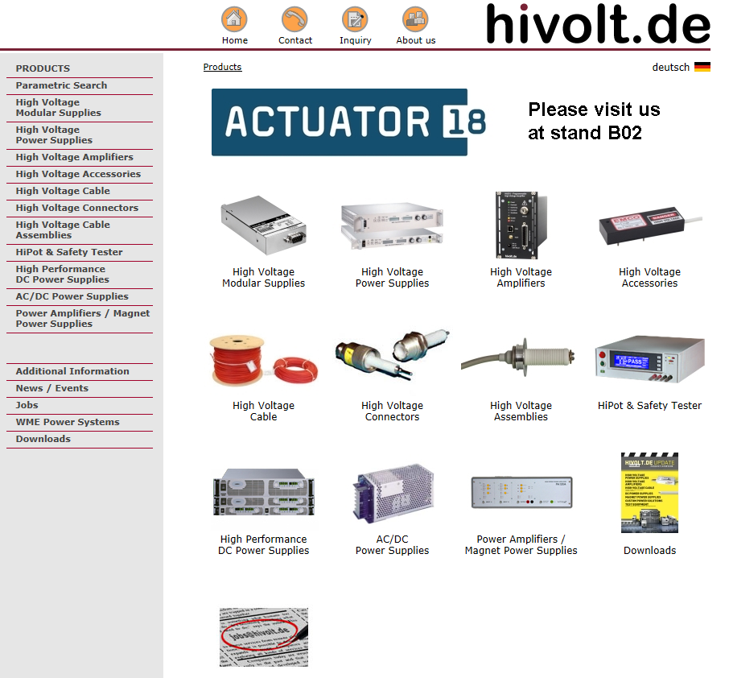
http://www.hivolt.de/fileadmin/hivolt/pdf/VP-CL_e.pdf
http://www.hivolt.de/fileadmin/hivolt/pdf/Catalog_HV_Cable_Connectors.pdf

Slide 3
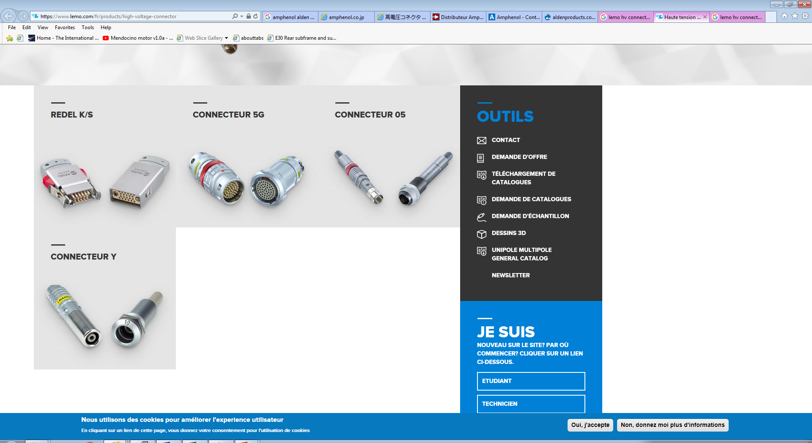
https://www.lemo.com/fr/products/high-voltage-connector

Slide 4
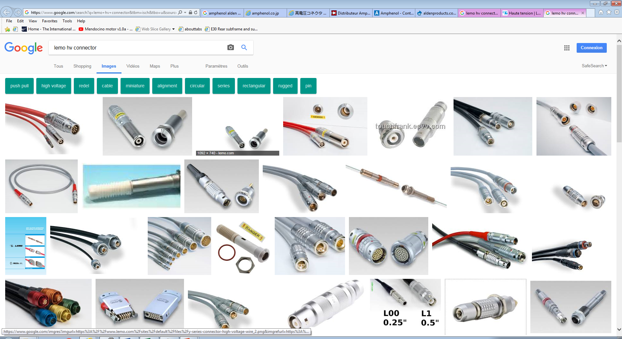

Slide 5
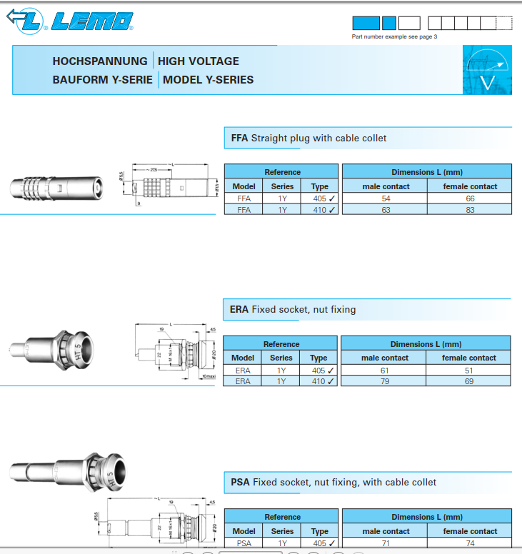
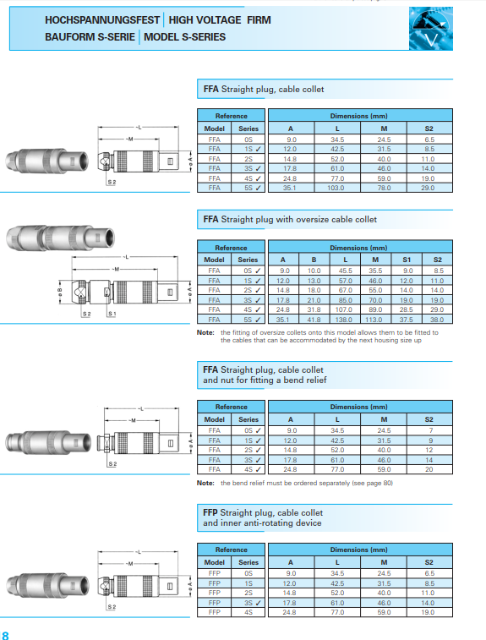
https://www.lemo.com/catalog/ROW/UK_English/high_voltage.pdf

Slide 6
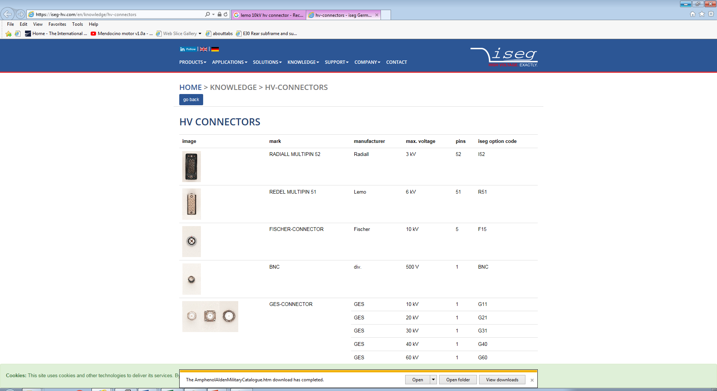
ISEG
https://iseg-hv.com/en/knowledge/hv-connectors

Slide 7
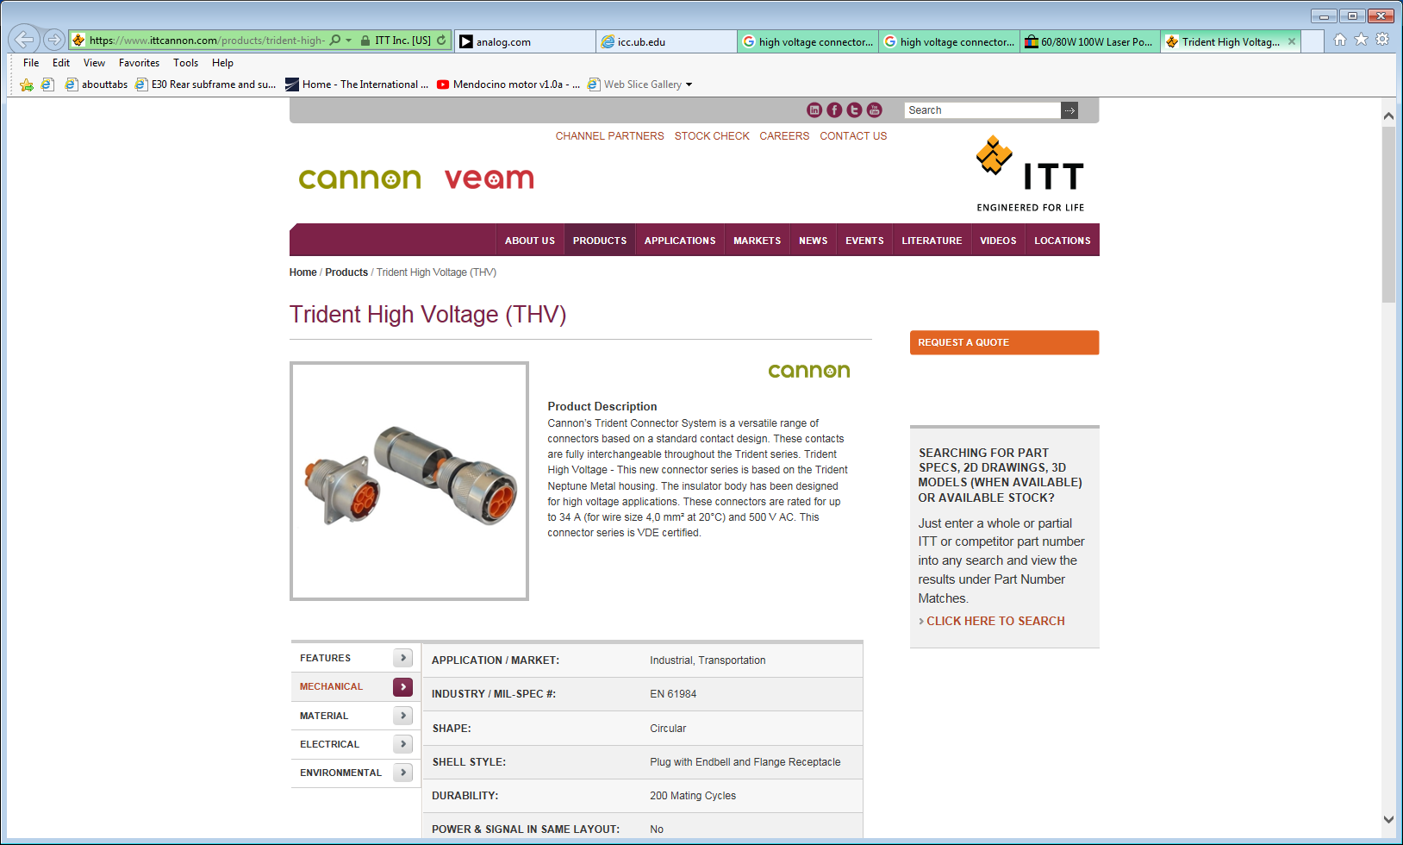
https://www.ittcannon.com/products/trident-high-voltage-(thv)/

Slide 8
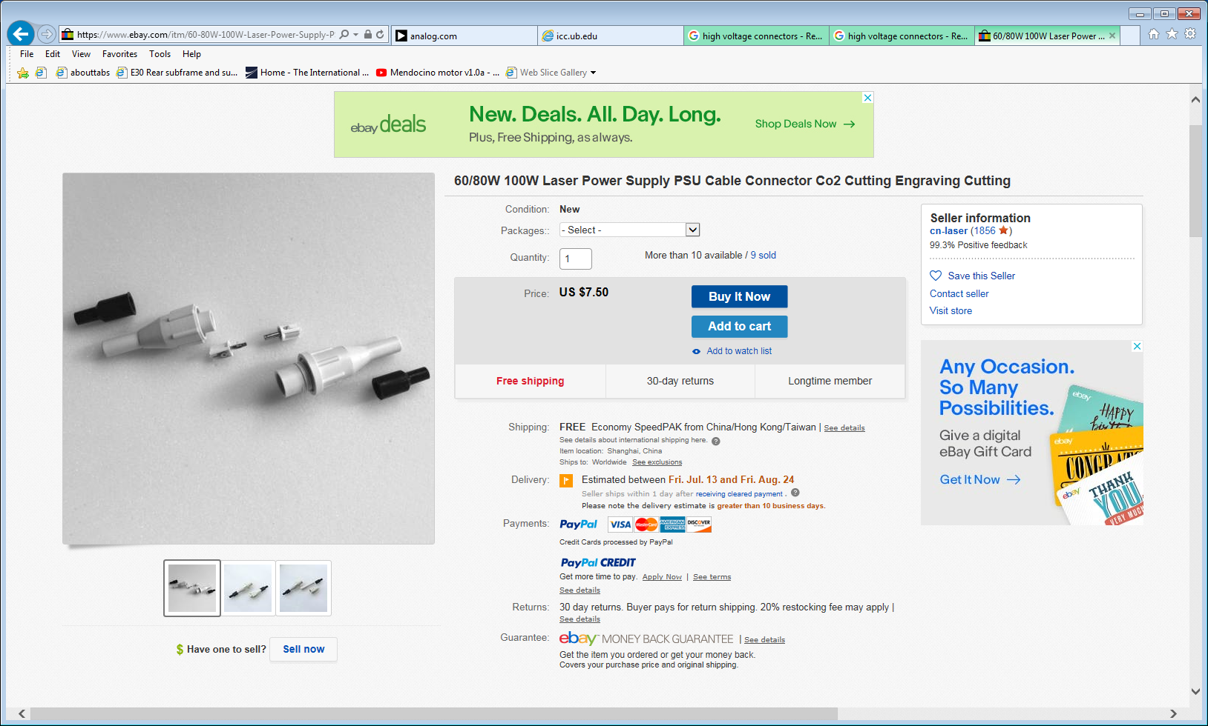
https://www.ebay.com/itm/60-80W-100W-Laser-Power-Supply-PSU-Cable-Connector-Co2-Cutting-Engraving-Cutting/222090741963?_trkparms=aid%3D222007%26algo%3DSIM.MBE%26ao%3D2%26asc%3D44039%26meid%3D969807e732084a79bcc864a96bd4161f%26pid%3D100005%26rk%3D1%26rkt%3D9%26sd%3D321135902636%26itm%3D222090741963&_trksid=p2047675.c100005.m1851

Slide 9
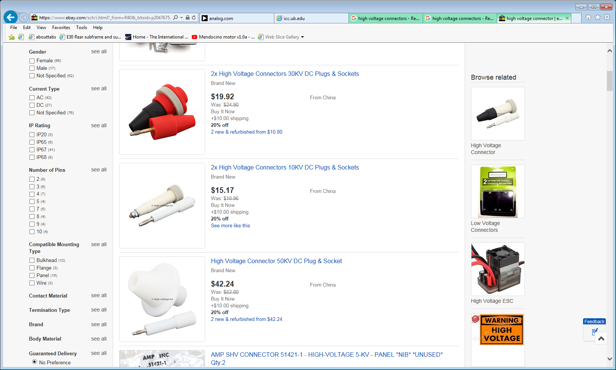
https://www.ebay.com/sch/i.html?_from=R40&_trksid=p2047675.m570.l1313.TR1.TRC0.A0.H0.Xhigh+voltage+connector.TRS0.TSS0&_nkw=high+voltage+connector&_sacat=0

Slide 10
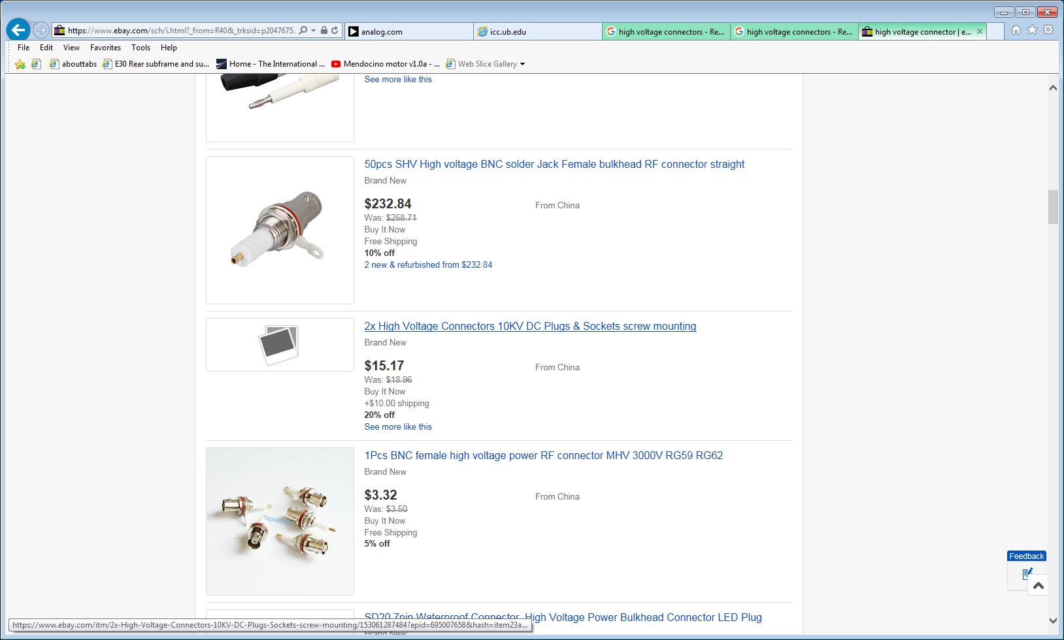

Slide 11
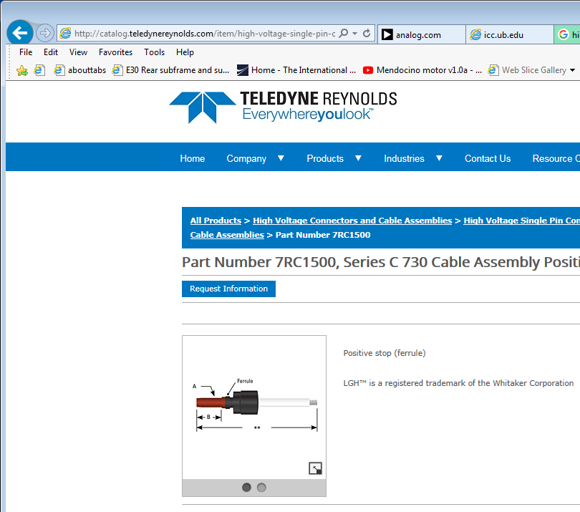
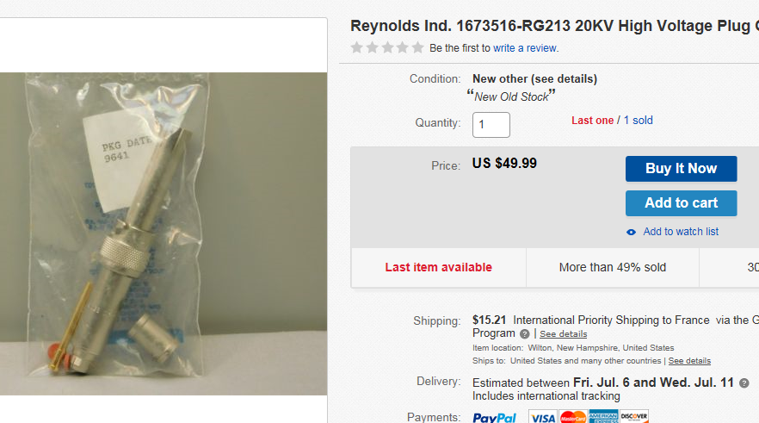
http://catalog.teledynereynolds.com/item/high-voltage-single-pin-connectors/eries-lgh-compatible-high-voltage-cable-assembli-2/7rc1500

Slide 12
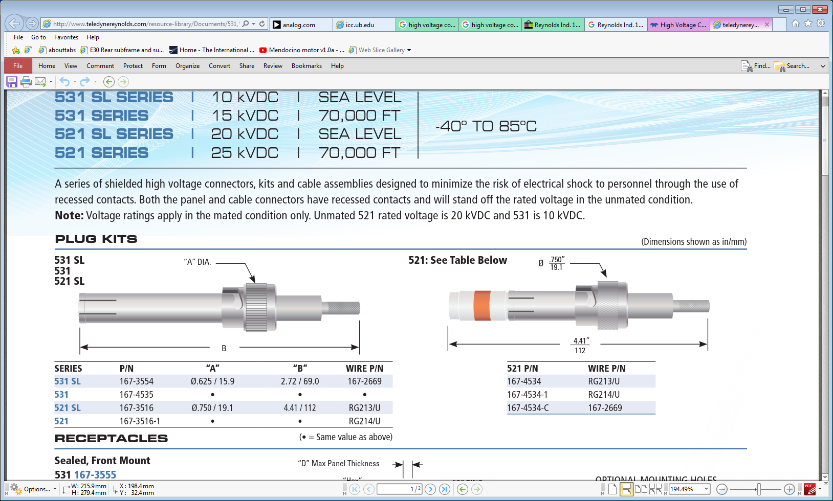
http://www.teledynereynolds.com/resource-library/Documents/531,%20531%20SL,%20521,%20521%20SL%20Series.pdf
http://www.teledynereynolds.com/products/high-voltage-connectors-and-assemblies/single-pin

Slide 13
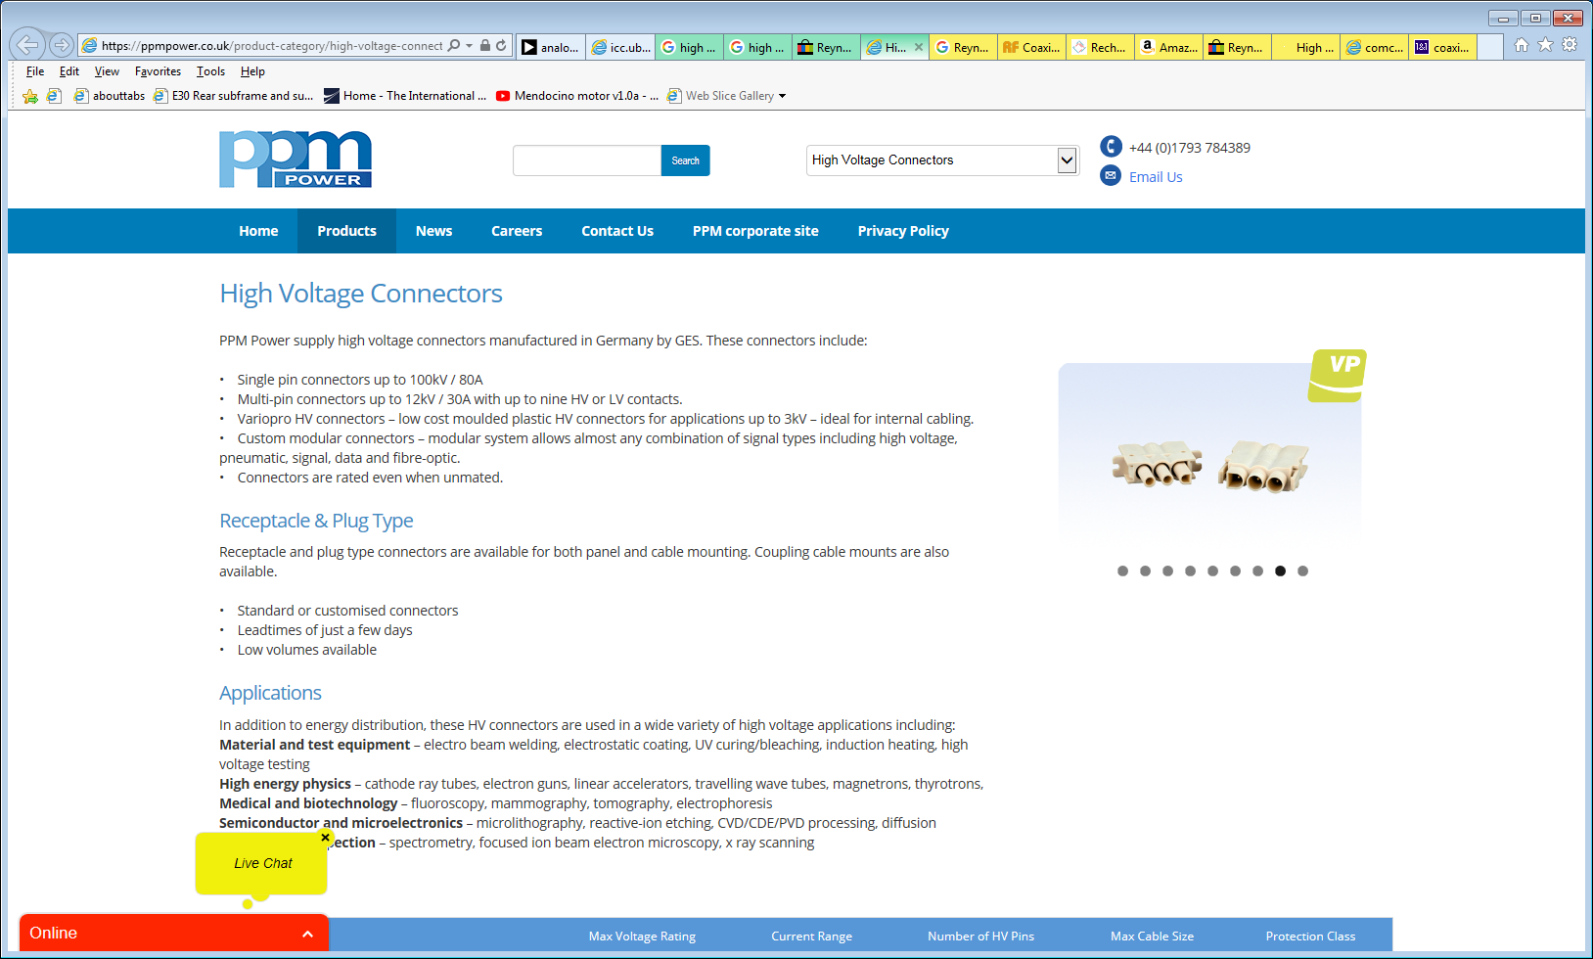
https://ppmpower.co.uk/product-category/high-voltage-connectors/

Slide 14
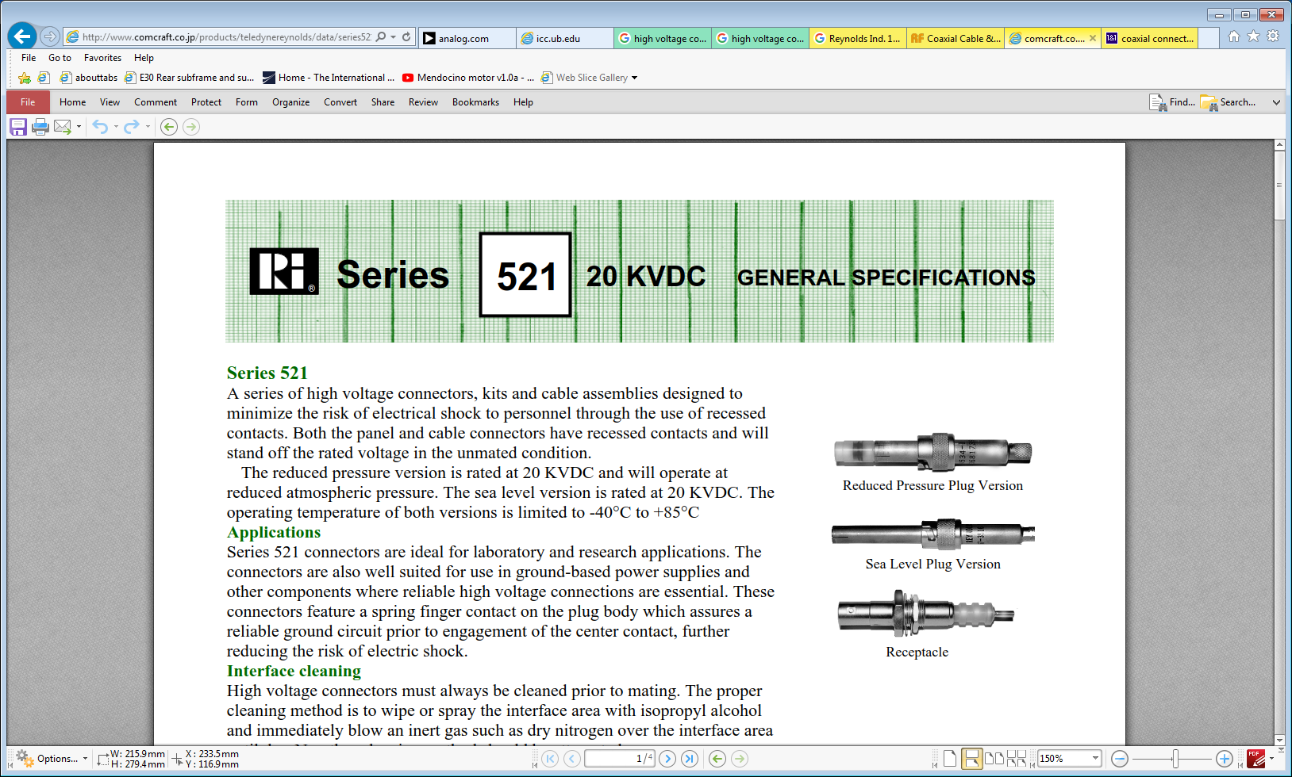
http://www.comcraft.co.jp/products/teledynereynolds/data/series521.pdf

Slide 15
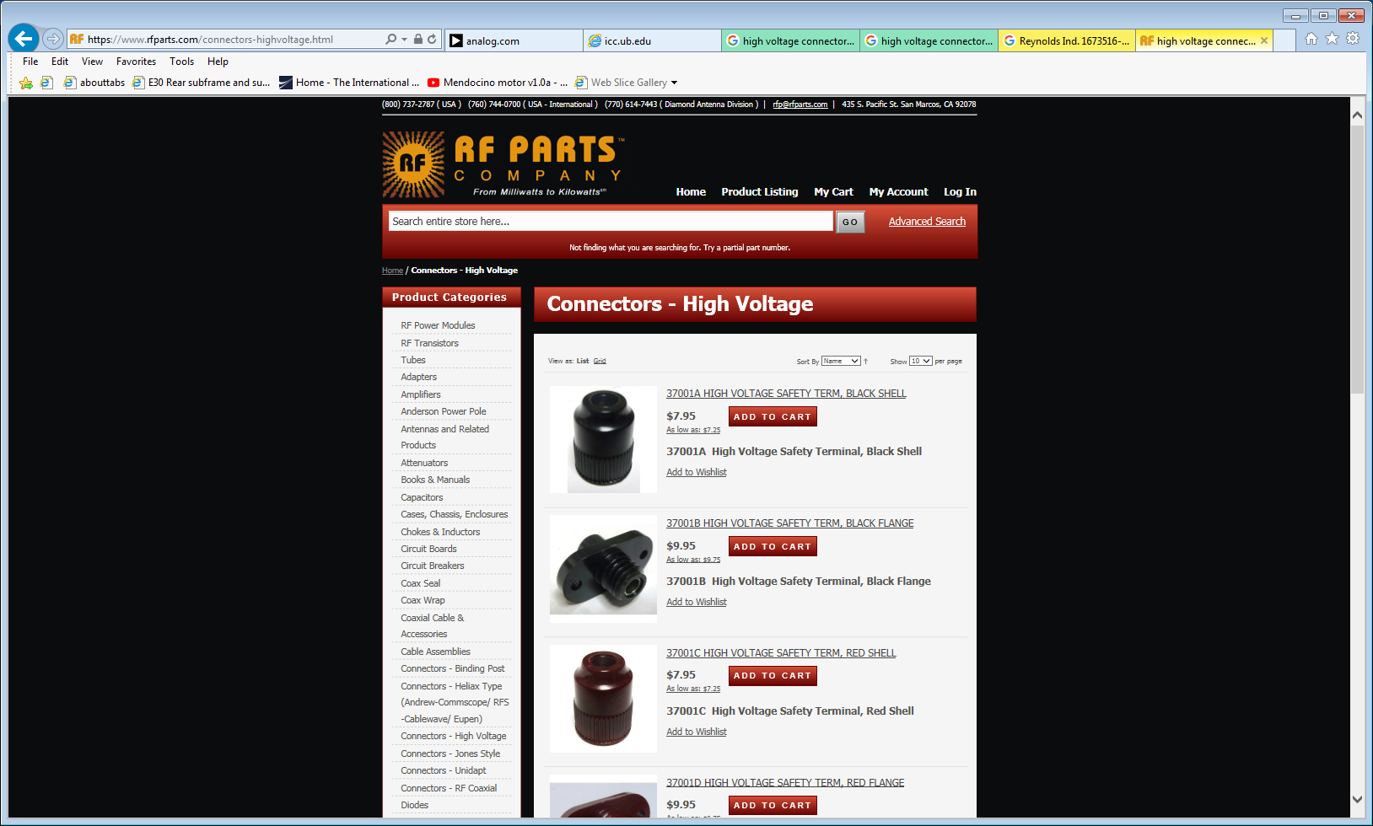
https://www.rfparts.com/connectors-highvoltage.html

Slide 16
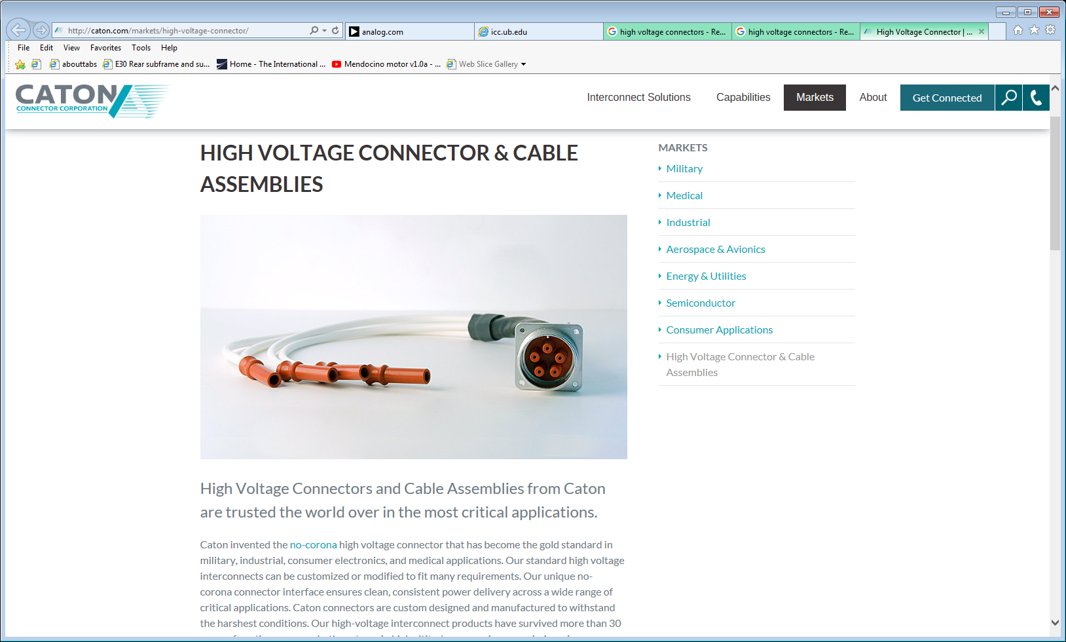
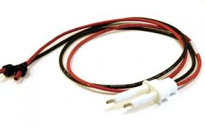
http://caton.com/markets/high-voltage-connector/

Slide 17
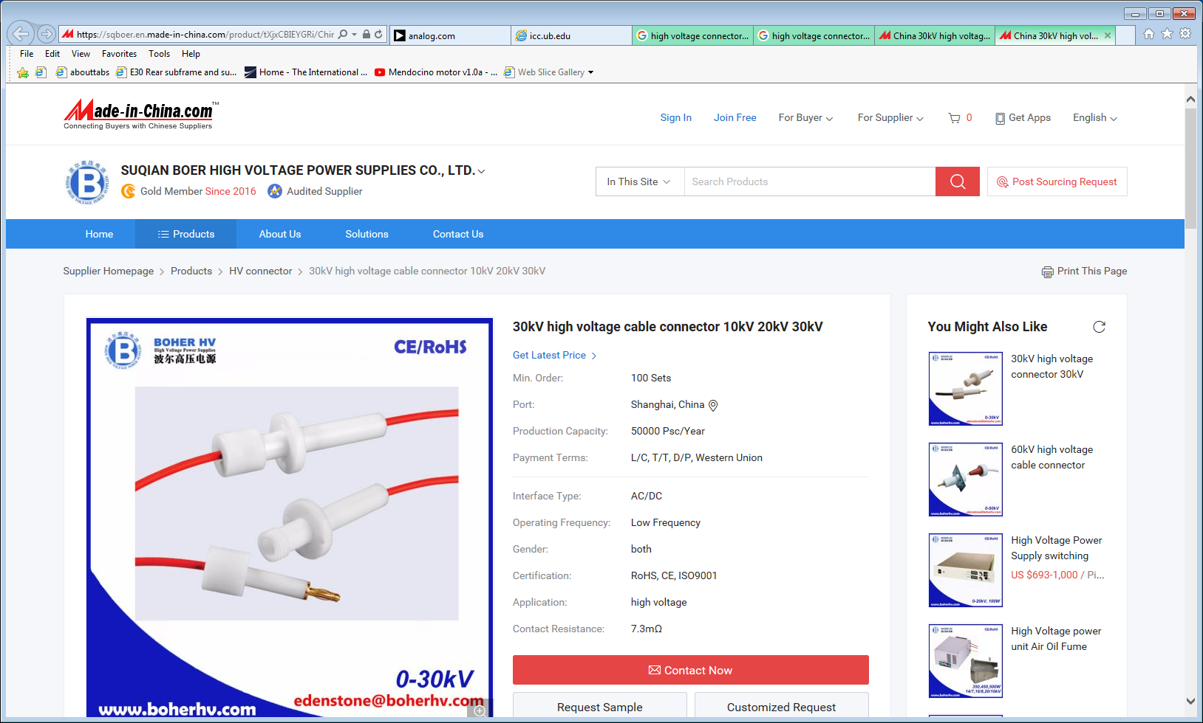

Slide 18
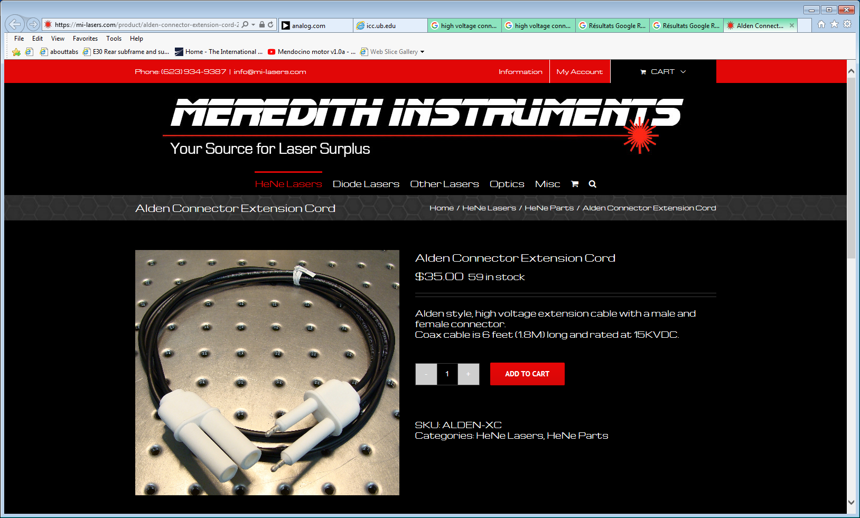
https://mi-lasers.com/product/alden-connector-extension-cord-2/

Slide 19
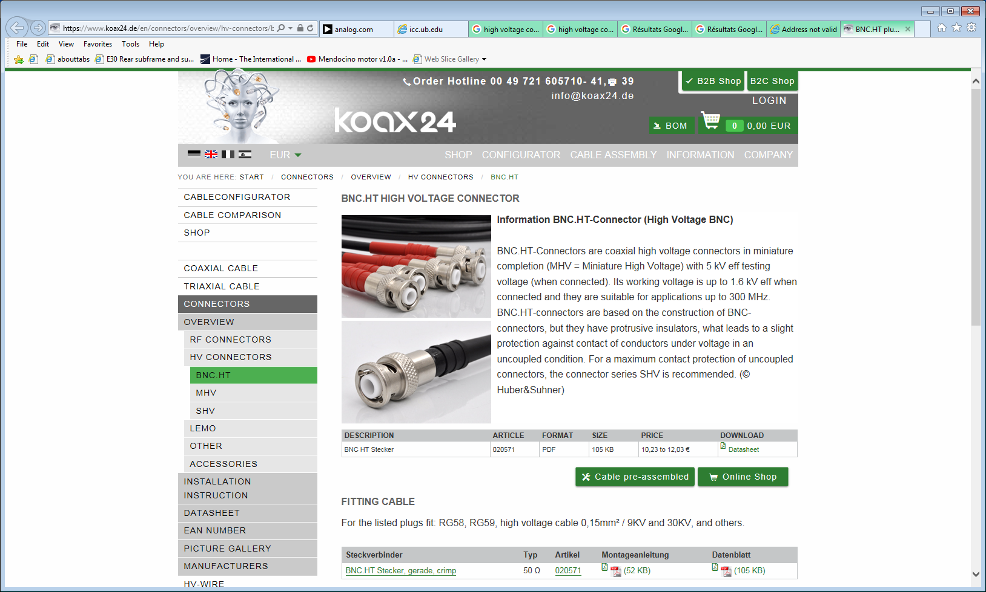
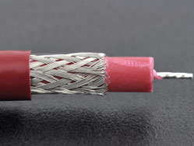
https://www.koax24.de/en/connectors/overview/hv-connectors/bncht.html

Slide 20
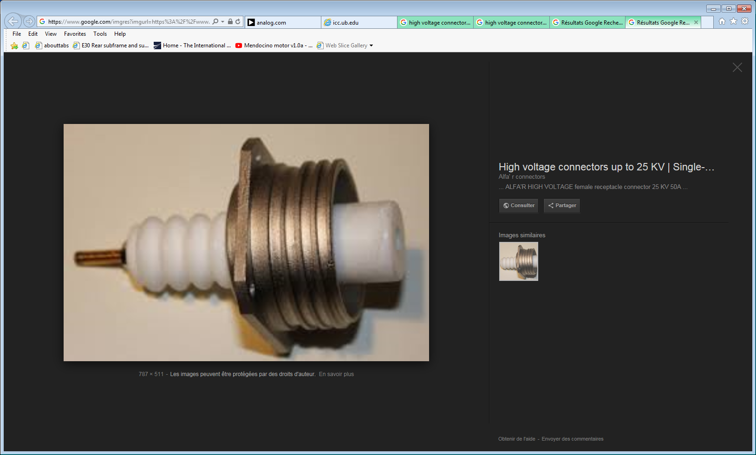
https://www.google.com/imgres?imgurl=https%3A%2F%2Fwww.alfarconnectors.com%2Fwp-content%2Fuploads%2F2017%2F12%2FHIGH-VOLTAGE-female-receptacle-connector-25-KV-50A-2.jpg&imgrefurl=https%3A%2F%2Fwww.alfarconnectors.com%2Findustrial-connectors%2Felectric-contacts%2Fhigh-voltage%2F&docid=vQbP2VuB0kT6GM&tbnid=1Y3o2RJT1VL7VM%3A&vet=12ahUKEwjzv7Df0fPbAhUpIJoKHXgzA8Q4yAEQMygFMAV6BAgBEAY..i&w=787&h=511&bih=859&biw=1612&q=high%20voltage%20connectors&ved=2ahUKEwjzv7Df0fPbAhUpIJoKHXgzA8Q4yAEQMygFMAV6BAgBEAY&iact=mrc&uact=8

Slide 21
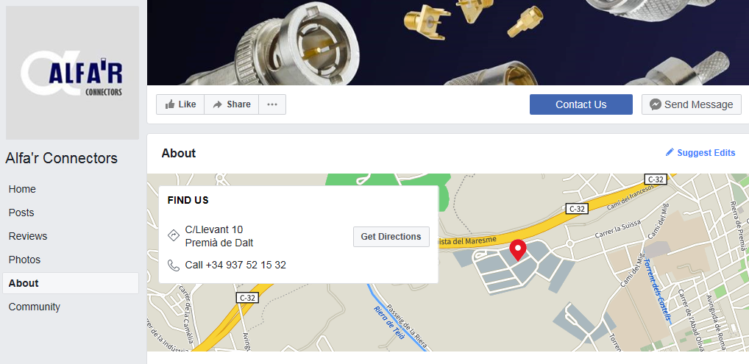
https://www.facebook.com/pg/Alfar-Connectors-458735687859722/about/?ref=page_internal

Slide 22
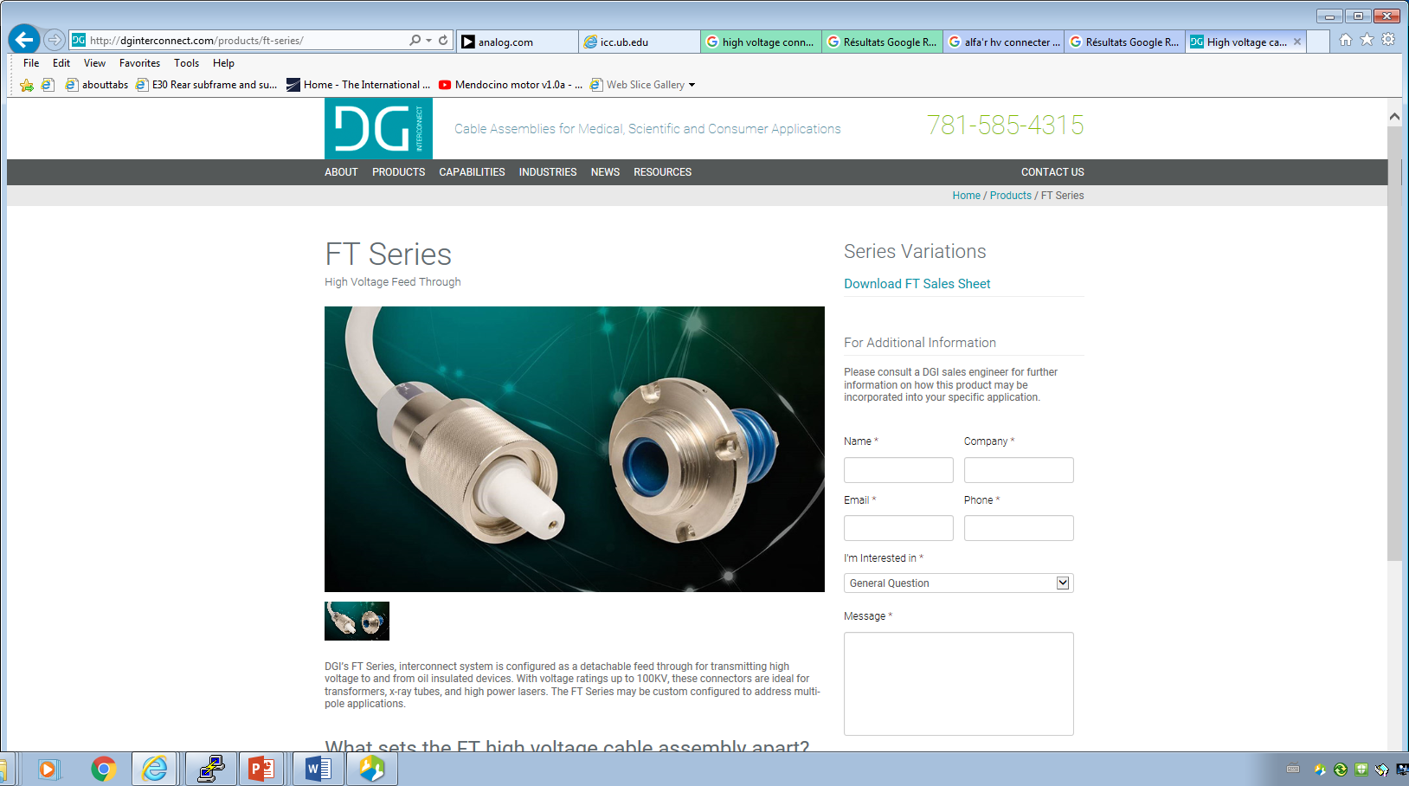
http://dginterconnect.com/products/ft-series/

Slide 23
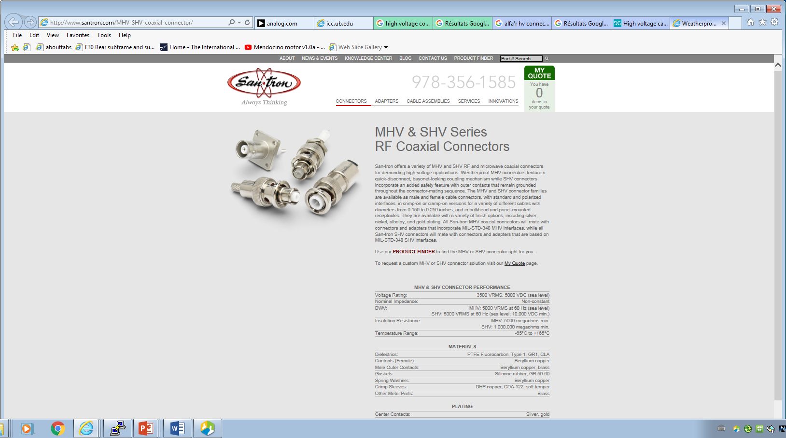
http://www.santron.com/MHV-SHV-coaxial-connector/

