Slide 1
HV connectors as proposed by Pigi 7 June 2018
Ian
13 June 2018

Slide 2
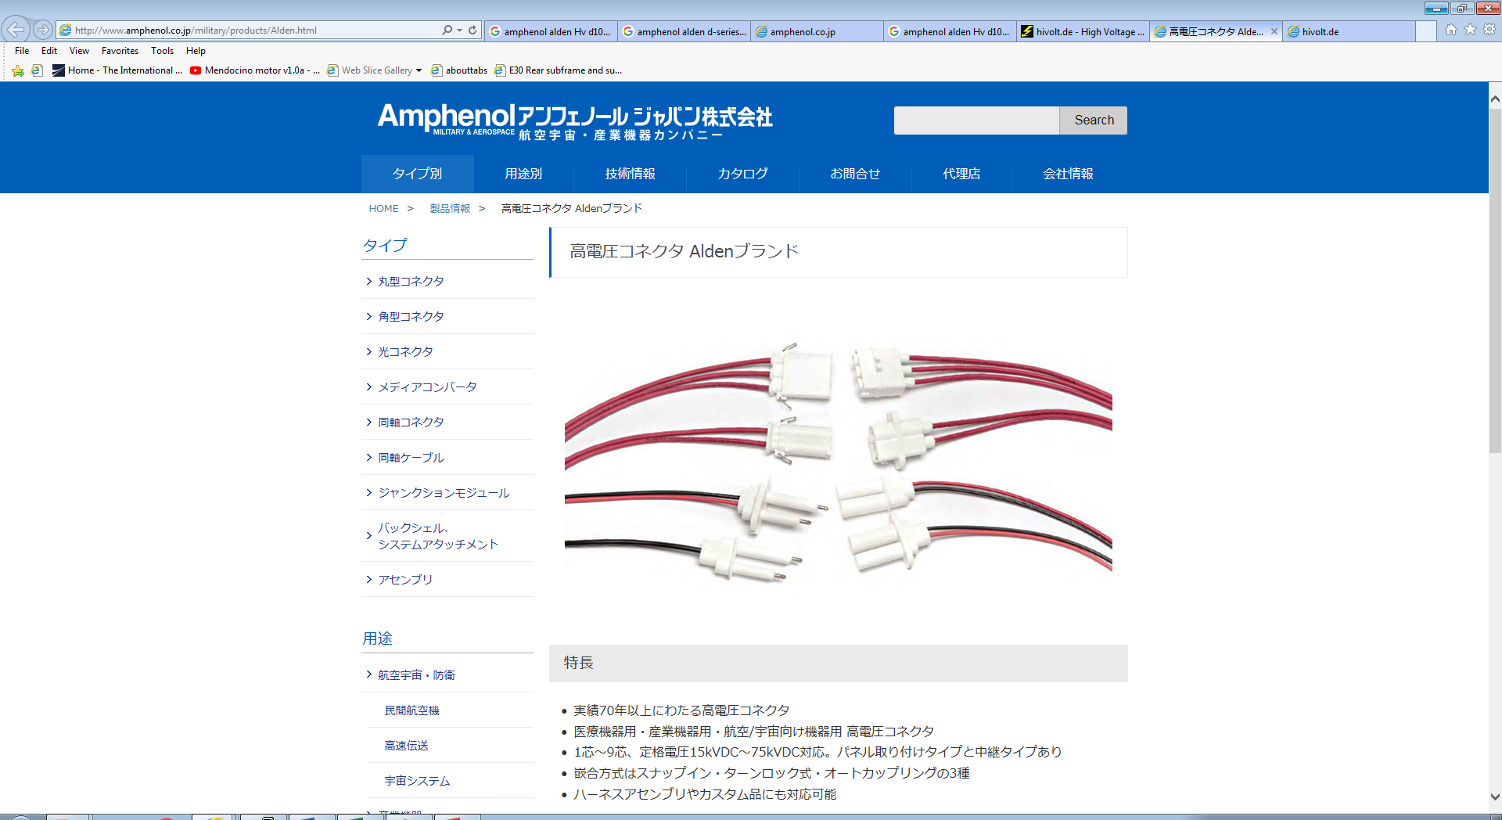
http://www.amphenol.co.jp/military/products/Alden.html

Slide 3
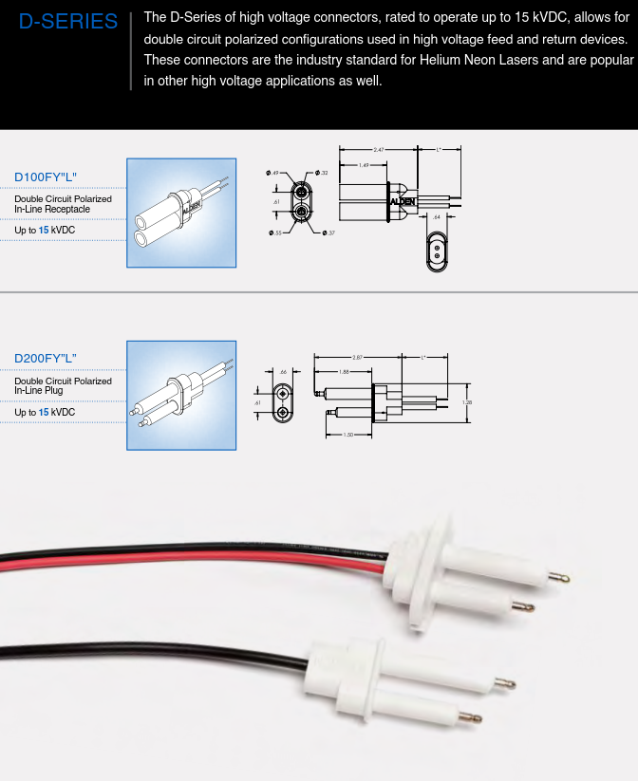
http://www.amphenol.co.jp/military/catalog/AldenHighVoltage.pdf

Slide 4
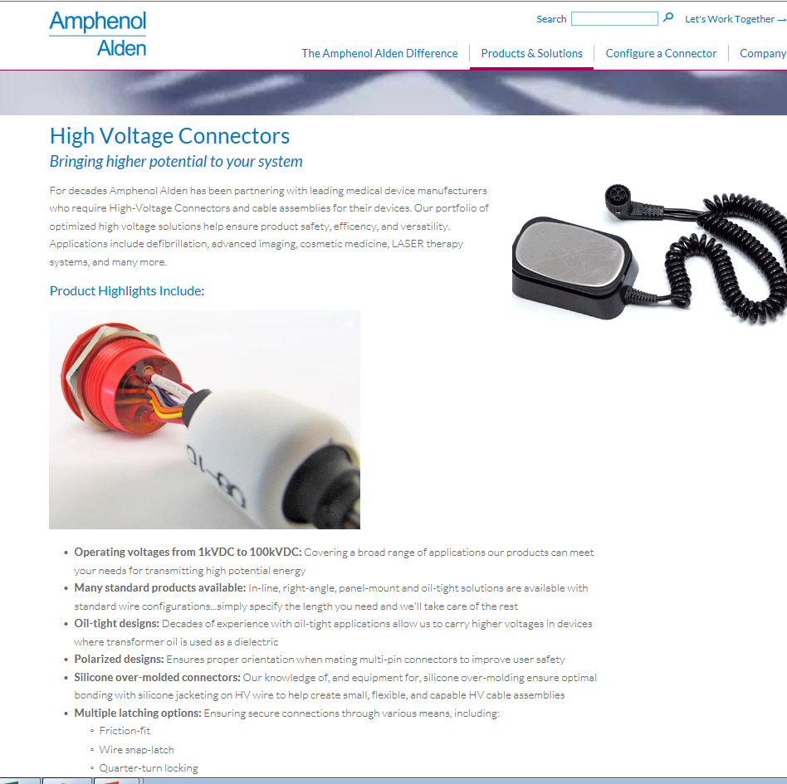
https://www.aldenproducts.com/medical-interconnect-products-solutions/high-voltage-connectors

Slide 5
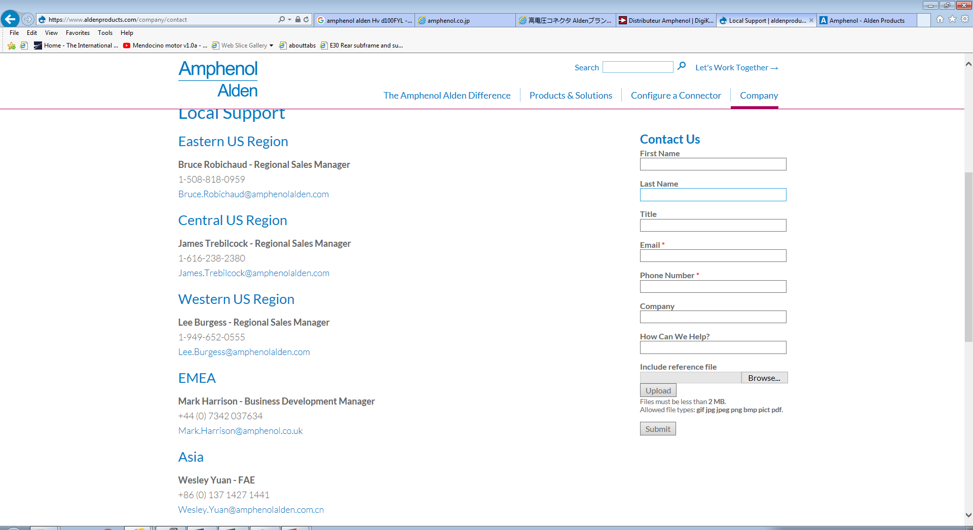
https://www.aldenproducts.com/company/contact
Amphenol UK Ltd
Tel: 01227 773200
composite@amphenol.co.uk
www.amphenol.co.uk

Slide 6
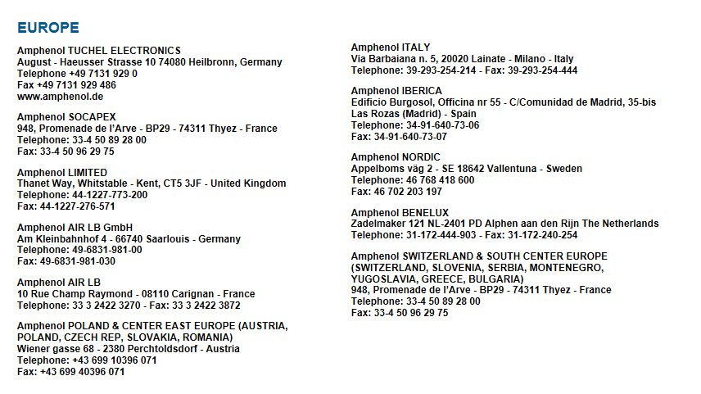

Slide 7
