Slide 1
RPC Power System Review
Anton Dimitrov
RPC Upgrade Workshop,
23.Jul.2018, CERN
Updated: 17.Sep.2020 for yet another RPC Upgrade Workshop
https://twiki.cern.ch/twiki/bin/view/CMS/Services_RPCPhase2Upgrade

Slide 2
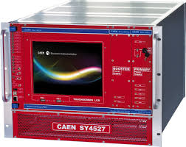
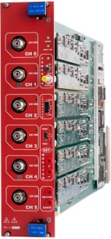
HV Power System Upgrade for RE3/1 & RE4/1 (I)
USC
UXC
SY4527
The HV power system will be based on CAEN NON-EASY system:
SY4527 – 2 (new)
12 New HV boards – prototype ready in 2019
Preferred Variant: Variant I
4 HV multiconductor cables per endcap. Each with 20 HV channels
All must go via the YE1’s main cable chains (MCC)
New boards
INSTALLED
JAN.2019
Long term maintenance will be secured by CERN-CAEN contract.
To be integrated in the RPC DCS.
2

Slide 3
S1H12
S1H07
HEX
HEX
HV Distribution Box
ENDCAP RACKS
S1H11 – S1H08
HV Distribution Box
SY4527
SY4527
HV Distribution Box
SY4527
HV Distribution Box
- No EASY system ➔ no EASY crates
- 2 SY4527 mainframes more
- 8 umbilical cables all arriving to one rack (S1H12)
- New type of HV boards!
- 8 HV Distributor Boxes in total (all in one rack), but bigger in size
since all inputs and outputs should be at the back side of the rack
- No rack cross reference in DSS Action Matrix
HEX
HV Distribution Box
HEX
HV Distribution Box
A3485S
SY4527
A3485S
A3485S
HV Distribution Box
A3485S
HV Distribution Box
2

Slide 4
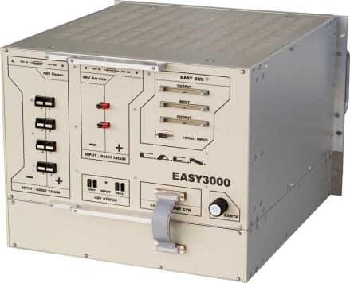
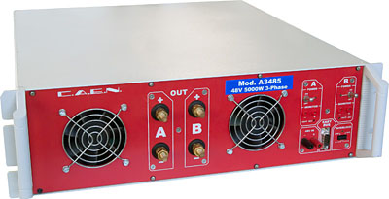
HV Power System Upgrade for RE3/1 & RE4/1 (II)
USC
UXC
SY4527
The HV power system will be based on CAEN EASY system
(practically, extension of the existing HV system):
SY4527 – 1 (existing)
A3485S - 2 modules (existing)
2 EASY3000 crates
A3512N – 12 HV Boards
TDR Baseline: Variant II
EASY3000
4 HV multiconductor cables per endcap. Each with 20 HV channels
All must go via the YE1’s main cable chains (MCC)
A3485S
A3512N
INSTALLED
JAN.2019
Long term maintenance will be secured by CERN-CAEN contract.
To be integrated in the RPC DCS.
3

Slide 5
S1H12
S1H07
HEX
HEX
HV Distribution Box
ENDCAP RACKS
S1H11 – S1H08
HV Distribution Box
HV Distribution Box
SY4527
HV Distribution Box
HV Distribution Box
HV Distribution Box
HEX
SY4527
HV Distribution Box
HV Distribution Box
48V DC cable connected after Crate3 in rack S1H09
Crate4
RE+3/1
RE+4/1
HEX
1 new rack (S1H12)
2 EASY crates
8 umbilical cables all arriving to one rack
12 A3512N HV boards (6 boards in each crate)
8 HV Distributor Boxes in total (all in one rack)
A3485S
Crate4
RE-3/1
RE-4/1
A3485S
48V DC cable connected after Crate3 in rack S1H11
A3485S
A3485S
4

Slide 6
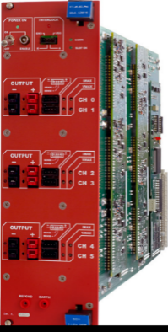
RPC LV Power System for RE3/1 & RE4/1
USC
UXC
YE+3: X2J52, X3J51, X3A51, X4A51
YE-3: X2V52, X3V51,X3S51, X4S51
CAEN EASY3000S
with CAEN A3009B
in X2Near && X4Far racks
Existing RE3&RE4 detector
SY4527 with A1676A
20 A3009B LV boards in total to power the FE of all RE3/1 and RE4/1 chambers.
9U in each X4Far YE3 tower rack for
  1 CAEN EASY3000S crate
  1 CAEN A3486S MAO- AC/DC 48VDC PS
9U in each X2Near YE3 tower rack for
  1 CAEN EASY3000S crate
  1 CAEN A3486S MAO- AC/DC 48VDC PS
A3486S
going through YE1-YE3 mini cable chains to existing RE racks on X3
Relay
YE1 LV PP
50pin Communication bus
48V Service power
5

Slide 7
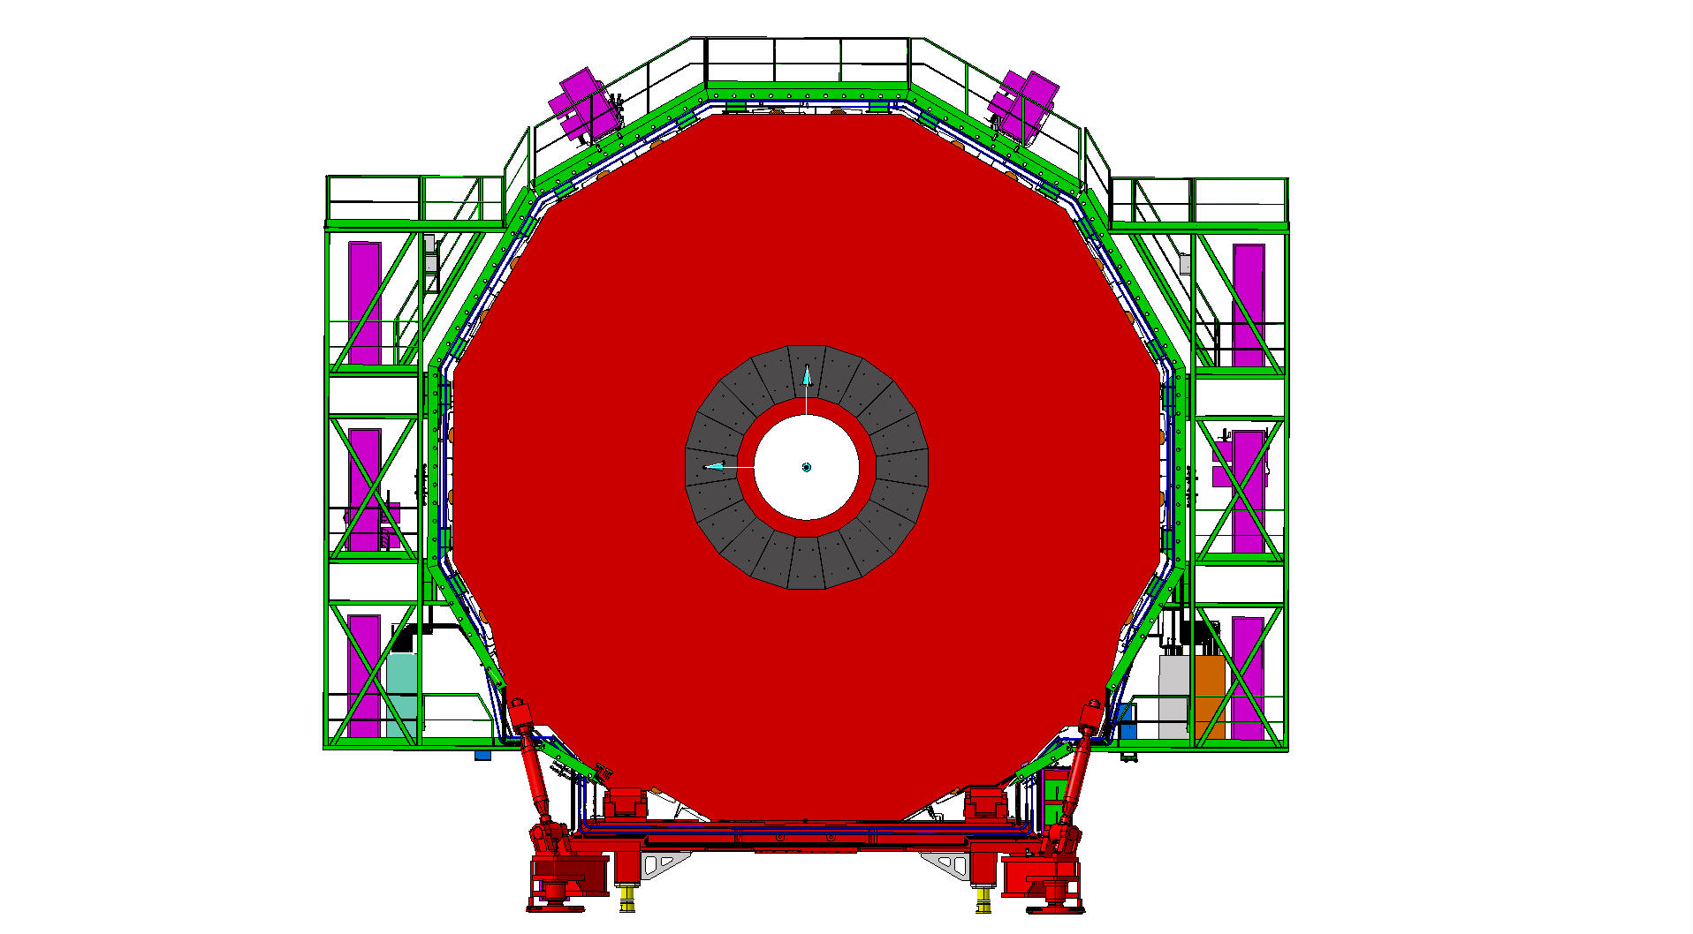
RPC LV Services
Near Side
Far Side
mini Cable Chains NEAR for
- LV power 230V 3-phase
(SCEM 04.08.80.072.6)
- DCS Communication 25TWP
(SCEM 04.21.51.550.4)
- 48VDC Service power
(SCEM 04.08.61.450.0)
mini Cable Chains FAR for
- LV power 230V 3-phase
(SCEM 04.08.80.072.6)
- DCS Communication 25TWP
(SCEM 04.21.51.550.4)
- 48VDC Service power
(SCEM 04.08.61.450.0)
X4
Existing RE3/RE4 LV Easy3000S crates
Existing RE3/RE4 LV Easy3000S crates
X2
X2Near – X4Far
diagonal
6

Slide 8
Far Side
YE+3
Near Side
X3A51
X4A51
X3J51
X2J52
Power Distribution
Power Distribution
Power Distribution
Power Distribution
Turbine
Turbine
Turbine
Turbine
HEX
HEX
HEX
EMU Maraton
EMU VME
RE3 LBB
EMU VME
HEX
1U CSC panel
RE3-4/1 FE EASY3000S
Crate2
EMU Maraton
EMU
EMU
HEX
RE4 LBB
RE4 LBB
RE4 LBB
RE4 LBB
RE3-4 LBB EASY3000S
Crate1
RE3-4 LBB EASY3000S
Crate1
RE A3486S AC/DC-1
CH0 CH1
FOS
RE3-4 FEB EASY3000S
Crate0
DSS 3U box
RE3-4 FEB EASY3000S
Crate0
RE A3486S AC/DC-1
CH0 CH1
EMU Maraton
RE3-4/1 FE EASY3000S
Crate2
RE A3486S AC/DC-0
CH0 CH1
HEX
RE A3486S AC/DC-0
CH0 CH1
EMU Maraton
Cable Distribution
Cable Distribution
RE3 LBB
RE4 LBB
HEX
RE3 LBB
HEX
Cable Distribution
HEX
HEX
Air Deflector
Air Deflector
Air Deflector
Air Deflector
Power Dist.
Power Dist.
Power Dist.
Power Dist.

Slide 9
Far Side
YE-3
Near Side
X3S51
X4S51
X3V51
X2V52
Power Distribution
Power Distribution
Power Distribution
Power Distribution
Turbine
Turbine
Turbine
Turbine
HEX
HEX
HEX
EMU Maraton
EMU VME
RE3 LBB
EMU VME
HEX
1U CSC panel
RE3-4/1 FE EASY3000S
Crate2
EMU Maraton
EMU
EMU
HEX
RE4 LBB
RE4 LBB
RE4 LBB
RE4 LBB
RE3-4 LBB EASY3000S
Crate1
RE3-4 LBB EASY3000S
Crate1
RE A3486S AC/DC-1
CH0 CH1
FOS
RE3-4 FEB EASY3000S
Crate0
DSS 3U box
RE3-4 FEB EASY3000S
Crate0
RE3-4/1 FE EASY3000S
Crate2
EMU Maraton
RE A3486S AC/DC-0
CH0 CH1
HEX
RE A3486S AC/DC-0
CH0 CH1
RE A3486S AC/DC-1
CH0 CH1
EMU Maraton
Cable Distribution
HEX
Cable Distribution
RE3 LBB
RE4 LBB
RE3 LBB
HEX
Cable Distribution
HEX
HEX
Air Deflector
Air Deflector
Air Deflector
Air Deflector
Power Dist.
Power Dist.
Power Dist.
Power Dist.

Slide 10
Status Report of RPC Power Service Installation
Design the RPC Phase-II Upgrade Power System, DONE, Jun.2017
Install LV Power Distribution Cables between YE1PP and YE3X4 through mCC. Multiconductor cable with 7 conductors, 6 sq.mm. each for LV power (230V). INSTALLED, Sep.2020
Install 48V DC Power & Service cables between YE1PP (Far)/X4N19/55 (Near) and YE1X4. INSTALLED, Sep.2020
Install 50-pin DCS communication jumper cable between YE1PP and YE1X4. To be procured
Install 4 EASY3000S crates in racks X2J52, X4A51, X2V52, X4S51. INSTALLED, Jun.2019
Install 4 A1676A Branch Controllers with properly loaded maps. To be procured
Install 4 A3486S AC/DC 48 VDC power supplies (MAO). To be procured
Implement RPC Phase-II Power System Upgrade on DCS. EYETS23/24, upon chamber installation
9

