Slide 1
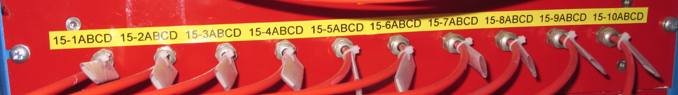
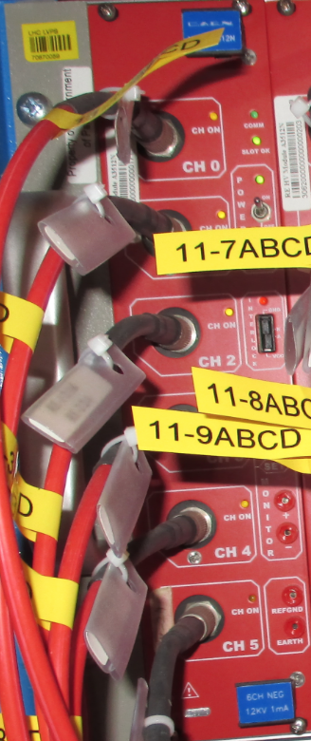
HV cables
USC
UXC
Patch panel: HV CPE connectors female/male
On the back : male and female connectors
YE1
Tripolar
HV cable : CPE Connectors CH-side
Distribution board
HV crate
HV board
Umbilical cable : 1 big cable = 10 individual cables
Coaxial cable
Umbilical has two different ends

