Slide 1
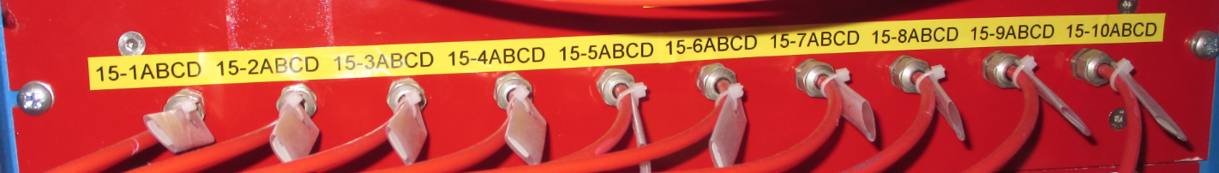
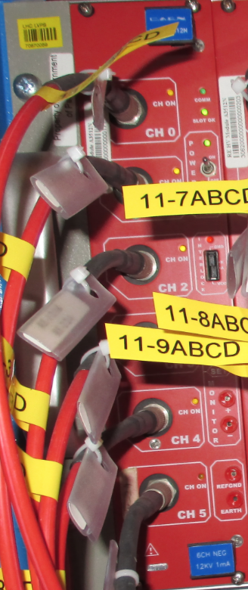
HV cables
Jupiter connector throughout
USC
UXC
Patch panel: HV CPE connectors female/male
On the back : male and female connectors
YE1
HV cable : dia 4.96mm
Distribution board
HV crate
HV board
Umbilical cable : 1 big cable = 10 individual cables = 20channels
X8 Umbilical cable from USC to UXC.
Dia 40mm
X36 HV cables dia 5mm in each Mini cable chain from YE1 PP to RE3/1 and RE4/1 stations
Coaxial cable

