Slide 1
PMA (ABB) as used by Polish trigger
Ian and andres
15 April 2019

Slide 2
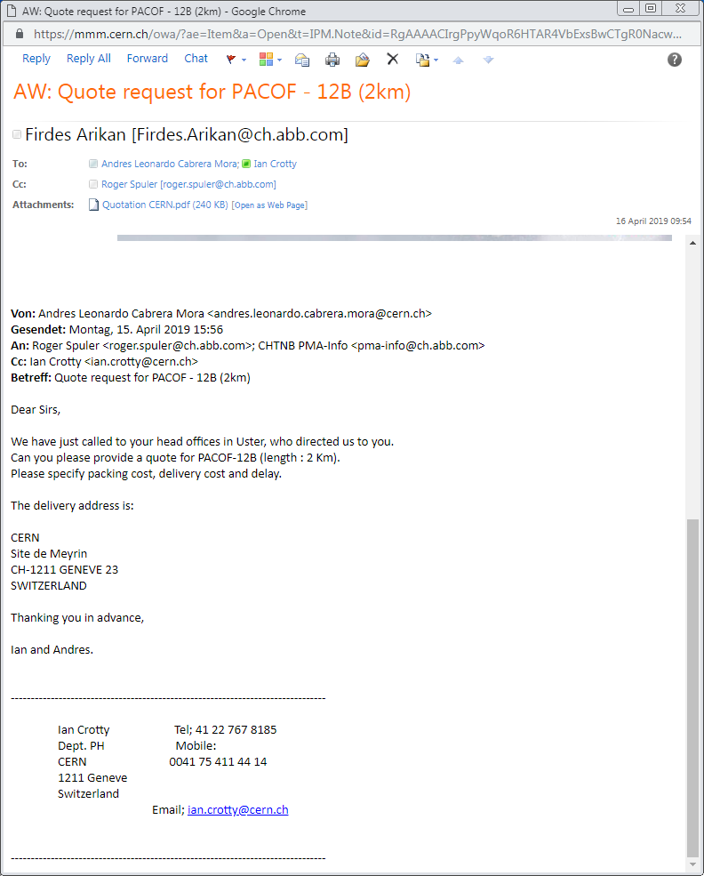
Email sent after call to ABB in Uster and obtained the name Mr Spuler.

Slide 3
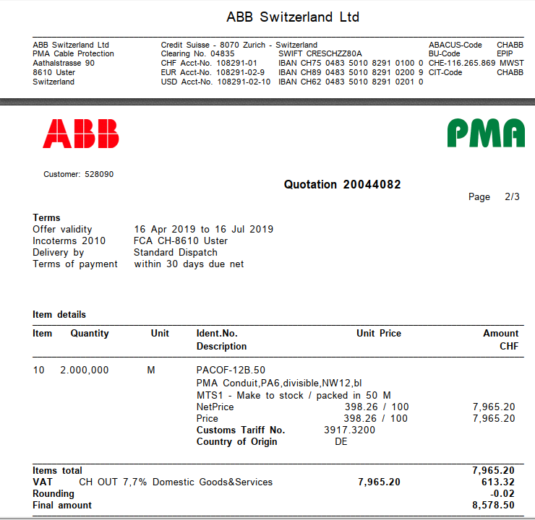
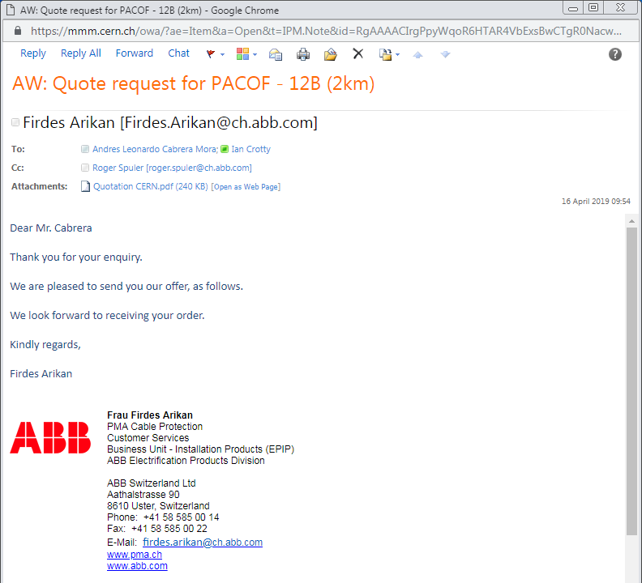
Delivery delay is not clear, called Spuler. He said call Mrs Arikan at 1130 16 april.
600m is ready on 16 April for immediate delivery
2km more is ready end April

Slide 4
Contacts for all companies contacted

Slide 5
