Slide 1
Justification T. Kramer
Ian
April

Slide 2
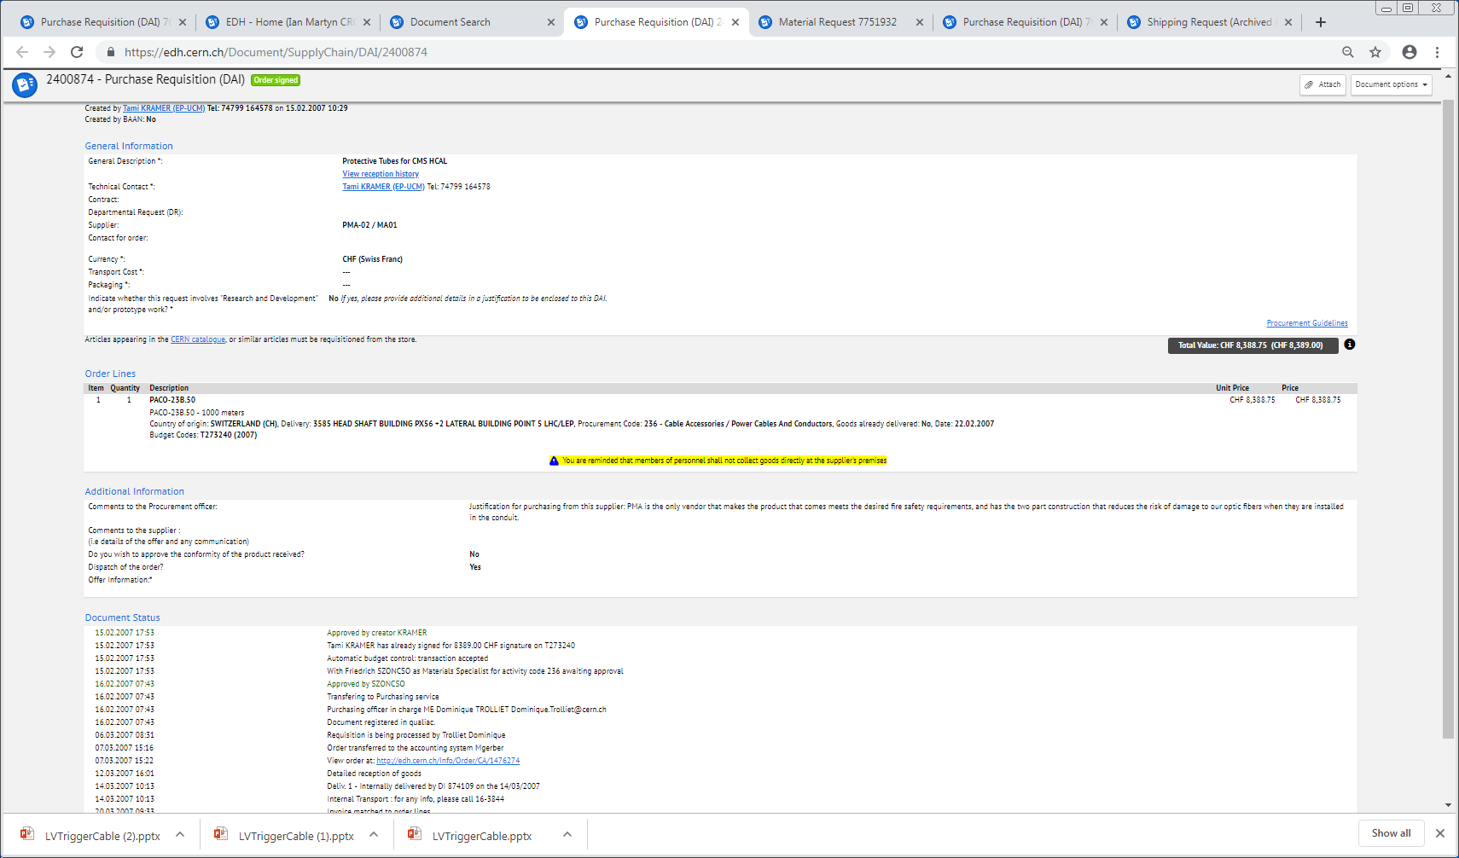

Slide 4
Justification for purchasing from this supplier: PMA is the only vendor that makes the product that comes meets the desired fire safety requirements, and has the two part construction that reduces the risk of damage to our optic fibers when they are installed in the conduit.

