Slide 1
Corrugated from Plica.ch
Ian & Andres
16 April 2019

Slide 2
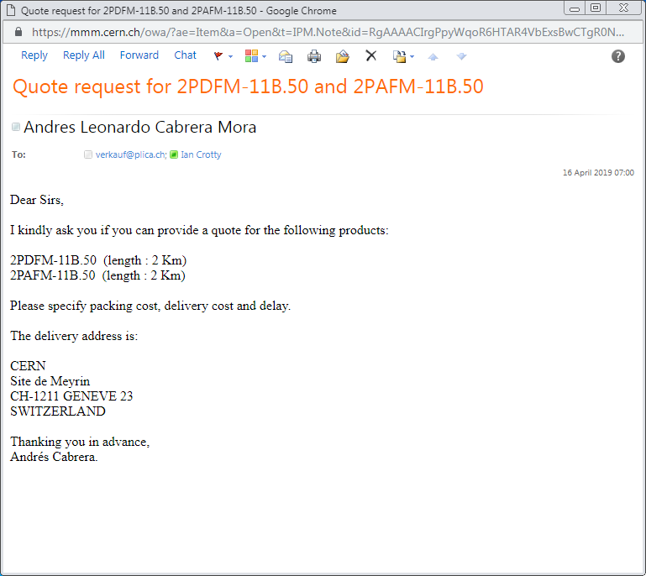
After call to 0041xxxxxx
On 15 April pm
They said they would reply in the middle of the week in order to check stock.

