Slide 1
T for Mini Manifold
Ian

Slide 2
Main catalogue
http://www.parker.com/Literature/Fluid%20Connectors%20Group/Fluid%20Connectors%20Group%20Static%20Files/F-Adapters.pdf

Slide 3
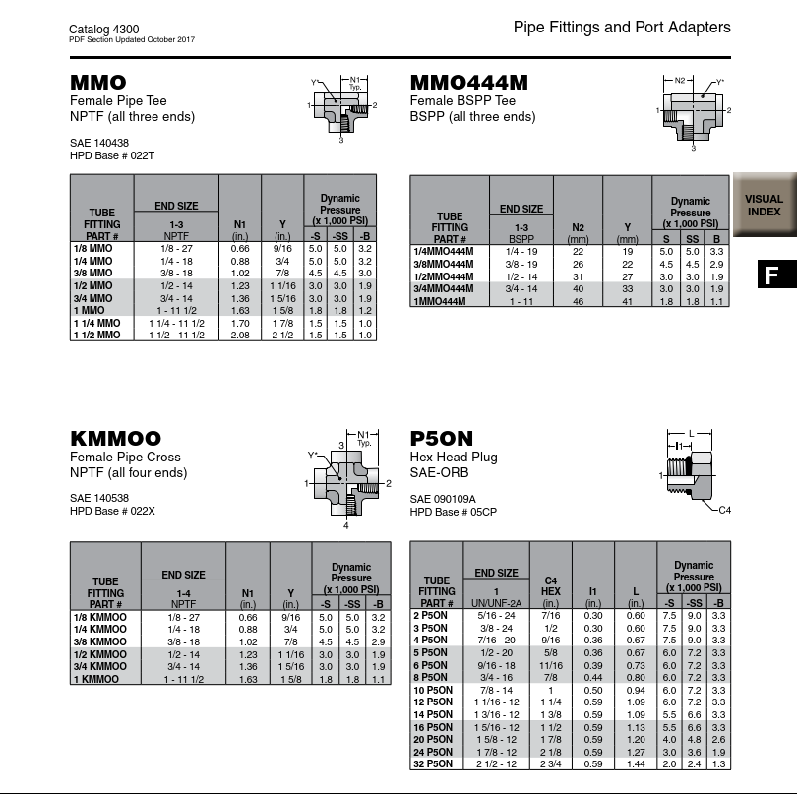
Steel ??
https://www.parker.com/literature/Tube%20Fittings%20Division/Pipe_Fittings_&_Port_Adapters.pdf

Slide 4
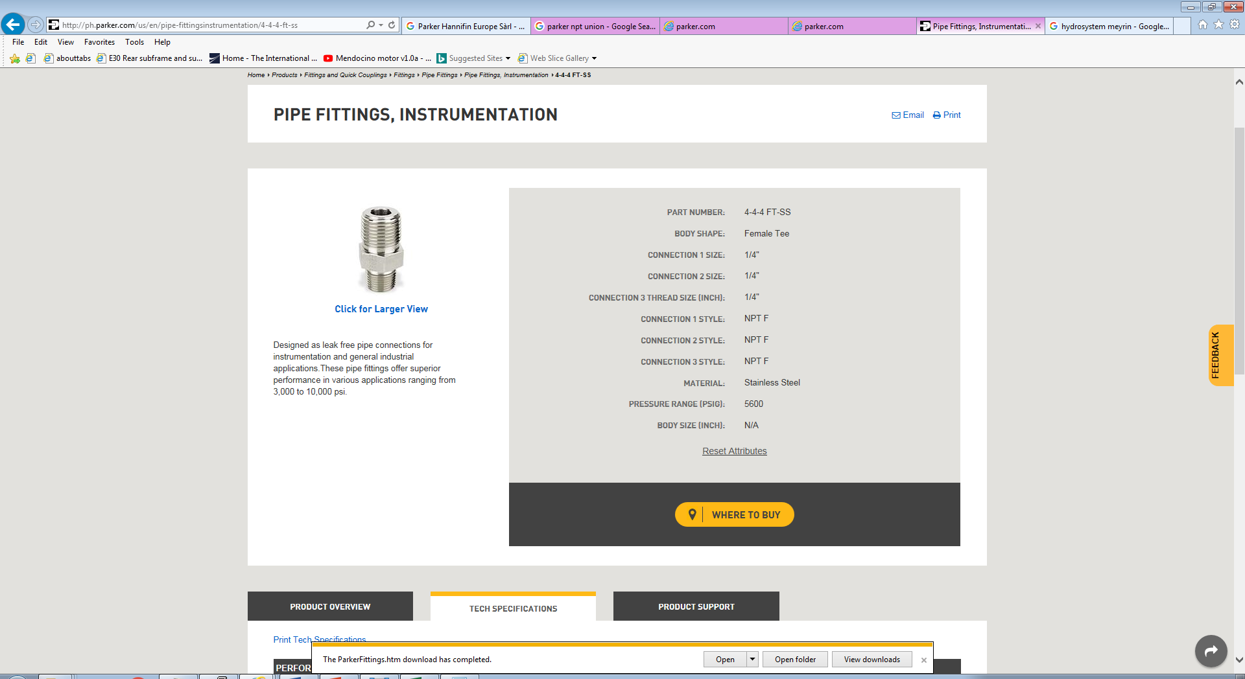
http://ph.parker.com/us/en/pipe-fittingsinstrumentation/4-4-4-ft-ss

Slide 5
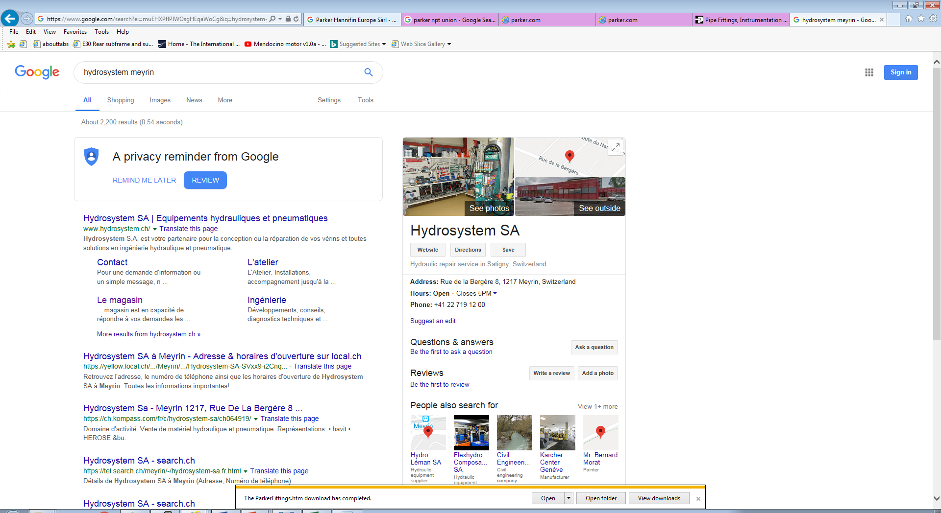

Slide 6
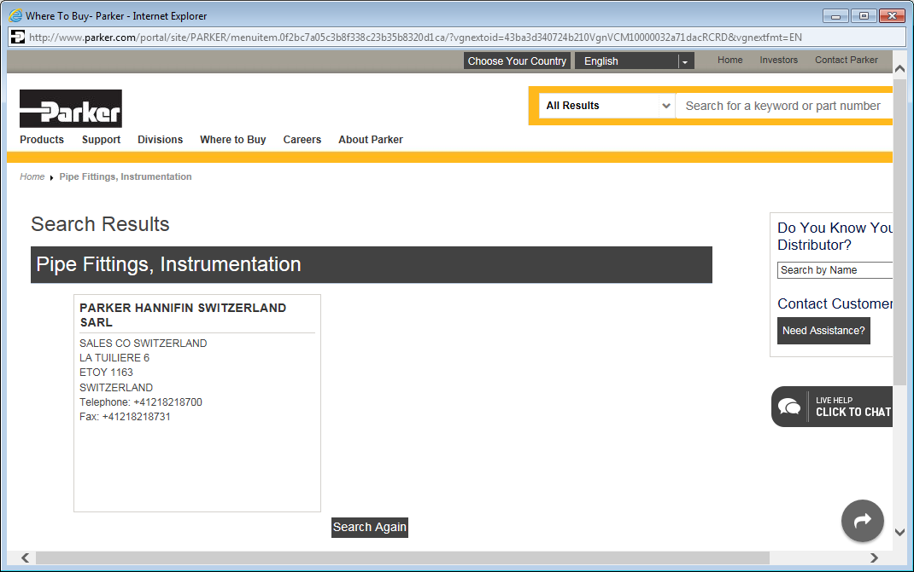

Slide 7
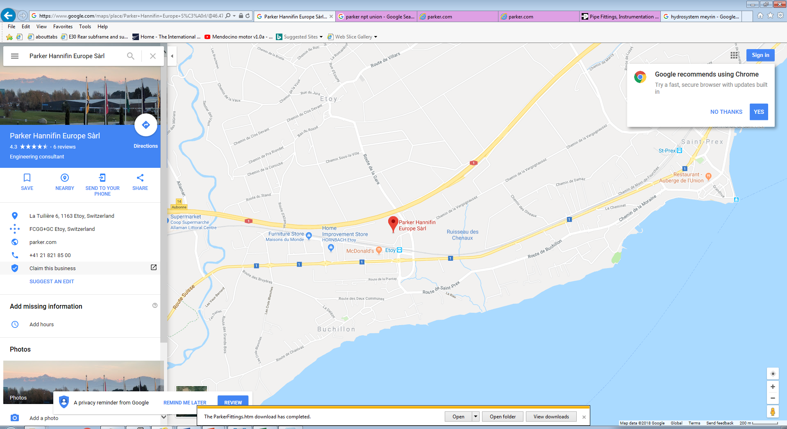

Slide 8
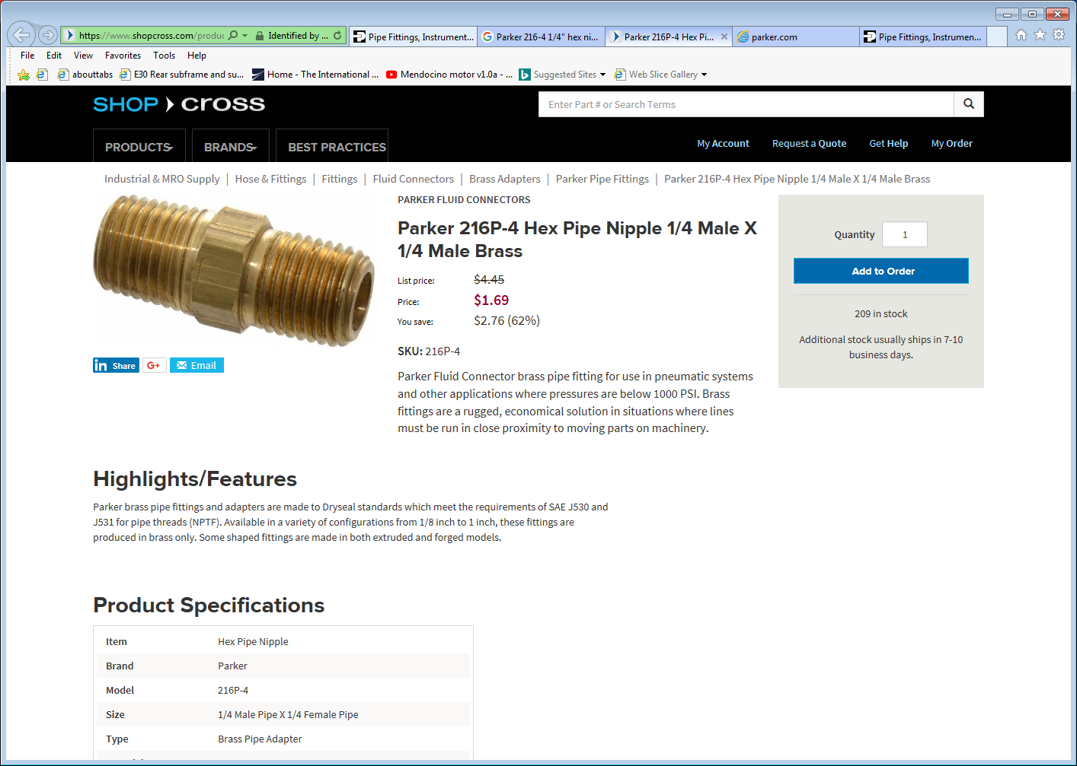
https://www.shopcross.com/product/parker-216p-4-hex-pipe-nipple-14-male-x-14-male-brass

Slide 9
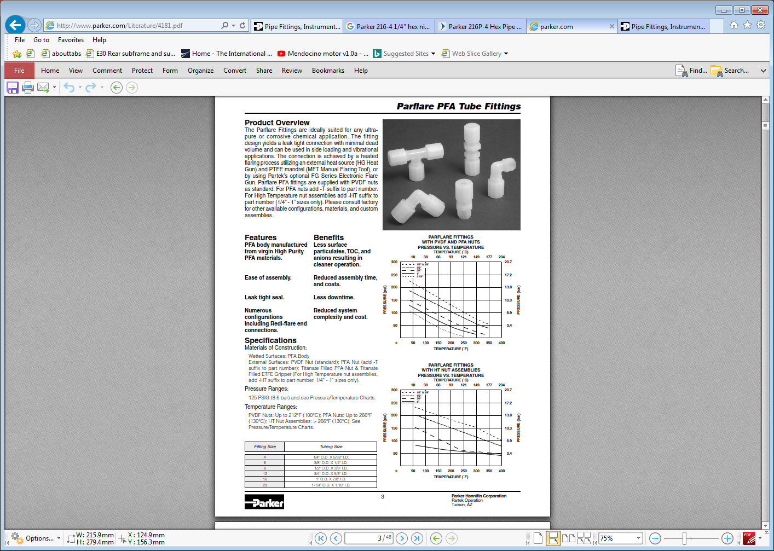
http://www.parker.com/Literature/4181.pdf

Slide 10
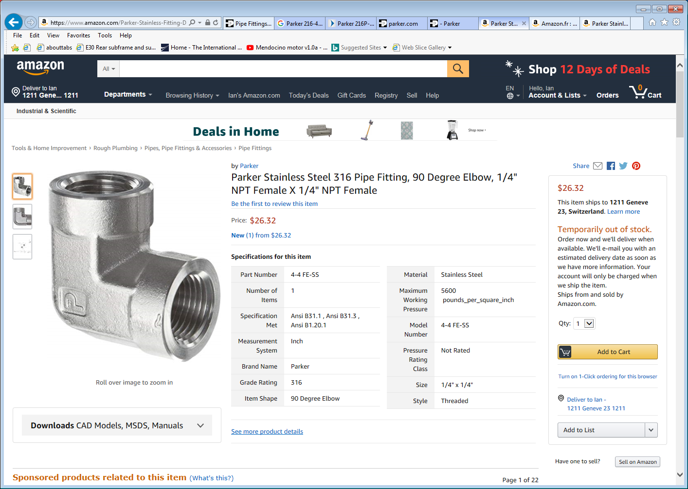

Slide 11
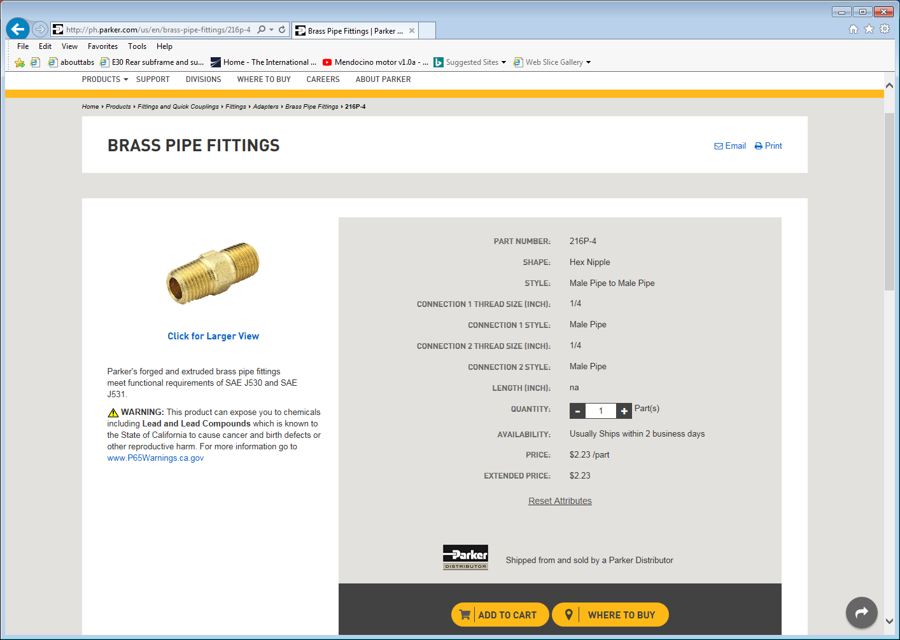
http://ph.parker.com/us/en/brass-pipe-fittings/216p-4

