Slide 1
Hose leak tests in 904
Ian
14 Oct 2019

Slide 3
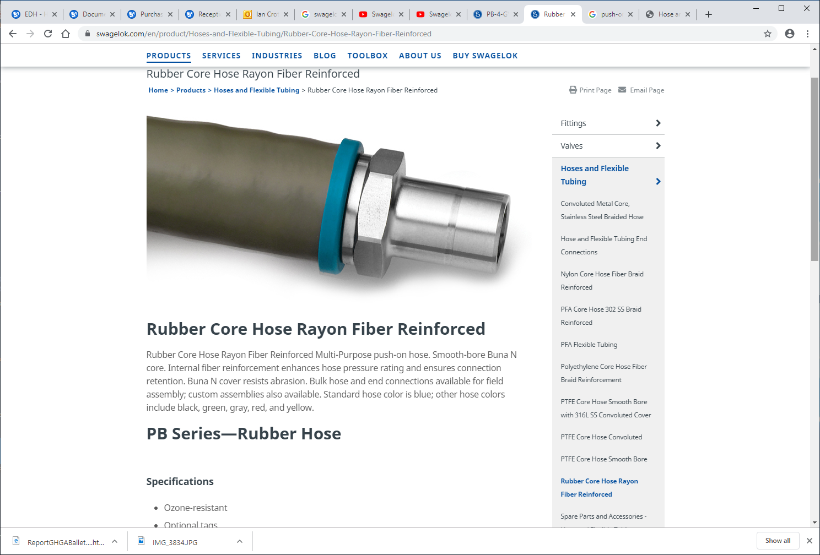

https://www.swagelok.com/en/product/Hoses-and-Flexible-Tubing/Rubber-Core-Hose-Rayon-Fiber-Reinforced

Slide 4
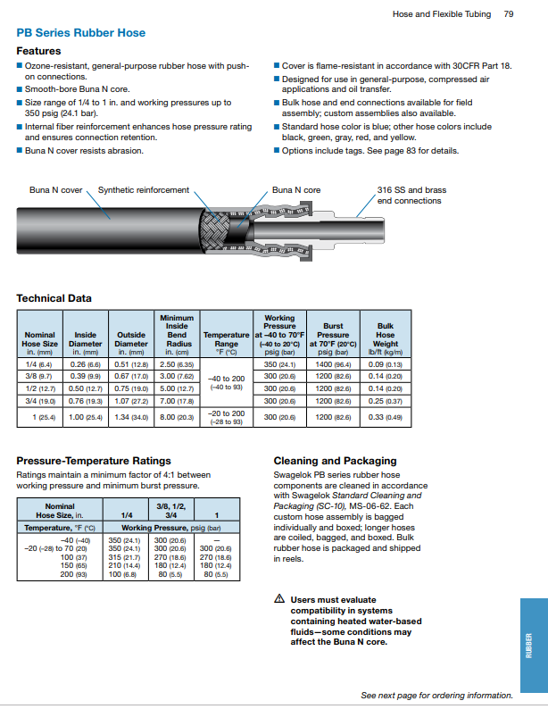

Slide 5
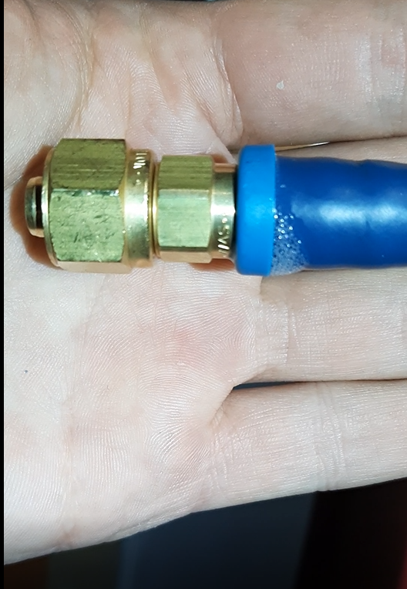
Video made by Piotr from ZEC in 10 Oct 2019 while pressure testing with Argon the RE+4/1 installed cooling hoses.
NOTA
The hose & union are not under pressure but have been !!!!
http://project-cms-rpc-endcap.web.cern.ch/project-cms-rpc-endcap/rpc/UpscopeHighEta/RPCDevelopements/RE31and41/Services/Cooling/PipingYoke/Modification/Installation/Photos/
Then select file ;
20191010101400.mp4
But if it does not work this file will;
redir.htm
follow the down load. It is 40Mb.

Slide 6
To see the video click here with right button and “open Hyperlink”
Or follow the link below;
http://project-cms-rpc-endcap.web.cern.ch/project-cms-rpc-endcap/rpc/UpscopeHighEta/RPCDevelopements/RE31and41/Services/Cooling/PipingYoke/Modification/Installation/Photos/20191010101400.mov

Slide 7
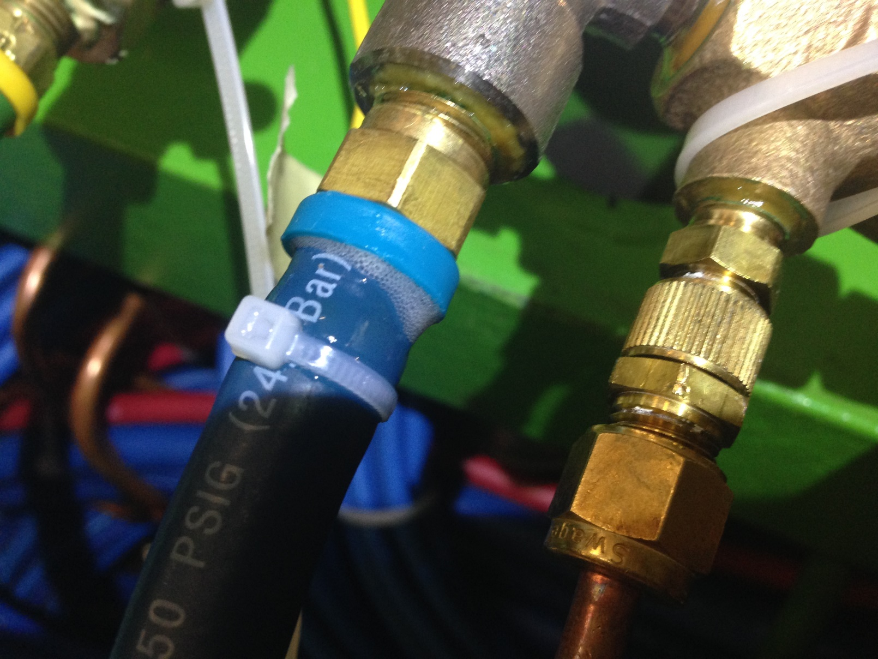
Photo taken on Friday by Anton with the line under 15 Bar Argon test pressure.
The cable tie has been applied AFTER the pressure was applied to try and stop the leak.
This is NOT the same condition indicated in the previous slide showing the video of the leak with NO pressure

Slide 8
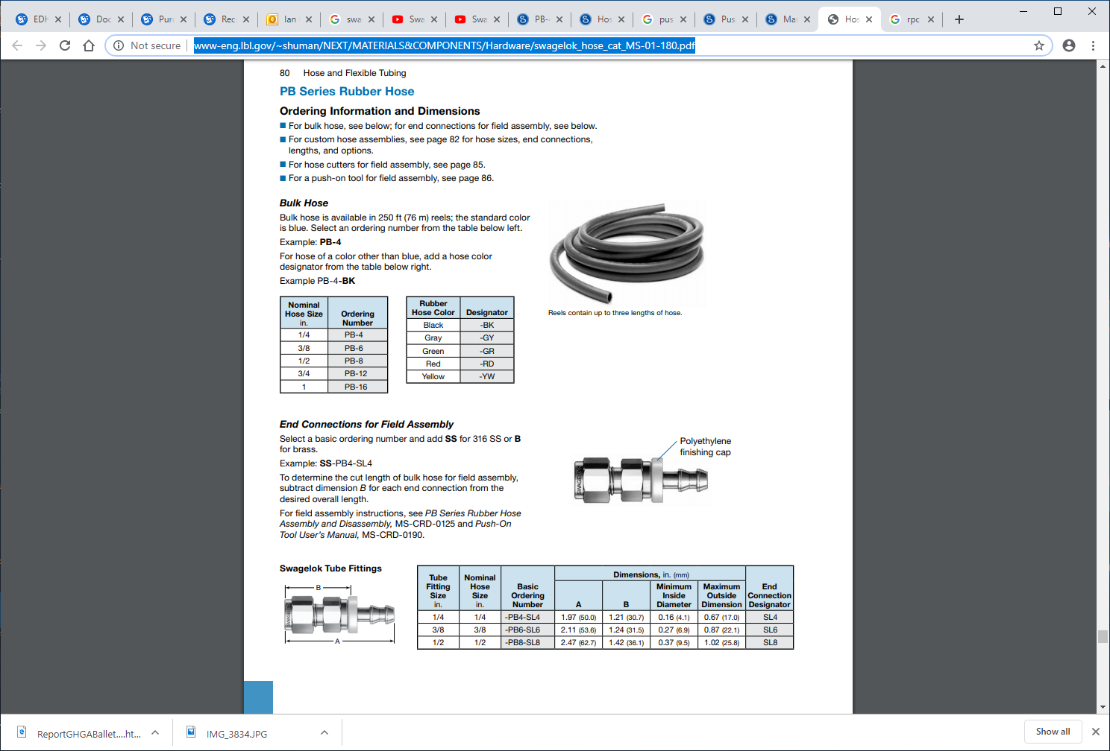
http://www-eng.lbl.gov/~shuman/NEXT/MATERIALS&COMPONENTS/Hardware/swagelok_hose_cat_MS-01-180.pdf

Slide 9
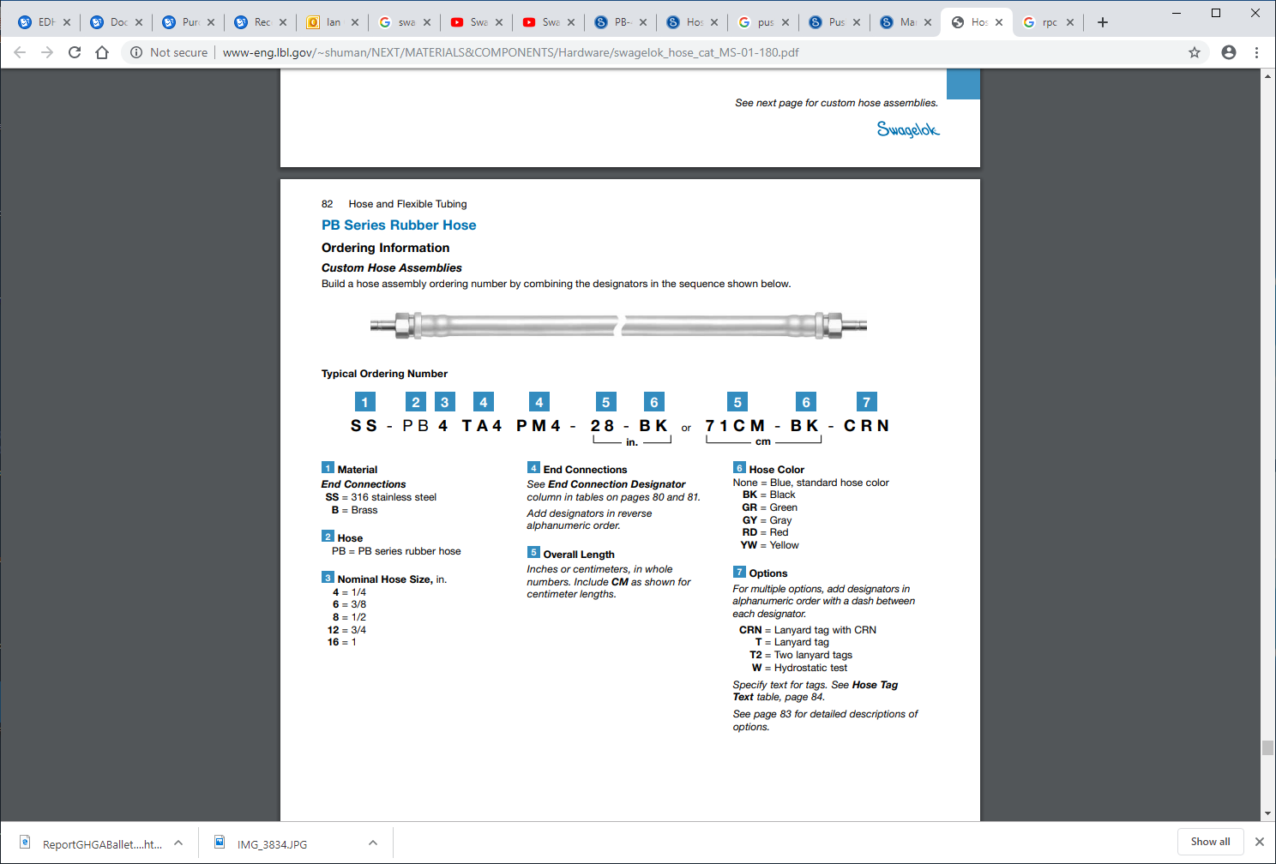

Slide 10
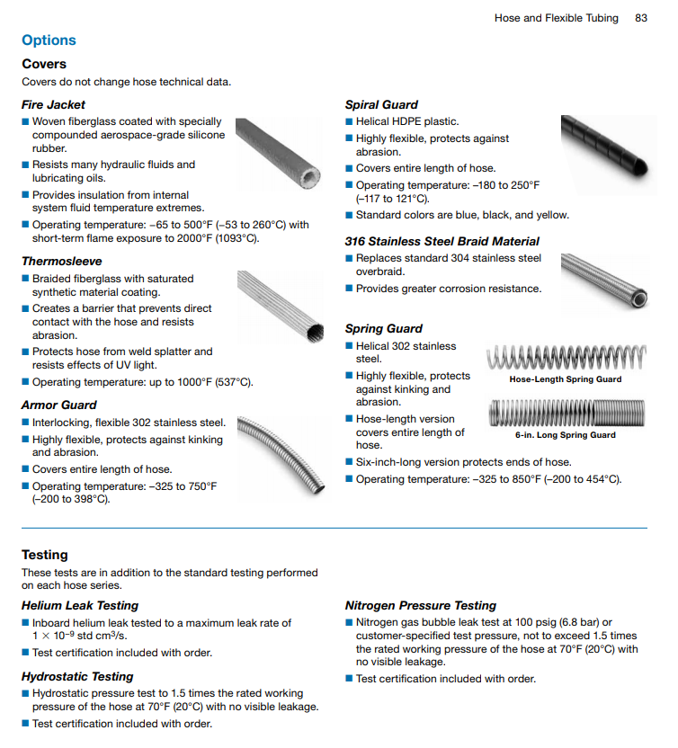


Slide 11
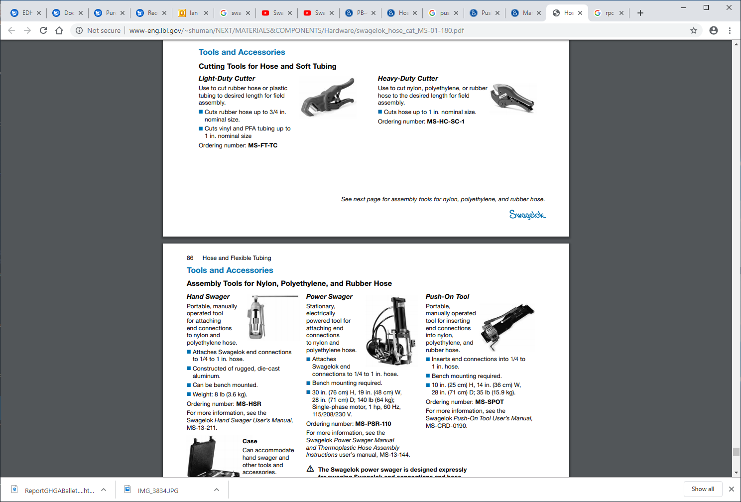

Slide 12
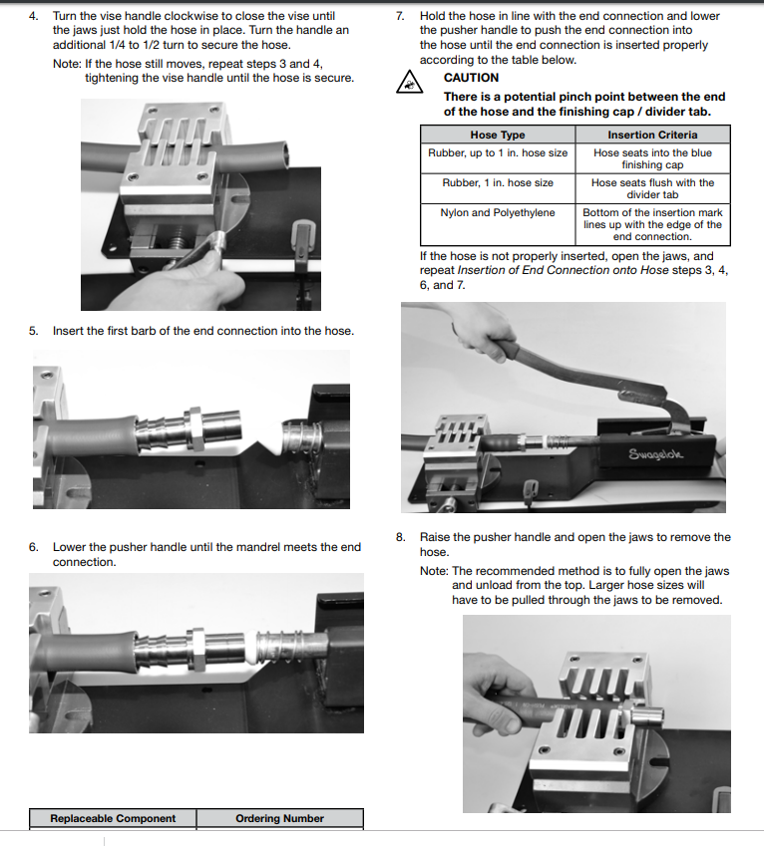
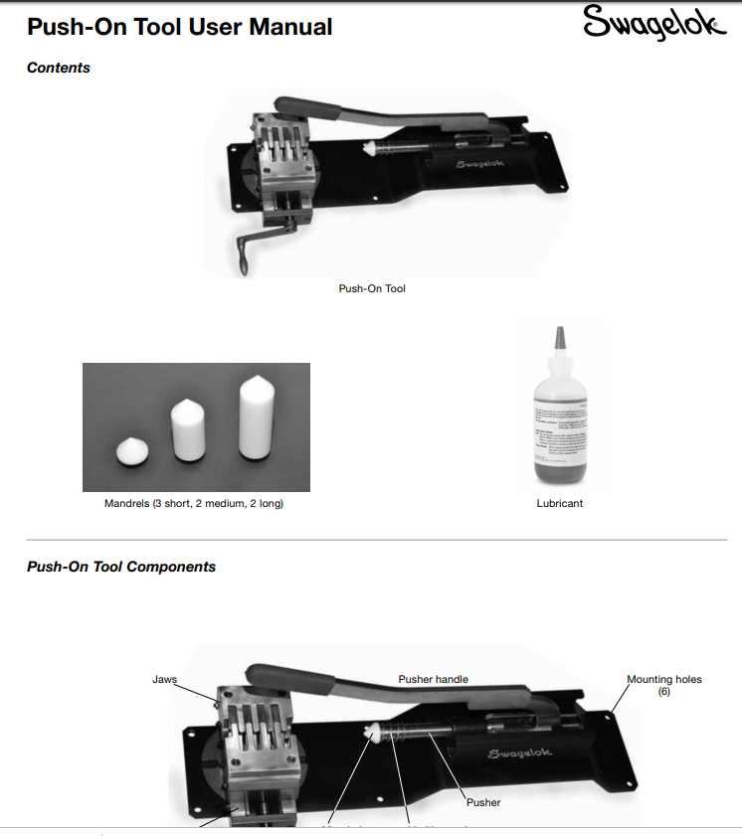
https://www.swagelok.com/downloads/webcatalogs/EN/MS-CRD-0190.PDF

Slide 13
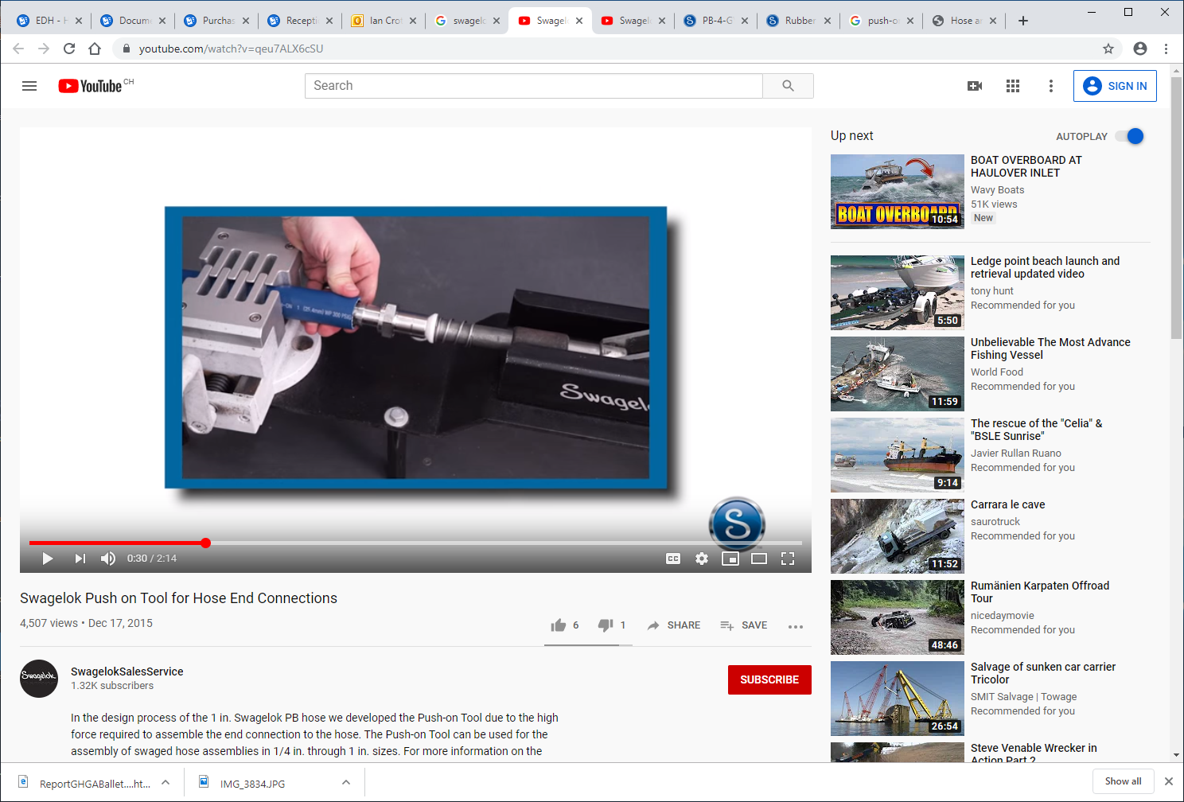
https://www.youtube.com/watch?v=qeu7ALX6cSU
https://www.youtube.com/watch?v=IAsKLmMpbtk

Slide 14
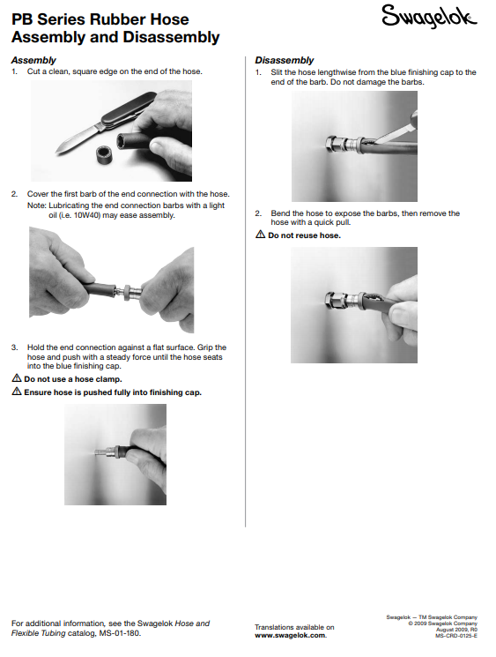
https://www.swagelok.com/downloads/webcatalogs/EN/MS-CRD-0125.PDF
This method is not good as the barbs WILL be damaged

Slide 15
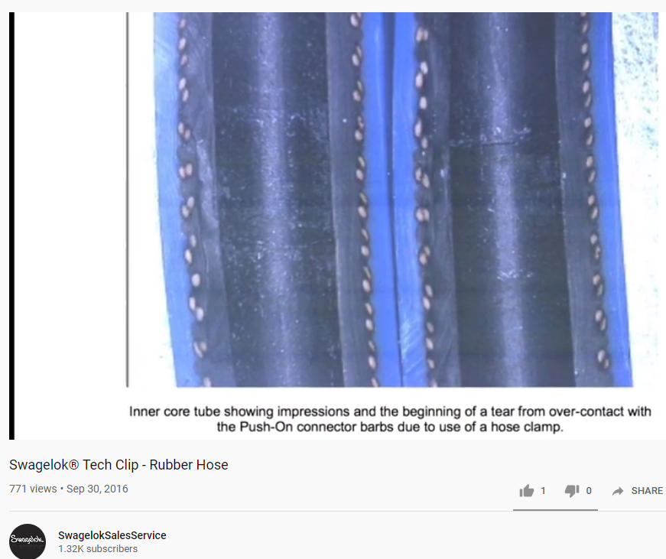
https://www.youtube.com/watch?v=IAsKLmMpbtk

Slide 16
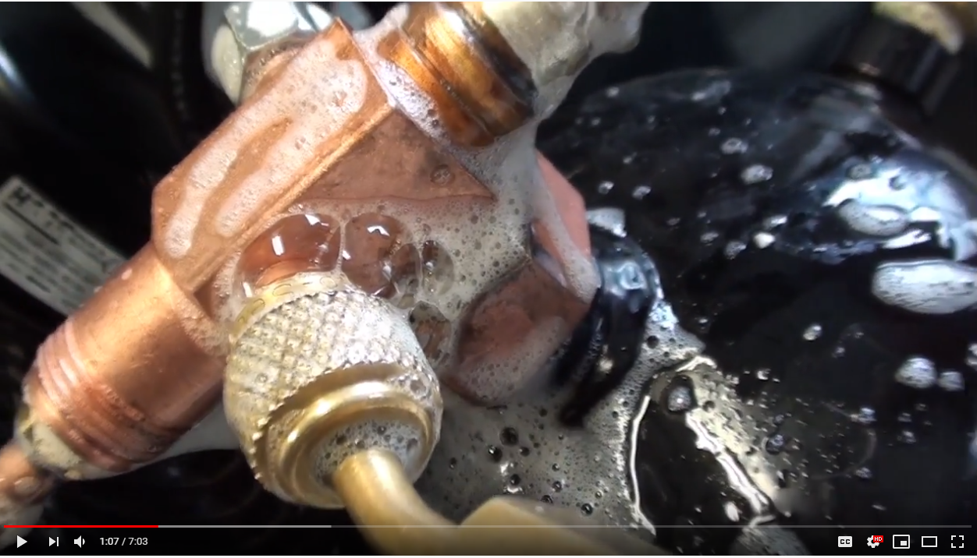

https://www.youtube.com/watch?v=MP0iFzyLaU4
Milles bulles

Slide 17
Video made by Piotr from ZEC in 10 Oct 2019 while pressure testing with Argon the RE+4/1 installed cooling hoses.
NOTA
The hose & union are not under pressure but have been !!!!
The gas “stored on the wall of the hose continues to leak out !
http://project-cms-rpc-endcap.web.cern.ch/project-cms-rpc-endcap/rpc/UpscopeHighEta/RPCDevelopements/RE31and41/Services/Cooling/PipingYoke/Modification/Installation/Photos/
Then select file ;
20191010101400.mp4
But if it does not work this file will;
redir.htm
follow the down load. It is 40Mb.

Slide 18
Photo taken on Friday by Anton with the line under 15 Bar Argon test pressure.
The cable tie has been applied AFTER the pressure was applied to try and stop the leak.
This is NOT the same condition indicated in the previous slide showing the video of the leak with NO pressure

Slide 19
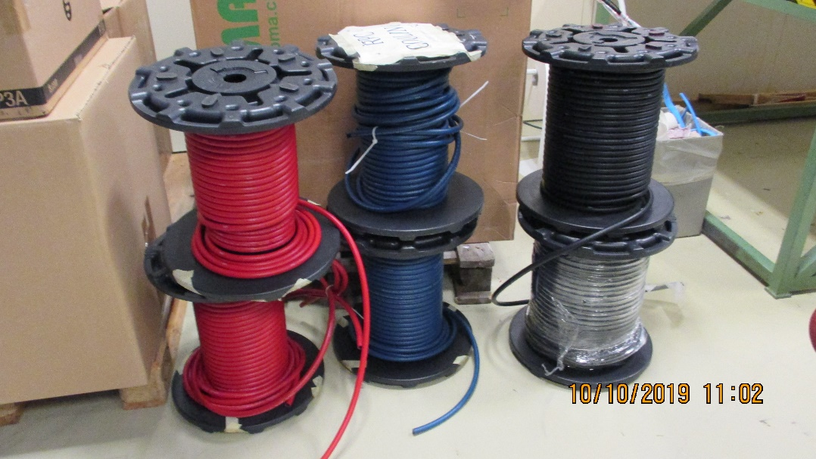
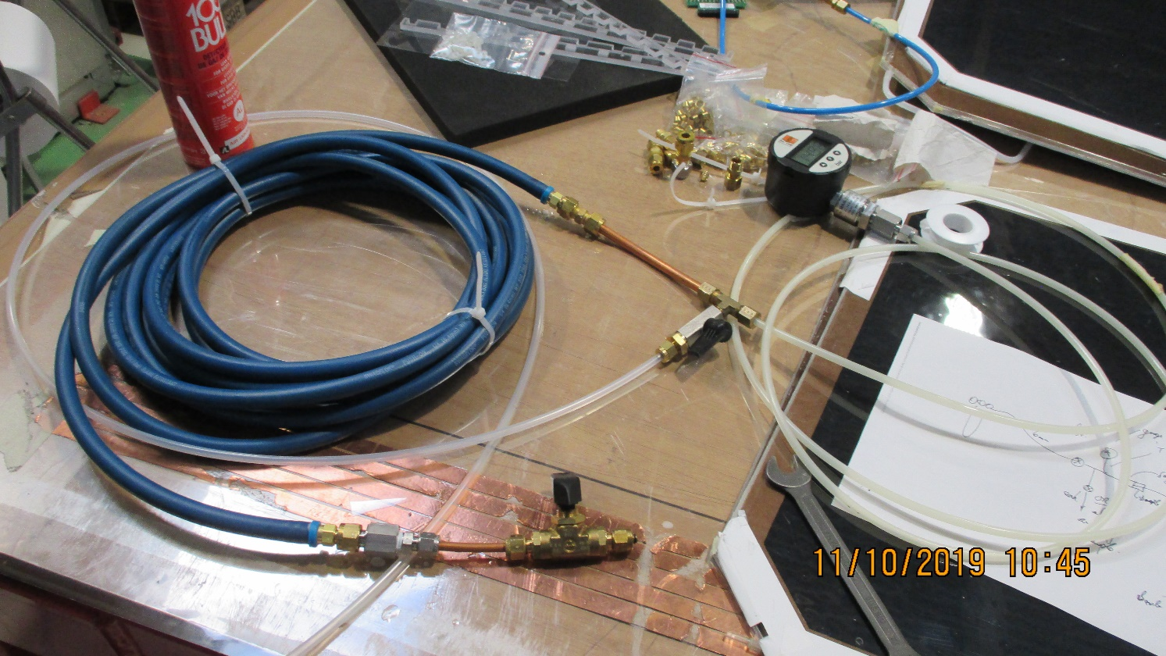
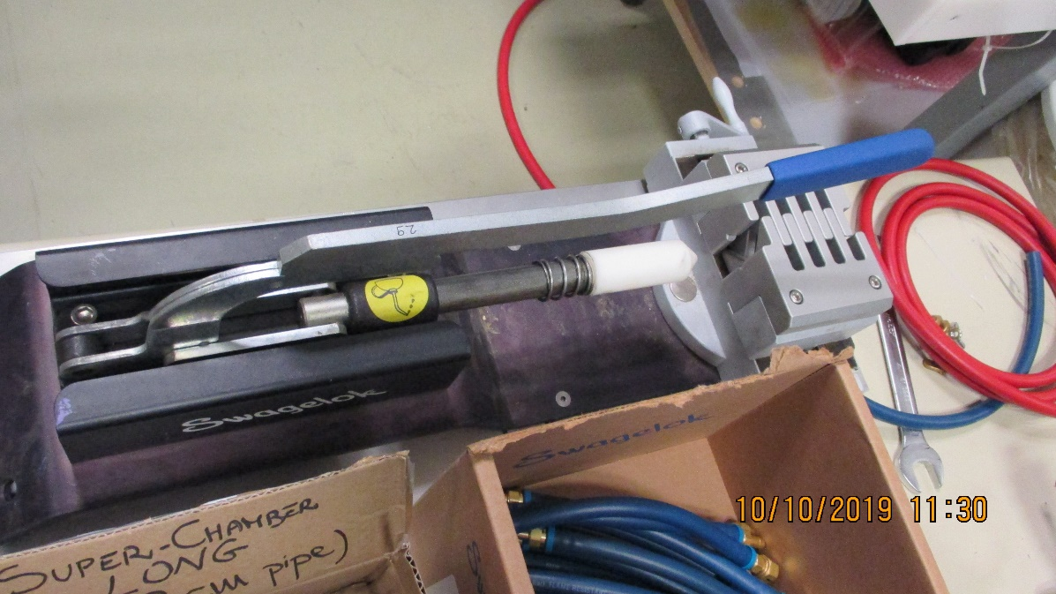

Slide 20
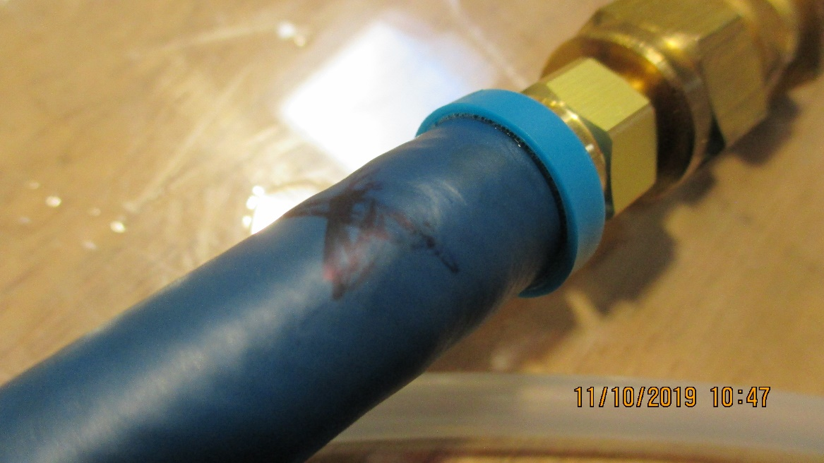
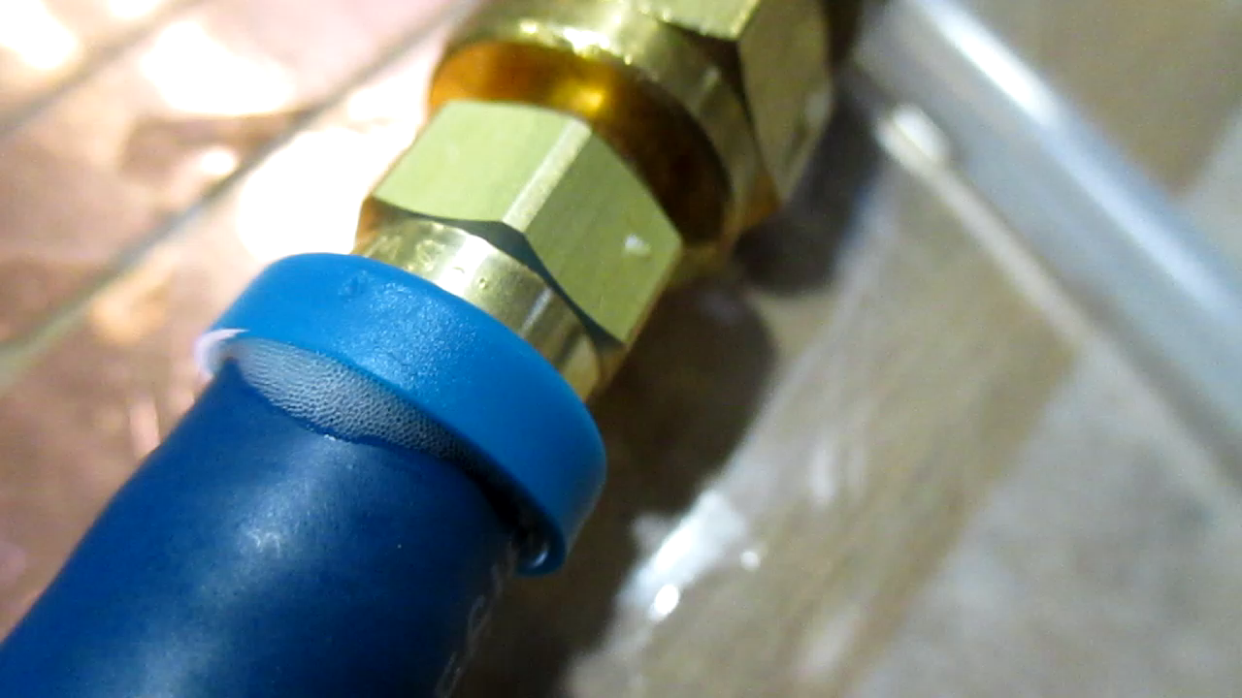
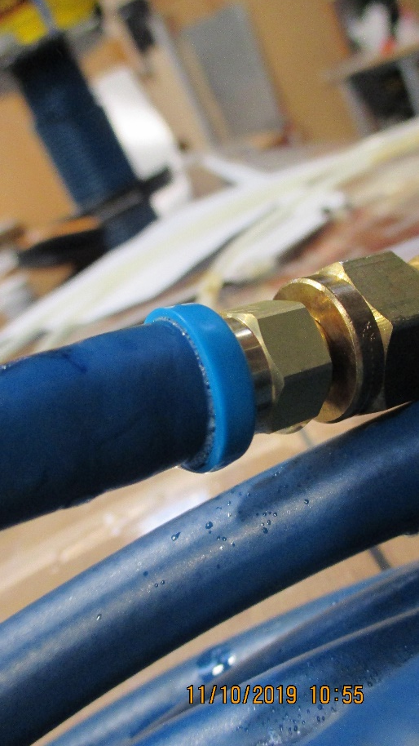
Same test hose but the othjer end done as instructed in the Swagelok documentation. Namely the hose must cove rthe barbs and enter the blue collerette
Video showing low bubble production rate on top of the hose
Following GEM method, insisting on pushing repeatedly on the handle of the tool to ensure the straight cut end of the hose is tight up against the union
Lower photo shows staic bubbles as formed as the solution comes out of rhe sparay can.

Slide 21
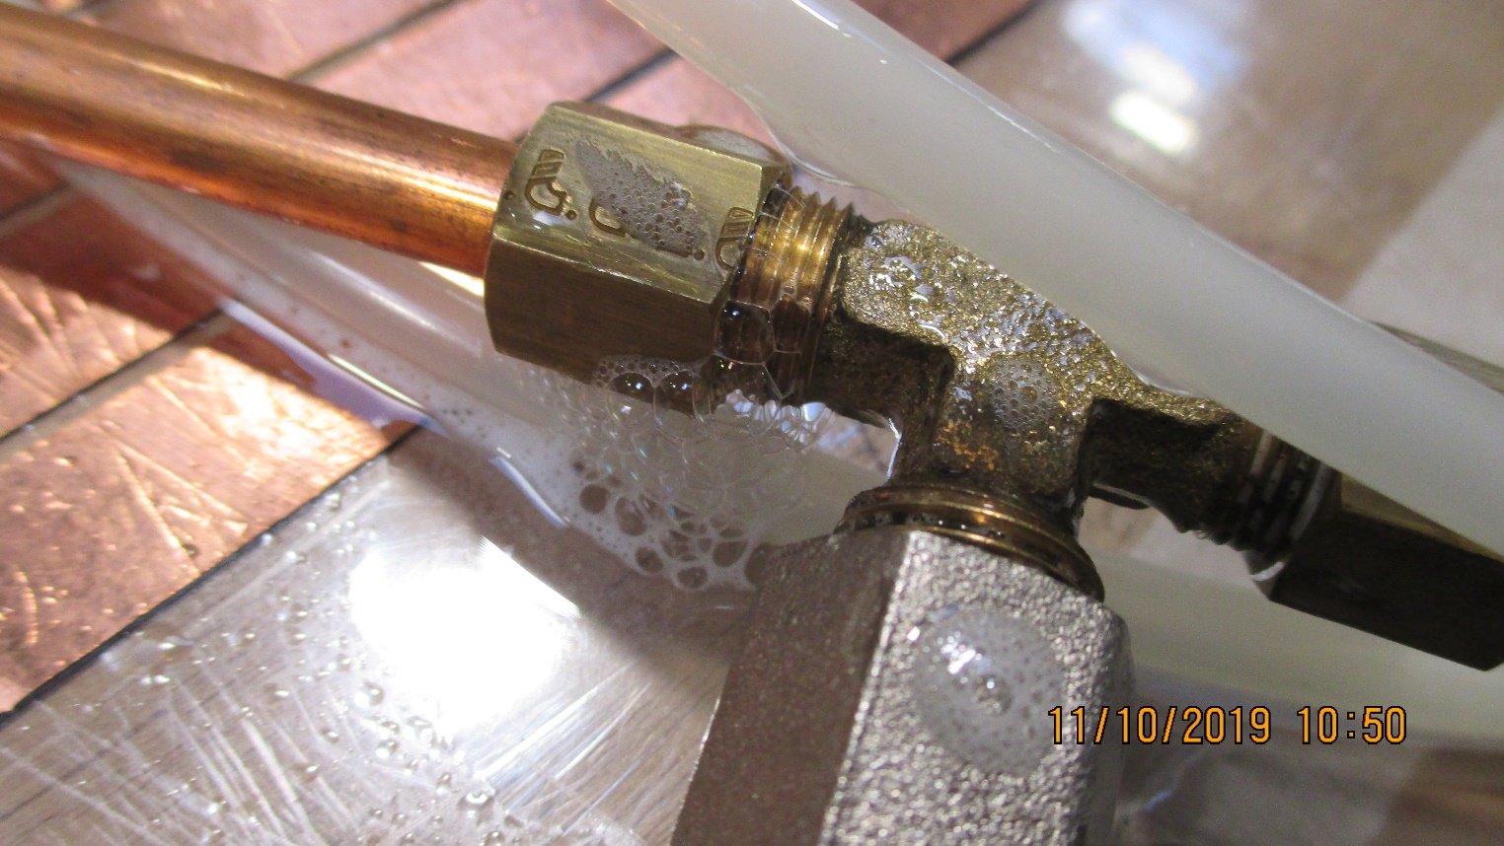
Large leak showing the production of bubbles larger than the ones that are formed as the solution is released from the spray can

Slide 22
Other manufactures and their hoses , unions and assembly methods

Slide 23
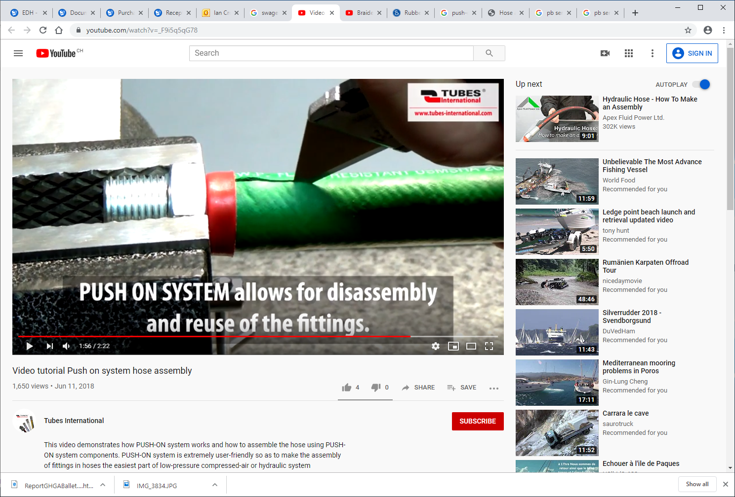
Tubes International
https://www.youtube.com/watch?v=_F9i5q5qG78

Slide 24
Parker

Slide 25
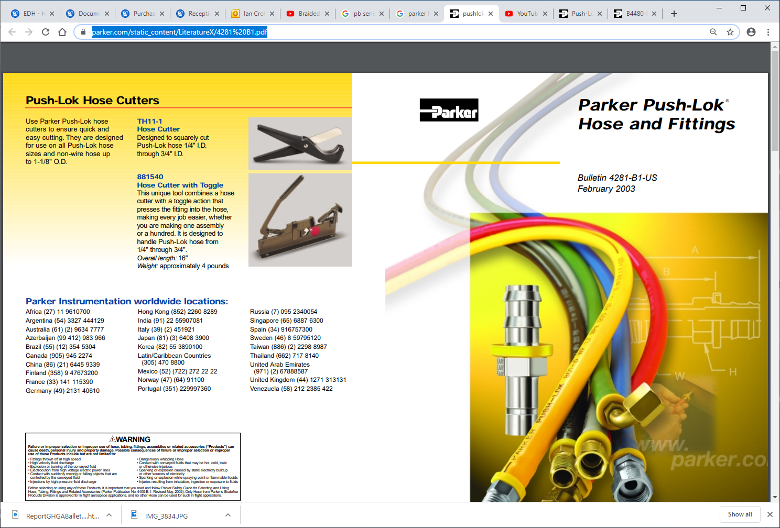
https://www.parker.com/static_content/LiteratureX/4281%20B1.pdf
https://www.parker.com/portal/site/PARKER/menuitem.223a4a3cce02eb6315731910237ad1ca/?vgnextoid=f92caf5c6f65e210VgnVCM10000048021dacRCRD&vgnextfmt=EN

Slide 26
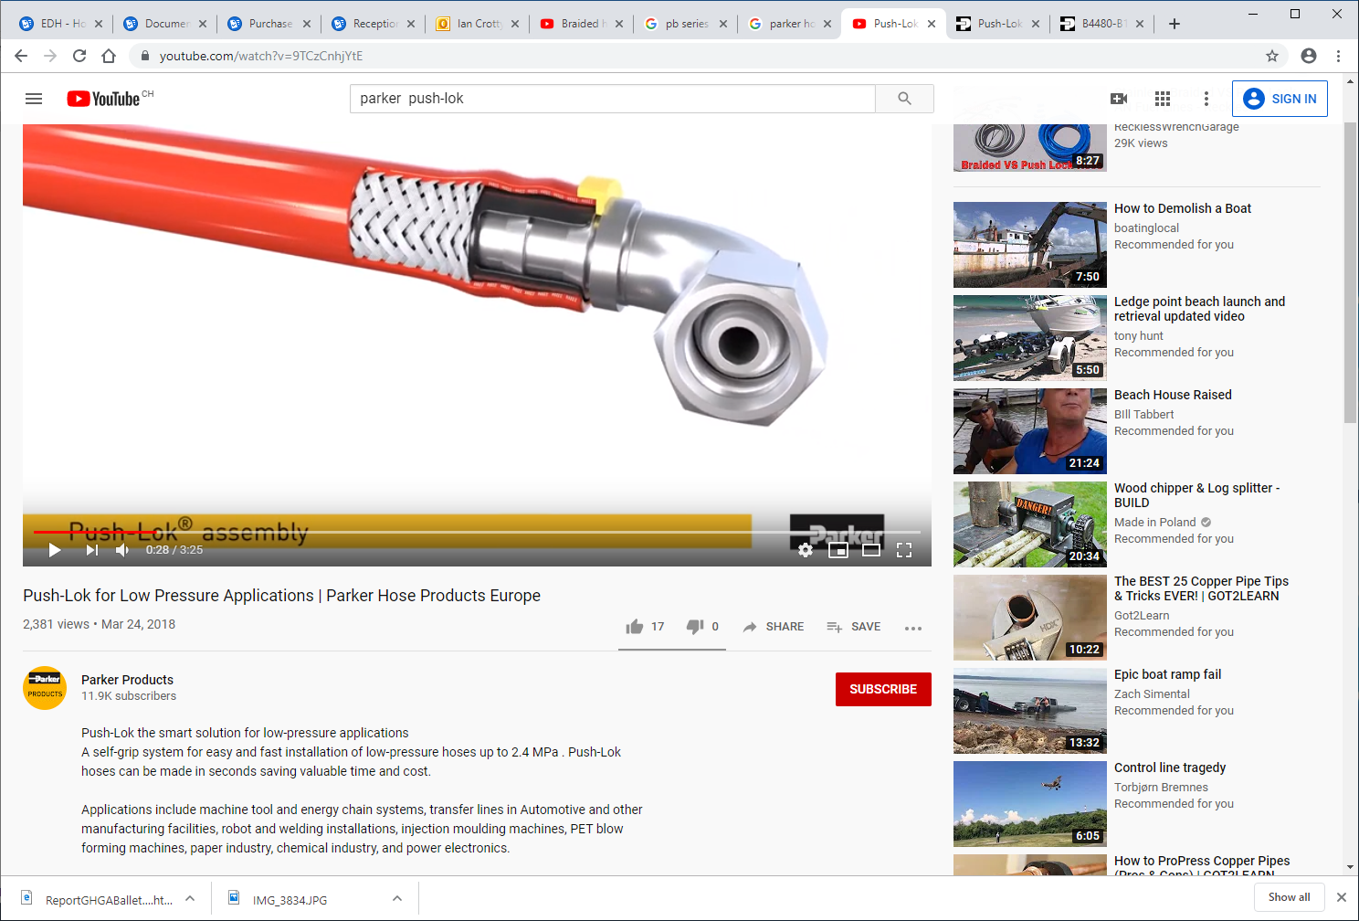
https://www.youtube.com/watch?v=rI_rVnmmy_E
https://www.youtube.com/watch?v=9TCzCnhjYtE

Slide 27
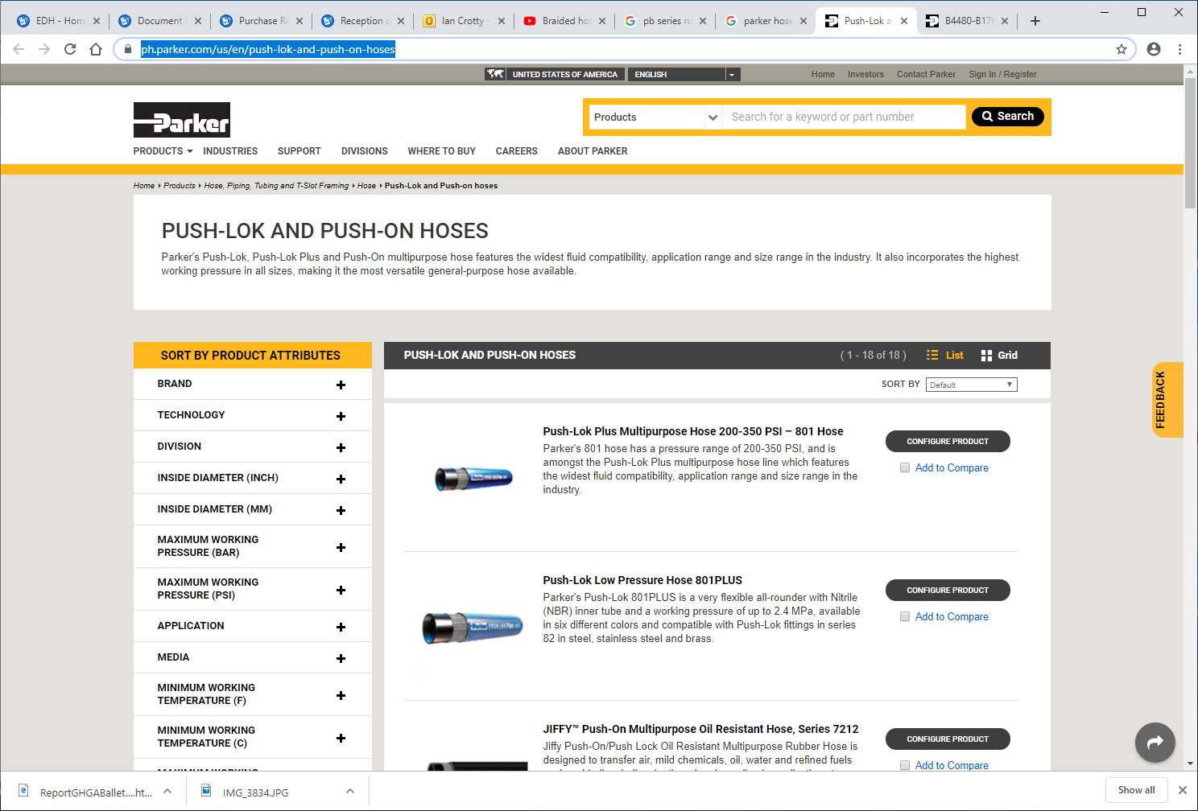
https://ph.parker.com/us/en/push-lok-and-push-on-hoses

Slide 28
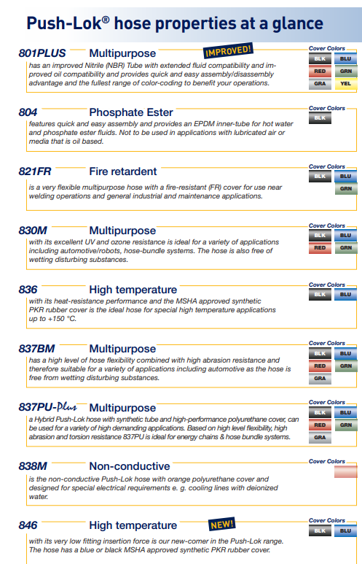
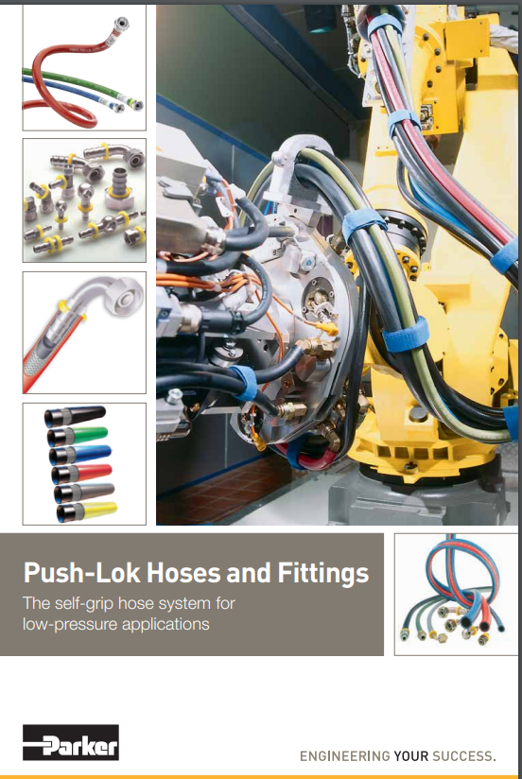
https://www.parker.com/Literature/Hose%20Products%20Division%20Europe/Literature_2014/Sales%20and%20Marketing%20Bulletins/Push-Lok%20Hose_Fittings_BUL_4480-B176_UK_2016-11.pdf

Slide 29
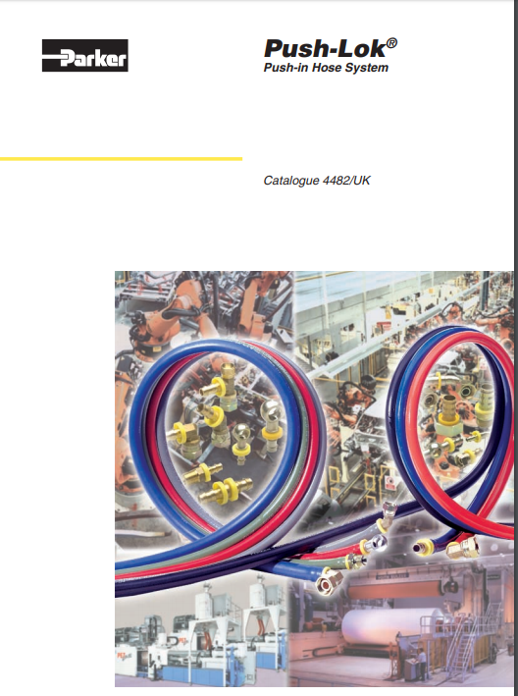
http://www.hccl.ie/uploads/1/4/7/3/1473854/parker_push_lok_catalogue_-_industrial.pdf
Cataloge from UK supplier 2007
Very complete union selection

Slide 30
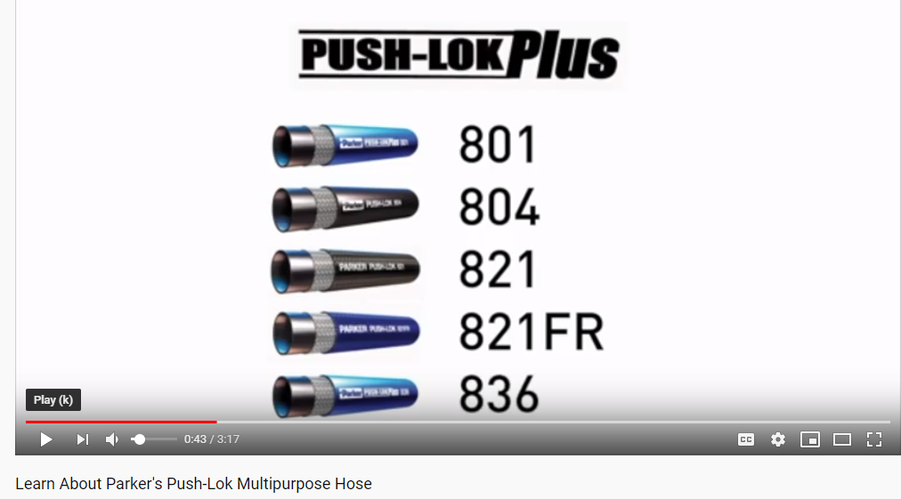
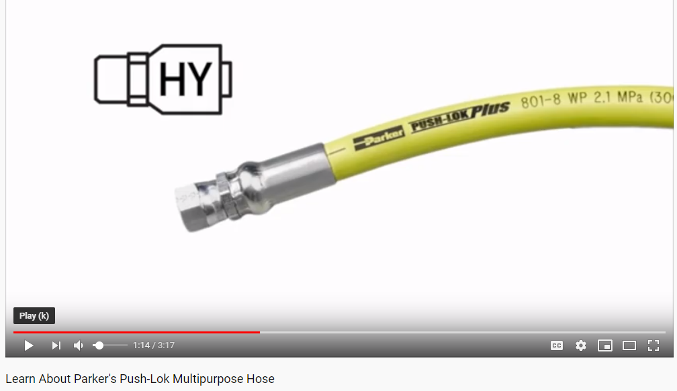
https://www.youtube.com/watch?v=f-hxFVYTh9Q

