Slide 1
Cooling Manifolds assembly and Inter Links. Notes
Ivan, Jan, Andres and Ian
26 Aug 2019
Notice change to ALL brass fittings for hose fittings

Slide 2
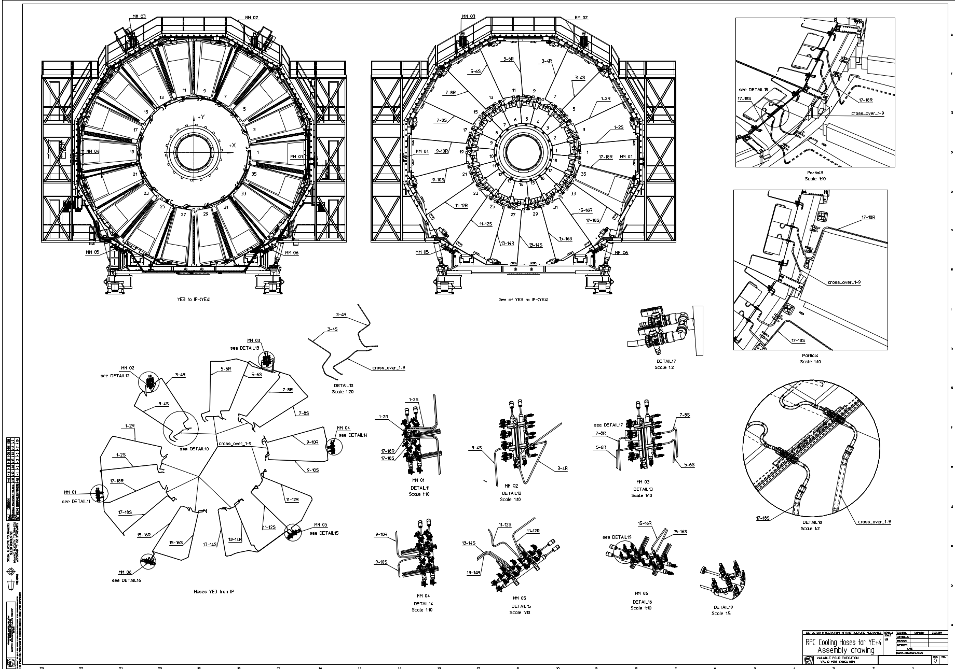
Web address of drawing
http://project-cms-rpc-endcap.web.cern.ch/project-cms-rpc-endcap/rpc/UpscopeHighEta/RPCDevelopements/RE31and41/Services/Cooling/PipingYoke/Modification/IvanInput/RPCCoolingHosesYEplus427072019.pdf

Slide 3
MM | chamber | pipe name | L mm. | Pcs. | L m. | extra length m. | total m. |  | Lable | lable for valves & DRAWING
01 | 1-2 | 1-2S | 6807 | 1 | 6.807 | 1.5 | 8.307 |  | RE4/1/1-2S/MM01 | 1-2S
 |  | 1-2R | 9582 | 1 | 9.582 | 1.5 | 11.082 |  | RE4/1/1-2R/MM01 | 1-2R
02 | 3-4 | 3-4S | 7150 | 1 | 7.15 | 1.5 | 8.65 |  | RE4/1/3-4S/MM02 | 3-4S
 |  | 3-4R | 7321 | 1 | 7.321 | 1.5 | 8.821 |  | RE4/1/3-4R/MM02 | 3-4R
03 | 5-6 | 5-6S | 7923 | 1 | 7.923 | 1.5 | 9.423 |  | RE4/1/5-6S/MM03 | 5-6S
 |  | 5-6R | 9022 | 1 | 9.022 | 1.5 | 10.522 |  | RE4/1/5-6R/MM03 | 5-6R
03 | 7-8 | 7-8S | 10150 | 1 | 10.15 | 1.5 | 11.65 |  | RE4/1/7-8S/MM03 | 7-8S
 |  | 7-8R | 7770 | 1 | 7.77 | 1.5 | 9.27 |  | RE4/1/7-8R/MM03 | 7-8R
04 | 9-10 | 9-10S | 6727 | 1 | 6.727 | 1.5 | 8.227 |  | RE4/1/9-10S/MM04 | 9-10S
 |  | 9-10R | 6825 | 1 | 6.825 | 1.5 | 8.325 |  | RE4/1/9-10R/MM04 | 9-10R
05 | 11-12 | 11-12S | 8080 | 1 | 8.08 | 1.5 | 9.58 |  | RE4/1/11-12S/MM05 | 11-12S
 |  | 11-12R | 5990 | 1 | 5.99 | 1.5 | 7.49 |  | RE4/1/11-12R/MM05 | 11-12R
05 | 13-14 | 13-14S | 9460 | 1 | 9.46 | 1.5 | 10.96 |  | RE4/1/13-14S/MM05 | 13-14S
 |  | 13-14R | 8025 | 1 | 8.025 | 1.5 | 9.525 |  | RE4/1/13-14R/MM05 | 13-14R
06 | 15-16 | 15-16S | 8070 | 1 | 8.07 | 1.5 | 9.57 |  | RE4/1/15-16S/MM06 | 15-16S
 |  | 15-16R | 5730 | 1 | 5.73 | 1.5 | 7.23 |  | RE4/1/15-16R/MM06 | 15-16R
01 | 17-18 | 17-18S | 9110 | 1 | 9.11 | 1.5 | 10.61 |  | RE4/1/17-18S/MM01 | 17-18S
 |  | 17-18R | 6360 | 1 | 6.36 | 1.5 | 7.86 |  | RE4/1/17-18R/MM01 | 17-18R
cross over |  | 1 to 9 | 1600 | 9 | 14.4 | 0.4 | 18 |  | RE4/1/cross over/1 to 9 | cross over-1 to 9
 |  | total |  |  | 154.5 |  | 185.1
 |  | total | + extra | 20% | 185.4 |  | 222.1

Slide 4
List of components required

Slide 5
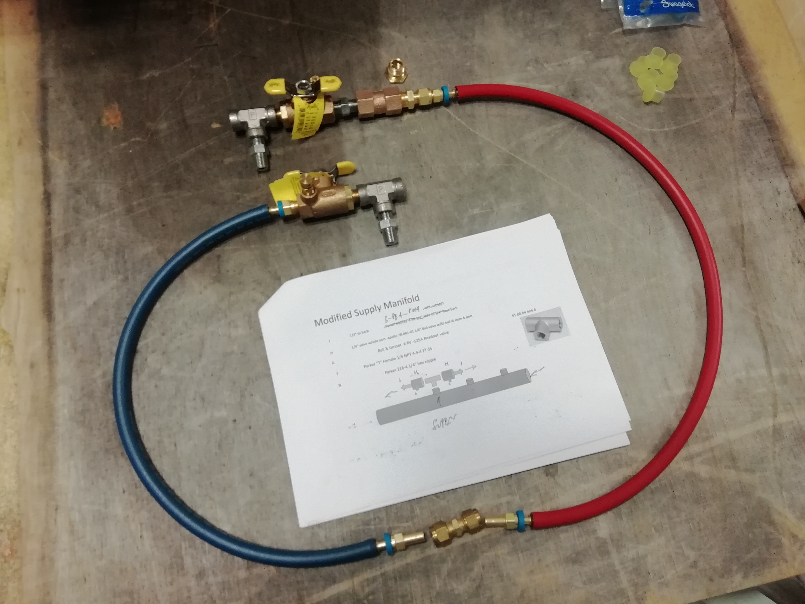
Return Red
Supply Blue
Sagana Union

Slide 6
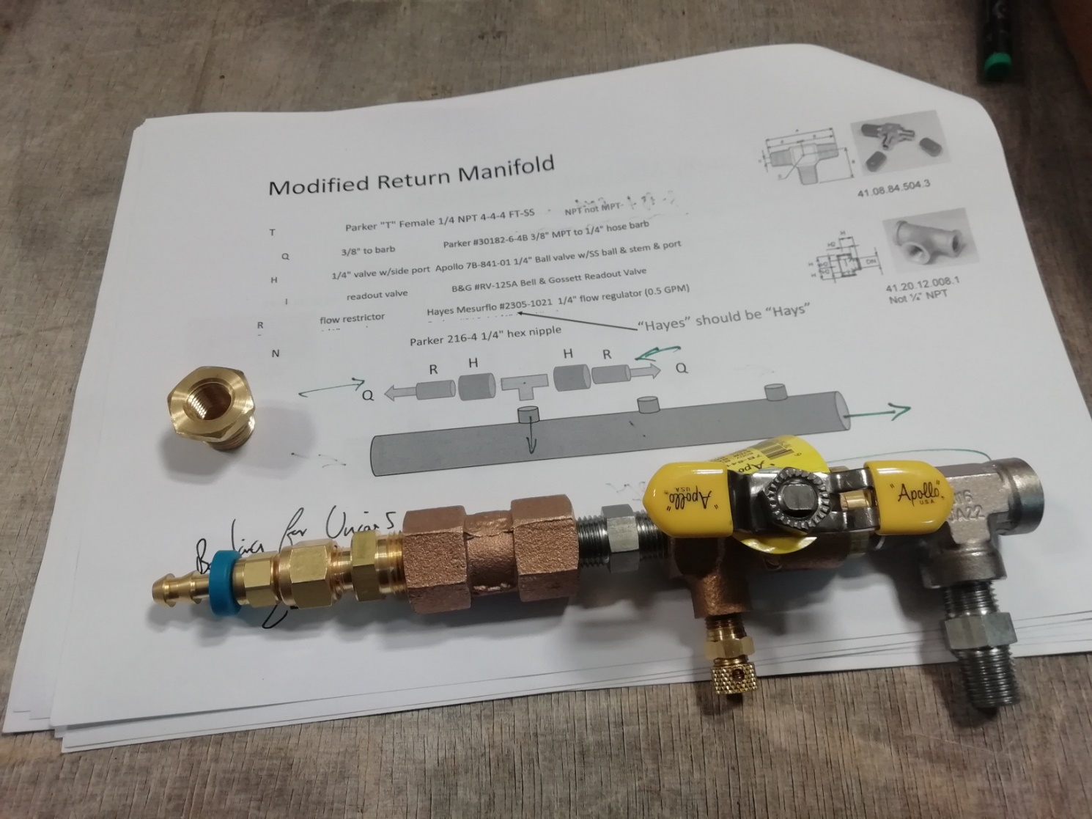
Return Manifold

Slide 7
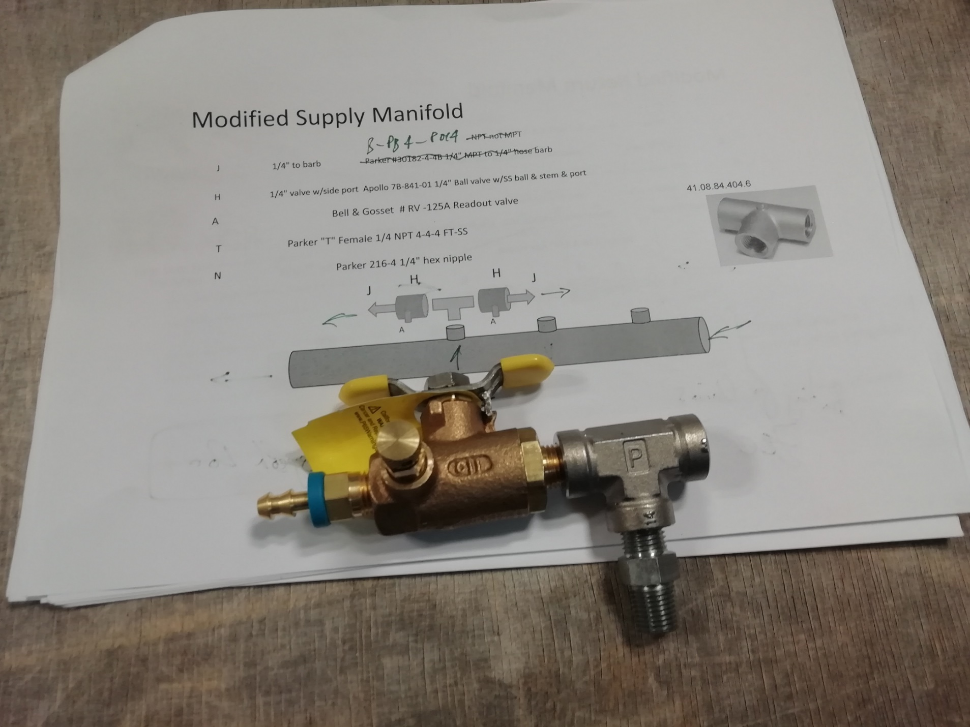
Supply Manifold

Slide 8
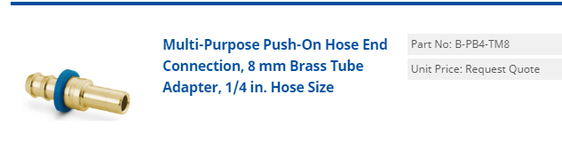
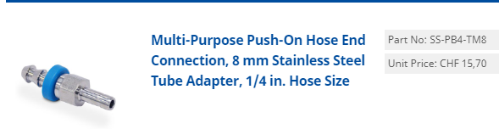
Notice the Barbed hose connection to dia.8mm straight (ref XX-PB4-TM8) exists in brass and in stainless steel.
ONLY the brass fitting is to be used
The SS fitting will NOT be used

Slide 9
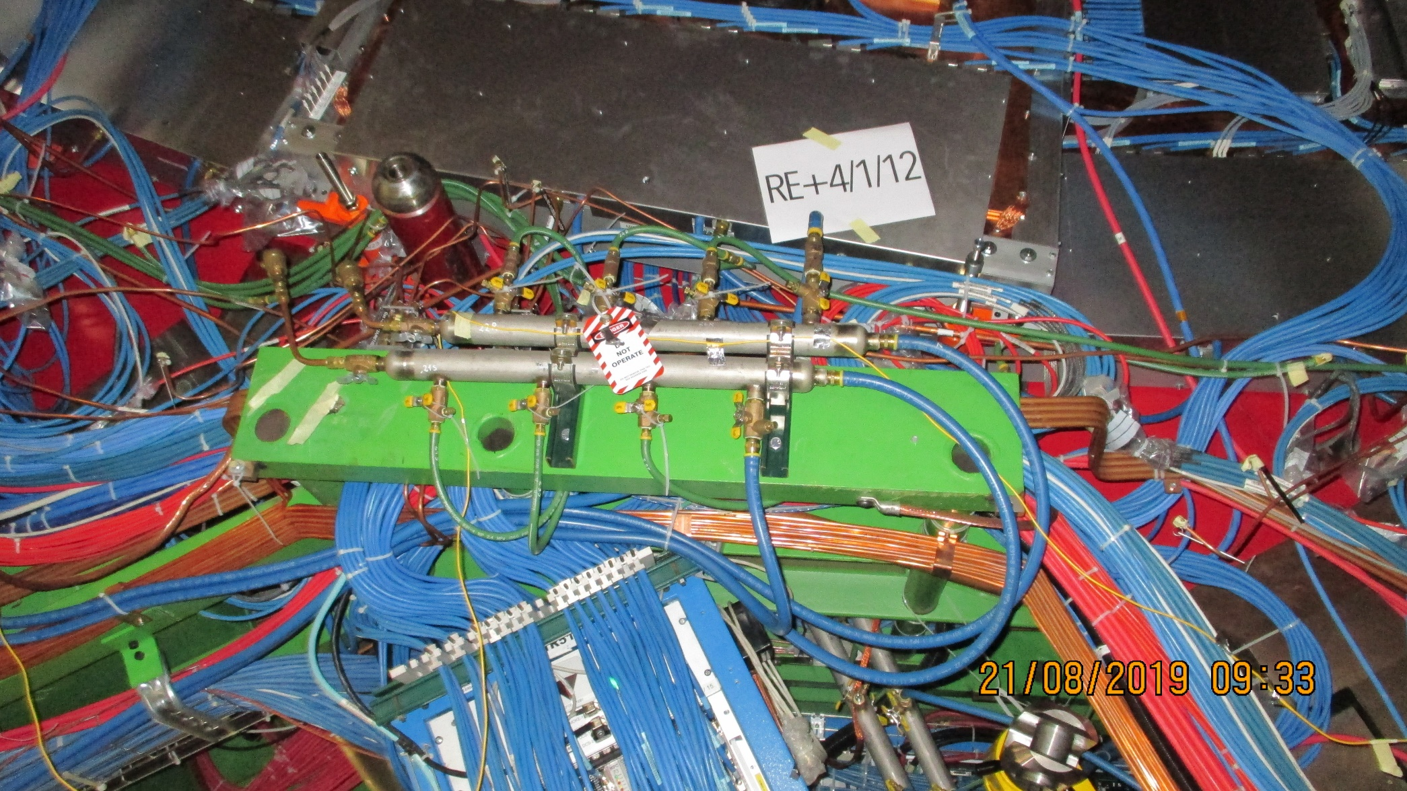
Mini Manifolds 3, 4 and 5 on the far side of RE+4/1.
Nota ALL Mini-manifolds will be modified with either One or Two connections. See table slide 3.

Slide 10
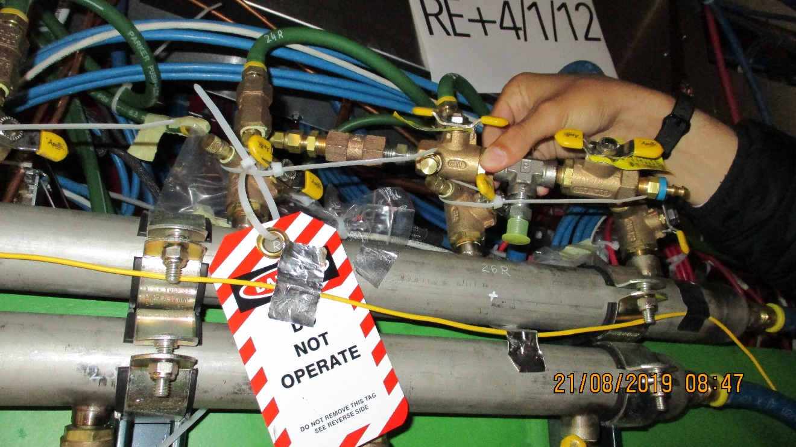
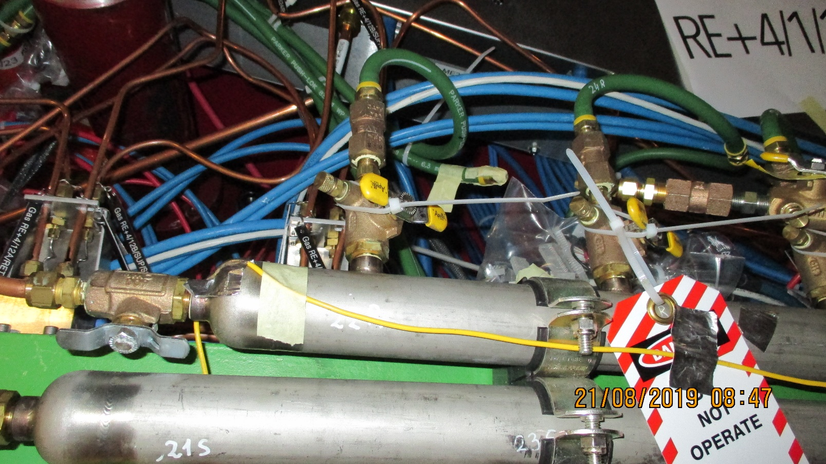
Mini Manifolds 5 Far side at the bottom

Slide 11
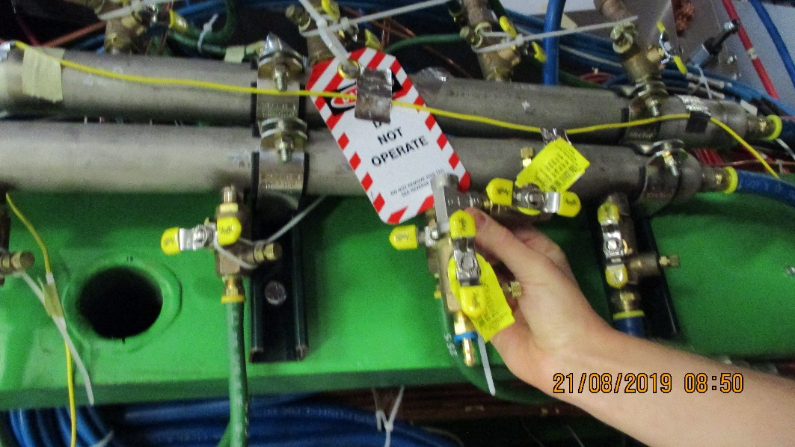
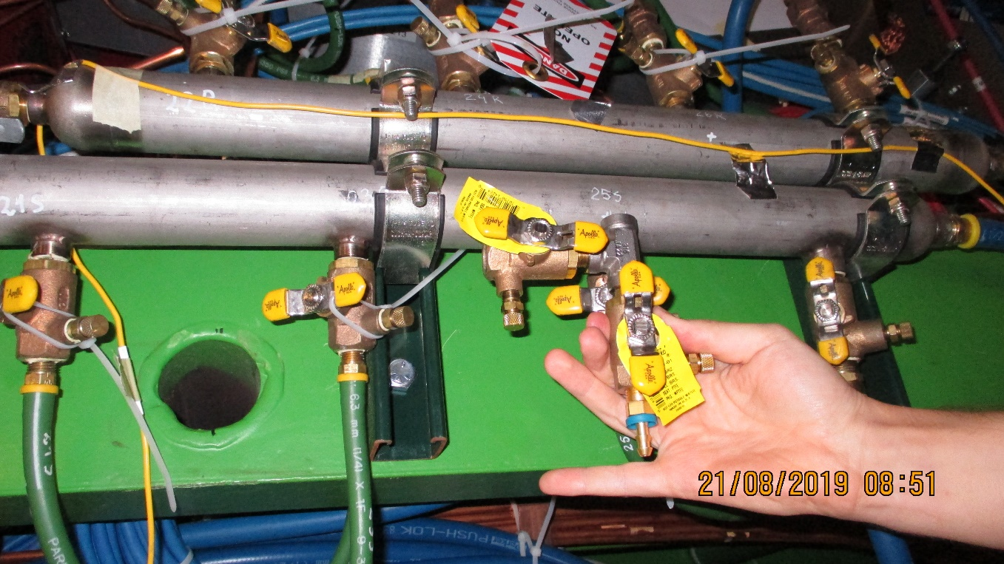
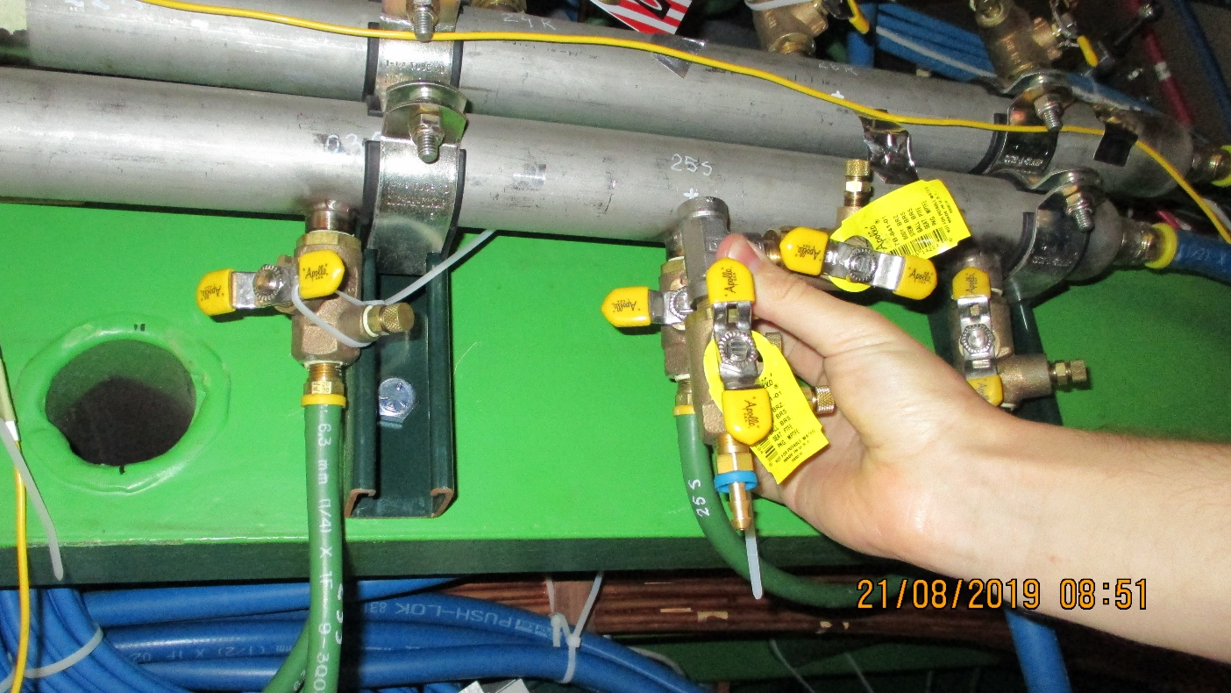
Alternative configuration
Mini Manifolds 5 Far side at the bottom
The use of the 90degree elbow can produce better configuration in terms of the hose bending radius. ZEC should judge the optimium solution.

Slide 12
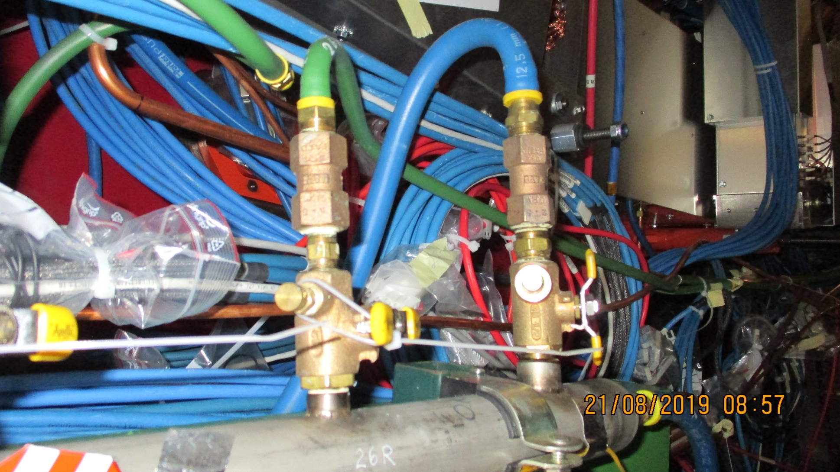
Configurations to avoid
Tight bending of the hoses

Slide 13
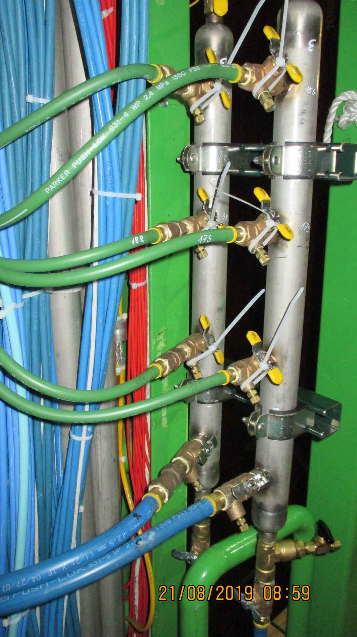
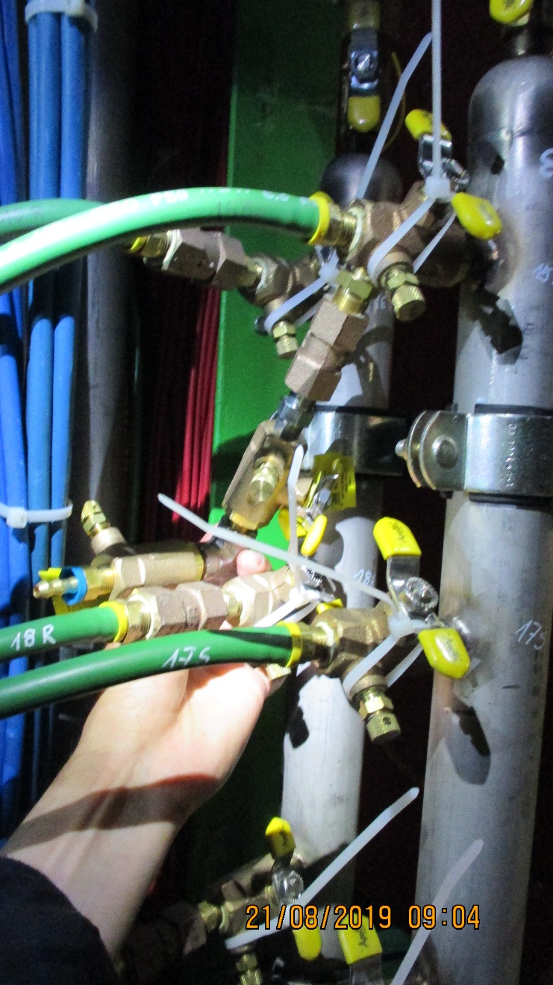
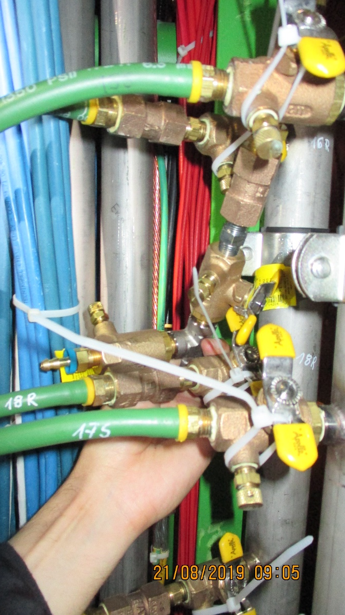
Mini Manifold 4 on the far side of RE+4/1 on X3 level
Again the 90 deg. Elbow can give a preferred hose routing, low hose stress

Slide 14
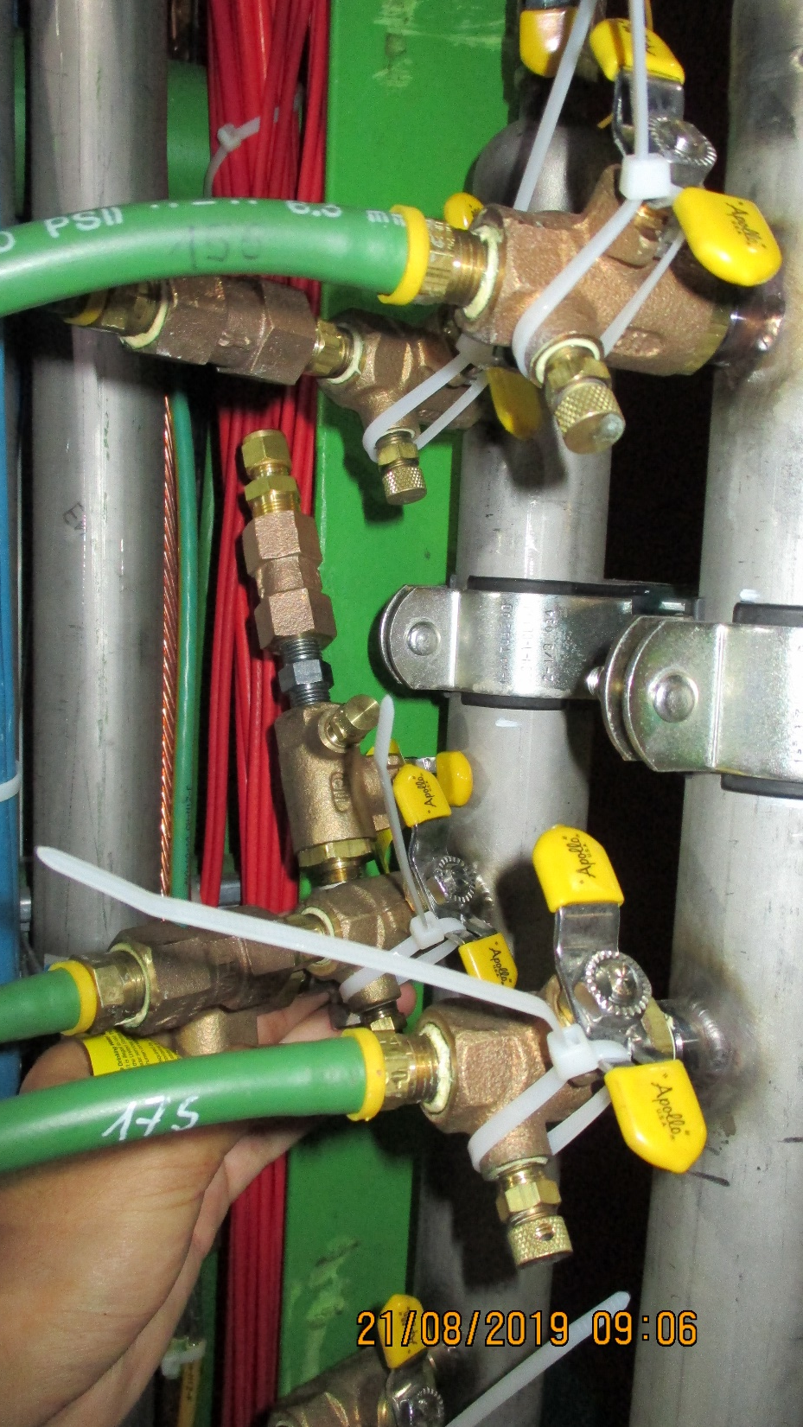

Slide 15
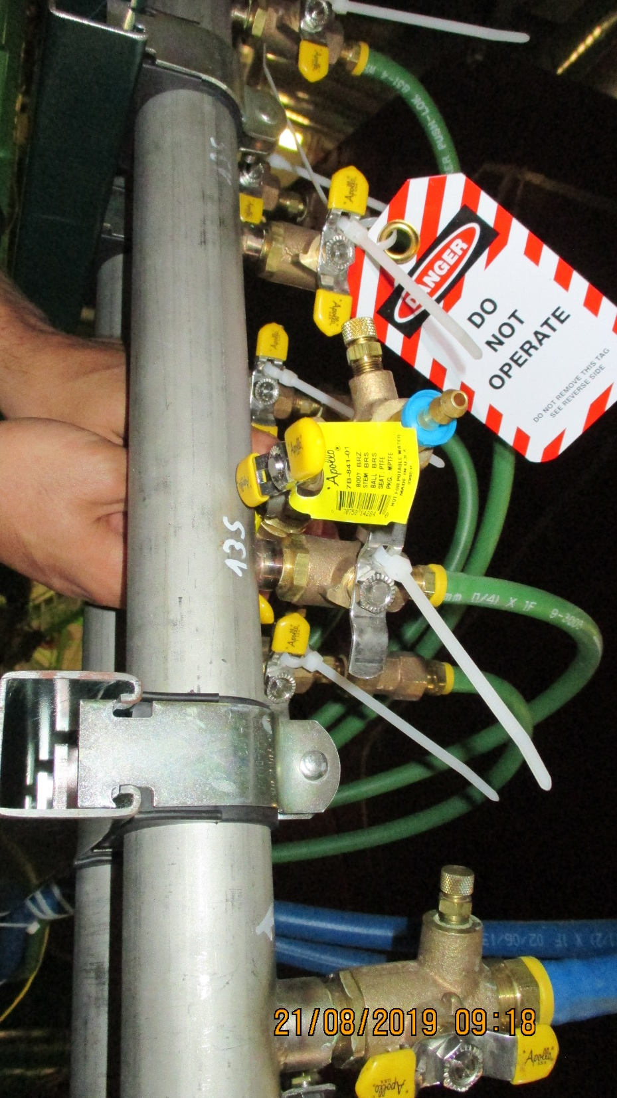
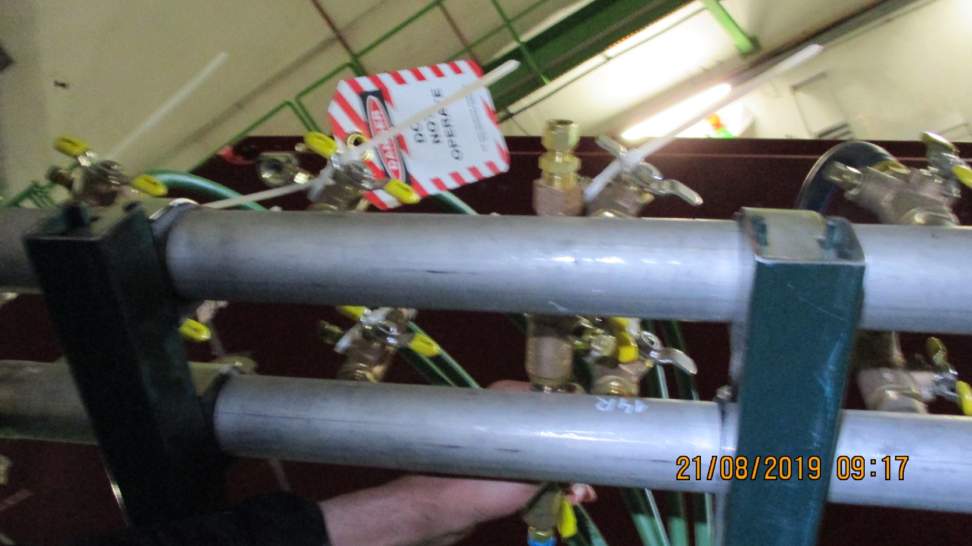
Mini Manifolds 3 on the far side of RE+4/1 on top walkway.
To avoid conflicts near the valve areas the Mini-manifolds can be slid axially
In their mountings as done in other positions.
In addition the Mini-Manifolds can be rotated to reduce hose stress. In this case they can be rotated down wards.

Slide 16
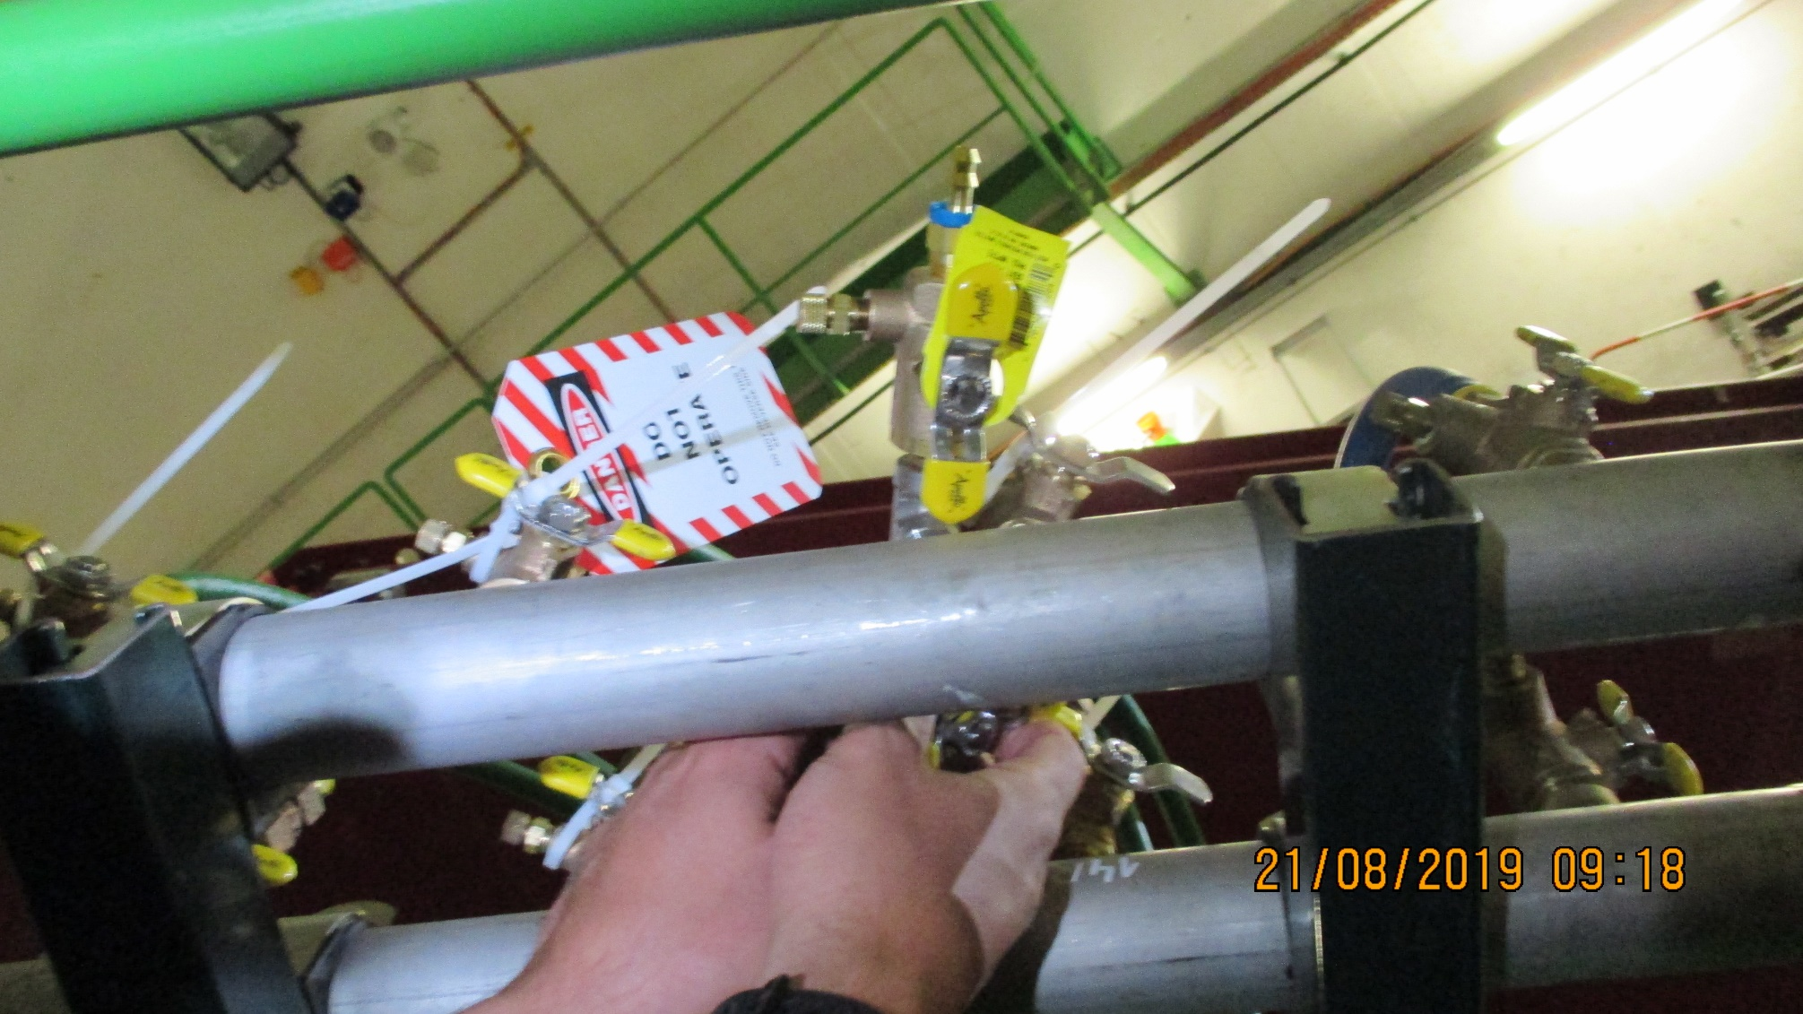

Slide 17
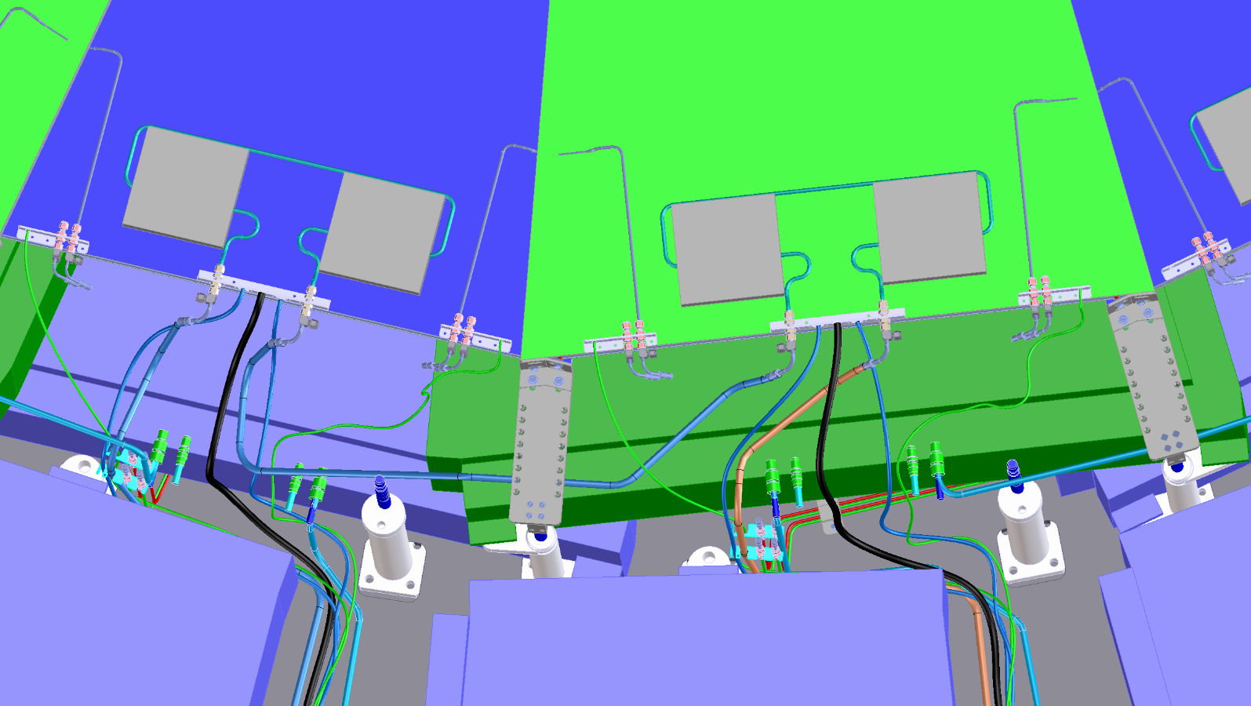
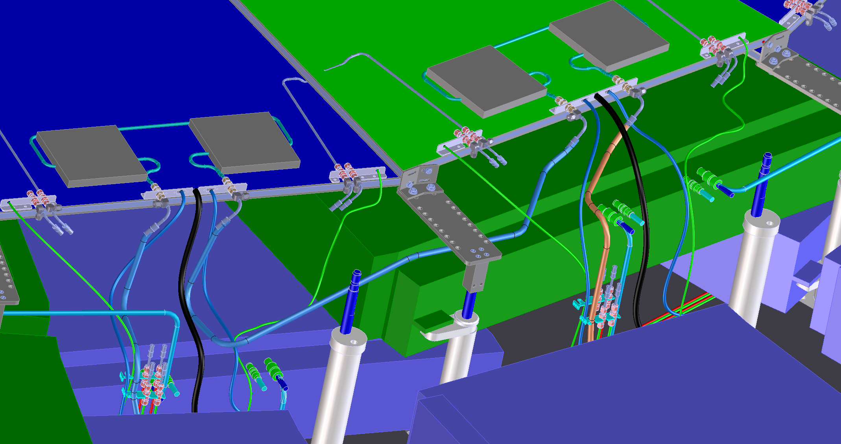
Chamber Interlinks
Stainless fittings here

Slide 18
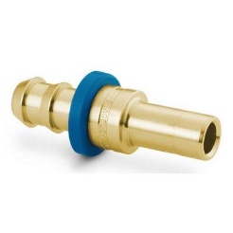
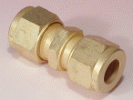
Chamber Inter- Link
Photo of both the black Swagelok Hose, Swagelok Barb ¼ inch to 8mm straight and the Sagana 8mm double union
Sagana 8mm CERN
Sagana 8mm CERN
Supply hose
Swagelok
Return hose
Swagelok
ChamberInterlink

Slide 19
GEM have the special tool for inserting the barb fitting into the hose, in 904.
ALL hoses are to be labelled with both bar codes and simple text labels.
They should both be covered with transparent heat shrink
Aluminium labels should be made up for ALL valves.

Slide 20
ZEC should be asked for their advice for each case, their knowledge and experience should adhered to.

