Slide 1
Cooling installation during LS2
Ian
11 Feb 2019

Slide 2
Power dissipated on chamber
30W per chamber
540W per station
1080W per Endcap
6 mini-manifolds for 18 chambers
3 chambers for 1 Mini-Mnifold
Each Mini Manifold has 3 channels
Each channel will me didvide into two.

Slide 3
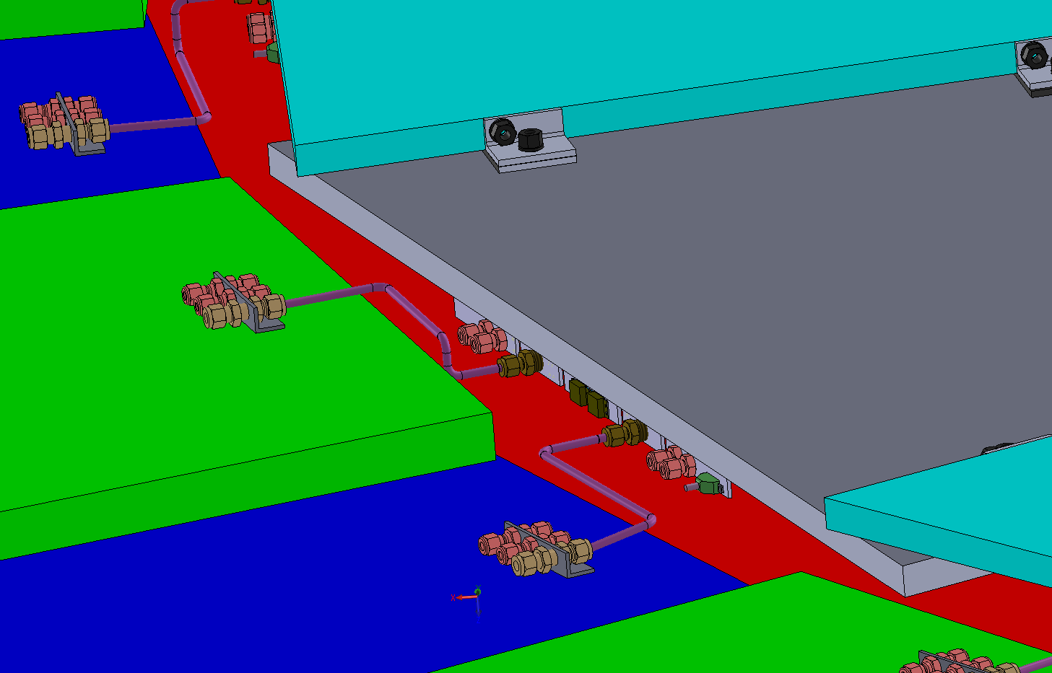
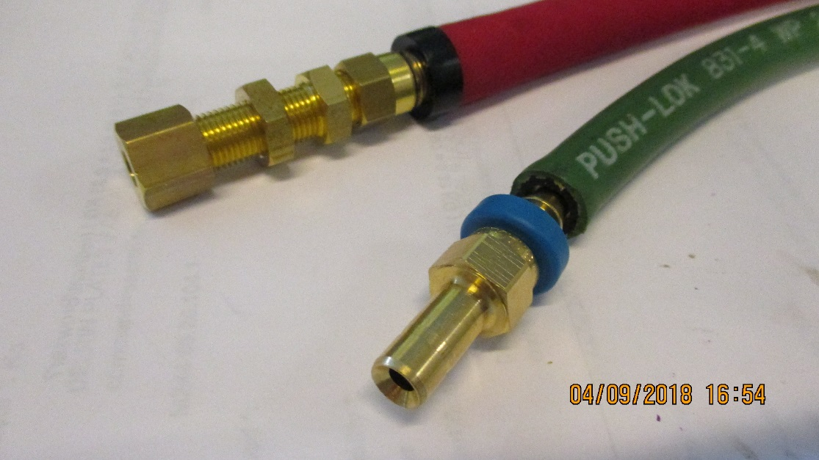
RE3/1 cooling link to RE3/2
x2 RE3/2 circuits feed x1 RE3/1 chamber
The rigid copper piping will be replaced by flexible hose links to reduce the strain on the unions.
Istallation done after RE3/1 installation

Slide 4

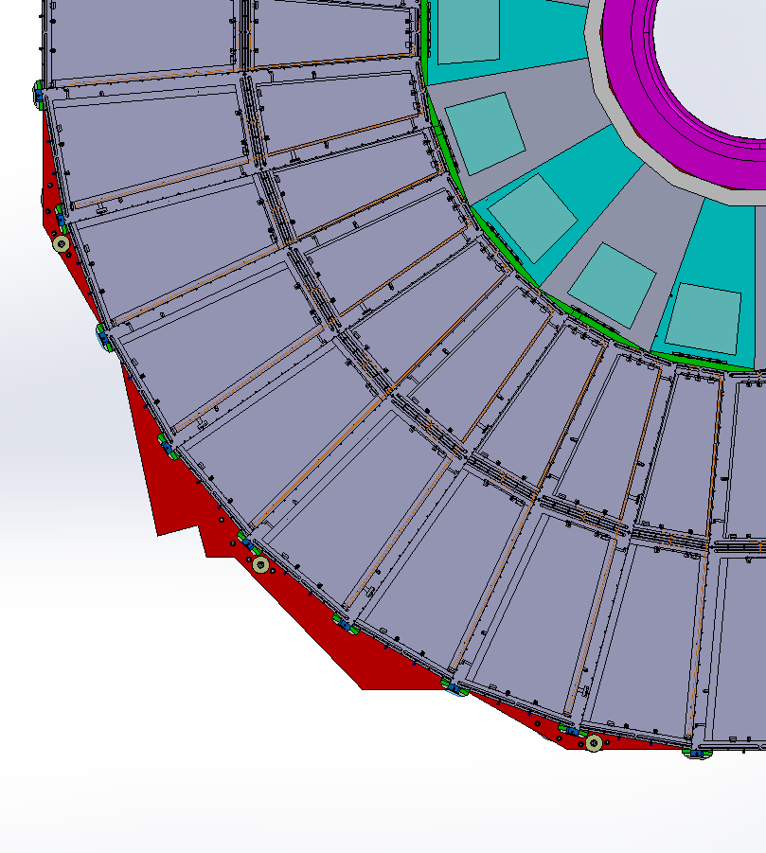
RE4/1 Cooling manifolds
RE4/1
Return
Manifold
Diagram of 1 channel per 2 chambers. Flexible hose from the “T” mounted on the mini manifold.
The two RE4/1s will also be linked by flexibles.
Supply

Slide 5
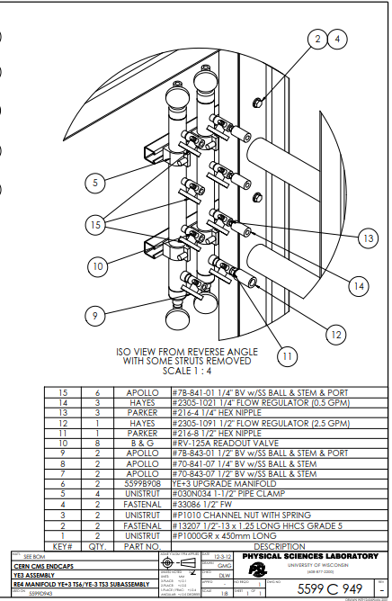
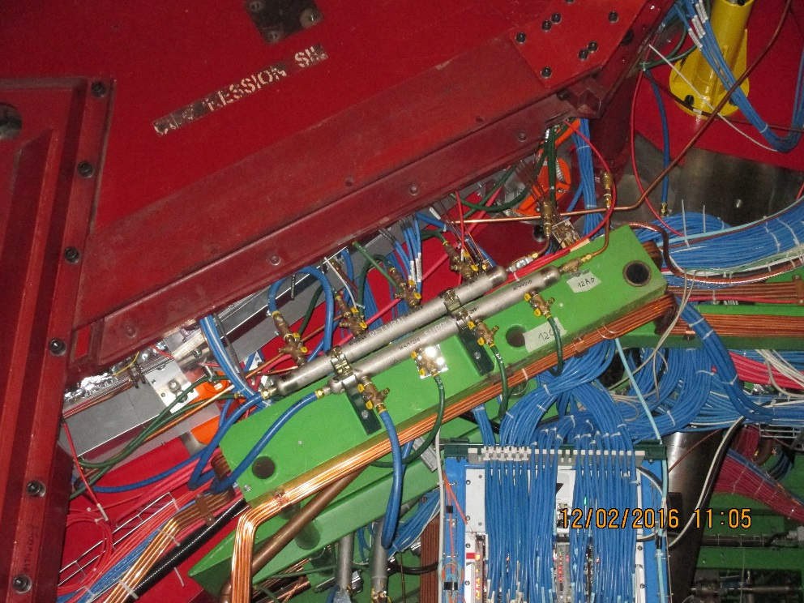


Slide 6
Components for the Mini Manifold modification for RE4/1 cooling
 | For one circuit | For one circuit |  | 9 circuits | 9 circuits | Total | Both Endcaps | 20% spares
 |  |  |  |  |  | One Endcap
 | Supply | Return |  | Supply | Return
Parker 216-4 1/4" hex nipple | 2 | 2 |  | 18 | 18 | 36 | 72 | 86
Parker "T" Female 1/4 NPT 4-4-4 FT-SS | 1 | 1 |  | 9 | 9 | 18 | 36 | 43
Apollo 7B-841-01 1/4" ball valve w/SS ball & stem & port | 1 | 1 |  | 9 | 9 | 18 | 36 | 43
Bell & Gosset # RV -125A Readout valve | 1 | 1 |  | 9 | 9 | 18 | 36 | 43
Hays Mesurflo #2305-1021 1/4" & 3/8"Flow Regulator (0.5gpm) |  | 1 |  |  | 9 | 9 | 18 | 22
Parker #30182-4-4B 1/4" NPT M to 1/4" hose barb | 1 |  |  | 9 |  | 9 | 18 | 22
Parker #30182-6-4B 3/8" NPT M to 1/4" hose barb |  | 1 |  |  | 9 | 9 | 18 | 22
Parker #831-4 1/4"Push-Lok hose green | 1 | 1 |  | 9 | 9 | 18 | 36 | 400m
Hays Mesurflo #2305-1011 1/4" & 3/8"Flow Regulator (0.25gpm) |  | 1 |  |  | 9 | 9 | 18 | 22
Ian Crotty 11 Dec 2018
Not requested as we will stick to what has been used so far in order to maintain same delta T and remove possible confusion during Mini-Manifold modification
Source for “T” stainless Steel
http://ph.parker.com/us/en/pipe-fittingsinstrumentation/4-4-4-ft-ss

Slide 7
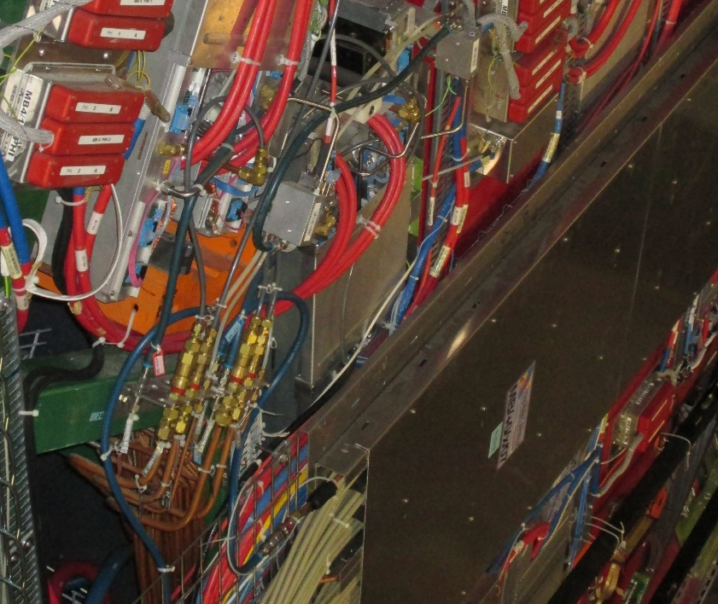
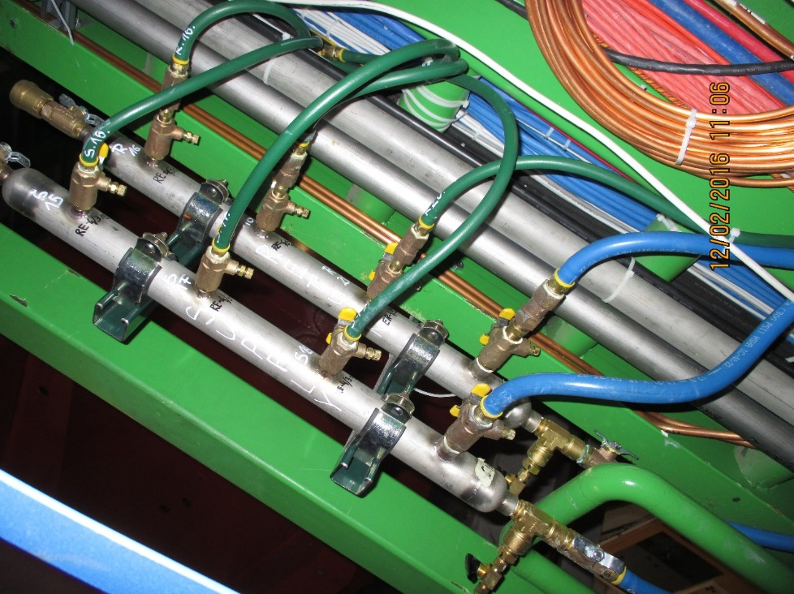
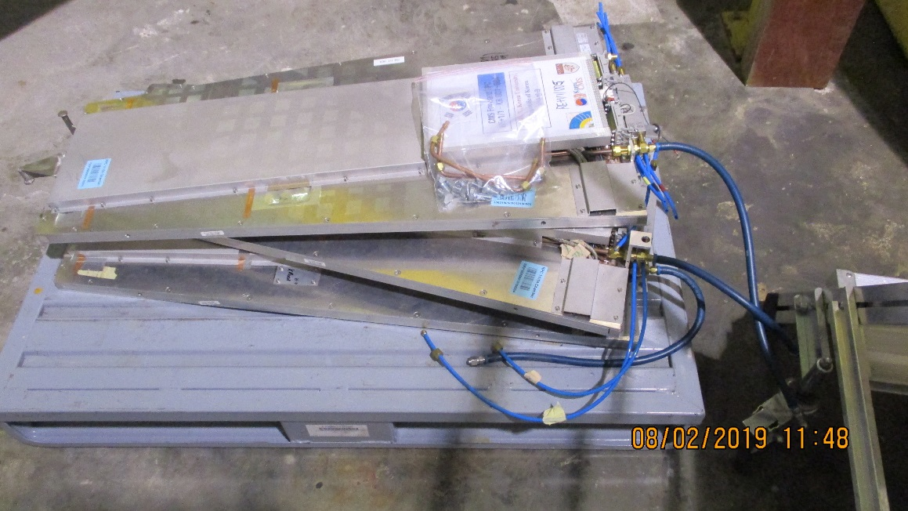
Flexible change from
Parker “Pusk-Lok” to Swagelok “Push-On”.
This will move the transition from Inch to metric from the chamber PP to the Mini-manifold with a European supplier
Derogation should be made by Niels

Slide 8
Conclusion
Material is available through Wisconsin for the inch size components
Material for the metric is available from a swiss distributor that CMS has used for years.
Installation in July 2019

