Slide 1
Cooling installation during LS2
Ian
2- Sept 2018

Slide 2
Power dissipated on chamber
30W per chamber
540W per station
1080W per Endcap
6 mini-manifolds for 18 chambers
3 chambers for 1 Mini-Mnifold
Each Mini Manifold has 3 channels
Each channel will me didvide into two.

Slide 4
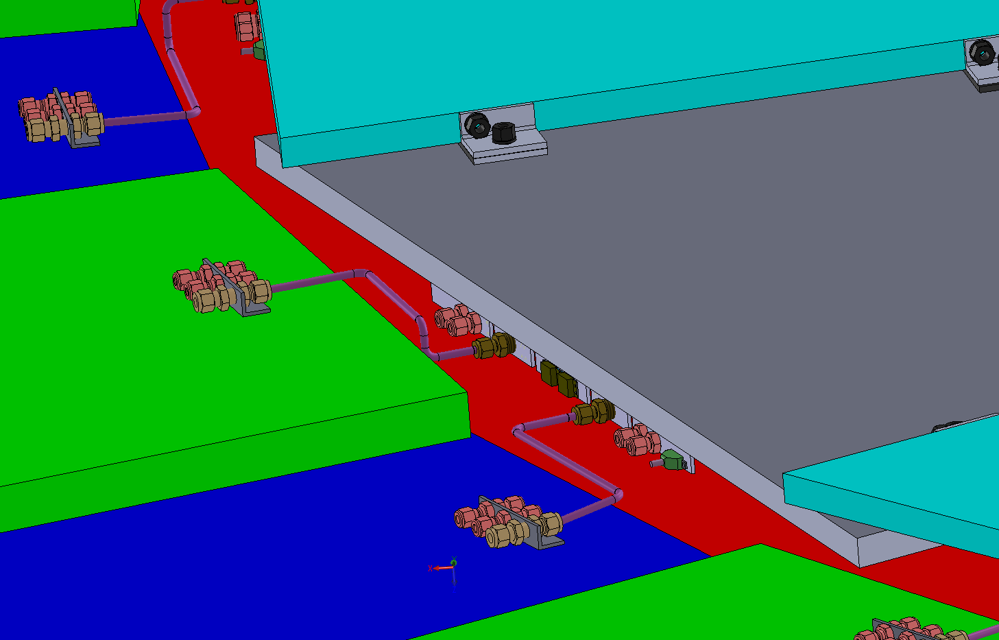
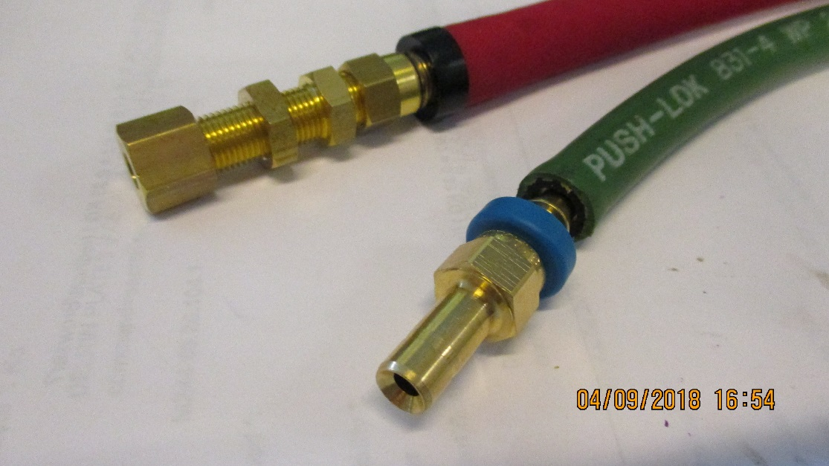
RE3/1 cooling link to RE3/2
x2 RE3/2 circuits feed x1 RE3/1 chamber
The rigid copper piping will be replaced by flexible hose links to reduce the strain on the unions.

Slide 5

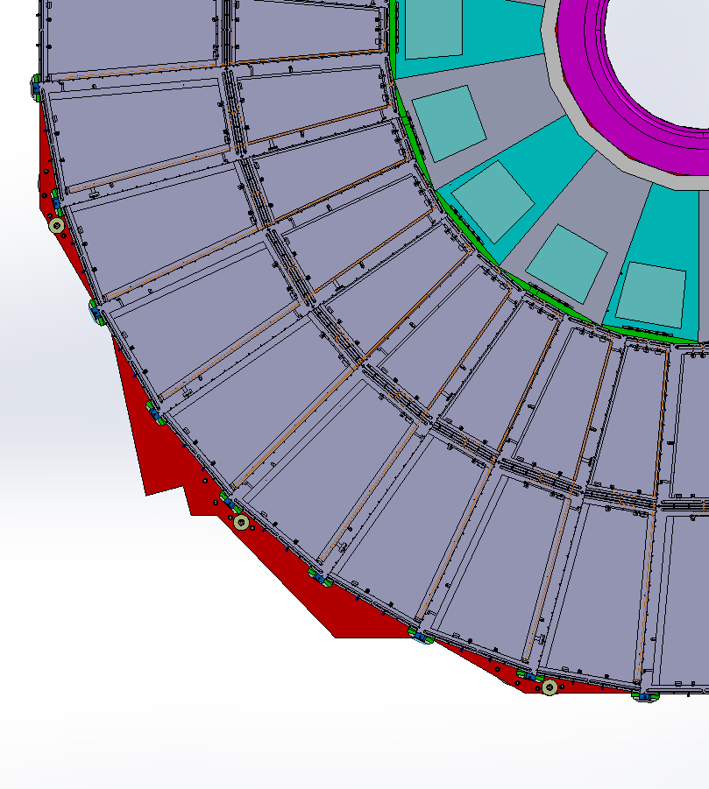
RE4/1 Cooling manifolds
RE4/1
Return
Manifold
Diagram of 1 channel per 2 chambers. Flexible hose from the “T” mounted on the mini manifold.
The two RE4/1s will also be linked by flexibles.
Supply

Slide 6
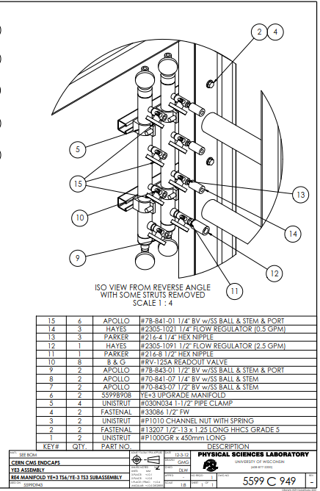
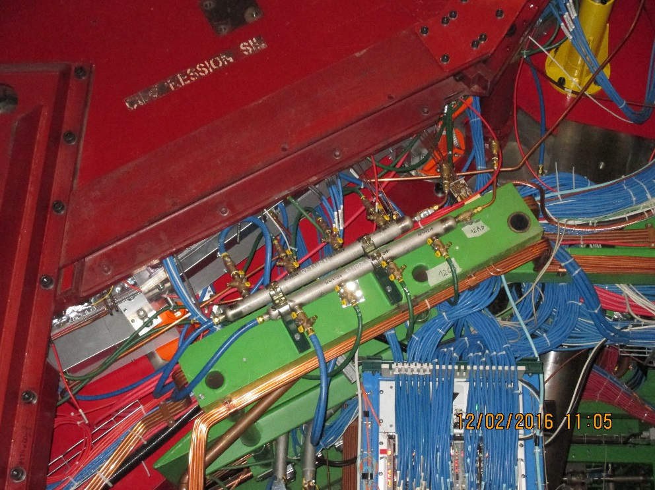


Slide 7
