Slide 1
GEM Cooling QA
Ian with XXXXX from Bulgaria
1 Feb 2019 in 27

Slide 2
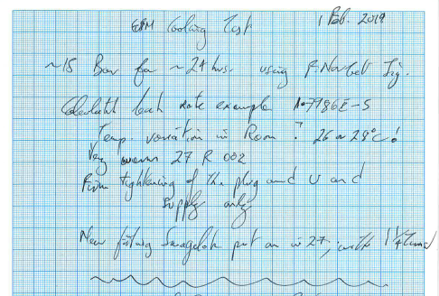

Slide 3
photos

