Slide 1
Endcap Chambers temperatures
Monitoring
Ian, Andrea, Gabriella

Slide 2
Analysis and outlook
Monitoring over 2018 (May-Dec): we selected one chamber for each ring and station.
Temperature distribution on the disk: we map the temperature chamber by chamber for one day
Comparison FOS and PT100 sensors
Conclusion
Note: the error that is not showed in the plots is 0.2 degres

Slide 3
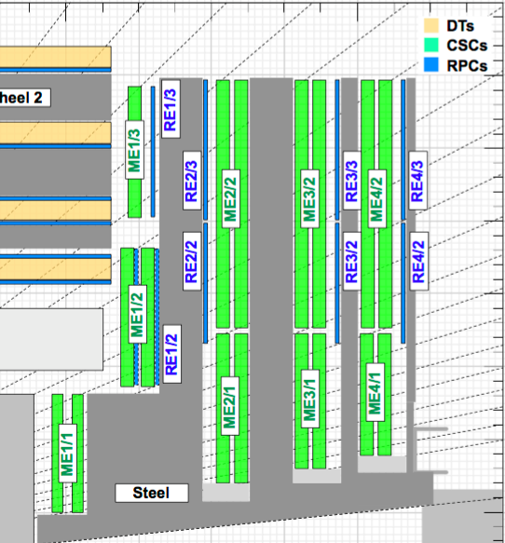
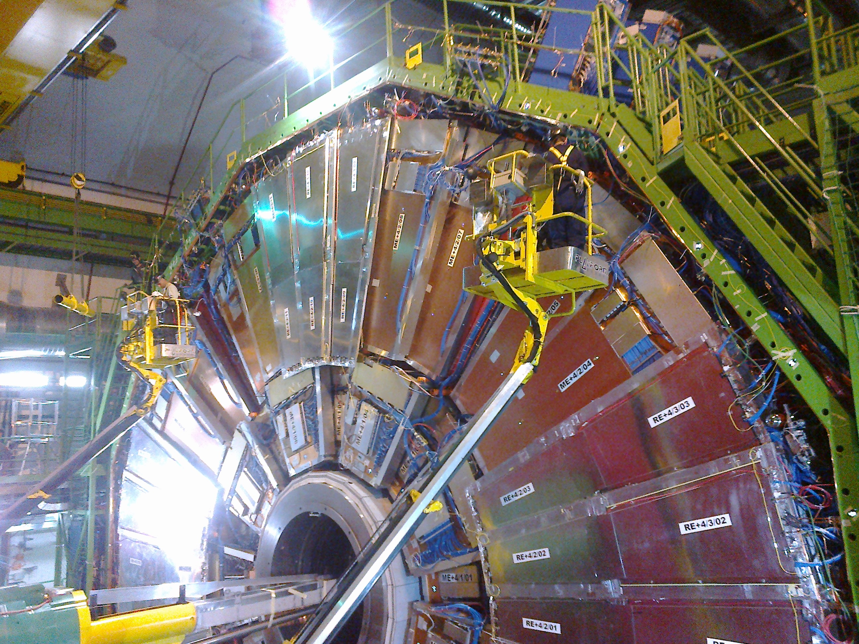
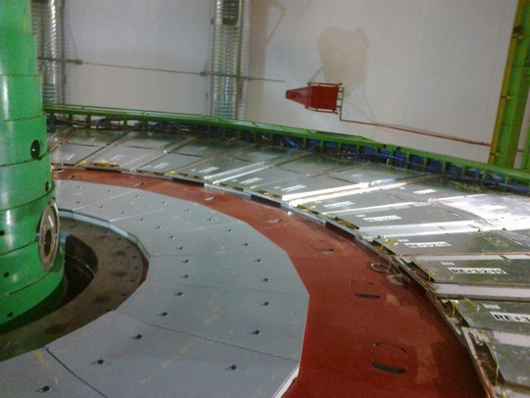
YE1
YE2
YE3
YE4
RE4 chambers are attached to the CSC
RE3 chambers are attached to the YE3
RE1 & RE2 chambers are attached to the YE1

Slide 4
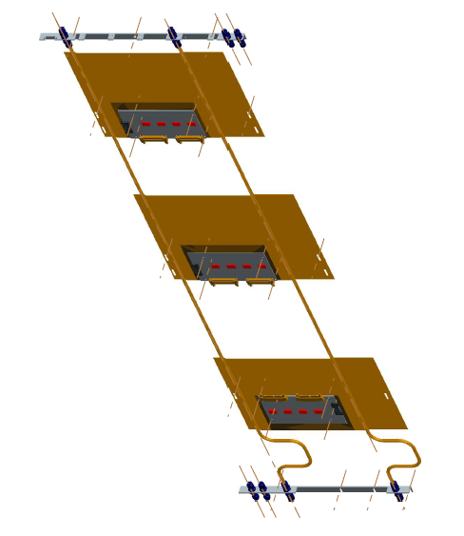
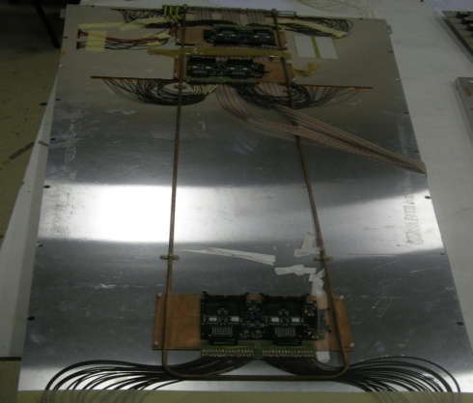
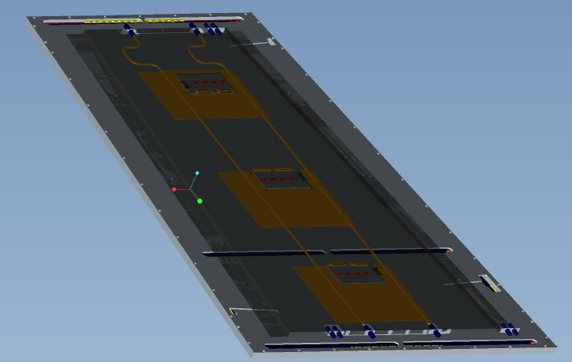
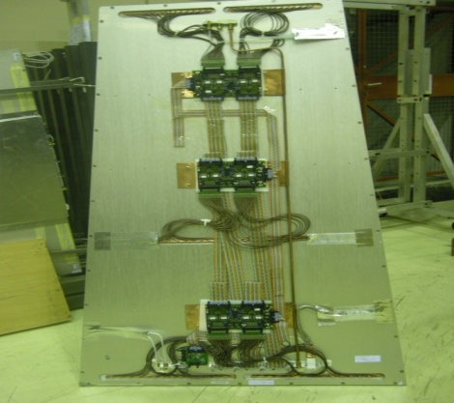
RPC cooling circuit
RE4
RE1
Chamber cooling:
RE1: double lines of copper pipes
RE2 and RE3: single line of copper pipe
RE4: double lines of copper pipes and bigger copper plates
RE2-RE3-RE4:
One cooling channel supplies 4 chambers connected in series: two chambers (one odd and one even) for each ring.
RE1: 6 chambers in series
Sensors:
PT-100 is located inside the chamber (one out of 6 chamber)
FOS Temperature sensors are located at the edge of the chamber (one per chamber)
RE2 and RE3

Slide 5
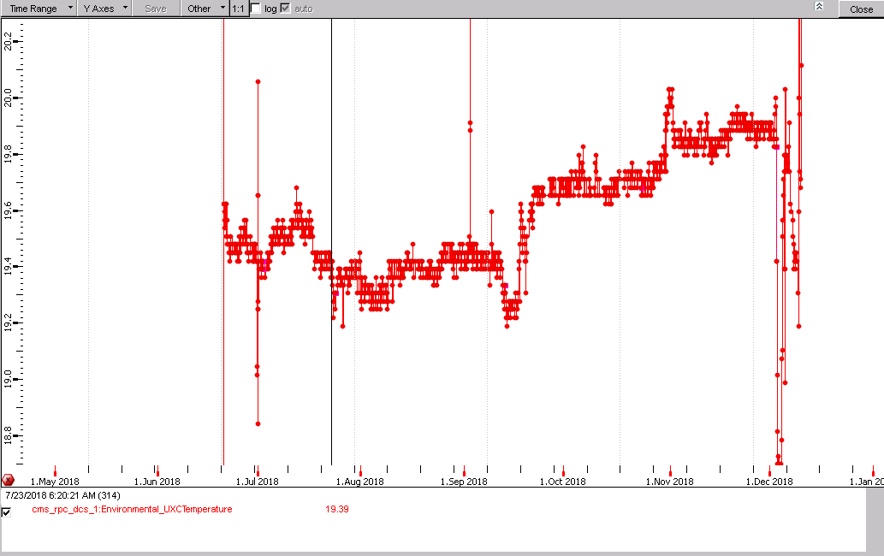
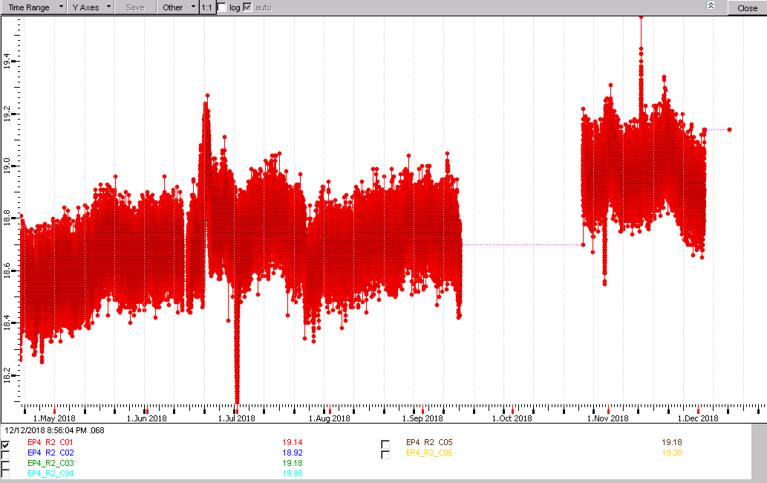
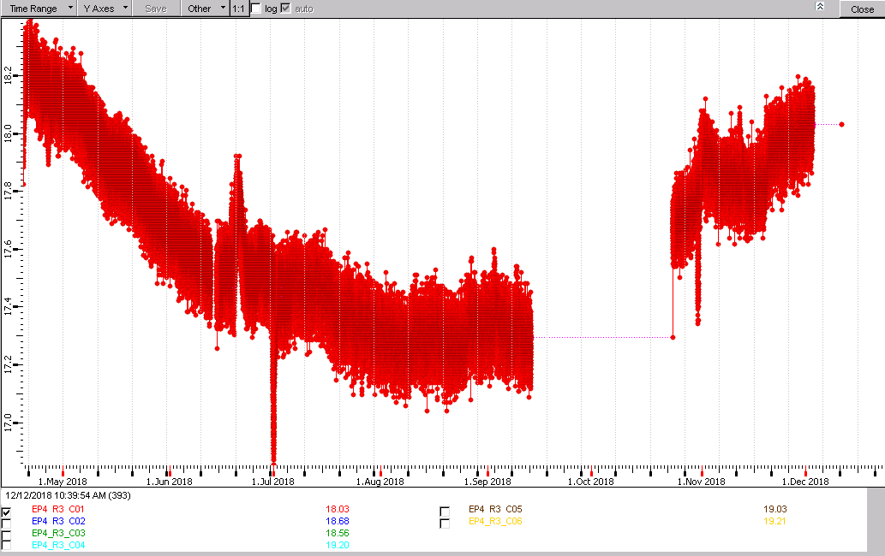
Cavern Temperature
19.9
19.2
FOS CH1
DISK4
Ring 2
18.6 ÷ 19.0
Ring 3
18.2 ÷ 17.4

Slide 6
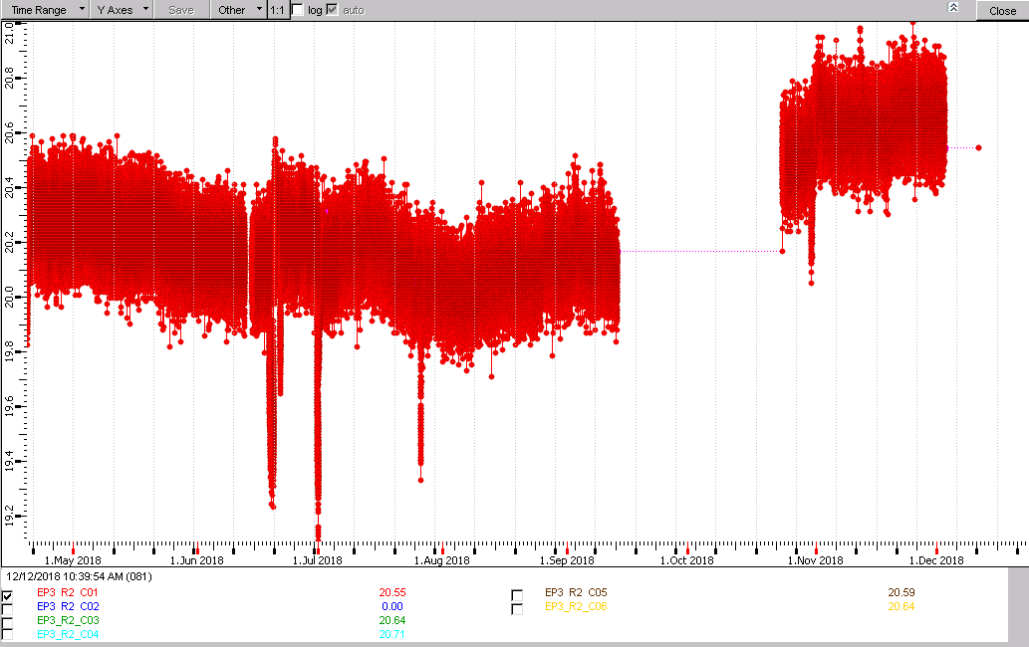
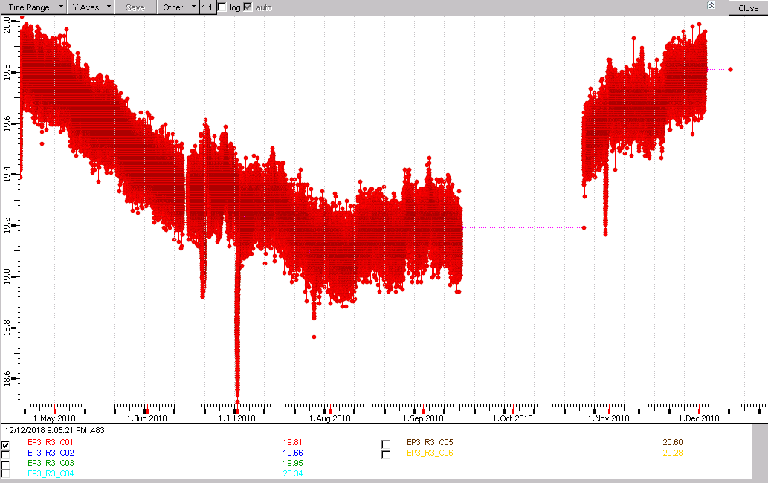
Cavern Temperature
19.9
19.2
FOS CH1
DISK3
Ring 2
20.6 ÷ 20.2
Ring 3
19.8 ÷ 19.0

Slide 7
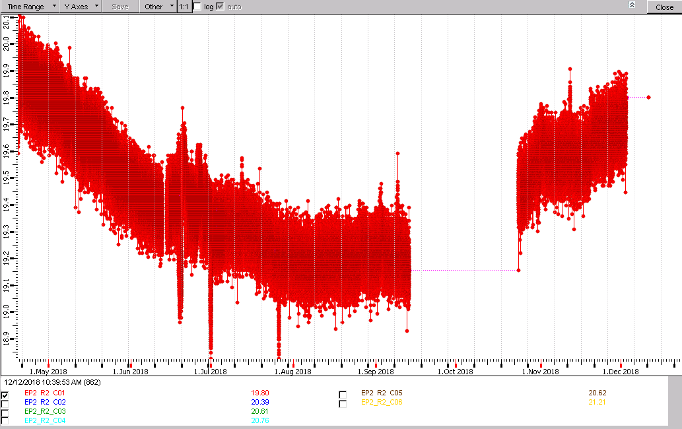
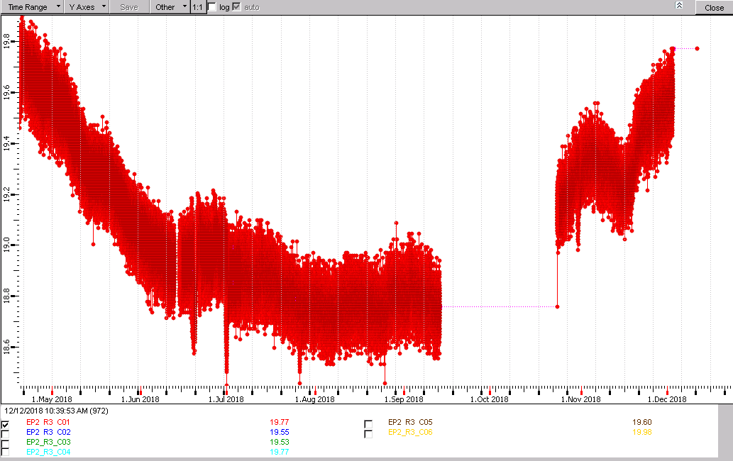
Cavern Temperature
FOS CH1
DISK2
Ring 2
19.9 ÷ 19.2
Ring 3
19.7 ÷ 18.8

Slide 8
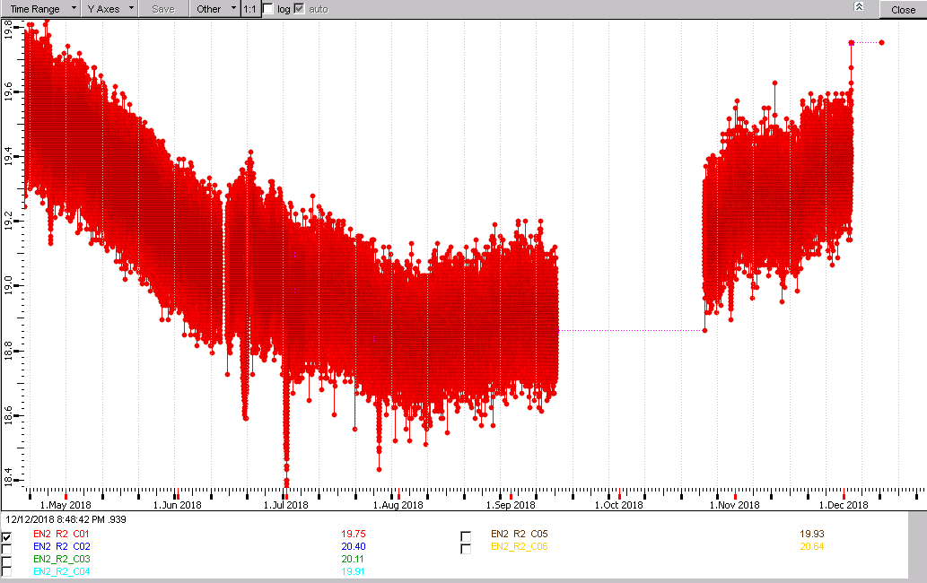
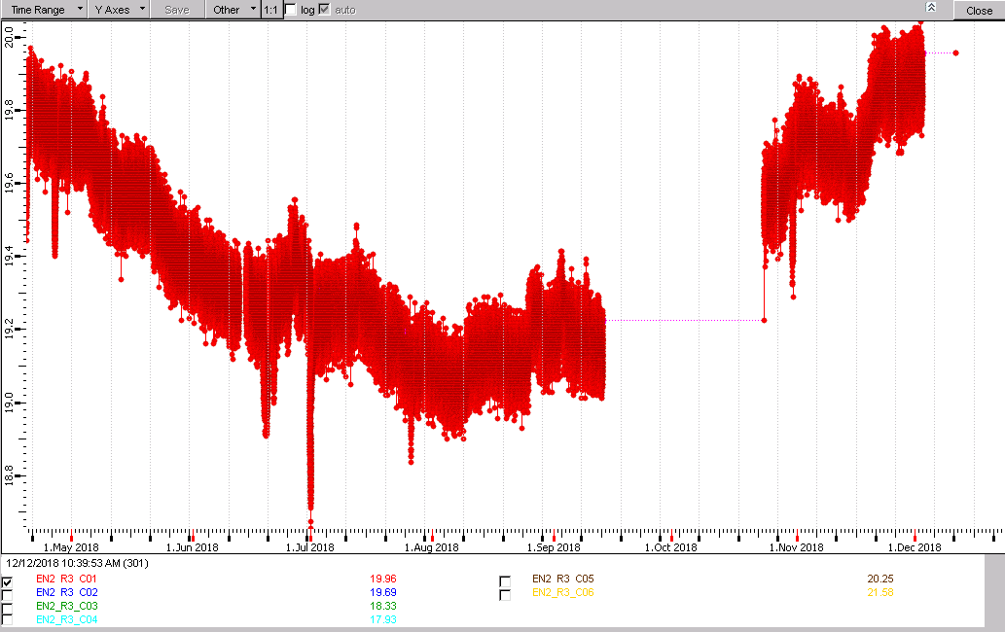
Monitoring of chamber # 1 in 2018
DISK-2
Ring 2
19.6 ÷ 18.9
Ring 3
19.8 ÷ 19.2

Slide 9
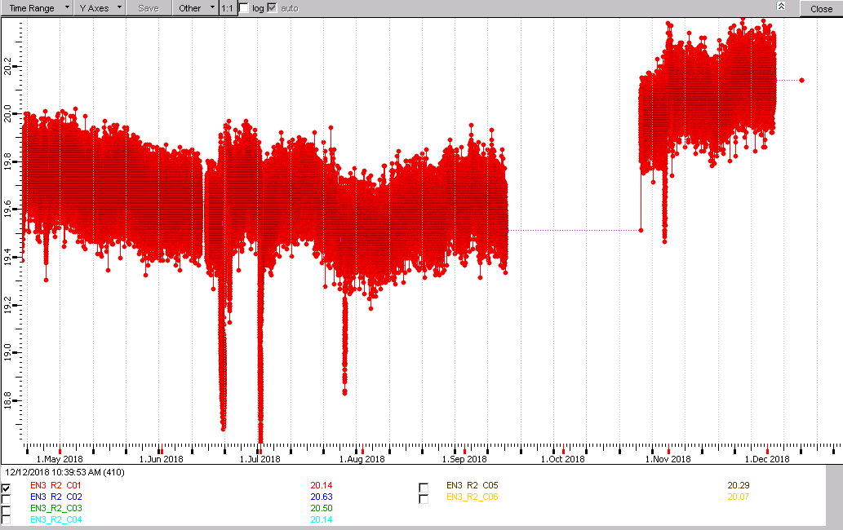
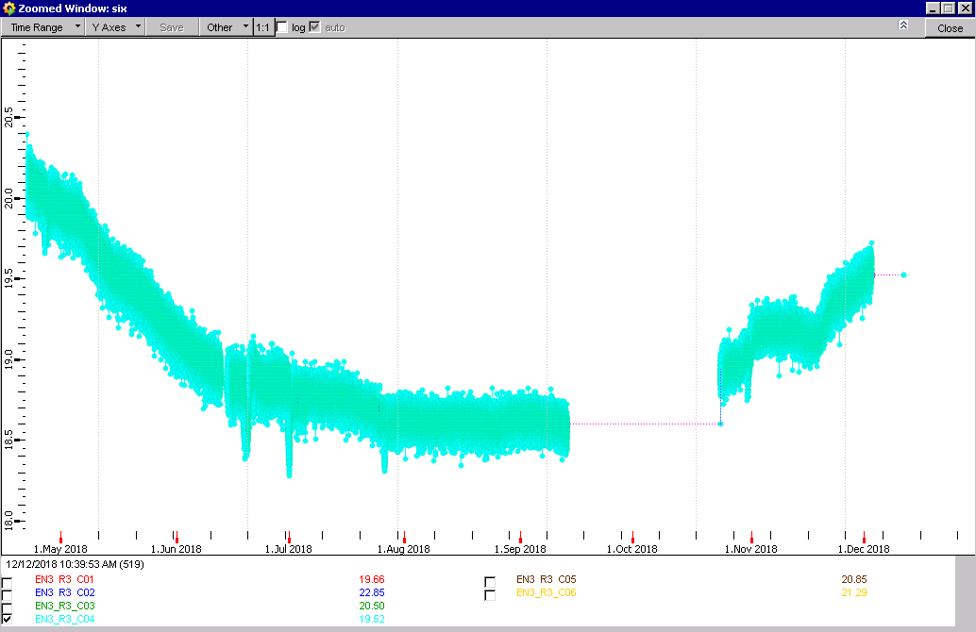
Monitoring of chamber # 1 in 2018
DISK-3
ring2
20.2 ÷ 19.3
ring3
20.2 ÷ 18.8

Slide 10
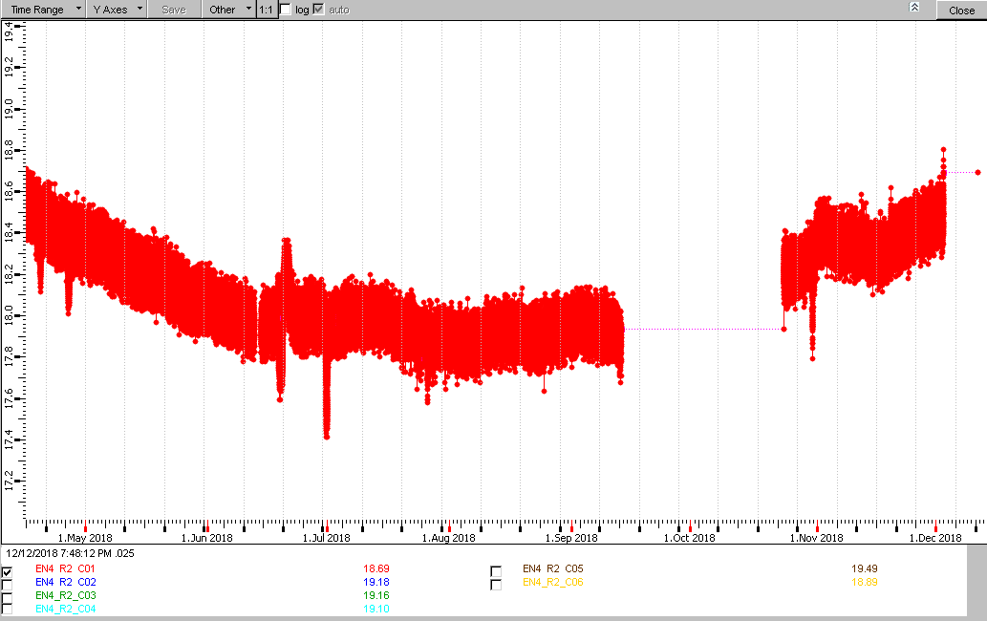
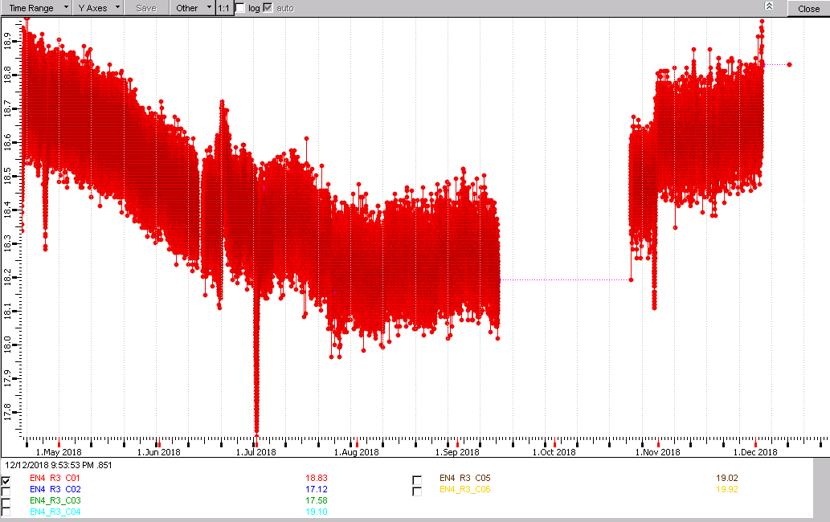
Monitoring of chamber # 1 in 2018
17.8 ÷ 18.8
DISK-4

Slide 11
Summary table and conclusion (1)
 | RE4 | RE3 | RE2 | RE-2 | RE-3 | RE-4
Ring 2 | 0.4⁰ 18.6-19.0⁰ | 0.5⁰ 20.7-20.2⁰ | 0.6⁰ 19.8-19.2⁰ | 0.6⁰ 19.5-18.9⁰ | 0.4⁰ 19.7-20.1⁰ | 0.5⁰ 18.5-18.0⁰
Ring 3 | 0.9⁰ 18.2-17.3⁰ | 0.6⁰ 19.8-19.2⁰ | 0.8⁰ 19.7-18.9⁰ | 0.8⁰ 19.9-19.1⁰ | 0.4⁰ 20.2-17.8⁰ | 0.3⁰ 18.7-18.4⁰
Maximum temperature variation over the year is 0.9 degrees
RE4+ and RE4- have lowest temperature
RE4- has a smaller variation because of the shaft
For all disks, the Ring 3 temperature has bigger variation. It could be due to the cavern temperature variations

Slide 12
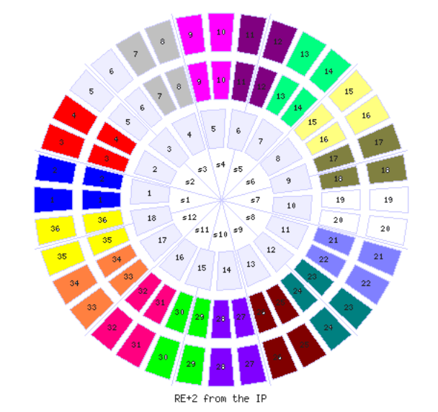
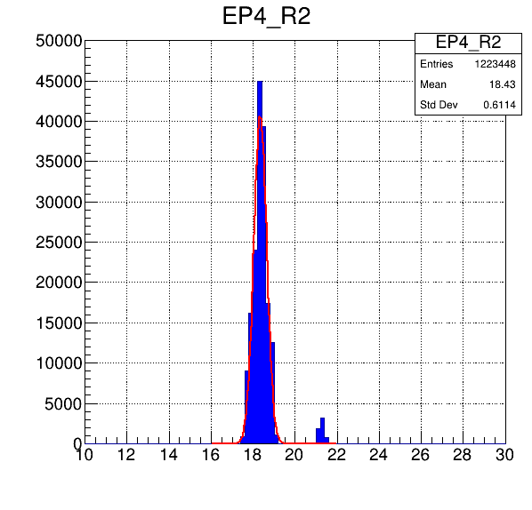
Temperature @ August 1st
 | Average
Ring 2 | 18.5⁰ | 18.5⁰
Ring 3 | 18.4⁰
Odd |  | 18.4⁰
Even |  | 18.4⁰
Upper Half | 18.6 | 18.5
 | 18.4
Lower Half | 18.5 | 18.4
 | 18.4
18.6
18.5
18.4
18.7
18
18.6
19.0
18.3
18.6
18.6
10.0
18.6
18.6
18.4
18.4
18.1
18.6
18.6
18.4
18.8
18.8
18.2
18
18.4
18.3
18.8
19
18.5
18.1
18.5
18.3
18.6
20.0
18.3
17.3
18.7
RE4
18.9
18.0
18.8
18.5
18.3
18.5
18.8
18.6
18.9
18.4
18.4
18.7
17.9
18.4
17.8
18.1
18.5
18.6
18.2
18.3
21.2
18.0
17.8
19
17.9
18.7
19.8
18.1
18.4
18.4
18.3
18.5
18.7
18.1
16.9
16.2
No significant dependence by chamber position with respect to the CSC position (on yoke – off yoke) and low half and upper half of the RPCs.
RE4

Slide 13
 | Average
Ring 2 | 19.8⁰ | 19.7⁰
Ring 3 | 19.6⁰
Odd |  | 19.5⁰
Even |  | 19.9⁰
Upper Half |  | 20.0⁰
Lower Half |  | 19.3⁰
20.3
20.1
21.3
19.5
19.2
21.0
21.7
19.6
19.6
19.8
19.0
19.1
19.6
19.5
19.9
20.3
19.2
19.0
20.3
19.1
20.1
19.2
19.1
20.3
18.9
19.3
20.1
19.5
18.7
19.8
20
19.5
20.0
20,2
19.1
20.2
RE+3
19.4
20.9
19
16.8
21.6
20.1
23.7
19.3
20.9
19.6
20.1
19.1
19.9
17.2
18.5
19.1
17.9
18.3
19.8
19.3
19.7
23.6
19.8
20.0
19.9
21.1
18.9
18.4
21.2
18.5
18.8
No significant dependence by chamber position with respect to the CSC position (on yoke – off yoke)
Lower half chambers with 1 degrees less then the upper half station
19.5
18.5
18.5
18.5
18.5
RE+3

Slide 14
Comparison between FOS and PT100 sensors
In RE1 station only PT sensors are installed
 | RE4 | RE3 | RE2 | RE1 | RE-1 | RE-2 | RE-3 | RE-4
FOS | 18.2⁰ | 19.5⁰ | 19.6⁰ |  |  | 18.7⁰ | 19.8⁰ | 17.8⁰
PT100 |  | 20.9⁰ | 20.1⁰ | 20.8⁰ | 20.6⁰ | 21.0⁰ | 21.7⁰
Approximately 2 degrees difference between FOS-PT100
The RE1 temperature is similar to the stations RE2 and RE3 despite having double copper pipe layout, 6 chambers in series and lower convection air

Slide 15
Conclusion
The present CMS cooling system is capable of maintaining stable temperature in the optimal range for longevity and stable performance of the RPCs
The improved RE4 circuit has proved to be more effective then the other stations (lower temperature and more stable).
The cooling circuit on the Yoke is fundamental to keeping stable and low the temperature on the four RPC stations.

Slide 16
SPARE

Slide 17
RE-2/ring2
RE-2/ring3

Slide 18
18
EP4
Ring 2
Ring 3

Slide 19
19
EP3
Ring 2
Ring 3

Slide 20
EP2
Ring 2
Ring 3

Slide 21
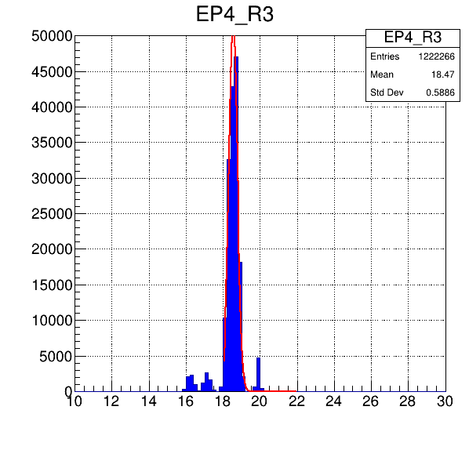
21
EP4
Ring 2
Ring 3

Slide 22
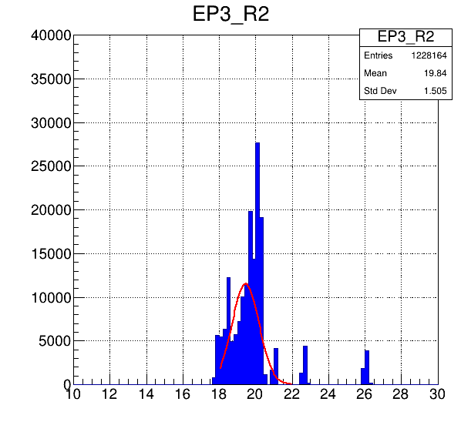
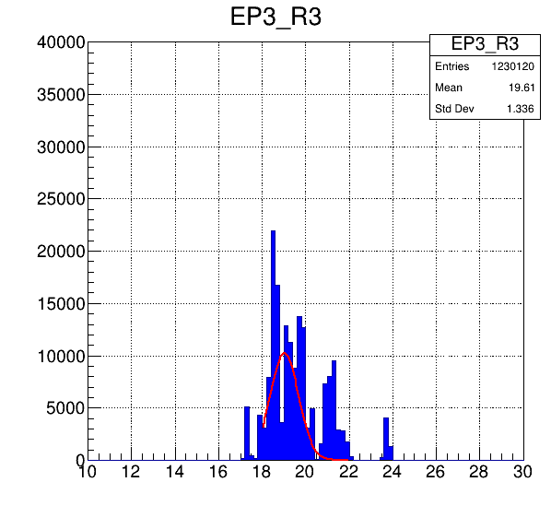
EP3
Ring 2
Ring 3

Slide 23
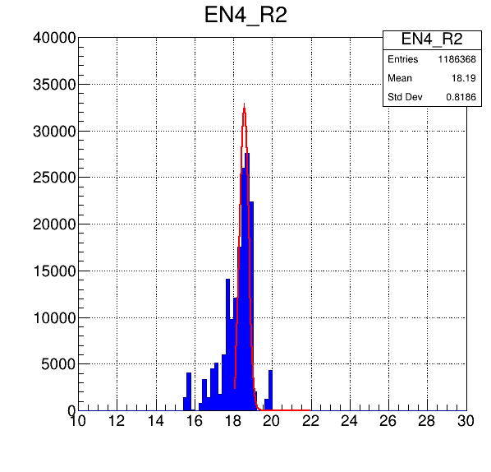
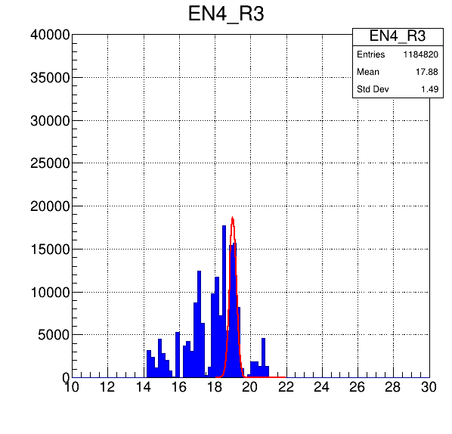
23
EN4
Ring 2
Ring 3

Slide 24
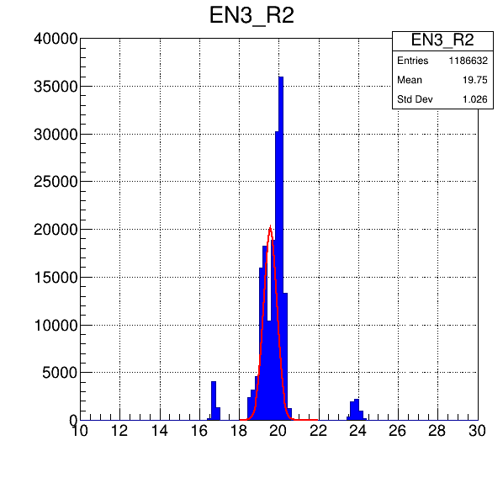
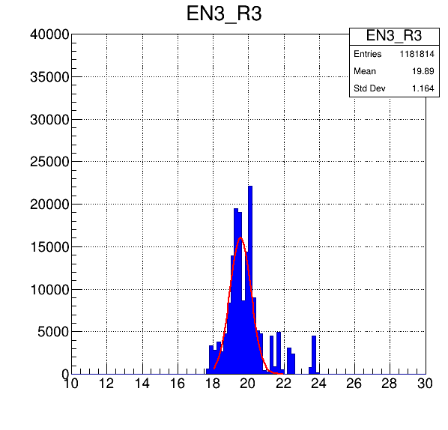
24
EN3
Ring 2
Ring 3

Slide 25
 | Average
Ring 2 | 19.1⁰ | 18.7⁰
Ring 3 | 18.4⁰
Odd |  | 18.7⁰
Pair |  | 18.7⁰
UP |  | 18.3
Down |  | 17.2
19.5
19.4
17
20.4
19.9
19.1
16.9
19.1
22.7
15.5
19.8
21
19.8
18.6
18
19.7
20.5
17.3
19.1
18.8
19.2
20
19.4
19.4
18.9
18.1
18.1
19.5
19.3
18.8
19.5
19.1
20.3
19.0
20.3
18.8
RE-2
18.2
19.0
18.9
20.3
17.6
19.4
18.7
20.7
17.8
17
19.9
17.8
17.4
20.5
18.4
19.6
20.6
16.6
17.6
19.5
19.1
17.3
17.2
20.4
14.9
18.9
19.1
19.3
19.2
15.1
17.5
11.4
17.3
18.2
18.7
18.2

Slide 26
10 days distributions (2-12 August)

Slide 27
 | Average
Ring 2 | 17.8⁰ | 17.8⁰
Ring 3 | 17.8⁰
Odd |  | 17.5⁰
Even |  | 18.2⁰
UP |  | 18.3
Down |  | 17.2
19
19
15.9
19.1
19
18.5
19.6
19
17.8
19.2
18.1
18.0
18.3
18.
18.4
18.8
19.8
19
18.5
18.9
18.4
18.9
17.1
18.5
17.7
14.4
18.3
18.3
16.4
1848
18.8
19.0
18.9
18.8
18.3
17.8
RE-4
4.8
17.6
18.1
18.6
17
17.6
19.4
18
August 1st
18.1
17.7
18.4
20.7
17.0
18.6
15.7
18.8
18.3
14.8
17.8
17.2
18.6
18.5
16.4
17.7
17
18.1
17.1
20.1
18.8
15.6
14.3
15.1
16.7
18.4
16.9
16.9

Slide 28
 | Average
Ring 2 | 19.6⁰ | 19.7⁰
Ring 3 | 19.8⁰
Odd |  | 19.7⁰
Even |  | 19.7⁰
UP |  | 19.9
Down |  | 19.4
19.2
20.6
20.0
20.2
20.0
20.4
20.5
20.0
21.7
22.4
20.1
19.1
19.6
19.5
20
19.9
19.2
18.6
19.3
19.1
20
19.2
19.9
20
18.9
20.2
20
19.5
19.1
20.1
20
23.6
20.0
20,2
19.8
19.8
RE-3
19.4
18.5
19
16.8
19.2
20.1
21.2
19.3
19.7
19.6
20.1
19.5
19.1
19.9
18.5
19.1
19.1
19.4
19.8
19.3
19.7
23.6
19.8
20.0
19.9
19.3
19.3
18.8
18.8
18.8
18.9
19.9
19.4
19.5
18.3
17.8

Slide 29
Summary table and conclusion (2)
 | RE4 | RE3 | RE2 | RE-2 | RE-3 | RE-4
Ring 2 | 18.5⁰ | 19.8⁰ | 19.3⁰ | 19.1⁰ | 19.6⁰ | 17.8⁰
Ring 3 | 18.4⁰ | 19.6⁰ | 19.6⁰ | 18.4⁰ | 19.8⁰ | 17.8⁰
Average | 18.5⁰ | 19.7⁰ | 19.5⁰ | 18.7⁰ | 19.7⁰ | 17.8⁰
Average temperature 19-20⁰
The RE4 circuit is more effective then RE3-2-1: lower temperature and more stable).
Negative side temperature lowest due to the shaft

Slide 30
Summary table and conclusion (2)
 | RE4 | RE3 | RE2 | RE-2 | RE-3 | RE-4
Ring 2 | 18.5⁰ | 19.8⁰ | 19.3⁰ | 19.1⁰ | 19.6⁰ | 17.8⁰
Ring 3 | 18.4⁰ | 19.6⁰ | 19.6⁰ | 18.4⁰ | 19.8⁰ | 17.8⁰
Average | 18.5⁰ | 19.7⁰ | 19.5⁰ | 18.7⁰ | 19.7⁰ | 17.8⁰
Average temperature 19-20⁰
The RE4 circuit is more effective then RE3-2-1: lower temperature and more stable).
Negative side temperature lowest due to the shaft

Slide 31
Comparison between FOS and PT100
(outside and inside chamber)
 |  | RE4 | RE3 | RE2 | RE1 | RE-1 | RE-2 | RE-3 | RE-4
Ring 2 | FOS | 18.5⁰ | 19.4⁰ | 19.5⁰ |  |  | 19.1⁰ | 19.8⁰ | 17.8⁰
 | PT100 |  | 21.2⁰ | 20.2⁰ | 21.4⁰ | 21.0⁰ |  | 22.0⁰
Ring 3 | FOS | 18.0⁰ | 19.7⁰ | 19.8⁰ |  |  | 18.5⁰ | 19.9⁰ | 17.8⁰
 | PT100 |  | 20.5⁰ | 20.1⁰ | 20.3⁰ | 20.2⁰ |  | 21.3⁰
Average | FOS | 18.2⁰ | 19.5⁰ | 19.6⁰ |  |  | 18.7⁰ | 19.8⁰ | 17.8⁰
 | PT100 |  | 20.9⁰ | 20.1⁰ | 20.8⁰ | 20.6⁰ | 21.0⁰ | 21.7⁰
FOS are not installed in RE1. PT100 are not installed in RE4
Approximately 1 degrees difference between outside and inside chamber (FOS-PT100).

