Slide 1
Endcap Chambers temperatures
2018
Ian, Andrea, Gabriella

Slide 2
Analysis
Monitoring of one chamber during all rings during all 2018
Chamber temperature distribution in 10 days
Temperature map in all chambers on 1 August 2018

Slide 3
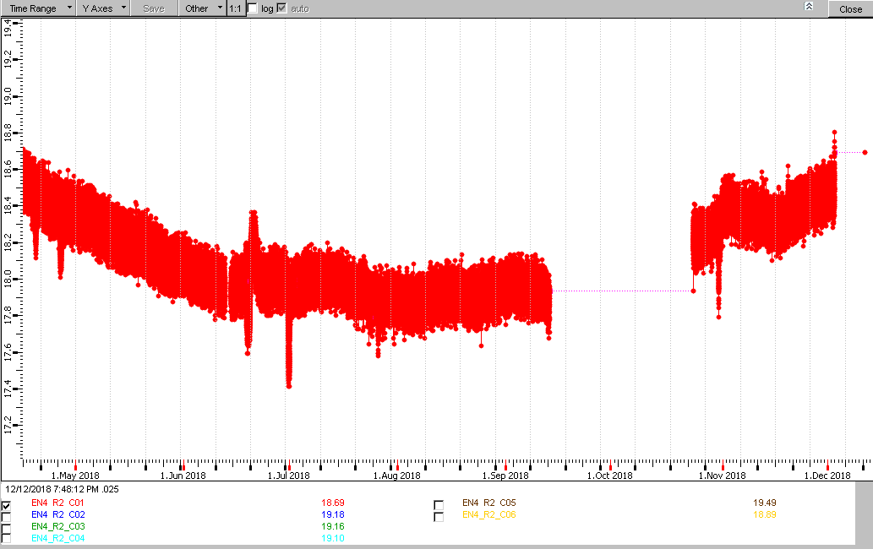
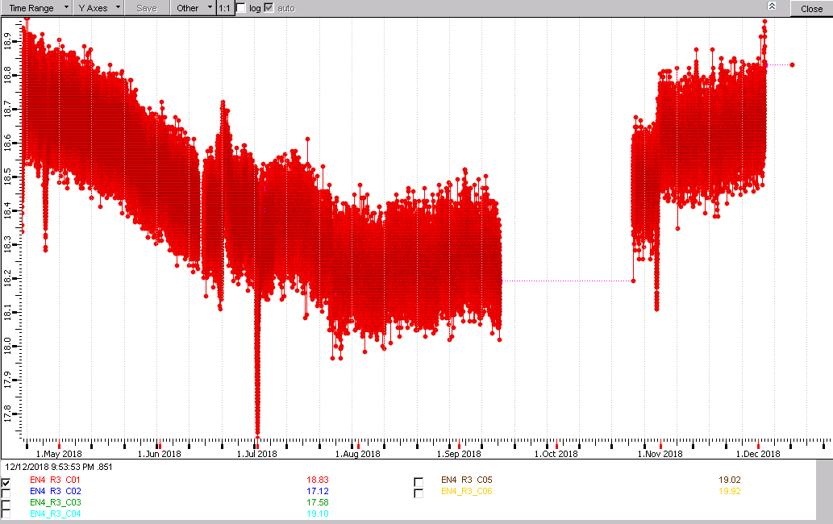
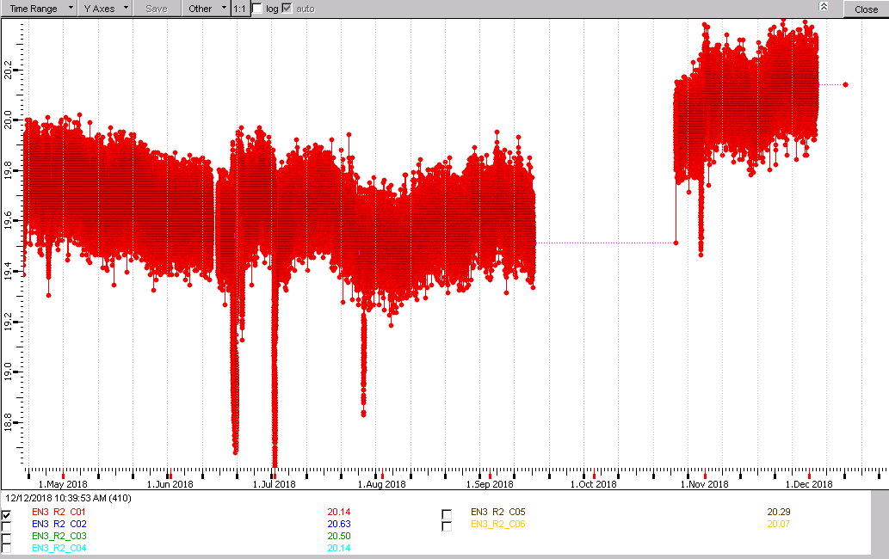
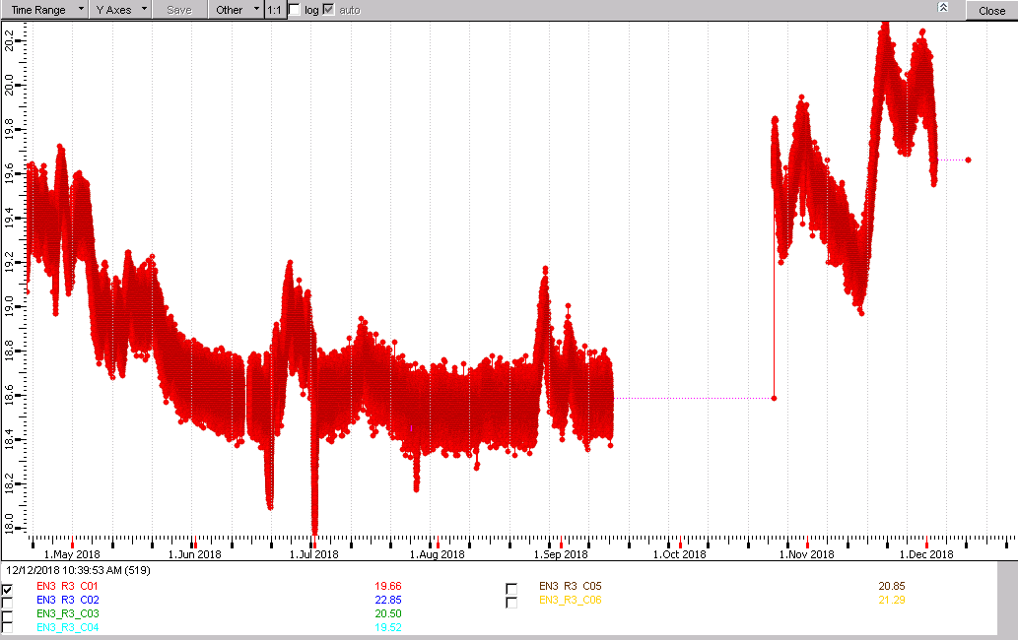
Monitoring of chamber # 1 in 2018
17.8 ÷ 18.8
RE-4/ring2
18.9 ÷ 18.1
RE-4/ring3
20.0 ÷ 19.3
RE-3/ring2
RE-2/ring3
20.2 ÷ 19.3

Slide 4
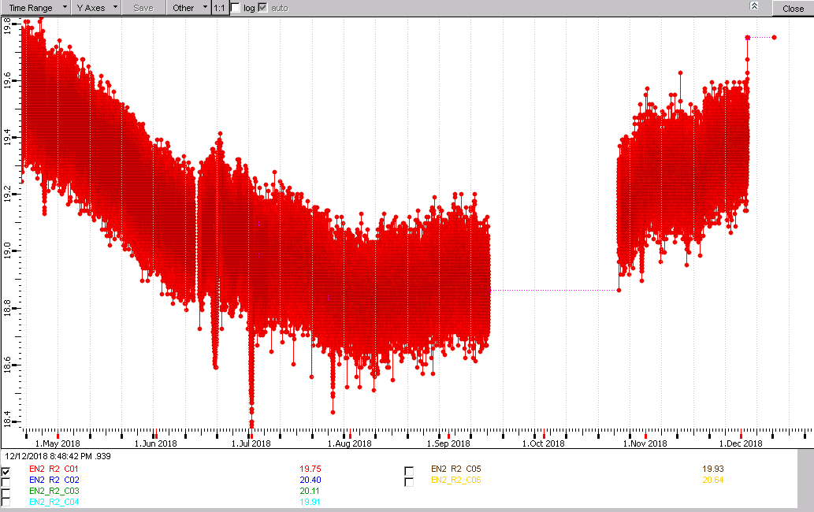
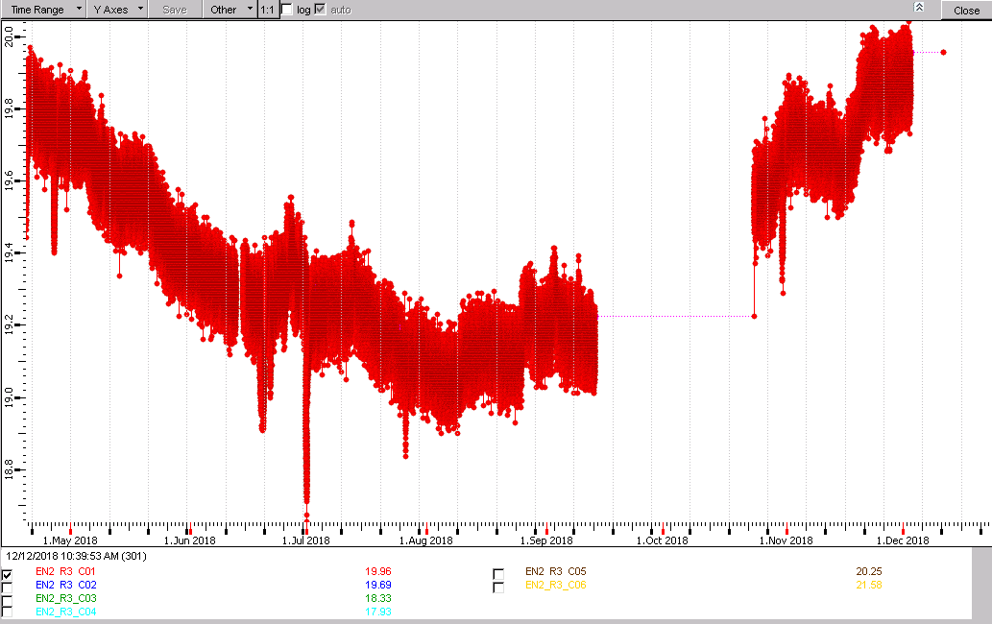
RE-2/ring2
RE-2/ring3

Slide 5
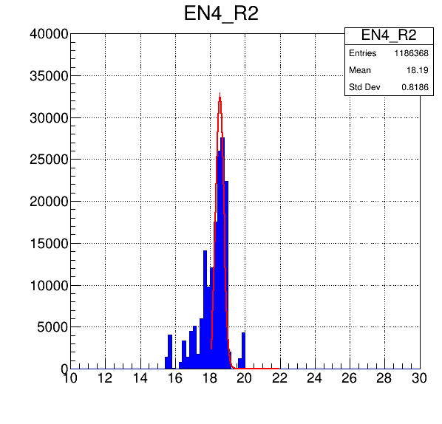
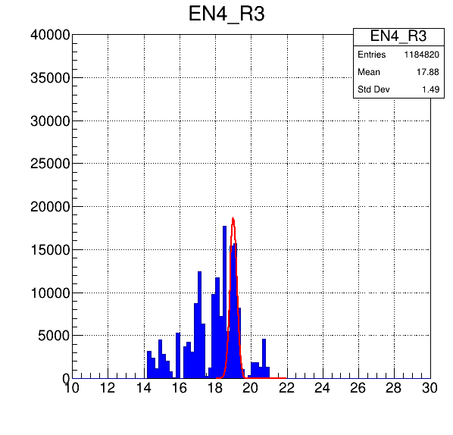
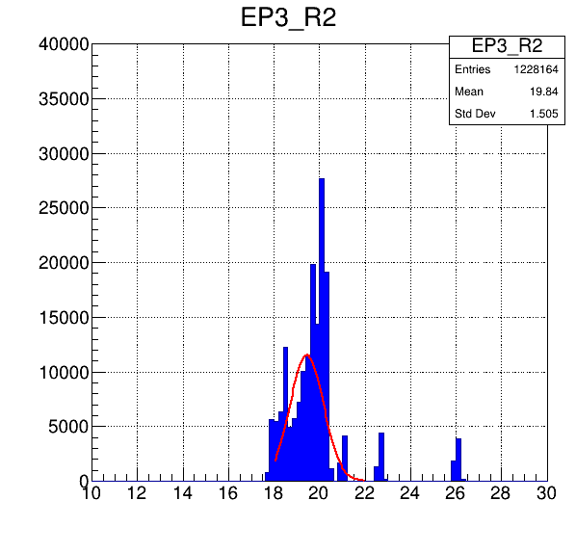
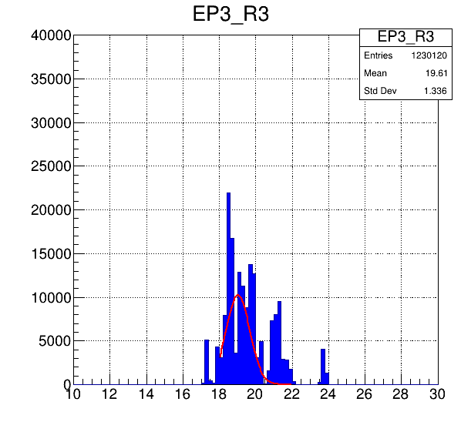
10 days distributions

Slide 6
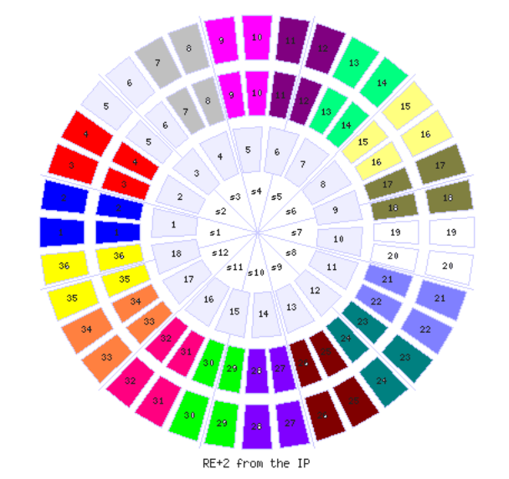
 | Average
Ring 2 | 19.1⁰ | 18.7⁰
Ring 3 | 18.4⁰
Odd |  | 18.7⁰
Pair |  | 18.7⁰
UP |  | 18.3
Down |  | 17.2
19.5
19.4
17
20.4
19.9
19.1
16.9
19.1
22.7
15.5
19.8
21
19.8
18.6
18
19.7
20.5
17.3
19.1
18.8
19.2
20
19.4
19.4
18.9
18.1
18.1
19.5
19.3
18.8
19.5
19.1
20.3
19.0
20.3
18.8
RE-2
18.2
19.0
18.9
20.3
17.6
19.4
18.7
20.7
17.8
17
19.9
17.8
17.4
20.5
18.4
19.6
20.6
16.6
17.6
19.5
19.1
17.3
17.2
20.4
14.9
18.9
19.1
19.3
19.2
15.1
17.5
11.4
17.3
18.2
18.7
18.2

Slide 7
 | Average
Ring 2 | 19.6⁰ | 19.7⁰
Ring 3 | 19.8⁰
Odd |  | 19.7⁰
Pair |  | 19.7⁰
UP |  | 19.9
Down |  | 19.4
19.2
20.6
20.0
20.2
20.0
20.4
20.5
20.0
21.7
22.4
20.1
19.1
19.6
19.5
20
19.9
19.2
18.6
19.3
19.1
20
19.2
19.9
20
18.9
20.2
20
19.5
19.1
20.1
20
23.6
20.0
20,2
19.8
19.8
RE-3
19.4
18.5
19
16.8
19.2
20.1
21.2
19.3
19.7
19.6
20.1
19.5
19.1
19.9
18.5
19.1
19.1
19.4
19.8
19.3
19.7
23.6
19.8
20.0
19.9
19.3
19.3
18.8
18.8
18.8
18.9
19.9
19.4
19.5
18.3
17.8

Slide 8
 | Average
Ring 2 | 17.8⁰ | 17.8⁰
Ring 3 | 17.8⁰
Odd |  | 17.5⁰
Pair |  | 18.2⁰
UP |  | 18.3
Down |  | 17.2
18.5
19.1
15.9
19.0
19.6
19.0
19.0
17.8
19.0
18.1
19.2
18.0
18.
18.3
19.0
19.8
18.8
18.4
18.9
18.5
18.9
18.4
14.4
17.7
18.8
17.1
18.3
18.5
19
18.8
18.4
16.4
18.8
18.9
17.6
4.8
RE-4
17.8
18.3
18.6
18.1
19.4
18.0
17.0
17.6
20.7
18.4
17.7
18.1
18.6
17
18.8
15.7
14.8
18.3
17.2
17.8
18.5
18.6
17.7
16.4
17
17.1
18.1
18.8
20.1
14.3
17.1
18.4
16.9
20.1
15.1
15.6

Slide 9
Summary table
 | RE2 | RE3 | RE4 | RE-2 | RE-3 | RE-4
Ring 2 | 19.3⁰ | 19.8⁰ | 18.5⁰ | 19.1⁰ | 19.6⁰ | 17.8⁰
Ring 3 | 19.6⁰ | 19.6⁰ | 18.4⁰ | 18.4⁰ | 19.8⁰ | 17.8⁰
Average | 19.5⁰ | 19.7⁰ | 18.5⁰ | 18.7⁰ | 19.7⁰ | 17.8⁰

Slide 10
SPARE

Slide 11
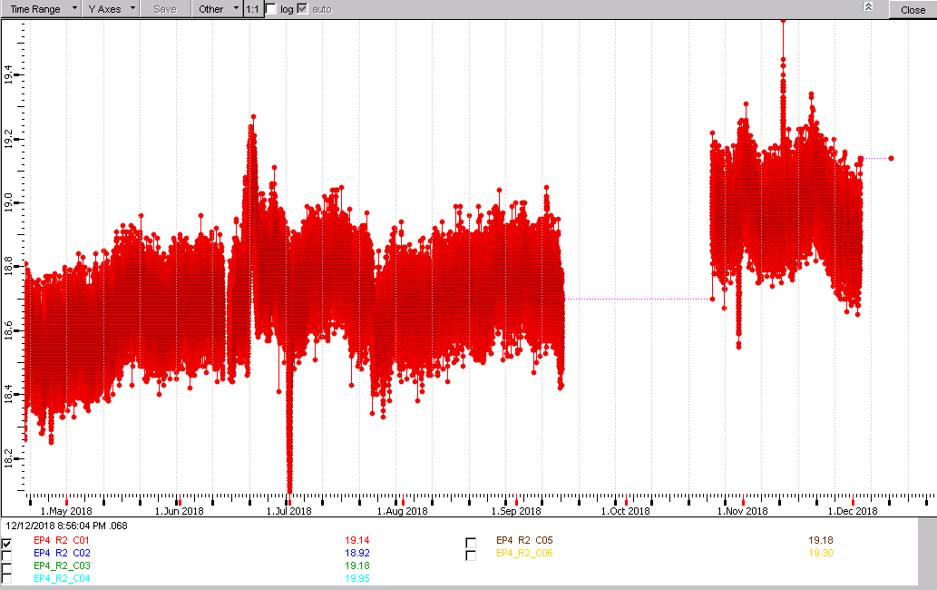
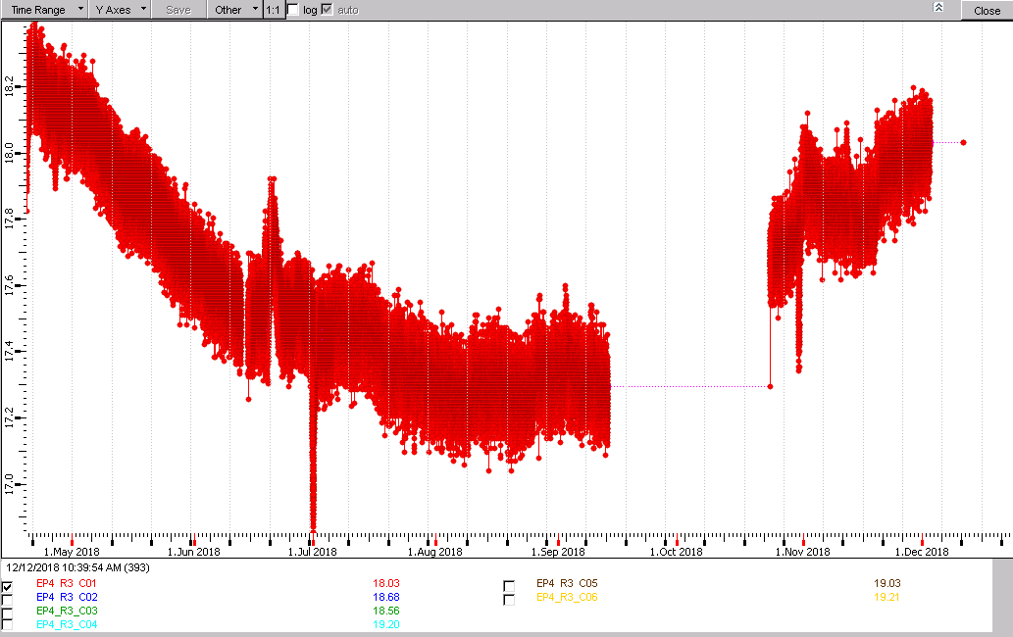
11
EP4
Ring 2
Ring 3

Slide 12
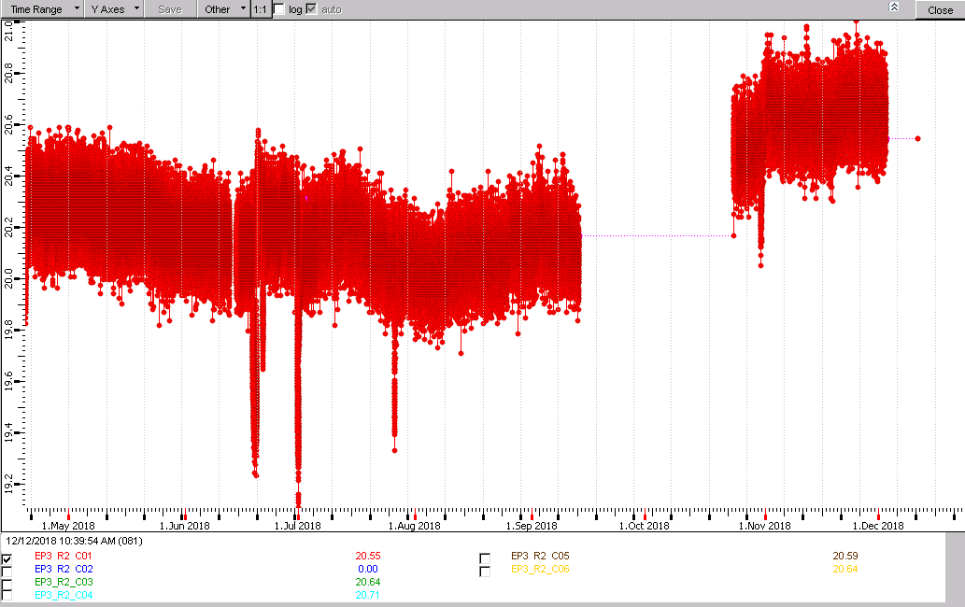
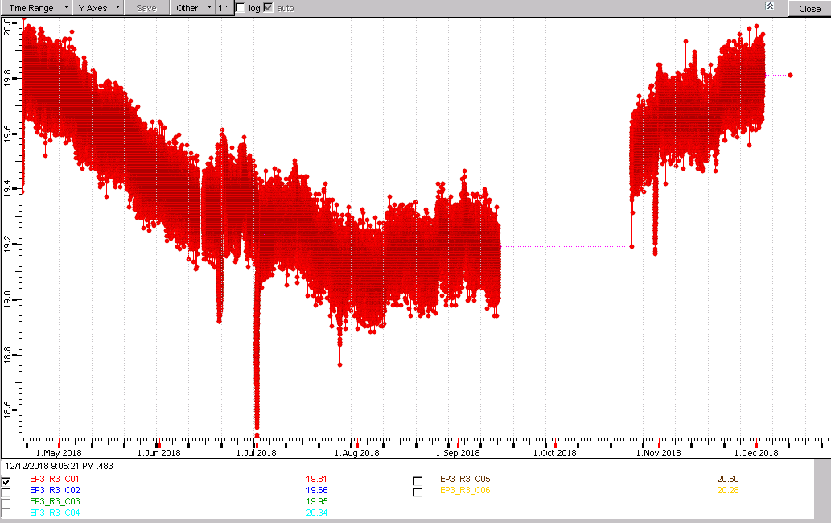
12
EP3
Ring 2
Ring 3

Slide 13
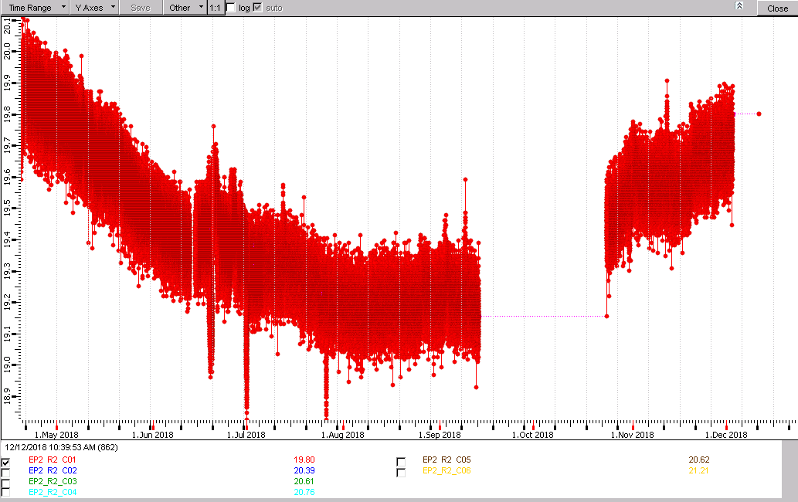
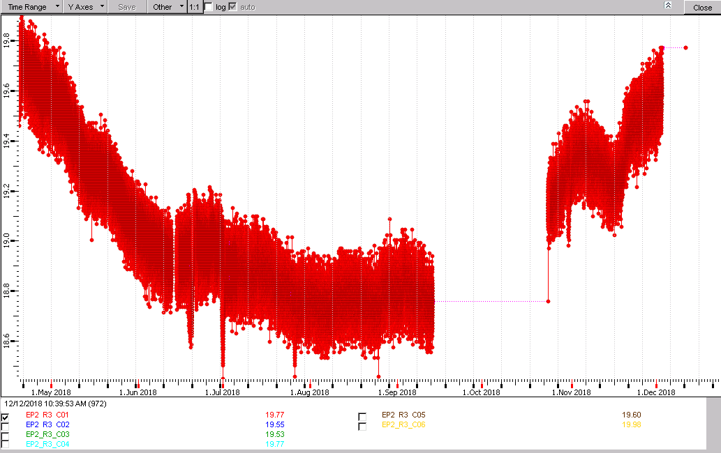
13
EP2
Ring 2
Ring 3

Slide 14
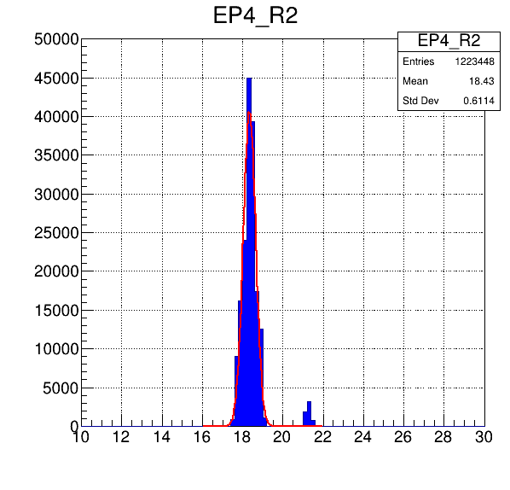
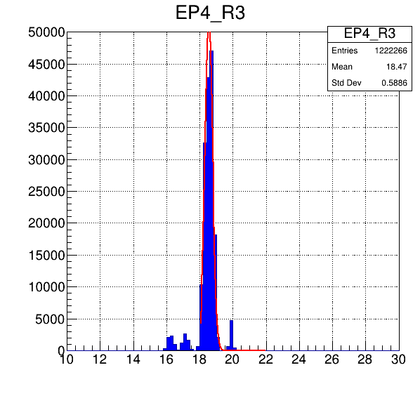
14
EP4
Ring 2
Ring 3

Slide 15
15
EP3
Ring 2
Ring 3

Slide 16
16
EN4
Ring 2
Ring 3

Slide 17
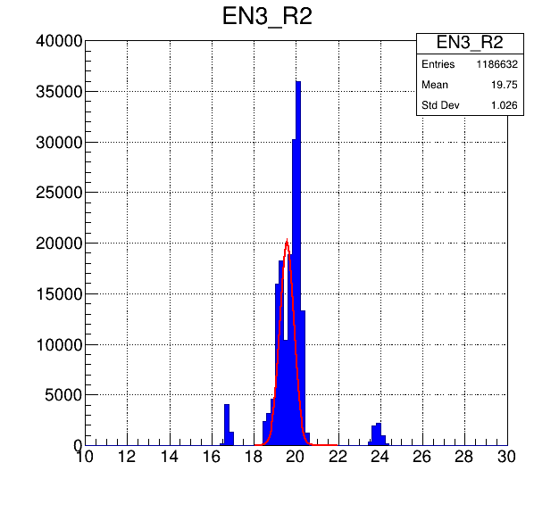
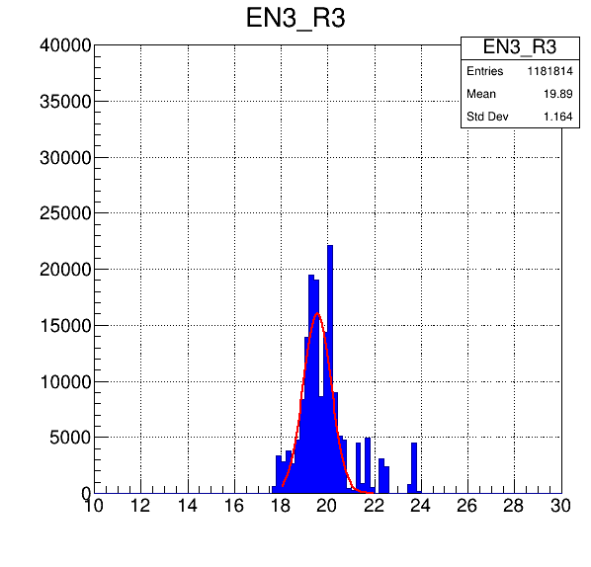
17
EN3
Ring 2
Ring 3

