Slide 1

New Cable-Chains for YE1 Phase 2
Cristina Penades EP-CMX-EI

Slide 2
Project baseline
• One of the key-project for Phase 2 New Services.
• Extra detectors and new services during LS2 and LS3 : extra cabling section.
• Existing YE1 main chains cross section 3,300cm²/chain, use in some slots of more than 70%.
• The guideline is to add two extra-chains per YE1 disk on the Near and Far side, four in total.
• To be installed at the X3 level of UXC5 balcony during LS2 (May 2019).
• Stroke allowing the full YE1 opening (>10.4m).
• Proposal Cross-Section 500X145 mm (same as YE1 - YE3).

Slide 3
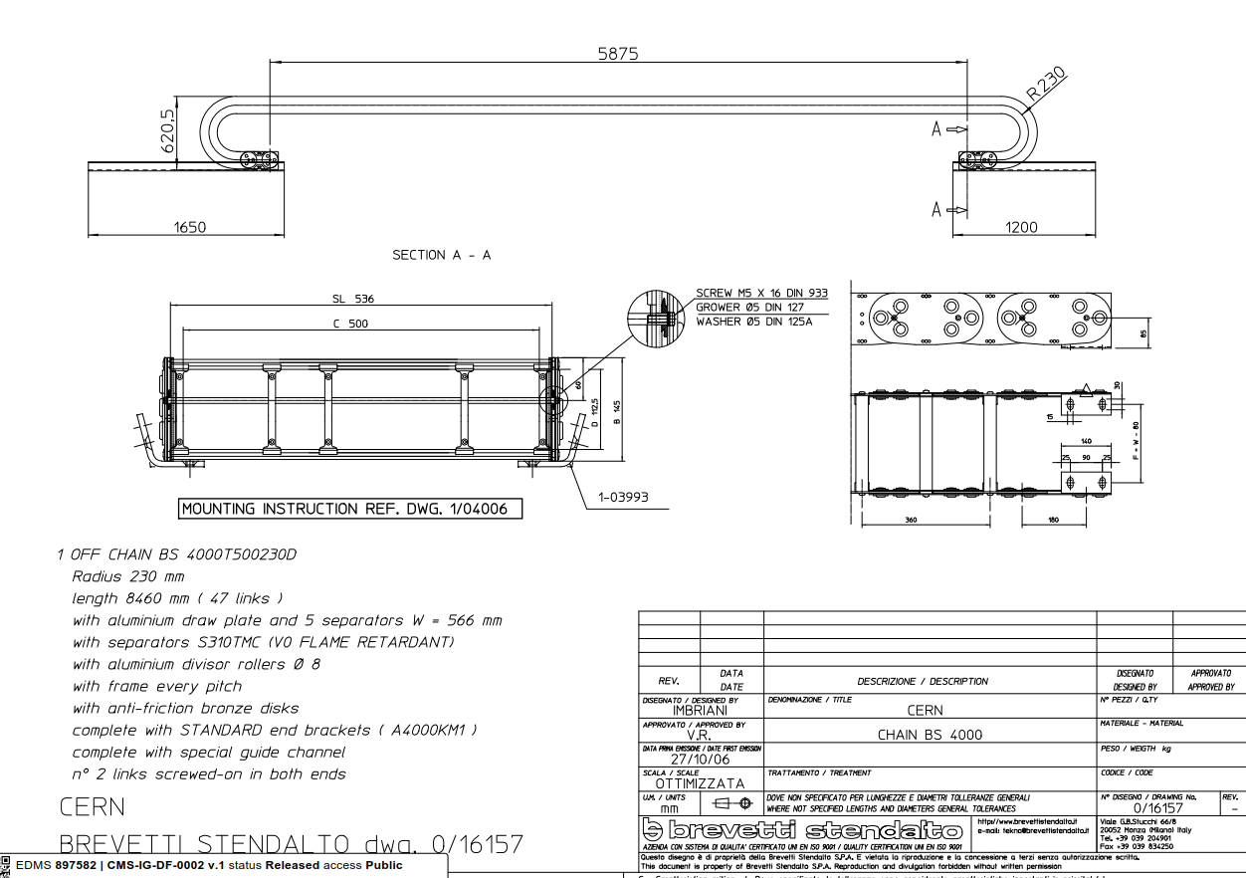
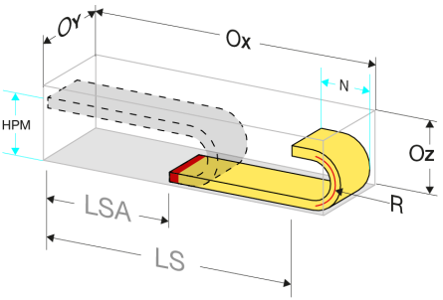
Proposed configuration actual Cable chain YE1-YE3 as reference
• Extra cross-section of 500cm2 (with spacers) per chain. Two chains per YE1 disk on both near and far side.
• Required stroke of 10.4m.
• Minimum cable chain length for reaching the stroke is 7.7m.
• Bending Radius of 250 mm.

Slide 4
Cable chain configurations
Cable chain position when detector opens >10.4m
Cable chain position when detector is closed
Fixed end
Movable end
Movable end
Fixed end
10.4 m

Slide 5
Cable chain technical characteristics
• General
-Chain carrying capacity of 500cm2
  A typical cable load is <60kg/m+ cable chain weight 30kg/m X 8m: 720kg
-If bigger cable chain possible cross-section 970cm2
  Cable load <100kg/m+ cable chain weight 45kg/m X 8m : 1160kg.
-Cable Chain is self-supporting (maximum 4m).
-Efficient layout of the services on the neutral axis with cable separators.
-Guide channels along the entire stroke.
Notes:
To put in a table. More clear

Slide 6
Cable chain technical characteristics
• Cable chain mounted on their short-side
-Changeable anti-frictions skids or pivoting wheels.
-Control the tendency of bunching towards the ground →special spacers between separators or split al or PVC cross pieces.
-Vertical guiding.
Notes:
To put in a table. More clear

Slide 7
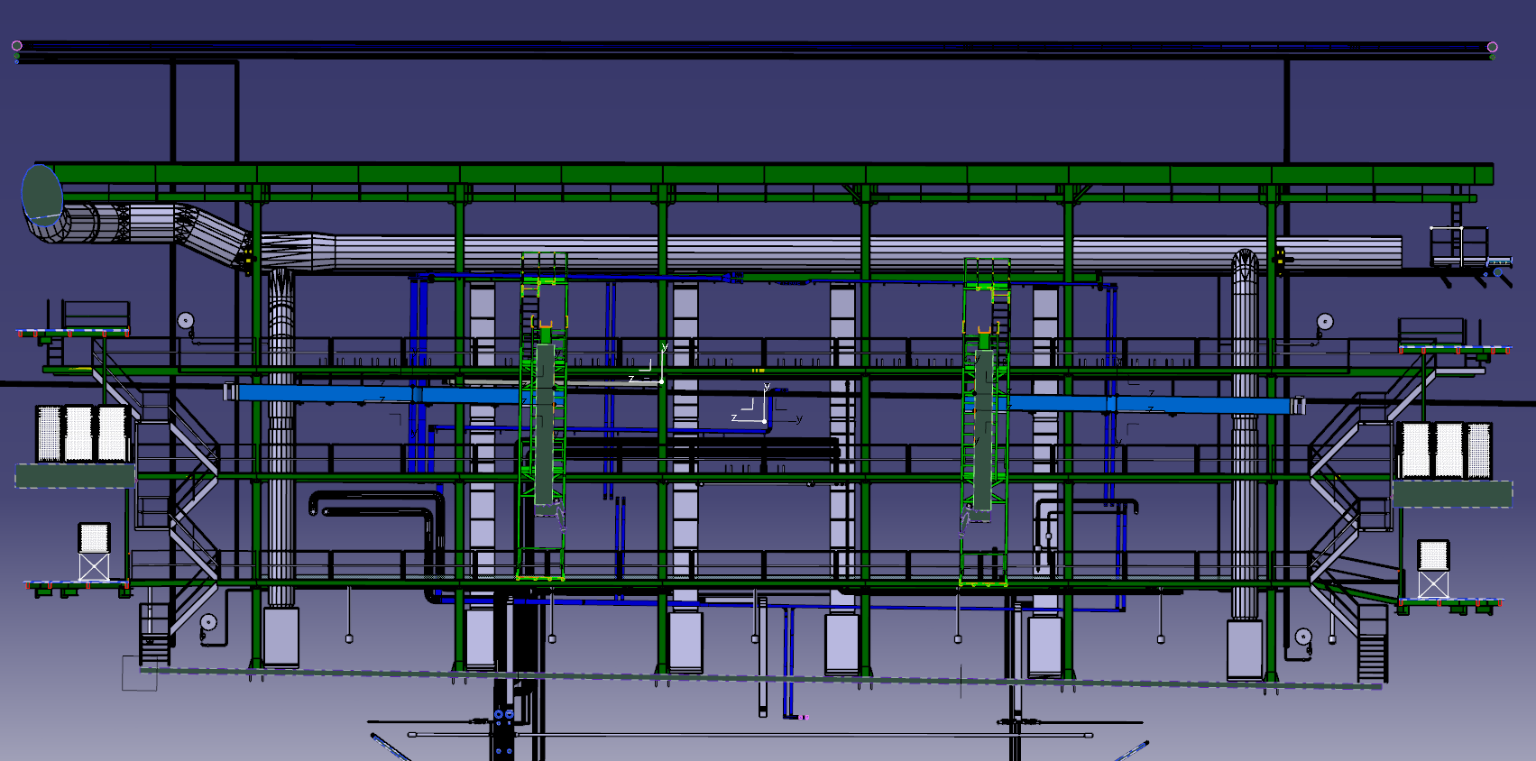
Project constraints – Global overview X3 level Near and Far side
• Towers are inclined with respect to the horizontal balconies level: slope of 1.23%.
Which is a difference of 15 cm in height along the 12m of cable chain stroke.
Far side +
1.3m
Far side -
0.96m
1.1m
1.4m
3.3m
IP5
12m
Supports height must be variable
12m
13.6m
YE+1
YE-1
In minus side, walking area reduced to 2m.

Slide 8
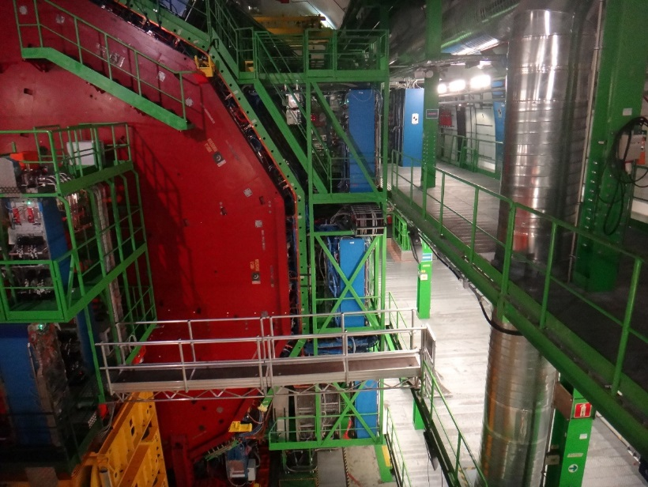
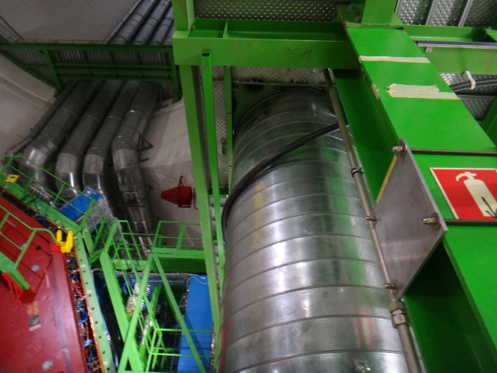
Project constraints - X3 Far side
• Mayor constraint
-Ventilation pipe leaves a gap of 25cm until the end of the balcony.
-Pillars position, every 7 meters in the middle of the balconies.
Cable chain need to be mounted on their short side and allocated on the balcony borderline

Slide 9
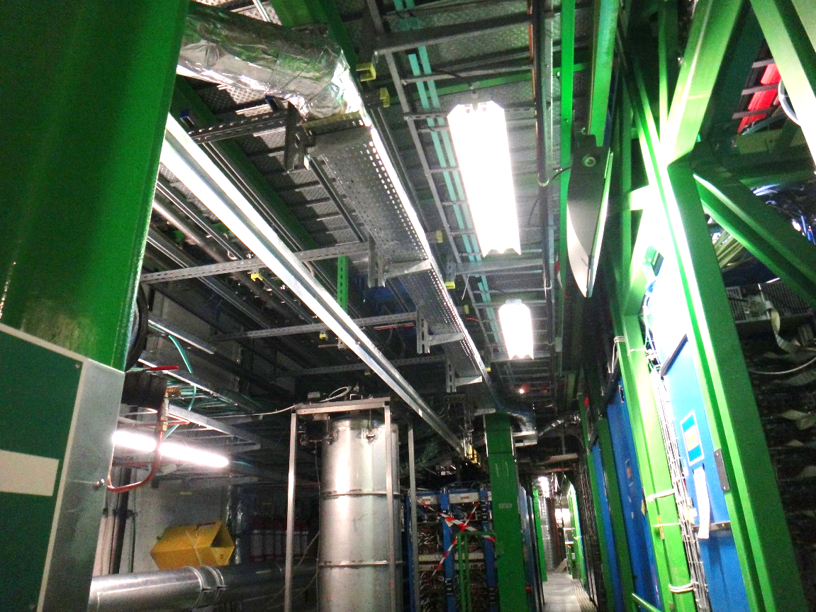
Project constraints - X3 Far side+
•Tracker cooling pipes (to be removed in LS3)
-Cable chain installation in LS2, supports shouldn't make an interference with this system.

Slide 10
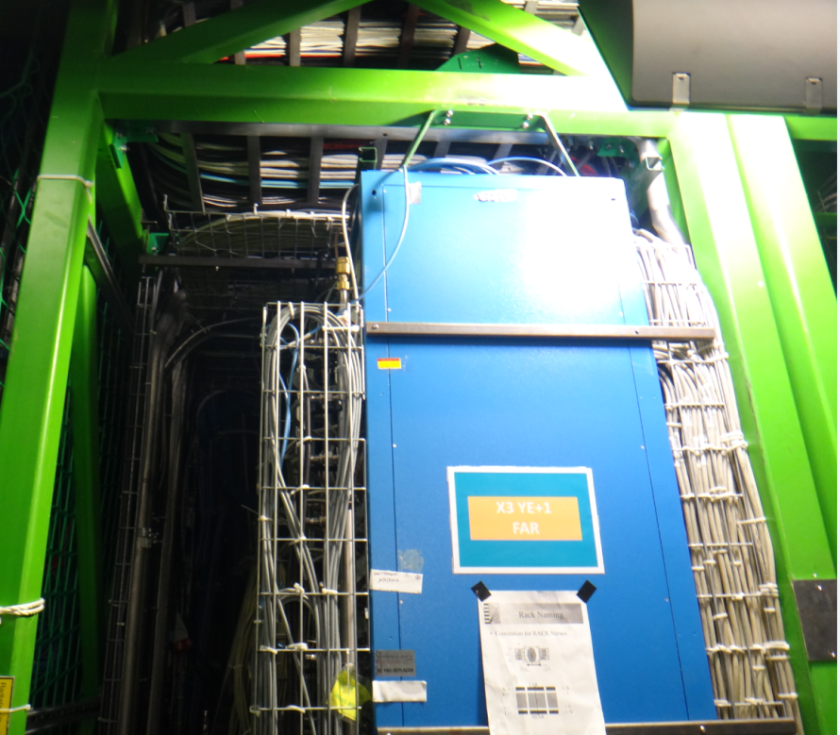
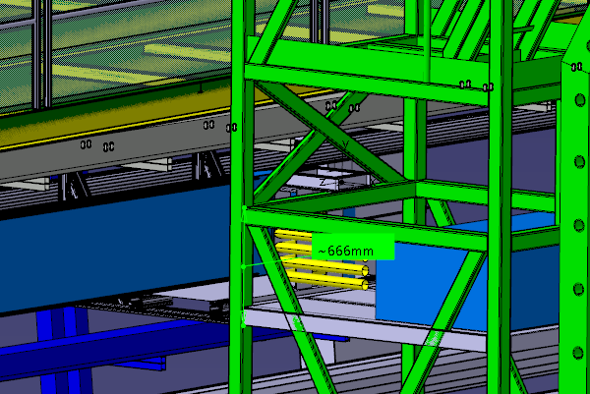
Project constraints- Detector towers Racks
• For LS2, Cable chain must be attached to YE1 tower to pull the cable chain together.
Total length available 630mm now.
-After cable chain installation the space for extracting existing crates would be reduced to over 200 mm. rack units (one rack unit = 25mm).
200mm
• For LS3, as more services will come a patch-panel on the detector towers is foreseen, same X3 level..
It would reduce the available space in height for the electronics racks by 666mm
630mm
660mm

Slide 11
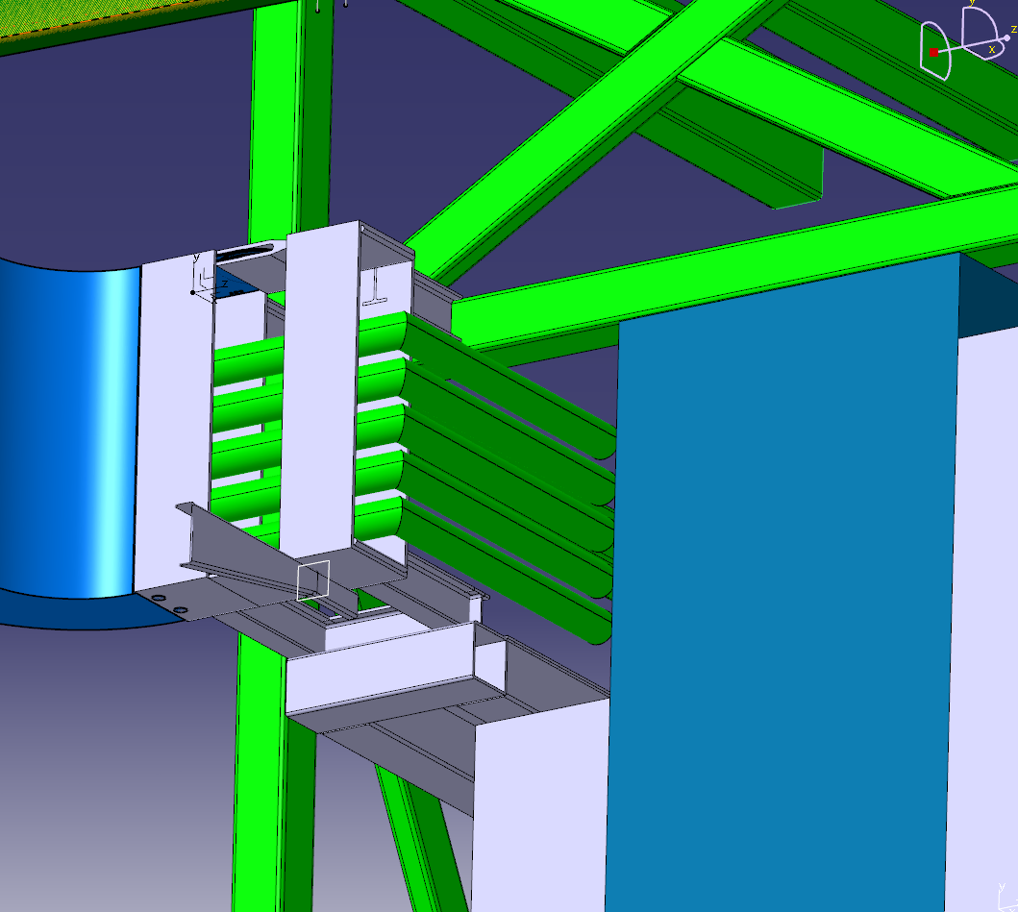
Attachment Cable chain to X3 YE+1 tower
• Lower platform to attach pull structure ( 2 profiles IPE 80). Connected to Cable chain end-bracket.
• In tower beam, Upper pull attachment ( 2 profiles IPE 80).
Notes:
To check CAD dimensions with measures taken

Slide 12
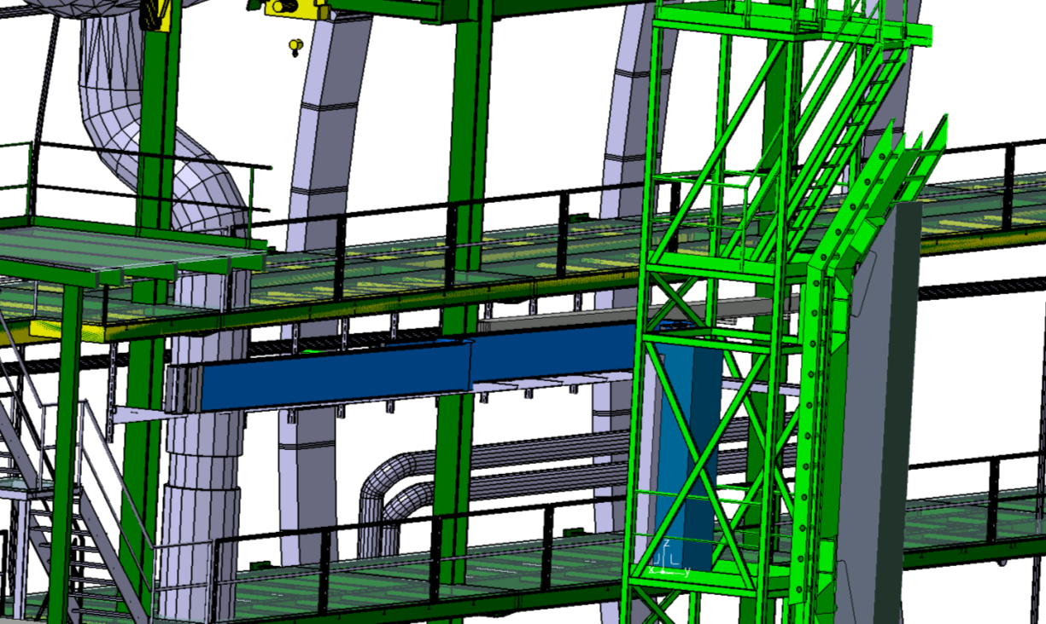
Preliminary design Far side +
• Cable chain positioned in Far side plus.
Minus side is the same without the tracker cooling pipes.

Slide 13
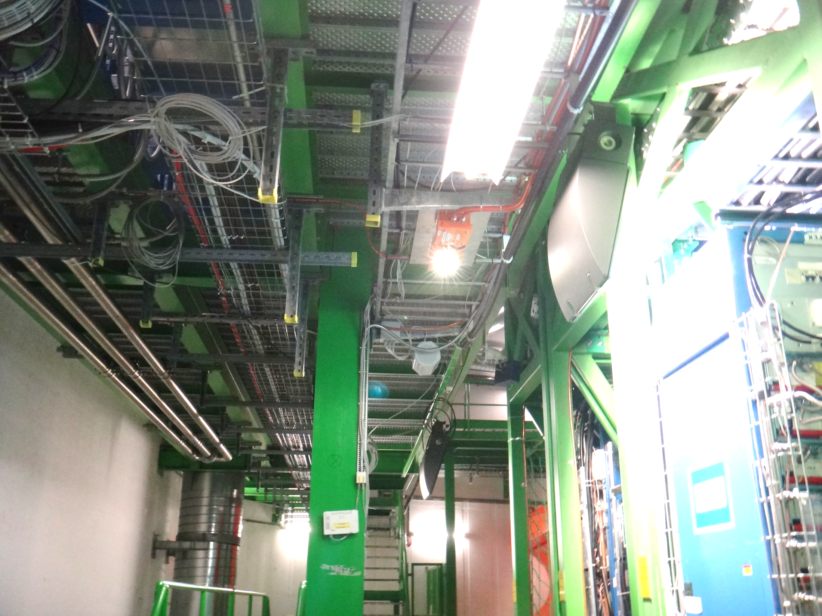
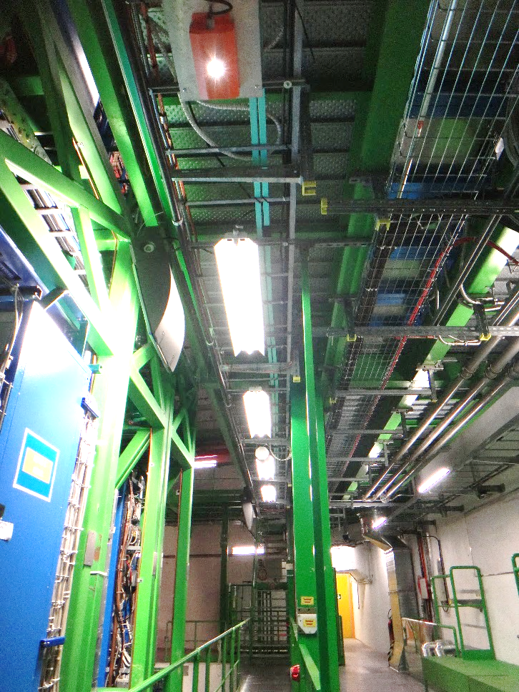
Balconies NEAR SIDE +/-
NEAR
X3 YE+1
NEAR
X3 YE-1

Slide 14
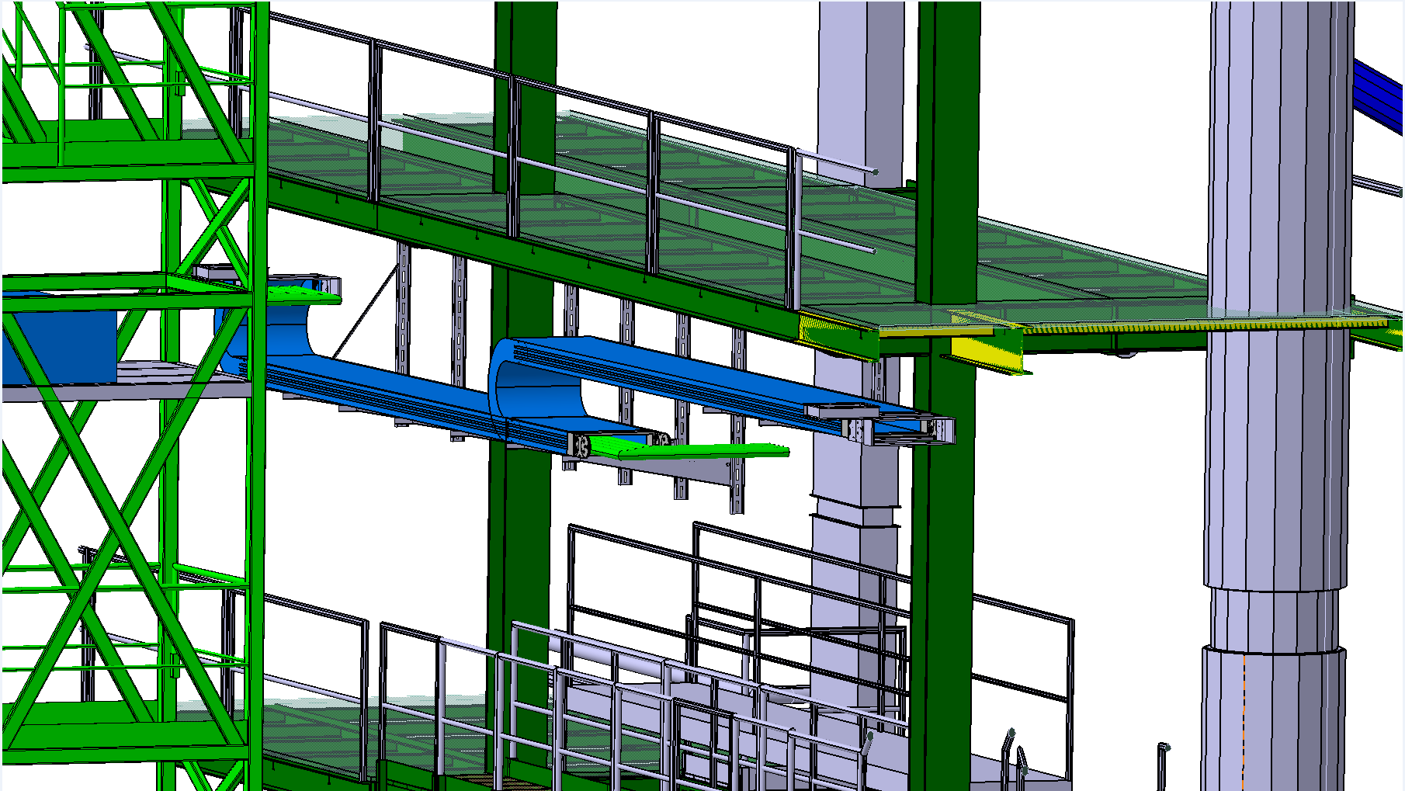
Preliminary design NEAR SIDE + /-
Fewer space restrictions.
In horizontal position: more easy guiding.
If needed, a bigger cross section could be installed maximum width 659 mm.
-Sample BS 45T-600x182

Slide 15
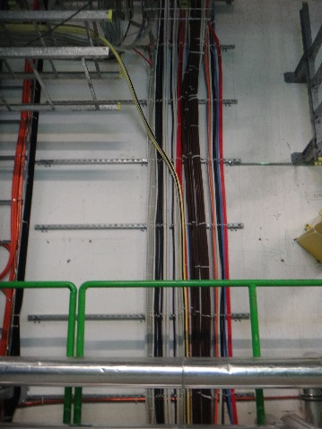
Cable routing Far/Near +/-
• Space available in existing cable ladders in front of YE1 from there, cables could be routed to the cable-chain fixed end.

Slide 16
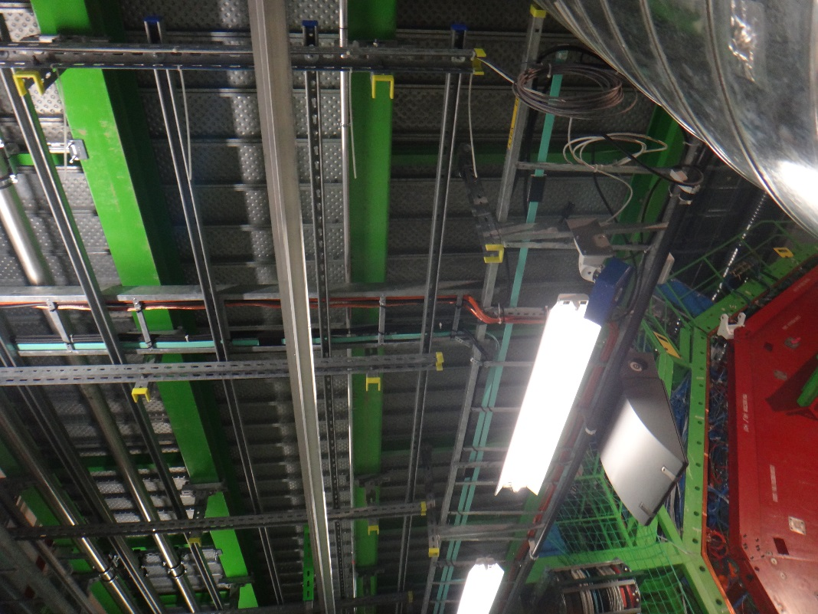
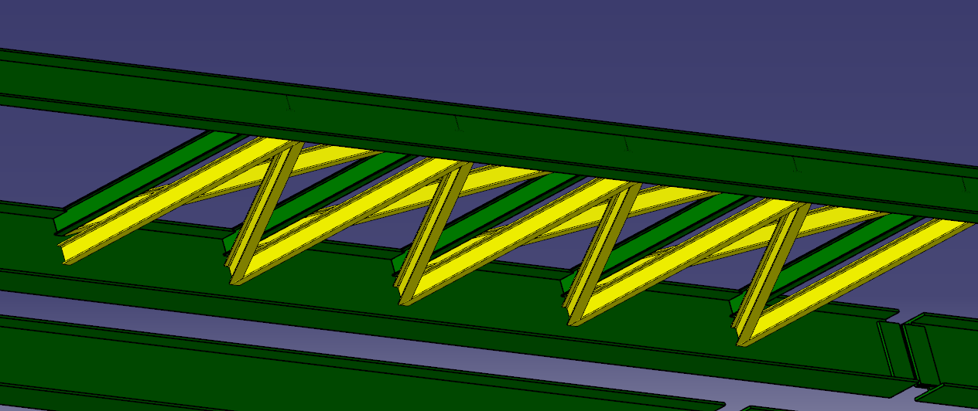
X4 roof reinforcement
•Existing IPE 80 beams that connect IPE 300 and UPN 200 could be reinforced with a reticular structure over the cable chain area.
Cable trays, luminaries, black lamps and GSM antenna (far and near)need to be moved away from the area.

Slide 17
Support preliminary design Maximum Reaction at supports with 1m spacing
UPN 200
IPE 300
1300mm
1600N
130N.m
1200mm

Slide 18
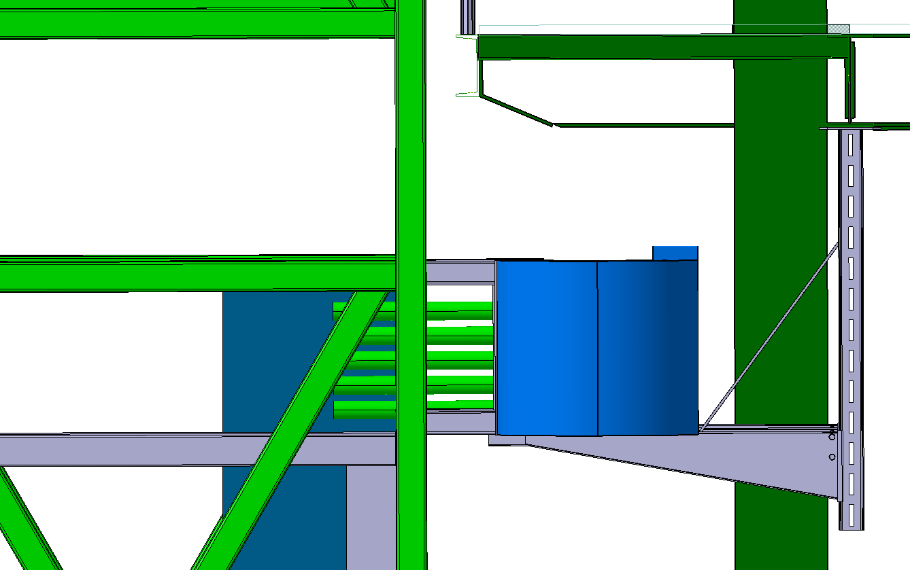
Support Bracket On X3 far/Near side +/-
UPN 200
-Rail IPE 80,
Attached to IPE 300 with direct girder clamping or with a head plate and bolted.
-Heavy duty support Bracket, AS55. The height infinitely adjustable.
Issues:
-Suppliers don’t recommend bracket with a length over 610mm. Too much leverage. Careful design.
-Maximum length available 1010mm + extra pad of 150mm.
-It is mandatory to add a reinforce.
IPE 300
IPE 80
Notes:
**change image, with tracker cooling pipe is confusing
****No direct clamping

Slide 19
Next steps
Summary
Work done so far
Integration study of 4 cables chains into UXC55.
Collecting technical requirements and first release of a cable chain cross-section.
Proposal of viable solution.
Collecting cabling request from different clients.
Structural calculations for the extra loading in X3 UXC55.
Contact potential suppliers to list the technical specifications and prepare an offer.
Notes:
To be completed

Slide 20
Back up slides
TOWARD LS2 up to LS3

Slide 21
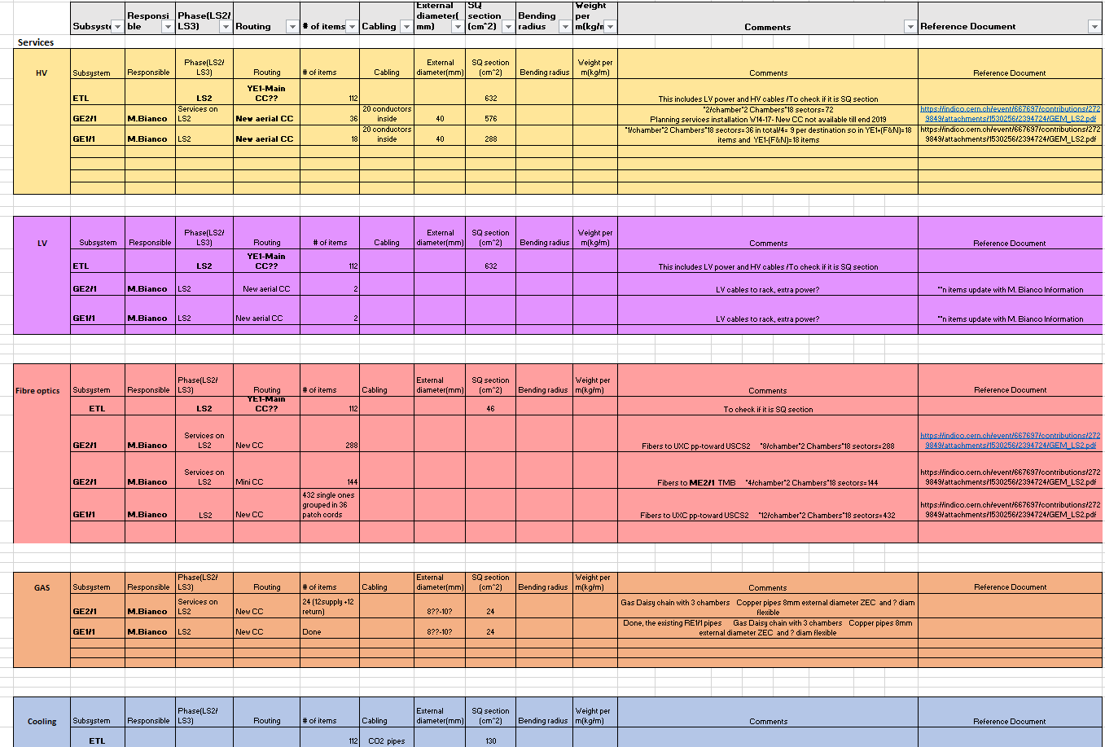
Outcome of New services-the requirement collection
YE1 disk
Position | Services | Coming on
YE1 | ETL | New services Installing during LS3
 | HGCal
 | MEO
 | GE1/1 | New services Installed during LS2. Cross-section estimation
 | GE2/1
 | ME1 | Clients that already exist, some of them will add extra services
 | RE1
 | RE2
YE2 | ME2
 | ME3
YE3 | ME4
 | RE3 | New services in LS2. Small cross-section to pass though Main and mini cable chains(YE1-YE3) in LS2.
 | RE4

Slide 22
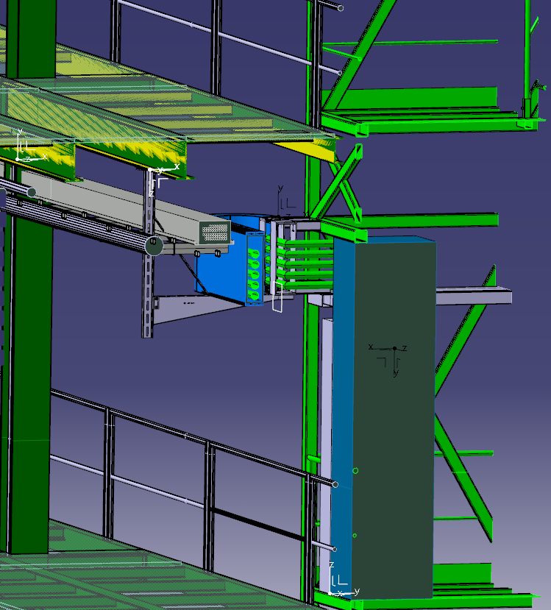
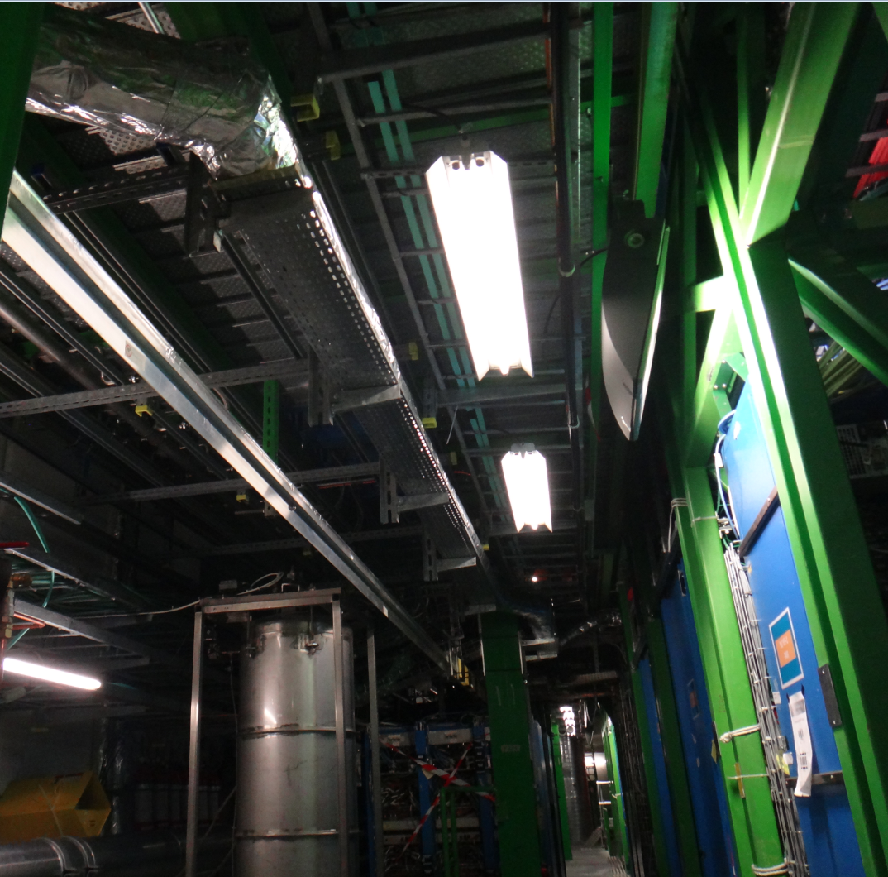
FAR side+, X3 YE+1 area
Alignment system
Tracker cooling pipes
X3 YE+1 patch panel

Slide 23
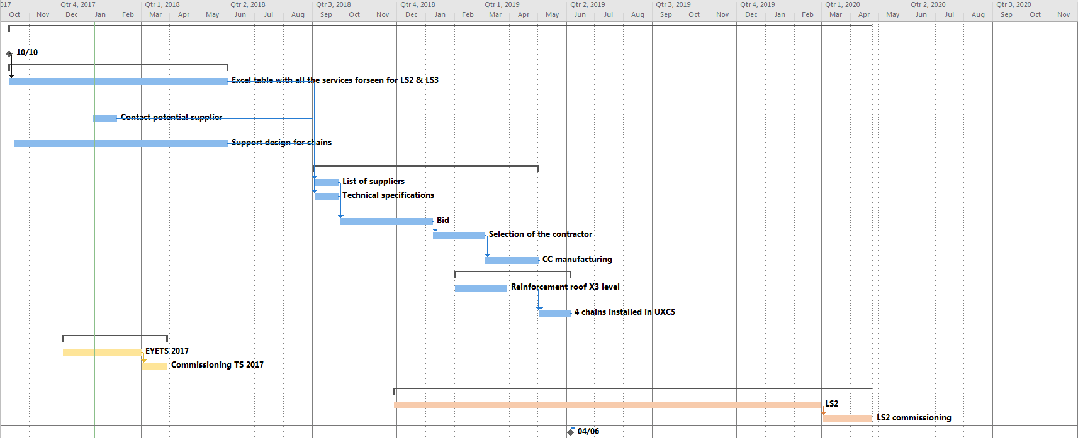
Gantt planning for new cable chain for YE1

Slide 24
New Cable-Chains for YE1 Phase 2
QUESTIONS?

