Slide 1
A first look at the degrees of freedom of the RE4/1 mounting configuration
Ian
29 Oct 2020

Slide 2
The structure of the chamber should be rigid to protect the Gas gaps.
However the chamber should be mounted in way that does not stress it.
Supporting it at it’s end points does put it in bending but as the plane is vertical nd the chamber is wide then the deflection vertically will be very small
My email
first point
2nd point
3rd point
4th point

Slide 3
Drawing from Ivan

Slide 4
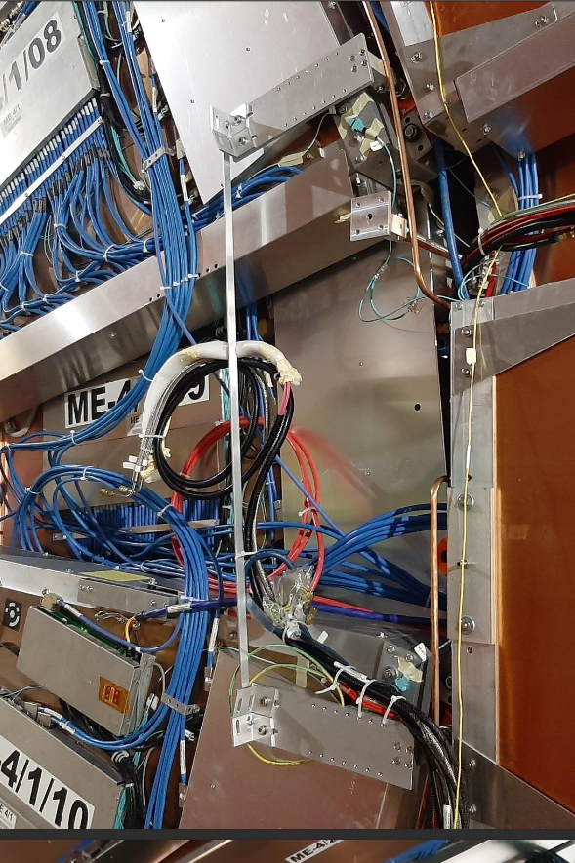

Slide 5
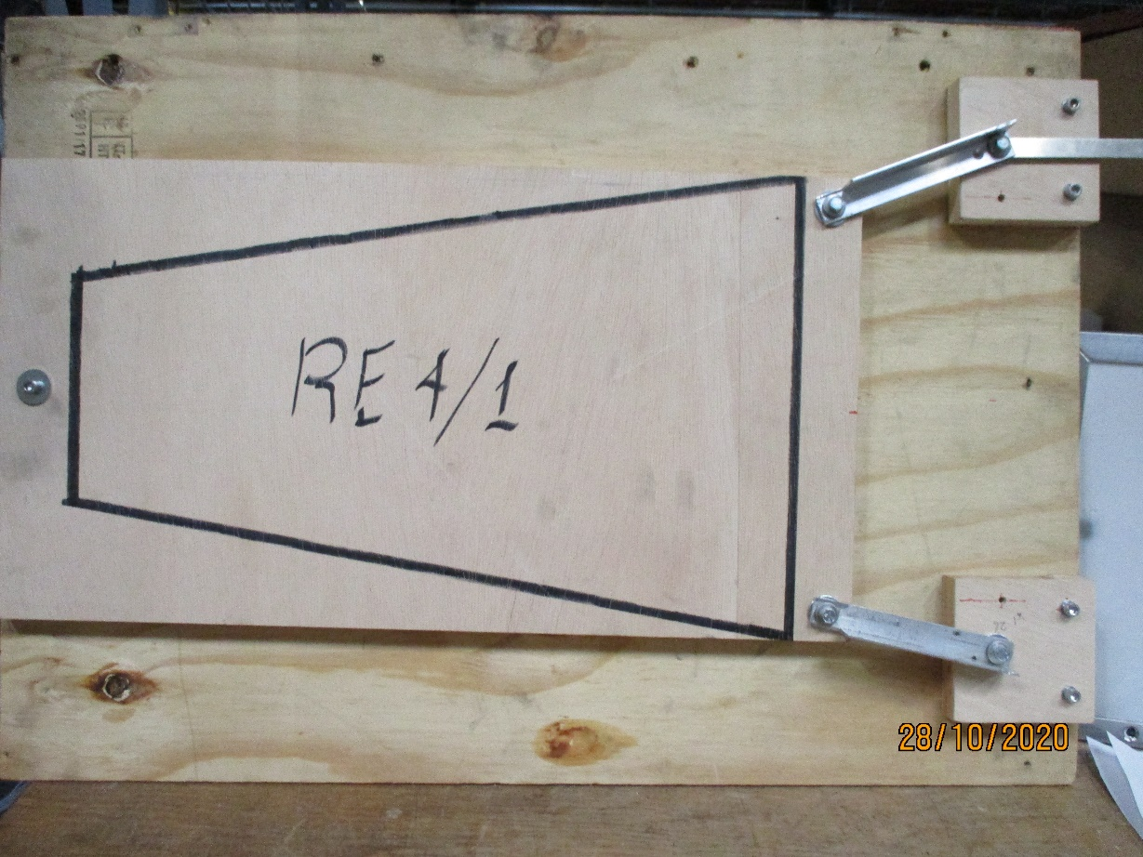
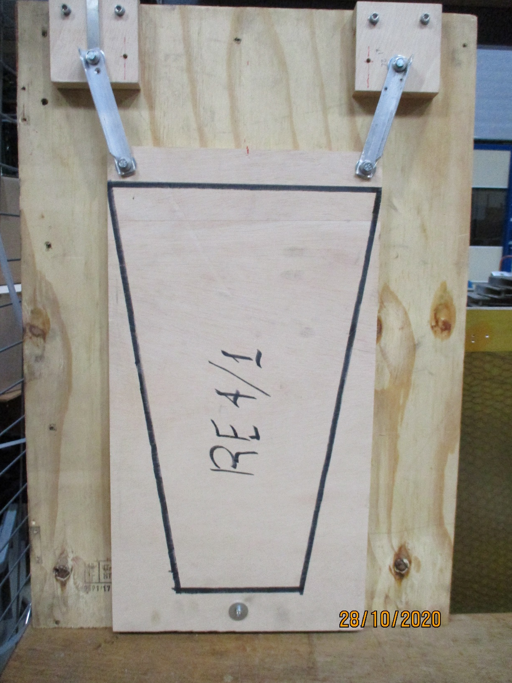
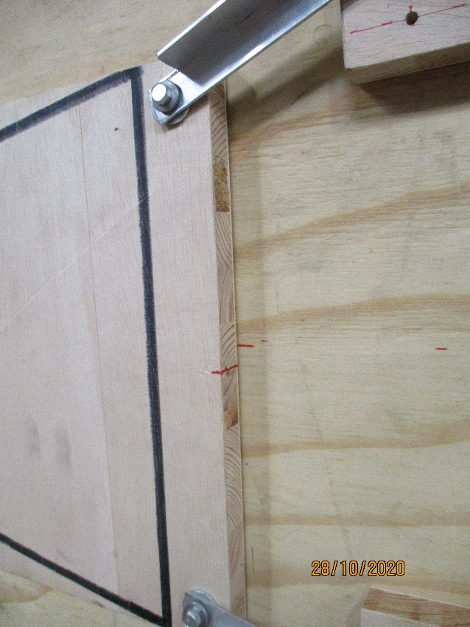
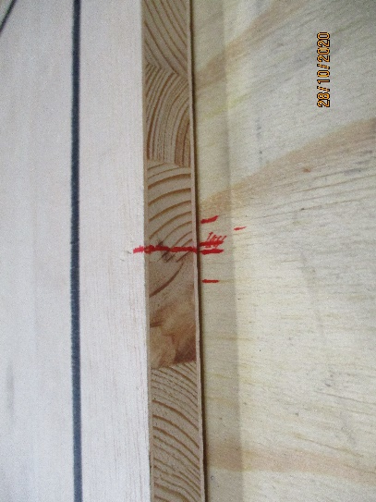
350mm
123mm
670mm

Slide 6
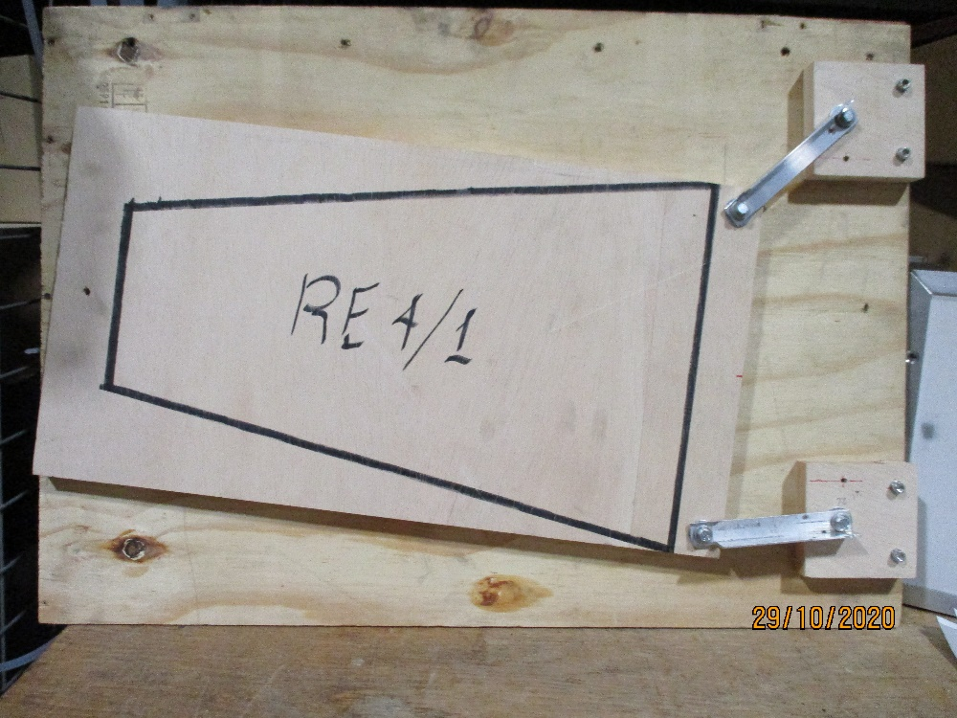
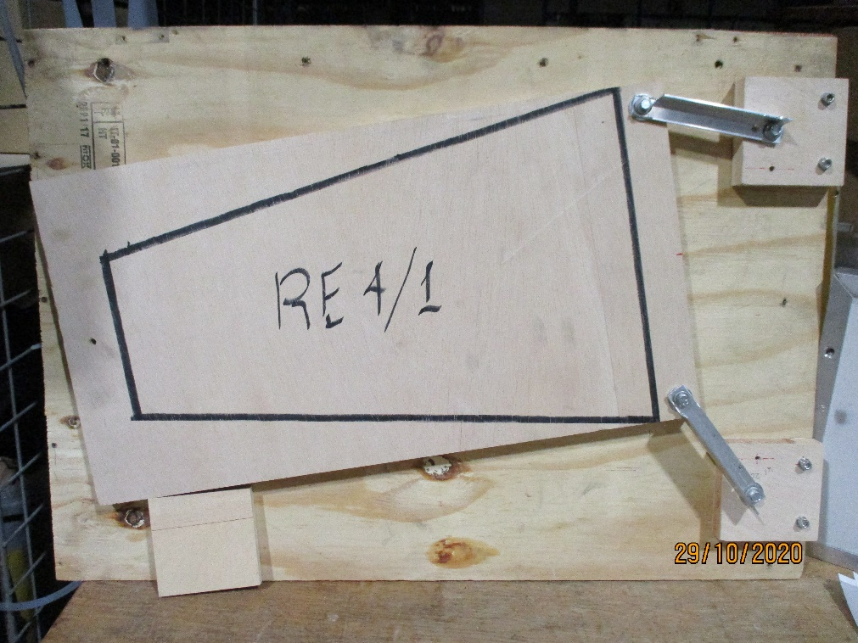
Removing the low “R” pivot allows the chamber to move away from that anchorage and is so putting the chamber in tension. The degree of non paralisome of the 2 high “R” mounting brackets define how it moves. See below.

Slide 8
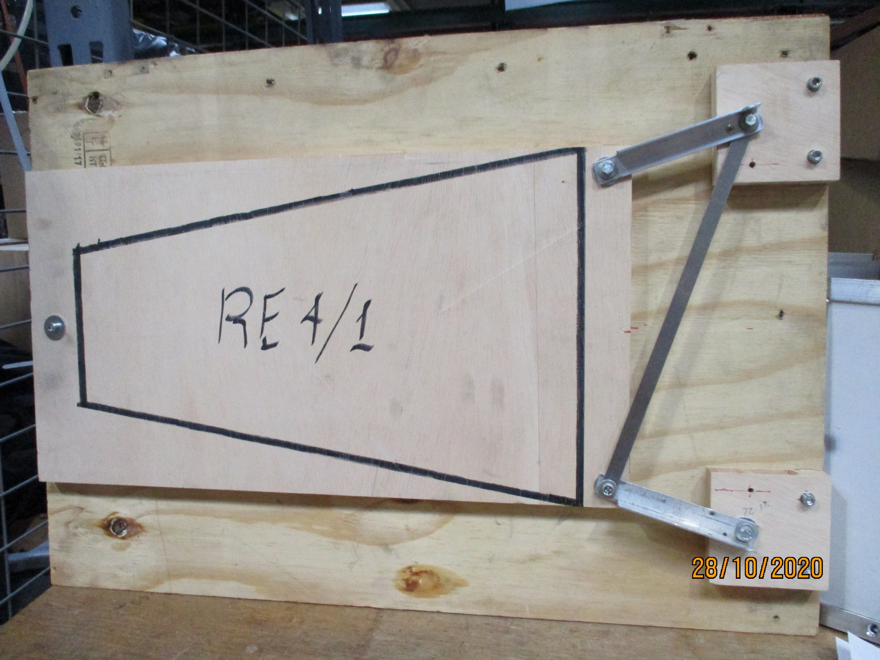
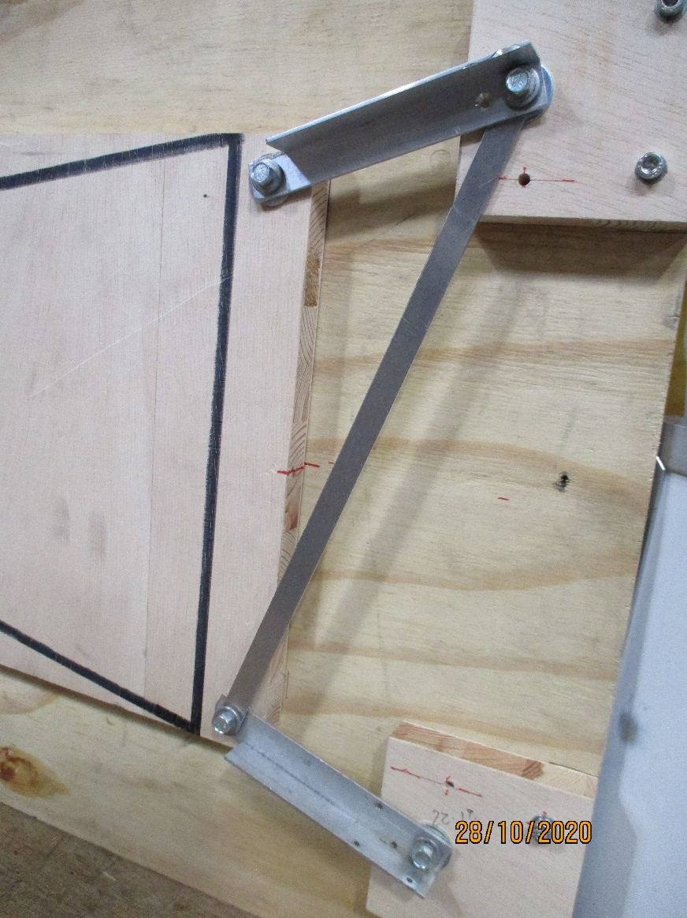

Slide 9
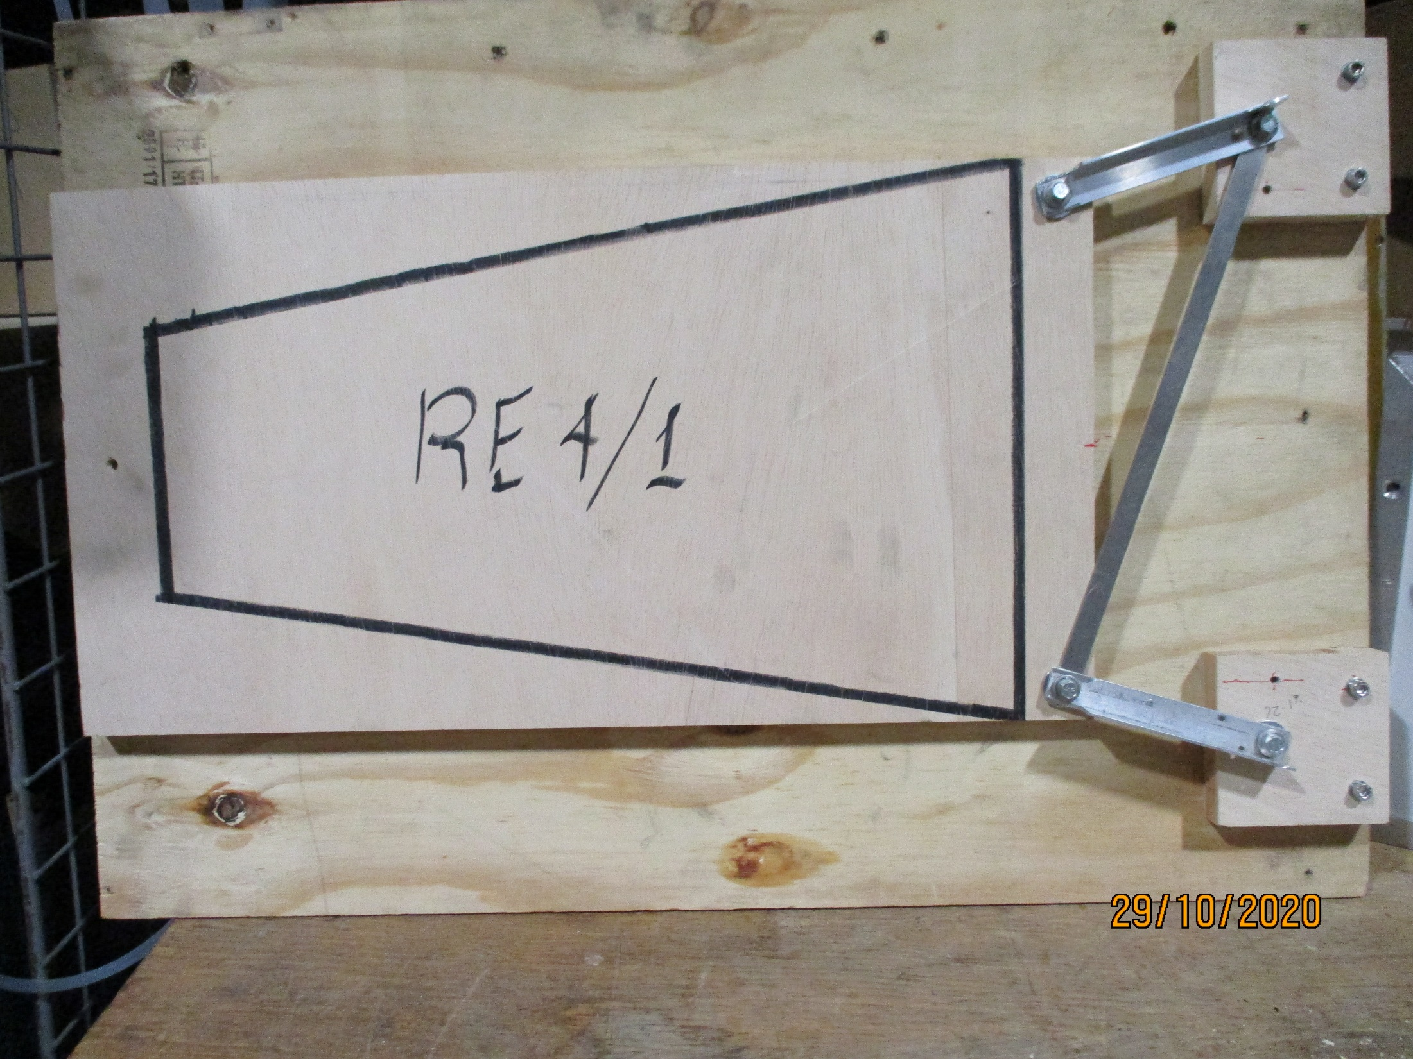
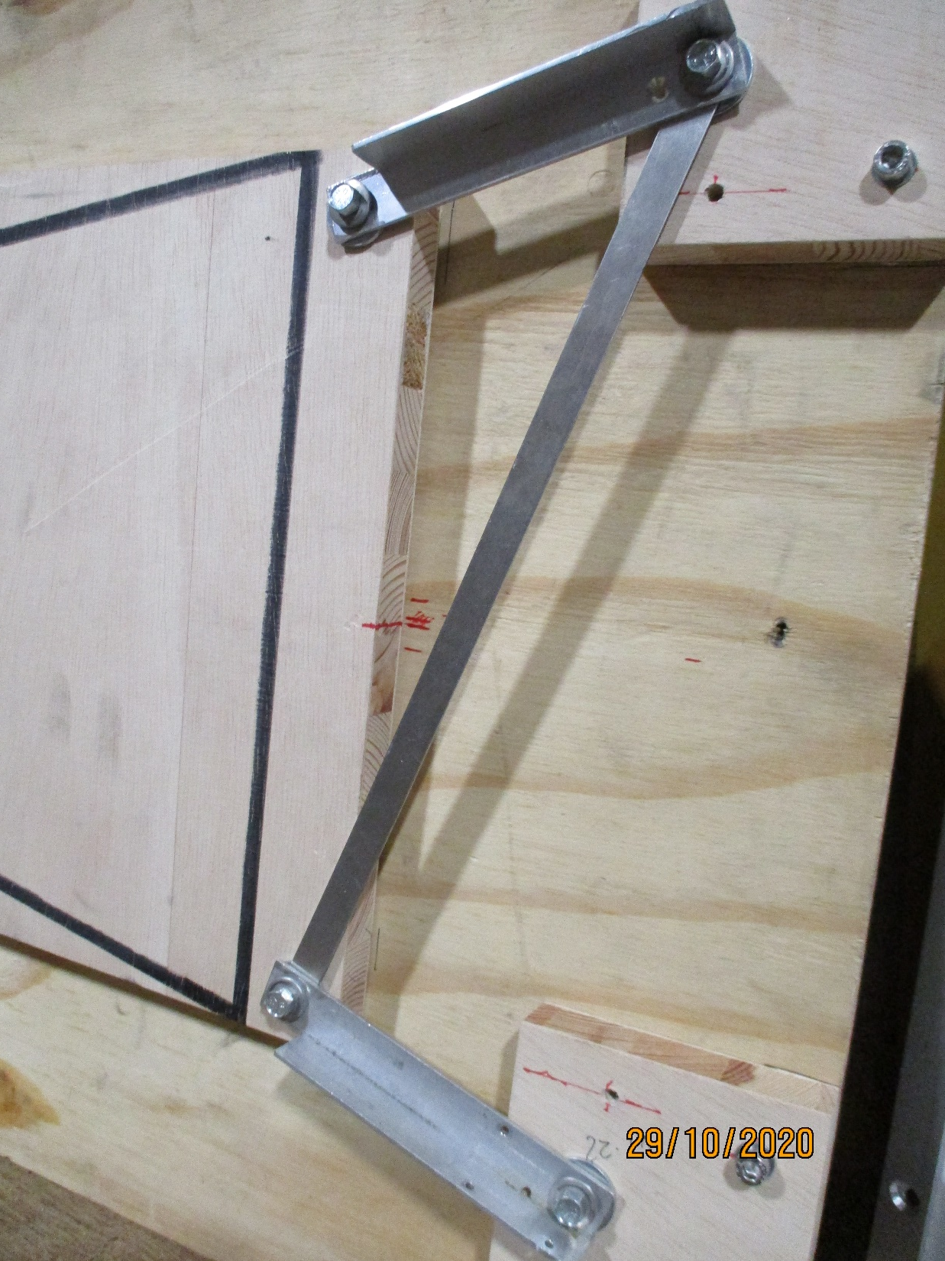

Slide 11
