Slide 1

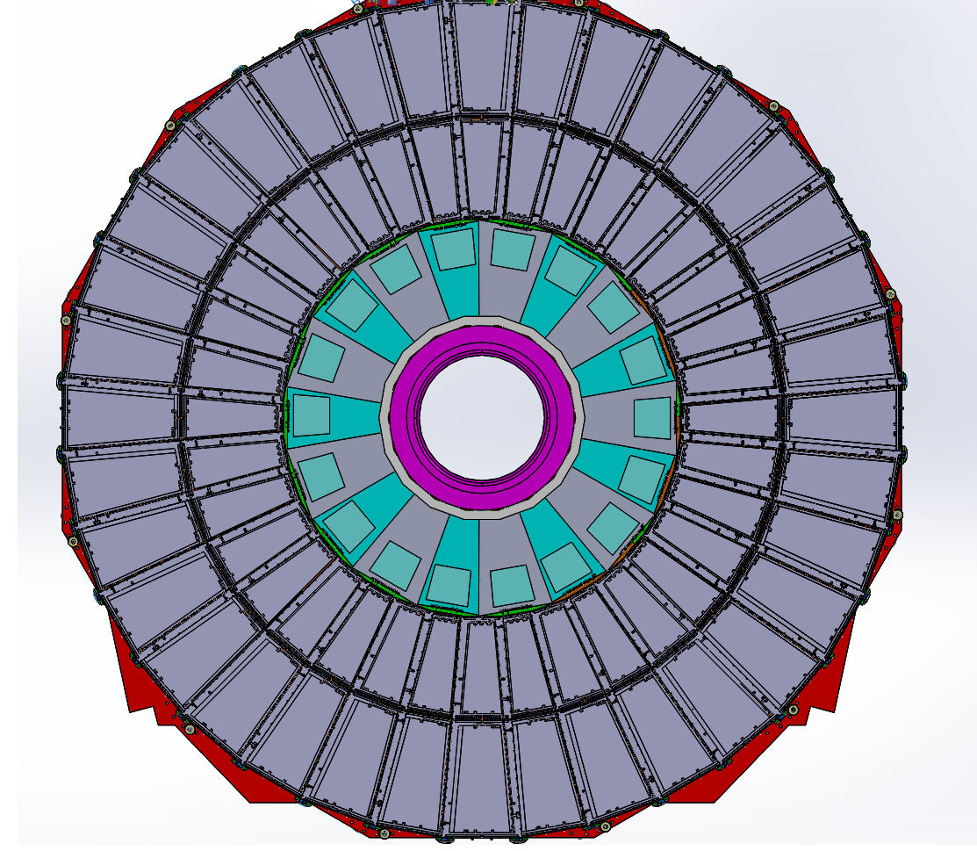
RE4 manifold positions
Position #1
Position #6
1 channels per 1 chambers
1 channels per 1 chambers
Position #2
Position #5
2 channels per 2 chambers
2 channels per 2 chambers
Position #3
Position #4
2 channels per 2 chambers
2 channels per 2 chambers

