Slide 1
Volume Survey for RE3/1
Elena and Ian
16 Jan 2017

Slide 2
4 methods to check the Volume “Z”
Integration office official drawings
Survey using laser scanner and laser tracker
Manual measurement
IR sensors
4 Periods possibly available, 2 used , 19 Dec 2016 and 10 Jan 2017

Slide 3
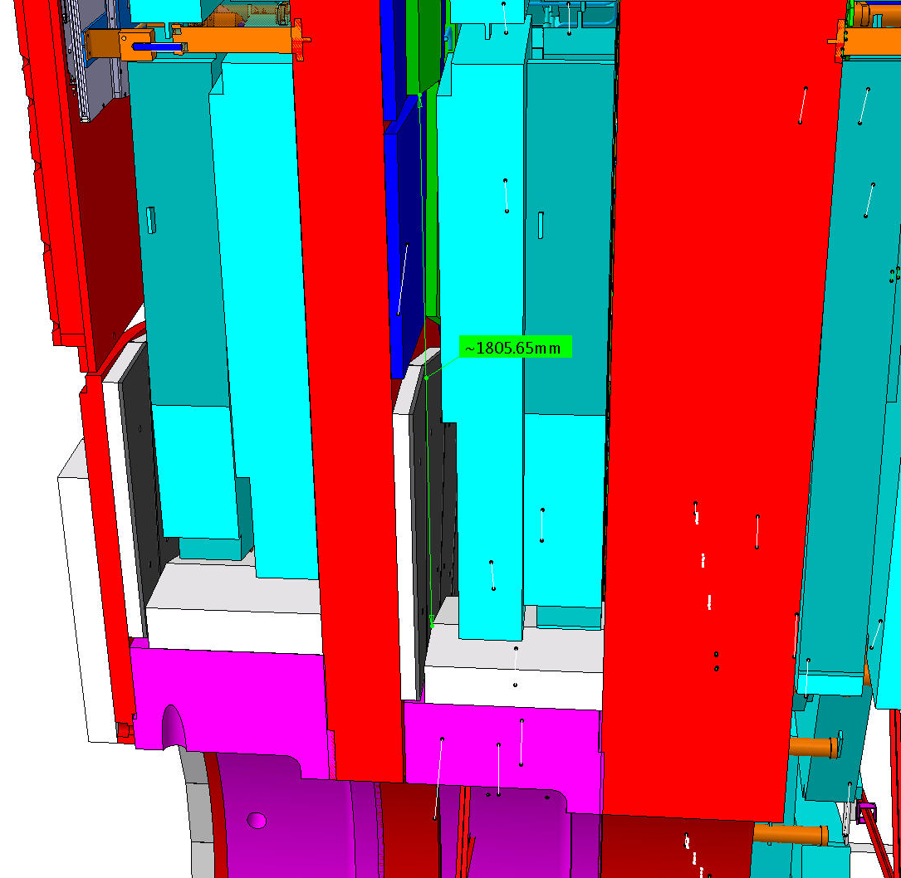
RE3/1 OI office drawing
Basic parameters
R Outer = 3302
R Inner = 1526
Delta = 1776
This area has to be studied and an envelope produced and agreed with Integration
Simple presentation of the area with errors

Slide 4
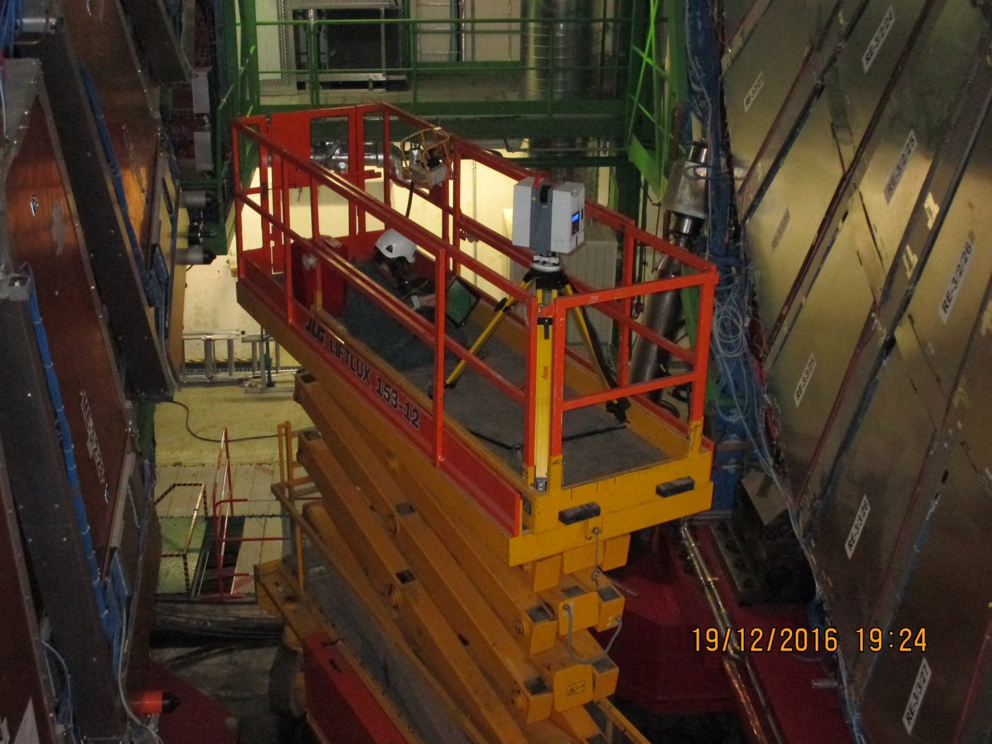
Laser Scanner, first time on a scissor lift
Results to come

Slide 5
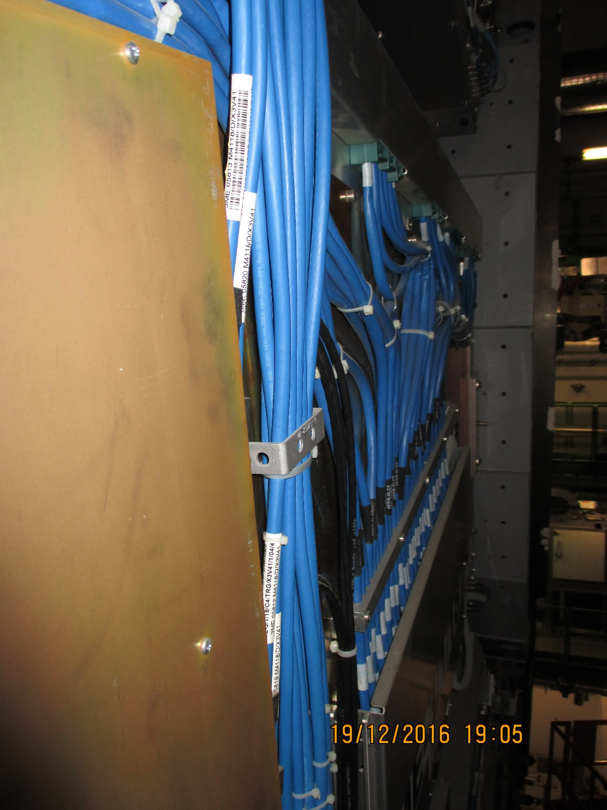
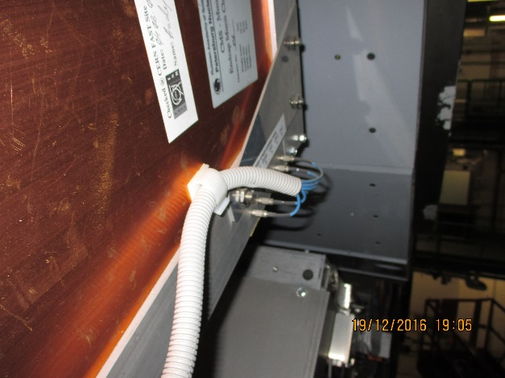
CSCs are not flat. complicate understanding
Cables over edge of chamber cover
Front End covers at different heights

Slide 6
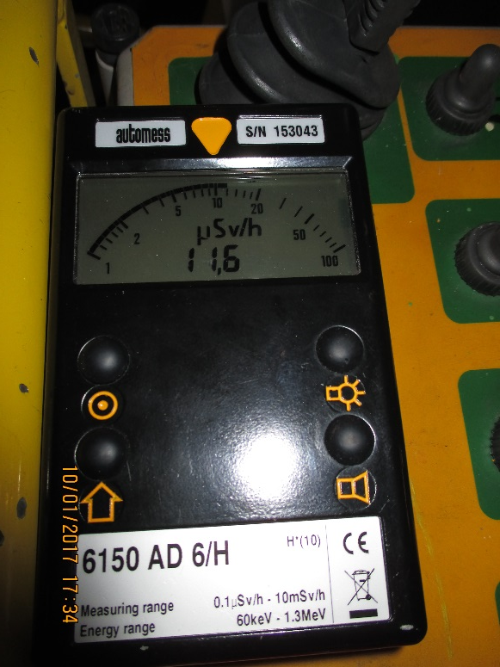
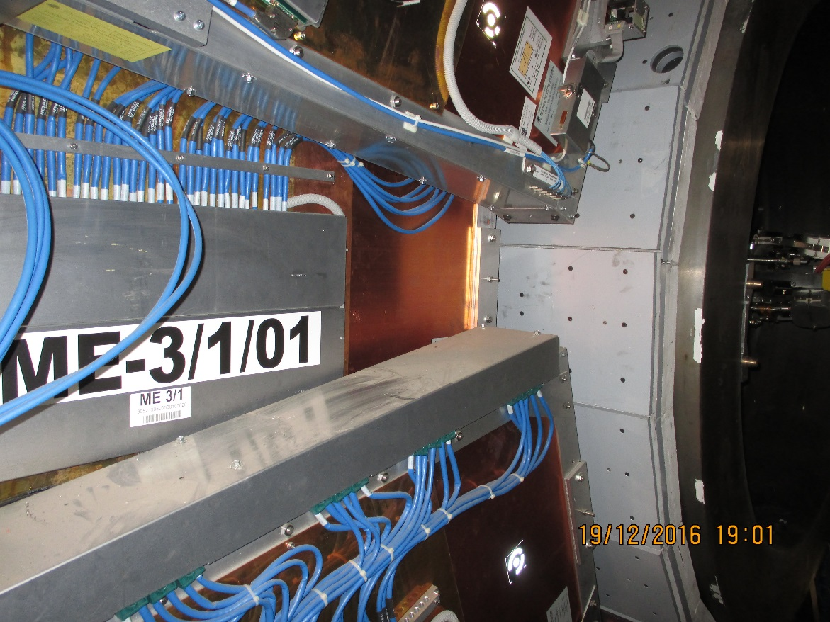
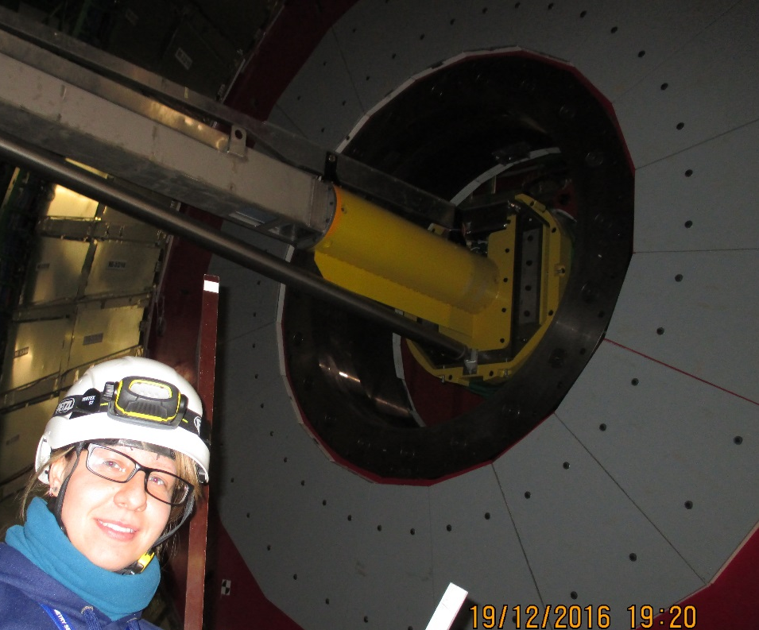
Manual measurement
Radiation dose is monitored. Not a “Controlled Zone”

Slide 7
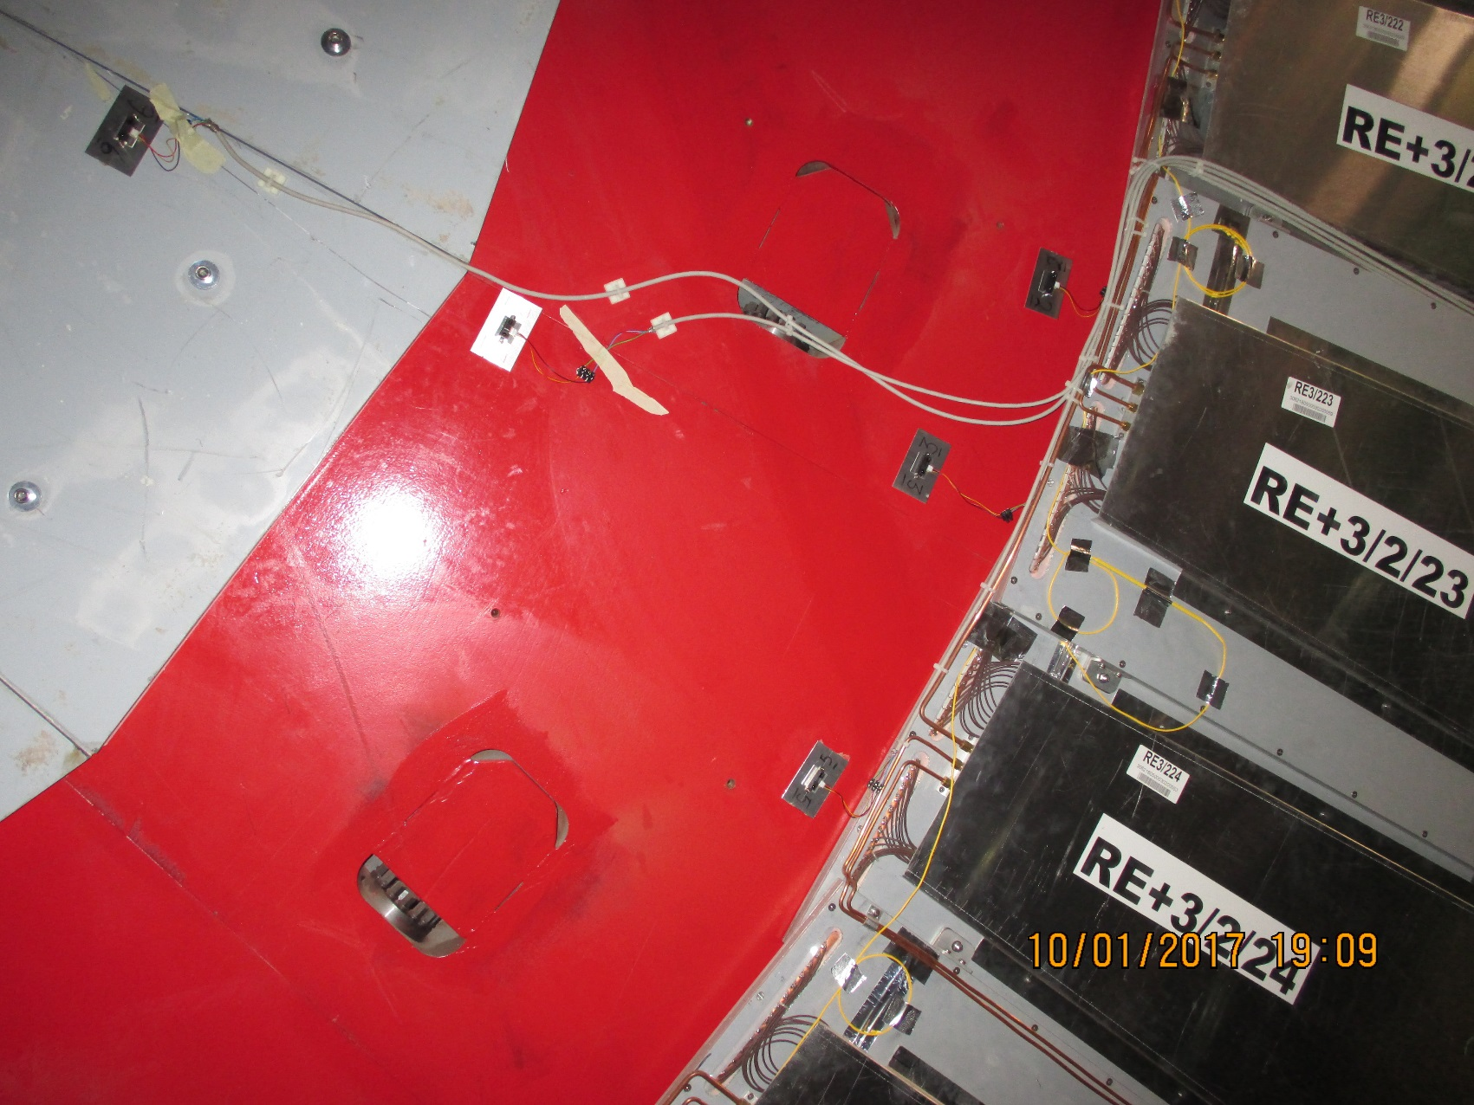
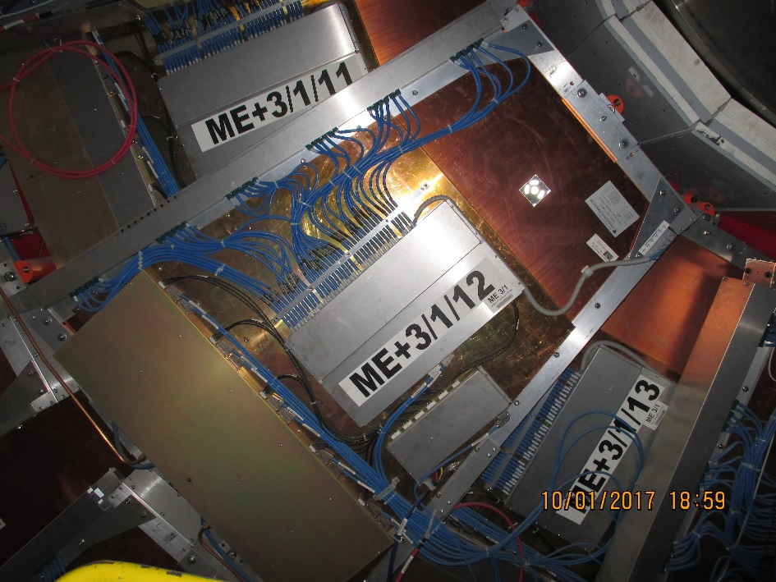
IR sensors Jan 2017
IR sensors with individual shielded cable
Target areas

Slide 8
Conclusion
Will be getting feed back from survey team soon.
Manual measurements will allow Elena to make accurate model of CSC and interface volume
IR sensors installed. To be read out asap. Although the discs are not locked we should obtain an understanding of the CSC topology.
Alignment sensors volume to be modelled.
IR sensor will be checked for operation in “B” field, to be used in end EYETS if confirmed/calibrated and modified readout.
Dose is kept to a minimum , ALARA policy, think before you go.

