Slide 1




Updates on RPC first slot of intervention: RE3/1 installation
^{1,2} E. Voevodina, ³ I. Crotty, ^{2,3} S. Buontempo,
³B. Smiljkovic
¹ Universita Federico II di Napoli, 1-80125 Napoli,
² Istituto Nazionale di Fisica Nucleare (INFN), Sezione di Napoli,
³ European Organization for Nuclear Research, Geneva (Switzerland)
RPC TC working meeting , February 2017

Slide 2
Plan
Results of measurements of value “Z” for RE3/1;
Fastening elements for fixing RE3/1 chambers on the YE3;
Studies of the value “Z” for RE4/1;
Mounting frames for RE4/1 chambers ;
The proposal about mounting of the frames using mounting posts M24 (outer “R”)
RPC TC working meeting 2/

Slide 3
Four methods to determine the value "Z" for RE3/1
Main drawing of the CMS;
Manual measurements;
Laser scanner and laser tracker;
IR - sensors.
RPC TC working meeting 3/

Slide 4
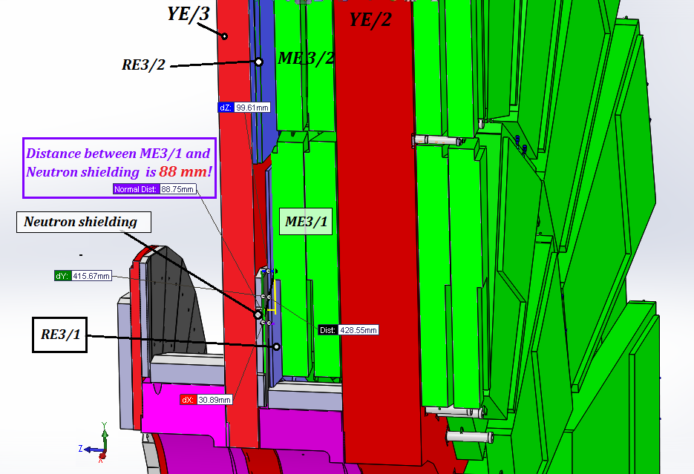
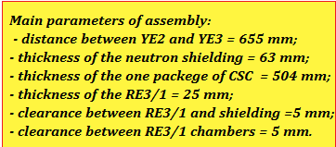
The value "Z" for RE3/1
1. Main drawing
On basis the main drawing of the CMS the value "Z" for RE3/1 is 88 mm!
RPC TC working meeting 4/

Slide 5
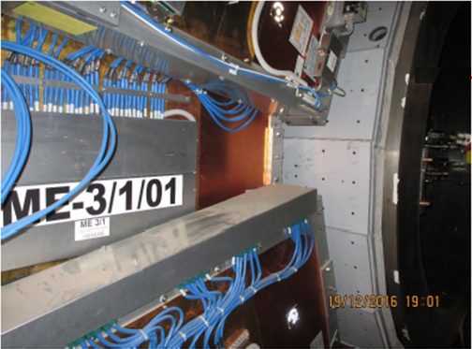
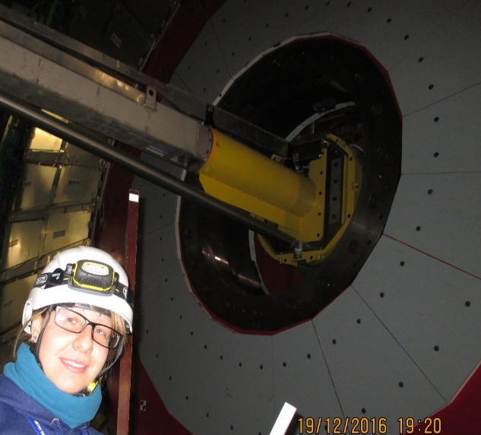
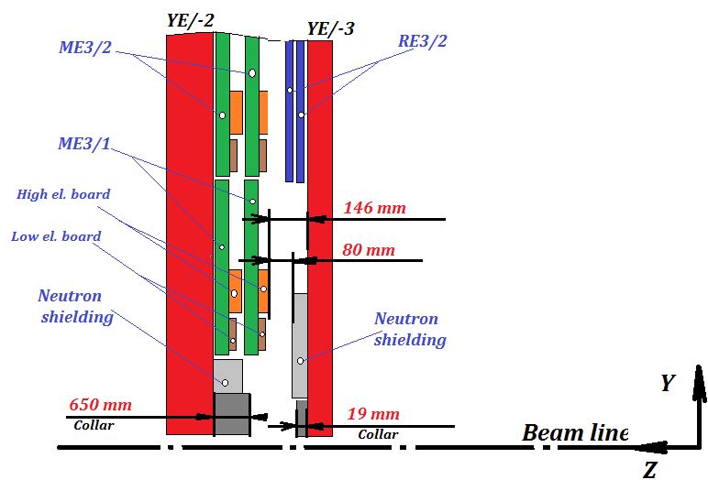
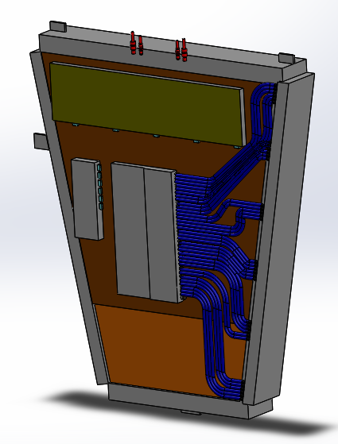
2. Manual measurements
The value "Z" for RE3/1
The value "Z" for RE3/1 from manual measurements is 80 mm!
Principle scheme for determination the value “Z ”
* The features design of the CSC chamber were taken into account.
(650+19)-523-66 =80mm
- 523 mm is CSC thickness
- 66 mm is the neutron shielding
* Manual measurements in P5 was 19 of December 2016
RPC TC working meeting 5/

Slide 6
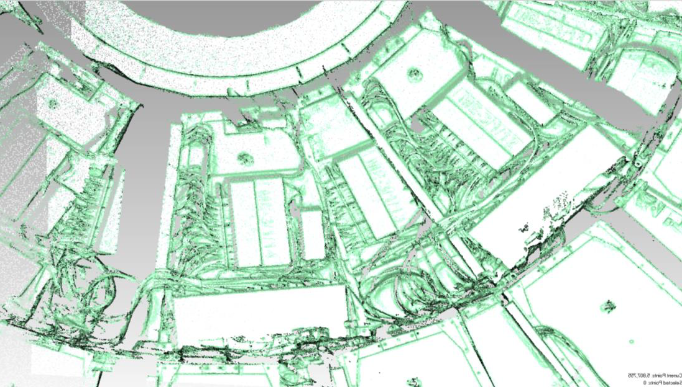
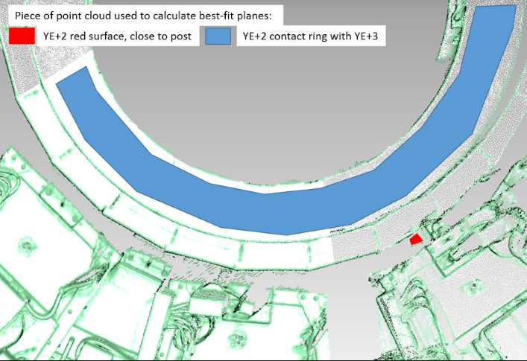
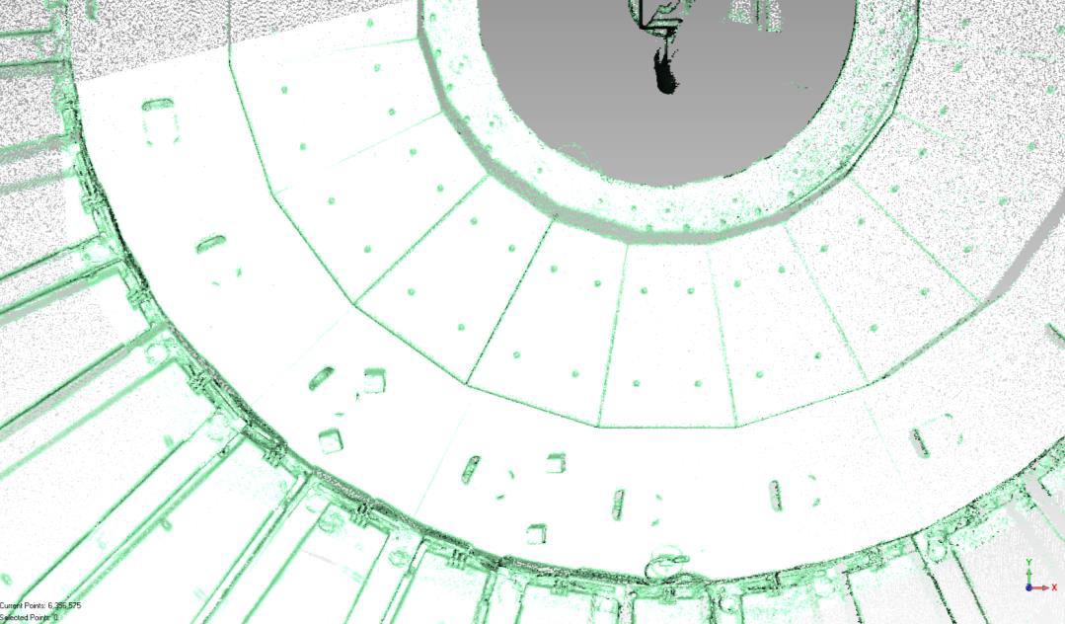
The value "Z" for RE3/1
3. Laser scanner and laser tracker
* Laser scanning in P5 was done 19 of December 2016 (for YE-2 and YE-3 around the ME-3/1/13) and 10 of January 2017 (for YE+2 and YE+3 around the ME+3/1/13)
YE/+2
Height Collar is 648. 6 mm
ME-3/1/13
YE/-3
Height Collar is 19. 6 mm
Neutron shielding
RE -3/2
RPC TC working meeting 6/

Slide 7
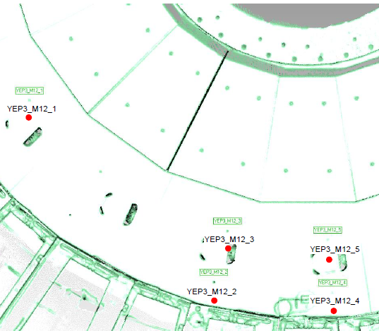
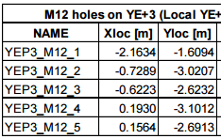
The value "Z" for RE3/1
Main results from laser scanner :
Surfaces between YE-2 / / YE+2 and YE-3// +3 around the CSC chambers ME/-3/1/13 // ME/+3/1/13 (below the beam pipe on far side ) have been measured;
The topology of CSC chambers is determined very good;
The average error of the best-fit is :
for YE/-2 and YE/-3 is +/-1.8 mm;
for YE/+2 and YE/+3 is +/-3.0 mm.
The maximum error is :
for YE/-2 and YE/-3 is +/-2.5 mm;
for YE/+ 2and YE/+3 is +/-3.0 mm.
The height of the collars are:
for YE/+3 is 19.6 mm; for YE/-3 is 20.4 mm;
for YE/+ 2 is 648.6 mm; for YE/- 2 red disk not measured.
These values agree with the manual measurements.
The position of five M12 holes measured in the area of YE/+3 in front of the
CSC chamber ME+3/1/13.
Inspection of the positions of the M12 holes
RPC TC working meeting 7/

Slide 8
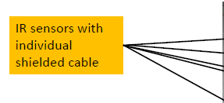
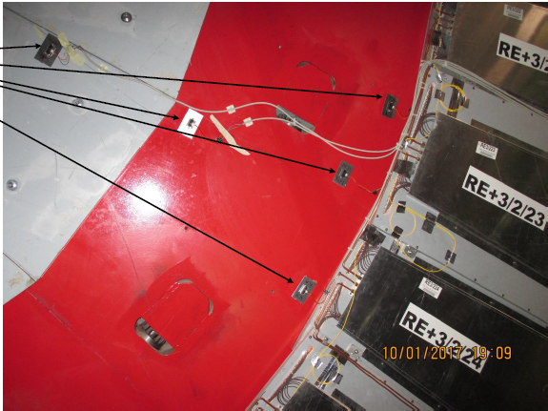
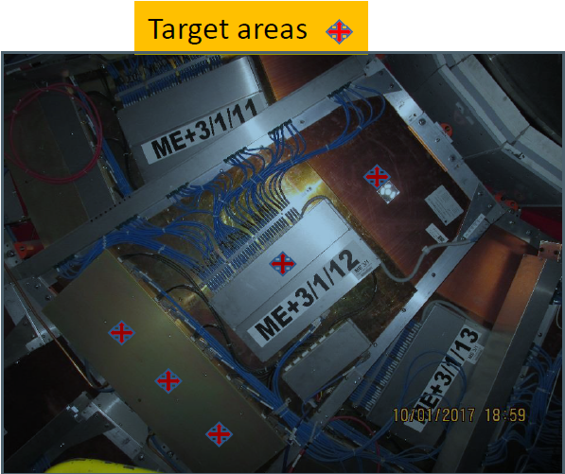
The value "Z" for RE3/1
4. IR sensors
* IR sensors were installed in 10th of January 2017
Results will be come later after closing YE/+2 and YE/+3.
RPC TC working meeting 8/

Slide 9
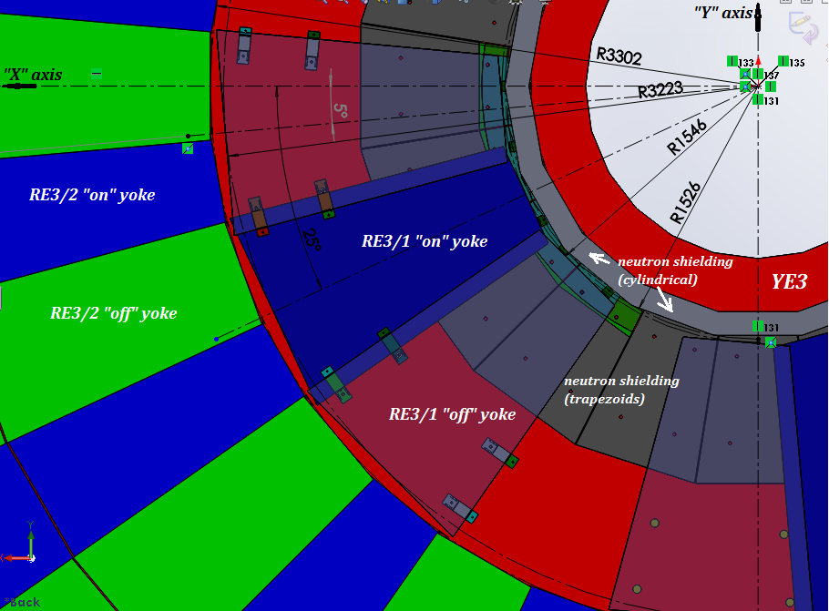
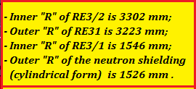
Fastening elements for fixing RE3/1 chambers on the YE3
1. Mounting of the RE 3/1 chambers on the YE3
1
2
Each RE3/1 chamber is fixed in the six points
5
M12 mounting holes
6
4
3
RPC TC working meeting 9/

Slide 10
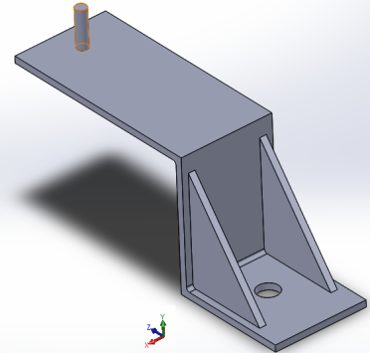
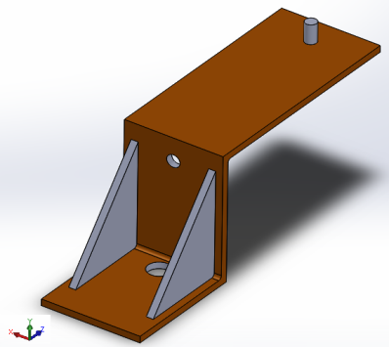
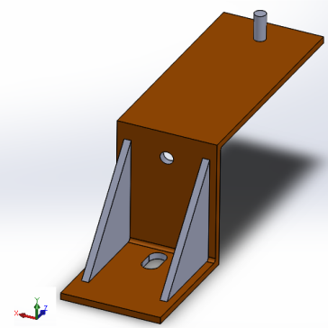
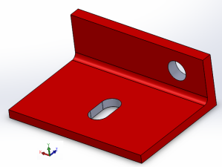
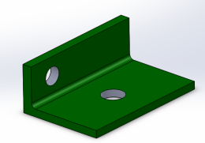
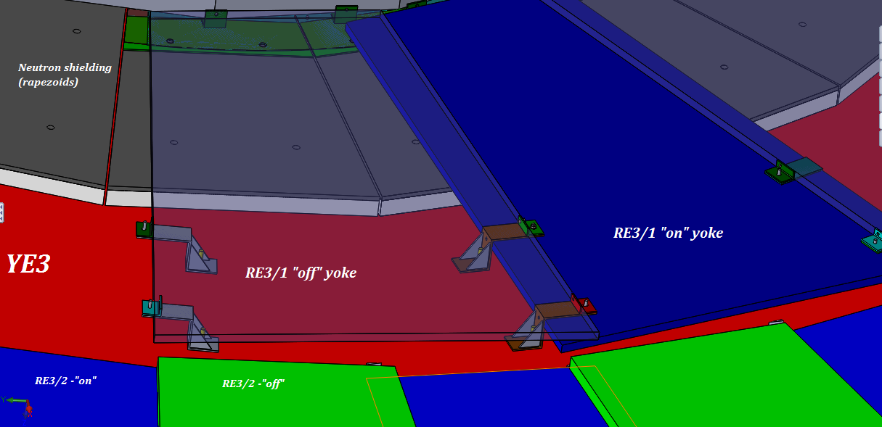
Fastening elements for fixing RE3/1 chambers on the YE3
2. Mounting brackets for the RE 3/1 chambers
3
4
Slot
1, 2
1, 2 and 3
The stiffeners
M12
Ф16
3
Ф16
Ф16
2
Ф 12.5
4
Slot
Ф 12.5
1
Degrees of freedom are not fully defined
RPC TC working meeting 10/

Slide 11
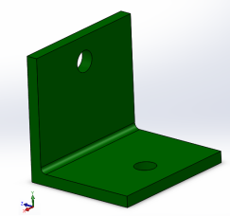
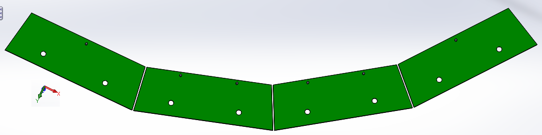
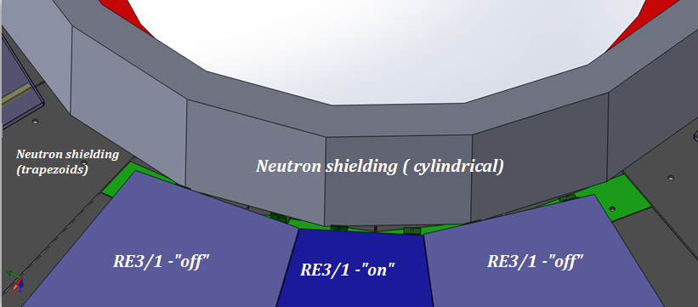
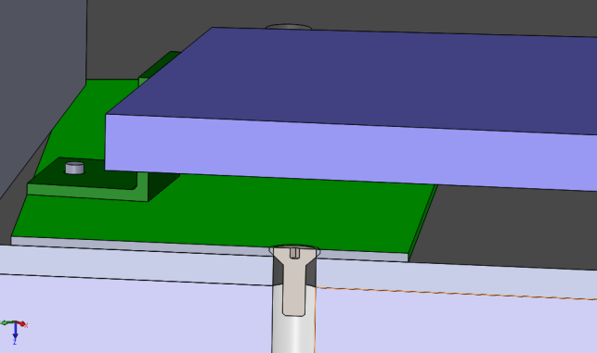
Fastening elements for fixing RE3/1 chambers on the YE3
3. Mounting plates for the RE 3/1 chambers
Brackets
Arc Plate for inner “R” of RE3/1
At the present time the cylindrical screws heads protrude beyond the shield.
Arc Plate for inner “R” are hidden under the RE3/1
Mounting Arc Plate on the neutron shielding
Screw with countersunk head
RPC TC working meeting 11/

Slide 12
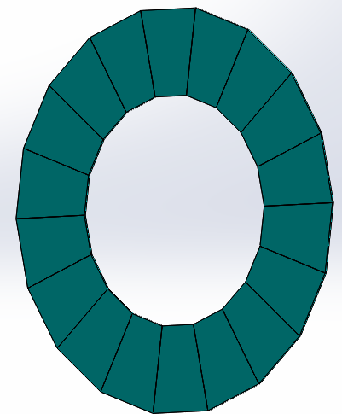
Studies of the value “Z” for RE4/1
Available space for RE4/1 chambers
On basis the main drawing of the CMS the value "Z" for RE4/1 is 85 mm.
At the present the IO thinks that there is only 80 mm available.
During the RE4/2 Super Module assembly the extra space was available and so the distance between CSC and RPC was increased.
The space between YE4 and RE4/1 should be a minimum of 20 mm;
Thickness of the RE4/1 “on” yoke is 25 mm;
Thickness of the RE4/1 “off” yoke is 25 mm;
The value gap is 5 mm;
Thickness Alu mounting plates is 8 mm.
___________________________
Total: 83 mm
Thus, we have the available space for RE4/1 chambers
without overlap!
Assembly RE4/1 chambers without overlap
Once this design we will be able to study the overlap configuration.
RPC TC working meeting 12/

Slide 13
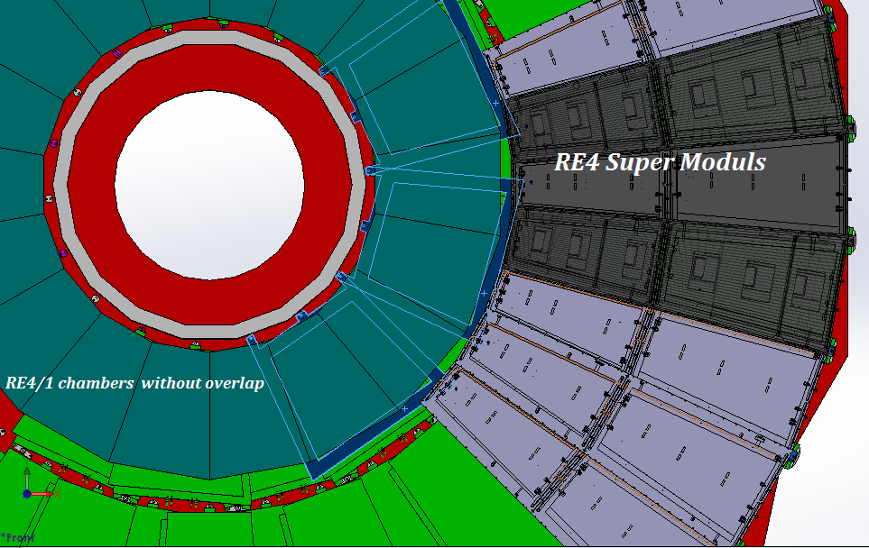
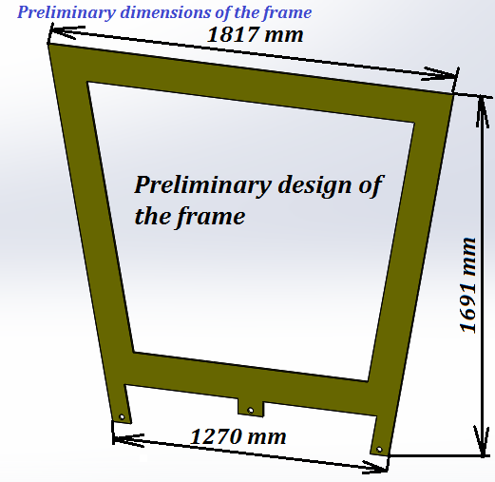
Mounting frames for RE4/1 chambers
Mounting frames
RPC TC working meeting 13/

Slide 14
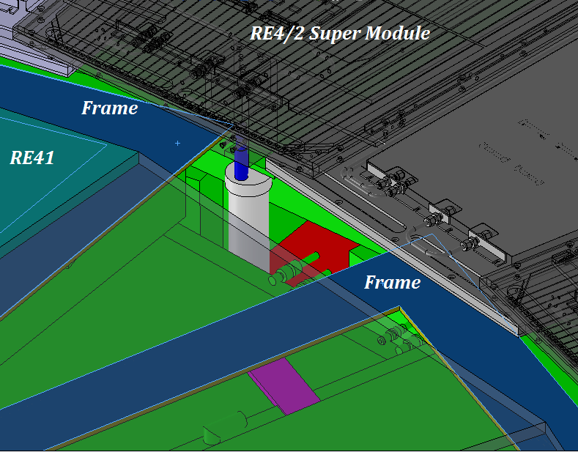
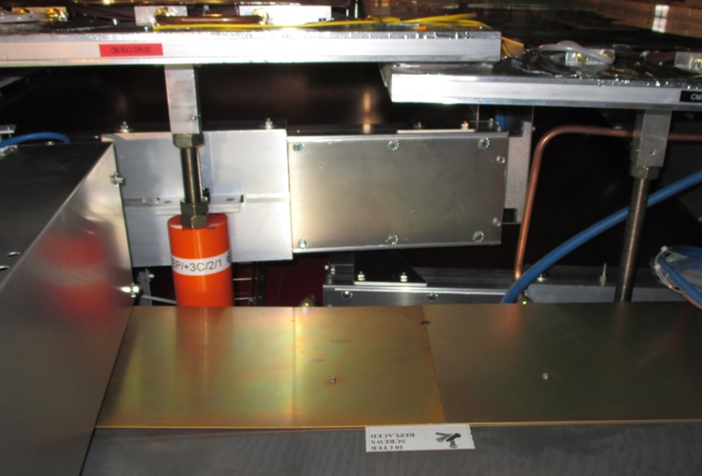
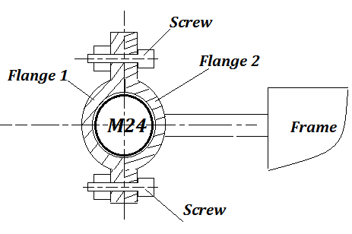
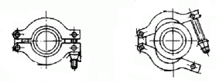
The proposal about mounting of the frames using
mounting posts M24 (outer “R”)
Two interesting questions:
How to mount the frame using the mounting positions M24?
How to attach the RE4/1 chambers on the frames?
Mounting posts M24
Area of mounting
Principle scheme
Or another version
Flange
M24
Screw

Slide 15
Conclusion
On the basis all received results we have the value “Z” for RE3/1 chambers 80 mm;
The RE3/1 chambers brackets and mounting plates for fixing were produced;
The drawings for brackets and mounting plates will be done in the end this week (Tuesday or Friday will be done);
Next step will be study of the Patch Panel and connectors with cables outside the chamber;
The available space for RE4/1 chambers is about 80 mm. It isn’t enough for RE4/1 chambers with overlap;
RE4/1 FEBs are visible and accessible in this design.
RPC TC working meeting 15/

Slide 16
Future work for RE3/1 and RE4/1
1. Section for RE3/1:
Neutron shielding support will require modification;
IR sensors will give definitive “Z” value;
Mock up for PP and services in 904;
“B” field deflection of YE3 and YE2 should be negligible but to be checked .
2. Section for RE4/1
Require ME4/1 laser scan
Install MP in P5 to study CSC services;
Install IR sensors in RE4/1 gap for real “Z” values;
Measure YE4 deflection;
Mock up of MP and chambers in 904.

Slide 17
Thanks for attentions!

Slide 18
Backup

Slide 19
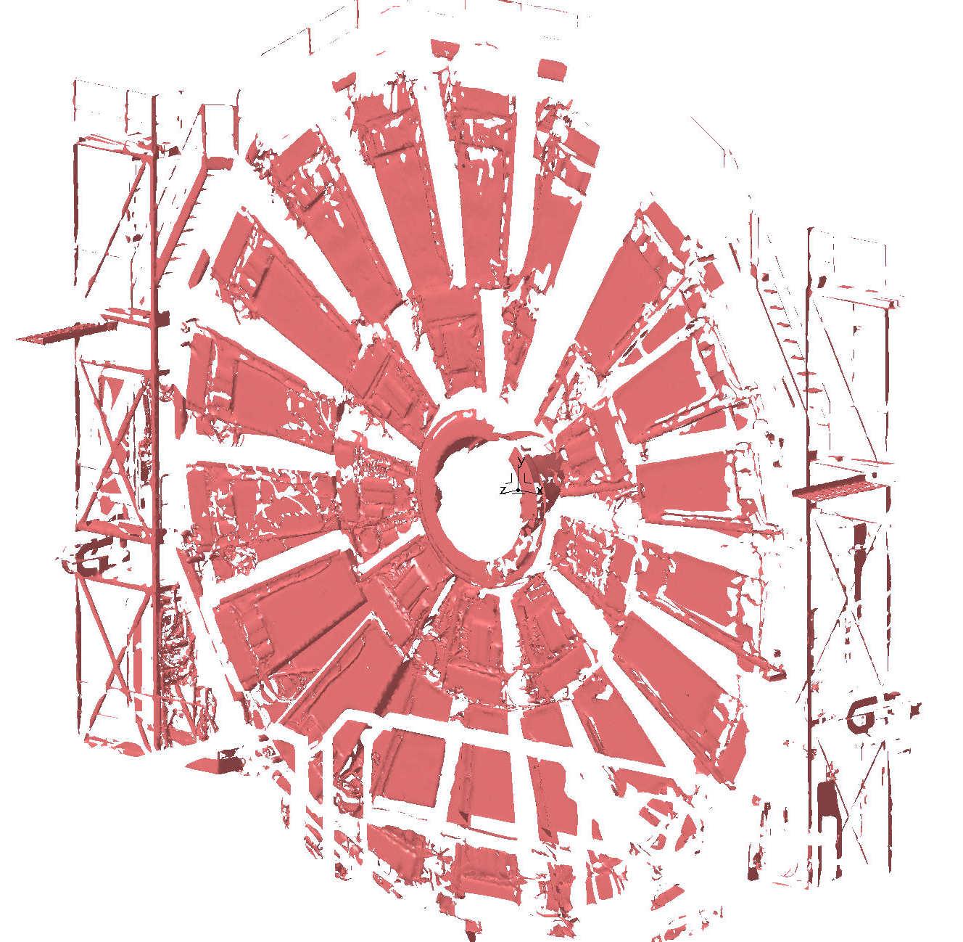
Scan
Scan YE/-2

Slide 20
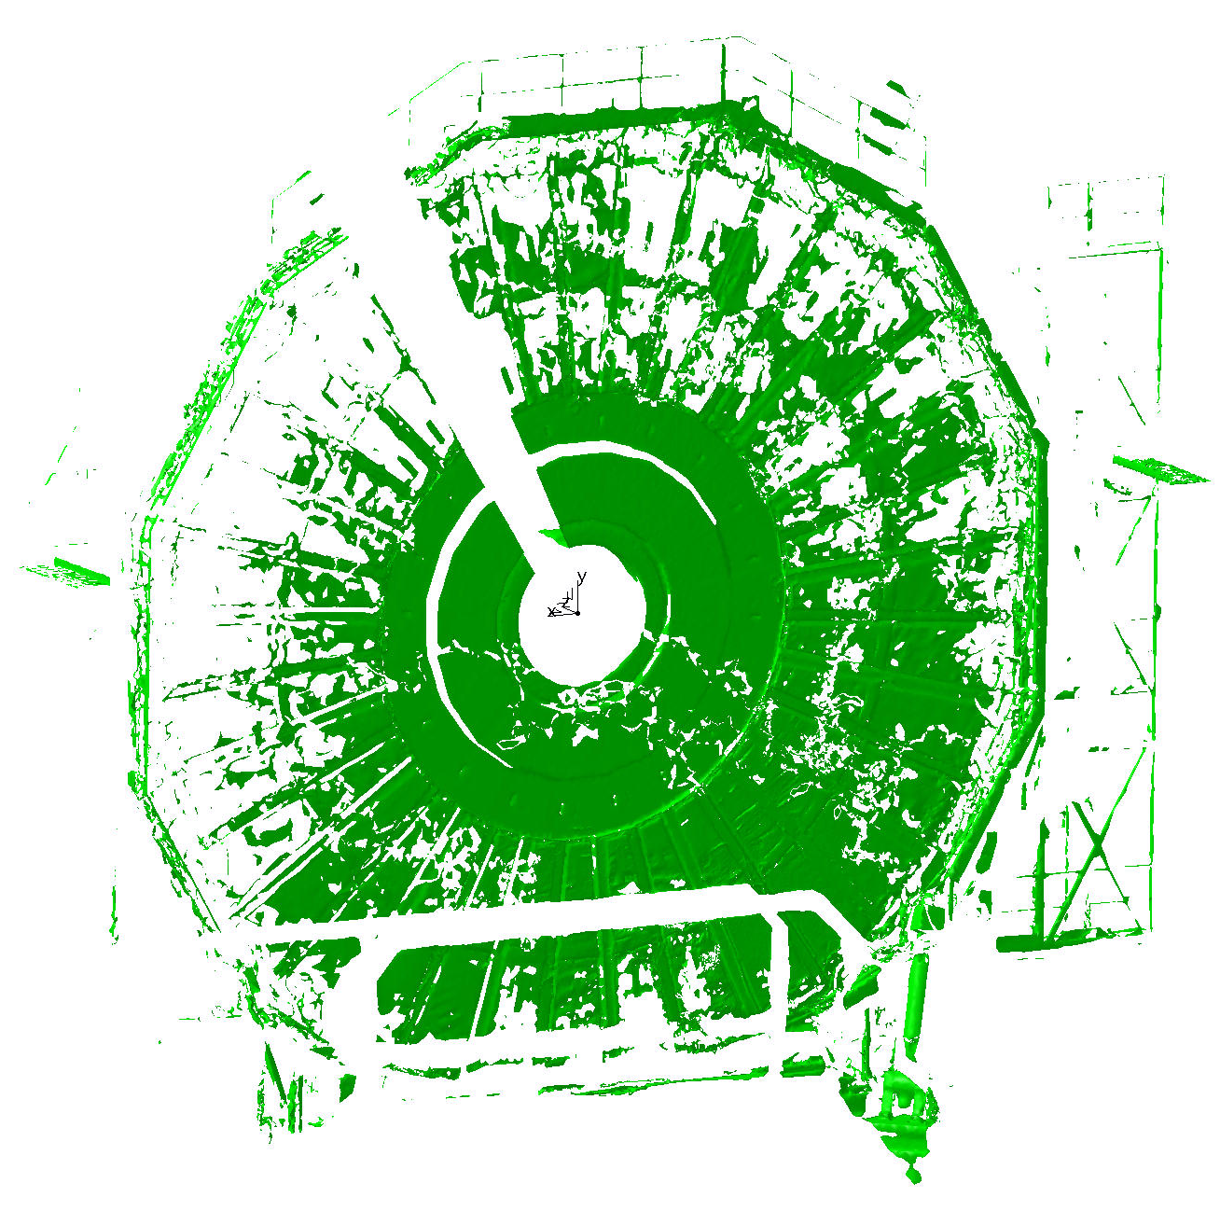
Scan YE/-3

Slide 21
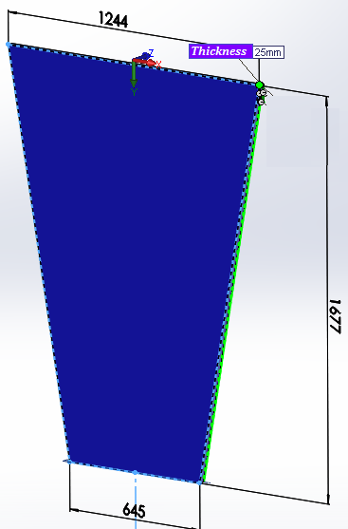
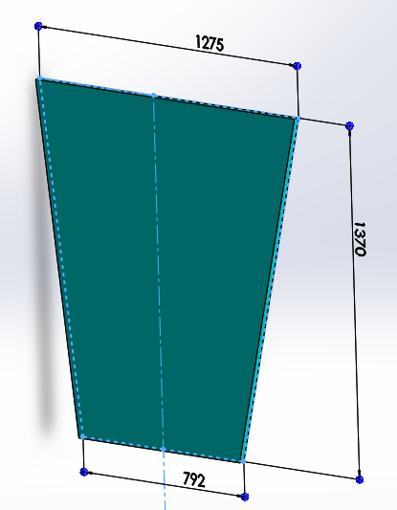
Design of the RE3/1 and RE41 chambers
Thicknesses RE3/1 and RE4/1 are 25 mm.
RE3/1
RE4/1
RE4/1

Slide 22
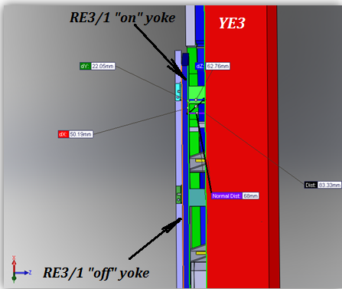
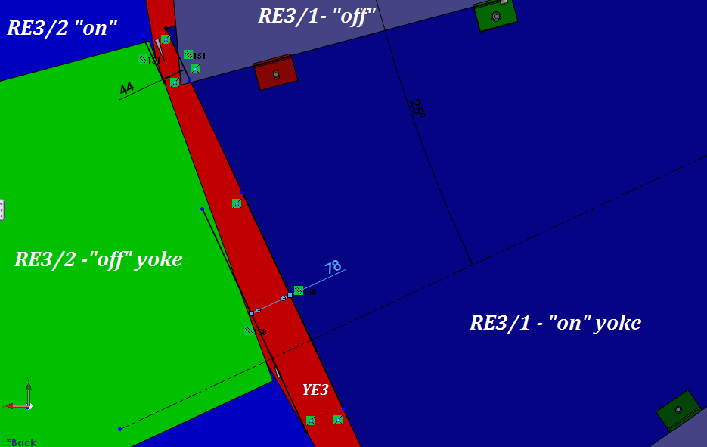
Available space for mounting FEBs
Available space for mounting FEBs is 68 mm
Cross section YE3
Space between RE3/2 and RE3/1 for the cooling/power connectors
Distance between YE3 and RE3/1 chamber “on” yoke is 68 mm

