Slide 1

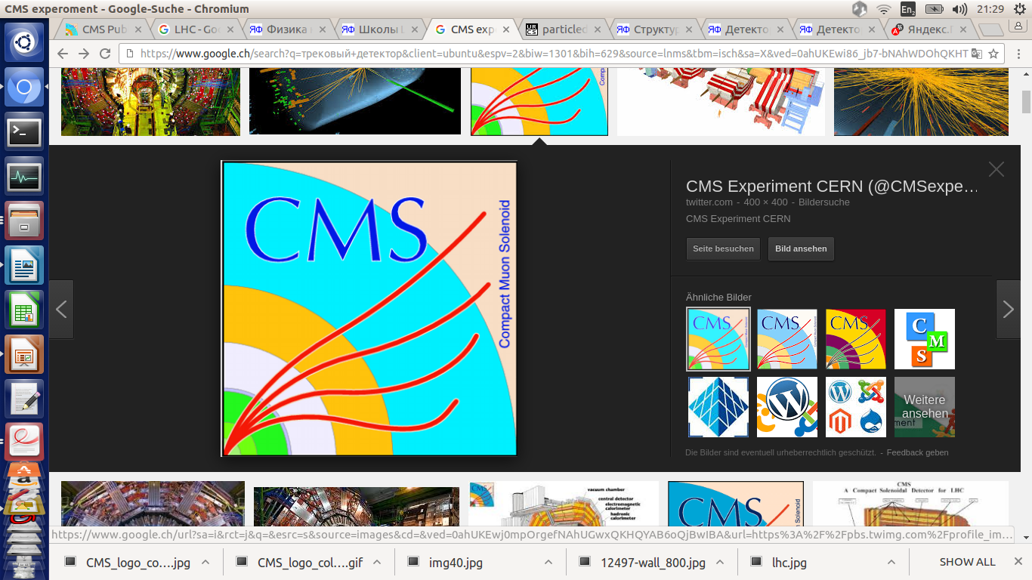


Updates on RPC RE3/1 and RE4/1
^{1,2} E. Voevodina, ³ I. Crotty, ^{2,3} S. Buontempo,
³B. Smiljkovic
¹ Universita Federico II di Napoli, 1-80125 Napoli,
² Istituto Nazionale di Fisica Nucleare (INFN), Sezione di Napoli,
³ European Organization for Nuclear Research, Geneva (Switzerland)
RPC Upgrade Workshop, 14-15 March 2017

Slide 2
Plan
1. RE3/1:
Studies of the value “Z” for RE3/1 (four methods of the determining) ;
Fastening elements for fixing RE3/1 chambers on the YE3.
2. RE4/1:
Studies of the value “Z” for RE4/1;
Mounting plates for RE4/1 chambers ;
The proposed MP outer “R” M24 posts which are underneath the RE4 SMs.
3. Future work for RE3/1 and RE4/1
Conclusion
RPC Upgrade Workshop, 14-15 March 2017 02/19

Slide 3
Four methods to determine the value "Z" for RE3/1
Main drawing of the CMS;
Manual measurements;
Laser scanner and laser tracker;
IR - sensors.
RPC Upgrade Workshop, 14-15 March 2017 03/19

Slide 4
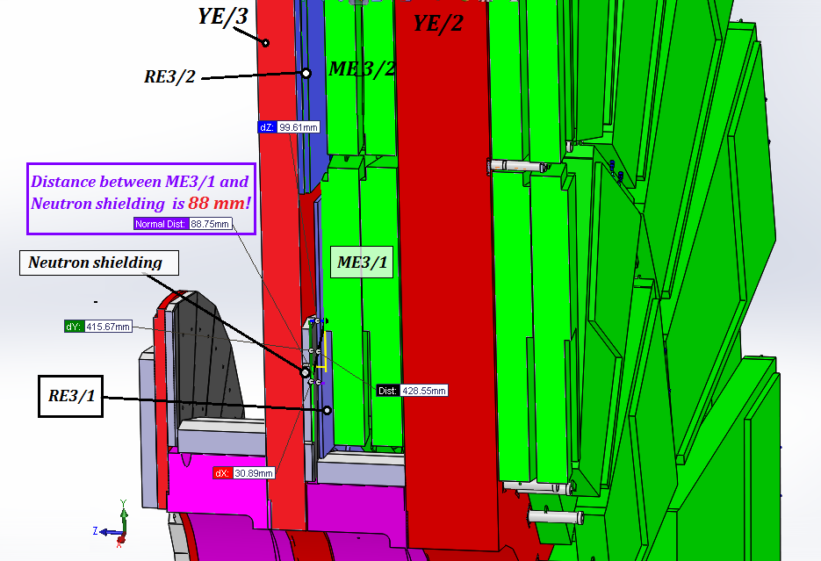
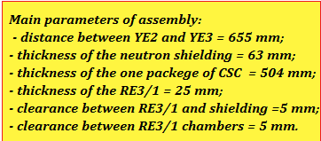
The value "Z" for RE3/1
1. Main drawing
On basis the main drawing of the CMS the value "Z" for RE3/1 is 88 mm!
RPC Upgrade Workshop, 14-15 March 2017 04/19

Slide 5
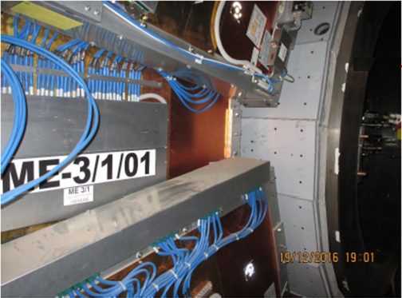
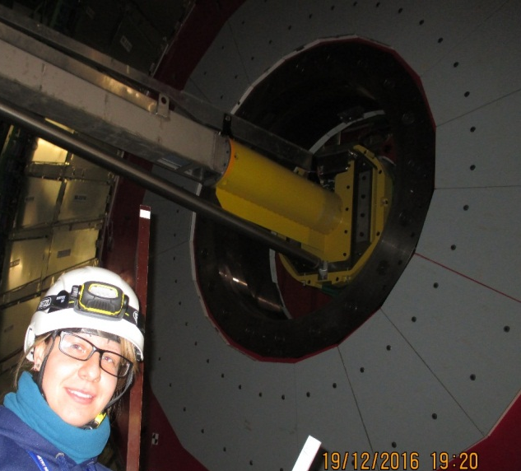
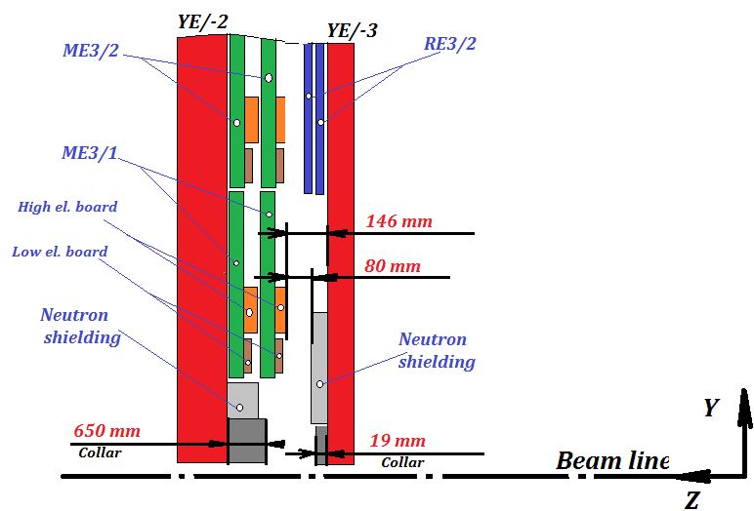
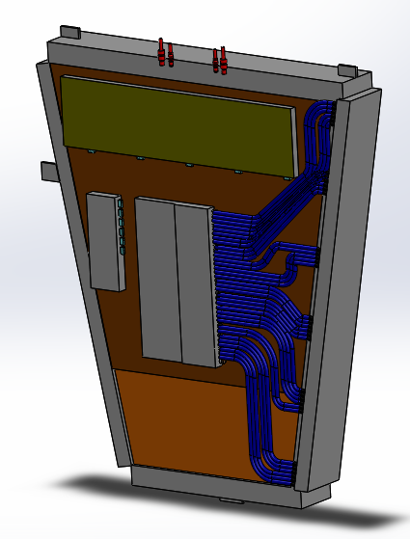
2. Manual measurements
The value "Z" for RE3/1
The value "Z" for RE3/1 from manual measurements is 80 mm! IO requires more 20 mm for clearance between CSC and RPC.
Principle scheme for determination the value “Z ”
* The features design of the CSC chamber were taken into account.
(650+19)-523-66 = 80 mm
- 523 mm is CSC thickness
- 66 mm is the neutron shielding
* Manual measurements in P5 was 19 of December 2016
RPC Upgrade Workshop, 14-15 March 2017 05/19

Slide 6
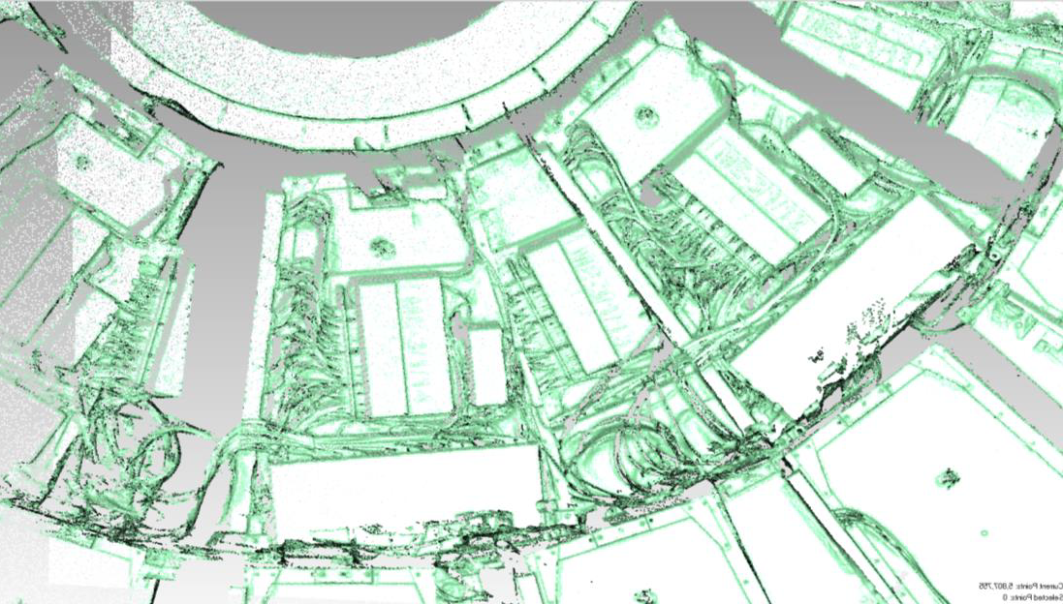
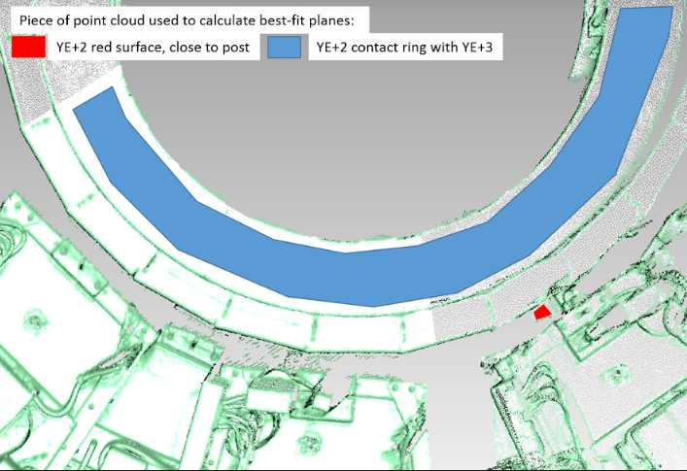
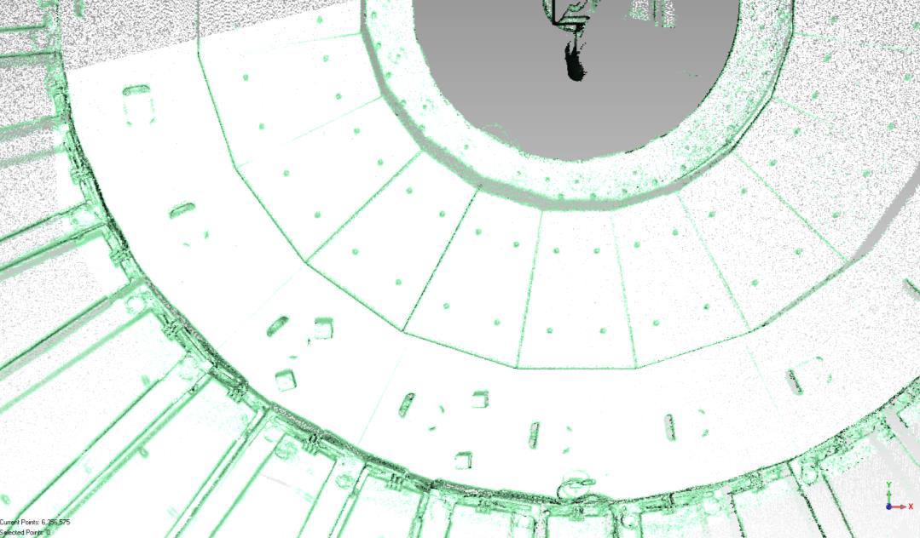
The value "Z" for RE3/1
3. Laser scanner and laser tracker
* Laser scanning in P5 was done 19 of December 2016 (for YE-2 and YE-3 around the ME-3/1/13) and 10 of January 2017 (for YE+2 and YE+3 around the ME+3/1/13)
YE/+2
Height Collar is 648. 6 mm
ME+3/1/13
YE/+3
Height Collar is 19. 6 mm
Neutron shielding
RE +3/2
RPC Upgrade Workshop, 14-15 March 2017 06/19

Slide 7
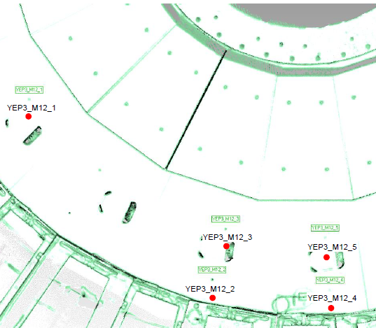
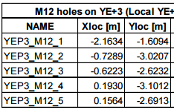
The value "Z" for RE3/1
Main results from laser scanner :
Surfaces between YE-2 / / YE+2 and YE-3// +3 around the CSC chambers ME/-3/1/13 // ME/+3/1/13 (below the beam pipe on far side ) have been measured;
The topology of CSC chambers is determined very good;
The average error of the best-fit is :
for YE/-2 and YE/-3 is +/-1.8 mm;
for YE/+2 and YE/+3 is +/-3.0 mm.
The maximum error is :
for YE/-2 and YE/-3 is +/-2.5 mm;
for YE/+ 2and YE/+3 is +/-3.0 mm.
The height of the collars are:
for YE/+3 is 19.6 mm; for YE/-3 is 20.4 mm;
for YE/+ 2 is 648.6 mm; for YE/- 2 red disk not measured.
These values agree with the manual measurements.
The position of five M12 holes measured in the area of YE/+3 in front of the
CSC chamber ME+3/1/13.
Inspection of the positions of the M12 holes
RPC Upgrade Workshop, 14-15 March 2017 07/19
RPC TC working meeting 7/

Slide 8
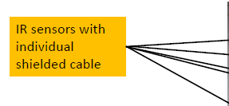
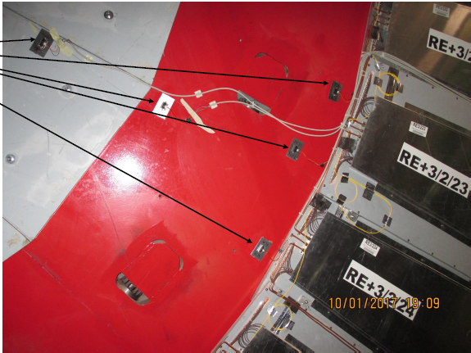
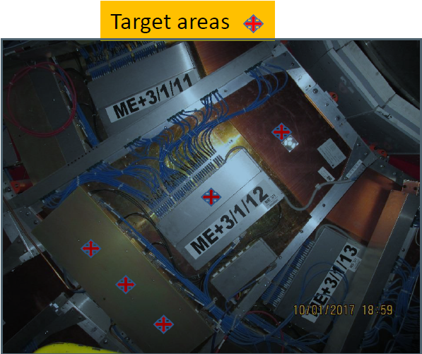
The value "Z" for RE3/1
4. IR sensors
* IR sensors were installed in 10th of January 2017
Results will be come later after closing YE/+2 and YE/+3.
RPC Upgrade Workshop, 14-15 March 2017 08/19

Slide 9
Conclusion
Table of the main results
Main parameters | CMS drawing | Manual measurements | Laser scanner | IR sensors
1. Distance between YE2 and YE3 , mm | 655 | 650 + 19 = 669 | 648.6 + 19.6 = 668.2 | ­-
2. Thickness of the neutron shielding, mm | 63 | 64.5 ÷ 66.0 |  | -
3. Distance between YE2 and max. higher surface of the CSC chamber, mm | 524 | 523 |  | -
4. Available space for RE3/1, mm | 88 | 80 ± 0.5 | 79.5 ± 3.0 | Data will come soon
RPC Upgrade Workshop, 14-15 March 2017 09/19

Slide 10
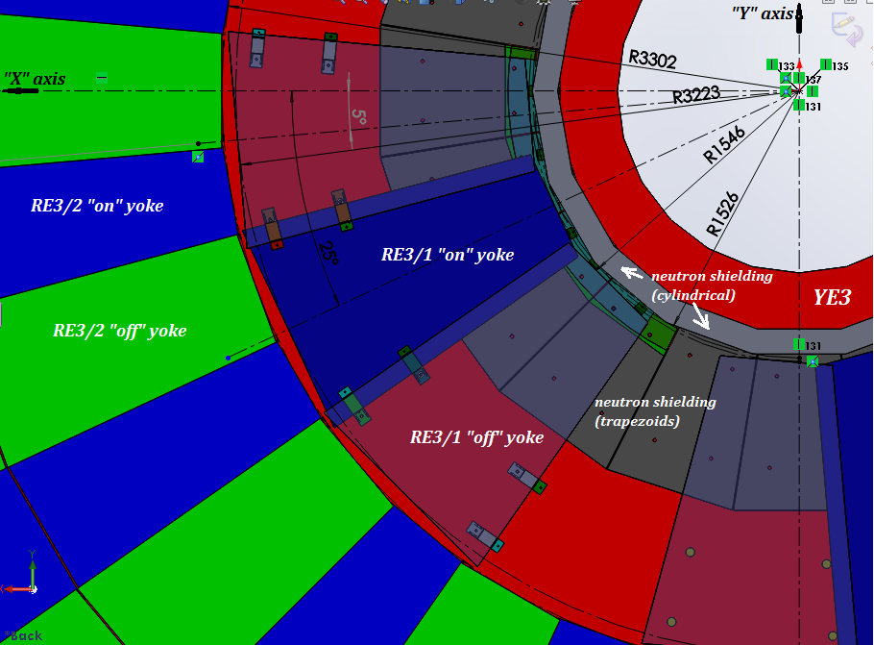
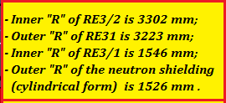
Fastening elements for mounting RE3/1 chambers on the YE3
1. Mounting of the RE 3/1 chambers on the YE3
1
2
Each RE3/1 chamber is fixed at six points
5
M12 mounting holes
6
4
3
RPC Upgrade Workshop, 14-15 March 2017 10/19

Slide 11
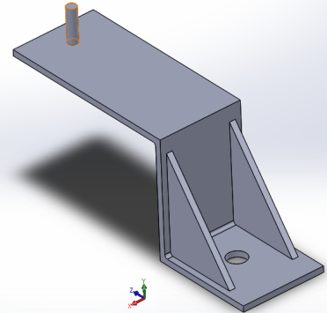
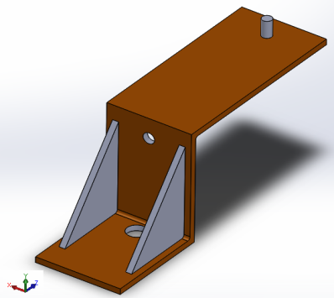
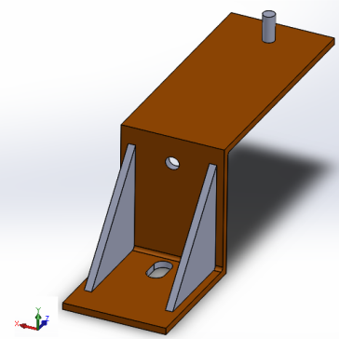
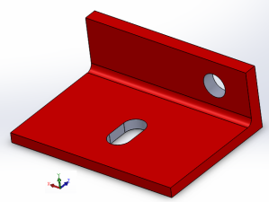
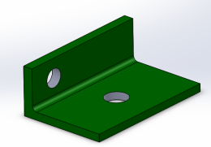
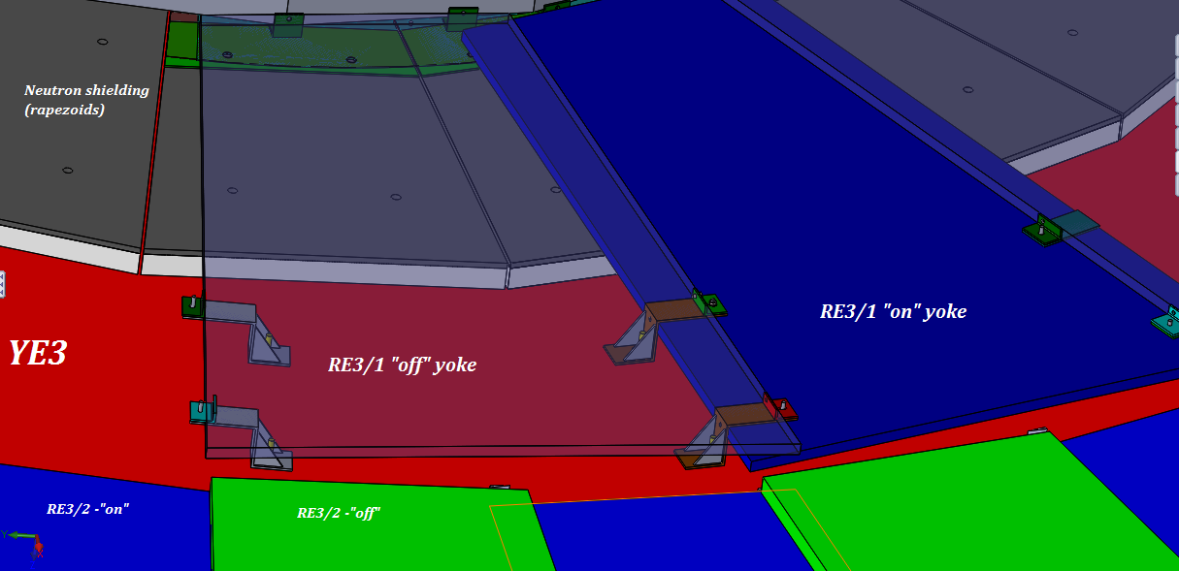
Fastening elements for fixing RE3/1 chambers on the YE3
2. Mounting brackets for the RE 3/1 chambers
3
4
Slot
1, 2
1, 2 and 3
The stiffeners
M12
Ф16
3
Ф16
Ф16
2
Ф 12.5
4
Slot
Ф 12.5
1
Degrees of freedom are not fully defined
RPC Upgrade Workshop, 14-15 March 2017 11/19

Slide 12
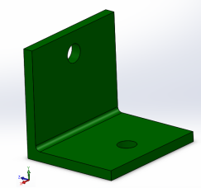
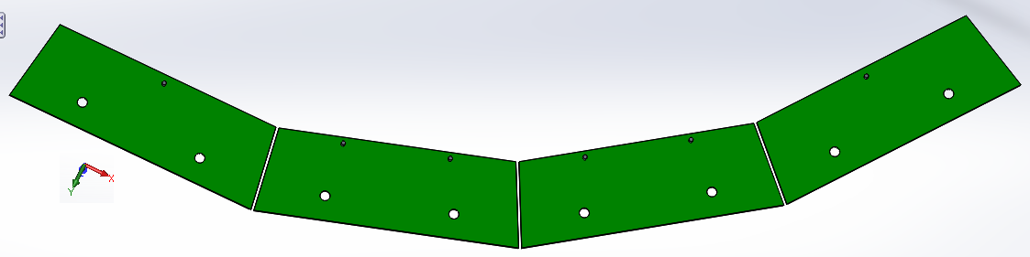
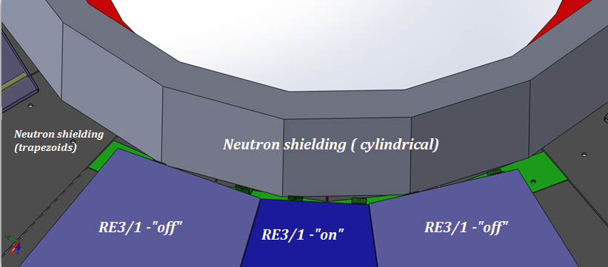
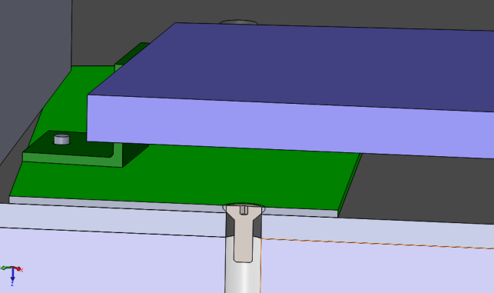
Supplementary inner “R” mounts RE3/1 chambers on the YE3
3. Mounting arcs for the RE 3/1 chambers
Brackets
Arc Plate for inner “R” of RE3/1
At the present time the cylindrical screws heads protrude beyond the shield.
Arc Plate for inner “R” are hidden under the RE3/1
Mounting Arc Plate on the neutron shielding
Screw with countersunk head
RPC Upgrade Workshop, 14-15 March 2017 12/19

Slide 13
Mock up for RE3/1
Work schedule
RPC Upgrade Workshop, 14-15 March 2017 13/19

Slide 14
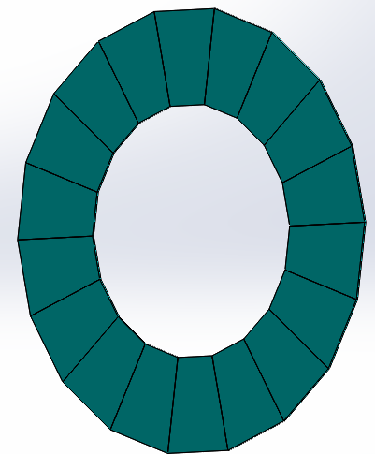
Studies of the value “Z” for RE4/1
Available space for RE4/1 chambers
On basis the main drawing of the CMS the value "Z" for RE4/1 is 85 mm.
At the present the IO thinks that there is only 80 mm available.
During the RE4/2 Super Module assembly the extra space was available and so the distance between CSC and RPC was increased.
The space between neutron shielding and RE4/1 should be a minimum of 20 mm;
Thickness of the RE4/1 “on” yoke is 25 mm;
Thickness of the RE4/1 “off” yoke is 25 mm;
The value gap is 5 mm;
Thickness Alu mounting plates is 8 mm.
___________________________
Total: 83 mm
Thus, we have the available space for RE4/1 chambers
without overlap!
Assembly RE4/1 chambers without overlap
Once this design we will be able to study the overlap configuration.
RPC Upgrade Workshop, 14-15 March 2017 14/19

Slide 15
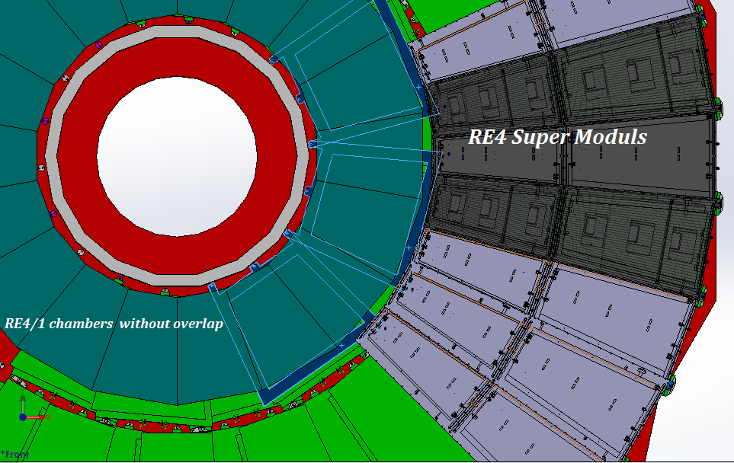
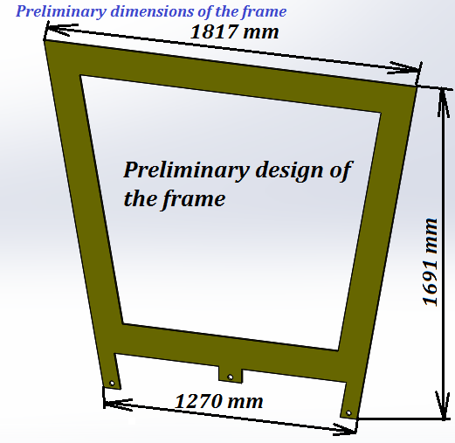
Mounting plate for RE4/1 chambers
Mounting plates
Preliminary design of the mounting plate
Thickness is 8 mm
RPC Upgrade Workshop, 14-15 March 2017 15/19

Slide 16
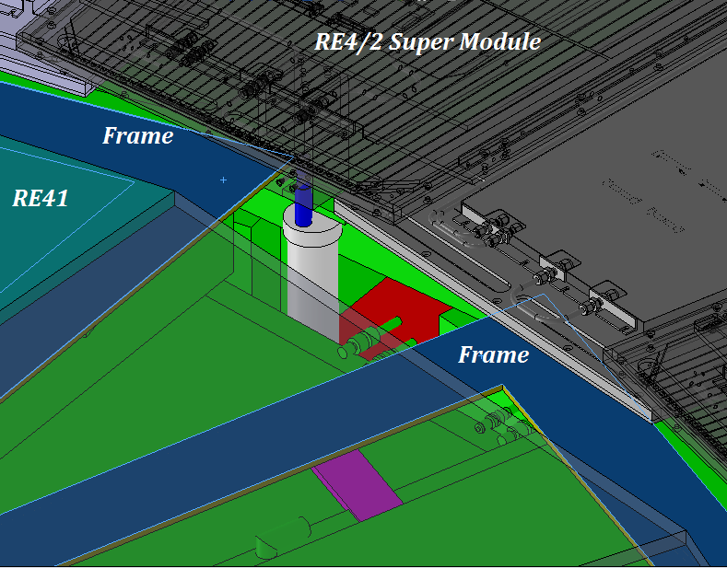
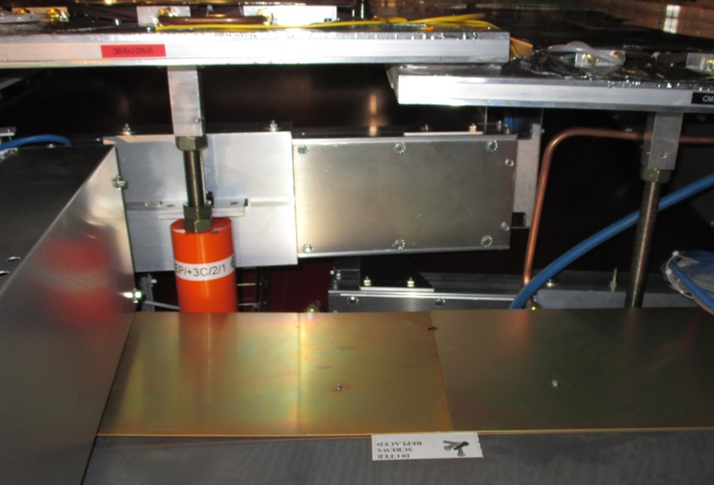
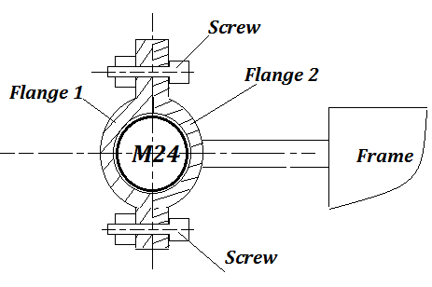
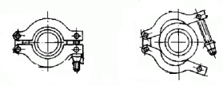
The proposed MP outer “R” M24 posts which are underneath the RE4 SMs
Two interesting questions:
How to mount the frame using the mounting positions M24?
How to attach the RE4/1 chambers on the frames?
Mounting posts M24
Area of mounting
Principle scheme
Or another version
Flange
M24
Screw
RPC Upgrade Workshop, 14-15 March 2017 16/19

Slide 17
Conclusion
RE3/1:
On the basis all received results we have the value “Z” for RE3/1 chambers 80 mm;
The RE3/1 chambers brackets and mounting plates for fixing were drawn;
Next step will be study of the Patch Panel and connectors with cables outside the chamber.
RE4/1:
The available space for RE4/1 chambers is about 80 mm. It isn’t enough for RE4/1 chambers with overlap (total space for RE4/1 chamber with overlap is 83mm);
RE4/1 FEBs are visible and accessible in this design.
RPC Upgrade Workshop, 14-15 March 2017 17/19

Slide 18
Future work for RE3/1 and RE4/1
1. Section for RE3/1:
Neutron shielding support will require modification;
IR sensors will give definitive “Z” value;
Full photographic record for ME3/1 (cabling, pipes and etc.)
Mock up for PP and services over 60 degree in 904;
“B” field deflection of YE3 and YE2 should be negligible but to be checked .
2. Section for RE4/1
Require ME4/1 laser scan
Install MP in P5 to study CSC services;
Install IR sensors in RE4/1 gap for real “Z” values;
Measure YE4 deflection with IR sensors;
Mock up of MP and chambers in 904.
RPC Upgrade Workshop, 14-15 March 2017 18/19

Slide 19
Thanks for attentions!

Slide 20
Backup

Slide 21
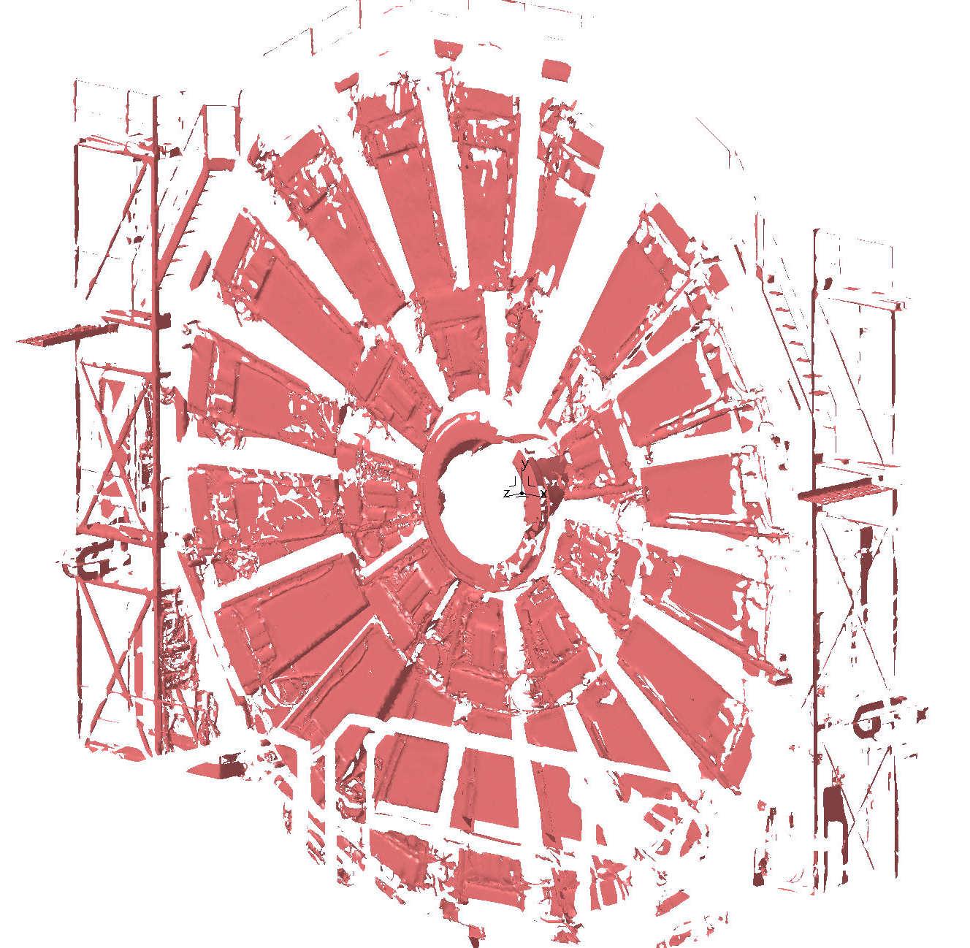
Scan
Scan YE/-2

Slide 22
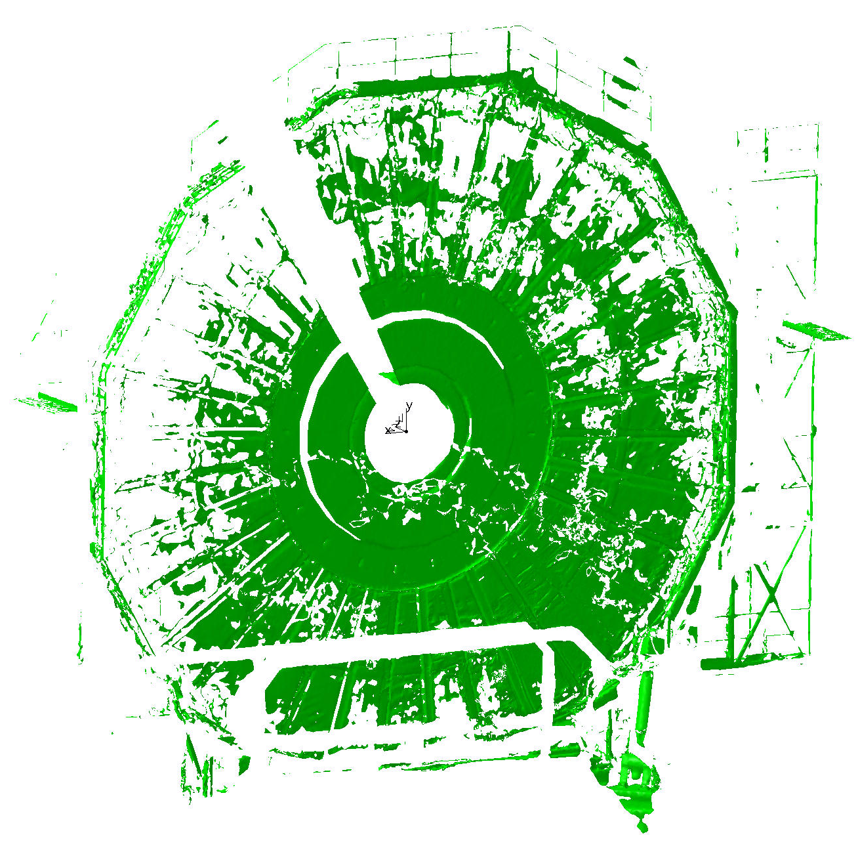
Scan YE/-3

Slide 23
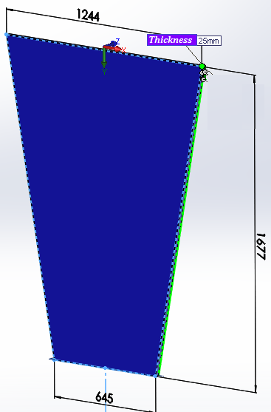
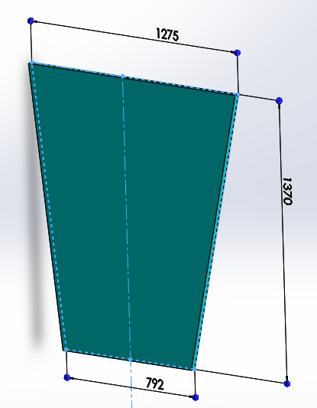
Design of the RE3/1 and RE41 chambers
Thicknesses RE3/1 and RE4/1 are 25 mm.
RE3/1
RE4/1
RE4/1

Slide 24
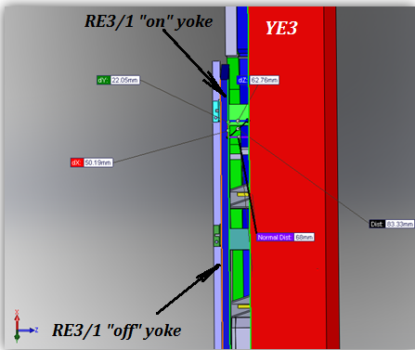
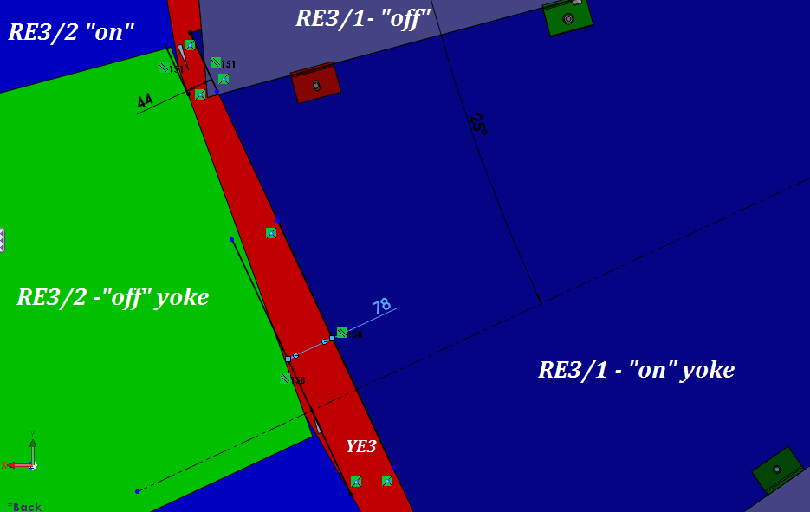
Available space for mounting FEBs
Available space for mounting FEBs is 68 mm
Cross section YE3
Space between RE3/2 and RE3/1 for the cooling/power connectors
Distance between YE3 and RE3/1 chamber “on” yoke is 68 mm

